Slide 1
Chapter 12: Macroanalysis and Microvaluation of the Stock Market
Analysis of Investments &
Management of Portfolios
10TH EDITION
Reilly & Brown

Slide 2
The Components of Market Analysis
This chapter is concerned with the market analysis portion of this process of the top-down, three-step market-industry-company investment process
The two components:
  The macroanalysis of the relationship between the aggregate securities markets and the aggregate economy
  The specific microvaluation of the stock market employing the valuation approaches

Slide 3
Macromarket Analysis
Economic activity and security markets
Economic series and stock prices
Cyclical indicator approach
Money supply and the economy
Monetary policy and stock returns
Inflation and interest rates
World security markets

Slide 4
Economic Activity and
Security Markets
Stock Market as a Leading Indicator
  Stock prices reflect expectations of earnings, dividends, and interest rates
  Stock market reacts to various leading indicator series
  Stock prices consistently turn before the economy does

Slide 5
Economic Series and Stock Prices
Research has documented that peaks and troughs in stock prices tend to occur prior to peaks and troughs in the economy,
Two broad categories of economic series
  Sets of economic series suggested by the National Bureau of Economic Research
  Alternative monetary series influenced by the Federal Reserve

Slide 6
Cyclical Indicator Approach to Forecasting the Economy
This approach contends that the aggregate economy expands and contracts in discernable periods
Cyclical indicator categories
Composite series and ratio of series
Analytical Measures of Performance
Surveys of Sentiment and Expectations

Slide 7
Cyclical Indicator Categories
Leading Indicators: Economic series that usually reach peaks or troughs before corresponding peaks or troughs in aggregate economy activity
Coincident Indicators: Economic series that have peaks and troughs that roughly coincide with the peaks and troughs in the business cycle

Slide 8
Cyclical Indicator Categories
Lagging Indicators: Economic series that experience their peaks and troughs after those of the aggregate economy
Selected Series: Economic series that do not fall into one of the three main groups such series as U.S. balance of payments and federal surplus or deficit
See Exhibit 12.1

Slide 9
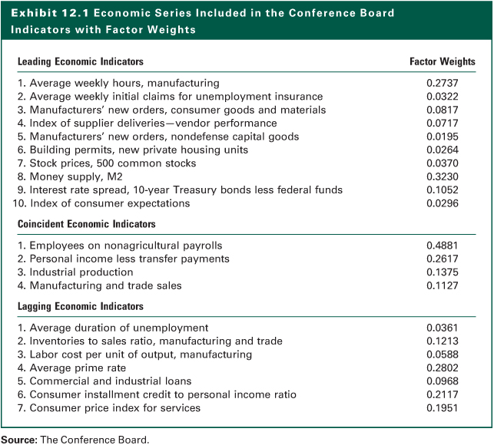
Exhibit 12.1

Slide 10
Composite Series and Ratio of Series
A composite time series combines these economic series
For example, the composite leading indicator index which is widely reported in the press each month as an indicator of the current and future state of the economy
There also are composite coincident and lagging indicator series
The ratio of these composite series can also been used in the analysis

Slide 11
Analytical Measures of Performance
Diffusion Indexes
  Trends
  Rates of change
  Direction of change
  Comparison with previous cycles
Rates of Change
  Measures how quick a index series changes
  Similar to the diffusion index, the rate of change values for a series reaches peaks or troughs prior to the peak or trough in the aggregate series

Slide 12
Limitations Of Cyclical Indicator Approach
False signals: This is when a series that is moving in one direction suddenly reverses and nullifies a prior signal
Currency of the data and revisions: Some data series take time to be reported, but a bigger problem are revisions in data especially if the revision changes the direction implied by the original data
Economic sectors not represented: Examples include the service sector, import-exports, data, and many international series

Slide 13
Other Leading Indicator Series
The Center for International Business Conditions Research (CIBCR) at the Columbia Graduate School of Business:
  Long-leading index
  leading employment index
  Leading inflation index
  International leading indicator series

Slide 14
Surveys Of Sentiment and Expectations
Consumer expectations are considered relevant as the economy approaches cyclical turning points
Two surveys of consumer expectations are reported monthly
  The University of Michigan Consumer Sentiment Index
  the Conference Board Consumer Confidence Index
Other surveys of business expectations focus on firms’ capital spending or inventory investment plans

Slide 15
Money Supply and the Economy
Friedman and Schwartz (1963) showed:
  Declines in the rate of growth of the money supply have preceded business contraction
  Increases in the rate of growth of the money supply have preceded economic expansions
Friedman (1969) suggested:
  A transmission mechanism through which changes in the growth rate of the money supply affect the aggregate economy
  Fed Reserve plays the central role through the open market operation

Slide 16
Money Supply and Stock Prices
Studies examine whether changes in the growth rate of the money supply precede changes in stock prices
  Earlier researches indicated a strong leading relationship between money supply changes and stock prices
  Later, others found that changes in the growth rate of the money supply consistently lagged stock returns
  Others found that stock prices adjust very quickly to unexpected changes in money supply growth

Slide 17
Monetary Policy and Stock Returns
The recent focus had been on monetary policy rather that only money supply
The relationship between some economic or company variables and stock returns can be significantly affected by the prevailing monetary environment
  The term spread, dividend yield, and the default spread have different effects on stock returns
Monetary policy variables were significant predictors of future stock returns along with dividend yield.

Slide 18
Inflation, Interest Rates, and Security Prices
Inflation and Interest Rates
  Generally move together
  Investors are not good at predicting inflation
  See Exhibits 12.3 and 12.4
Inflation Rates and Bond Prices
  Negative relationship
  More effect on longer term bonds
Inflation, Interest Rates and Stock Prices
  Not direct and not consistent
  Effect varies over time

Slide 19
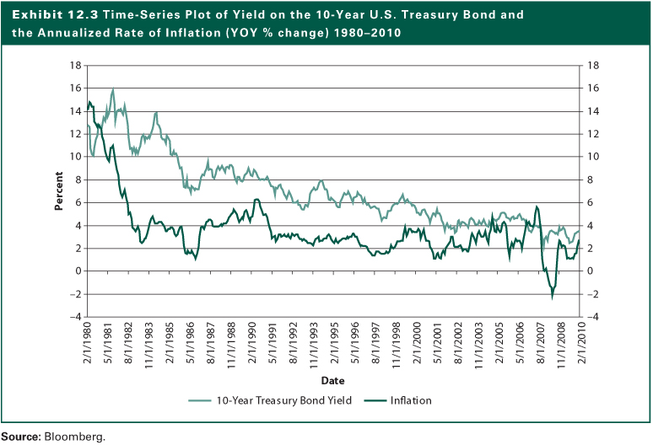
Exhibit 12.3

Slide 20
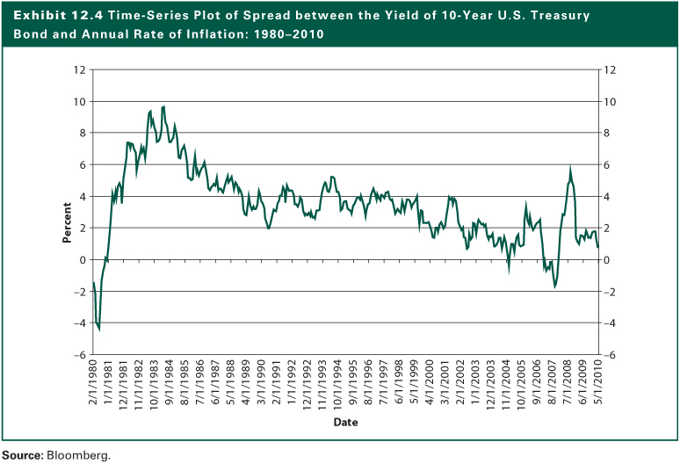
Exhibit 12.4

Slide 21
Analysis of World Security Markets
Leading economic series are available for virtually all the developed countries, and the empirical relationships to the economy are quite similar to those of the United States
Real GDP growth is typically consistent with what is implied by the leading series
Other factors include
  The monetary environment
  The inflation outlook

Slide 22
Microvaluation Analysis
The purpose is to estimate specific values for an aggregate stock market series
Using the various valuation models presented in Chapter 11 with industry-wide data rather than company’s data.
Four Sets of Valuation Techniques
  The Dividend Discount Model (DDM)
  The Free Cash Flow to Equity Model (FCFE)
  The Earnings Multiplier Technique
  Other Relative Valuation Ratios

Slide 23
Estimating Expected Earnings Per Share
Estimating Gross Domestic Product
Estimating Sales per Share for a Market Series
Alternative Estimates of Corporate Net Profits
Estimating Aggregate Operating Profit Margin
Estimating Depreciation Expense
Estimating Interest Expense
Estimating the Tax Rate

Slide 24
Estimating the Stock Market Earnings Multiplier
Determinants of the Earnings Multiplier
Estimating the Required Rate of Return
Estimating the Growth Rate of Dividends
Estimating the Dividend-Payout Ratio

Slide 25
Calculating an Estimate of the Value for the Market Series
It is important to understand the relevant variables and how they relate to the critical estimates of earnings per share and the earnings multiplier
The two critical estimates that are necessary for both the cash flow models and the earnings multiplier approach are the required rate of return discount rate and the expected growth rate of earnings, cash flow, and dividends

Slide 26
Using Other Relative Valuation Ratios
The price-to-book-value ratio (P/BV)
The price-to-cash-flow ratio (P/CF)
The price-to-sales ratio (P/S)

Slide 27
Microvaluation of World Markets
Three Important Factors:
  The basic valuation model and concepts apply globally
  While the models and concepts are the same, the input values can and will vary dramatically across countries
  The valuation of non-domestic markets will almost certainly be more onerous because of several additional variables or constraints that must be considered such as exchange rate risk and country or political risk

Slide 28
The Internet Investments Online
http://www.morganstanley.com
http://www.globalinsight.com
http://www.yardeni.com
http://www.whitehouse.gov/fsbr/esbr.html
http://www.federalreserve.gov
http://www.worldbankorg
http://www.phil.frb.org/econ/forecast/index.html
http://www.spglobal.com/index.html
http://www.bis.org/cbanks.htm
http://www.bankamerica.com/
http://www.nabe.org
http://www.conference-board.org
http://www.bea.doc.gov/bea/pubs.htm
http://www.stats.bls.gov
http://www.cbo.gov
http://www.whitehouse.gov/cea/
http://www.gpoaccess.gov/indicators/browse.html
http://www.census.gov/csd/qfr
http://www.federalreserve.gov/pubs/bulletin

