Slide 1
AD-AS Model
Part 1

Slide 2
The IS-LM Model…
Is about the general equilibrium of the two markets.
Can tell us about how the two markets interacts.
Can tell us about the effects of policies.
Analyzes economy in the short-run.
Assumes that Price Level is constant.

Slide 3
The AD-AS Model…
Is about the “demand” and “supply” of the economy.
Is used to analyze “BUSINESS CYCLES”. For example, what if we produce more than full-employment output?
Can also tell us about the effects of policies.
Analyzes economy in the short run and the long run.
***Assumes that Price Level is endogenous.***
P is determined by AD and AS.

Slide 4
Price and Inflation
The AD-AS also analyzes economy in the long run.
Hence, the price and wage are no longer sticky.
There will inflation/deflation, but inflation/deflation will disappear when the economy reaches a new long-run equilibrium.
Thus, the AD-AS DOES NOT allow for persistent inflation/deflation.

Slide 5
Deriving the AD-AS Model
Note that IS-LM and AD-AS are NOT strongly related.
Different economists developed these two models.
We can derive the AD-AS model from Keynesian Cross.
However, in this course, we will derive it from the IS-LM.

Slide 6
From IS-LM to AD-AS…
Demand and Supply are relationships between P and Y.
The IS curve (goods market) is NOT directly related to P.
Y = C(Y – T) + I(i) + G
This is because all variables are REAL variables, which do not depend on P. But, P can affect IS through LM.
The LM curve (money market) is directly related to P.
M/P = L(i, Y)
Thus, we will derive the AD curve from the LM curve.

Slide 7
From the LM to the AD…
We want to plot a relationship between P and Y from the LM curve.
LM Equation: M/P = L(i, Y)
Real Money Supply = Real Money Demand
An increase in P will reduce the Real Money Supply.
Smaller Real Ms will drive up interest rate.
Higher interest rate discourages investment.
Lower investment reduces output (lower Y).
Hence, AD relationship: P↑ >> Y↓

Slide 8
From the LM to the AD…
An increase in P is like Contractionary Monetary Policy.
When P↑
Money Mkt (LM): P↑ >> i↑
Goods Mkt (IS): i↑ >> I↓ >> AE↓ >> Y↓
Thus, we have the AD relationship: P↑ >> Y↓
Interest rate links the two markets and is what makes the AD downward-sloping.

Slide 9
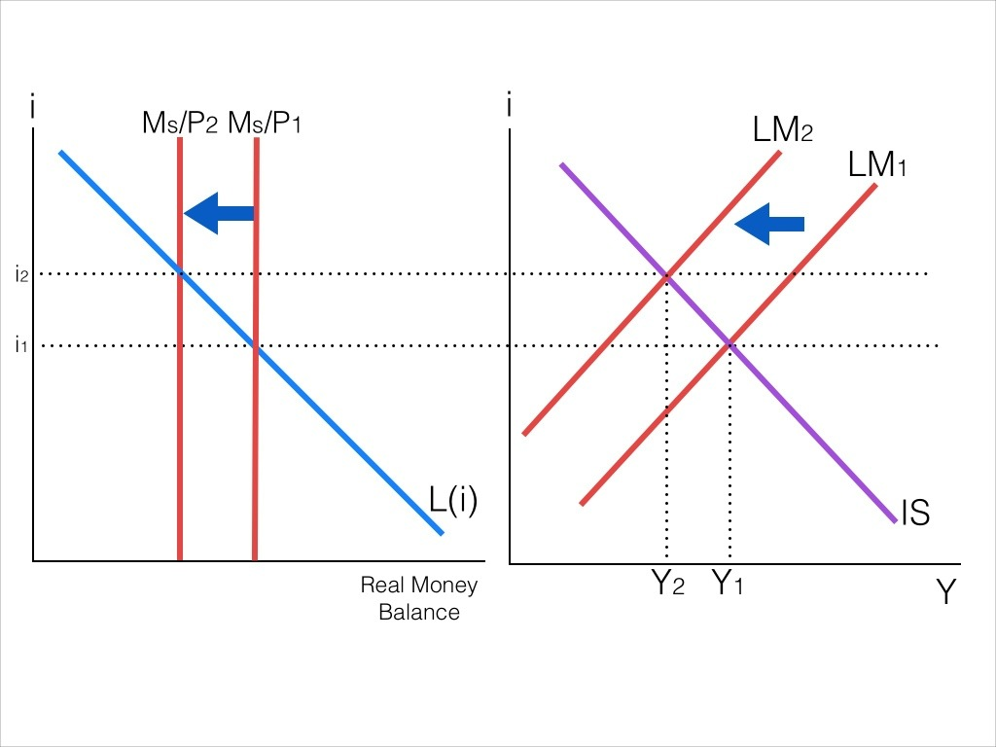
Higher P reduces Real Ms
LM curve then shifts to the LEFT.
Real Money Mkt

Slide 10
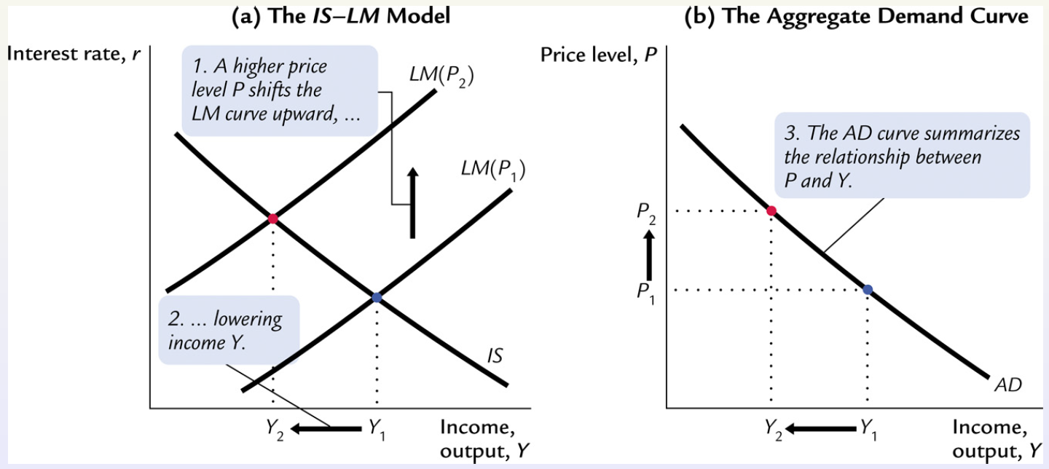
From the LM to the AD…

Slide 11
Shifts in the AD Curve
Changes in Price cause movement along the AD curve.
Shift in the AD means that output changes while the price remains constant.
Therefore, the factors that shifts the AD, are the NON-PRICE factors that shift the IS-LM.

Slide 12
Shifts in the AD Curve
Non-Price factors (in Bold) that shifts the IS-LM
Shifts in the IS: Y = AE = C + I + G
C = C₀ + C₁(Y – T)
I = I₀ – I₁∙ i
G = G₀
T = T₀
Fiscal Policy (G and T) can shift the AD.
Changes in Autonomous C and I can shift the AD too.

Slide 13
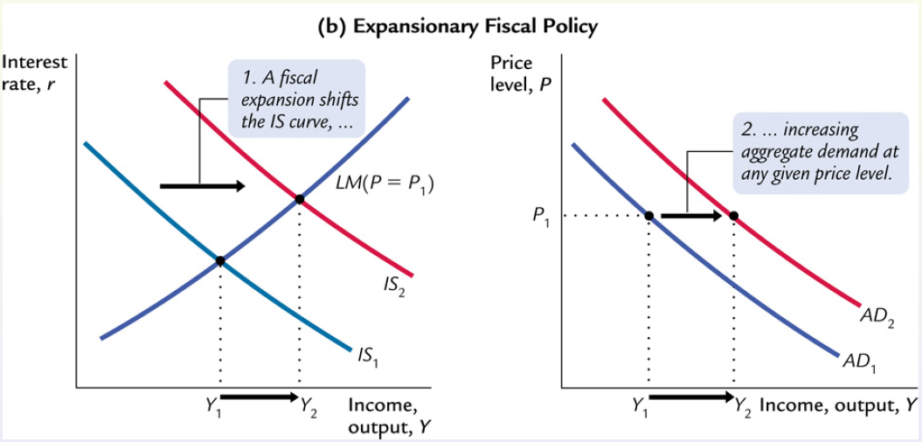
Shifts in the AD Curve

Slide 14
Shifts in the AD Curve
Non-Price factors (in Bold) that shifts the IS-LM
Shifts in the LM: M/P = L(i, Y)
L(i, Y) = L₀∙ Y – L₁∙ i
M = M₀
P = P₀
Monetary Policy (M) can shift the AD.

Slide 15
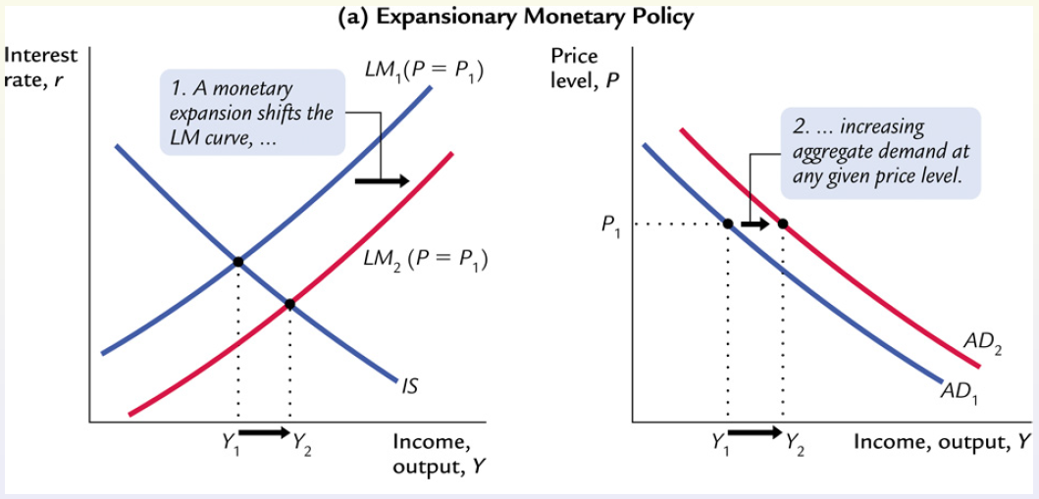
Shifts in the AD Curve

