Slide 1
FN 281: Personal Finance
Thanachote Rungsitivat, CFA, FRM

Slide 2
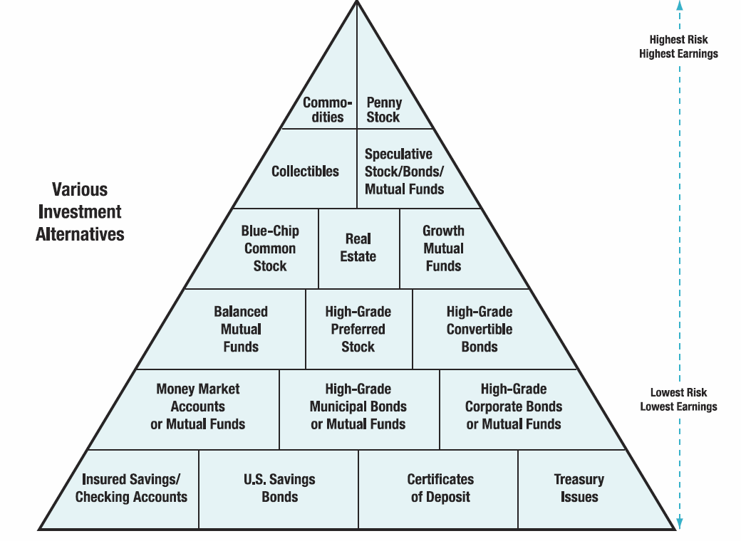
Notes:
http://hsfpp.nefe.org/instructors/channels.cfm?chid=88&tid=1&deptid=22
NEFE Unit 3 Student Guide

Slide 3
Real Estate Investment
Identify types of real estate investments
Evaluate the advantages of real estate investments
Asses the disadvantages of real estate investments
Analyze the risks and rewards of investing in precious metals, gems, and collectibles

Slide 4
Investing in Real Estate
Objective 1: Identify types of real estate investments
Direct Real Estate Investments
  As the investor, you hold legal title to the property
  Your home as an investment
    A place to live
    A major asset of most households

Slide 5
Investing in Real Estate
(continued)
Direct Real Estate Investments (continued)
  Shelter income from taxes if you have a large mortgage - interest is deductible
  Possible hedge against inflation. Be aware of possible real estate “bubbles”

Slide 6
Investing in Real Estate
(continued)
Your vacation home
  Tax advantages
  Primary reason to own a vacation home is because you want to use it

Slide 7

Investing in Real Estate
(continued)
Commercial property
  Land and buildings that produce lease or rental income
  Most common investment of this type is a duplex or small apartment building. It also includes hotels, office buildings, stores, and many other types of commercial establishments

Slide 8

Investing in Real Estate
(continued)
  Will income be greater than expenses?
  Tax deductions, such as depreciation and property taxes are limited to the amount of rental income you receive
    Passive activities and passive losses

Slide 9

Investing in Real Estate
(continued)
Undeveloped land
  Can be tremendous gains but this type of investment poses enormous risks. All the money is riding on a single parcel of land
  Most people buy land with the idea of subdividing the land

Slide 10
Investing in Real Estate
(continued)
Indirect Real Estate Investments
  Real estate syndicates or limited partnerships
    A syndicate is a temporary association of individuals or firms organized to perform a specific task that takes a large amount of capital. Can be organized as a corporation, trust, or limited partnership
    Provide professional management and limited liability for its members, and diversification, if several properties are owned

Slide 11

Investing in Real Estate
(continued)
Limited partnerships
  A limited partnership has a general partner who has unlimited liability and sells participation units to the limited partners. The partner’s liability is limited to the extent of their initial investment, such as $5,000 or $10,000

Slide 12
Investing in Real Estate
(continued)
Real estate investment trusts (REIT)
  REITs are similar to a mutual fund or investment company and trade shares on stock exchanges or over the counter.
  Equity REITs own and operate income-producing properties; Mortgage REITs loan money or invest in mortgages; Hybrid REITS own both properties and mortgages

Slide 13
Investing in Real Estate
(continued)
Investing in First and Second Mortgages
Participation certificates
    A risk-proof real estate investment
    Equity investment in a pool of mortgages that have been purchased by one of several government agencies, such as Ginnie Mae and Freddie Mac

Slide 14

Advantages of
Real Estate Investments
Objective 2: Evaluate the advantages of real estate investments
A possible hedge against inflation
Easy entry as a limited partner, such as investing $5,000 to own part of an apartment building

Slide 15

Advantages of
Real Estate Investments (continued)
Limited financial liability— limited partners
No management concerns - REITs, mortgages
Financial leverage
  Use of borrowed funds for investment purposes, allows you to acquire a more expensive property than you could buy on your own

Slide 16
Disadvantages of
Real Estate Investments
Objective 3: Asses the disadvantages of real estate investments
Illiquidity
Declining property values
Lack of diversification
Lack of a tax shelter for real estate syndicates
Long depreciation period
Management problems—direct real estate

Slide 17

Investing in Precious Metals, Gems, and Collections
Objective 4: Analyze the risks and rewards of investing in precious metals, gems, and collectibles
A hedge against inflation
A safe haven during political or economic upheaval
Need a storage place

Slide 18

Investing in Precious Metals, Gems, and Collections (continued)
Can be risky due to price variations
Gold - lower interest rates often result in higher gold prices
  Bouillon - bars and wafers
  Gold bouillon coins
  Gold stocks
  Gold certificates

Slide 19
Investing in Precious Metals, Gems, and Collections (continued)
Silver, platinum, palladium and rhodium
  Silver prices have fluctuated from $24.25 an ounce in 1932, to over $50 an ounce in early 1980, and then back to less than $18.49 an ounce in June 2010.
  The last three are industrial catalysts, used mostly in automobile production
  Can be both a hedge against inflation and a safe haven during political or economic upheavals

Slide 20

Investing in Precious Metals, Gems, and Collections (continued)
Precious Stones
  Precious stones like diamonds, sapphires, rubies, and emeralds can be a hedge against inflation
  Appeal to investors because of their small size, ease of concealment, inflation hedge, and great durability

Slide 21

Investing in Precious Metals, Gems, and Collections (continued)
Risks include..
  Not easily turned into cash
  Difficult to know if you are getting a good stone
  De Beer’s controls 85% of the world’s supply of rough diamonds
  Expect to buy at retail and sell at wholesale

Slide 22
Investing in Precious Metals, Gems, and Collections (continued)
Collectibles
  Includes rare coins, works of art, antiques, stamps, rare books, sports memorabilia, rugs, Chinese ceramics, paintings and other items that appeal to collectors and investors
  Can be a good investment and a hobby, or a financial disaster
  It’s “buyer beware.” Be careful of investment scams and forgeries
  Know dealer’s reputation and be wary of promises. Get a second opinion
  Use common sense & comparison shop

Slide 23
Investing in Precious Metals, Gems, and Collections (continued)
Collectibles on the Net
  Easier to compare items
  Easier to find items
  The number of collectibles websites is growing very rapidly - eBay is the biggest auction site

Slide 24
Investing in Precious Metals, Gems, and Collections (continued)
Disadvantages of purchasing collectibles over the internet.
  You can’t touch and feel the item and examine it for flaws
  There may also be some security risk since you don’t know who’s getting your cash or credit card number

Slide 25
Derivatives
TFEX
http://www.tfex.co.th/en/education/knowledge.html
Use for Risk Management/Risk Taking (high risk)

Slide 26
Appendix
http://www.tsi-thailand.org/images/stories/TSI2012_Investor/Download/goldfuturessilverfutures_8june2013.pdf

Slide 27
Investment in Cryptocurrencies
Bitcoin is software-based online payment system described by Satoshi Nakamoto in 2008. and introduced as open-source software in 2009.
Payments are recorded in a public ledger using its own unit of account (Bitcoin).
It is a form of digital currency (physical form is absent), created and held electronically. It can be used to buy things electronically and in that sense it is no different than conventional dollars.
Bitcoin is commonly referred to as cryptocurrency and it can be divided into smaller unit called Satoshi (one hundred milionth of a BTC).

Slide 28
What is Bitcoin based on?
System is runned by The Bitcoin protocol
It is based on mathematics unlike conventional currencies that had been based on fixed quantity of metal (gold, silver…) or fiat currencies.
Bitcoin has several features that set it apart from fiat currencies:
  It is decentralized
  It is easy to set up and it is fast
  It is anonymous
  It is completely transparent
  Transaction fees are miniscule
  Transactions are irreversible

Slide 29
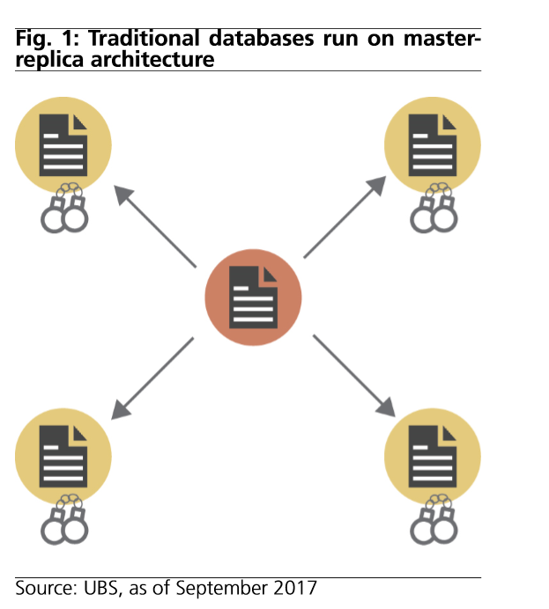
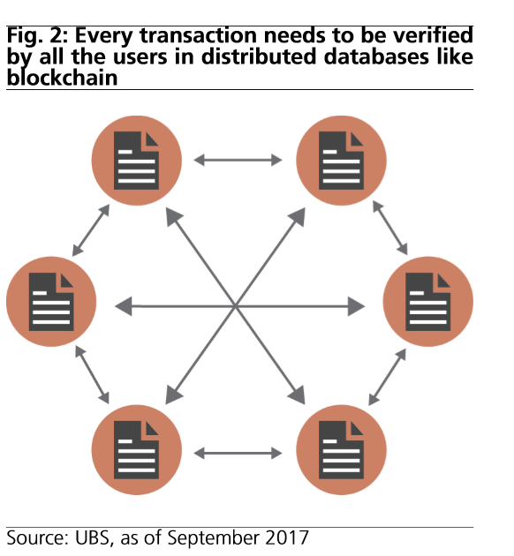
How it works?

Slide 30
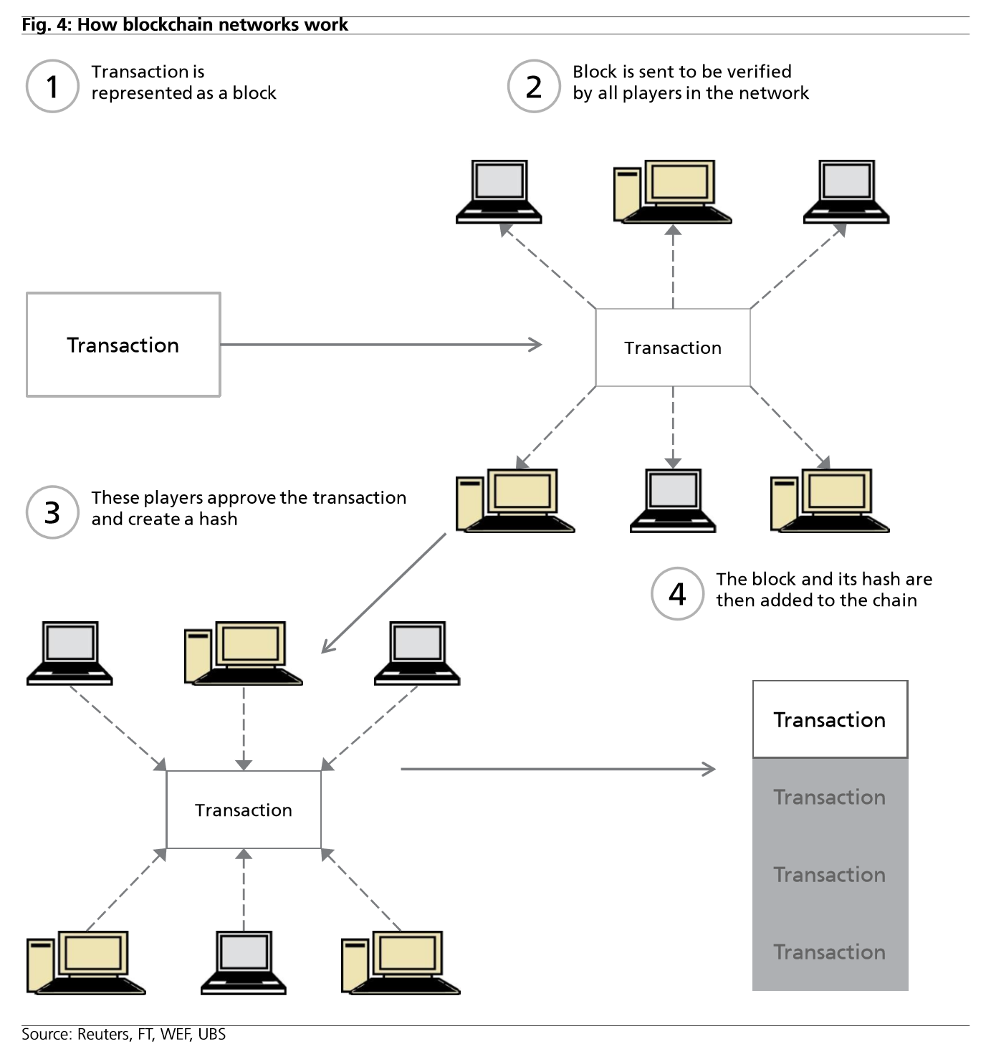
How it works?

Slide 31
Decentralized
Base for the Bitcoin protocol is a peer-to-peer system which means that there is no need for a third party.
Therefore, in theory, bitcoin network is not controled by central authority (fully decentralized monetary system).
Bitcoins are being created by a community of people that anyone can join.
In theory, there is no authority (financial institution) which can tinker with monetary policy and in that sense devalue or revalue Bitcoin currency.

Slide 32
Anonymous and Transparent
Bitcoins are stored in wallet with digital credentials for your bitcoin holdings and allows you to access them.
Wallet uses public-key cryptography, in which two keys, one public and one private are generated. Public key can be thought of as an account number or name and the private key, ownership credentials.
Bitcoin is transferred to the next owner when the next owner gives a public key and previous owner uses his private key to publish a record into system announcing that the ownership has changed to the new public key.
Bitcoin protocol stores details of every single transaction that occurred in the network in huge version of general ledger (Block chain).

Slide 33
Negligible Fees and Irrevesible Process
Bitcoin doesn’t charge fees for either national or international transfers.
Bitcoin is not the first private money, not the first digital currency, and not first currency based on cryptography, but it has been the first to rely on peer to peer network decentralization to avoid double spending.
Bitcoin protects against double spending by verifying each transaction added to the block chain to ensure that the inputs for the transaction had not previously already been spent.

Slide 34
Why price of bitcoins soared and why it became the world pionner in virtual currency field?
Financial crisis that caused meltdown of the economy started 2008-2009.
It caused a transfer of assets form real-estate and financial sphere to investment into commodities that are traditionally considered as a stable store of values.
Historically, Gold is best known commodity of that type because quantity of this metal is limited and, therefore, it is great way how to hedge your portfolio in times when usage of expansive monetary policy is highly likely.
In this sense, bitcoin is similar to gold (except there is no intrinsic value) and when the value of gold started to decrease due to the price roof that it had reached and partial recovery of financial market, value of bitcoin soared because it was cleverly designed financial product with finite quantity.

Slide 35
Theoretical and technical problems which goes against favour of bitcoin usage
Illegal activities, speculations and nature of this currency
Theoretical base for digital currency usage
Regulation and taxation issue
Disputable status of independent and decentralized currency
Mining problems
Skepticism towards implementation of new, unregulated, theologies in finance sphere

Slide 36
Understand Portfolio Rebalancing
What is portfolio rebalancing?
  The process of bringing portfolios back into given target asset allocation ratios
What causes the need to rebalance?
  Changes occur due to:
    Changes in asset class performance
    Changes in investor objectives or risk
    Introduction of new capital
    Introduction of new asset classes

Slide 37
Portfolio Rebalancing
Why is this rebalancing so critical?
  There are competing principles:
    Minimize transactions costs and taxes
    Minimize tracking error at your risk tolerance level
What is tracking error?
  It is the return that is lost from your portfolio being different from your target weight
What are the different ways of rebalancing?
  Periodic-based (or calendar-based)
  Percent-range-based (or volatility-based)

Slide 38
Portfolio Rebalancing
Periodic-based rebalancing
  Specify a time period, i.e. bi-annually, annually, etc. After each time period, rebalance the portfolio back to your original asset allocation targets
  Advantages
    Most simple of the methods
    Longer periods have lower transactions and tax costs (but higher tracking error costs)
  Disadvantages
    Independent of market performance
    Performance will depend on relative timing of large market moves and rebalancing

Slide 39
Portfolio Rebalancing (continued)
Percent-range-based rebalancing
  Rebalance the portfolio every time actual holdings are +/-5% (or +/-10%) from target ratios. Rebalance whenever you are outside this range
  Advantages
    Easy to implement
    Wider ranges will reduce transactions costs (at the expense of higher tracking error)
    Asset performance will trigger rebalancing
  Disadvantages
    Setting an effective range is difficult
    Assets with higher target ranges and volatility will generate most rebalances

Slide 40
Management and Evaluation
What factors lead to above-benchmark or excess returns?
  1. Superior asset allocation
    Shifting assets between a poor-performing asset class and a better performing asset class, i.e. between large cap to international or small cap
  2. Superior stock selection
    Picking sectors, industries, or companies within a specified benchmark which, as a whole, outperform the return on the specified benchmark

Slide 41
Management and Evaluation
What is superior asset allocation?
  The process where the investor gains a higher return than the benchmark from adjusting the investment portfolio for movements in the market
    The investor shifts among stocks, bonds and other asset classes based on their expectations for returns from each of the asset classes
What are the results?
  Done well, superior asset allocation yields higher returns with lower risk.
  Done poorly, it yields lower returns, higher transactions costs, and higher taxes
Notes:
3

Slide 42
Management and Evaluation
What is superior stock selection?
  The process where the investor builds an investment portfolio which earns returns in excess of the benchmark through buying or selling undervalued stocks, sectors or industries
    The investor shifts among the various securities of the index in an attempt to buy the securities with the highest growth potential
What are the results?
  Done well, superior selection yields higher returns with lower risk.
  Done poorly, it yields lower returns, high transactions costs, and high taxes
Notes:
8

Slide 43
Management and Evaluation
What is portfolio evaluation?
  The process of monitoring financial asset performance, comparing asset performance to the relevant benchmarks, and determining how well the fund is meeting its objectives.
    If the assets are underperforming benchmarks, the investor may sell underperforming assets and purchase other assets which would more closely align asset performance with benchmarks

Slide 44
Management and Evaluation
Why monitor performance?
  Unless you monitor performance, you will not know how you are doing in working toward accomplishing your objectives
  You need to know how every asset you own is performing, and performing versus its benchmark, so you can determine how well you are moving toward your goals

Slide 45
Management and Evaluation
How do you evaluate performance?
  Calculate:
    1. The period return on each owned asset
    2. The period index return for each benchmark
    3. The difference between the asset return and benchmark return
    4. The weight of each asset or portfolio in the overall portfolio
    5. The overall portfolio return
  With this information, you can know how each asset is performing versus its benchmark, and how well the portfolio is moving toward its objectives

Slide 46
Management and Evaluation
What is portfolio reporting?
  The process of reviewing portfolio performance with the necessary participants, i.e. your spouse
    If you are managing your portfolio, you should report performance to your spouse at least monthly or quarterly
    If others are helping you manage your portfolio, they should report performance to you and your spouse at least quarterly as well.
  Be careful not to do too much buying and selling, as these incur transactions costs and taxes

Slide 47
Thank you

