Slide 1
Environment and climate change case studies in clmv
EE361/363 Economies of CLMV Countries
Faculty of economics
Thammasat university

Slide 2
Case studies
Nam Theun 2 Hydropower, Lao PDR
Biodiversity Conservation Corridors, Cambodia
Forestry and Livelihood Improvement in the Central Highlands, Viet Nam

Slide 3
Nam Theun 2 Hydropower, Lao PDR

Slide 4
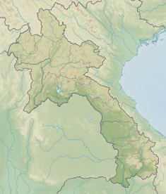
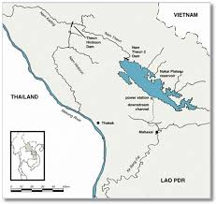
background
Located in Khammouane province, Nam Theun 2 (NT2) is one of Lao PDR’s largest hydropower projects, implemented by the NT2 Power Company and the Lao government
Total cost was around $1.5 billion funded by various international funding partners and the Lao government
NT2 has introduced industry-standard technologies and practices; generated needed revenues for poverty reduction; and supports improved livelihoods through community driven development with a strong focus on environmental protection

Slide 5
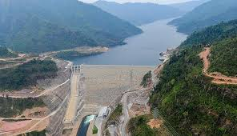
Project design
The NT2 includes the development, construction, and operation of the following:
1,070 MW trans-basin diversion power plant
450-sqkm reservoir on the Nakai Plateau
39-meter-high dam
powerhouse 350 meters below the plateau
a regulating pond below the powerhouse
27 km channel from the regulating pond to the Xe Bang Fai River Basin

Slide 6
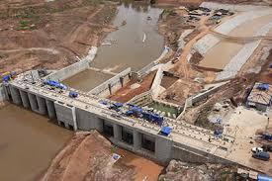
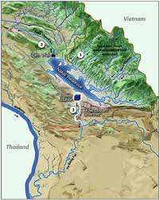
Project features
NT2 is a build-own-operate-transfer facility with a concession period of 31 years. Thereafter NT2 will be transferred to the Lao government free of charge
NT2 began commercial operations in 2010; power is exported to Thailand (1000 MW) and used domestically (70 MW)
Revenues also contributed to road construction, repair, and maintenance, as well as rural electrification.

Slide 7
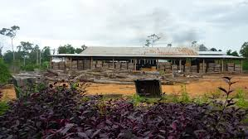
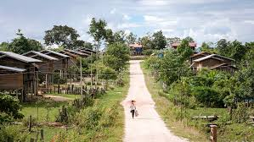
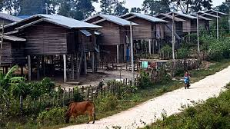
Project features
Project features
NT2 generated over $170 million between 2010 and 2017
NT2 contributed to poverty reduction efforts, environmental management, and improved education and health through various programs (School Block Grants and the Health Equity Fund)

Slide 8
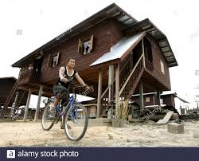
Socioeconomic impacts
NT2 resettled 6,300 people, provided community infrastructure, introduced agricultural livelihood programs, and provided food supplements for vulnerable households which improved peoples’ standard of living and doubled their incomes. 99% households were able to save (21% in 2006).
Primary school enrollment is 94% (previously 31%); stunting dropped by 9%.
Access to markets has improved with paved roads. Travel time from Nakai to Thakhek, the provincial capital, decreased from half day, to only one hour.

Slide 9
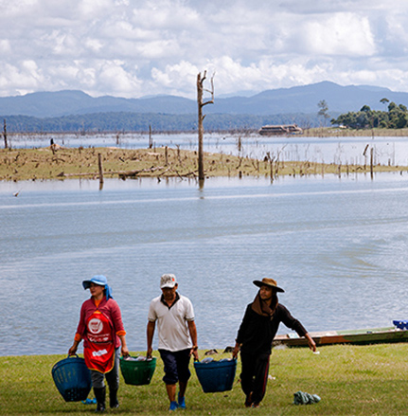
Environmental impacts
NT2 supported villages downstream and upstream of the Nakai Reservoir to compensate for changes in river flows on fishing incomes, river gardens and other assets, and consequent changes in income and protein intake.
Mechanisms are in place to monitor fish levels and erosion and to support affected households through village development planning.
Development of commercial forestry in the resettled area were less successful and therefore efforts were redirected to grazing, non-timber forest products, and conservation.

Slide 10
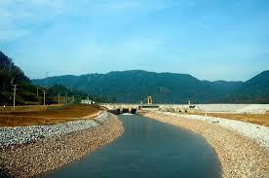
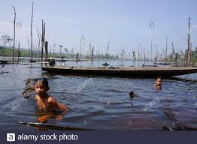
Sustainability measures
About $1.3 million is allocated each year to protect the Nakai Nam Theun National Protected Area, which has rich biodiversity.
NT2 recognizes that adaptation and sustainability requires long term commitment and provides the needed support

Slide 11
Biodiversity Conservation Corridors, Cambodia

Slide 12
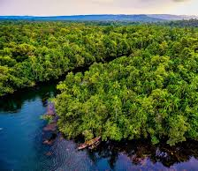
Background
The BCC seeks to enhance transboundary cooperation for mitigating fragmentation of biodiversity rich forests of the Cardamom Mountains, Triborder Forest areas of southern Laos, and the central highlands in Viet Nam
The project promotes sustainable resource use, restore and improve vegetative cover in marginal lands, and address constraints to land tenure and rural household access to socioeconomic assets to enhance productivity of these areas.

Slide 13
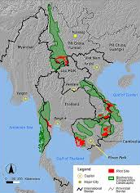
Problem identification
GMS countries have identified several important biodiversity conservation landscapes that are vulnerable to increased development pressures and environmental degradation arising from the development of regional hydropower systems, roads, large-scale tourism infrastructure, mining, and plantation agriculture.
These high-value biodiversity landscapes and watersheds need to be conserved to safeguard local livelihoods and investments in energy and hydropower, transport, water, and food security enhancing sectors

Slide 14
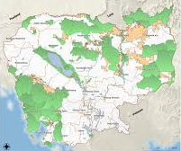
Project design
The project aims to ensure climate-resilient sustainable forest ecosystems benefiting local livelihoods and sustainably managed biodiversity corridors in Cambodia, the Lao PDR, and Viet Nam
Institutions and communities will be strengthened to restore, protect, and maintain biodiversity corridors; people’s livelihoods will be improved and through small-scale infrastructure support provided in target communities

Slide 15
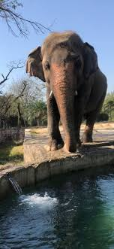
Lessons learned
Establishing protected areas to safeguard the areas of origin and representative samples of local agriculture genetic resources and ecosystems has proven to be an effective development strategy in the agriculture sector.
Uncertain tenure and resource use rights, particularly in the regions surrounding protected areas leads to irresponsible development that degrades watersheds and their potential to support agriculture.
Encroachment is degrading natural systems. Up to 10 percent of all protected areas are affected by encroachment especially in the densely populated southern and western regions of Cambodia.

Slide 16
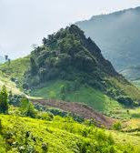
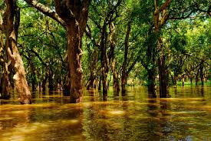
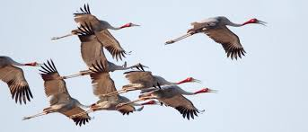
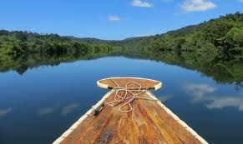
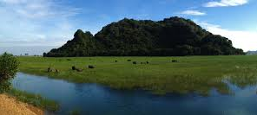

Slide 17
Forestry and Livelihood Improvements
Central Highlands, Viet Nam

Slide 18
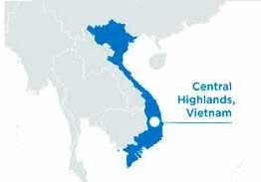
background
Viet Nam’s forests were under considerable threat despite logging bans and official sanctioning of reduced harvesting.
Poor forest management and over-harvesting resulted in low forest stocks, causing production and productivity losses.

Slide 19
Project impact and outcome
The project’s expected impact was improved forest productivity and livelihoods and reduced poverty in the Central Highlands.
The expected outcome was to enable the government to strengthen sustainable forest management (SFM) in the Central Highlands, an important forest region of the country and to secure 70% of national timber needs in 2010–2015.

Slide 20
Project design
The project design comprised four outputs:
sustainable forest resource management and development planning for 3 million ha of forest, which included (a) forestland management planning, (b) forest resource development, and (c) business development
livelihood improvement

