Slide 1

INTEGRATED BRAND COMMUNICATION
Massimiliano La Franca
Lesson 5
YAWP

Slide 2
Response models: implications
Why is this important for us? What are the implications?
3 major points to remember:
  Analysis helps marketers understanding where is the crucial problem and what stage that they want to influence with their activities
    Example: is there a problem with this new product because people don’t understand how it works (knowledge) or because they don’t know that the product exist (awareness). Implication: 2 different message/activities to solve the 2 above problems
  Forces marketer to think ahead what response they want from their activities. This clarifies the brief for agencies
  Given the type of the category marketers work on, different type of messages, executions and channels will be relevant (ex. high involvement vs. low involvement products)

Slide 3
How we use this in real life (1)?
A brand or a product can suffer a specific problem at any specific stage in the described model (ex. low awareness or low conviction).
How many people of them do actually buy?
How many people think this brand is better?
How many people like this brand?
How many people know this brand?

Slide 4
How we use this in real life (2)?
Once identified the issue, we want to use communication to solve it. In other words we give communication a specific role: this is called communication objective.
Roles of communication:
Create awareness/saliency
Create a favorable impression/ Link to needs, desires
Modify attitudes
Sustain awareness, top-of-mind/list
Reinforce attitudes
Evoke an immediate response

Slide 5
How we use this in real life (3)?
Once defined what’s the objective of the communication we can start thinking how we want them to react when they see our stories (ex. If they don’t like us, we want to produce communication that might surprise them)
Planners call this types of “desired response” we expect from people when they are exposed to our communication.
We think of this in advance so we can calibrate our messages (ex. if low conviction we might want to use rational arguments, comparison, science to convince people).
Type of desired responses:
“Now I’ve heard of you/it”
“What a good idea”
“Really?”
“That reminds me”
“I always knew it”
“I should go do that”

Slide 6
LET’S GET FAMILIAR WITH DIFFERENT TYPES OF RESPONSES

Slide 7
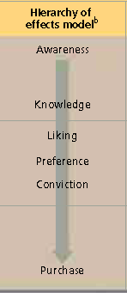
How to get to your desired response
Role of Communication
Create awareness/saliency
Create a favorable impression/ Link to needs, desires
Modify attitudes
Sustain awareness, top-of-mind/list
Reinforce attitudes
Evoke an immediate response
Learn
Feel
Do

Slide 8
How to get to your desired response
Role of Communication
Desired response
Create awareness/saliency
Create a favorable impression/ Link to needs, desires
Modify attitudes
Sustain awareness, top-of-mind/list
Reinforce attitudes
Evoke an immediate response
Learn
“Now I’ve heard of you/it”
“What a good idea”
“Really?”
“That reminds me”
“I always knew it”
“I should go do that”
Feel
Do

Slide 9

“Now I’ve heard of you/it”
Communication task is to introduce something,
bring something to the forefront, or create or
maintain awareness.
Employed by new companies, products or
services that are trying to get on the consumer
radar. Or brands that need constant saliency.
Also when an existing company has
something new to say.
Examples:
Launch of a new product
Launch date for new movie
Introduction of new packaging

Slide 10
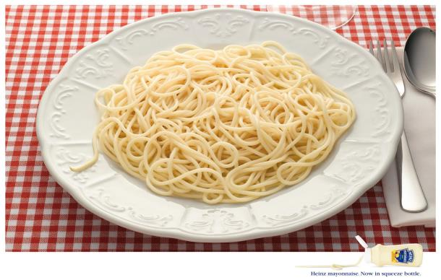
“Now I’ve heard of you/it”

Slide 11
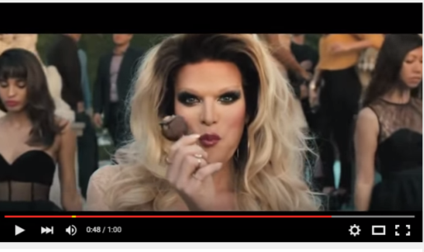
“Now I’ve heard of you/it”
https://www.youtube.com/watch?v=ei96-Breysg

Slide 12

“Now I’ve heard of you/it”
https://www.youtube.com/watch?v=qQQMygivn0g

Slide 13

“What a good idea”
Task is to create a favorable impression or to make a link between the product/service
and individual needs, wants or desires.
Employed to show how a product or service can
serve a particular role or to introduce a new or unexpected role in the lives of consumers.
Examples:
Toothpaste with floss in the cap helps you look after your teeth even better
Showing how a new technology helps make life easier

Slide 14

“What a good idea”

Slide 15
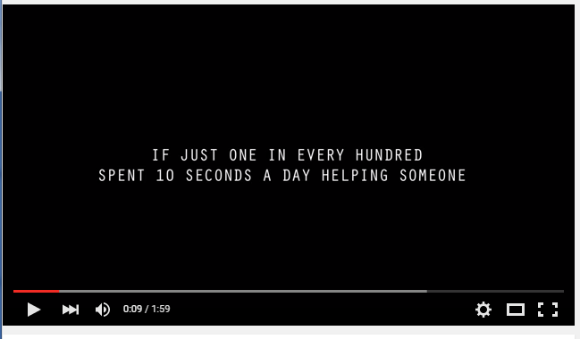
“What a good idea”
https://www.youtube.com/watch?v=IOSVN30RPE4

Slide 16
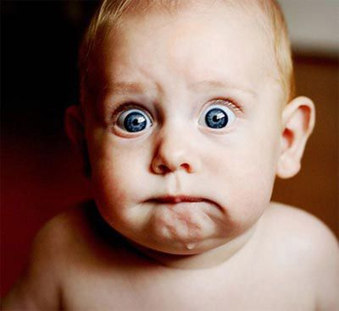
“Really? I should think that”
This communication task is to modify or change an existing attitude.
To change a perception that is either undesirable, undifferentiated or inaccurate to something more relevant, motivating, true and different.
Examples:
Illustrating how beer can be part of a healthy lifestyle
Shock advertising to make people think about health issues

Slide 17
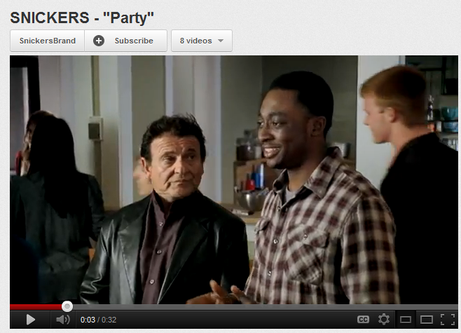
“Really? I should think that”

Slide 18
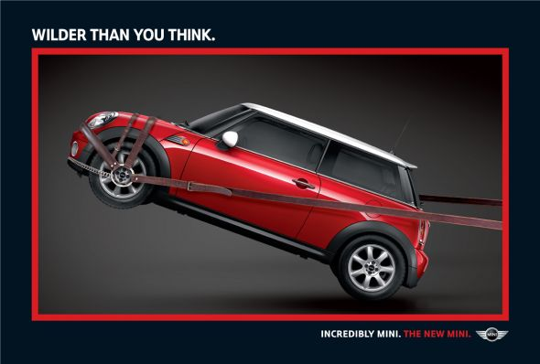
“Really? I should think that”

Slide 19
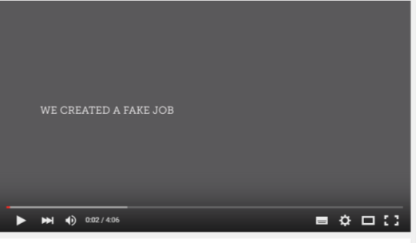
“Really? I should think that”
https://www.youtube.com/watch?v=HB3xM93rXbY

Slide 20

“I always knew it”
Reinforces/evokes some intrinsic truth about the company, product/service or some other associations that come from within brand or the company.
  When consumers have the brand’s proposition in their head but it is either fading, latent or under pressure.
  When companies have products or services in categories where a competitive advantage must
  remain top of mind to keep the brand top of list
Examples:
Volvo re-expressing its safety credentials
Levi’s expressing its American roots

Slide 21
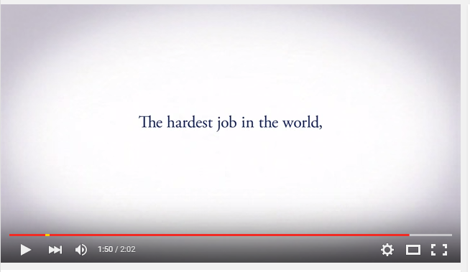
https://www.youtube.com/watch?v=0ruHOaHrGnQ

Slide 22
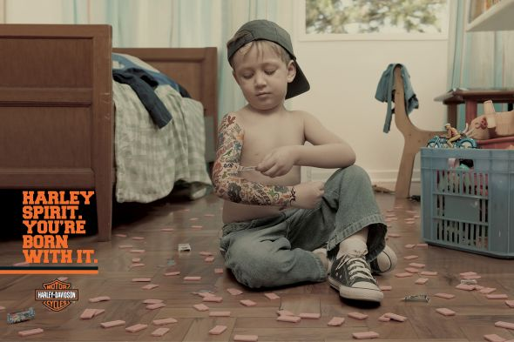

Slide 23

“That reminds me”
Conjures highly potent and common experiences that the audience universally recognizes.
Cues universal external truths about the consumer’s world in which the product or service has resonance, fits particularly well or resolves uniquely
Presents the product as a way to resolve or enhance that situation.
Examples:
Bing reminding us of search result overloads from Google

Slide 24
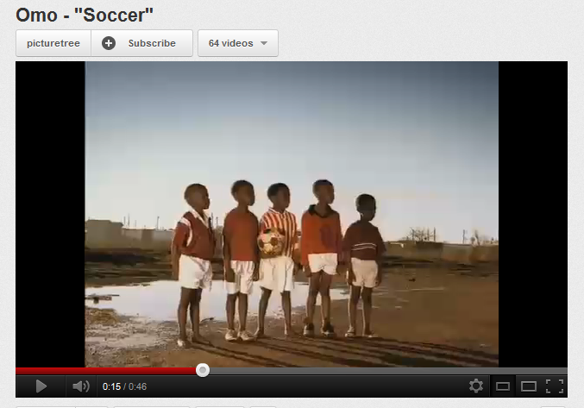
“That reminds me”

Slide 25
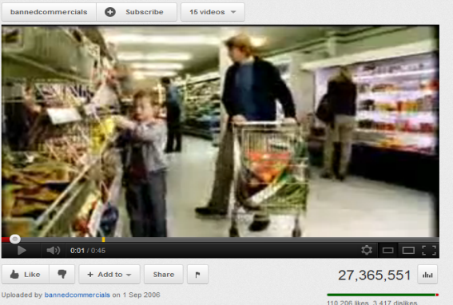
“That reminds me”

Slide 26

“I should go do that right now”
Communication drives an immediate action or response.
For either direct selling (e.g., call now to order) or as a mechanism to encourage another stage in the buying process (e.g., test drive, check out website, etc.).
Examples:
“Subscribe to xxx program and get a free xxx”
Prada store texting top customers with “1 Hour Sale” announcements

Slide 27
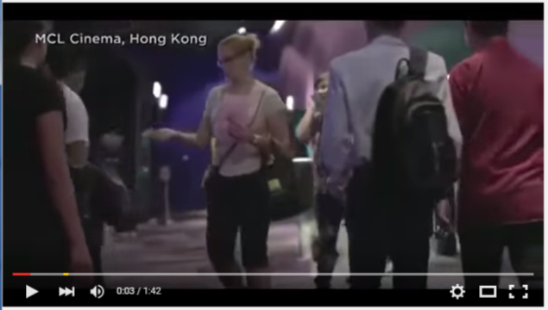
https://www.youtube.com/watch?v=m3a-hOwPLxQ

Slide 28

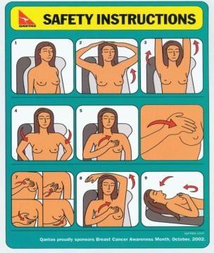
“I should go do that right now”

Slide 29
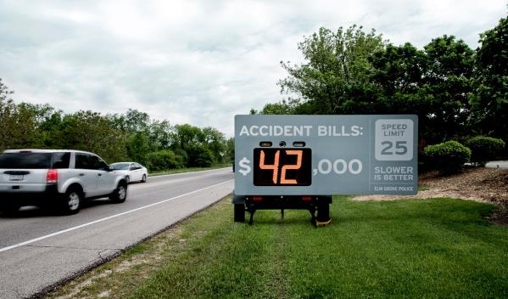
“I should go do that right now”

Slide 30
Ok let’s try
What category of products?
What is the key message?
What’s the role of the communication?
What is the response they’re looking for?

Slide 31
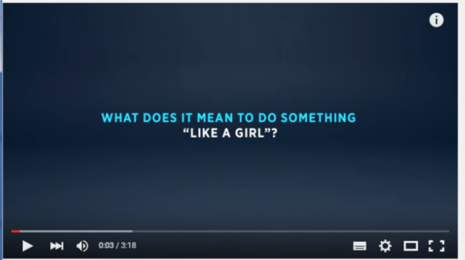
https://www.youtube.com/watch?v=XjJQBjWYDTs

Slide 32
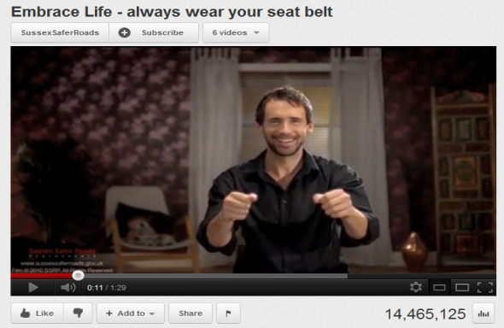
“I should go do that right now”

Slide 33

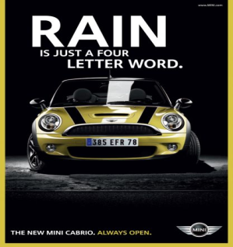


Slide 34
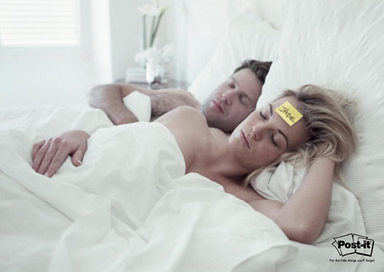
“I always knew it”

Slide 35
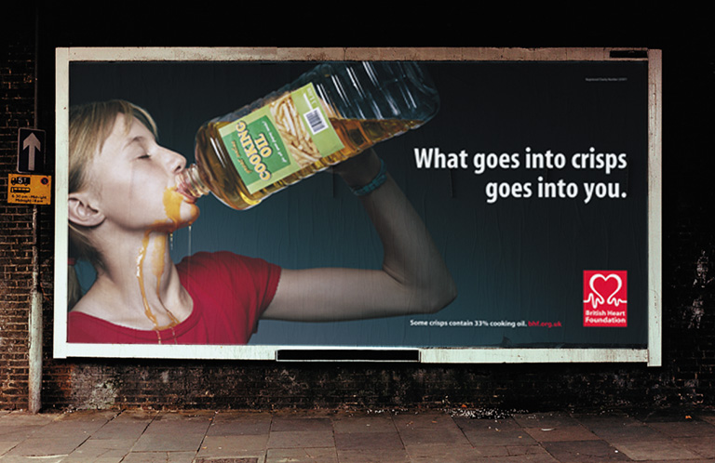

Slide 36
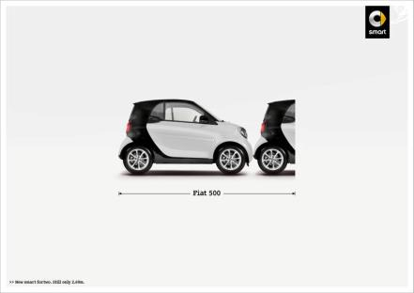
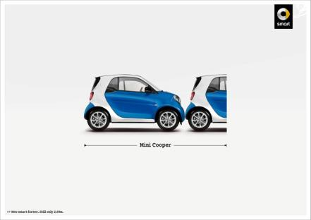

Slide 37
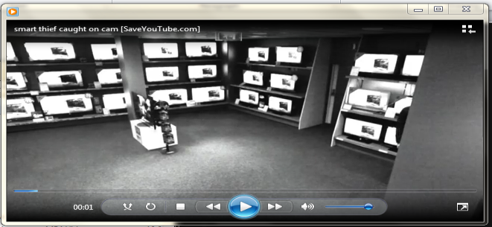
https://www.youtube.com/watch?v=EYX5fFxcXWU

Slide 38


Slide 39


Slide 40

https://www.youtube.com/watch?v=TCv3RnXIGT0

Slide 41


Slide 42
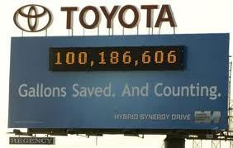

Slide 43
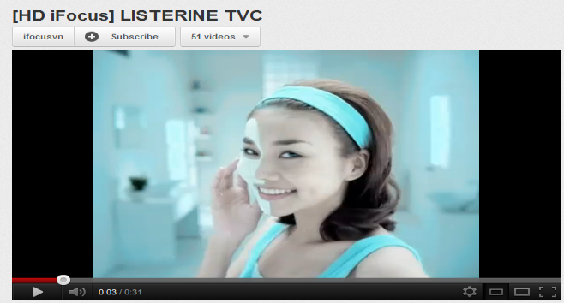

Slide 44


Slide 45
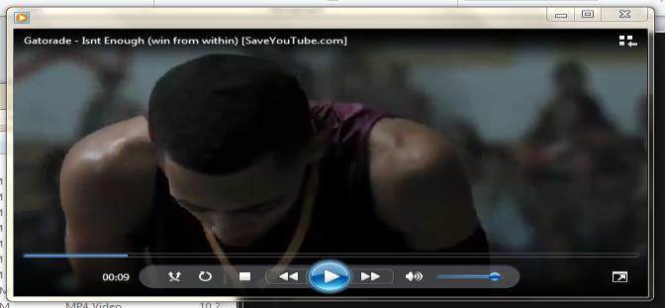

Slide 46
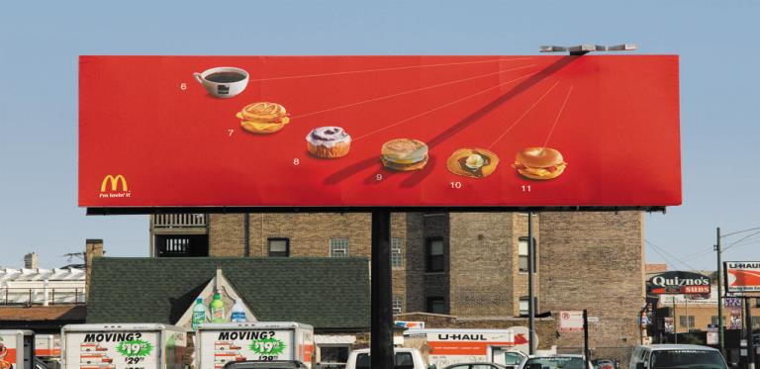

Slide 47
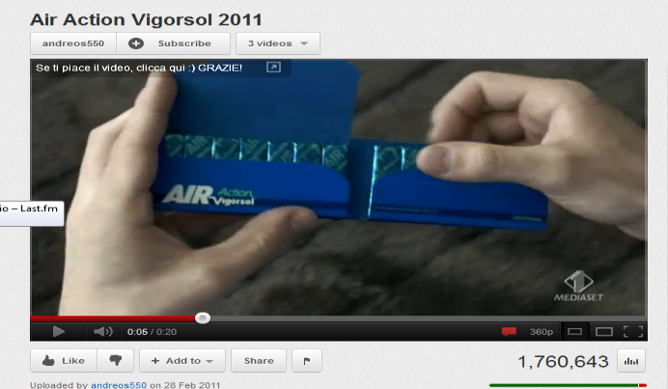
https://www.youtube.com/watch?v=o8RCOb3WQOs

Slide 48




Slide 49
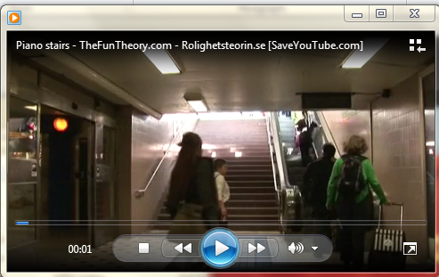

Slide 50


