Slide 1

Chapter 1
Chapter 11
DEVELOPING AND MANAGING
CUSTOMER RELATIONSHIPS
MK 312 Marketing Planning
By
Ajarn Suwalya K.

Slide 2
Ch. 11 - Learning objectives
After studying this chapter you should be able to:
■ discuss loyalty, satisfaction and perception of value as determinants for development of the Customer Relationship Management (CRM) strategy
■ understand how CRM, one-to-one marketing and GAM (Global Account Management) differ from each other
■ explain how customer lifetime value can be measured.

Slide 3

Factor that determine the shape of the CRM Strategy
Customer loyalty
Customer satisfaction
Customer perception

Slide 4

Customer relationships
Long-standing customer relationships represent a company’s most valuable assets, assets that will pay dividends well into the future.
By knowing how much equity really resides in its customer relationships, a company can have a very good understanding of how these relationships will pay returns to shareholders in the future through their contribution to a stream of revenue on which the company can rely.

Slide 5
Loyalty
Loyalty, like so many other concepts that we encounter when discussing consumer psychology and marketing, is a state of mind.
As implied above, loyalty is a subjective concept, one that is best defined by customers themselves. There are degrees of loyalty: some customers are more loyal than others, and customers are very loyal to some companies and less loyal to others.

Slide 6
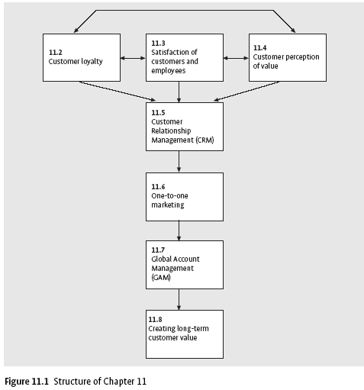
Structure of Chapter 11

Slide 7

Satisfaction of customers and employees
Achieving the highest possible level of customer satisfaction is the ultimate goal of marketing. In fact, much attention has been paid recently to the concept of ‘total satisfaction’, the implication being that achieving the partial satisfaction is not sufficient to drive customer loyalty and retention. When customers are satisfied with how they have been handled during the purchase and how the product and service has performed, they are much more likely to come back to make additional purchases and say good things to their friends and family members.

Slide 8

Satisfaction of customers and employees
In this representation, customer satisfaction is seen to be a function of the value created for the customer through the quality of service provided by a firm and its employees. This satisfaction is seen as a major contributor to customer retention and by extension, profitability.
Satisfied employees are more likely to provide superior levels of service; they stay longer with the firm and have a greater sense of commitment to the company and its customers.

Slide 9

Value: customer perception of value
Value is a predictor of customer choice and loyalty. Buyers who are considering a purchase in a particular product or service category will consider their options and develop a ‘consideration set’ that consists of all the brands and models they will consider purchasing. The customer will purchase the product or service that he or she perceives to deliver the most value.

Slide 10

Value:customer perception of value
The simple definition of value as what customers get for what they give is broad enough to allow for the incorporation of many different types of benefits and costs.
The concept of give and get goes beyond the basics of money and core product or service, however. The costs that the customer might give in the exchange situation with a firm include money, time, energy or effort and psychological costs.

Slide 11

Value: customer perception of value
Different segments of customers perceive value in different ways. Customers combine various elements of the value proposition in order to define the value from their perspective. As a result, what is considered valuable or an important element of value proposition by one customer is not considered valuable by another. Value may created in different ways.

Slide 12
Customer value drivers
Four sources of value can be identified.
1. Process: optimizing business processes and viewing time as a valuable customer resource.
2. People: employees are empowered and able to respond to the customer.
3. Product/service/technology: competitive features and benefits of products and services, lowering productivity interruptions.
4. Support: being there when the customer needs assistance.

Slide 13
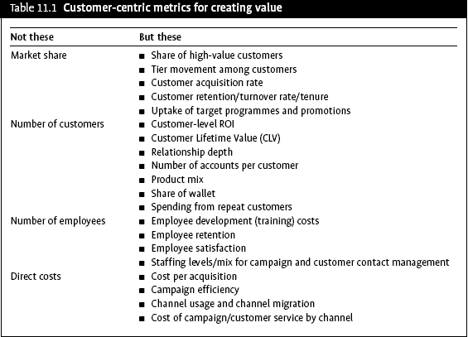
Customer value metrics

Slide 14

Customer Relationship Management
(CRM)
CRM is a company-wide business strategy designed to optimize profitability, revenue and customer satisfaction by focusing on highly defined and precise customer groups. This is accomplished by organizing the company around customer segments, encouraging and tracking customer interaction with the company, fostering customer-satisfying behaviors, and linking all processes of the company from its customers through its suppliers.

Slide 15

Implementing a CRM System
Companies that implement a CRM system adhere to a customer-centric focus or model.
A customer-centric company and its representatives learn continually from customers about ways to enhance their product and service offerings. Learning in a CRM environment is normally an informal process of collecting customer information through customer comments and feedback on product and service performance

Slide 16

Implementing a CRM System
The success of CRM- building lasting and profitable relationships-can be directly measured by the effectiveness of the interaction between customer and organization.
CRM is a company-wide process that focuses on learning, managing customer knowledge and empowerment. It differs from one-to-one marketing in a very important way: one-to-one marketing is an individualized marketing method that utilizes customer information to build a long-term, personalized and profitable relationship with each customer. CRM is broad and systemic, whereas one-to-one marketing will be dealt with in the next section.

Slide 17
One-to-one marketing
One-to-one marketing is the ultimate goal of a new trend in marketing that focuses on understanding customers as individuals instead of a part of a group. To achieve this, contemporary marketers are making their communications more customer-specified.

Slide 18
One-to-one marketing
One-to-one marketing may be no more than a relationship cultivated by a sales person with the customer.
A successful sales person builds a relationship over time, constantly thinks about what the customer needs and wants, and is mindful of the trends and patterns in the customer’s purchase history.
A good sales person often knows what the customer needs even before the customer does!
The sales person may also inform, educate and instruct the customer about new products, technology or applications in anticipation of the customer’s future needs or requirements.

Slide 19
One-to-one Marketing
Several focuses have helped shaped this new one-to-one focus on customers. They include the following:
  A more diverse society
  More demanding and time poor consumers
  Decline of brand loyalty
  Explosion of new media alternatives
  Marketing accountability

Slide 20
Online One-to-one marketing
Many marketers are capitalizing on the web’s full set of interactive marketing capabilities.
Internet companies are learning more about their customers and using this information to fine-tune their marketing efforts and build relationships with each customer on a more individual level.

Slide 21
Online One-to-one marketing
An important advantage of online one-to-one marketing is:
the ability to deliver personalized promotional messages to each customer visiting a company’s website. Past customer transaction history, clickstream data and survey responses are used to identify buying patterns and interests.
based on information known about the customer visiting its site, such as colour and brand preferences, geographic location and past customer transaction data, the marketer can develop a targeted and personalized online promotion or custom catalogue.

Slide 22
Global Account Management
Global Account Management (GAM) is an organizational form employed by multinational / global supplier organizations and used to co-ordinate and manage worldwide activities of servicing a customer centrally by a managed team.
GAM focuses on dealing with the needs of an important global customer (Global Account GA) in the B2B market.

Slide 23

Global Account Management
An important motivation for the supplier to accept GAM-programmes is the pressure from the customer (Global Account) to ‘standardize’ pricing on a global basis
Global customers may attempt to use GAM as a means to lower prices globally in the guise of inferring that there should be equity / commonality of pricing throughout the global network of customer organizations

Slide 24
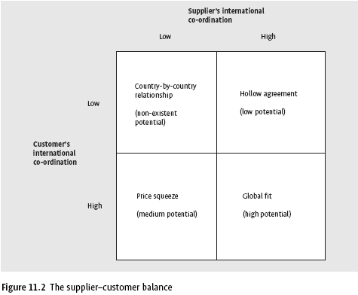
Global Account Management

Slide 25
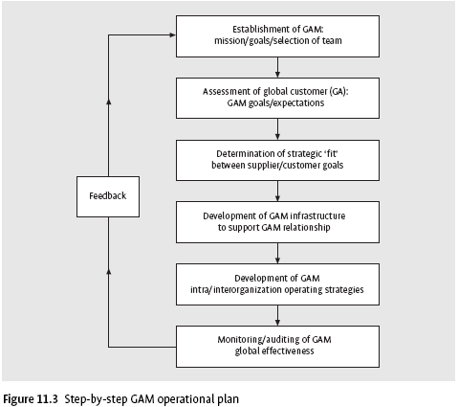
Global Account Management

Slide 26

Creating long-term customer value
Customer lifetime value (CLV) projects the future value of the customer over a period of years. One of the basic assumptions in any lifetime value calculation is that marketing to repeat customers is more profitable than marketing to first-time buyers.

Slide 27
Creating long-term customer value
CRV has a number of uses:
(i) it shows marketers how much they can spend to acquire new customer;
(ii) it provides a level of profitable spending to retain a customer
(iii) it provides a basis for targeting new customers who look like a company’s most profitable customers.
Lifetime value analysis allows a firm to identify its most valuable customers and profit from them over the long term by building relationships with them.

Slide 28
Creating long-term customer value
The increasing importance of the customer-centric approach to marketing is evident in the numerous CRM initiatives prevalent today, such as one-to-one marketing and data-base marketing.
Most of these customer-centric marketing initiatives aim to increase the length of the customer life-cycle as well as the value of transaction between the firm and customer during each stage of the life cycle.

Slide 29

Creating long-term customer value
CLV models can be very useful in helping firms make strategic as well as tactical decisions – that is, strategic decisions in terms of identifying who its customers are and their characteristics and which customers to go after in the long run.
CLV models help quantify the relationship of the firm with its customers and subsequently allow the firm to make more informed decisions in a structured framework. CLV models also help a firm to know who its profitable customers are, and customer profitability provide a metric for the allocation of marketing resources to consumers and market segments. Marketing efforts are best directed at the most profitable consumers.

Slide 30

Defining a customer
The first challenge is to define the customer unit. It is an individual, an account, a household or a business address?
A second challenge is linking customer information to a single customer record when they leave and return multiple times during their lifetime.

Slide 31


Defining a customer
CLV for a firm is the net profit or loss to the firm from a customer over the entire life of transactions that customer with the firm. Hence, the lifetime value of a customer for a firm is the net of the revenues obtained from the customer over the lifetime of transactions with the customers minus the cost of attracting, selling and servicing the customer, taking into account the time value of money (Fig.11.4).

Slide 32
Evaluating costs
The indirect costs are especially difficult to divide and allocate. In solving these problems, three key costing principles should be applied.
  1. Customer costs must be related to the revenues they generate.
  2. Not all costs within the organization should be attributed down to a customer level.
  3. It should be made absolutely clear who can influence different types of cost and revenues.

Slide 33
Evaluating the duration of customer loyalty
The duration of customer business relationships is difficult to measure in the present economic environment, characterized as it is by unpredictability and rapid change. Many companies are using as their main predictive tool the analysis of historical data about the past behavior of these segments into the future.
This method can be used successfully only in relatively stable market environments because it assumes that:
  Customers will repeat their past behavior in the future
  Market conditions will not change significantly

Slide 34
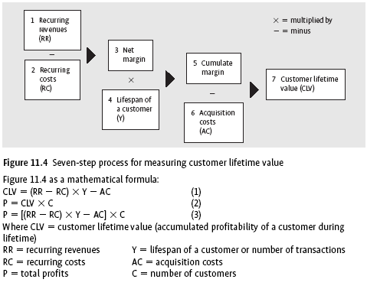
Customer lifetime value

