Slide 1
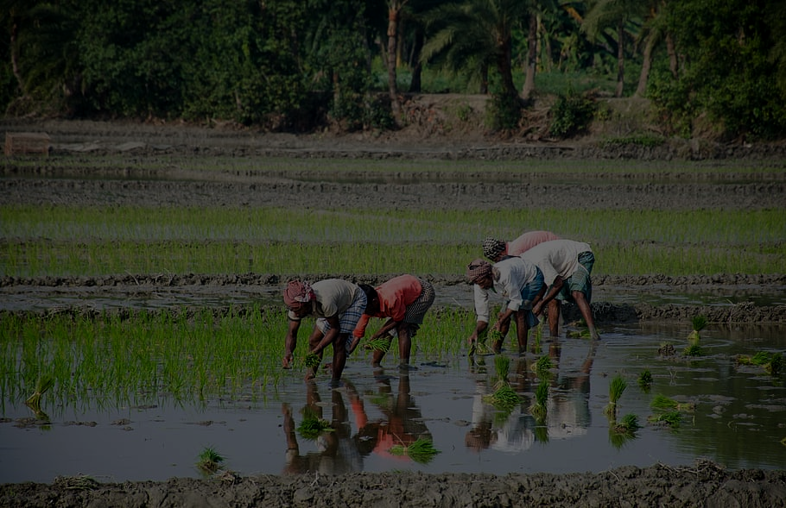
Economic development in Singapore, Thailand and Myanmar

Slide 2
Agenda
01
Colonization
02
Education
03
FDI
04
Framework

Slide 3
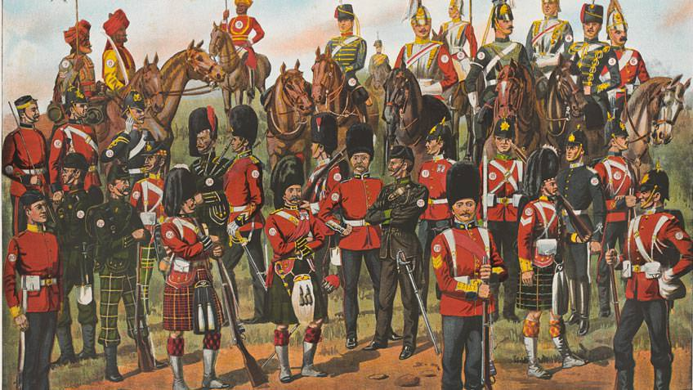
Colonization

Slide 4
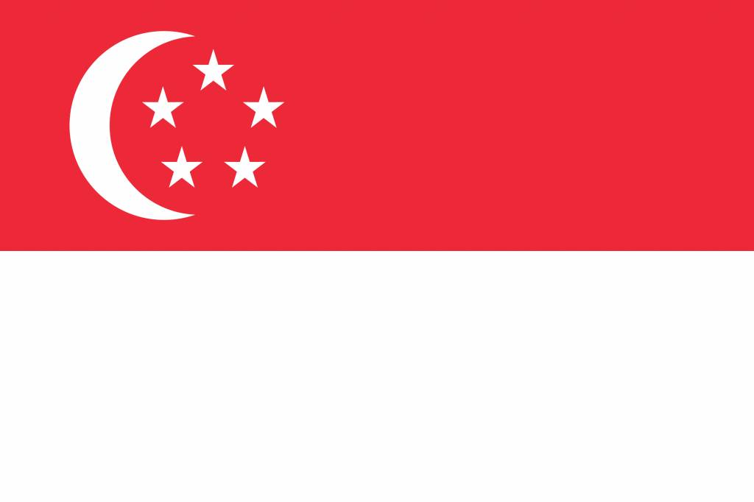
Colonization effect (Singapore)
EMPLOYMENT
EDUCATION
LIVING CONDITIONS
LEISURE AND ENTERTAINMENT
CONNECTIONS TO THE WORLD
Source : Colonial Singapore (1819-1941)
Colonization
Education
FDI
Framework

Slide 5
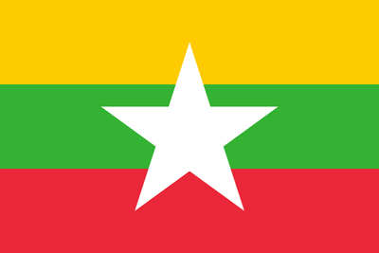
Colonial economy crisis (Myanmar)
Although Burma was the wealthiest country in Southeast Asia under British rule. Among its exports, The British made southern Burma into one of the world’s largest rice exporting regions and also exploited rubies and other products that they sold on the world market.
The British ruthlessly exploited the countries resources and left little in return. The country was very much shaken.
At the same time, thousands of Indian labourers migrated to Burma and, because of their willingness to work for less money, quickly displaced the Burmese farmers,
Source : https://uca.edu/politicalscience/dadm-project/asiapacific-region/burmamyanmar-1948-present/
Colonization
Education
FDI
Framework

Slide 6

Post-Independence Crisis (Myanmar)
After Burma achieved its independence from Britain on January 4, 1948, there was a conflict within Myanmar’s government. The Central Council of the Burmese Communist Party-White Flag (BCP-WF) got arrested by government police and so on BCP-WF rebels launched a military offensive against government after the incident. The civil war went on until 1989 then everything was solved.
Source : http://factsanddetails.com/southeast-asia/Myanmar/sub5_5a/entry-3007.html
Colonization
Education
FDI
Framework

Slide 7
Colonization affect education (Myanmar)
British transformed the education system during the mid-19th to early 20th centuries(1824-1948). For the pre-colonial period, the education system was most likely based on religious Theravada Buddhist monastic order, or the Sangha. During the colonial period, the British attempted to reform the existing system, initially by working to incorporate more secular subjects into the monastic curriculum and later by setting up a system of secular schools with the rise of the nationalistic spirit in the 20th century, the educated Burmese demanded education reforms and created national schools.
Source : http://factsanddetails.com/southeast-asia/Myanmar/sub5_5a/entry-3007.html
Colonization
Education
FDI
Framework

Slide 8
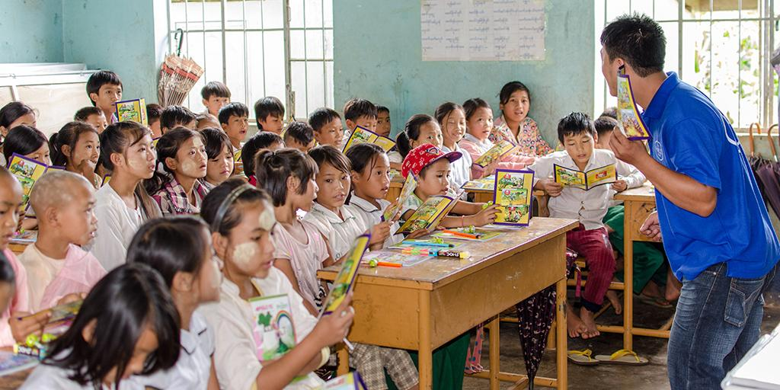
Education

Slide 9
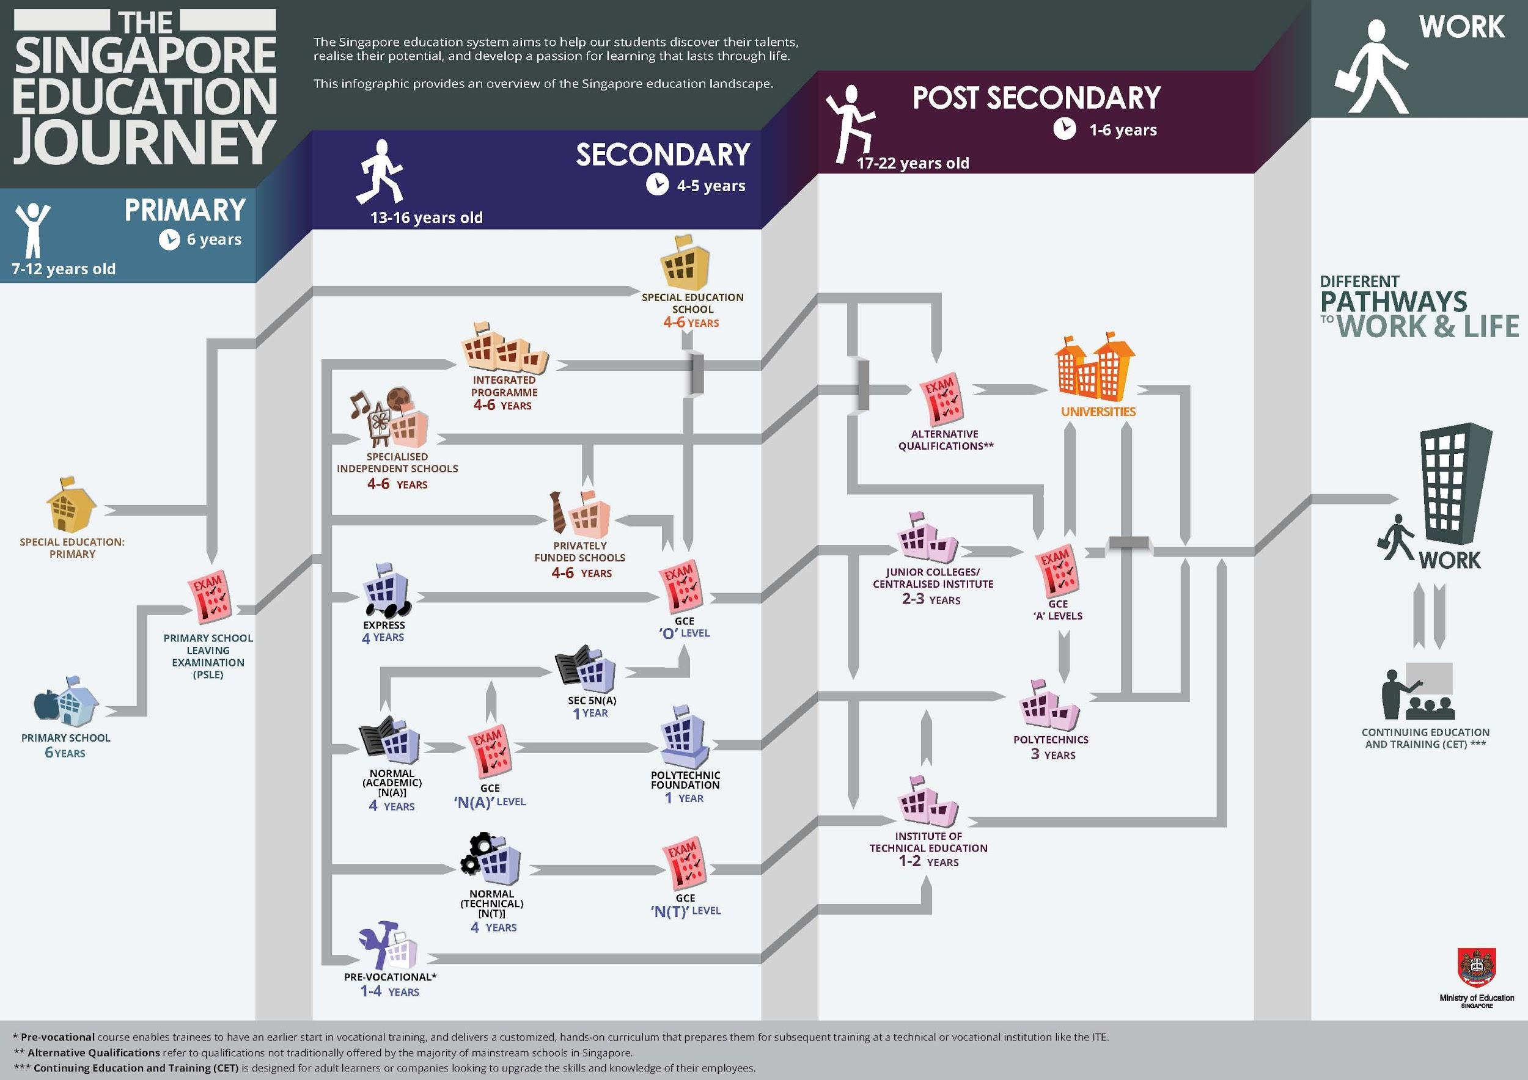

Slide 10
Education (Singapore)
Singapore's compulsory education system consists of six years of primary school, four years of secondary, and between one and three years of post-secondary school. Students undergo two major exams before even leaving primary school.
System
Why is Singapore's education system so successful?
Singaporean students also score among the best in the world on international exams. Education in Singapore is superior because the classes are focused on teaching the students specific problem solving skills and subjects.
Parents play a crucial role in their child's education.
Source : UNCTAD, 2016
Colonization
Education
FDI
Framework

Slide 11
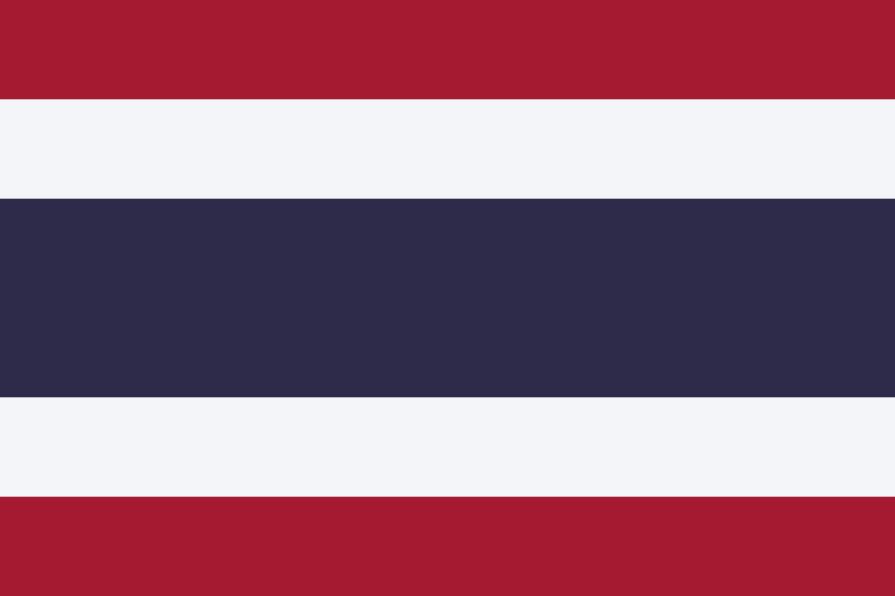
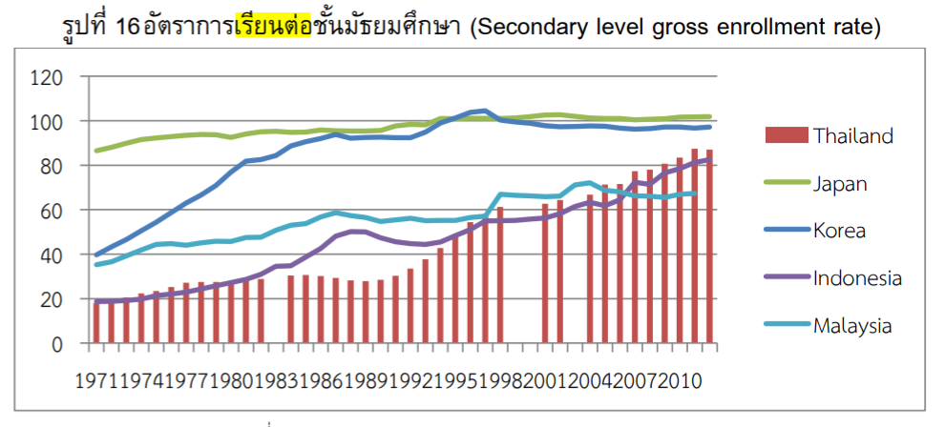
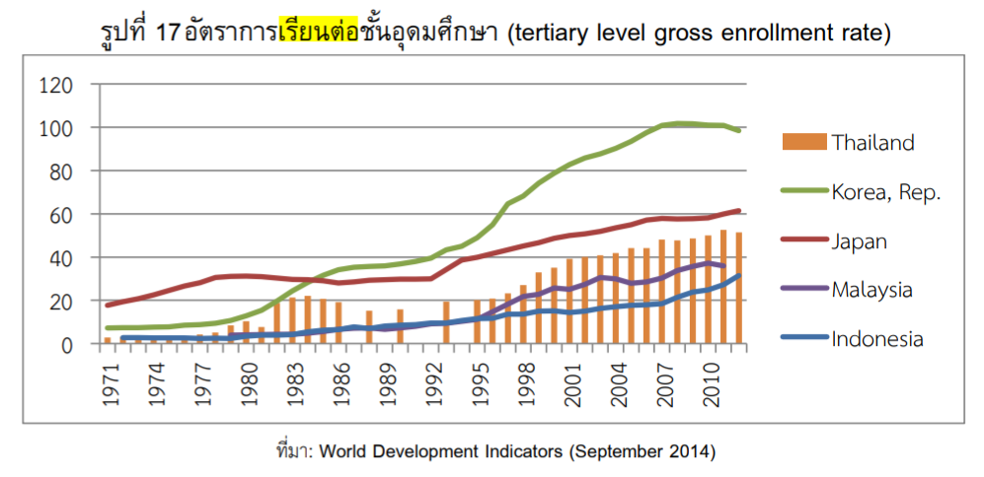
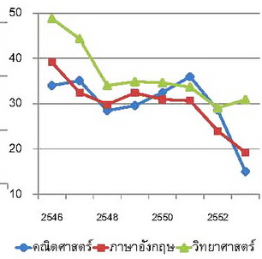
Education (Thailand)
How education link to middle income trap
R&D
Innovation
Skilled worker
Developed country
Somkiat Tangkijvanit,2016
Average O-net score
Source :
รายงานการวิจัย เรื่อง ความเหลื่อมล้ำในสังคมไทย:แนวโน้ม นโยบาย และแนวทางขับเคลื่อนนโยบาย, สมชัย จิตสุชน,2015

Slide 12
Education (Thailand)
The accountability of education needs to be improved:
Thailand has an accountability system based on test scores, yet learning outcomes have not improved from 2003-2015.
The government would also benefit from developing credible and efficient regulations as well as monitoring mechanisms and adhering to follow-up sanctions when standards are not met. There are no regulations on the maximum number of pupils per teacher in either primary or secondary education.
Thailand uses student evaluations to feed into evaluations of teachers, which are subject to bias. The validity of student evaluations rests on the assumption that students understand, observe and recognize good teaching, and report it truthfully.
There are data challenges in Thailand: In Thailand, the National Institute of Educational Testing Service (NIETS) has administered the Ordinary National Educational Test (O-NET). The data is used by local education authorities to compare individual schools against district or national averages. There are no common student performance standards, and the main role of O-NET is to certify education level completion. O-NET scores fluctuate between years.
Source : https://bangkok.unesco.org/content/20172018-global-education-monitoring-report-thailand-highlights
Colonization
Education
FDI
Framework
Notes:
https://www.bangkokpost.com/business/1845489/international-education-in-thailand-–-30-years-on
https://bangkok.unesco.org/content/20172018-global-education-monitoring-report-thailand-highlights

Slide 13



Education (Myanmar)
Reconstruction with the concept of homogenous system of schools in 1947.
Encourage Bilingual instruction in Primary and Post school.
They need to have a good knowledge of English language, and then they are able to enter government service and profession.
Before Independence
(1945-1948)
The curriculum that prioritize practical and prevocational subjects and activity programmes ( Gardening, Art)
New education plan (PEET)
After Independence
(1948-1962)
Discrimination
Children’s examination results at an early age determined the shape of their adult life ( A-list student, B-list student)
More focus on Science, but less focus on Art.
Under Military Rule
(1962-1988)
Source : Education in Burma (1945-2000) (Thein Lwin, 2000)

Slide 14
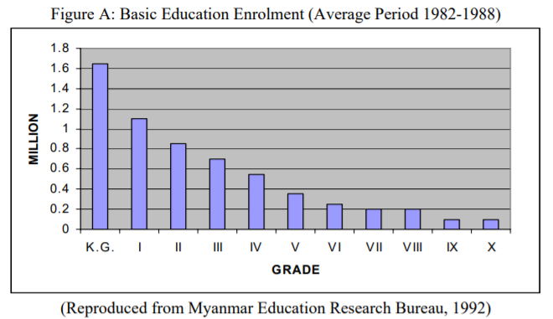
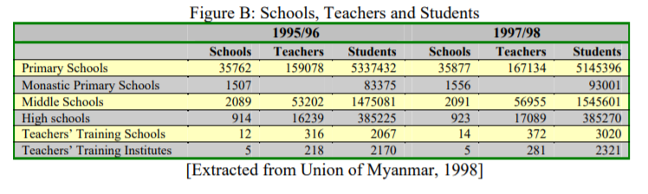
Source : Education in Burma (1945-2000) (Thein Lwin, 2000)

Slide 15


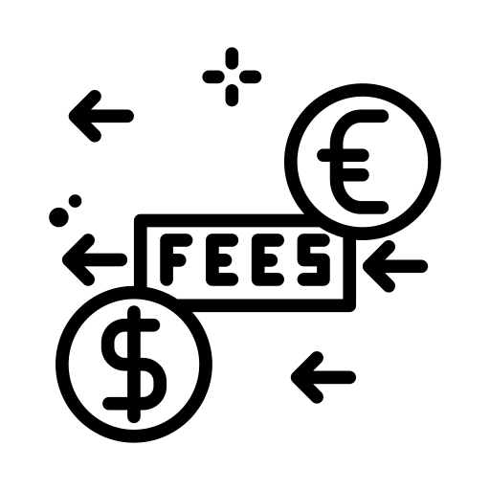

Current Education Problem (Myanmar)
Problem
Restriction in the quality of education services, bad school infrastructure, outdated teaching method, and lack of qualified teachers.
Mostly, children affected from the conflict-affected area including Kachin, Rakhine, and northern shan states.
Fees is one of the major issues for several children to give up on schooling.
Natural disasters
Source : https://www.unicef.org/myanmar/education
Colonization
Education
FDI
Framework

Slide 16

Foreign Direct Investment

Slide 17
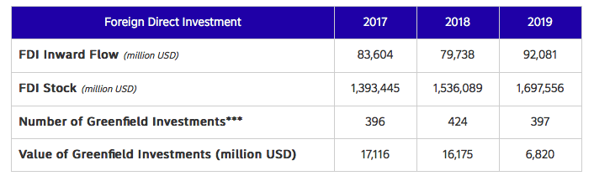
FDI (Singapore)
Source : UNCTAD, 2016
Colonization
Education
FDI
Framework

Slide 18
FDI (Singapore)
Weak Points
Although Singapore is a free port, tariff protection for industrial enterprises is not granted.
Singapore levies high excise taxes on alcohol, tobacco, automobiles and petroleum products.
Strong Points
Its workforce is one of the most qualified in the world
High value-added sectors are very well developed.
Important hub for regional and international trade.
In order to attract more and more FDI, the country is working to maintain an attractive tax regime.
Source : UNCTAD, 2016
Colonization
Education
FDI
Framework

Slide 19
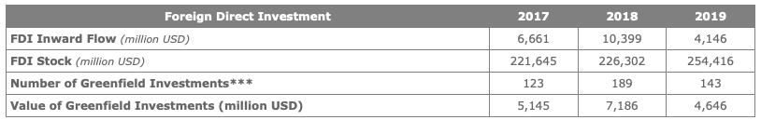
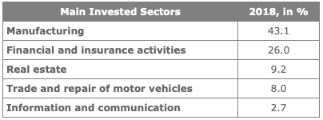
FDI (Thailand)
Foreign direct investment is an important element of Thailand's economic development, and the country is one of the major FDI destinations in its region. However, according to UNCTAD's World Investment report 2020, FDI flows decreased to USD 4 billion in 2019, down from USD 10 billion in 2018. This was the result of a general drop in investment in ASEAN member States.
Thailand is among the countries with the most reforms in business regulation over the past few years. The country has taken steps to clarify corporate governance, ownership and control structures.
Source : https://santandertrade.com/en/portal/establish-overseas/thailand/foreign-investment
Colonization
Education
FDI
Framework
Notes:
https://santandertrade.com/en/portal/establish-overseas/thailand/foreign-investment

Slide 20
FDI (Myanmar)
Myanmar’s Foreign Investment Law was enacted in 1988 soon after the adoption of a market-oriented economic system. FDI inflow into Myanmar gradually increased during the period from 1989 to 1996. However, after 1997, FDI inflow was dramatically reduced until 2004. In 2005, FDI inflow increased at an unprecedented rate and reached the highest level in the country’s history. However, this growth was not sustainable in the subsequent years, as it declined again and turned stagnant at the previous level.
Source : https://www.ide.go.jp/English/Publish/Download/Dp/149.html
Colonization
Education
FDI
Framework

Slide 21
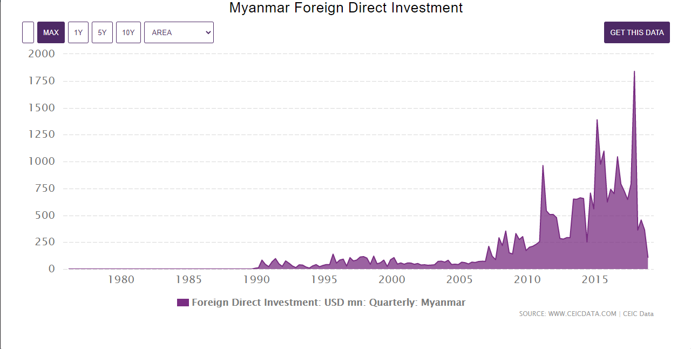

Slide 22
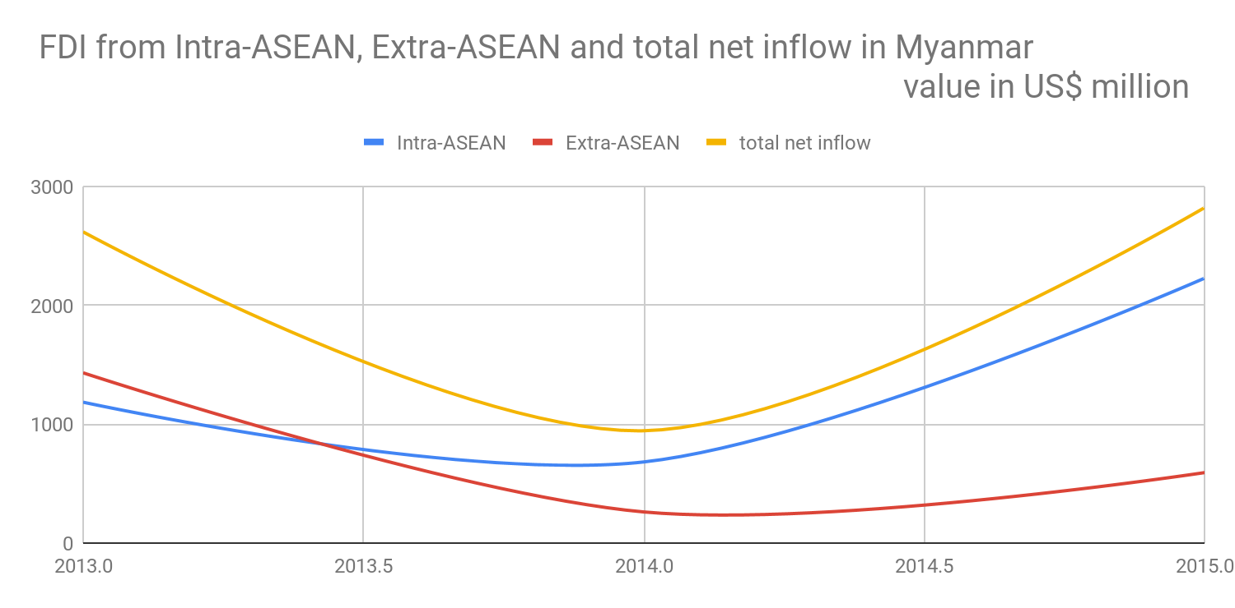
FDI in 2013-2015 (Myanmar)
Source : https://data.aseanstats.org/fdi-by-hosts-and-sources
Colonization
Education
FDI
Framework

Slide 23

Theoretical framework
Why are some nations more prosperous than others?
Why are some nations unable to escape poverty for hundreds of year and so on?
Inclusive/extractive
Economic Institution
FDI
Natural resource
Enhance or obstruct growth
facilitate
Virtuous Circle
or
Vicious Circle
Colonization
Education
Political institution
Inclusive/extractive
Political stability
Source : Why Nations Fail: The Origins of Power, Prosperity and Poverty, 2013
Colonization
Education
FDI
Framework

Slide 24

Q&A

Slide 25
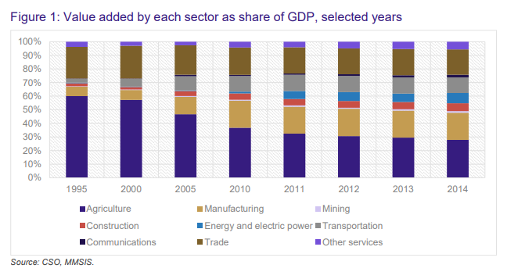
Myanmar natural resource

Slide 26
Natural resources (Singapore)
Natural resources in Singapore were categorized into 2 parts which are
Non-renewable & Renewable resources
Non-Renewable resources
Natural resource, such as coal, oil, or natural gas, which takes millions of years to form naturally. Singapore took a conscious decision to move from fuel oil to natural gas in 2001. Currently natural gas accounts for 80 per cent of the electricity generation.
Renewable Resources
Singapore has tremendous potential to tap solar energy, being situated in the equatorial belt. The country has to find a solution to the problem of lack of availability of land, if it has to truly leverage on its solar energy potential. Renewable resources have become a focal point of the environmental movement. Energy obtained from renewable resources puts much less strain on the limited supply of fossil fuels.

