Slide 1

Group Assignment
Retail Locations in Thailand

Slide 2

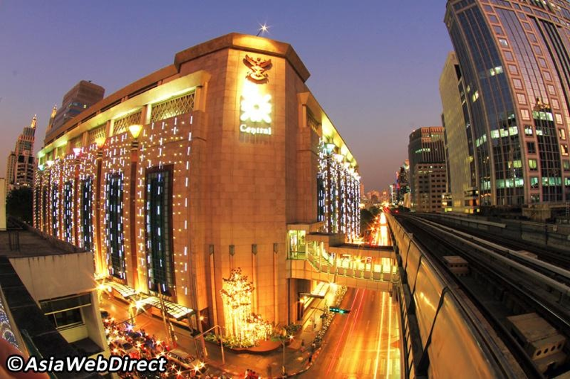

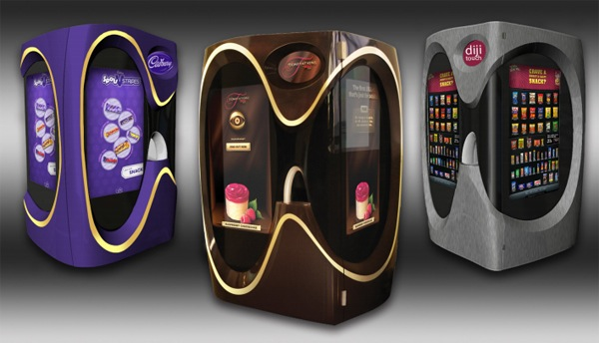
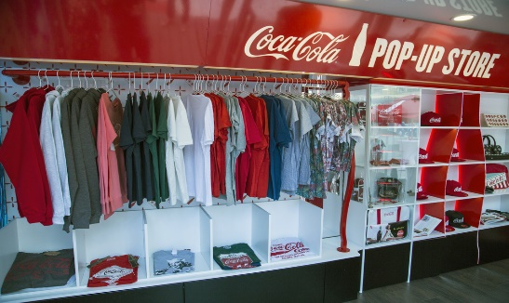
RETAIL CATEGORIES
1. Unplanned Locations
2. Shopping Centers and Planned Retail Locations
3. Nontraditional Locations

Slide 3
Group Assignment: Retail Locations in Thailand
Please research on the types of retail locations in Thailand for the 3 Retail categories ( does not need to be your group project category, please feel free to find any interesting location in Thailand, let’s surprise the class if such a retail exists ☺ )
All Unplanned Retail locations
Shopping Centers and All Planned Retail locations
All Nontraditional Locations
Then briefly explain the pros and cons of each retail example.
Please create maximum 6 pages ppt. slides to be due next Tuesday March 15th. Please design the slides by using photos, graphs, charts, visuals to make the slides interesting ka.
Each group will be required to present at least 1 slide from your presentations. To stand by ka.
Notes:
1

