Slide 1
Linear Models and Matrix Algebra II
Pawin Siriprapanukul
CW Ch.4

Slide 2
Outline
Commutative, Associative, and Distributive Laws
Identity Matrices and Null Matrices
Transposes and Inverses
Finite Markov Chains

Slide 3
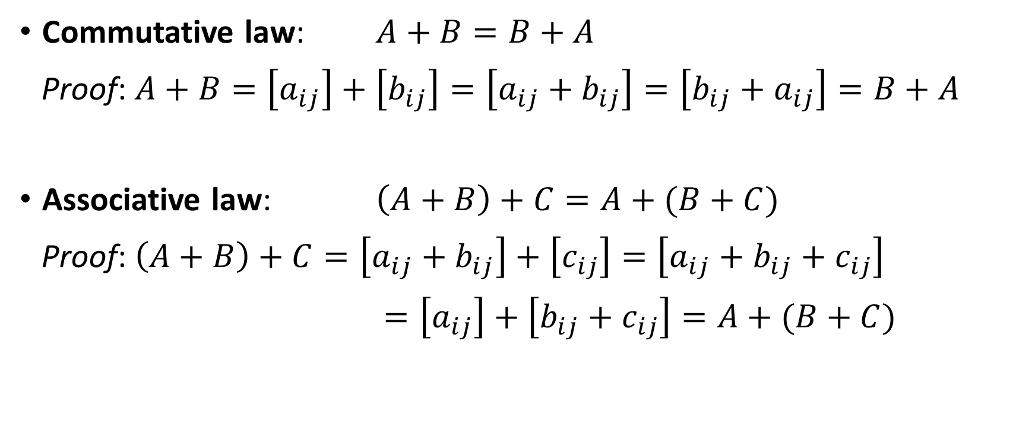
Matrix Addition
Commutative law: $A+B=B+A$
Proof: $A+B=\left[a_{ij}\right]+\left[b_{ij}\right]=\left[a_{ij}+b_{ij}\right]=\left[b_{ij}+a_{ij}\right]=B+A$
Associative law: $\left(A+B\right)+C=A+(B+C)$
Proof: $\left(A+B\right)+C=\left[a_{ij}+b_{ij}\right]+\left[c_{ij}\right]=\left[a_{ij}+b_{ij}+c_{ij}\right]$
$=\left[a_{ij}\right]+\left[{b_{ij}+c}_{ij}\right]=A+(B+C)$

Slide 4
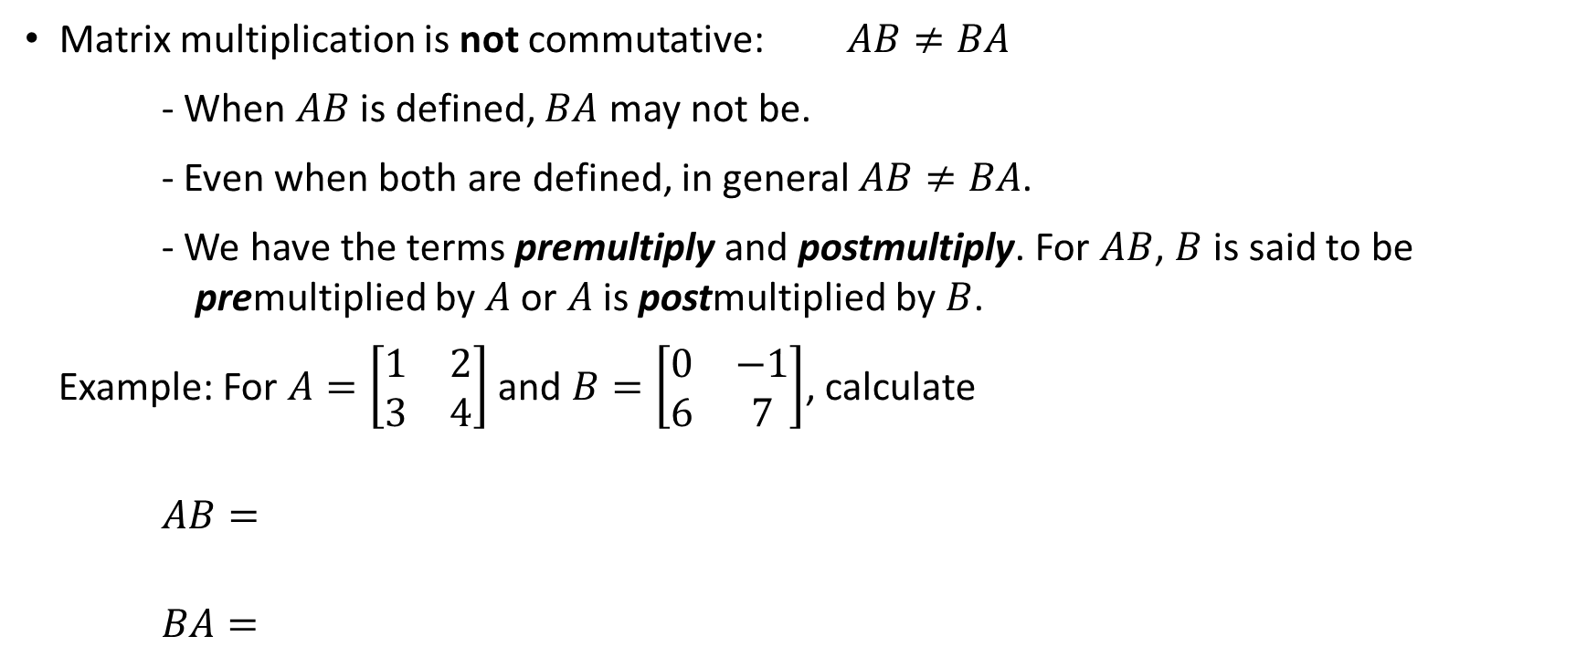
Matrix Multiplication
Matrix multiplication is not commutative: $AB≠BA$
- When $AB$ is defined, $BA$ may not be.
- Even when both are defined, in general $AB≠BA$.
- We have the terms premultiply and postmultiply. For $AB$, $B$ is said to be premultiplied by $A$ or $A$ is postmultiplied by $B$.
Example: For $A=\left[\begin{matrix}1 & 2 \\ 3 & 4\end{matrix}\right]$ and $B=\left[\begin{matrix}0 & −1 \\ 6 & 7\end{matrix}\right]$, calculate
$AB=$
$BA=$

Slide 5
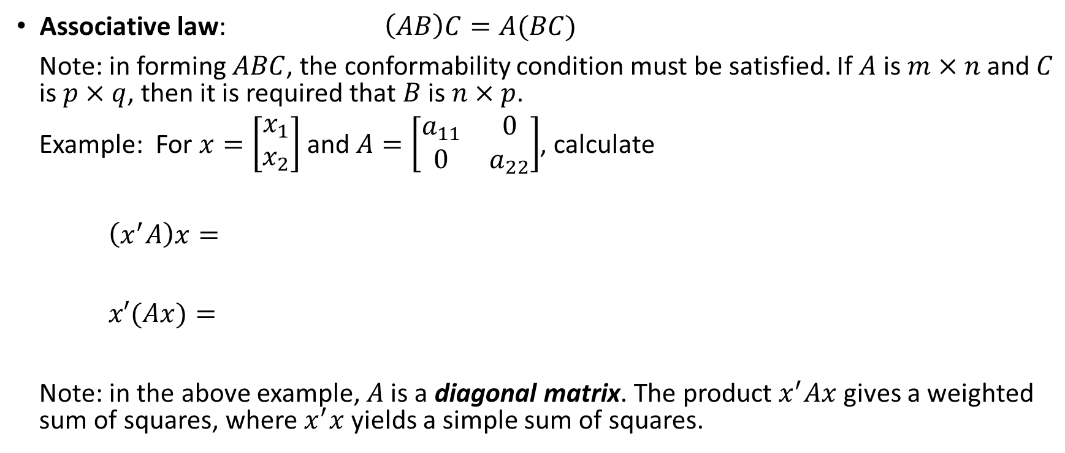
Matrix Multiplication
Associative law: $\left(AB\right)C=A(BC)$
Note: in forming $ABC$, the conformability condition must be satisfied. If $A$ is $m×n$ and $C$ is $p×q$, then it is required that $B$ is $n×p$.
Example: For $x=\left[\begin{matrix}x_{1} \\ x_{2}\end{matrix}\right]$ and $A=\left[\begin{matrix}a_{11} & 0 \\ 0 & a_{22}\end{matrix}\right]$, calculate
$\left(x^{′}A\right)x=$
$x′(Ax)=$
Note: in the above example, $A$ is a diagonal matrix. The product $x^{′}Ax$ gives a weighted sum of squares, where $x^{′}x$ yields a simple sum of squares.

Slide 6
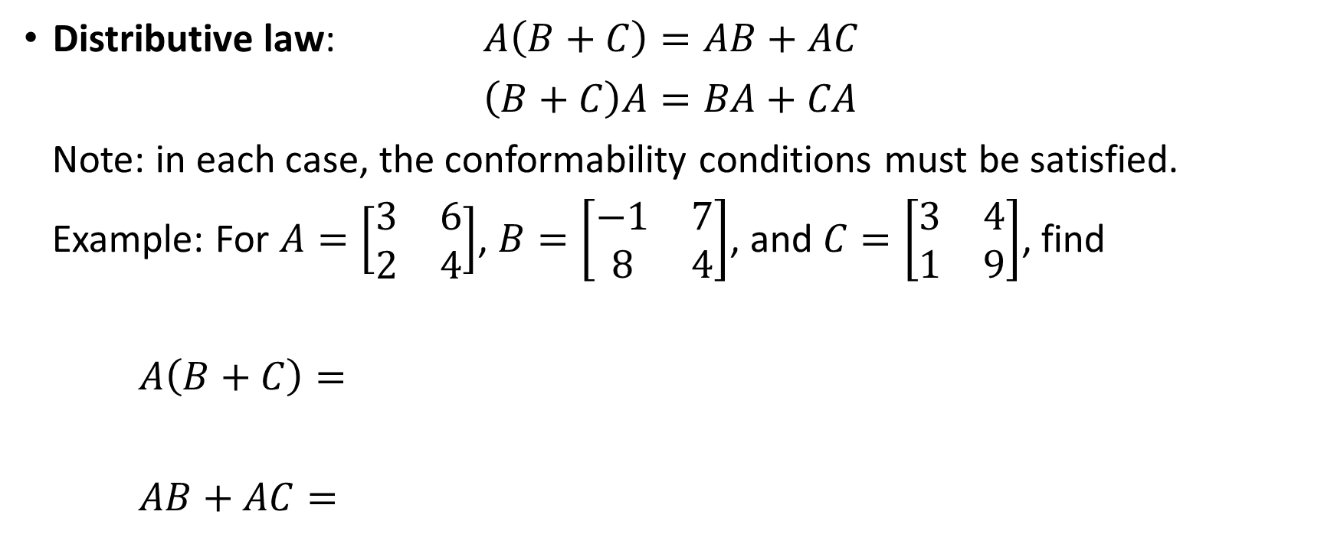
Matrix Multiplication
Distributive law: $A\left(B+C\right)=AB+AC$
$\left(B+C\right)A=BA+CA$
Note: in each case, the conformability conditions must be satisfied.
Example: For $A=\left[\begin{matrix}3 & 6 \\ 2 & 4\end{matrix}\right]$, $B=\left[\begin{matrix}−1 & 7 \\ 8 & 4\end{matrix}\right]$, and $C=\left[\begin{matrix}3 & 4 \\ 1 & 9\end{matrix}\right]$, find
$A\left(B+C\right)=$
$AB+AC=$

Slide 7
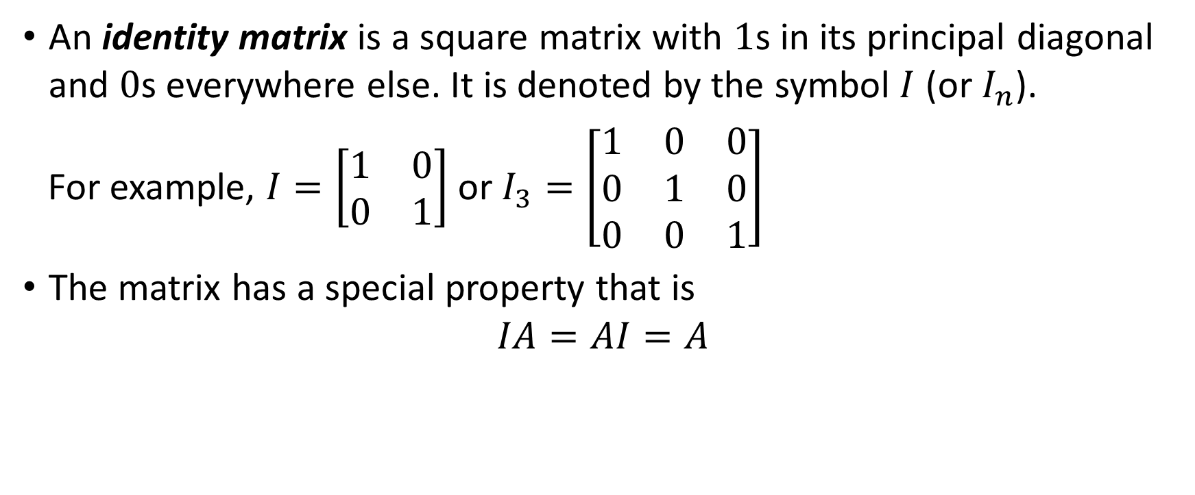
Identity Matrices and Null Matrices
An identity matrix is a square matrix with $1$s in its principal diagonal and $0$s everywhere else. It is denoted by the symbol $I$ (or $I_{n}$).
For example, $I=\left[\begin{matrix}1 & 0 \\ 0 & 1\end{matrix}\right]$ or $I_{3}=\left[\begin{matrix}1 & 0 & 0 \\ 0 & 1 & 0 \\ 0 & 0 & 1\end{matrix}\right]$
The matrix has a special property that is
$$IA=AI=A$$

Slide 8
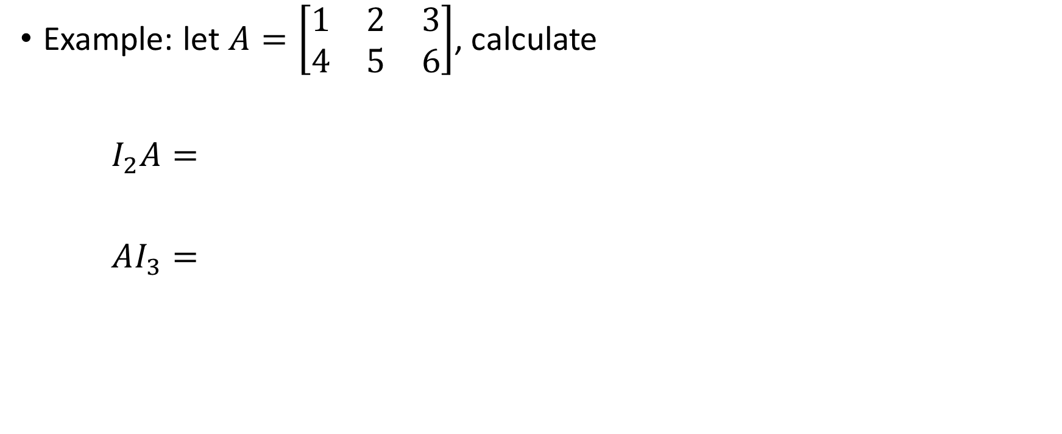
Identity Matrix
Example: let $A=\left[\begin{matrix}1 & 2 & 3 \\ 4 & 5 & 6\end{matrix}\right]$, calculate
$I_{2}A=$
$AI_{3}=$

Slide 9
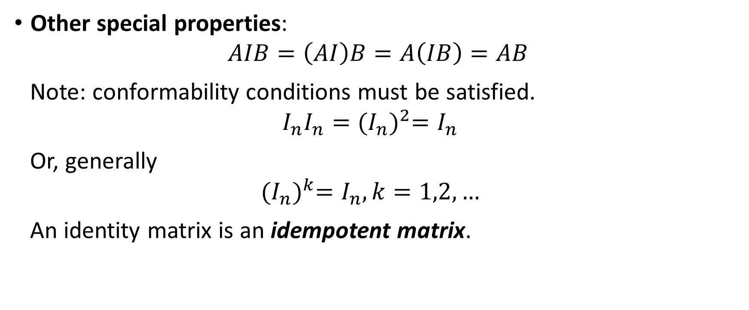
Identity Matrix
Other special properties:
$$AIB=\left(AI\right)B=A\left(IB\right)=AB$$
Note: conformability conditions must be satisfied.
$$I_{n}I_{n}={(I_{n})}^{2}=I_{n}$$
Or, generally
$${(I_{n})}^{k}=I_{n}, k=1,2,…$$
An identity matrix is an idempotent matrix.

Slide 10
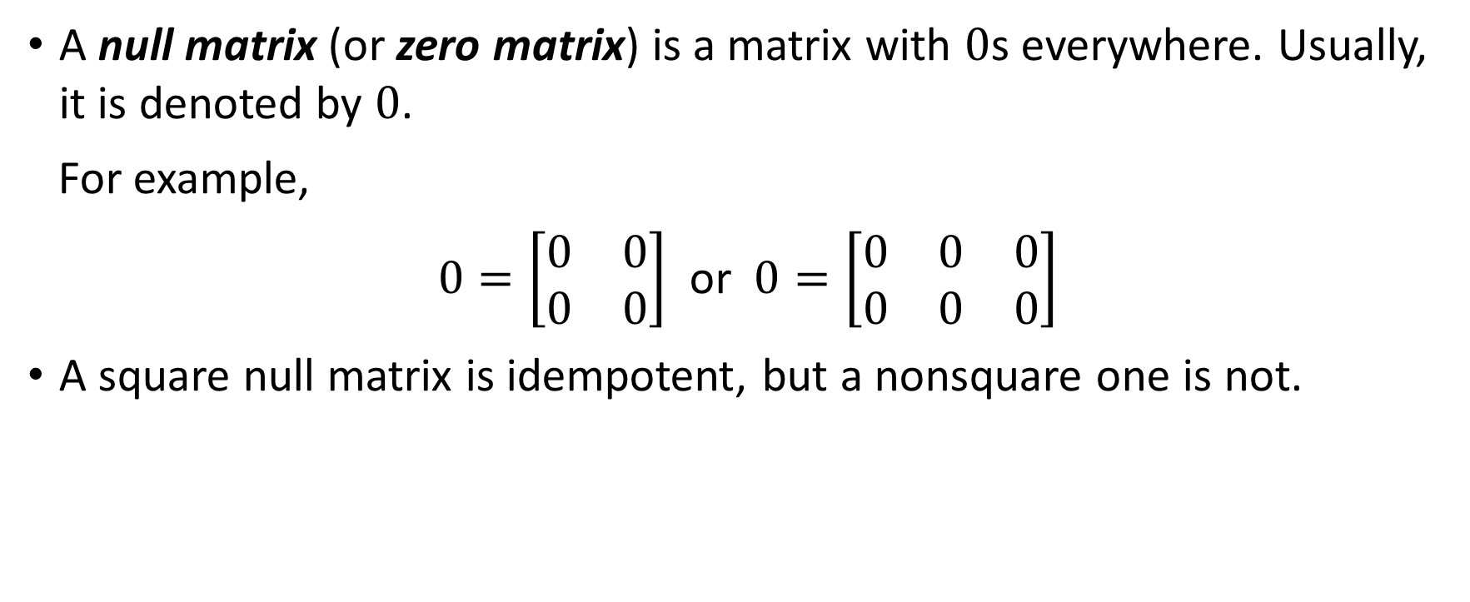
Null Matrices
A null matrix (or zero matrix) is a matrix with $0$s everywhere. Usually, it is denoted by $0$.
For example,
$0=\left[\begin{matrix}0 & 0 \\ 0 & 0\end{matrix}\right]$ or $0=\left[\begin{matrix}0 & 0 & 0 \\ 0 & 0 & 0\end{matrix}\right]$
A square null matrix is idempotent, but a nonsquare one is not.

Slide 11
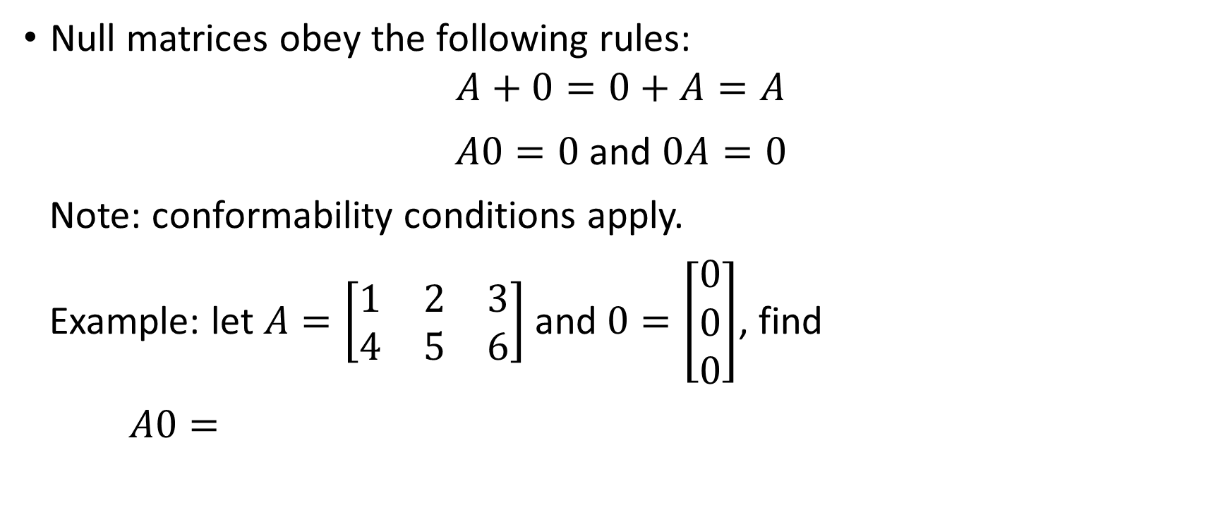
Null Matrices
Null matrices obey the following rules:
$$A+0=0+A=A$$
$A0=0$ and $0A=0$
Note: conformability conditions apply.
Example: let $A=\left[\begin{matrix}1 & 2 & 3 \\ 4 & 5 & 6\end{matrix}\right]$ and $0=\left[\begin{matrix}0 \\ 0 \\ 0\end{matrix}\right]$, find
$A0=$

Slide 12
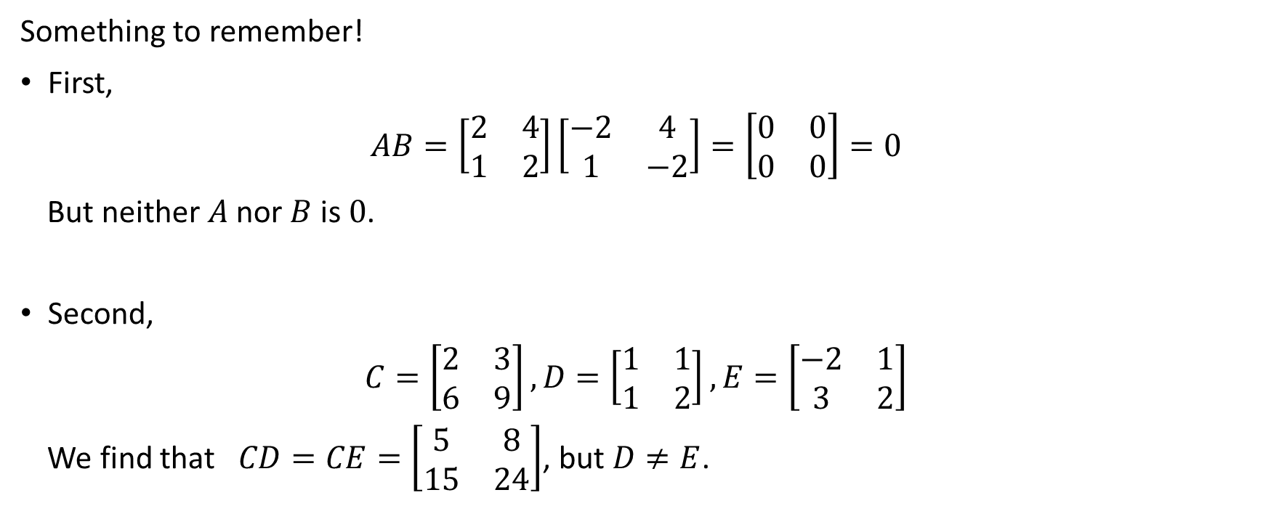
Idiosyncrasies of Matrix Algebra
Something to remember!
First,
$$AB=\left[\begin{matrix}2 & 4 \\ 1 & 2\end{matrix}\right]\left[\begin{matrix}−2 & 4 \\ 1 & −2\end{matrix}\right]=\left[\begin{matrix}0 & 0 \\ 0 & 0\end{matrix}\right]=0$$
But neither $A$ nor $B$ is $0$.
Second,
$$C=\left[\begin{matrix}2 & 3 \\ 6 & 9\end{matrix}\right],D=\left[\begin{matrix}1 & 1 \\ 1 & 2\end{matrix}\right],E=\left[\begin{matrix}−2 & 1 \\ 3 & 2\end{matrix}\right]$$
We find that $CD=CE=\left[\begin{matrix}5 & 8 \\ 15 & 24\end{matrix}\right]$, but $D≠E$.

Slide 13
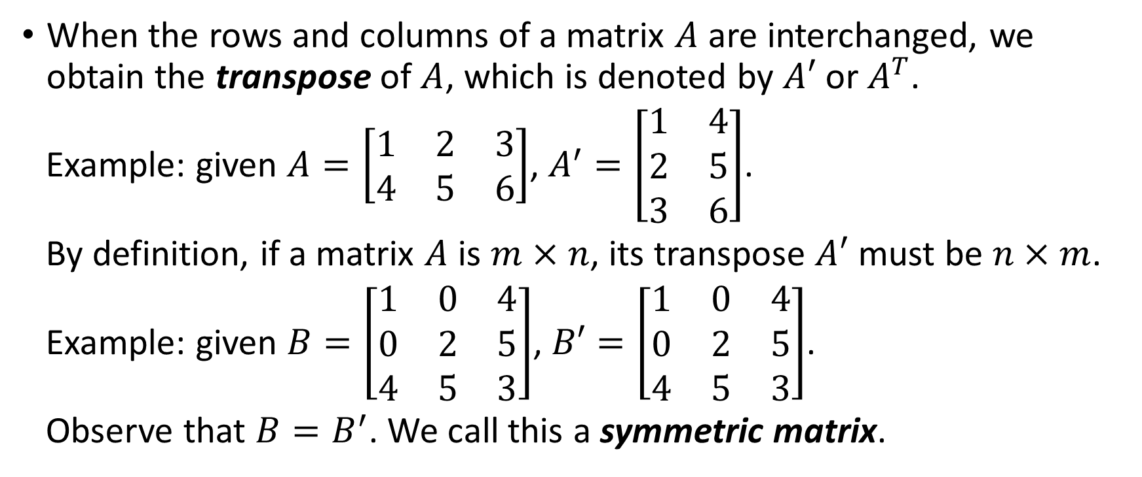
Transposes and Inverses
When the rows and columns of a matrix $A$ are interchanged, we obtain the transpose of $A$, which is denoted by $A′$ or $A^{T}$.
Example: given $A=\left[\begin{matrix}1 & 2 & 3 \\ 4 & 5 & 6\end{matrix}\right]$, $A^{′}=\left[\begin{matrix}1 & 4 \\ 2 & 5 \\ 3 & 6\end{matrix}\right]$.
By definition, if a matrix $A$ is $m×n$, its transpose $A′$ must be $n×m$.
Example: given $B=\left[\begin{matrix}1 & 0 & 4 \\ 0 & 2 & 5 \\ 4 & 5 & 3\end{matrix}\right]$, $B′=\left[\begin{matrix}1 & 0 & 4 \\ 0 & 2 & 5 \\ 4 & 5 & 3\end{matrix}\right]$.
Observe that $B=B^{′}$. We call this a symmetric matrix.

Slide 14
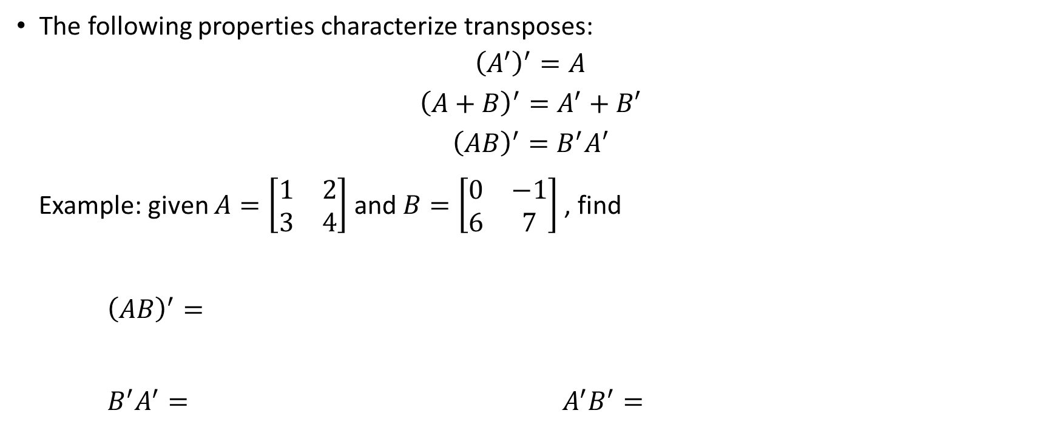
Properties of Transposes
The following properties characterize transposes:
$${\left(A^{′}\right)}^{′}=A$$
$${\left(A+B\right)}^{′}=A^{′}+B′$$
$${\left(AB\right)}^{′}=B^{′}A′$$
Example: given $A=\left[\begin{matrix}1 & 2 \\ 3 & 4\end{matrix}\right]$ and $B=\left[\begin{matrix}0 & −1 \\ 6 & 7\end{matrix}\right]$ , find
${\left(AB\right)}^{′}=$
$B^{′}A^{′}=$ $A^{′}B^{′}=$

Slide 15
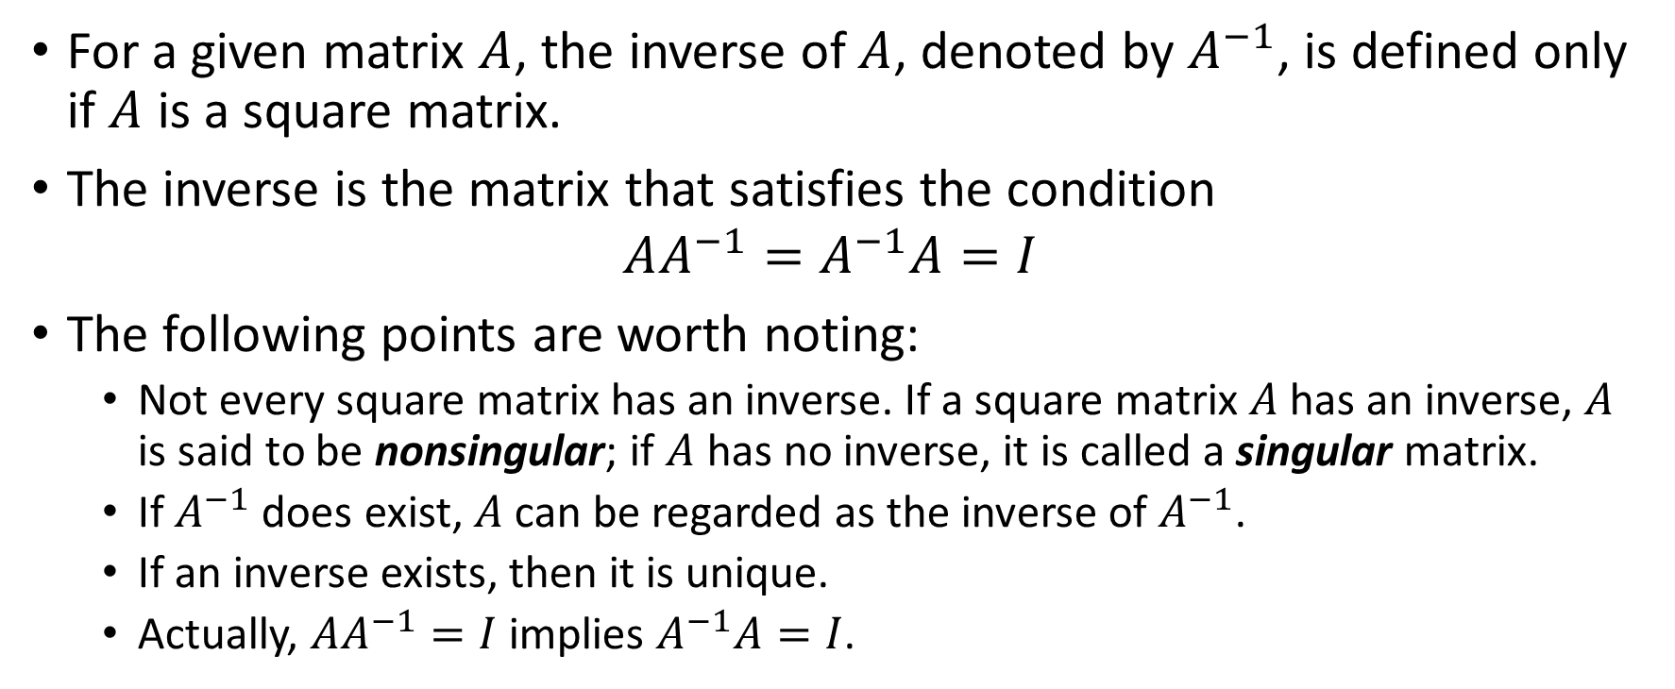
Inverses and Their Properties
For a given matrix $A$, the inverse of $A$, denoted by $A^{−1}$, is defined only if $A$ is a square matrix.
The inverse is the matrix that satisfies the condition
$$AA^{−1}=A^{−1}A=I$$
The following points are worth noting:
  Not every square matrix has an inverse. If a square matrix $A$ has an inverse, $A$ is said to be nonsingular; if $A$ has no inverse, it is called a singular matrix.
  If $A^{−1}$ does exist, $A$ can be regarded as the inverse of $A^{−1}$.
  If an inverse exists, then it is unique.
  Actually, $AA^{−1}=I$ implies $A^{−1}A=I$.

Slide 16
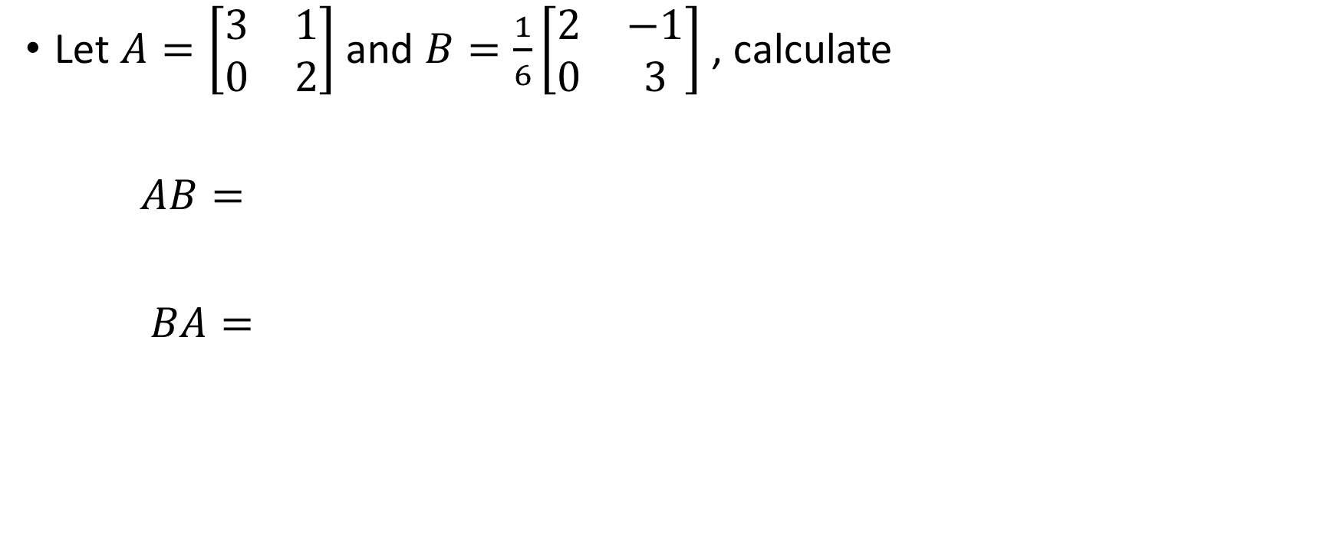
Example
Let $A=\left[\begin{matrix}3 & 1 \\ 0 & 2\end{matrix}\right]$ and $B=\frac{1}{6}\left[\begin{matrix}2 & −1 \\ 0 & 3\end{matrix}\right]$ , calculate
$AB=$
$BA=$

Slide 17
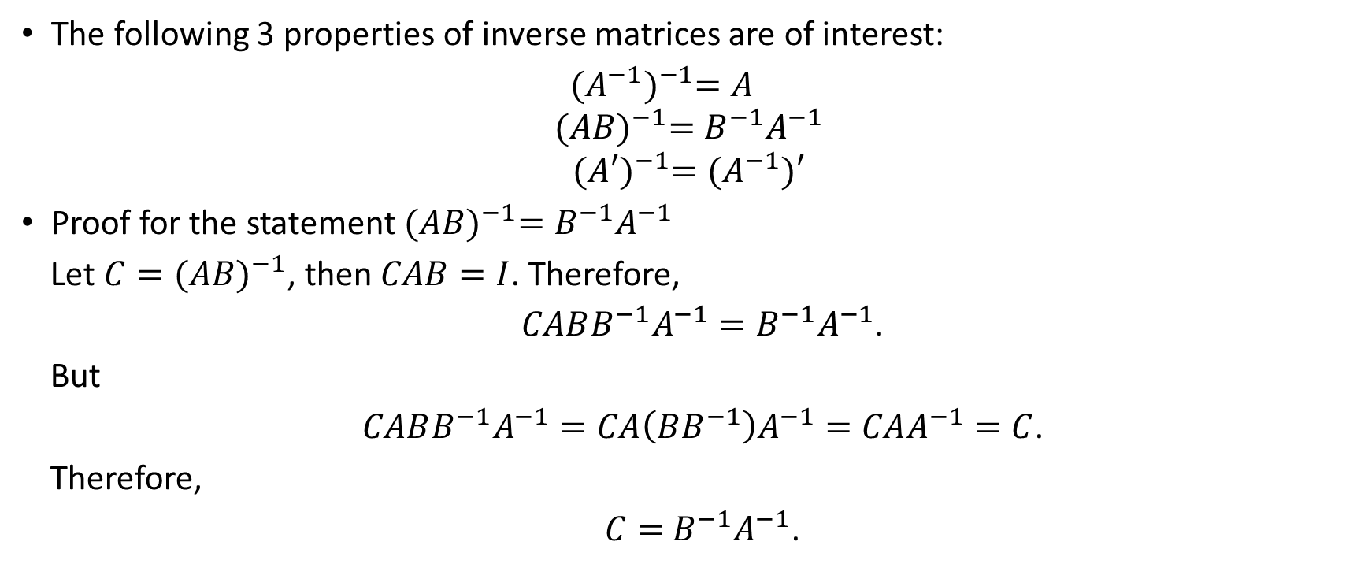
Additional Properties
The following 3 properties of inverse matrices are of interest:
${(A^{−1})}^{−1}=A$
$${(AB)}^{−1}=B^{−1}A^{−1}$$
$${(A′)}^{−1}=(A^{−1})′$$
Proof for the statement ${(AB)}^{−1}=B^{−1}A^{−1}$
Let ${C=(AB)}^{−1}$, then $CAB=I$. Therefore,
$CABB^{−1}A^{−1}=B^{−1}A^{−1}$.
But
$CABB^{−1}A^{−1}=CA\left(BB^{−1}\right)A^{−1}=CAA^{−1}=C$.
Therefore,
$C=$ $B^{−1}A^{−1}$.

Slide 18
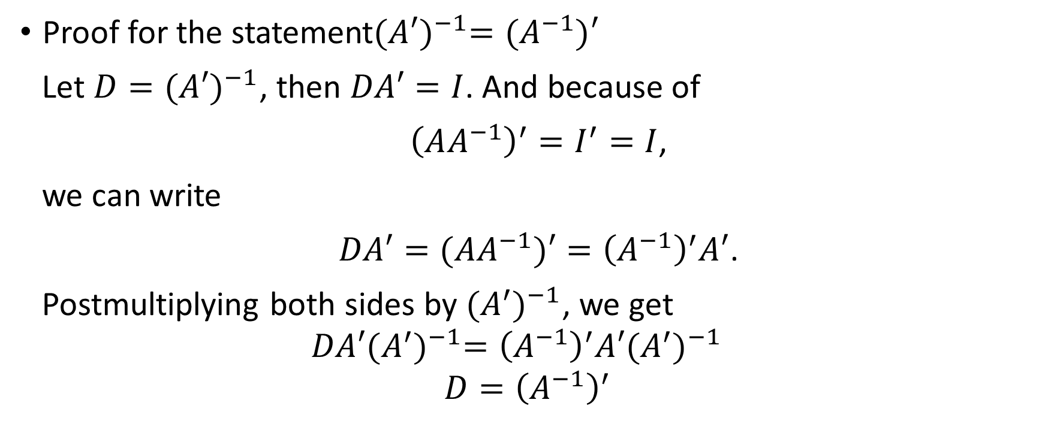
Additional Properties
Proof for the statement${(A′)}^{−1}=(A^{−1})′$
Let ${D=(A′)}^{−1}$, then $DA′=I$. And because of
${\left(AA^{−1}\right)}^{′}=I^{′}=I$,
we can write
$DA′=(AA^{−1})′={\left(A^{−1}\right)}^{′}A′$.
Postmultiplying both sides by ${(A^{′})}^{−1}$, we get
$$DA′{(A^{′})}^{−1}={\left(A^{−1}\right)}^{′}A′{(A^{′})}^{−1}$$
$$D={\left(A^{−1}\right)}^{′}$$

Slide 19
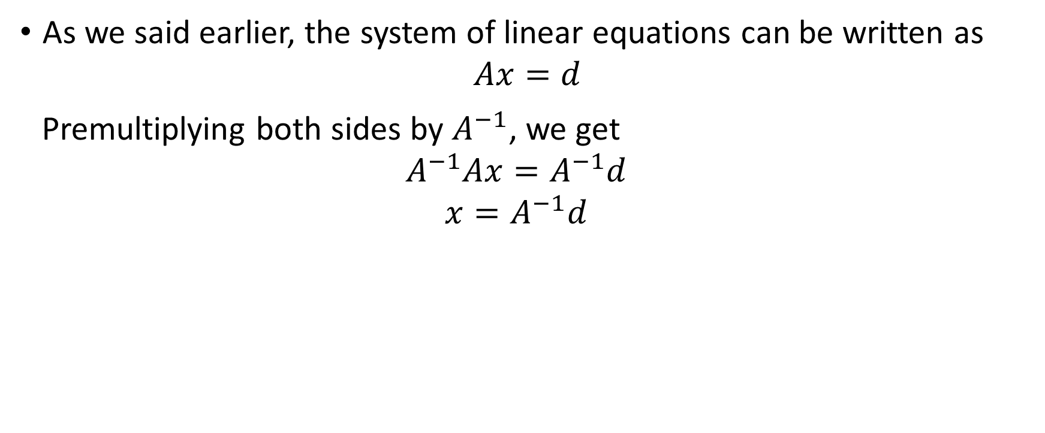
Inverse Matrix and Solution of Linear-Equation System
As we said earlier, the system of linear equations can be written as
$$Ax=d$$
Premultiplying both sides by $A^{−1}$, we get
$$A^{−1}Ax=A^{−1}d$$
$$x=A^{−1}d$$

Slide 20
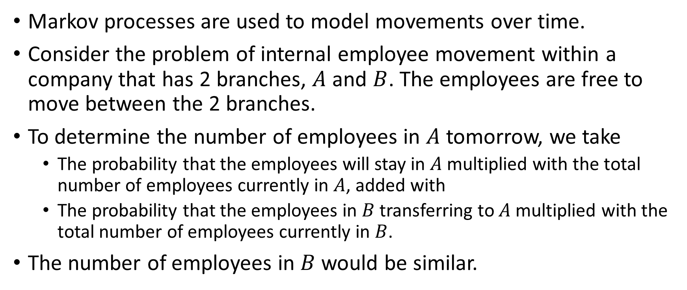
Finite Markov Chains
Markov processes are used to model movements over time.
Consider the problem of internal employee movement within a company that has 2 branches, $A$ and $B$. The employees are free to move between the 2 branches.
To determine the number of employees in $A$ tomorrow, we take
  The probability that the employees will stay in $A$ multiplied with the total number of employees currently in $A$, added with
  The probability that the employees in $B$ transferring to $A$ multiplied with the total number of employees currently in $B$.
The number of employees in $B$ would be similar.

Slide 21
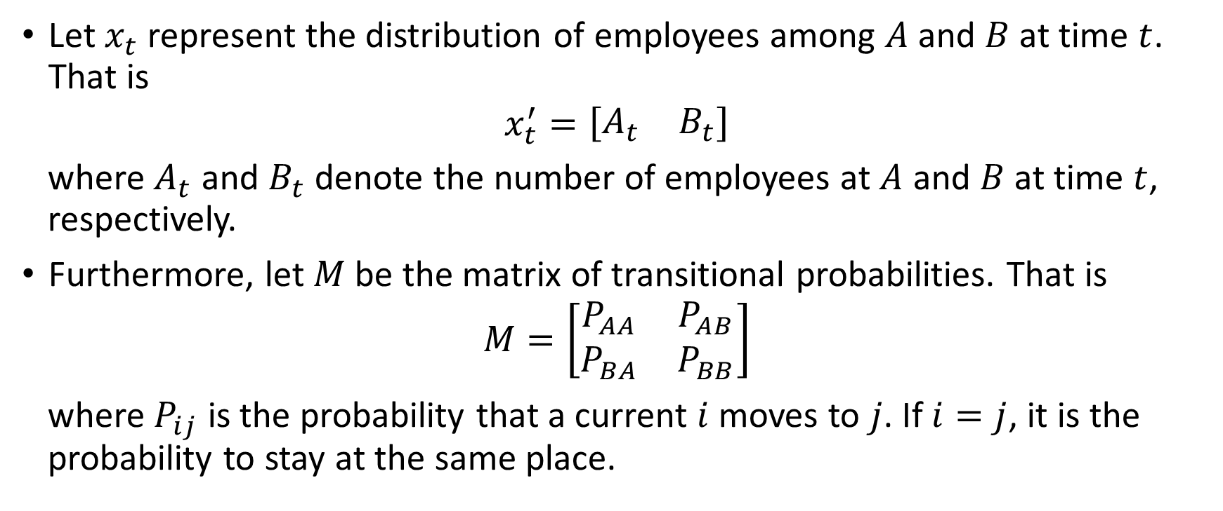
Finite Markov Chains
Let $x_{t}$ represent the distribution of employees among $A$ and $B$ at time $t$. That is
$$x_{t}^{′}=\left[\begin{matrix}A_{t} & B_{t}\end{matrix}\right]$$
where $A_{t}$ and $B_{t}$ denote the number of employees at $A$ and $B$ at time $t$, respectively.
Furthermore, let $M$ be the matrix of transitional probabilities. That is
$$M=\left[\begin{matrix}P_{AA} & P_{AB} \\ P_{BA} & P_{BB}\end{matrix}\right]$$
where $P_{ij}$ is the probability that a current $i$ moves to $j$. If $i=j$, it is the probability to stay at the same place.

Slide 22
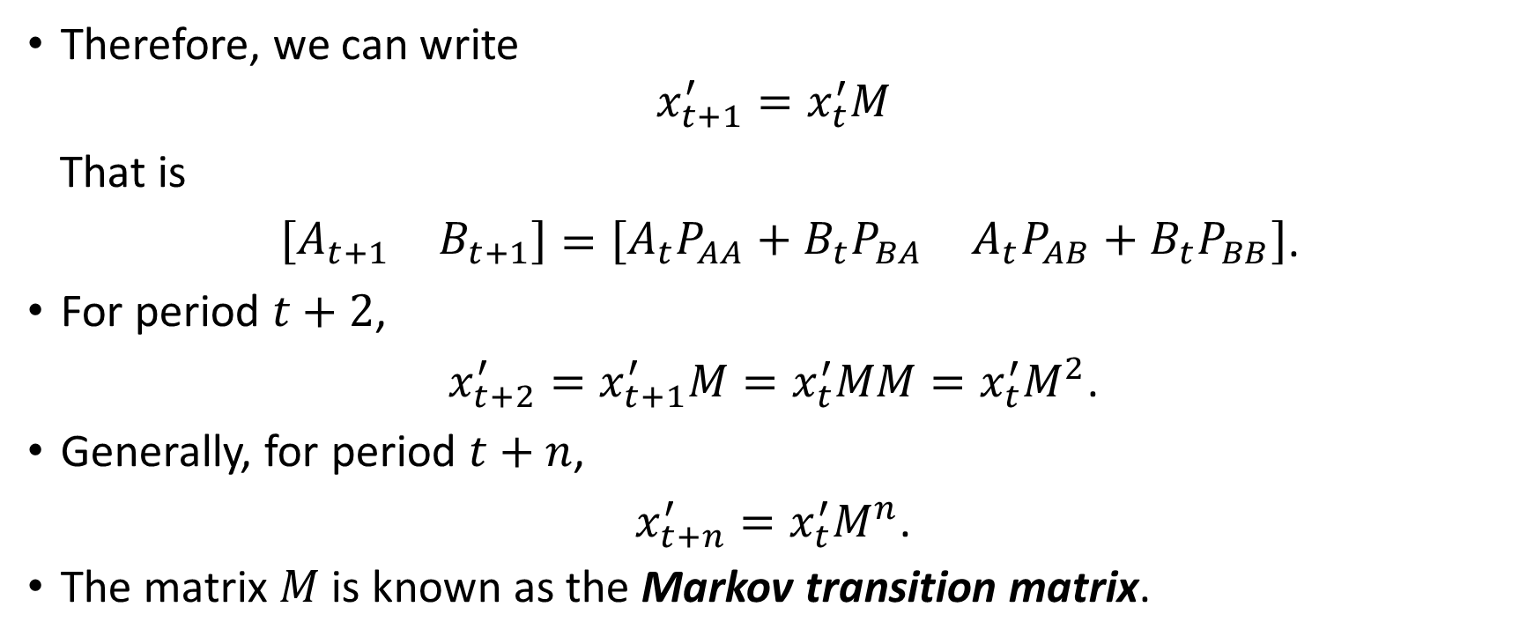
Finite Markov Chains
Therefore, we can write
$$x_{t+1}^{′}=x_{t}^{′}M$$
That is
$\left[\begin{matrix}A_{t+1} & B_{t+1}\end{matrix}\right]=\left[\begin{matrix}A_{t}P_{AA}+B_{t}P_{BA} & A_{t}P_{AB}+B_{t}P_{BB}\end{matrix}\right]$.
For period $t+2$,
$x_{t+2}^{′}=x_{t+1}^{′}M=x_{t}^{′}MM=x_{t}^{′}M^{2}$.
Generally, for period $t+n$,
$x_{t+n}^{′}=x_{t}^{′}M^{n}$.
The matrix $M$ is known as the Markov transition matrix.

