Slide 1
Reform and Economic Growth
YOUR LOGO
FACULTY OF ECONOMICS, THAMMASAT UNIVERSITY
MODULE 2
Notes:
© Copyright Showeet.com – Creative & Free PowerPoint Templates

Slide 2
ECONOMIC REFORMS
Are government policies to:
Lessen government restrictions
Attract private sector participation
Improve economic performance
Notes:
© Copyright Showeet.com – Creative & Free PowerPoint Templates

Slide 3
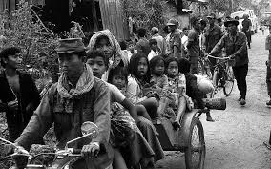
Rationale
1970s: Period of war and social conflict
1980s: CLMV faced political and economic hardships; Soviet Union unable to supply goods
Large government budget deficits due to inflation, lack of currency reserves
Inefficient production; people cannot afford to buy their needs
There is pressure for change from within the country and outside
Exodus to the countryside - Cambodia
Notes:
© Copyright Showeet.com – Creative & Free PowerPoint Templates

Slide 4
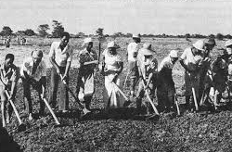
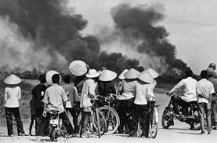
War and social conflict – Viet Nam
Collective farming – Viet Nam

Slide 5
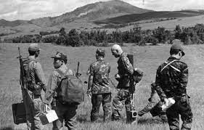
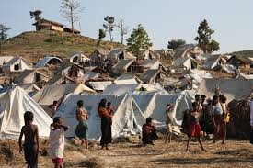
Ethnic conflict - Myanmar
Civil war - Laos

Slide 6
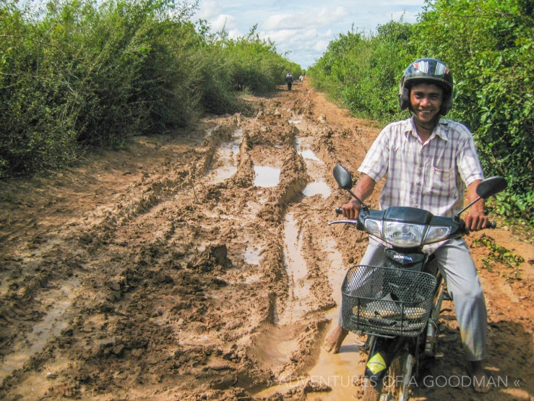
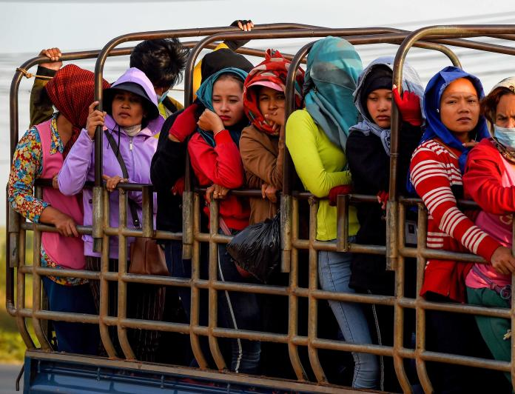
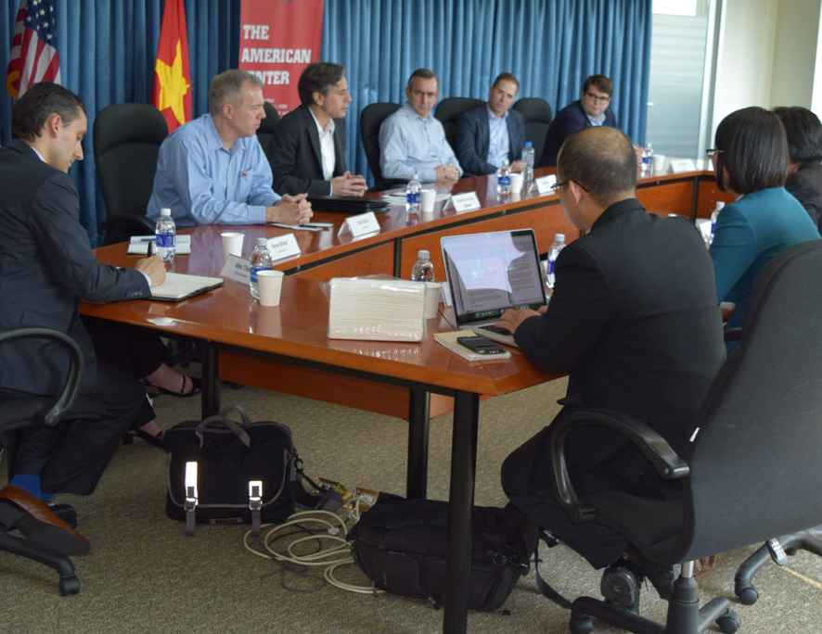
Bottlenecks to economic growth
Poor infrastructure – roads, water supply, power, sanitation
Lack of human resources–skilled labor, management financial and technical
Institutional weaknesses – governance, regulations, coordination

Slide 7
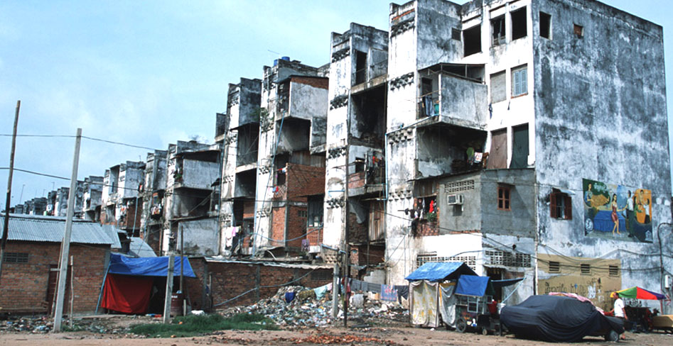
Reform measures
Short term: macroeconomic stabilization
Medium term: open economy to foreign capital/investments
Long term: structural adjustment for long term sustainability requires changes in regulations, institutions and accepted norms

Slide 8
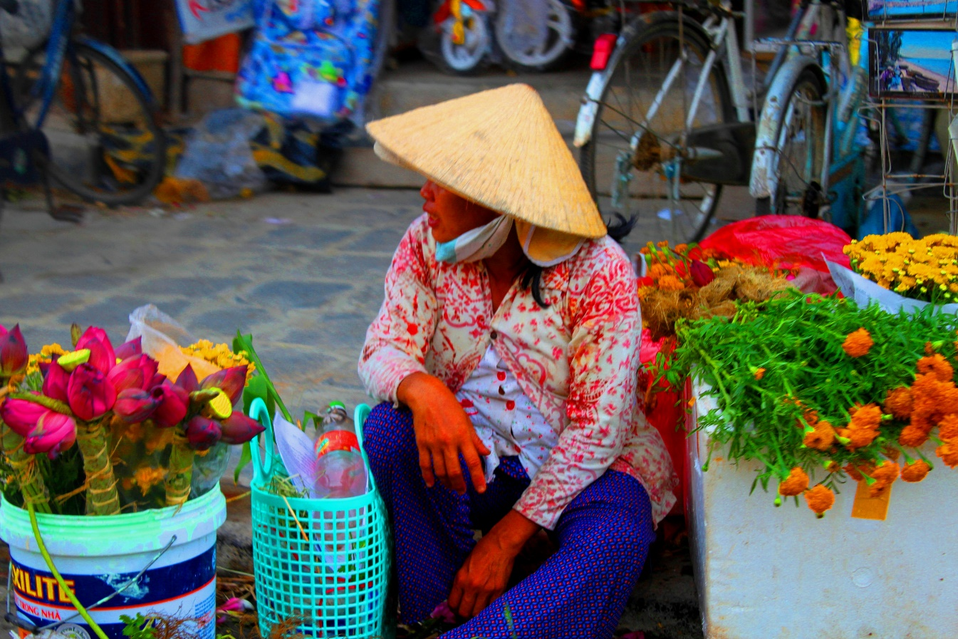
Short and medium term actions
Short term: stabilize macroeconomy
control inflation
stabilize exchange rates
ensure adequate foreign currency
could be done through borrowing
Medium term: open up economy
to foreign capital/investments. This will require creating a conducive business climate

Slide 9
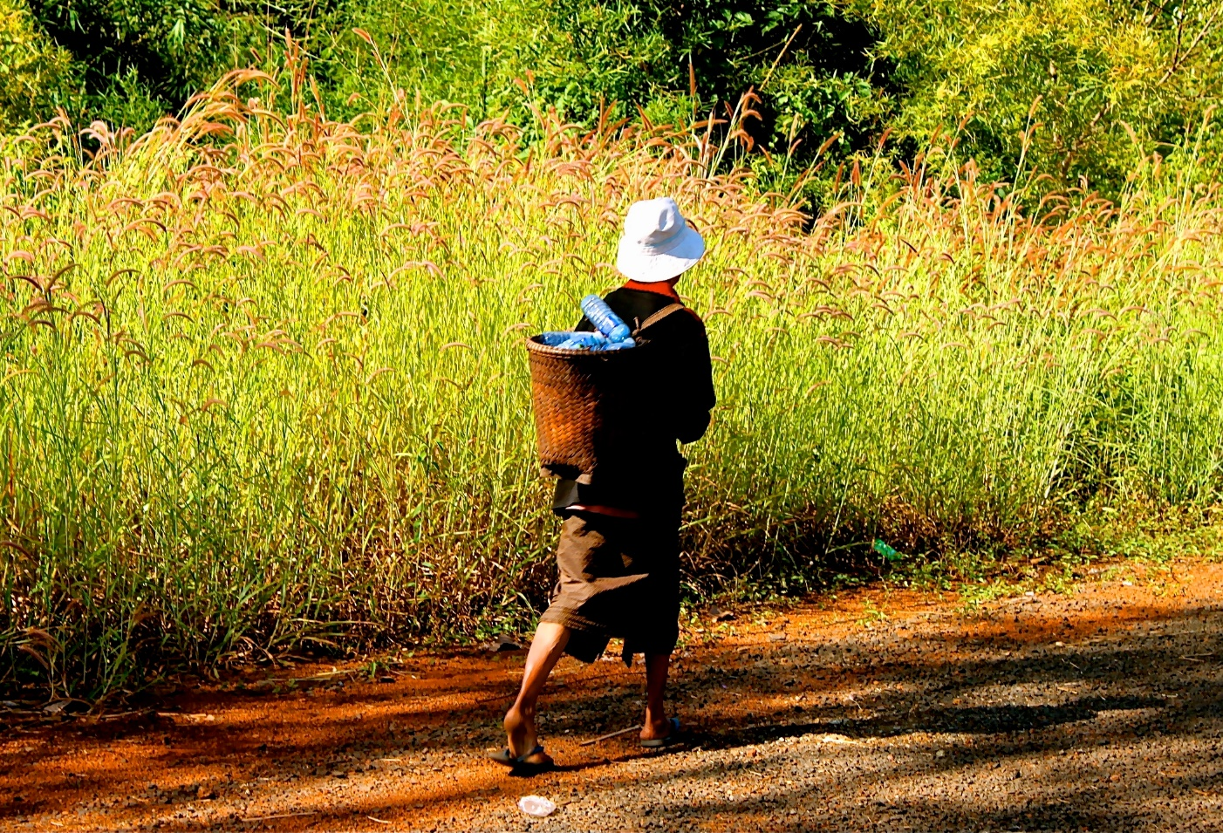
Long term: structural adjustment
Rationalize state-owned enterprises
Decentralize state functions
Build human resource capacity
Better manage the environment
Increase productivity

Slide 10
Reforms: benefits and risks
Benefits
Generate foreign exchange
Enable the country to compete internationally
Further socioeconomic development
Strengthen government institutions
Risks
Crowd out domestic investors
Financial sector instability – vulnerable to external shocks
Risk of environmental degradation
Increase inequality
Reforms in CLMV
Initiated in the mid 1980s after periods of prolonged war and conflict
After 1990s CLMV experienced rapid economic growth and poverty reduction
Global and regional factors helped “push” economic development

Slide 11
Comparisons of GDP per capita, 1984-2019

Slide 12
Poverty Reduction, 1992-2017

Slide 13
IMPORTANT DISTINCTION
Economic growth = increase in national output
Economic development = economic growth + improvements in the human dimension (education; health; environment, governance; institutions)
Notes:
© Copyright Showeet.com – Creative & Free PowerPoint Templates

Slide 14
INDIVIDUAL COUNTRY EXPERIENCES
Cambodia and Lao PDR: rapid economic growth, but from a low base
Vietnam: economic growth and development; demonstrated strong leadership
Myanmar: authoritarian government, economic performance lags behind CLV countries
Notes:
© Copyright Showeet.com – Creative & Free PowerPoint Templates

Slide 15

Cambodia

Slide 16
Cambodia
Economic reforms; Rectangular Strategy and National Socioeconomic Development Plans
Foreign aid and foreign investments began to flow
GDP growth averaged 10% (2000-2008) and 6% (2010-2016)
Economic base: garment, construction, agriculture, tourism
Challenges: natural disasters, widening gap between rich and poor; narrow economic base; weak governance
Key Milestones
1979: End of Khmer Rouge, bringing more stability to Cambodia
1991: Paris Peace Talks unites conflicting parties to form coalition
1993: UN aids Cambodia towards peaceful political and economic transition

Slide 17
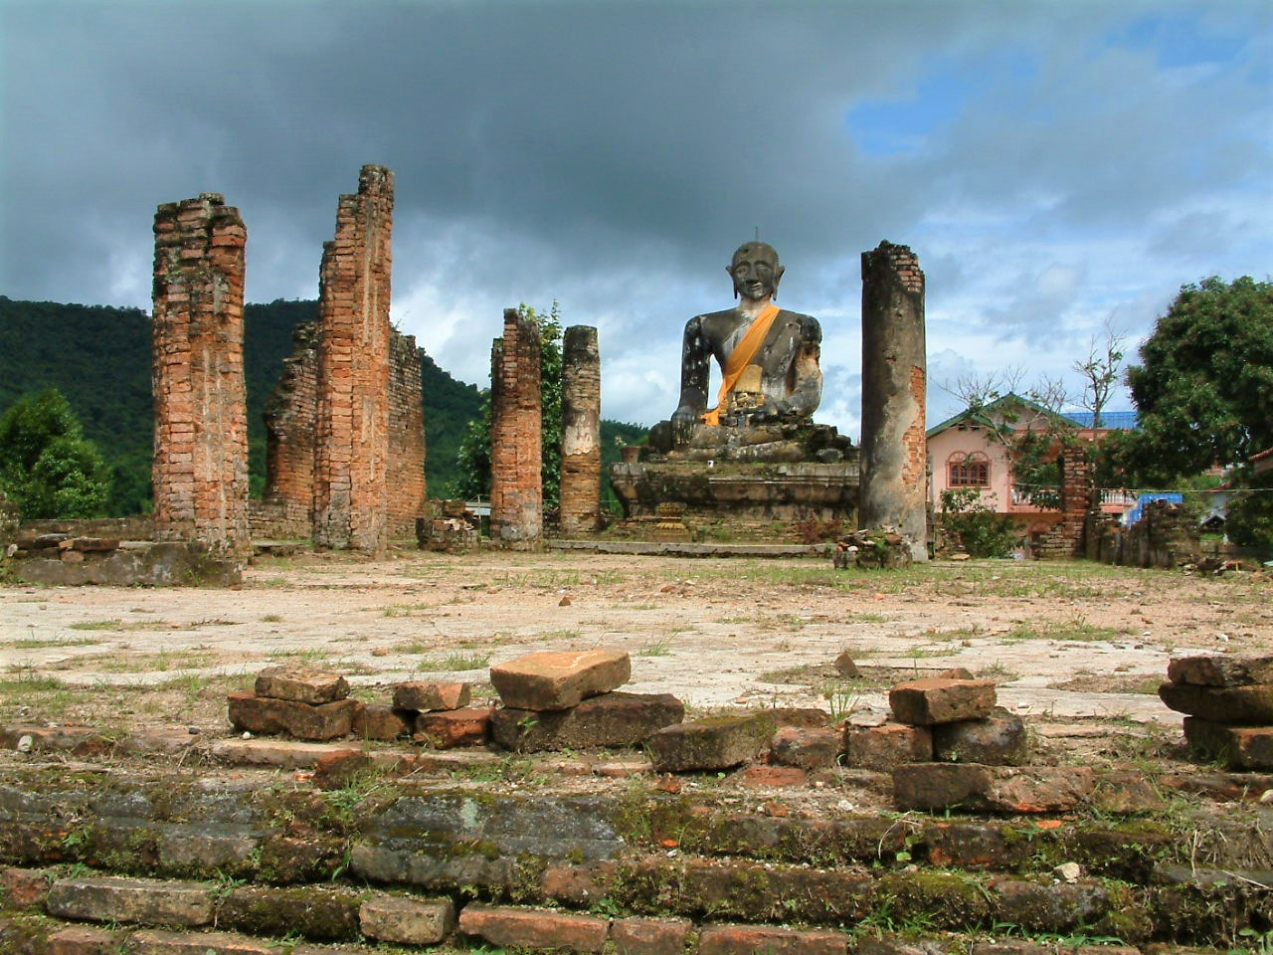
Laos

Slide 18
Lao PDR
New Economic Mechanism: transition from central planning to market-based; stabilize macroeconomy, deregulate private sector, stabilize food prices, decentralization
Agricultural, enterprise and land laws issues
GDP growth averaged 7% since 2004
Economic base: hydropower, natural resources and tourism
Challenges: weak human capacity and governance, environmental degradation, low agricultural productivity; low volume of exports
Key Milestones
1975: Monarchy was abolished and Pathet Lao comes to power
1986: 4th Congress passes the New Economic Mechanism (NEM)
1997: Lao PDR joins ASEAN, joins AFTA in 2008

Slide 19

Myanmar

Slide 20
Myanmar
Reforms: macroeconomic stabilization, currency adjustment, relaxed import restrictions
Restructuring of state-owned enterprises (telecom, finance, energy)
Revaluation of the Myanmar Kyat resulted in large inflows of capital
Reforms of state-owned enterprises not forthcoming; limited inflow of capital
Challenges: lack of skilled workers, technology, skepticism from foreign investors, over reliance on extractive industries
Key Milestones:
1948-1962: successive civilian governments followed by military coup d’etat
1987: reorientation towards market economy; however reform not carried out
2011: civilian government returns and pursues economic reform

Slide 21
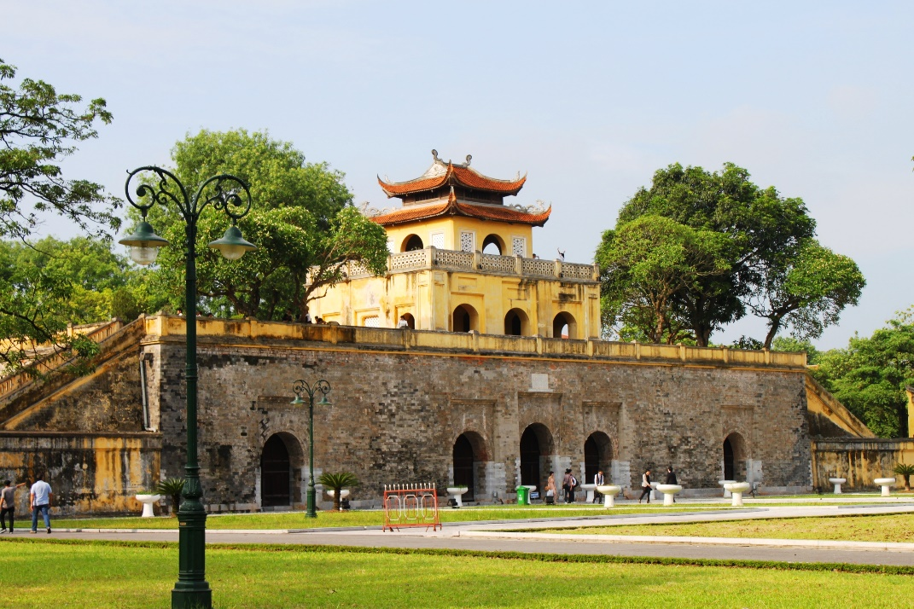
Vietnam

Slide 22
Vietnam
Doi Moi: shift from central planning to market-based; stabilize macroeconomy, price liberalization, financial reform
Agriculture law and policies to increase rice production; enterprise law and polices to attract foreign investment and private sector
GDP growth increase: 2.7 times (2000-2019); infrastructure has much improved
Poverty reduction: 26% in 1990 to 12% in 2017
Challenges: widening inequality, environmental degradation and pollution, balance between rural and urban development
Key Milestones:
1975: Reunification of North and South Viet Nam
1986: 6th Congress passes the Doi Moi (renovation) policy
2008: Vietnam joins WTO

Slide 23
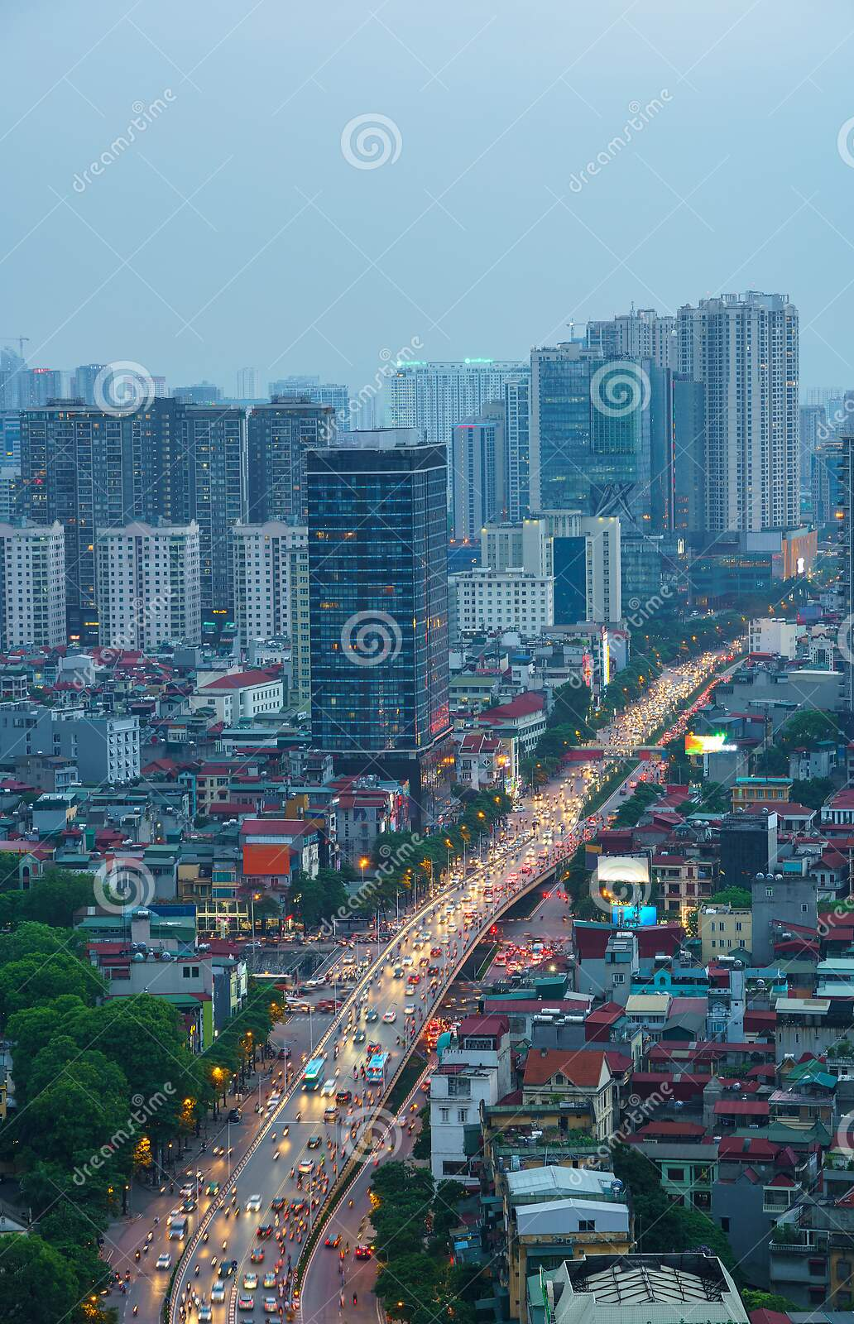
Why different experiences?
Cheang and Wong:
Political will and structure to implement reforms and leadership (pull factors)
Ability of economic reforms to tie in political and institutional reforms
Regional and global market forces (push factors)

Slide 24
Conclusion
CLMV economic reforms were followed by economic growth; the extent in all countries are not even
Economic reform focus: macroeconomic stabilization, opening economy to foreign capital; private sector deregulation; however structural adjustment is lagging behind
The State has been a key driver of economic reforms; external factors contributed to economic growth
CLMV countries experienced annual GDP growth of between 6-10% (except during the 2007-08 global financial crisis)

Slide 25
Conclusion
Agricultural still dominates employment; however productivity (except Viet Nam) is low
Need to develop human capital to increase productivity to produce higher quality goods
Exports are mostly low value goods
Vietnam is rapidly industrializing; Cambodia moving from primary products to labor intensive manufacturing; Lao PDR still dependent on hydropower and extractive industries; Myanmar has not much developed

Slide 26
Thank You !
Notes:
© Copyright Showeet.com – Creative & Free PowerPoint Templates

