Slide 1
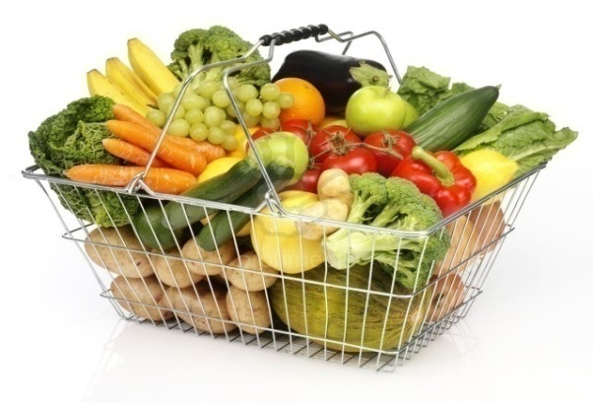
The Retail Industry
EE 488 : Integrated Business Economics

Slide 2
Outline
Retail Industry Overview
The Supermarket industry
Industrial Economic Concepts
Case studies
  Tesco case
  Aldi case
  Wal-mart case
Expansion of a retailer
  Finance
  Human Resource
  International Financing

Slide 3
The Retail Industry Overview
Aj.Wanwiphang Manachotphong

Slide 4
Definition
“Retail consists of the sale of physical goods or merchandise from a fixed location, such as a department store, boutique or kiosk, or by mall, in small or individual lots for direct consumption by the purchaser.”
(Source: wikipedia, http://en.wikipedia.org/wiki/Retail)

Slide 5
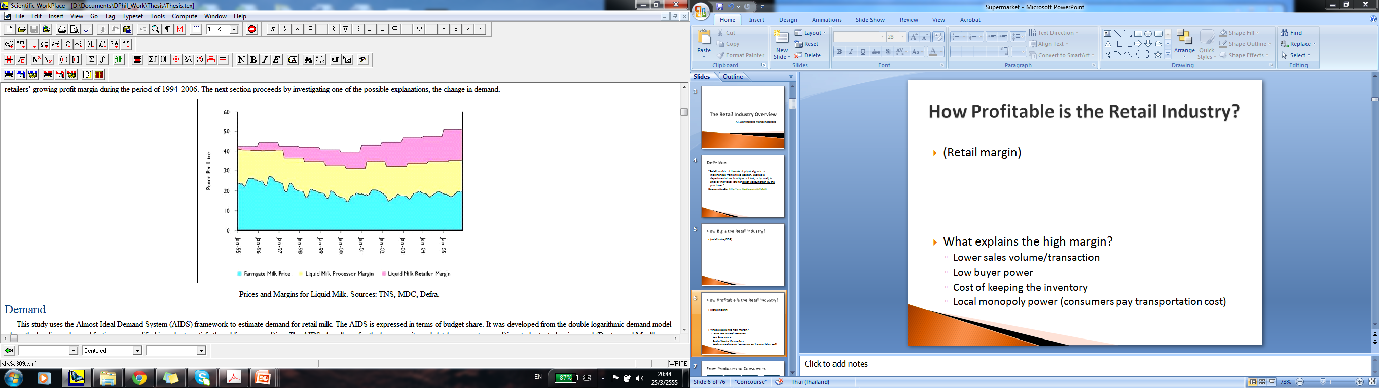
How Profitable is the Retail Industry?
What explains the high margin?
  Lower sales volume/transaction
  Low buyer power
  Cost of keeping the inventory
  Local monopoly power (consumers pay transportation cost)

Slide 6

From Producers to Consumers
…..
…..
……
…
…
Farmer1
Farmer2
Farmer3
Farmer n.
Middle man 1
Middle man 2
Middle man n.
Processor 1
Processor 2
Processor n.
Seller 1
Seller 2
Seller 3
Seller n.

Slide 7

Why big corporations make more $?
Farmer
+
Processor
+
Seller
Vertical Integration reduces the total cost of production
Given a fixed number of consumers (so fixed size of market), larger firms = fewer firms. Thus, firms have more market power.

Slide 8
Why big corporations make more $?
F1
F2
F4
Big firms also have the “buyer power”.
F3
Processor
+
Seller

Slide 9
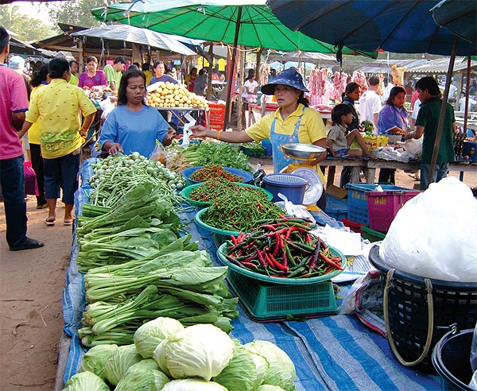
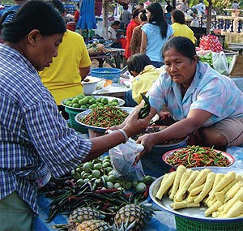
The Supermarket Industry

Slide 10
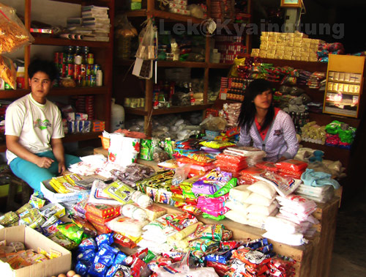
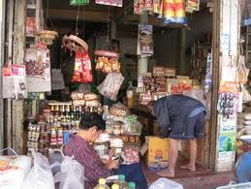
The Supermarket Industry

Slide 11
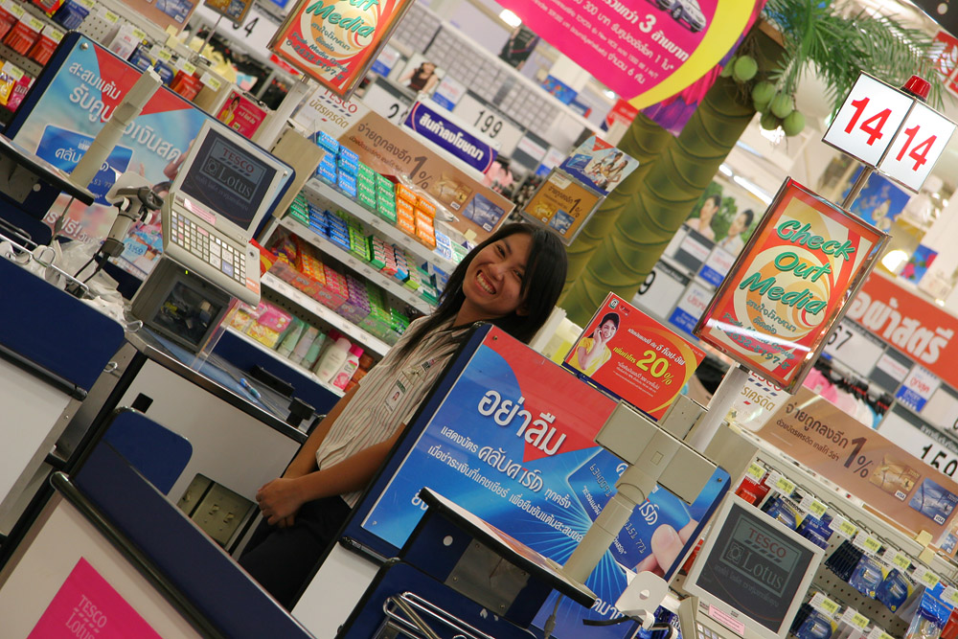
The Supermarket Industry

Slide 12
Large players in the world source: จันทวีสมบูรณ์ (2551), p.94
Rank | Company | Country of Origin | DomesticShare (%) | Foreign Sales (%)
1 | Wal-mart | USA | 6 | 22
2 | Carrefour | France | 2 | 53
3 | Metro Group | Germany | 1.5 | 55
4 | Tesco | UK | 1.5 | 25
5 | Seven & I | Japan | 1.3 | 34
….
12 | Casino | France | 0.9 | 42
15 | Aldi | Germany | 0.9 | 47

Slide 13
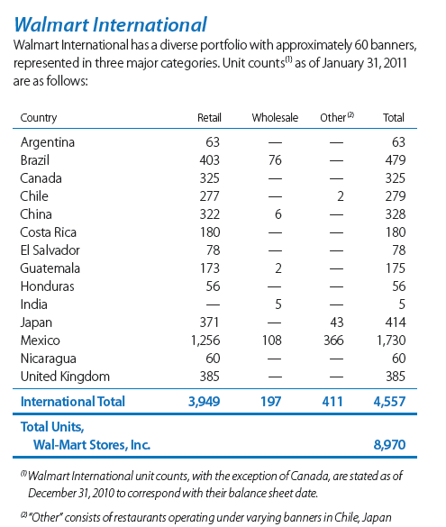
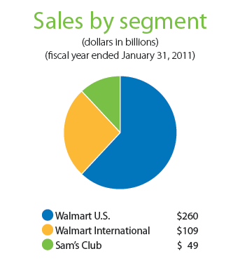
Wal-mart
Source: Walmart’s annual report
2010.

Slide 14
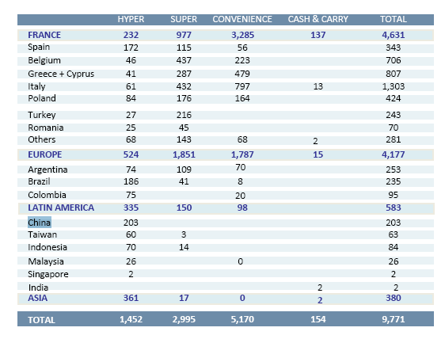
Carrefour
Source: Carrefour’s Annual Report 2010.

Slide 15
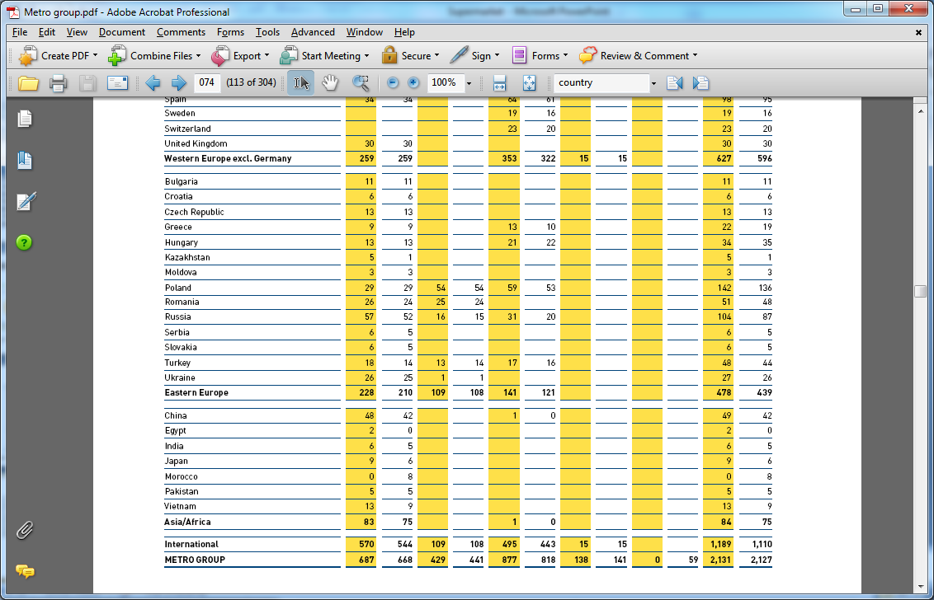
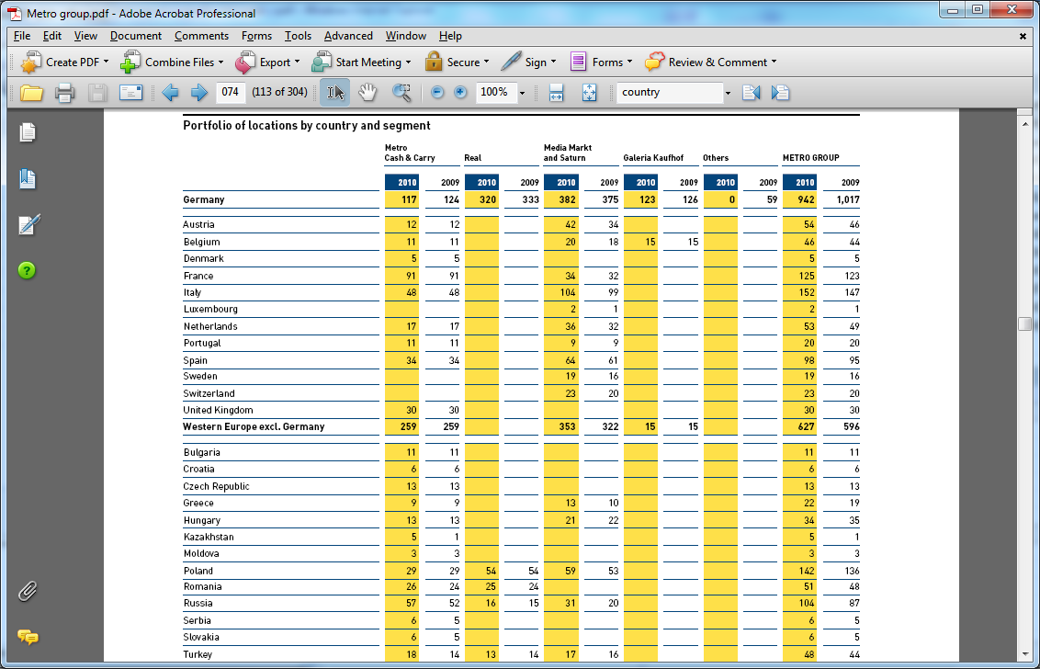
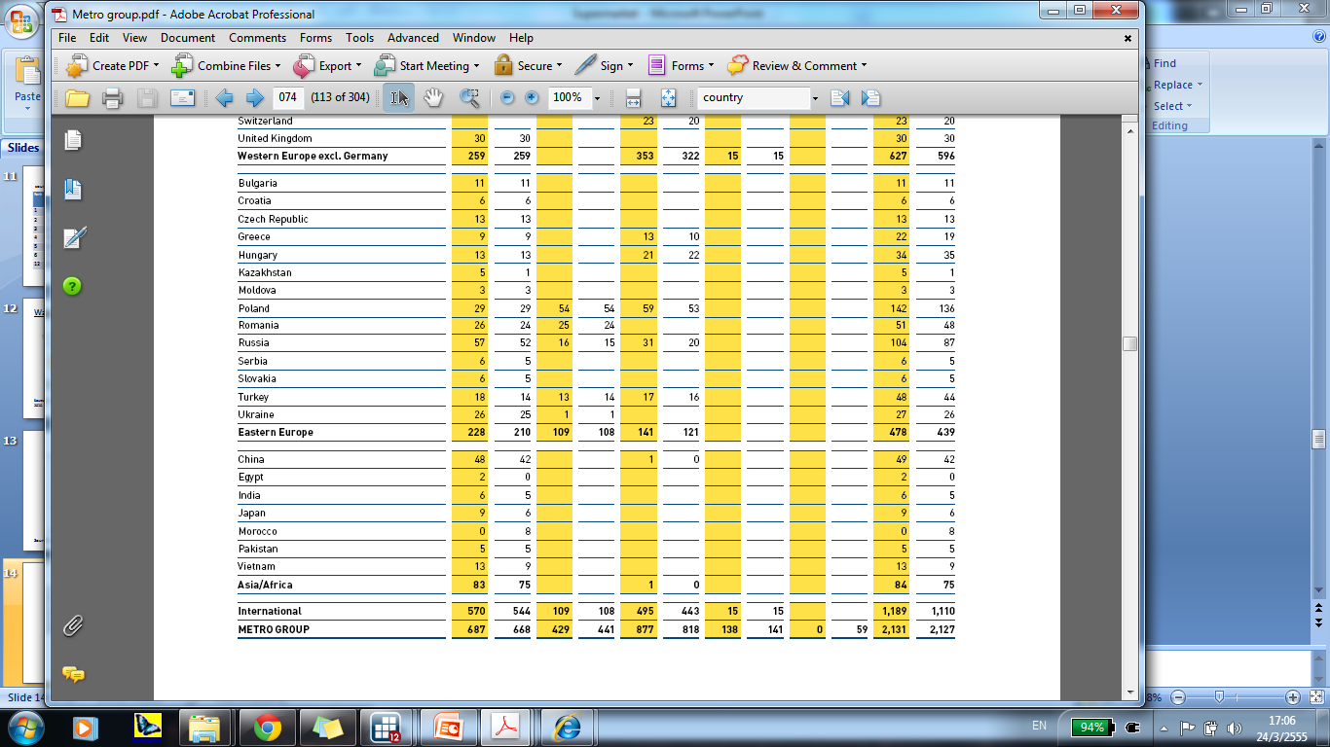
Metro Group source: Metro Group annual report (2010)

Slide 16
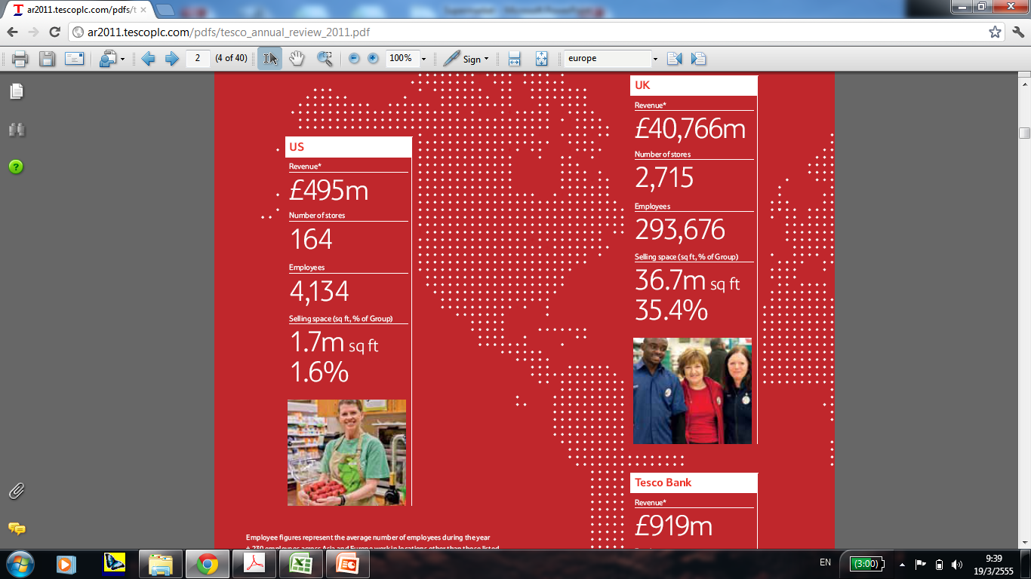
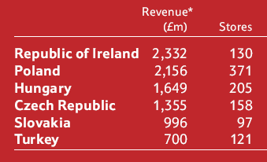
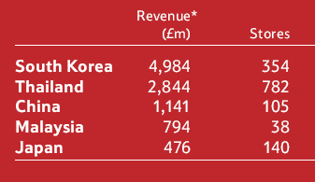
Tesco Plc
Europe Asia
Source: Tesco Plc’s Annual Report (2010)

Slide 17
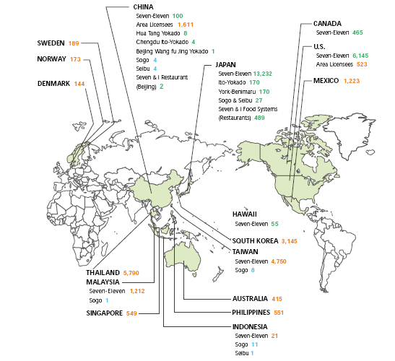
Seven & i
operated directly
by the company’s
subsidiaries
operated by
companies in
each country
granted a defined
area license
with license to use
trademark of Sogo
& Seibu Co., Ltd.
Source: Seven & i’s annual report (2011)

Slide 18
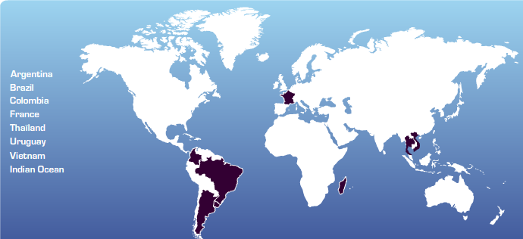
Casino
Number of stores:
Argentina = 23, Brazil = 1,647, Colombia = 299, France = 9,461, Thailand = 116, Uruguay = 53, Vietnam = 14, Indian Ocean = 50.
Source: Casino’s website
(http://www.groupe-casino.fr/en/Strong-positions-in-international.html)

Slide 19
The Asian Market
Countries | Companies
China | All the big 4 + Seven
Japan | Walmart, Metro, Tesco, Seven
India | All the big 4
Thailand | Tesco, Casino, Seven, (Carrefour exited)
Vietnam | Metro, Casino
Singapore | Seven, Carrefour
Malaysia | Tesco, Seven, Carrefour
South Korea | Tesco, Seven
Philippines | Seven
Taiwan | Seven, Carrefour
Indonesia | Seven, Carrefour

Slide 20
Types of retailers
Hypermarket
  grocery and other merchandise products
Supermarket
  mainly grocery products
Department store
  mainly non-grocery consumer products
Convenient store
  smaller than supermarket, located in residential areas, more expensive than supermarket

Slide 21
Types of retailers (cont.)
Hard discounter
  cheap products, but not necessarily the highest quality or the most trendy
Category Killer
  sell a few categories of merchandise but offer a wide range of selections
Cash & Carry
  wholesale warehouse
Mom & Pop – traditional retail store

Slide 22
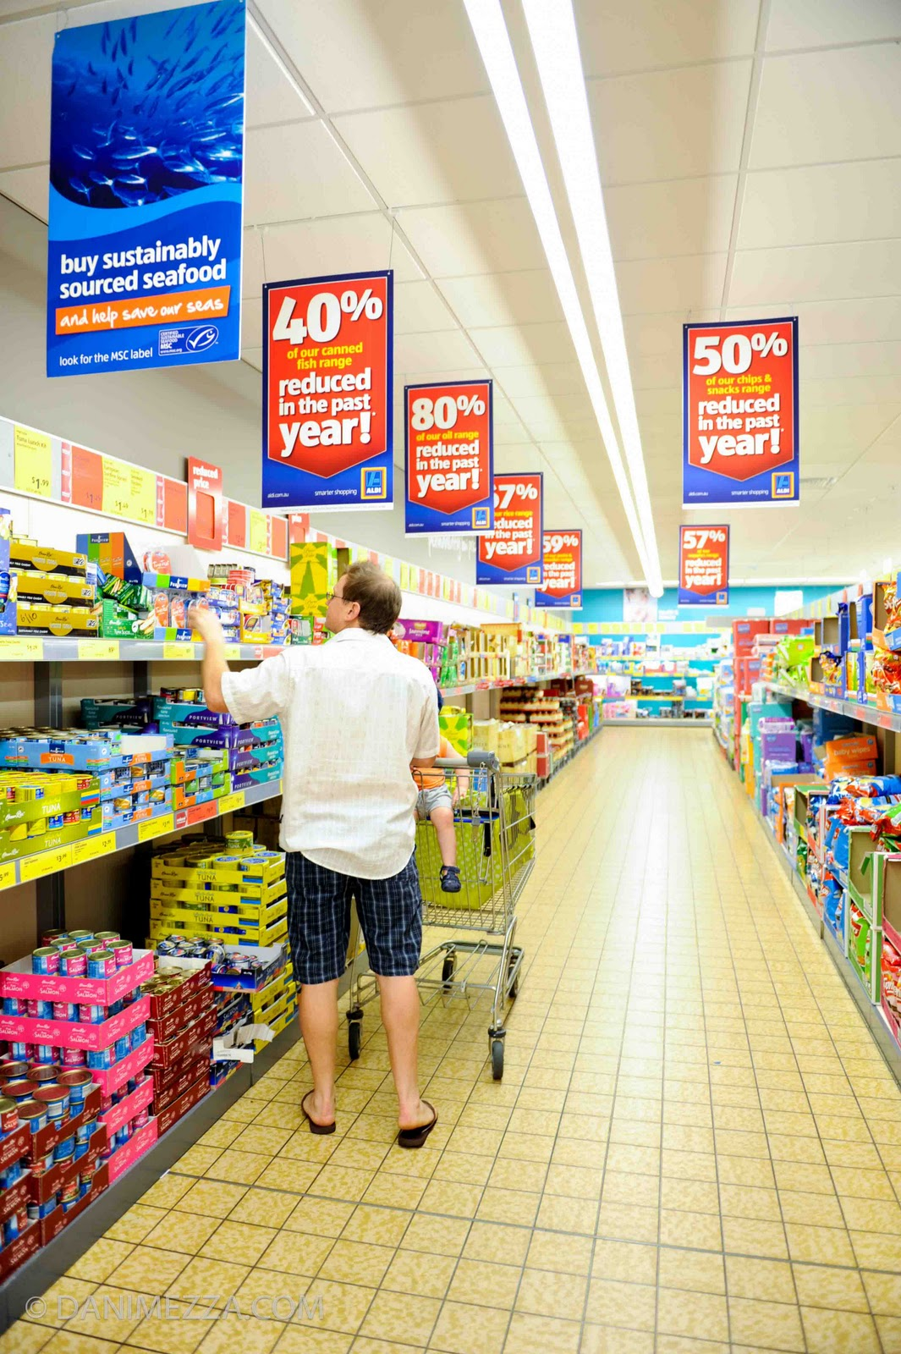
Hard Discounter
Wal-mart
Aldi (German brand)
Tesco คุ้มค่า

Slide 23
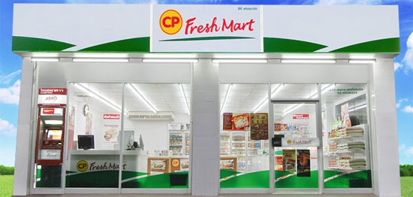
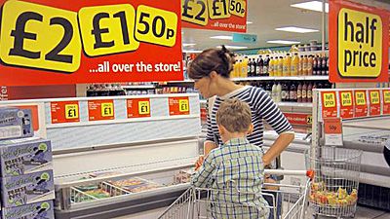
Category Killer
Home Depot (USA)
Toy ‘R’ Us (Worldwide)
CP Freshmart (Thailand)
Iceland (UK)

Slide 24
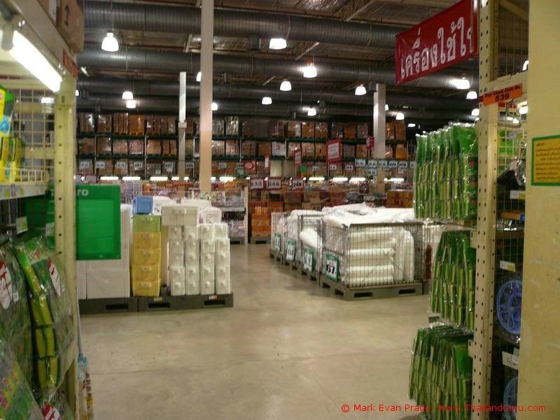
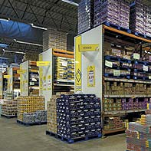
Cash and Carry
Makro (Thailand)
Metro

Slide 25
Market Boundary & Market Definition
Thailand has all these types of stores.
How do you know what type of stores are competitors?
  Same customers
  So, their products have to be substitutes.

Slide 26



Market Boundary & Market Definition source: TDRI (2545)
Hypermarket
vs.
Supermarket
Hypermarket
vs.
Department Store
Supermarket
vs.
Department Store
Hypermarket
vs.
Convenient Store
Hypermarket
vs.
Mom&Pop Store
Department store
vs.
Convenient Store
Mom&Pop store
vs.
Convenient Store
Supermarket store
vs.
Convenient Store
Hypermarket
Department
Store
Supermarket
Convenient
Store
Mom&Pop
Store

Slide 27
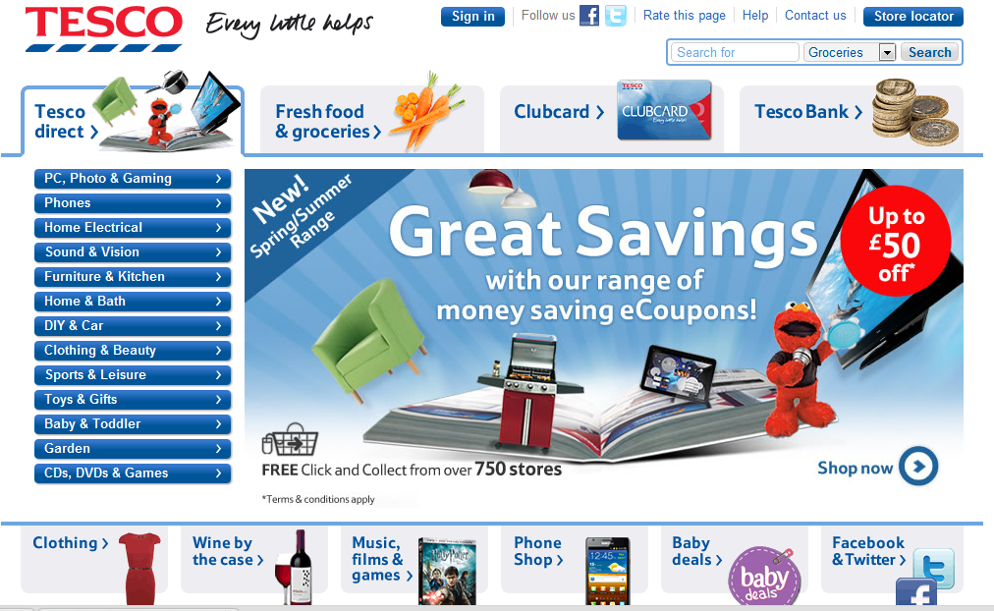
Online Shopping
Most supermarkets in industrialized countries offer online shopping.

Slide 28
Mobile Shopping?
Tesco’s “Home plus” in Korea
http://blog.i2fly.com/?p=1596
Any prospect for Thailand?

Slide 29
Competition Keywords
Preemption
Brand proliferation
Lost-leader
Vertical integration & Vertical Restraint
Horizontal integration
Collusion
Economy of scale
Buyer Power
Customer Loyalty
Information Technology
House brand

Slide 30
Case study 1: Tesco
Established in 1919 by 21-year old Jack Cohen
  His supplier’s name was T. E. Stockwell
By the end of 1990s, Tesco became the largest food retailer in the UK.
In 2010, Tesco operated 4,811 stores worldwide
  2,482 stores in the UK

Slide 31
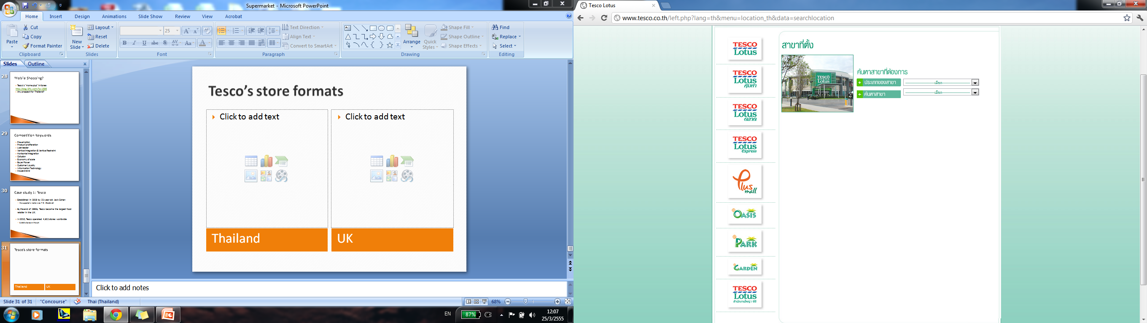
Tesco’s store formats
Tesco Express (8%)
Tesco Metro (6%)
Tesco Superstore (42%)
Tesco Extra (42%)
Tesco Homeplus (2%)
(not the same as Home plus in Korea)
Thailand
UK (% of total floor space)

Slide 32
Brand Proliferation

Slide 33
Tesco’s International Expansion
Started to expand overseas in the mid-1980s.
First Ireland. Then, France and Scotland.
By mid-1990s, started to focus on countries with minimal competition from other larger global chains.

Slide 34
Tesco’s International Expansion
Tesco’s strategy was to acquire smaller, established local retailers.
  Keep the local management in place.
For example, it acquired:

Slide 35
Tesco’s International Expansion
Tesco said that it
“aimed for market leadership ahead of profitability”
Question:
What do you think they will get out of this strategy?

Slide 36
Brand Preemption

Slide 37
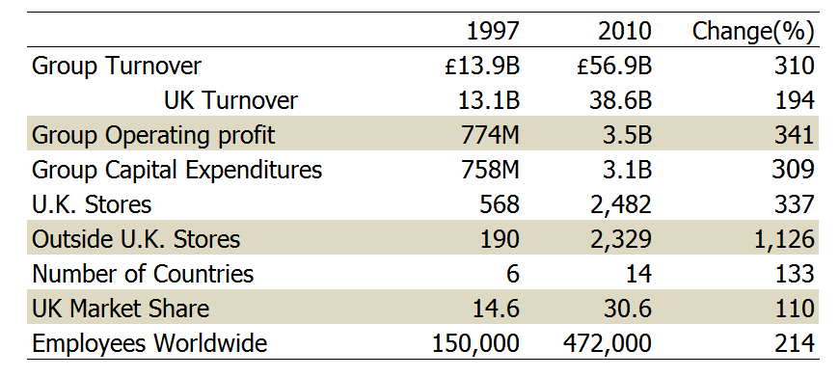
Tesco’s Progress: 1997 vs. 2010
source: Quelch (2010)

Slide 38
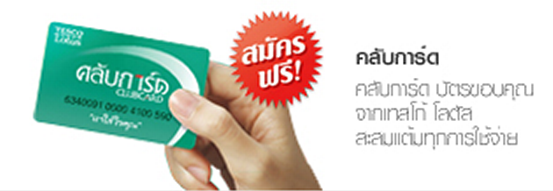
Loyalty Cards
Increase customers’ switching costs
Understand customers’ demand pattern
  To offer more effective promotions!

Slide 39
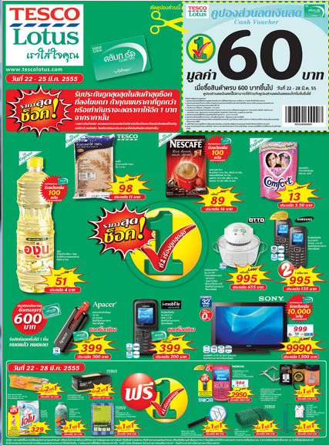
Discount Brochures
What do you think Tesco’s promotions are for?

Slide 40
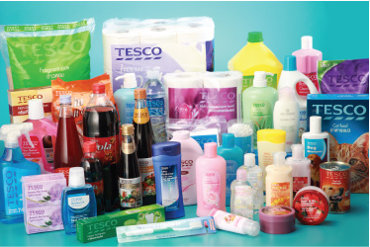
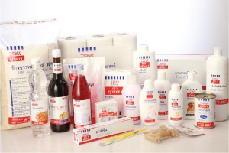
Tesco’s House Brand, Generic Brand
Q: What are they for?

Slide 41
Tesco’s House Brand, Generic Brand
House Brand products meet a comparable standard to “The BRC (British Retail Consortium)”
This makes it difficult for small, less standardized brands to enter Tesco
…

Slide 42
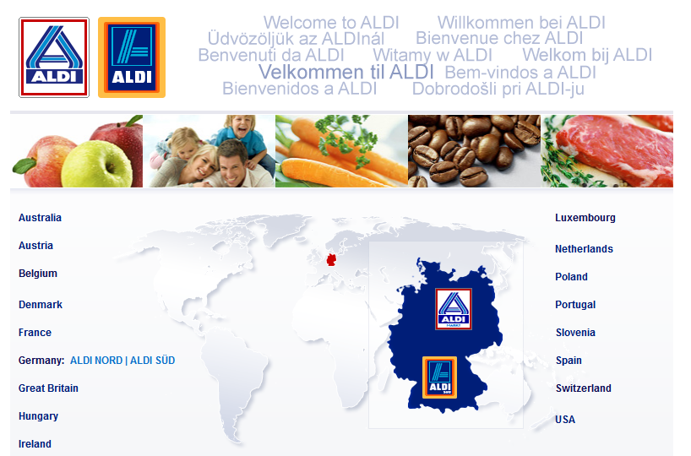
Aldi

Slide 43
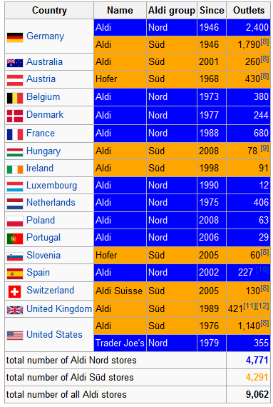
Aldi
A German hard discounter chain
Ranked 15th in the world in terms of total sales
..
Is growing very fast in Europe after the financial crisis.
source: www.wikipedia.com

Slide 44
Aldi’s Business Model
Slogans:
“Smarter shopping”,“Top quality at incredible low prices”
Low-cost model
Sells only staple items (milk, bread, tissue paper, etc.)
…
Limited number of products
...
…
…

Slide 45
Aldi
P&G’s president for Europe once said “P&G’s most dangerous competitor is not Danone, Nestle, or Unilever but an Aldi store.” (Steenkamp and Kumar, 2009)
http://www.youtube.com/watch?NR=1&v=rkA_y9lz0mY&feature=endscreen
http://www.youtube.com/watch?v=-QWgf2KM748&feature=related
http://www.youtube.com/watch?v=gNHuxhX2dW8&feature=related

Slide 46
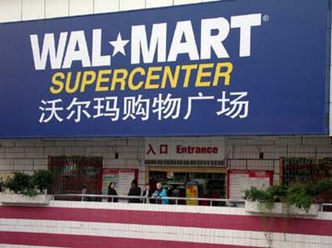
Wal-mart
One of the biggest companies in the world
Ranked 1st in the world in terms of total sales
  4,413 stores the US
  4,557 stores outside the US
  Walmart is very successful in China

Slide 47
Wal-mart store formats
Tesco Lotus, Thailand = 5,000 – 12,000 sq.ft.

Slide 48
Expansion of a retailer
Aj. Pawin Siriprapanukul

Slide 49
1. Financing

Slide 50
Conditions
Retailer owns a chocolate shop (worth 200 baht).
Each month,
  Selling 1 box of chocolate, for 100 baht
  Cost of 1 box of chocolate is 80 baht
  Wholesaler provides 3 months of credit.
Starting cash of the retailer is 0 baht.

Slide 51

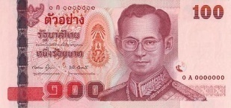
Month 1
Shop
Wholesaler
Shop B/S
Asset | Liability
Cash 100 | A/P 80 Equity 20
Customer

Slide 52
Month 2
Shop
Wholesaler
Shop B/S
Asset | Liability
Cash 200 | A/P 160 Equity 40
Customer

Slide 53
Month 3
Shop
Wholesaler
Shop B/S
Asset | Liability
Cash 300 | A/P 240 Equity 60
Customer

Slide 54
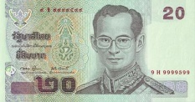
Month 4
Shop
Wholesaler
Shop B/S
Asset | Liability
Cash 320 | A/P 240 Equity 80
Customer

Slide 55
In Summary
For the retailer at month 4, there is Cash of 320 baht, composing of
  240 baht from A/P
  80 baht from profit.
Can the retailer set up a second shop?

Slide 56
Month 5
Shop
Wholesaler
Shop B/S
Asset | Liability
Cash 340 | A/P 240 Equity 100
Customer

Slide 57
Let’s look at the wholesaler
Wholesaler owns a shop (Worth 100 baht).
Each month,
  Selling 1 box of chocolate, for 80 baht
  Cost of 1 box of chocolate is 60 baht, paying in cash
  Wholesaler provides 3 months of credit.
The starting cash is 200 baht, from equity.

Slide 58
Month 1
Shop
Wholesaler
Wholesaler B/S
Asset | Liability
Cash 140 A/R 80 | Equity 220
Producer

Slide 59
Month 2
Shop
Wholesaler
Wholesaler B/S
Asset | Liability
Cash 80 A/R 160 | Equity 240
Producer

Slide 60
Month 3
Shop
Wholesaler
Wholesaler B/S
Asset | Liability
Cash 20 A/R 240 | Equity 260
Producer

Slide 61
Month 4
Shop
Wholesaler
Wholesaler B/S
Asset | Liability
Cash 40 A/R 240 | Equity 280
Producer

Slide 62
In Summary
For the wholesaler at month 4, there is Cash of 40 baht.
Equity of 280 is divided into
  Cash of 40 baht
  A/R of 240 baht.
Can the wholesaler set up a second shop?

Slide 63
Month 5
Shop
Wholesaler
Wholesaler B/S
Asset | Liability
Cash 60 A/R 240 | Equity 300
Producer

Slide 64
Net Profit Margin
Source: www.settrade.com

Slide 65
2. Human Resources

Slide 66
Number of Employees
Source: Form 56-1 of each company

Slide 67
CPALL Corporate Structure
Source: Form 56-1, CPALL

Slide 68
3. International Financing

Slide 69
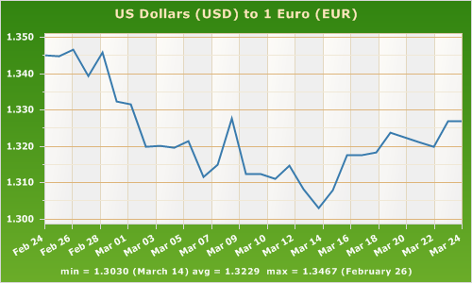
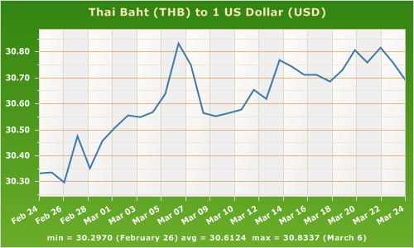
Exchange Rate Risk
The risk that a business’ operations or an investment’s value will be affected by changes in exchange rates.
Read more: http://www.investorwords.com/1808/exchange_rate_risk.html#ixzz1q7T9f2tc

Slide 70
Forward Rate
Banks will not bear any exchange rate risks.
If a company want to buy a THB/USD 1-year forward contract, banks will:
  Borrow money 30 baht (Assume Spot rate at 30 THB/USD)
  Buy 1 USD in Spot market
  Deposit 1 USD for 1 year
  On the due date, withdraw 1 USD to deliver to the company
  Therefore, the Forward rate is 30(1+R) / (1+R*)
Forward premium = Forward rate – Spot rate

Slide 71
Part I (required for every group)
Read the Carrefour case and answer the following questions:
What does interest-rate parity says about international borrowing costs?
Assuming the bonds are issued at par, what is the cost in euros for each of the bond alternatives?
Which debt issue would you recommend?

Slide 72
Part II
(choose only 1 out of the following 2 topics)
Topic 1
If you were consultants for Wal-mart on entering the
Thai market.
  Briefly review the current market structure.
  suggest and discuss what type(s) of store should Wal-mart operate, what kind of products/product-range they should sell, what type(s) of area should they locate.
  Give your explanations along with your answers.

Slide 73
Topic 2
If you were the Thai government, discuss the pros and
cons of having modern food retailers in Thailand. Also
discuss your view on the following issues.
  Market power and buyer power of large modern retailer chains. Will this decrease consumers’ welfare?
  Possible negative effects on the owners of mom & pop stores. Should the government provide any help? Or should them let the free market operates?

Slide 74
References
Church, J. and R. Ware (2000). Industrial Organization: A Strategic Approach, McGraw-Hill Press.
Quelch, J. A. (2010). Tesco PLC: Fresh & Easy in the United States. Harvard Business Case. Cambridge, MA, Harvard Business School.
TDRI (2545). การค้าปลีกของไทย : ผลกระทบของการแข่งขันจากผู้ประกอบการค้าปลีกขนาดใหญ่จากต่างประเทศ, Thailand Development Research Institute. Bangkok.
จันทวีสมบูรณ์ (2551). ไล่ล่า ... ขุมทรัพย์ค้าปลีกไทย, บริษัท โรยัล ฟาร์ม จำกัด, Bangkok.

