Slide 1

MK 322 Retail Management
Chapter 18: Customer Service
By Ajarn Suwalya K.

Slide 2

Strategic Advantage through Customer Service

Slide 3

Customer Service
Customer service is the set of activities and programs undertaken by retailers to make shopping experience more rewarding
Notes:
1

Slide 4
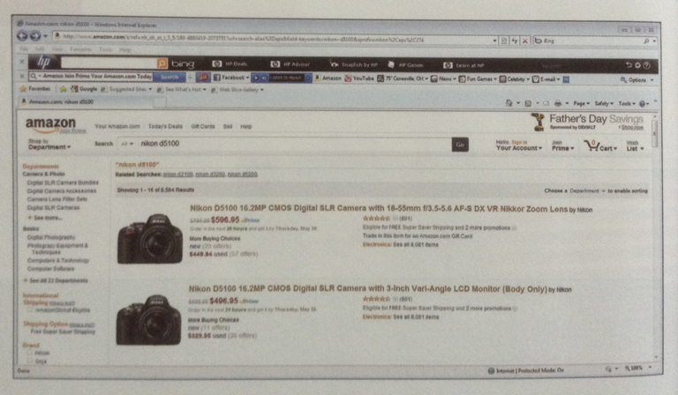
Services Offered by Retailers
Shopping at Amazon is very easy
Notes:
1

Slide 5
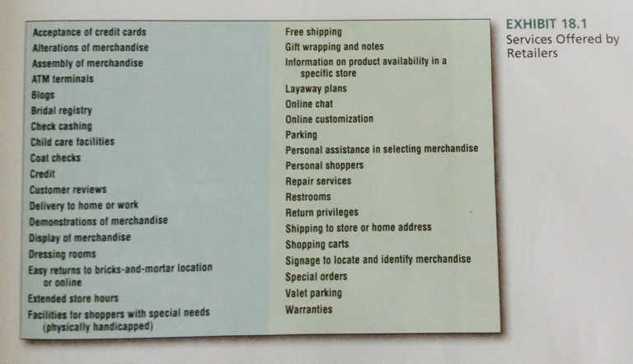
Services Offered by Retailers
Notes:
1

Slide 6
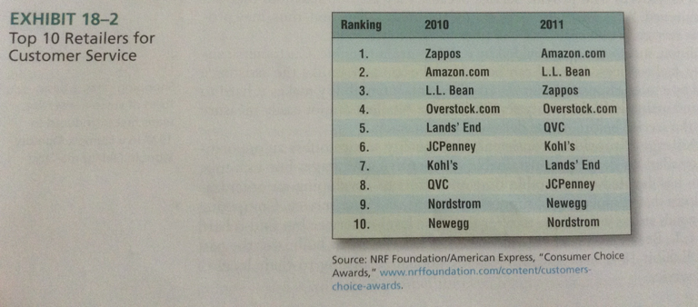
Top 10 Retailers for Customer Service
Notes:
1

Slide 7
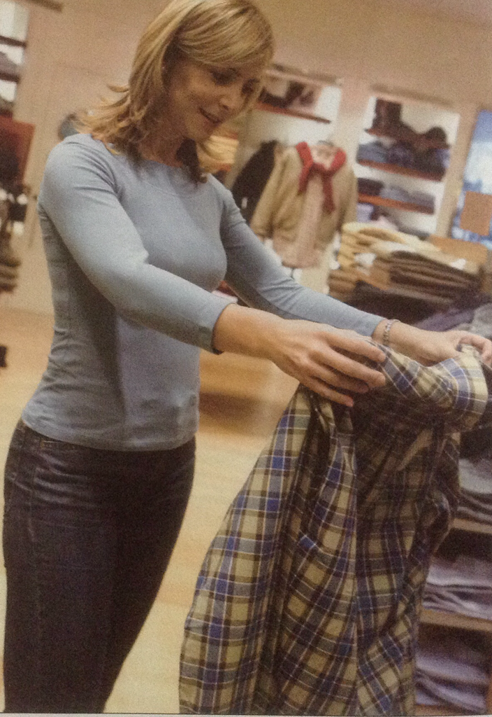
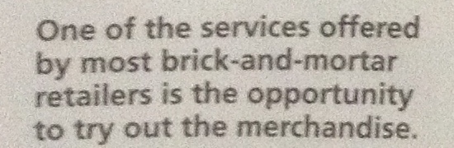
Customer Service
Notes:
1

Slide 8
Customer Service Approaches
Personalized services requires that service providers tailor their services to meet each customer's personal needs
Standardized service is based on establishing a set of rules and procedures for providing high -quality service and ensuring that they get implemented consistently
Notes:
1

Slide 9
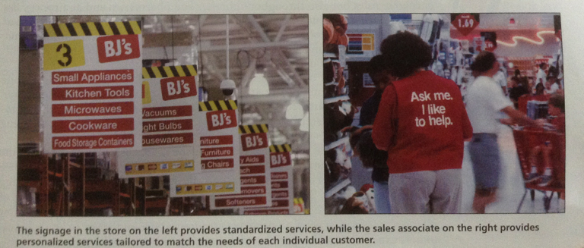
Customer Service Approaches
Notes:
1

Slide 10
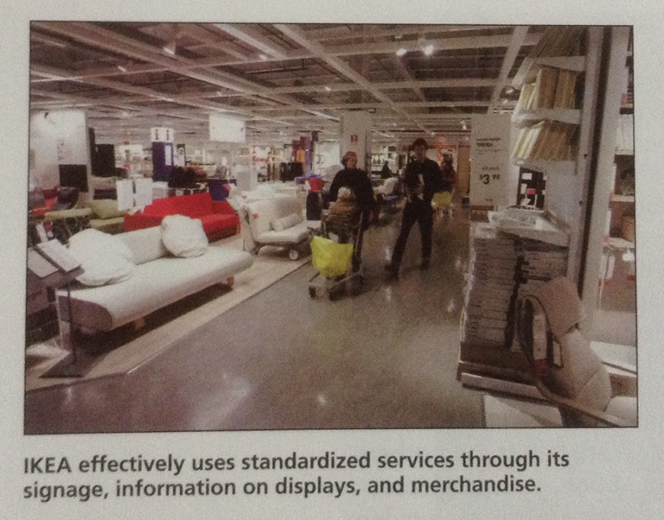
Customer Service Approaches
Notes:
1

Slide 11

Customer Service Approaches
Use of Service Approach – the buying process that consumers go through depends on the consumers' past experiences and risk associated with that purchase decision
Notes:
1

Slide 12
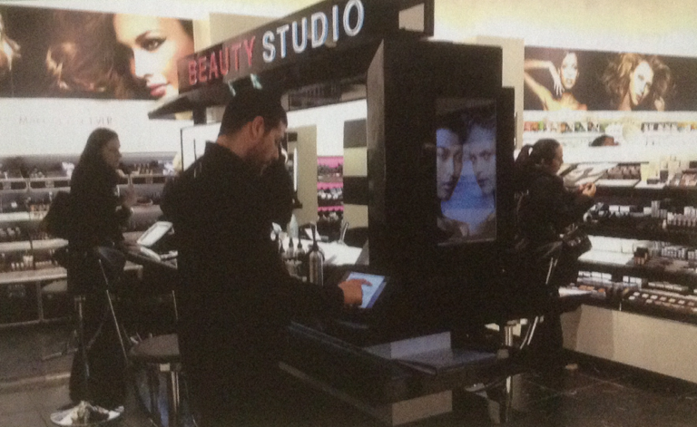
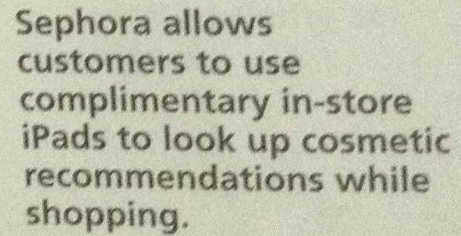
Customer Service Approaches
Notes:
1

Slide 13

Customer Evaluations of Service Quality

Slide 14

Perceived Service
Reliability- the ability to perform the service dependably and accurately, such as performing the service as promised or contracted or meeting promised delivery dates
Assurance- is the knowledge and courtesy of employees and their ability to convey trust and confidence
Notes:
1

Slide 15
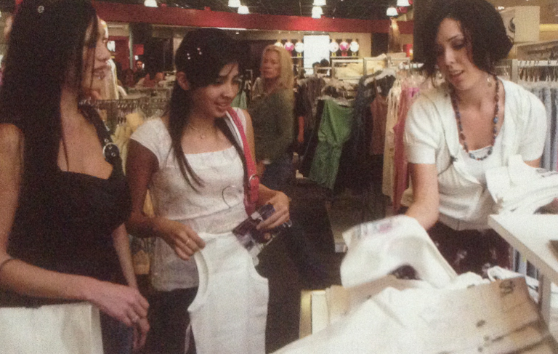
Perceived Service
Great customer service is always a priority at Nordstom
Notes:
1

Slide 16

Perceived Service
Tangibility – is associated with physical facilities, equipment, personnel and communication materials
Notes:
1

Slide 17

Perceived Service
Empathy – refers to caring, individual attention provided to customers
Responsiveness – means to provide customer service personnel and sales associates that really want to help customers and provide prompt service
Notes:
1

Slide 18
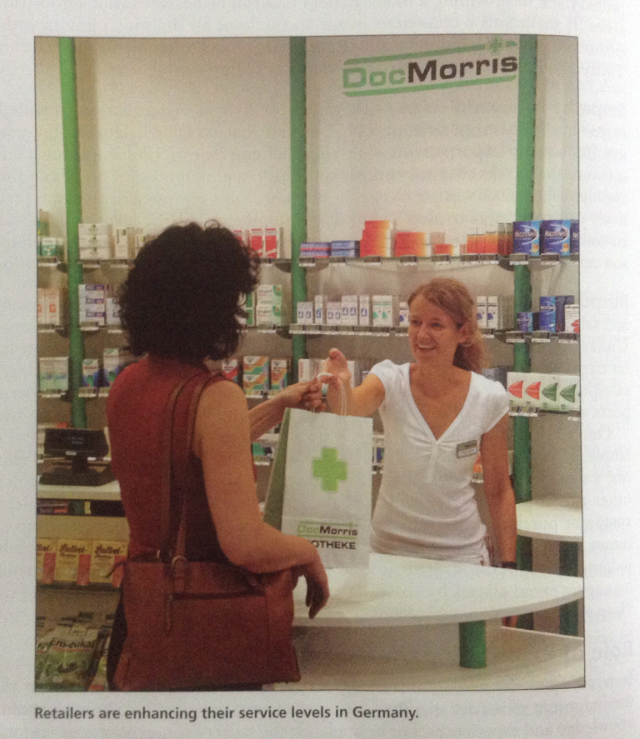
Perceived Service
Notes:
1

Slide 19

The Gaps Model for Improving Retail Customer Service Quality

Slide 20
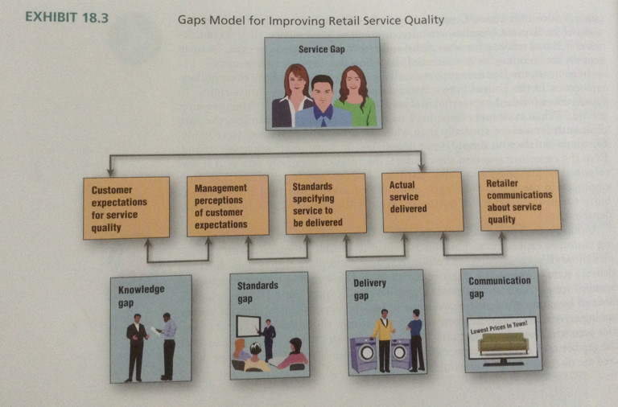
Gaps Model
Notes:
1

Slide 21
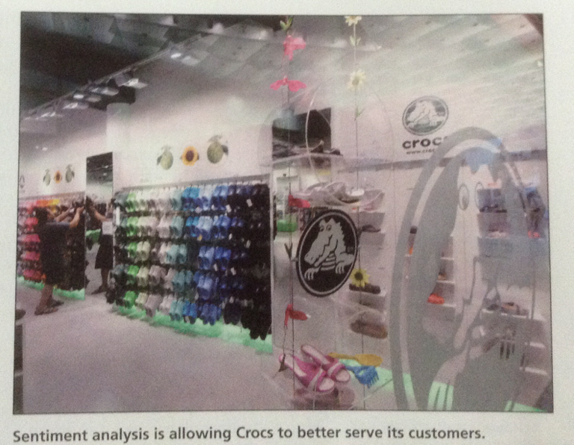
Gaps Model
Notes:
1

Slide 22
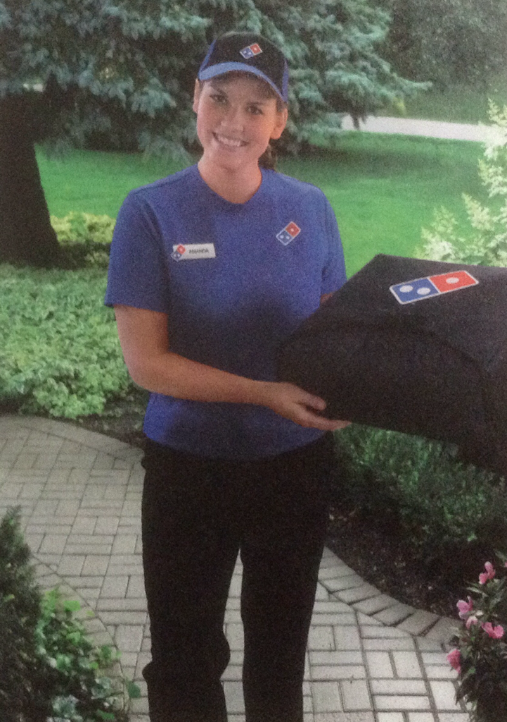
Gaps Model
Domino's has revamped its image- both the food and its service
Notes:
1

Slide 23
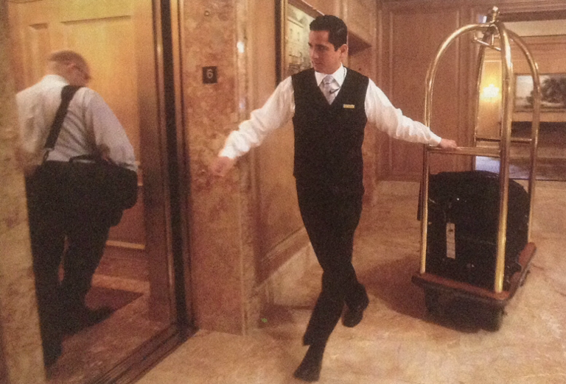
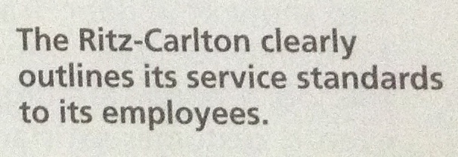
Gaps Model
Notes:
1

Slide 24
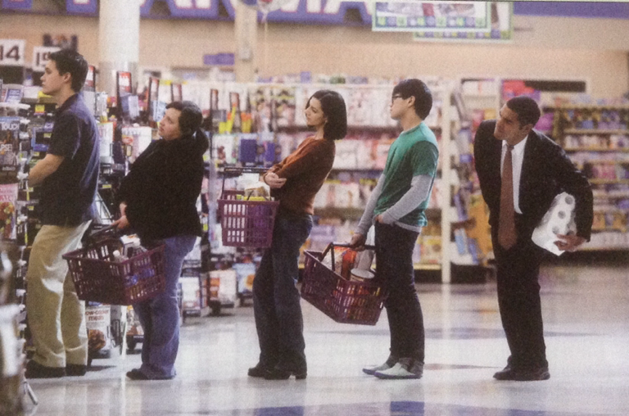
Gaps Model
Notes:
1

Slide 25


