Slide 1
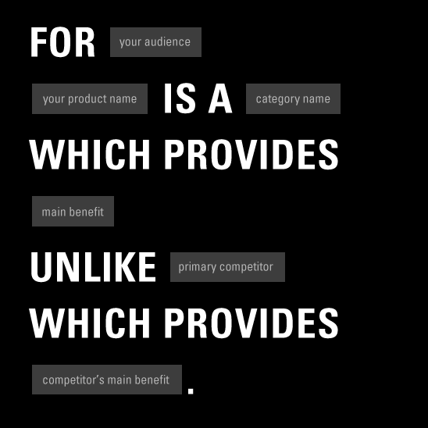
Slides on
STP

Slide 2
Brand Positioning
Is at the heart of the marketing strategy
“. . . the act of designing the company’s offer and image so that it occupies a distinct and valued place in the target customer’s minds.”
Philip Kotler

Slide 3
Determining a frame of reference
Marketers need to know:
Who the target consumer is
Who the main competitors are
How the brand is similar to these competitors
How the brand is different from them

Slide 4
Target Market
A market is the set of all actual and potential buyers who have sufficient interest in, income for, and access to a product.
Market segmentation divides the market into distinct groups of homogeneous consumers who have similar needs and consumer behavior, and who thus require similar marketing mixes.
Market segmentation requires making tradeoffs between costs and benefits.

Slide 5
Example of the toothpaste market
Four main segments:
Sensory: Seeking flavor and product appearance
Sociables: Seeking brightness of teeth
Worriers: Seeking decay prevention
Independent: Seeking low price

Slide 6
Determining a frame of reference
What are the ideal points-of-parity and points-of-difference brand associations vis-à-vis the competition?

Slide 7
Points-of-Parity and Points-of-Difference
Points-of-difference (PODs) are attributes or benefits that consumers strongly associate with a brand, positively evaluate, and believe that they could not find to the same extent with a competitive brand.
Points-of-parity associations (POPs), on the other hand, are not necessarily unique to the brand but may in fact be shared with other brands.

Slide 8
Criteria for Segmentation
Identifiability
Size
Accessibility
Responsiveness:
Can we easily identify the segment?
Is there adequate sales potential in the segment?
Are specialized distribution outlets and communication media available to reach the segment?
How favorably will the segment respond to a tailored marketing program?

Slide 9
Nature of Competition
Deciding to target a certain type of consumer often defines the nature of competition
Do not define competition too narrowly
  Ex: a luxury good with a strong hedonic benefit like stereo equipment may compete as much with a vacation as with other durable goods like furniture

Slide 10
Positioning & differentiation
Positioning Statement:
We are (name of brand).
We produce (type of offering) for (target consumer)
This market offering provides benefits that satisfy(consumer needs)
Our offering uniquely attracts our target consumer
Because (source of competitive uniqueness).
Our benefits differ from competitors’ benefits in the following
Way(s): (points of differentiation).

Slide 11
Positioning & differentiation
Gatorade
We are Gatorade. We produce sports drinks for physical
activity enthusiasts who consider themselves to be
accomplished, but not necessarily competitive, athletes.
This market offering provides benefits that satisfy our
Consumer’s need to quench thirst in a healthy and fun
(but not frivolous)way. Our offering uniquely attracts
Our target consumer because it is absorbed in the body
12 times faster than water and because it is heavily promoted
Using imagery of everyday athletes working up a sweat.
Our benefits differ from competitors’ benefits in the following
ways: fun, scientifically-backed quenching.

