Slide 1
Topic 3 Part 3
Applications

Slide 2
Review – Corner Solution
Generally, people consume positive amounts of X and Y.
In this case, such bundle is said to be an interior solution.
But, some people choose to consume ONLY one good.
In this case, such bundle is said to be a corner solution.

Slide 3
Review – Corner Solution
When the optimality condition “MUx/Px = MUy/Py” holds, we will have an interior solution.
This is because this condition implies the bundle where the IC and BL are tangent (their slopes are equal).
This in turn implies that such bundle is affordable and gives the highest utility.

Slide 4
Review – Corner Solution
Suppose that MUx/Px > MUy/Py.
This means spending one dollar on X will give higher MU.
Hence, we should consume more X.
Note that when X increase, MUx falls, equating
MUx/Px = MUy/Py, and the optimal bundle is reached.
What if there is NO bundle such that
MUx/Px = MUy/Py?

Slide 5
Review – Corner Solution
Suppose that MUx/Px > MUy/Py for all affordable bundles.
This means that, for every bundle we can buy, $1 spent on X will ALWAYS give higher MU than $1 spent on Y.
Therefore, we should spend money on X, i.e. we should consume only X.
This is what a corner solution means.

Slide 6
Applications of the Consumer Theory
Voucher vs Cash Subsidy
Demand for Leisure and Supply of Labor
Consumer Price Index

Slide 7
Choice with Composite Goods
In previous analysis, a consumer has two choices: good X and good Y.
We will introduce a Composite Good.
Suppose that good Y represents a composite good, then good Y includes every other good except good X.

Slide 8
Choice with Composite Goods
We will plot a composite good in place of good Y, i.e. on the vertical axis.
We assume that its price is $1, i.e. Py = 1.
Hence, the slope of the budget line becomes
–Px/Py = –Px/1 = –Px.

Slide 9
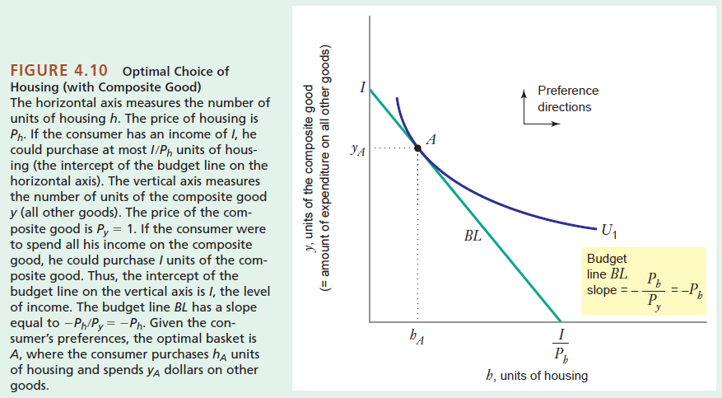
Choice with Composite Goods

Slide 10
App: Coupons and Cash Subsidies
Governments often have programs (coupons and subsidies) aimed at helping the poor purchase more essential goods, e.g. food, housing, and education.
Cash Subsidies is essentially an increase in income of a consumer, shifting his/her BL to the right.
Coupons/Vouchers permit consumers to buy more of a specific good only, partly shifting his/her BL to the right.

Slide 11
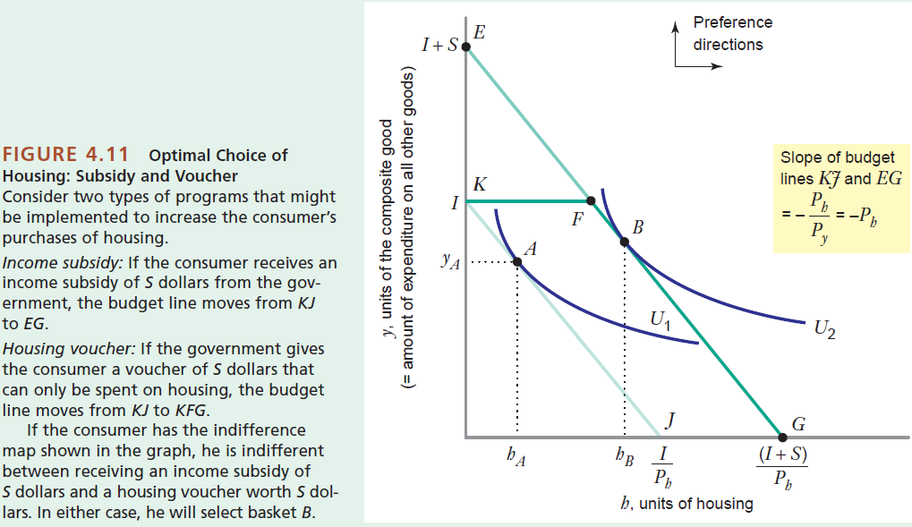
App: Coupons and Cash Subsidies

Slide 12
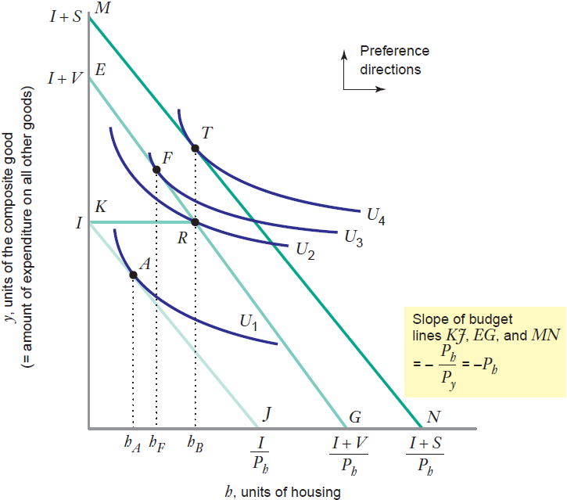
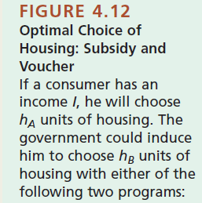
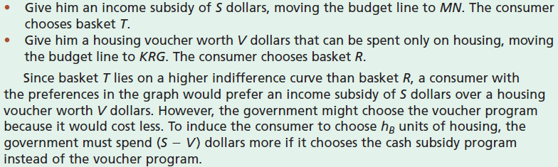

Slide 13
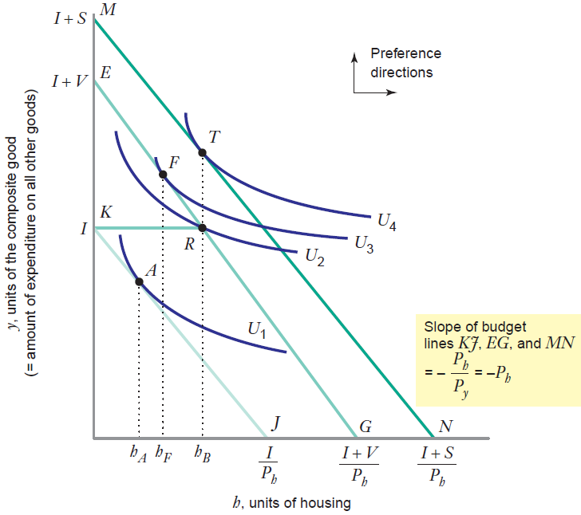
A is the original bundle.
T is the bundle when the govt gives a cash subsidy of S.
F is the bundle when the govt gives a cash subsidy of V.
R is a bundle when the govt gives a housing voucher of V.
F gives higher utility than R. But, at F, the consumer buys less housing.
Suppose the govt wants h_{B} units of housing to be consumed. It can save money of S-V if it chooses a voucher program instead of a cash subsidy.

Slide 14
App: Coupons and Cash Subsidies
Key Points
Since a cash subsidy allows a consumer to buy whatever he wants and whatever he needs, this program tends to give higher utility.
Coupons/Vouchers will save cost for the government, and are effective when the government wants to increase the consumption of a specific good.

Slide 15
App: Labor Supply Curve
All workers face labor-leisure trade-off.
They have 24 hours a day, which are allocated between working and resting.
Workers value both income from working and their leisure time.
MU for both are positive but diminishing.
Leisure is a normal good: as income rise, people want to consume more leisure.

Slide 16
App: Labor Supply Curve
One can think of “wage” as “price of leisure” since when we rest, we forego wage income.
Now, if wage rises, leisure becomes more expensive.
SE implies that workers will work more.
IE implies that, with more money from higher wage, workers can work less and rest more.
Two effects work in the opposite directions.

Slide 17
App: Labor Supply Curve
The labor supply curve slopes upward over the region where the SE > IE.
Because leisure is more expensive, workers substitute away from leisure and work more.
The labor supply curve bends backward over the region where the IE > SE.
Given a higher wage, workers now become richer. Since leisure is a normal good, more leisure is consumed, and workers work less.

Slide 18
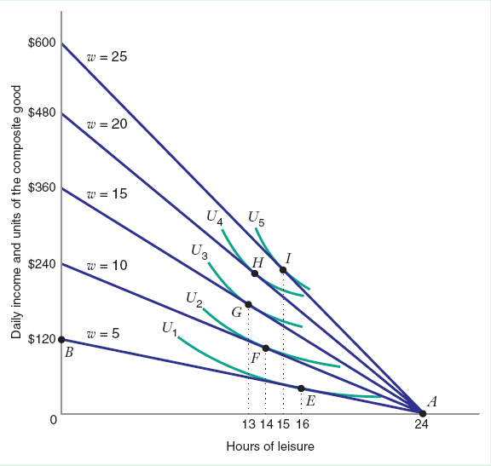
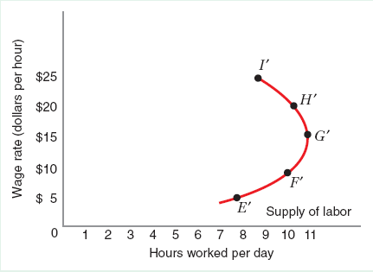
App: Labor Supply Curve
Backward-Bending Labor Supply
Hrs of Leisure
Hrs of Work

Slide 19
App: Consumer Price Index (CPI)
CPI is an index (a number) that tells us about the cost of living of typical consumers.
It measures changes in the price level and can be used to calculate the inflation rate.
CPI is a fixed-weight index, calculated from a fixed basket of goods.

Slide 20
App: Consumer Price Index (CPI)
Since CPI is calculated from a fixed basket of goods, it ignores the fact that people would “substitute” expensive goods with cheaper goods.
This is called the “substitution bias” and causes CPI to overestimate the cost of living when the price level rises.

Slide 21
App: Consumer Price Index (CPI)
Example
Assume a consumer buys two goods:
food with P_{F,1} = $3 and clothing with P_{C,1} = $8.
At these prices, the consumer buy 80 units of food and 30 units of clothing, (F, C) = (80, 30).
Thus, the cost of living before the price change is $480.

Slide 22
App: Consumer Price Index (CPI)
Example (cont)
Suppose the prices of food and clothing rises; the new prices are P_{F,2} = $6 and P_{C,2} = $9.
CPI assumes that the consumer would still buy the original bundle, (F, C) = (80, 30). With this approach, the cost of living after the price change would be $750.
CPI = 750/480 = 1.56. Inflation = 56%.

Slide 23
App: Consumer Price Index (CPI)
Example (cont)
In reality, there exists a bundle that could give the consumer the same happiness as (F, C) = (80, 30).
From the diagram, such bundle is (40, 60) and costs $720 after the price change.
If CPI were to account for the substitution, CPI would be 720/480 = 1.5. Inflation = 50%.

