Slide 1

Chapter 1
Chapter 10
Marketing Mix Decisions IV:
Communications
MK 312 Marketing Planning
By
Ajarn Suwalya K.

Slide 2
Ch. 10 - Learning objectives
After studying this chapter you should be able to:
■ discuss the role of communication in the marketing mix
■ describe the main elements of the promotional mix
■ identify the local market characteristics that affect the advertising and promotion of products
■ explain the five steps in developing an international advertising campaign
■ discuss the role of personal selling in international marketing
■ explain the considerations and steps in designing and managing an international sales force
■ discuss how to design compensation systems for an international sales force
■ explain the principles of multi-channel customer management.

Slide 3
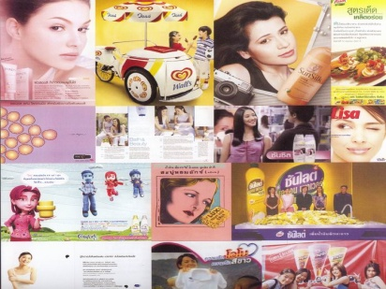

Introduction
Without an effective marketing communications program, a marketing strategy will fail. Target customers must be made aware of the product and its benefits, be continually reminded of these benefits and stimulated to take action.
Building awareness, message comprehension and interest are essential phases in building a high level of customer response.

Slide 4
Promotion mix:
Advantages / disadvantages of different elements

Slide 5
Promotion mix:
Advantages / disadvantages of different elements

Slide 6

Advertising
Of all the elements of the marketing mix, decisions involving advertising are those most often affected by cultural differences among country markets. Consumers respond in terms of their culture, its style, feelings, value systems, attitudes, beliefs and perceptions.
Global advertising can be defined that is more or less uniform across many countries, often, but not necessarily, in media vehicles with global reach. In many cases complete uniformity is unobtainable because of linguistic and regulatory differences between nations, or differences in media availability.

Slide 7


Advertising
In contrast, multidomestic advertising is international advertising deliberately adapted to particular markets and audiences in terms of message and/or creative execution.
Several problems traditionally face the decision-maker in global advertising.
One is how to allocate a given advertising budget among several market countries.
Another is the message to use in these various markets.
A third is what media to select. Even before tackling these management decisions, however, the advertiser needs to define the objectives of the advertising in the different countries.

Slide 8

Five steps in international advertising
Five steps are involved in creating international advertising campaigns:
1 strategic objectives
2 message creation
3 media selection
4 advertising budgeting
5 executing the campaign.

Slide 9
International communication process
In the international communications process, each of the seven identifiable stages listed below can ultimately affect the accuracy of that process.
1 An information source: an international marketing executive with a product message to communicate.
2 Encoding: the message from the source converted into effective symbolism for transmission to a receiver.
3 A message channel: the sales force and/or advertising media that convey the encoded message to the intended receiver.
(cont. on next slide)

Slide 10
International communication process
4 Decoding: the interpretation by the receiver of the symbolism transmitted from the information source.
5 Receiver: consumer action by those who receive the message and are the target for the thought transmitted.
6 Feedback: information about the effectiveness of the message that flows from the receiver (the intended target) back to the information source for evaluation of the effectiveness of the process.
7 Noise: uncontrollable and unpredictable influences, such as competitive activities and confusion, that detract from the process and affect any or all of the other six factors.

Slide 11

Effective global advertising
Global advertising is most powerful under the following conditions:
■ the image communicated can be identical across countries
■ the symbols used carry the same meaning across countries
■ the product features desired are the same
■ the usage conditions are similar across markets.

Slide 12

Exhibit 10.1 Adaption of Danone’s international advertising

Slide 13

Different types of
Sales Promotion
Price-based promotions
  Discount pricing and sales
  Money-off coupons
  Improved payment terms (interest-free credit)

Slide 14
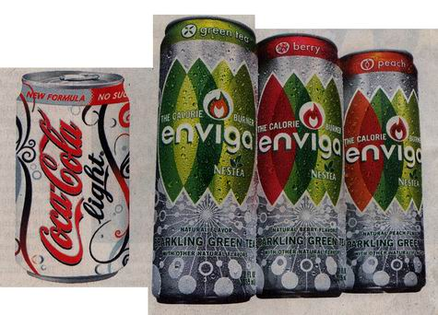
Different types of
Sales Promotion
Product-base promotions
  Product samples
  Multipacks and multibuys
  Improved product quality or features

Slide 15
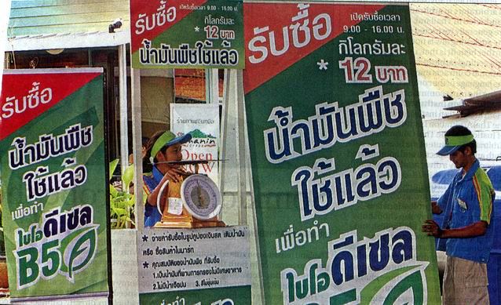
Different types of
Sales Promotion
Opportunity-based promotions
  Competitions
  Promotional information

Slide 16
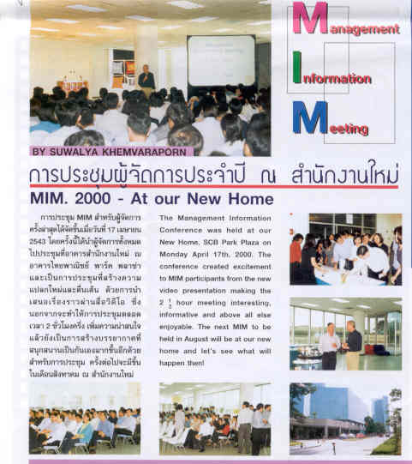
Public Relations and Sponsorship
Creating good relationships with the popular press and other media to help companies communicate messages to their publics-customers, the general public and government regulators – is the role of public relations (PR).
The job consists not only of encouraging the press to cover positive stories about companies, but also of managing unfavorable rumors, stories and events. Effective damage control-actions taken to limit spillover into negative public opinion – requires both good PR and timing.

Slide 17
Exhibit 10.2 Snickers sponsors key sporting events

Slide 18
Effective online advertising strategies
Following questions are important to answer:
Who to advertise to?
How to advertise?
What to advertise?
When to advertise?
Where to advertise

Slide 19
Online advertising metrics
Some of the most commonly used measures include:
• clickthroughs – the number of times that users click on an advertisement
• cost per click – the amount spent by the advertiser to generate one clickthrough
• cost per action/lead (CPA/L) – the amount spent by the advertiser to generate one lead, one desired action, or simply information on one likely user; the advertiser pays an amount based upon the number of users who fulfil the desired action
• cost per sale (CPS) – the amount spent by the advertiser to generate one sale; here, the advertiser pays an amount based upon how many users actually purchase something.

Slide 20
Building online buyer loyalty
Using the web as a vehicle for building loyalty on the part of international buyers involves five stages:
1. Attract
Attract clients to visit the website. They do so on a voluntary basis and will not come simply because a site has been created. To create awareness of a site, it is necessary to use banner ads and links to other sites.
2. Engage
Engage visitors’ attention. This is necessary in order to get the visitor to a site in order to participate and encourage interaction. Most sites fail as promotional mediums because they are boring and have poorly presented material. In this regard, the content of the site is most important.

Slide 21
Building online buyer loyalty
3. Retain
Retain the visitor’s interest in your site. This is important to ensure repeat visits to the site and the creation of a one-to-one relationship between the firm and its potential overseas customers.
4. Learn
Learn about the client and their preferences. This is enabled by providing on the site an easy-to-use facility for feedback and comment. The use of cookies can assist in this.
5. Relate
Adopt a deliberate policy of building relationships with site visitors. This is achieved by providing value-added content, by tailoring the product/service to the needs of each customer and promising customized delivery.

Slide 22
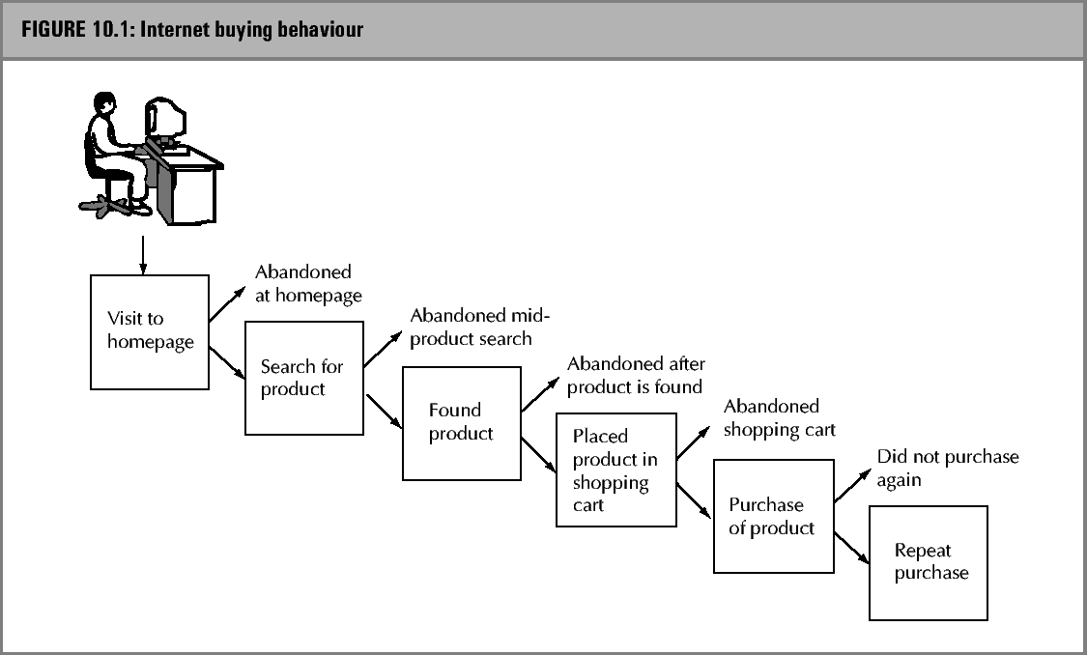
Online buying behaviour

Slide 23
Viral marketing
Viral marketing is the multiplier effect achieved when visitors to a website provide contact information not only for themselves but also for others who may be interested in a product or service, or when they pass on the site’s information to others.

Slide 24
M-marketing
M-business represents ‘mobile’ business and refers to the new communications and information delivery model created when telecommunications and the Internet converge.
M-marketing is defined as the application of marketing to the mobile environment of smart phones, mobile phones, personal digital assistants (PDAs) and telematics.
M-marketing is characterized by both the interaction with the World Wide Web and the location-specific context, which enhances communication and delivery of information.

Slide 25
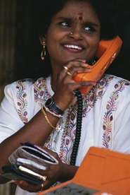
Direct marketing
Direct marketing is defined by the Direct Marketing Association (DMA) as
‘an interactive marketing system that uses one or more advertising media to effect a measurable response and/or transaction at any location.’

Slide 26
E-mail marketing
The following is an example of a checklist for launching a successful email marketing campaign (Linkon, 2004)
  Solid planning
  Excellent content
  Appropriate and real ‘from’field
  Strong ‘subject’field
  Right frequency and timing
  Appropriate use of graphics
  Lead with your strength
  Shorter is better
  Personalize
  Link to your website

Slide 27
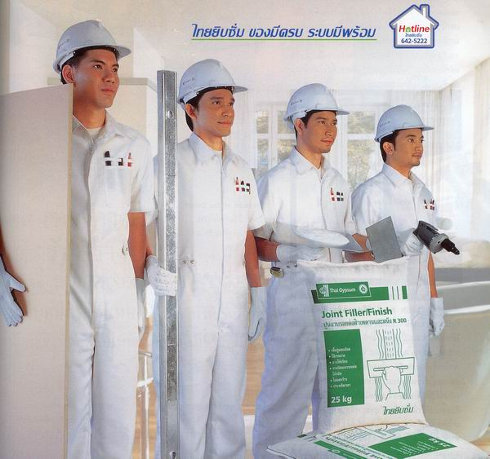
Personal Selling
Structuring and managing a sales force
Structuring and managing a sales force involves:
■ designing the sales force
■ recruiting marketing and sales personnel
■ selecting sales and marketing personnel
■ training for international marketing
■ motivating sales personnel
■ designing compensation systems
■ evaluating and controlling sales representatives.

Slide 28

International sales force
Compensation programmes for sales force:
Straight salary
Straight commission
Combination plans

Slide 29
International sales force

Slide 30
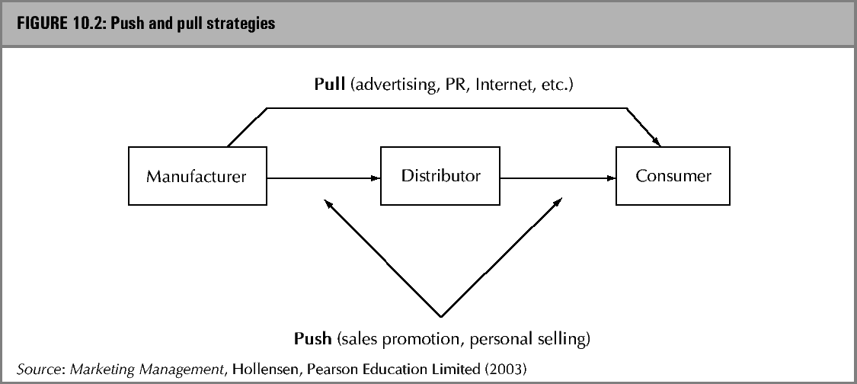
Push- and pull strategies

