Slide 1
FN 221: Personal Finance
Thanachote Rungsitivat, CFA, FRM

Slide 2
Measuring Your Credit Capacity
You first need to make your budget
  Should include also the basic necessities such as rent, food, clothing
  Also spare some amount for other durable goods, such as new phones, etc if needed or maintenance of those goods.

Slide 3
Can you Afford a Loan?
Ask yourself
  Whether you can meet all of your essential expenses and still afford the monthly loan payments (including interest)
  What you plan to give up to make the monthly loan payment? Are you prepared to make this trade-off?

Slide 4
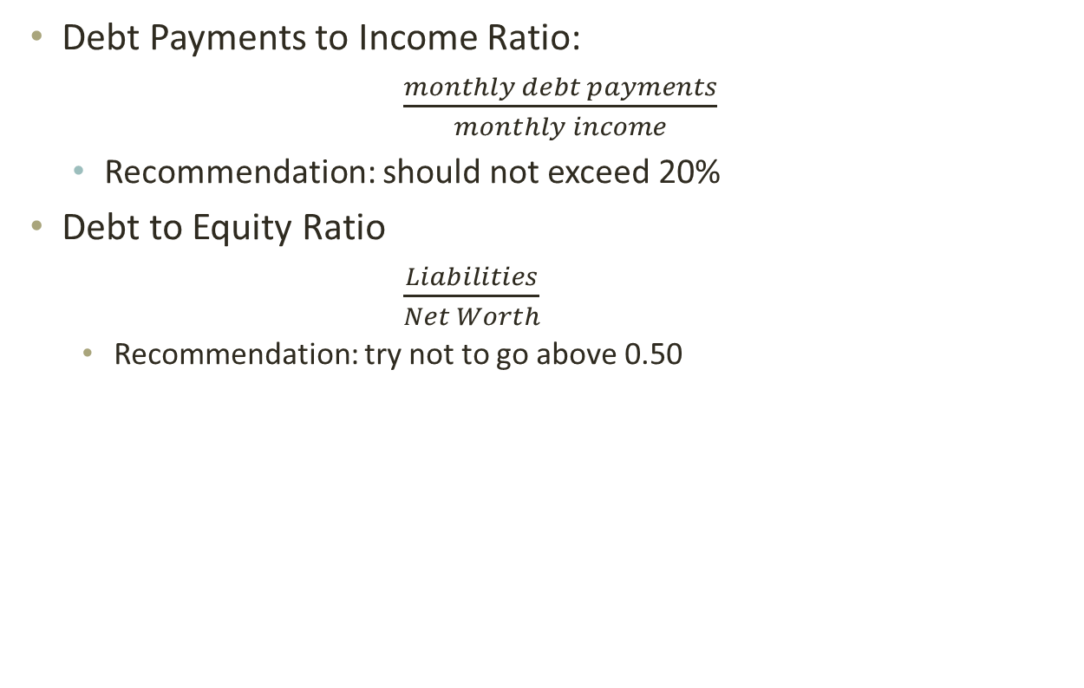
General Rules of Credit Capacity
Debt Payments to Income Ratio:
  $\frac{monthly debt payments}{monthly income}$
  Recommendation: should not exceed 20%
Debt to Equity Ratio
  $\frac{Liabilities}{Net Worth}$
    Recommendation: try not to go above 0.50

Slide 5
Cosigning a Loan
Think before you give an answer if someone asks you to cosign a loan
You are being asked to guarantee this debt. Think carefully before you do. If the borrower doesn’t pay the debt, you will have to. Be sure you can afford to pay if you have to, and that you want to accept this responsibility.
You may have to pay up to the full amount of the debt if the borrower does not pay. You may also have to pay late fees or collection costs, which increase this amount.

Slide 6
Building and Maintaining your Credit Rating
National Credit Bureau
  The concept to establish a credit data center started in 1961. The Thai Banker’s Association discussed with Bank of Thailand that there should be a center to exchange the data of the clients of commercial banks to reduce the risk of giving a loan and prevent the damages that may happen to commercial banks. Bank of Thailand was asked to be the center to gather all the data. Then Bank of Thailand has started the central credit registration since 1964. After that, it had continuously been developed until 1995, the government by the Ministry of Finance, Bank of Thailand, and the Securities and Exchange Commission, Thailand, made up a plan of financial system development together. It was about establishing the credit data center on the proportion of financial organizations that support the financial system development.

Slide 7
National Credit Bureau
The establishment of the credit data center was divided into 2 sections including a section set up by the Government Housing Bank that established Thai Credit Bureau Co., Ltd. and Bank of Thailand together with the Thai Banker’s Association established Central Information Services Co.,Ltd. Both companies were established with the same objective including being the center to gather clients’ data to help reduce the risk and increase the efficiency of giving loans and to prevent bad debt or non-performing loan problems in the economic system.

Slide 8
National Credit Bureau
In 2005 Central Credit Information Services Co., Ltd. merged the business with another credit data company, Thai Credit Bureau Co., Ltd. Central Credit Information Services Co., Ltd. had bought all the shares of Thai Credit Bureau Co., Ltd. and increased the capital to 250 million baht. The company name was changed to National Credit Bureau Co., Ltd. on May 19, 2005, of which shareholders include the shareholders of Thai Credit Bureau Co., Ltd. and banks as well as government financial institutes. The portion of the shareholders after the merger consists of Thai commercial banks hold the same portion of the shares totaling 24.5%, Business Online PCL. and TransUnion Inc. hold the same portion of 12.25% totaling 24.50%. The total of shares held by the shareholders of the former Central Credit Information Services Co., Ltd. are of 49%. The shareholders of Thailand Credit Data Co., Ltd. hold the portion of 30% including Government Housing Bank 15% and PCC Capital Co., Ltd.15%. The rest of another 21% are held by government financial institutes including Government Savings Bank, Dhipaya Insurance PCL., and Small and Medium Enterprise Development Bank of Thailand hold the share portions of 9%, 6% and 6% respectively.

Slide 9
National Credit Bureau
There are two reports: Consumer Credit report and Commercial Credit Report
Who provide such information?
  Banks and Specialized Financial Institutions
What do they provide?
  Credit Limit that they provide and if you make repayments on time
You are asked to get it (or the bank can get it for you) whenever you apply for credit from the bank

Slide 10
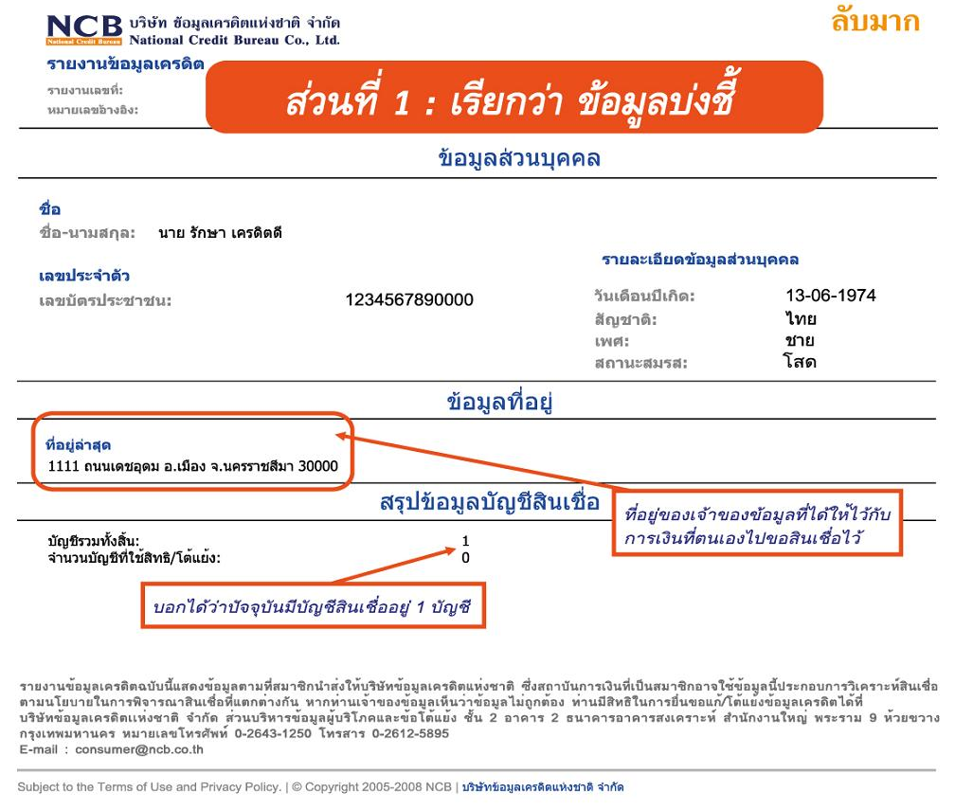
NCB Report

Slide 11
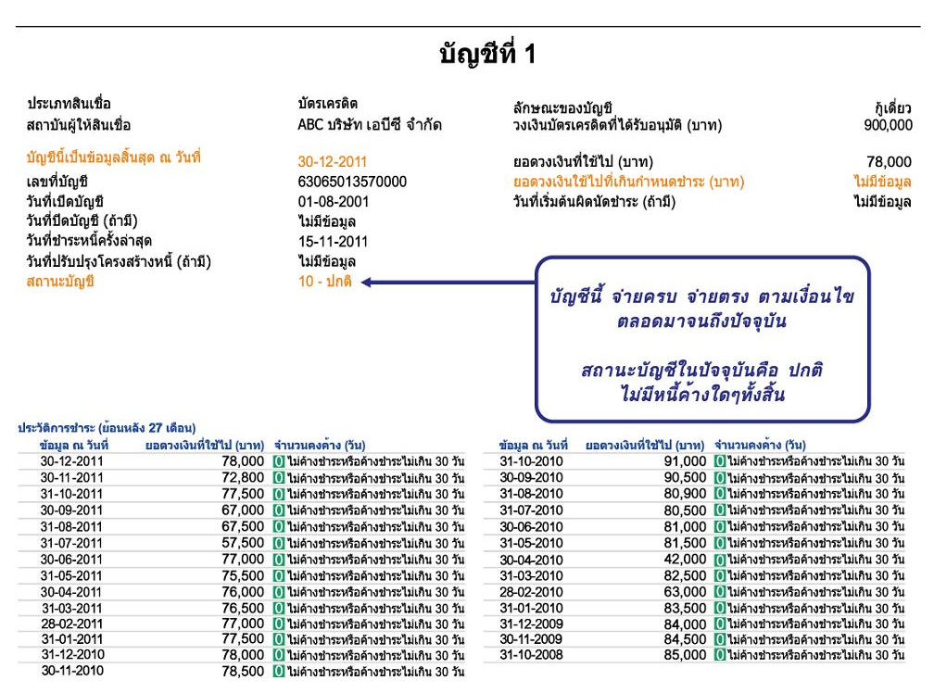
NCB Report

Slide 12
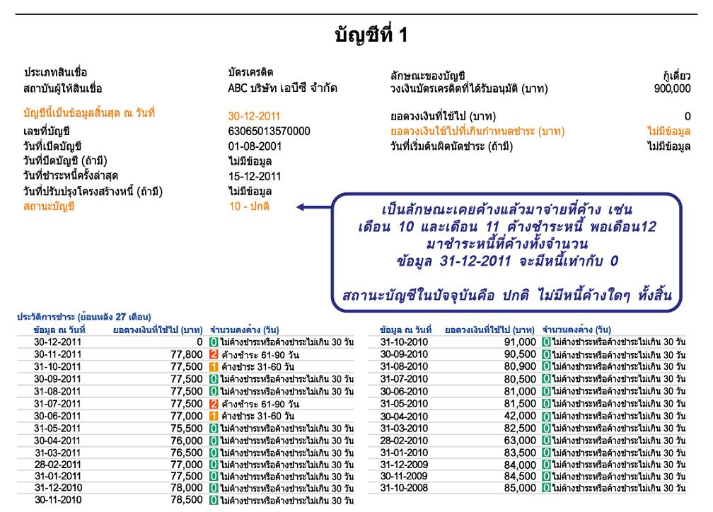
NCB Report

Slide 13
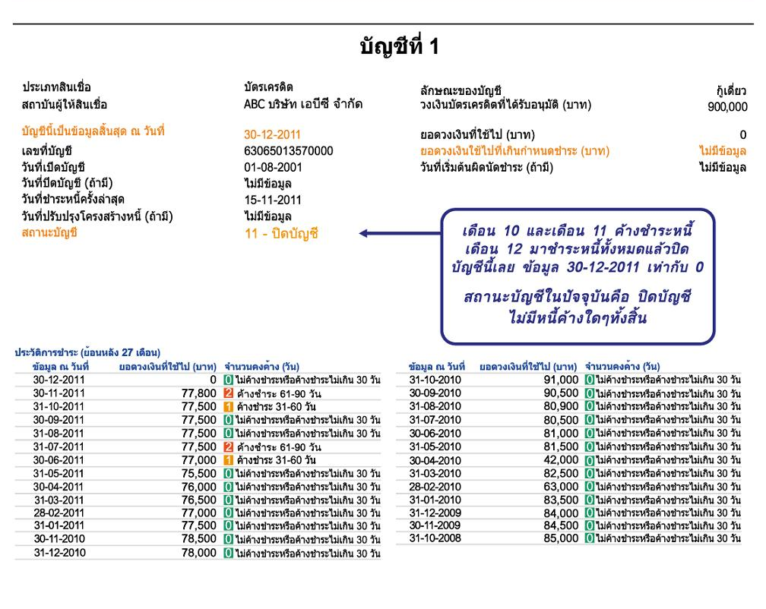
NCB Report

Slide 14
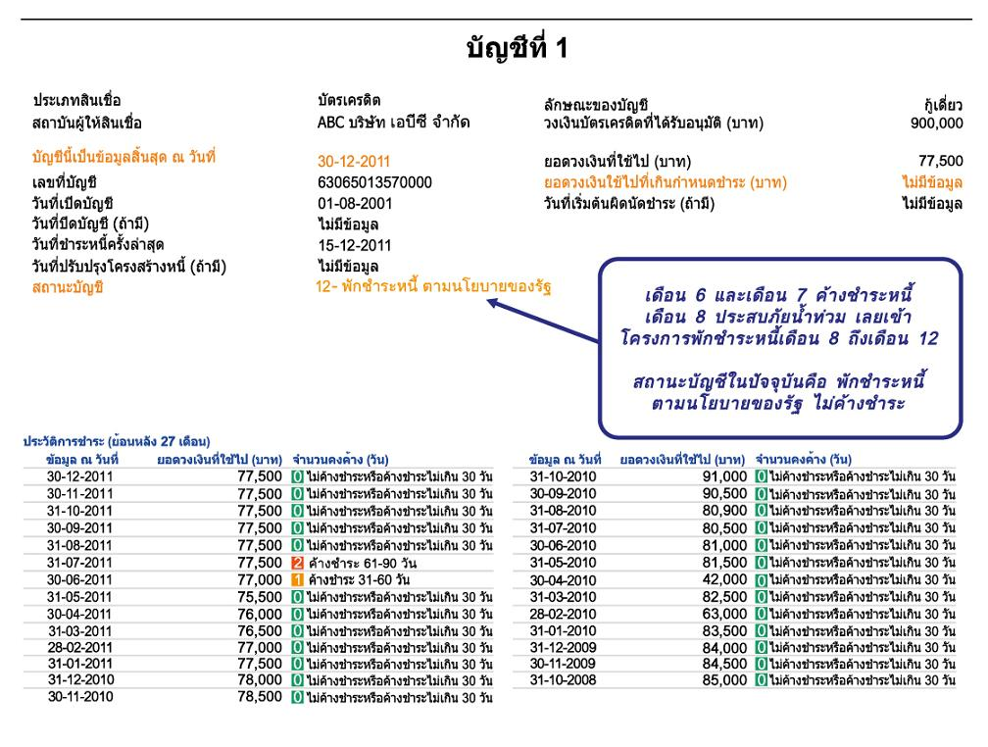
NCB Report

Slide 15
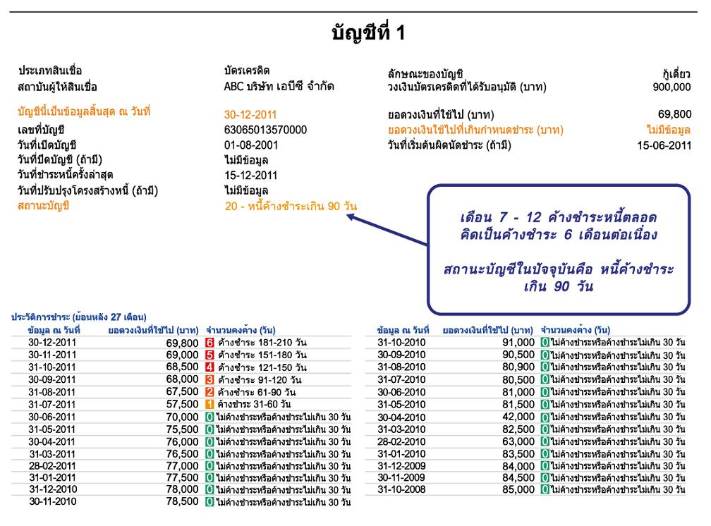
NCB Report

Slide 16
What Creditors Look for
Credit Rating (also using NCB Report as a guide)
Five Cs
  Character
    Borrower’s attitude toward credit obligations.
  Capacity
    Financial ability to meet the obligations (salary, statements, etc.)
  Capital
    Assets or Net worth
  Collateral
    Asset that you pledge to a financial institution to obtain a loan.
  Conditions
    General economic conditions that can affect your ability to repay a loan. (job security, etc.)

Slide 17
The situation
Jil brown is a little nervous about getting a credit card while she is still in college. She knows there re many people who have misused credit cards at her university. However, she decides to carefully weigh the advantages and disadvantages of having a credit card.
Notes: Jill brown is appropriately nervous about getting a credit card. If you do manage your credit wisely, your debt can quickly get out of control and cause added stress which can have adverse consequences on your financial health.

Slide 18
Advantages of credit
Advantages
  it enables Jill to enjoy goods and services now
  She may receive advance sale notices or other extras
  It may be easier for her to return merchandise
  It enables her to have shopping convenience and efficiency
  It is safer to use than carrying large amount of cash
  It provides a record of expenses
  Allows up to a 50 day float

Slide 19
Disadvantages of credit
Disadvantages
  The temptation to overspend
  Failure to pay can lead to loss of income, valuable property and Jill’s good reputation
  It can lead to long term financial problems
  It can damage family relation ships
  Does not increase total purchasing power
  Credit costs money

Slide 20
Type of Credit
Closed - End Credit
  Installment Sales Credit
  Installment Cash Credit
  Single Lump – Sum Credit
Open - End Credit
  Revolving Credit
  Incidental Credit

Slide 21
Installment Sales Credit
Jill purchases a used car and secures a loan from a bank where she makes payments of $450 per month over the next 36 months. Her payments include interest on the loan and partial payment of the principal on the loan.

Slide 22
Installment Cash Credit
Jill gets a $5,000 loan in cash from her bank. She plans on using the money for a summer vacation to Aruba. She will repay this loan in monthly payments of $430 over the next year.

Slide 23
Single Lump –Sum Credit
Jill’s mom purchases a new dinning room table and six chairs from a large furniture retailer. The cost of the furniture is $1,050. However, she decides to get a loan from he retailer that allows her to make one payment of $1,100 at the end of 90 days.

Slide 24
Revolving Credit
Jill’s brother, James, has a credit card with a line of credit of $10,000. Most months he uses it to charge about $500 in goods and services. He must make a minimum payment within 30 days of receiving the bill of $20. If he does not pay the entire balance, the he is charged interest at a rate of 19.5% compounded monthly.

Slide 25
Incidental Credit
James has a puppy named Brownie which requires frequent treatments at the vet’s office during the first year of his life. As a courtesy to James, his vet bills him once a month rather than making him pay for each visit separately.

Slide 26
Jill’s Cobranded Credit Card
Jill lovers to read and has applied for a Waldenbooks Visa card. She knows that she will get one $5 gift certificate to Waldenbooks for every $500 she puts on her credit card. She believes she sill be able to buy at least 5 free books a year with this credit card.

Slide 27
Can Jill Afford a loan?
Jill is thinking of taking out another small loan in order to purchase the new Apple iPad. She knows from her friend enrolled in the personal finance course that she needs to keep the following ratios in mind when applying for the loan.
Debt Payment to Income ratio:
Monthly debt payment (excluding house payment)/net monthly income
Debt to Equity ratio : total liabilities / net worth
In Jill’s case, case her debt to income ratio is 30%, and her debt to equity ratio is 8.

Slide 28
James Apples for a Loan
Character : his attitude towards credit obligations
Capacity : his financial ability to meet credit obligations
Capital : his assets and net worth
Collateral : A valuable asset pledged to ensure loan payments
Conditions : General economic conditions that affect his ability to repay a loan

Slide 29
Character
( Will you repay the loan?)
Does James pay his bills on time?
Has he used credit before?
Has he ever filed for bankruptcy?
Does he live within his means?
Does he own his own home?
How long has he lived at his current address?
How long has he been employed by his present employer?

Slide 30
Capacity
(Can you repay the loan?)
What is Jame’s job and what is his salary?
How reliable is that income?
Does he have any other sources of income?
How many dependents does he have?
What are the other claims on his income?
What are his current debts?

Slide 31
Capital
(What are your assets and net worth?)
James needs to list the value of all of his assets
James needs to list the value of all of his liabilities
James can then calculate his net worth

Slide 32
Collateral
(What if you don’t repay the loan?)
What assets can James use to secure the loan?
Do the assets used to secure the loan have any warranties/guarantees?
Do the assets used to secure the loan have sufficient insurance?
What is the age of the assets used to secure the loan?
Are there any claims to the title of the assets used to secure the loan?
What sources does he have besides income (savings, stocks, bonds, insurance, etc.)?

Slide 33
Conditions
(What general economic conditions can affect your repayment of the loan)?
How secure is Jame’s job?
How secure is the company that James works for?
What is the condition of the industry that James is employed in?

Slide 34
Choosing Sources of Credit
Inexpensive Loans – Parents or family members are often the source of the least expensive loans. However, such loans can complicate family relationships. All loans to or from family members should be in writing and state the interest rate, if any repayment schedule, and the final payment date.
Medium-priced loans – Often you can obtain medium-priced loans from commercial banks. New car loans and Used car (slightly more expensive) are included.
Expensive Loans – Convenient to obtain, from finance companies or bank through credit cards.

Slide 35
The Cost of Credit
Finance Charge and Annual Percentage Rate (APR)
Finance charge: the total amount you pay to use credit (this includes interest cost and sometimes other costs such as service charges, credit-related insurance premiums or appraisal fees.
Annual Percentage Rate (APR): percentage cost of credit on a yearly basis. The APR is key to comparing credit costs, regardless of amount od credit or how much time you have to repay it.

Slide 36
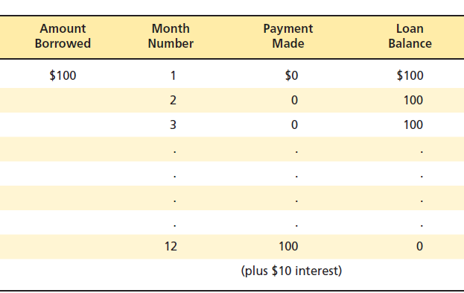
APR
APR is 10%

Slide 37
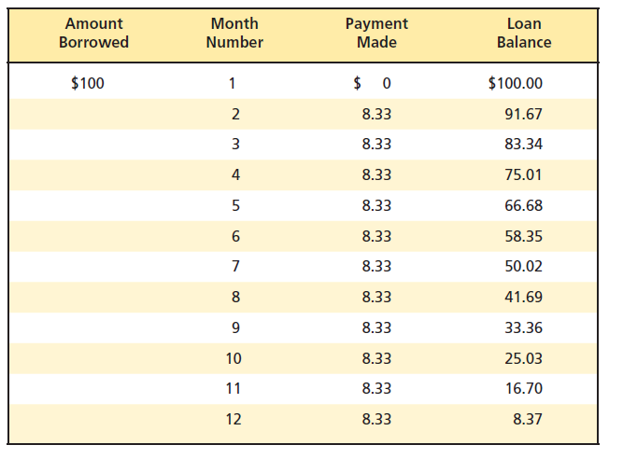

APR
APR here is 18.5% because you pay 10% of 100 but you get to use less than 100 each month. Normally, to approximate the APR is to use the average balance.

Slide 38
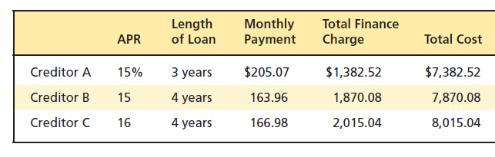
Trade-Offs
Term Versus Interest Costs
  Many people choose longer-term financing because they want smaller monthly payments. But the longer the term for a loan at a given interest rate, the greater the amount you must pay in interest charges.
  Suppose you are buying a USD 7,500 watch and you need to borrow USD 6,000

Slide 39
Trade-Offs
Lender risk versus Interest Rate
You may prefer financing that requires low fixed payments with a large final payment or only a minimum of up-front cash. But both of these requirements can increase your cost of borrowing because they create more risk for your lender.
Variable Interest Rate – based on fluctuating rates in the banking system. With this type of loan, you share the interest rate risks with the lender. Therefore the lender may offer a lower initial interest rate than it would with a fixed-rate loan.
A Secured Loan – If you pledge property as collateral, you’ll probably receive a lower interest rate on your loan.
Up-Front Cash – many lenders believe you have a higher stake in repaying a loan if you pay cash for a large portion of what you are financing. This may reduce the credit cost charged to you.
A Shorter Term – The shorter the period of time for which you borrow, the smaller the chance that something will prevent you from repayment and the lower the risk to the lender.

Slide 40
The Situation
Samantha jones wants to borrow $5,000 to buy a used car. She has several options when it comes to getting a loan, but needs to decide which option id the best in this situation. She has never taken out a loan before and is not certain she will be qualified for a loan.

Slide 41
Inexpensive Loan: A Loan from Her Grandmother
Samantha knows that her grandmother will not charge her very much interest, just enough to cover her own costs.
Samantha is worried that if things go wrong she could ruin her relationship with her grandmother.
Samantha knows this loan will not help her establish a good credit history, since there will be no record of it.

Slide 42
Medium – Priced Loan: A Loan from the Local Credit Union
She knows a loan from a credit union will be a little more expensive but still reasonable.
She knows that if she has payment problems, they will work with her to overcome those problems.
The credit union will offer personalized service on the loan.
Credit unions provide free credit life insurance.
She will begin to establish a good credit history.

Slide 43
Expensive Loan: A Loan from a Finance Company
Samantha knows that a loan from a finance company is likely to have a very high interest rate.
Finance companies often lend to people without an establish credit history, so she should have no trouble getting the loan.
Samantha knows they will also process her credit application quickly, so she can take her car home very soon.

Slide 44
Samantha’s Decision
Samantha decides to apply for a loan with the credit union. She has had saving and checking accounts there since she was a kid. They know her, and she thinks they will be willing to lend her the money. She does not want tot take a chance and ruin the relationship she has with her grandmother and she is not comfortable with the interest rate the finance company will charge her.

Slide 45
The Terms of a Loan
Samantha faces several trade-offs between the terms she wants on the loan and the cost of her loan. The terms often loan will affect the finance charge, as well as the annual percentage rate (APR). If she is willing to take steps to reduce the lender’s risk, then she can reduce the interest rate she will have to pay on the loan.

Slide 46
Variable versus Fixed Rate Interest
If Samantha is willing to take a variable rate loan, then the interest rate on the loan will start out lower. However, Samantha may face higher payments later on if interest rates rise.

Slide 47
A Secured Loan versus an Unsecured Loan
If Samantha is willing to pledge property or other assets as collateral for the loan, then the loan cost will likely be lower. The collateral can be seized by the credit union in the event that Samantha were to default on the loan.

Slide 48
Up-Front Cash
The larger the down payment that Samantha is willing to pay up front in cash for the purchase of her car, the lower the interest rate is likely to be on the loan.

Slide 49
A Shorter Term versus a Longer Term Loan.
Samantha also needs to decide what time period she wants the loan for. A longer time period will make her payments more affordable, but it will mean that she will pay more in total interest charges. If she uses a shorter term loan, then her payments will be higher but the credit union likely to give her a lower interest rate.

Slide 50
Samantha’s choice
Samantha chooses a fixed rate loan, because she does not want her payments to rise over the life of the loan.
Samantha does use the car she is purchasing as collateral for the loan.
Samantha has saved some money and decides to put $1,000 in cash towards the purchase od the car which means she will only borrow $4,000.
Samantha chooses a two-year loan rather than a longer term one.

Slide 51
Calculating the Cost of Credit
Simple Interest
Simple Interest on the Declining Balance
Add-on Interest

Slide 52
Simple Interest
Simple interest is calculated on principal only and without compounding
Interest = Principal x Rate of Interest x Time
= P x r x T
If Samantha wants USD 5,000 loan for 1 year at 5% interest rate, then her total interest will be USD250 (5,000 x 0.05 x 1) since she will have to use the USD 5,000 for the entire year

Slide 53
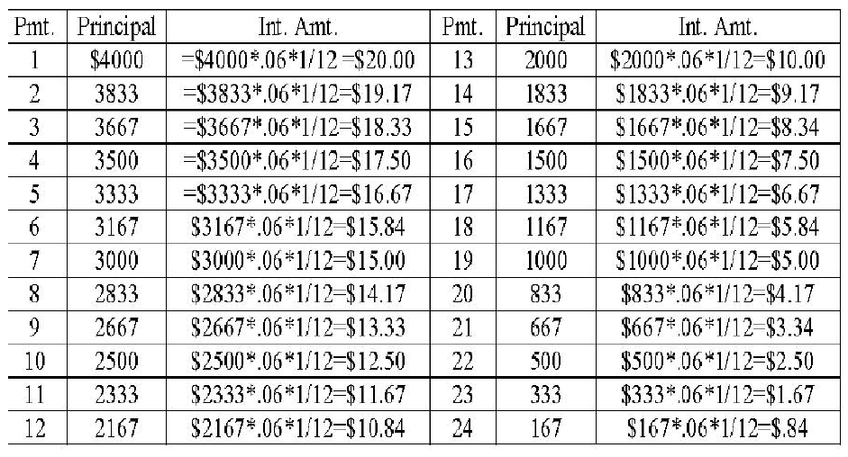
Simple Interest on Declining Balance

Slide 54
Simple Interest on Declining Balance
Samantha will make monthly payments for two years of this loan. If the payment amount is calculated using simple interest on the declining balance. Then each payment includes a different amount of interest. Samantha will pay interest only on the amount of original principal that she has not yet paid. While the annual interest rate on the loan is 6%, this equates to a monthly interest rate of 1/12 of 6%. Therefore, the first payment will be the principal amount of USD 166.67 (USD 4,000 / 24 months) plus the interest owed on the principal left. At this point, the USD 4,000 is the principal left and so the interest portion of the payment is USD 20. The total payment in the first month is therefore USD 187.67. As each payment is made, the amount of principal left goes down by the principal payment and the amount of interest paid is a bit smaller each month.

Slide 55
Add-On Interest
USD 4,000 * 0.6 * 2 = USD 480
(USD 4,000 + USD 480) /24 = USD 186.67
In an add-on interest loan, the interest is based on the full amount of the original principal times the interest rate times the number of years of the loan. This interest amount is then added to the principal and divided by the number of payments. This determines the monthly payment on the loan. In the case of Samantha’s loan, the add-on payment amounts would be USD 186.67 per month. Since the interest is paid on the beginning principal over the life of the loan, the amount of interest pad is high.

Slide 56
Cost of Open-End Credit
Some creditors add finance charges after subtracting payments made during the billing period – this is called the adjusted balance method
Others give you no credit for payments made during the billing period – this is called previous balance method
The fairest method is the average daily balance method – creditors add your balances for each day in the billing period then divide by the number of days in the period. The average daily balance may include or exclude new purchases during the billing period.
Average daily balance method
  Creditors
    1) add your balances for each day in the billing period
    2) divide this total by the number of days in the billing period
    3) multiply this average by the monthly interest rate.

Slide 57
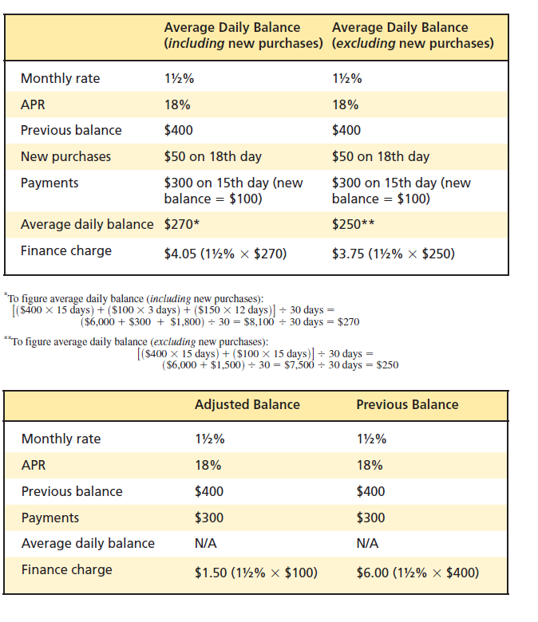
Cost of Open-End Credit

Slide 58
Example
Jack has a credit card with a balance at the beginning of the month of THB 20,000
On the 15th day of the month, Jack purchase THB 5,000 worth of stereo equipment using his credit card
On the 20th day of the month, Jack makes a payment on his credit card of THB 10,000
Jack’s annual interest rate on his credit card is 18%
Jack knows he has incurred a finance charge of THB 250 on his credit card but is not sure how his bank has calculated this finance charge.

Slide 59
Adjusted Balance Method
THB 20,000 – THB 10,000 = THB 10,000
THB 10,000 * .015 = THB 150
The payments that are made during the month are subtracted from the balance at the beginning of the month before finance charges are calculated. Jack’s interest rate is 18% for the year or 1.5% for each month. Therefore, after subtracting out Jack’s payment of THB 10,000 from his beginning balance of THB 20,000, his total finance charge for the month would be THB 150 under this method.

Slide 60
Previous Balance Method
THB 20,000 * .015 = THB 300
Any payments that Jack made are not included. The interest rate is 1.5% for the month, in this case, finance charge would be at THB 300 for the month.

Slide 61
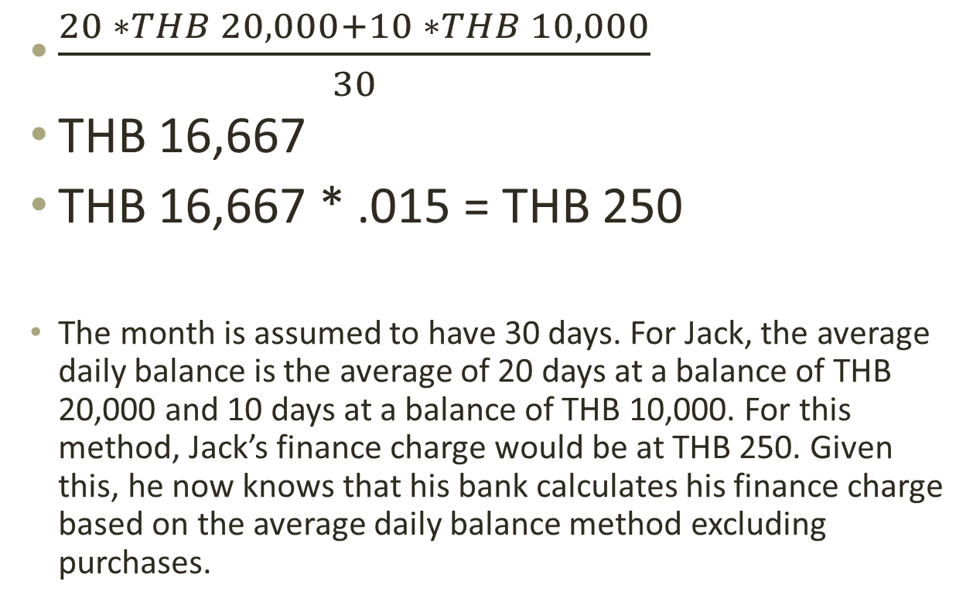
Average Daily Balance (Purchases Excluded)
$\frac{20 ∗THB 20,000+10 ∗THB 10,000}{30}$
THB 16,667
THB 16,667 * .015 = THB 250
The month is assumed to have 30 days. For Jack, the average daily balance is the average of 20 days at a balance of THB 20,000 and 10 days at a balance of THB 10,000. For this method, Jack’s finance charge would be at THB 250. Given this, he now knows that his bank calculates his finance charge based on the average daily balance method excluding purchases.

Slide 62
Avoid the Minimum Monthly Payment Trap
You purchase a USD 2,000 laptop using a credit card with 19 percent interest and a 2 percent minimum payment. If you pay just the minimum every month, it will take you 265 months – over 22 years – to pay off the debt and will cost you nearly USD 4,800 in interest payments. Doubling the amount paid each month to 4% of the balance owed would allow you to shorten the payment time to 88 months from 265 months (7 years as opposed to 22 years). You also save USD 3,680.

Slide 63
Practice
Page 230 on your textbook

Slide 64
Credit Insurance
Credit insurance ensures the repayment of your loan in the event of death, disability, or loss of property. The lender is named the beneficiary and directly receives any payments made on submitted claims.

Slide 65
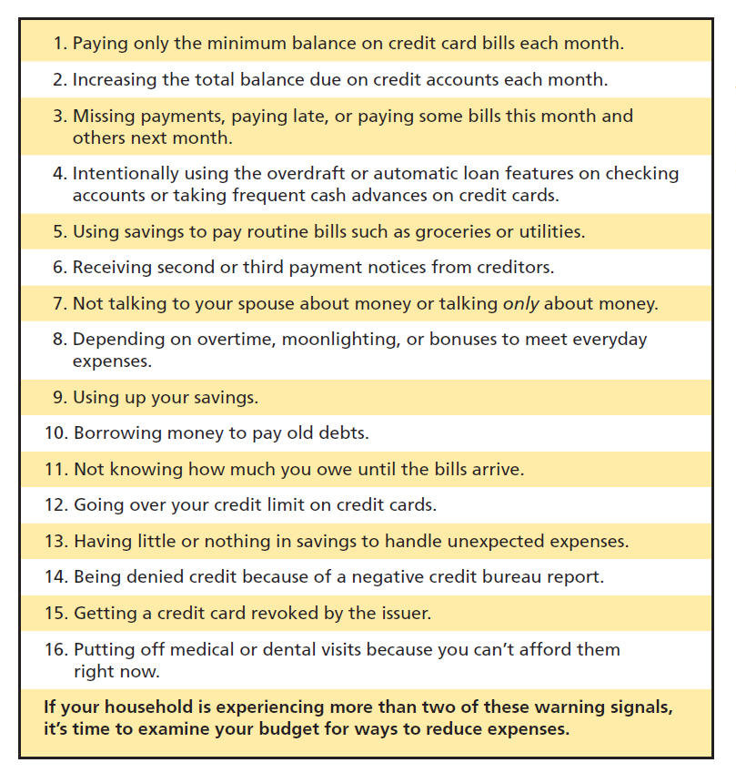
Danger signals of potential debt problems

Slide 66
Managing your Debts:
Reasons for Excessive Debt
Emotional problems
The use of money to punish
The expectation of instant comfort
Keeping up with the neighbors
Overindulgence of children
Misunderstanding or lack of communication

Slide 67
Charlie Smith’s Debt Problems
Charlie Smith has a mortgage on his house of $85,000.
He is leasing a brand new Lexus Convertible and has lease payments of $560 per month.
He has maxed out three credit cards with a total line of credit of $40,000.
He also has borrowed money from the local consumer electronic store to purchase a big screen TV.
Charlie is beginning to think he has a problem with overindebtedness.

Slide 68
Danger Signs of Debt Problems
Paying Only the Minimum Payment on Credit Cards
Missing Payments or Paying Some Bills This Month and Others Next Month
Intentionally Using Overdraft Protection on Checking Account
Using Savings to Pay Routine Bills
Receiving Second or Third Payment Notices Getting A credit Card Revoked by an Issuer
Not talking about Money with Your Spouse
Depending on Overtime to Meet Everyday Expenses
Using up Savings Completely
Borrowing Money to Pay Old Debts
Going Over Credit Limits on Credit Cards
Having Nothing in Saving Handle Emergencies
Putting off Medical Visits Because you can’t afford Them

Slide 69
Thank you

