Slide 1
General Equilibrium and
Economic Efficiency
EE311
Chayun Tantivasadakarn
Faculty of Economics, Thammasat University

Slide 2
Topics to be Discussed
General Equilibrium Analysis
  Efficiency in Exchange
    Equity and Efficiency
    Social welfare function
  Efficiency in Production
  Efficiency in Combination of Product
The Efficiency of Competitive Markets
Why Markets Fail

Slide 3
General Equilibrium Analysis
Up to this point, we have been focused on partial equilibrium analysis
  Activity in one market is has little or no effect on other markets.
Market interrelationships can be important
  Complements and substitutes
  Increase in firms input demand can cause market price of the input and product to rise

Slide 4
General Equilibrium Analysis
To study how markets interrelate, we can use general equilibrium analysis
  Simultaneous determination of the prices and quantities in all relevant markets, taking into account feedback effects.
The feedback effect is the price or quantity adjustment in one market caused by price and quantity adjustments in related markets

Slide 5
Two Interdependent Markets – Movies and DVDs
$1 tax on each movie ticket causes supply to fall
General Equilibrium Analysis:
Increase in movie ticket prices
increases demand for videos.
Price
Price
S*_{M}
S_{M}
S_{V}
$3.50
$6.35
$3.00
$6.00
D’_{V}
D_{M}
D_{V}
Q’_{M}
Q_{M}
Number of
Movie Tickets
Q_{V}
Q’_{V}
Number
of Videos

Slide 6
Two Interdependent Markets – Movies and DVDs
The increase in the price
of videos increases the
demand for movies.
General Equilibrium Analysis:
The Feedback effects continue.
Price
Price
S*_{M}
S_{M}
S_{V}
$6.82
$6.75
$3.58
$3.50
$6.35
D*_{V}
D*_{M}
$3.00
$6.00
D’_{V}
D’_{M}
D_{M}
D_{V}
Q’_{M}
Q”_{M}
Q*_{M}
Q_{M}
Number of
Movie Tickets
Q_{V}
Q’_{V}
Q*_{V}
Number
of Videos

Slide 7
Two Interdependent Markets – Movies and DVDs
Observation
  Without considering the feedback effect with general equilibrium, the impact of the tax would have been underestimated
  This is an important consideration for policy makers.
You can check for yourself that in the market for complements, the tax would be overestimated

Slide 8



General Equilibrium Analysis
General equilibrium in exchange
General equilibrium in production
General Equilibrium in Combination of Product

Slide 9

Efficiency concept
The main objective of general equilibrium analysis is to find the most efficient allocation.
Pareto improvement: an allocation of goods that at least one is made better off without making someone else worse off.
Pareto efficiency: An efficient allocation of goods is one where no one can be made better off without making someone else worse off

Slide 10

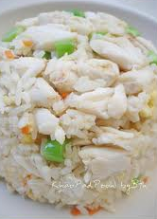
I. General equilibrium in exchange
Assumptions
  Two consumers (countries)
  Two goods
  Both people know each others preferences
  Exchanging goods involves zero transaction costs
  James & Karen have a total of 10 units of food and 6 units of clothing.
  Each may trade to maximize his or her utility
  Their utilities are independent.

Slide 11
General equilibrium in exchange
Individual
Initial Allocation
Trade
Final Allocation
James
7F, 1C
-1F, +1C
6F, 2C
Karen
3F, 5C
+1F, -1C
4F, 4C
To determine if they are better off with trade, we need to know the preferences for food and clothing

Slide 12
The Edgeworth Box Diagram
A diagram showing all possible allocations of either two goods between two people or of two inputs between two production processes is called an Edgeworth Box
The Edgeworth Box diagram come from combining two indifference curves or isoquants diagrams. One is turn 180^{O} to form a box with the dimension of the total endowments.

Slide 13
Exchange in an Edgeworth Box
Karen’s Food
10F
3F
0_{K}
6C
The initial allocation
before trade is A: James
has 7F and 1C & Karen
has 3F and 5C.
James’s
Clothing
Karen’s
Clothing
1C
5C
A
6C
0_{J}
7F
10F
James’s Food

Slide 14
General equilibrium in exchange
Karen has a lot of clothing and little food.
  Suppose MRS of food for clothing is 3
  To get 1 unit of food, she will give up 3 units of clothing ->she likes food more
Suppose James’ MRS of food for clothing is only ½
  He will give up ½ unit if clothing for 1 unit of food ->he likes clothing more

Slide 15
Comparing preferences
C
C
At A: James’ MRS = 1/2
At A: Karen’s MRS = 3
U_{K}¹
5C
A
MRS_{J} = ½
A
1C
MRS_{K} = 3
U_{J}¹
0_{J}
7F
0_{K}
3F

Slide 16
Comparing preferences
C
At A: James’ MRS = 1/2
C
At A: Karen’s MRS = 3
3F
U_{B}¹
0_{B}
C
MRS_{B} = 3
5C
A
MRS_{A} = ½
A
1C
U_{A}¹
MRS_{B} = 3
0_{A}
7F
F
0_{B}
3F

Slide 17
General equilibrium in exchange
The initial allocation A is not efficient
There is room for trade
  James values clothing more than Karen
  Karen values food more than James
  Karen willing to give up 3 units of clothing to get 1 unit of food, but James is willing to take only ½ unit of clothing for 1 unit of food
Actual terms of trade are determined through bargaining
  Trade for 1 unit of food will fall between ½ and 3 units of clothing

Slide 18
Efficiency in Exchange
10F
Karen’s Food
3F
0_{K}
6C
A: U_{J}¹ = U_{K}¹,
but the MRS
is not equal.
All combinations
in the shaded
area are
preferred to A.
Area that both may have gains from trade
James’s
Clothing
MRS_{K} = 3
Karen’s
Clothing
J is better
MRS_{J} = ½
A
1C
U_{J}¹
5C
B is better
U_{K}¹
6C
0_{J}
James’s Food
7F
10F

Slide 19
Exchange that mutually increase welfare
Welfare for both will be improved when:
Both sides want to exchange to achieve highest utilities
Indifference curves have the normal properties; e.g., negative slope, convex to the origin, never cross
More is preferred to less
Independent preferences: welfare of each individual is independent form others

Slide 20
Efficient Allocations
The shaded area between these two indifference curves represents all the possible allocations of food and clothing that would make both James and Karen better off than A
  Describes all mutually beneficial trades
  or all Pareto improvement from A
The allocation of resources will be optimal when MRS of every one is the same

Slide 21
Efficiency in Exchange
10F
Karen’s Food
0_{K}
6C
D is also a possible efficient allocation depending on bargaining
Point B is on higher IC but is not efficient
D
James’s
Clothing
Karen’s
Clothing
C
At point C, MRSs are equal and allocation is efficient
B
U_{J}³
A
U_{J}²
U_{K}³
U_{J}¹
U_{K}²
U_{K}¹
6C
0_{J}
James’s Food
10F

Slide 22


Efficient Allocations
We can see both parties are better off at point B since they both end up on a higher indifference curve
  Not efficient since MRSs different – indifference curve have different slopes
Although a trade might make both parties better off, the new allocation is not necessarily efficient

Slide 23
Efficient Allocations
How do these parties reach an efficient allocation?
  When there is no more room for trade
  When their MRSs are equal
  They will keep trading, reaching higher indifference curves, until they can no longer do so and still make each better off
  This is when indifference curves are tangent – they have the same slope and same MRS

Slide 24


The Contract Curve
Karen’s Food
0_{K}
E, F, & G are
Pareto efficient .
Contract
Curve
G
James’s
Clothing
F
Karen’s
Clothing
E
A
0_{J}
James’s Food

Slide 25
Contract curve
All points of tangency between the indifference curves are efficient.
  MRS of individuals is the same
  No more room for trade
The contract curve shows all allocations that are Pareto efficient.
  Pareto efficient allocation occurs when further trade will make someone worse off.

Slide 26
Consumer Equilibrium in a Competitive Market
Assumptions
There are many Jameses and Karens.
They are price takers
Assuming that the relative price of food and clothing = 1
  Trade depends on relative prices, not actual prices

Slide 27
Consumer Equilibrium in a Competitive Market
C_{J}
C_{K}
U_{J}²
U_{J}³
J’s Offer Curve
P
P
U_{K}³
U_{K}²
C
A
-2
K’s Offer Curve
+2
C
U_{J}¹
A
U_{K}¹
P/
P/
-2
F_{J}
+2
F_{K}

Slide 28
Consumer Equilibrium in a Competitive Market
We can show opportunities for trade for many consumers
  When prices of food and clothing are equal, we can show the price line, PP/ with a slope of –1
    Shows all possible allocations that exchange can achieve
  James buys 2 clothing for 2 food: A to C
  Karen buys 2 food for 2 clothing: A to C
  Both increase satisfaction

Slide 29
เส้นเสนอ (Offer Curve)
C_{J}
C_{K}
U_{J}¹
U_{J}²
J’s Offer Curve
P
U_{K}²
P
U_{K}¹
E
J
J
K’s Offer Curve
E
P/
P/
F_{J}
F_{K}

Slide 30
Consumer Equilibrium in a Competitive Market
10F
Karen’s Food
0_{K}
6C
Price Line
Begin at A:
Each James buys 2C and sells 2F
moving from U_{J}¹ to U_{J}³, which
is preferred (A to C).
Begin at A:
Each Karen buys 2F and sells 2C moving from
U_{K}¹ to U_{K}³, which
is preferred (A to C).
P
C
Karen’s
Clothing
+2
James’s
Clothing
-2
+2
U_{J}³
A
U_{J}¹
U_{K}³
U_{K}¹
P/
6C
0_{J}
-2
10F
James’s Food

Slide 31
Consumer Equilibrium in a Competitive Market
The amount of clothing that Karen wanted to sell is equal to the amount of clothing that James wanted to buy
An equilibrium is a set of prices at which the quantity demanded equals the quantity supplied in every market
  Also called competitive equilibrium
If the relative price is 1/3, there will be an excess supply of cloths and an excess demand for food
  Price of Food will increase and price of cloth will decrease

Slide 32
Economic Efficiency of Competitive Markets
As shown before, we can see that the allocation in a competitive equilibrium is economically efficient
  The efficient point must occur where the two indifference curves are tangent
  If not, one of the consumers can increase their utility and be better off

Slide 33
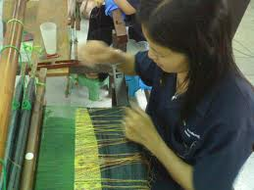
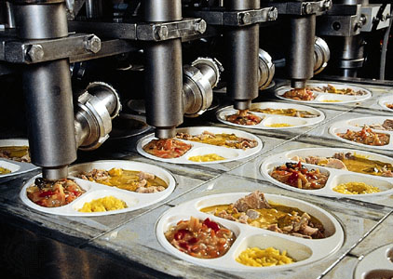
II. General equilibrium in in Production
Using the Edgeworth box diagram, we can show efficient use of inputs in production
  Two fixed inputs: capital and labor
  Produce same two goods: food and clothing
  Labor on horizontal axis
  Capital on vertical axis
  50 hours of labor and 30 hours of capital available
  Each origin is an output

Slide 34
Production in an Edgeworth Box
Labor in Clothing Production
50L
15L
0_{C}
30K
The initial allocation is A.
Every combination of labor and capital used to produce two goods is represented as point in box
Capital in Clothing Production
Capital in Food Production
5K
25K
A
30K
0_{F}
35L
50L
Labor in Food Production

Slide 35
Edgeworth Box สำหรับการผลิต
At the same relative factor price, C uses K/L ratio higher than F
C is a capital intensive good; while F is a labor intensive good
K
K_{C} / L_{C}
Slope = w/r
K_{C}
K_{F} / L_{F}
K_{F}
C
F
L_{C}
L_{F}
L
O

Slide 36
Production in an Edgeworth Box
Labor in Clothing Production
50L
15L
0_{C}
30K
100F
D
Capital in Clothing Production
80F
Capital in Food Production
25C
10C
30C
C
B
A
60F
5K
25K
50F
50C
30K
0_{F}
35L
50L
Labor in Food Production

Slide 37
Production in an Edgeworth Box
To find efficient production, must find different combinations of inputs used to produce the two outputs
An allocation of inputs is technically efficient if the output of one good cannot be increased without decreasing the output of another goods
Production at point A is inefficient since we can increase production of both goods.
  Shaded area indicates increases in production of both goods if begin at A

Slide 38
Production in an Edgeworth Box
Points B and C are efficient allocations and therefore lie on the production contract curve
  Curve showing all technically efficient combinations of inputs.
  Curve connects the origins, O_{F} and O_{C}
  All points on curve are tangencies between two isoquants

Slide 39
Production in an Edgeworth Box
Labor in Clothing Production
50L
15L
0_{C}
30K
Production Contract Curve
D
Capital in Clothing Production
80F
Capital in Food Production
25C
10C
30C
C
B
A
60F
5K
25K
50F
30K
0_{F}
35L
50L
Labor in Food Production

Slide 40
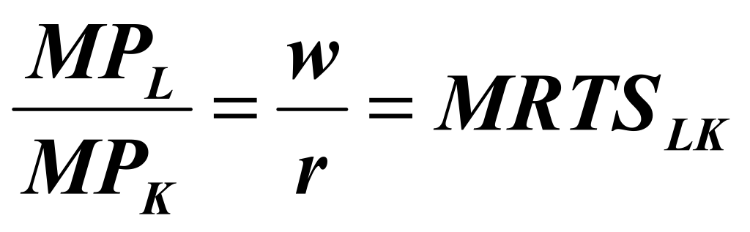
Producer Equilibrium – Competitive Input Markets
If input markets are competitive, an efficient point will be achieved
In competitive input markets
  Wage rate, w, will be equal in all industries
  Rental rate of capital, r, will be equal in all industries
To minimize cost, each firm will mix inputs until

Slide 41
Production Possibilities Curve (PPC)
PPC shows the various combinations of two goods that can be produced with fixed quantities of inputs.
PPC is derived from the production contract curve
Points on PPC show efficiently produced levels of both goods
Points underneath the PPC show inefficient combination of inputs or under utilization of resources

Slide 42
Production Possibilities Curve
100F
C
50L
O_{C}
30K
50
D
30
M
H
25C
80F
30C
G
10C
G
25
M
D
60F
10
H
50F
50C
30K
F
O_{F}
50L
50
60
100
80
Q: If both goods have the same factor intensity, what should be the shape of PCC ?

Slide 43
Production Possibilities Curve
PPC is downward sloping
  In order to produce more of one good, must give up producing some of the other good
PPC is concave
  Slope is the MRT which increases as the level of production of food increases
  The inputs release from one good do not fit the input intensity of the other good
  Capital-intensive C releases more K and less L than what Labor-intensive F needs

Slide 44
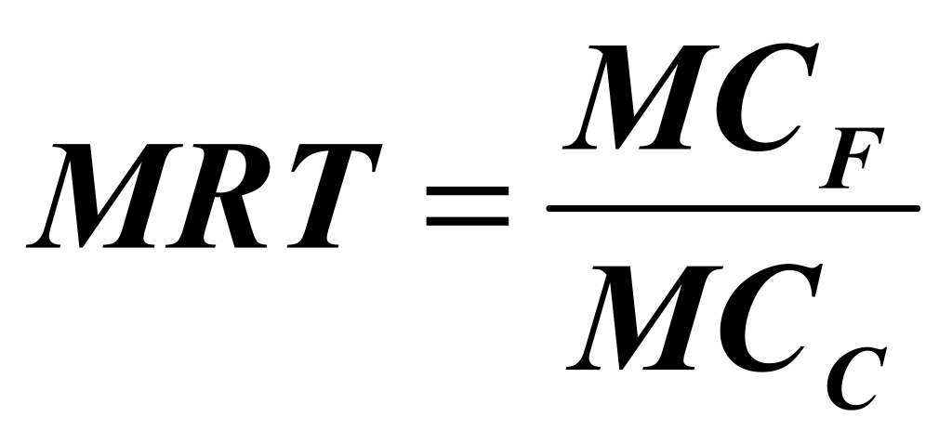
Marginal Rate of Transformation
Marginal rate of transformation (MRT) of food for clothing is the magnitude of the slope of the frontier at each point
  How much clothing must be given up to produce one additional unit of food
  As we increase the production of food my moving along the PPC, the MRT increases
  It is possible to prove that MRT is the ratio of MCs

Slide 45
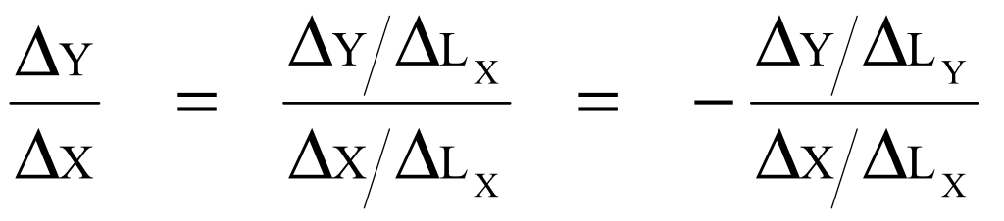
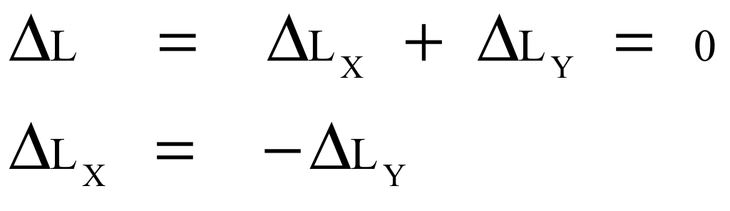
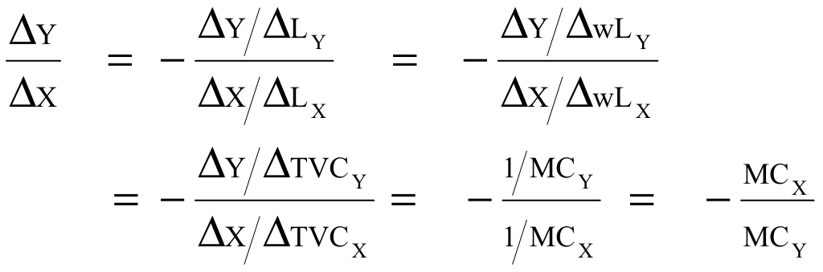
Marginal Rate of Transformation
MRT =
The last term is true because L = L_{X} + L_{Y}. Thus,

Slide 46
III. General equilibrium in Combination of Product
For efficiency,
  Good produced at minimum cost
  Must be produced in combinations that match peoples willingness to pay
  MRS = consumer’s WTP for additional food by consuming less clothing
  MRT = cost of additional unit of food in terms of producing less clothing
Efficiency means MRS = MRT

Slide 47
Combination of Product Efficiency
What if MRT < > MRS
  Suppose MRT = 1 and MRS =2
  Consumer willing to give up 2 units of clothing to get 1 unit of food
  Cost of getting additional food is only 1 unit of lost clothing
  Too little food is being produced
  Food production must increase, MRS falls and MRT increase until two are equal again

Slide 48
Combination of Product Efficiency
Clothing(units)
MRS = MRT = P_{F}/P_{C}
A
60
C*
E
CIC₂
CIC₁
100
Food (units)
F*

Slide 49
Combination of Product Efficiency
From the equilibrium point E, construct an Edgeworth Box for exchange from F*, C*
There must be at least one allocation such as at point T that is Pareto efficient and has the same price ratio as point E
Clothing(units)
MRS = MRT = P_{F}/P_{C}
60
PPF
E = O_{K}
C*
CIC
T
P_{F}/P_{C}
O_{J}
F*
100
Food (units)

Slide 50

Combination of Product Efficiency
In the competitive markets, all consumers allocate his or her budget between the two goods such that MRS = P_{F}/P_{C}
Firms maximize profits at the point where P = MC, which cause MRT = MC_{F}/MC_{C} = P_{F}/P_{C}

Slide 51
Overview – Efficiency of Competitive Markets
Efficiency in Exchange
  MRS^{J}_{FC} = MRS^{K}_{FC}
  MRS^{J}_{FC} = P_{F}/P_{C} = MRS^{K}_{FC}
Efficiency in the use of inputs in production
  MRTS^{F}_{LK} = MRTS^{C}_{LK}
  MRTS^{F}_{LK} = w/r = MRTS^{C}_{LK}

Slide 52
Overview – Efficiency of Competitive Markets
Efficiency in the combination of output
  MRT_{FC} = MRS_{FC} (for all consumers)
  P_{F} = MC_{F}, P_{C} = MC_{C} resulting in
  MRT_{FC} = MC_{F}/MC_{C} = P_{F}/P_{C}; therefore
  MRS_{FC} = MRT_{FC}

Slide 53
Welfare economics
First Theorem of Welfare Economics
  If everyone trades in a competitive market place, all mutually beneficial trades will be completed and the resulting equilibrium allocation of resources will be economically efficient
  Welfare economics involves the normative evaluation of markets and economic policy

Slide 54
Equity and Efficiency
Although there are many efficient allocations, some may be more fair than others
The difficult question is what is the most equitable allocation?
We can show that there is no reason to believe that efficient allocation from competitive markets will give an equitable allocation
Example: Point B is more equitable than point E

Slide 55
Equity and Efficiency
Karen’s Food
0_{K}
E, F, & G are
Pareto efficient .
Contract
Curve
G
B
James’s
Clothing
Karen’s
Clothing
F
E
A
0_{J}
James’s Food

Slide 56
Equity and Efficiency
From previous example, we can see that an inefficient allocation might be more equitable than an efficient one.
But how do we define an equitable allocation?
  It depends on what we believe equity to entail
  Requires interpersonal comparisons of utility

Slide 57
Equity and Perfect Competition
A competitive equilibrium can occur at any point on the contract curve depending on the initial allocation.
Since not all competitive equilibriums are equitable, we rely on the government to help reach equity by redistributing income.
  Taxes
  Pubic services

Slide 58
Equity and Perfect Competition
Must a society that wants to be more equitable necessarily operate in an inefficient world?
Second Theorem of Welfare Economics: If individual preferences are convex, then every efficient allocation (every point on the contract curve) is a competitive equilibrium for some initial allocation of goods.
  Any equilibrium that is equitable can be achieved by redistributing resources and may be efficient.

Slide 59
Equity and Efficiency
Tax Karen = EH and transfer it to James. Competitive market will lead to point F which is more equitable than point E and still Pareto efficient.
Karen’s Food
0_{K}
Contract
Curve
G
James’s
Clothing
Karen’s
Clothing
F
E
H
0_{J}
James’s Food

Slide 60
Kaldor-Hicks efficiency
Kaldor–Hicks criterion, is a measure of economic efficiency that captures the intuitive appeal of Pareto efficiency, but has less stringent criteria and is hence applicable to more circumstances.
Kaldor–Hicks efficiency: an outcome is considered more efficient if a Pareto optimal outcome can be reached by arranging sufficient compensation from those that are made better off to those that are made worse off so that all would end up no worse off than before.

Slide 61
Equity and Perfect Competition
Any equilibrium that is equitable can be achieved by redistributing resources and may be efficient
Typical ways to redistribute goods, however, are costly
  Taxes lead to bad incentives
    Firms devote fewer resources to avoid taxes
    Encourage individuals to work less

Slide 62
Social Welfare Functions
Weights are often applied to individual’s utility to determine what is socially desirable.
  How these weights are applied comes from the social welfare functions
The utilitarian function weights everyone’s utility to maximize utility for the whole society
W_{u} = w₁u₁ + w₂u₂ + …. + w_{n}u_{n}

Slide 63
Social Welfare Functions
Each social welfare function is associated with a particular view of equity
Some views of equity do not assign weights and cannot be represented by a welfare function
  Some economists believe that competitive market process is equitable because it rewards those who are most able and work hardest
  Believes competitive equilibrium would be most equitable

Slide 64
Social Welfare Functions
The Rawlsian view: individuals don’t know what their endowment will be
Rawls argues that if you don’t know your own fate, you will opt for the system in which the least well-off person is treated reasonably well.
The most equitable allocation maximizes the utility of the least well-off person in society

Slide 65
Social Welfare Functions
An egalitarian view believes that goods should be equally shared by all individuals in society
Could have situation where reward more productive people thereby producing more goods and then having more to reallocate to all of society

Slide 66
Four Views of Equity
All members of society receive equal amount of goods
Egalitarian
Maximize the utility of the least-well-off person
Rawlsian
Maximize the total utility of all members of society
Utilitarian
Market - Oriented
The market outcome is the most equitable

Slide 67
Why Markets Fail
Market Power
  Those with market power choose the price and quantity
  Less output is sold than in competitive markets
  Inefficiency
  Can have market power as producers or as inputs

Slide 68
Why Markets Fail
Incomplete Information
  Consumers must have accurate information about market prices or production quality for markets to operate efficiency
  Lack of information can change supply
    Buy products with no value
    Don’t buy enough of products with value
  Some markets may never develop

Slide 69
Why Markets Fail
Externalities
  Market prices do not always reflect the activities of either producers or consumers
  Consumption or production has indirect effect on other consumption or production not reflected in market prices
  May be impossible to get insurance because suppliers of insurance lack information

Slide 70
Why Markets Fail
Public Goods
  Nonexclusive, nonrival good that can be made available cheaply but which, once available, is difficult to prevent others from consuming
  Company thinking about researching a new technology if can’t get patent
    Once it’s made pubic, others can duplicate it

