Slide 1
FN 221: Personal Finance
Thanachote Rungsitivat, CFA, FRM

Slide 2
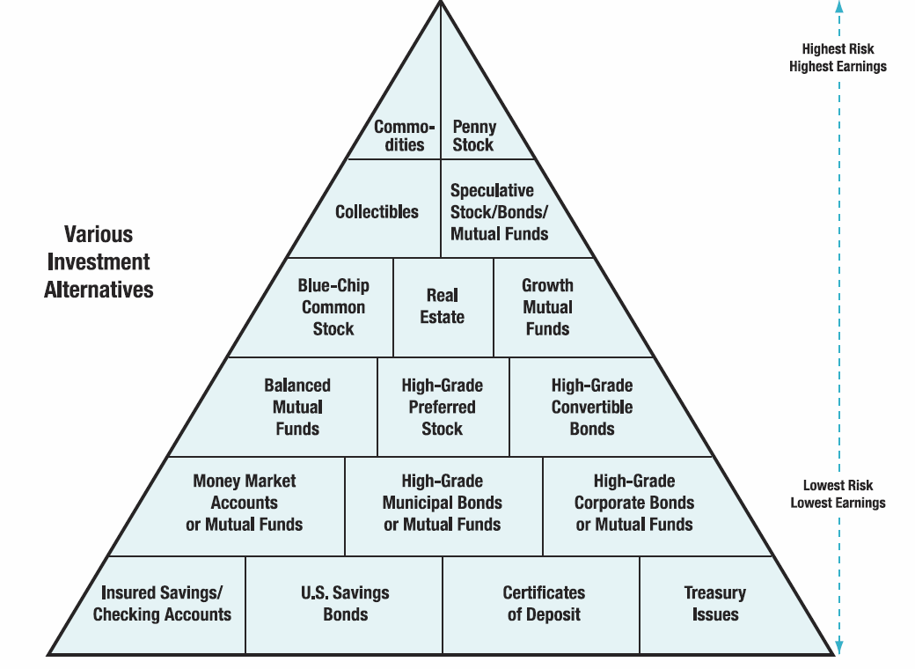
Notes:
http://hsfpp.nefe.org/instructors/channels.cfm?chid=88&tid=1&deptid=22
NEFE Unit 3 Student Guide

Slide 3
Real Estate Investment
Identify types of real estate investments
Evaluate the advantages of real estate investments
Asses the disadvantages of real estate investments
Analyze the risks and rewards of investing in precious metals, gems, and collectibles

Slide 4
Investing in Real Estate
Objective 1: Identify types of real estate investments
Direct Real Estate Investments
  As the investor, you hold legal title to the property
  Your home as an investment
    A place to live
    A major asset of most households

Slide 5
Investing in Real Estate
(continued)
Direct Real Estate Investments (continued)
  Shelter income from taxes if you have a large mortgage - interest is deductible
  Possible hedge against inflation. Be aware of possible real estate “bubbles”

Slide 6
Investing in Real Estate
(continued)
Your vacation home
  Tax advantages
  Primary reason to own a vacation home is because you want to use it

Slide 7

Investing in Real Estate
(continued)
Commercial property
  Land and buildings that produce lease or rental income
  Most common investment of this type is a duplex or small apartment building. It also includes hotels, office buildings, stores, and many other types of commercial establishments

Slide 8

Investing in Real Estate
(continued)
  Will income be greater than expenses?
  Tax deductions, such as depreciation and property taxes are limited to the amount of rental income you receive
    Passive activities and passive losses

Slide 9

Investing in Real Estate
(continued)
Undeveloped land
  Can be tremendous gains but this type of investment poses enormous risks. All the money is riding on a single parcel of land
  Most people buy land with the idea of subdividing the land

Slide 10
Investing in Real Estate
(continued)
Indirect Real Estate Investments
  Real estate syndicates or limited partnerships
    A syndicate is a temporary association of individuals or firms organized to perform a specific task that takes a large amount of capital. Can be organized as a corporation, trust, or limited partnership
    Provide professional management and limited liability for its members, and diversification, if several properties are owned

Slide 11

Investing in Real Estate
(continued)
Limited partnerships
  A limited partnership has a general partner who has unlimited liability and sells participation units to the limited partners. The partner’s liability is limited to the extent of their initial investment, such as $5,000 or $10,000

Slide 12
Investing in Real Estate
(continued)
Real estate investment trusts (REIT)
  REITs are similar to a mutual fund or investment company and trade shares on stock exchanges or over the counter.
  Equity REITs own and operate income-producing properties; Mortgage REITs loan money or invest in mortgages; Hybrid REITS own both properties and mortgages

Slide 13
Investing in Real Estate
(continued)
Investing in First and Second Mortgages
Participation certificates
    A risk-proof real estate investment
    Equity investment in a pool of mortgages that have been purchased by one of several government agencies, such as Ginnie Mae and Freddie Mac

Slide 14

Advantages of
Real Estate Investments
Objective 2: Evaluate the advantages of real estate investments
A possible hedge against inflation
Easy entry as a limited partner, such as investing $5,000 to own part of an apartment building

Slide 15

Advantages of
Real Estate Investments (continued)
Limited financial liability— limited partners
No management concerns - REITs, mortgages
Financial leverage
  Use of borrowed funds for investment purposes, allows you to acquire a more expensive property than you could buy on your own

Slide 16
Disadvantages of
Real Estate Investments
Objective 3: Asses the disadvantages of real estate investments
Illiquidity
Declining property values
Lack of diversification
Lack of a tax shelter for real estate syndicates
Long depreciation period
Management problems—direct real estate

Slide 17

Investing in Precious Metals, Gems, and Collections
Objective 4: Analyze the risks and rewards of investing in precious metals, gems, and collectibles
A hedge against inflation
A safe haven during political or economic upheaval
Need a storage place

Slide 18

Investing in Precious Metals, Gems, and Collections (continued)
Can be risky due to price variations
Gold - lower interest rates often result in higher gold prices
  Bouillon - bars and wafers
  Gold bouillon coins
  Gold stocks
  Gold certificates

Slide 19
Investing in Precious Metals, Gems, and Collections (continued)
Silver, platinum, palladium and rhodium
  Silver prices have fluctuated from $24.25 an ounce in 1932, to over $50 an ounce in early 1980, and then back to less than $18.49 an ounce in June 2010.
  The last three are industrial catalysts, used mostly in automobile production
  Can be both a hedge against inflation and a safe haven during political or economic upheavals

Slide 20

Investing in Precious Metals, Gems, and Collections (continued)
Precious Stones
  Precious stones like diamonds, sapphires, rubies, and emeralds can be a hedge against inflation
  Appeal to investors because of their small size, ease of concealment, inflation hedge, and great durability

Slide 21

Investing in Precious Metals, Gems, and Collections (continued)
Risks include..
  Not easily turned into cash
  Difficult to know if you are getting a good stone
  De Beer’s controls 85% of the world’s supply of rough diamonds
  Expect to buy at retail and sell at wholesale

Slide 22
Investing in Precious Metals, Gems, and Collections (continued)
Collectibles
  Includes rare coins, works of art, antiques, stamps, rare books, sports memorabilia, rugs, Chinese ceramics, paintings and other items that appeal to collectors and investors
  Can be a good investment and a hobby, or a financial disaster
  It’s “buyer beware.” Be careful of investment scams and forgeries
  Know dealer’s reputation and be wary of promises. Get a second opinion
  Use common sense & comparison shop

Slide 23
Investing in Precious Metals, Gems, and Collections (continued)
Collectibles on the Net
  Easier to compare items
  Easier to find items
  The number of collectibles websites is growing very rapidly - eBay is the biggest auction site

Slide 24
Investing in Precious Metals, Gems, and Collections (continued)
Disadvantages of purchasing collectibles over the internet.
  You can’t touch and feel the item and examine it for flaws
  There may also be some security risk since you don’t know who’s getting your cash or credit card number

Slide 25
Derivatives
TFEX
http://www.tfex.co.th/en/education/knowledge.html
Use for Risk Management/Risk Taking (high risk)

Slide 26
Appendix
http://www.tsi-thailand.org/images/stories/TSI2012_Investor/Download/goldfuturessilverfutures_8june2013.pdf

Slide 27
Understand Portfolio Rebalancing
What is portfolio rebalancing?
  The process of bringing portfolios back into given target asset allocation ratios
What causes the need to rebalance?
  Changes occur due to:
    Changes in asset class performance
    Changes in investor objectives or risk
    Introduction of new capital
    Introduction of new asset classes

Slide 28
Portfolio Rebalancing
Why is this rebalancing so critical?
  There are competing principles:
    Minimize transactions costs and taxes
    Minimize tracking error at your risk tolerance level
What is tracking error?
  It is the return that is lost from your portfolio being different from your target weight
What are the different ways of rebalancing?
  Periodic-based (or calendar-based)
  Percent-range-based (or volatility-based)

Slide 29
Portfolio Rebalancing
Periodic-based rebalancing
  Specify a time period, i.e. bi-annually, annually, etc. After each time period, rebalance the portfolio back to your original asset allocation targets
  Advantages
    Most simple of the methods
    Longer periods have lower transactions and tax costs (but higher tracking error costs)
  Disadvantages
    Independent of market performance
    Performance will depend on relative timing of large market moves and rebalancing

Slide 30
Portfolio Rebalancing (continued)
Percent-range-based rebalancing
  Rebalance the portfolio every time actual holdings are +/-5% (or +/-10%) from target ratios. Rebalance whenever you are outside this range
  Advantages
    Easy to implement
    Wider ranges will reduce transactions costs (at the expense of higher tracking error)
    Asset performance will trigger rebalancing
  Disadvantages
    Setting an effective range is difficult
    Assets with higher target ranges and volatility will generate most rebalances

Slide 31
Management and Evaluation
What factors lead to above-benchmark or excess returns?
  1. Superior asset allocation
    Shifting assets between a poor-performing asset class and a better performing asset class, i.e. between large cap to international or small cap
  2. Superior stock selection
    Picking sectors, industries, or companies within a specified benchmark which, as a whole, outperform the return on the specified benchmark

Slide 32
Management and Evaluation
What is superior asset allocation?
  The process where the investor gains a higher return than the benchmark from adjusting the investment portfolio for movements in the market
    The investor shifts among stocks, bonds and other asset classes based on their expectations for returns from each of the asset classes
What are the results?
  Done well, superior asset allocation yields higher returns with lower risk.
  Done poorly, it yields lower returns, higher transactions costs, and higher taxes
Notes:
3

Slide 33
Management and Evaluation
What is superior stock selection?
  The process where the investor builds an investment portfolio which earns returns in excess of the benchmark through buying or selling undervalued stocks, sectors or industries
    The investor shifts among the various securities of the index in an attempt to buy the securities with the highest growth potential
What are the results?
  Done well, superior selection yields higher returns with lower risk.
  Done poorly, it yields lower returns, high transactions costs, and high taxes
Notes:
8

Slide 34
Management and Evaluation
What is portfolio evaluation?
  The process of monitoring financial asset performance, comparing asset performance to the relevant benchmarks, and determining how well the fund is meeting its objectives.
    If the assets are underperforming benchmarks, the investor may sell underperforming assets and purchase other assets which would more closely align asset performance with benchmarks

Slide 35
Management and Evaluation
Why monitor performance?
  Unless you monitor performance, you will not know how you are doing in working toward accomplishing your objectives
  You need to know how every asset you own is performing, and performing versus its benchmark, so you can determine how well you are moving toward your goals

Slide 36
Management and Evaluation
How do you evaluate performance?
  Calculate:
    1. The period return on each owned asset
    2. The period index return for each benchmark
    3. The difference between the asset return and benchmark return
    4. The weight of each asset or portfolio in the overall portfolio
    5. The overall portfolio return
  With this information, you can know how each asset is performing versus its benchmark, and how well the portfolio is moving toward its objectives

Slide 37
Management and Evaluation
What is portfolio reporting?
  The process of reviewing portfolio performance with the necessary participants, i.e. your spouse
    If you are managing your portfolio, you should report performance to your spouse at least monthly or quarterly
    If others are helping you manage your portfolio, they should report performance to you and your spouse at least quarterly as well.
  Be careful not to do too much buying and selling, as these incur transactions costs and taxes

Slide 38
Thank you

