Slide 1
Thinking, Language, Intelligence
PY200/ PY211

Slide 2
Agenda
Thinking
  What is thinking?
  Building blocks of thinking: Concept
Problem Solving
  What is it?
Problem Solving strategies
  Trial and Error
  Algorithms
  Heuristics
Factors that effect problem solving
  Expertise
  Mental sets
  Insight
  Incubation
  Functional fixedness
Notes:
The cognitive approach is one method of studying how we process, store, and use information and how this information in turn influences what we notice perceive learn remember believe and feel

Slide 3
Cognitive process
Key assets for our human survival
Cognition: mental activity involved in understanding, processing and communicating information

Slide 4
Thinking: What does it mean?
Thinking (cognition) - mental activity that goes on in the brain when a person is organizing and attempting to understand information and communicating information to others.
Thinking means
  attending to information,
  representing it mentally,
  reasoning about it, and
  making judgements and decisions about it
Conscious, planned attempts to make sense of the world and change it.

Slide 5
Thinking and Mental Images
Mental images - mental representations that stand for objects or events and have a picture-like quality.
Representations in the mind of an object or event
  Not just visual representation
  Every sensory modality produces corresponding mental images
  Mental images have properties of the actual stimuli they represent
  Production of mental images improves various skills
    Example: Athletic training
Notes:
Our ability to hear a tune in our heads also relies on a mental image

Slide 6
Cognitive Psychologists
Thinking involves a number of mental activities, which are listed below. Cognitive psychologists study these in great detail.
Concepts
Problem solving
Decision making
Judgment formation

Slide 7

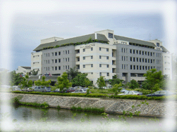
Building blocks of Thinking
Concept: A mental category that is used to class together objects, relations, events, abstractions, or qualities that have some common properties
Prototypes: A concept of a category of objects or events that serves as a good example of a category. (Best example)
Exemplars: Specific examples
Notes:
Once we place an item in a category our memory shifts toward the prototype
Concept: a mental grouping of similar objects, events, or people

Slide 8
Development of Concepts
Examplar Model
You form a concept of an object, event, animal, or person by defining or making a mental list of the essential characteristics of a particular thing
Dog → learning its essential characteristics → concepts
It barks, has long nose, 2 ears, 2 eyes, 4 legs, some hair, has a tail
Mental definition → sorted through all animal definitions until you find one that included the essential properties of a dog
We form some concepts with definitions

Slide 9
Fruit/ Vegetable
Orange
Apple
Peach
Cucumber
Potato
Strawberry
Watermelon
Asparagus
Pumpkin
Lettuce
Lemon
Celery
Tomato
Cabbage
Carrot
Onion
Mushroom
Grape

Slide 10
Problems with Examplar Model
Too many feature
It is very difficult to list all the features that define any object
If the list of features to define a fruit was not complete the list might also apply to vegetable
If your list of feature to define a fruit included every possible feature, such a mental list would be complete but take so long to go through → slow to use & need memory
Too many exceptions
A list defining feature & list all the exceptions

Slide 11
Development of Concepts
Prototype Theory
You form a concept by creating a mental image that is based on the average characteristics of an object.
This average looking is called a “prototype”
To identify a new object you match it to one of your already formed prototyped of objects, people, or animals
Average features – do not have to make a mental list of all the defining features of the object
Quick recognition – the more new object resembles a prototype the more quickly you can identify (the less it matches your prototype, the longer it takes)

Slide 12
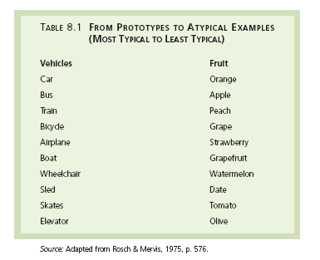

Slide 13
Learning Concepts
Children develop many concepts or categories by experiencing or interacting with objects and things in the environment.
Many simple prototypes (dog, red) are taught by examplars (specific examples)
  We learn from experience with examplars rather than working definitions
  Positive instances: examples of the concept (this is a dog)
  Negative instances: examples of what is not the concept (this is not a dog)
  Overextension: overinclusion of instances in a category (references to horses as dogs)
Abstract concepts tend to be formed through explanations
A child’s ability to form and develop concepts is helped not only by having a stimulating environment but also how the brain is organised

Slide 14
Functions of Concepts
Organise information
  Allow you to group things into categories and thus better organize and store information in memory
Avoid relearning
  Concepts can be used to classify and categorized things
  You can easily classify new things without having to relearn what each thing is
Some forms of brain damage destroy a person’s ability to form concepts, so that the person is unable to name or categorize what he or she sees → visual agnosia

Slide 15
Problem Solving

Slide 16
  What is Problem Solving?
  Using the thoughts and actions to move from the current state to the goal state, in other words achieving a desired goal that is not readily attainable, often by devising strategies to overcome obstacles
Problem solving - process of cognition that occurs when a goal must be reached by thinking and behaving in certain ways.
Notes:
Problem solving involves searching for some rule, plan, or stategy that results in our reaching a certain goal that is currently out of reach

Slide 17
Understanding the problems
The parts or elements of our mental representation of the problem relate to one another in a meaningful way (shapes)
The elements of our mental representation of the problem correspond to the elements of the problem in the outer world
We have a storehouse of background knowledge that we can apply to the problem
Notes:
One of the requirements of problem solving is attending to relevant information
How can we know which information is relevant or not?
Background experience and knowledge

Slide 18
Problem Solving
Problem solving strategies include:
Trial and Error
Algorithms
Heuristics
Notes:
Preview Question 2: What strategies assist problem solving, and what obstacles hinder it?

Slide 19
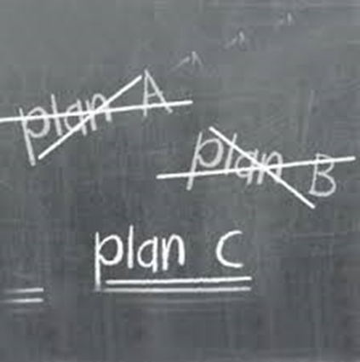
Trial and Error
An approach to problem solving in which one solution after another is tried in no particular order until the answer is found
Used when we have little or no knowledge relevant to the problem

Slide 20
Algorithms
Algorithms, which are very time consuming, exhaust all possibilities before arriving at a solution. Computers use algorithms.
S P L O Y O C H Y G
If we were to unscramble these letters to form a word
using an algorithmic approach, we would face
907,200 possibilities.
Algorithms = Specific procedure for solving a type of problem
  Yield correct answers if the right formula is used. Any math formula is an example of Algorithm
Notes:
very specific, step-by-step procedures for solving certain types of problems.
Algorithms: systematic procedures for solving a problem that works invariably when it is applied correctly (ex- Google)
Anagrams
a rule that, if applied appropriately, guarantees a solution to a problem

Slide 21
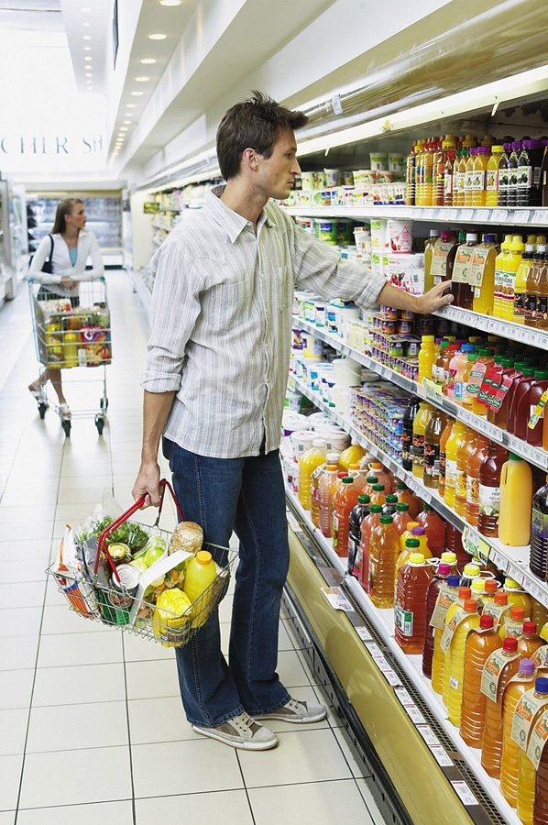
Heuristics
Heuristics are simple, thinking strategies that allow us to make judgments and solve problems efficiently. Heuristics are less time consuming, but more error-prone than algorithms.
B2M Productions/Digital Version/Getty Images
Notes:
an educated guess based on prior experiences that helps narrow down the possible solutions for a problem. Also known as a “rule of thumb.”
Means–end analysis - heuristic in which the difference between the starting situation and the goal is determined and then steps are taken to reduce that difference.

Slide 22
Heuristics
Heuristics make it easier for us to use simple principles to arrive at solutions to problems.
S P L O Y O C H Y G
S P L O Y O C H G Y
P S L O Y O C H G Y
P S Y C H O L O G Y
Put a Y at the end, and see if the word
begins to make sense.

Slide 23
Heuristics
Shortcuts; mental rules of thumb used to solve a problem
Means-end analysis (subgroups)
  Evaluate and reduce difference between the current situation and goal
  Breaking problem down into series of sub-problems
  Example: get lost, how to reach the destination
Analogies
  Refer to a previous problem to solve a new problem
  Using past experience to solve current problems
Notes:
Analogy is a strategy for finding similarity between the new situation, and an old familiar situation – the more experience you have, the better you become at using analogies to solve problems
Heuristics- Generalizations that help us simply and solve problems
Representative Heuristics: people judge the probability or frequency of a hypothesis by considering how much the hypothesis resembles available data
Availability Heuristics: people predict the frequency of an event, or a proportion within a population, based on how easily an example can be brought to mind

Slide 24
Factors that affect problem solving
Expertise
Mental set
Insight
Incubation
Functional Fixedness

Slide 25
Expertise
  Experts use parallel processing; novices use serial processing:
  how long it will take you to unscramble this word: DNSUO
Mental Sets
  Tendency to use an approach that was previously successful with similar problem
Insight
  Sudden perception permitting the solution
  Sudden awareness of the relationships among various elements that had previously appeared to be unrelated to one another
Functional Fixedness
  Tendency to think of an object in terms of its familiar function
Notes:
Mental set: You typically enter a store by pushing a door open. Every time they come to a door after that, you push the door expecting it to open, even though some doors only open by pulling.

Slide 26
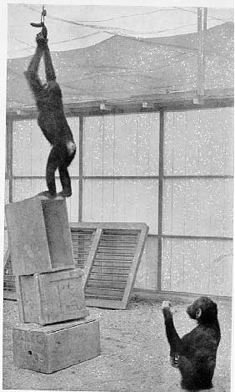
Insight
Insight involves a sudden novel realization of a solution to a problem. Humans and animals have insight.
Grande using boxes to
obtain food
Notes:
sudden perception of a solution to a problem.
Wolfgang Kohler, besides having one of the coolest names around, is well known for his studies on insight learning using chimpanzees. Insight learning occurs when one suddenly realizes how to solve a problem. Sometimes when you are taking a test you happen upon a problem that you have no idea how to solve. Then all of a sudden, the answer comes to you. Hopefully before you hand the test in, but most of the time the answer comes to you that night in the shower.
Kohler showed the power of insight learning by placing a banana above the reach of chimpanzees and watching how they attempted to reach the food. In the room there were several boxes, none of which was high enough to enable the chimpanzees to reach the banana. Kohler found that the chimpanzees spent most of their time unproductively rather than slowly working towards a solution. They would run around, jump, and be generally upset about their inability to snag the snack until, all of a sudden, they would pile the boxes on top of each other, climb up, and grab the bananas.

Slide 27
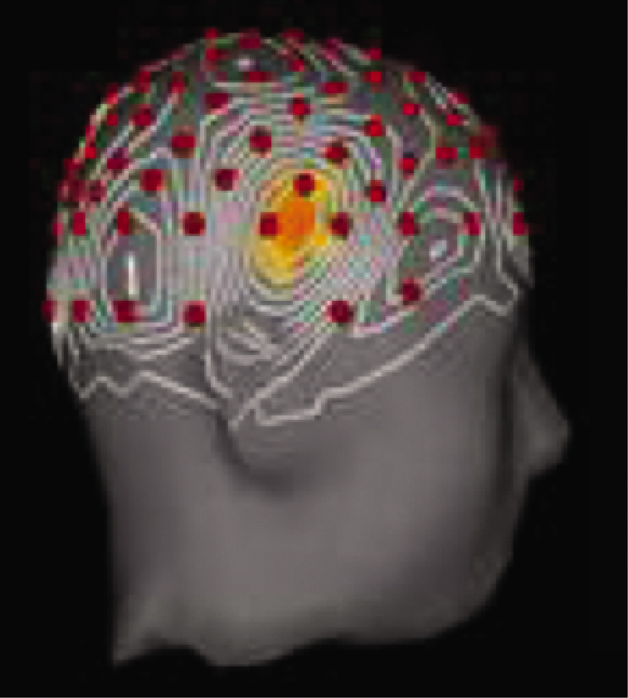
Insight
Brain imaging and EEG studies suggest that when an insight strikes (the “Aha” experience), it activates the right temporal cortex (Jung-Beeman & others, 2004). The time between not knowing the solution and realizing it is about 0.3 seconds.
From Mark Jung-Beekman, Northwestern
University and John Kounios, Drexel University

Slide 28
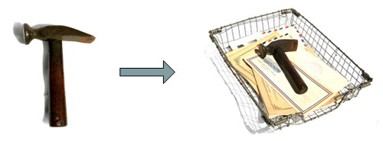
Functional fixedness
What can I do with a hammer?
The problem is we tend to just see an object’s use, not the object itself.
The result: our brain’s incredible inertia to move toward the common, presents an enormous barrier to coming up with new ideas. This automatic neural response is the enemy of innovation.

Slide 29
Creativity and Problem Solving
Creativity: Ability to generate original ideas or solve problems in novel ways
  Divergent thinking: thinking that generates unusual, yet appropriate, responses to problems or questions
  Convergent thinking: thinking in which a problem is viewed as having a single answer
    And which produces responses that are based primarily on knowledge and logic
Cognitive complexity - Preference for elaborate, intricate, and complex stimuli and thinking patterns

Slide 30
Factor affecting our judgements

Slide 31
“Steve is very shy and withdrawn, invariably helpful, but with little interested in people, or in the world of reality. A meek and tidy soul, he has a need for order and structure, and a passion for detail."
Assess the probability that Steve is engaged in a particular occupation form this list
  Farmer
  Salesman
  Airline pilot
  Librarian
  Physician (Baumeister & Bushman, 2011)
Notes:
What do you think his profession would be?
the probability that Steve is a librarian, for example, is assessed by the degree to which his is representative of, or similar to, the stereotype of a librarian

Slide 32
Answer the question
In a series of 10 coin tosses, which series is likely to happen more
  HHTTHTHTTH
  HHHHHHHHHH
H is heads and T is tails
(Bernstein, 2011)
Notes:
50-50
The reason is that the first series looks more random than the second series. It "represents" our idea of what a random series should look like."

Slide 33
Answer these questions
If a random word is taken from an English text, is it more likely that the word starts with a K, or that K is the third letter?
What is more likely to kill you, your dog or falling off from your couch?
What is more likely to kill you, hot tap water and a plane crash?
Notes:
people answer questions like these by comparing the availability of the two categories and assessing how easily they can recall these instances.
In other words, it is easier to think of words that begin with "K", more than words with "K" as the third letter.
Thus, people judge words beginning with a "K" to be a more common occurrence. In reality, however, a typical text contains twice as many words that have "K" as the third letter than "K" as the first letter.
There are three times more words with "K" in the third position than words that begin with "K“
We are nearly 30 times more likely to die from falling off furniture in your own house than you are to be killed by a dog!
We are far more likely to be killed by hot tap water than a plane crash

Slide 34
Heuristics
Representative Heuristics: people judge the probability or frequency of a hypothesis by considering how much the hypothesis resembles available data
The use of past experiences to guide the decision-making process
Judging the likelihood of things or objects in term of how well they represent, or match a particular prototype
Notes:
Heuristics being used to solve problems and are often used in daily life to make decision and draw conclusion

Slide 35
Heuristics
Availability Heuristics: people predict the frequency of an event, or a proportion within a population, based on how easily an example can be brought to mind
People overestimate the importance of information that is available to them.
Smoking is not unhealthy since I know someone who lived to 100 and smoked 3 packs a day

Slide 36
Intelligence

Slide 37
Introduction
Intelligence: The capacity to
  Understand the world
  Think rationally
  Use resources effectively when faced with challenges

Slide 38
Theories of Intelligence: Are There Different Kinds of Intelligence?
g or g-factor: The single, general factor for mental ability assumed to underlie intelligence in some early theories of intelligence

Slide 39
Theories of Intelligence: Are There Different Kinds of Intelligence?
Fluid intelligence: Reflects the ability to think logically, reason abstractly, and solve problems
Crystallized intelligence: Accumulation of information, knowledge, and skills that people learn through experience and education

Slide 40
Theories of Intelligence: Are There Different Kinds of Intelligence?
Theory of multiple intelligences
  Gardner’s intelligence theory
  Proposes that there are eight distinct spheres of intelligence
  Possibility of more types of intelligence
    Existential intelligence - Identifying the fundamental questions of human existence

Slide 41
Eight Forms of Intelligence
Musical intelligence
Bodily kinesthetic intelligence
Logical-mathematical intelligence
Linguistic intelligence
Spatial intelligence
Interpersonal intelligence
Intrapersonal intelligence
Naturalist intelligence

Slide 42
Practical and Emotional Intelligence
Practical intelligence: Related to overall success in living
Analytical intelligence: focuses on abstract but traditional types of problems measured on IQ tests
Creative intelligence: involves the generation of novel ideas and products
Emotional intelligence: Set of skills that underlie the accurate assessment, evaluation, expression, and regulation of emotions

Slide 43
Assessing Intelligence
Intelligence tests: Devised to quantify a person’s level of intelligence
  Benefits
    Identifying students in need of special attention in school
    Diagnosing specific learning difficulties
    Helping people make the best educational and vocational choices
  Controversial
    Raises social and educational issues

Slide 44
Binet and the Development of IQ Tests
Mental age (MA): Age for which a given level of performance is average
Intelligence quotient (IQ): Takes into account an individual’s mental and chronological ages (CA)

Slide 45
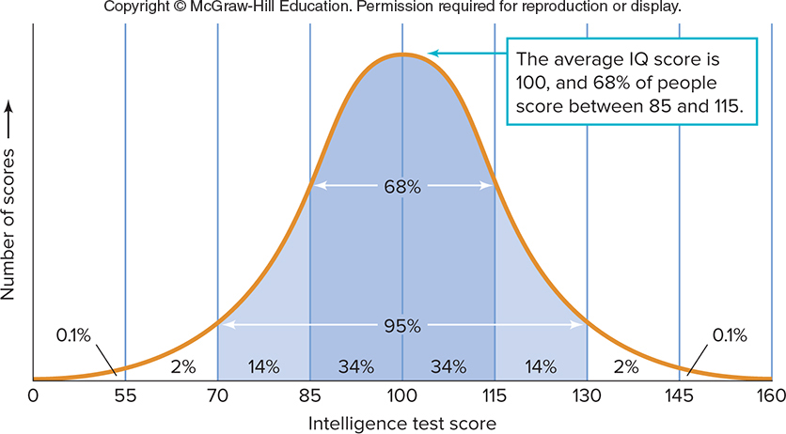

Slide 46
Contemporary IQ Tests: Gauging Intelligence
Stanford-Binet intelligence scale - Consists of a series of items that vary according to the age of the person being tested
Wechsler Adult Intelligence Scale-IV (WAIS-IV)
  WISC-V is for children

Slide 47
Contemporary IQ Tests: Gauging Intelligence
WAIS and WISC measure:
  Verbal comprehension
  Perceptual reasoning
  Working memory
  Processing speed
Stanford-Binet, WAIS-IV, and WISC-V
  All require individualized administration
  Are relatively difficult to administer
Some IQ tests allow group administration

Slide 48
Variations in Intellectual Ability
Intellectual disability: disability characterized by significant limitations both in intellectual functioning and in adaptive behavior, which covers many everyday social and practical skills
Degrees of intellectual disability
  Mild = IQ of 55 to 69
    Constitutes 90% of all people with intellectual disabilities
  Moderate =IQ of 40 to 54
  Severe = IQ of 25 to 39
  Profound = IQ below 25

Slide 49
Identifying the Roots of Intellectual Disabilities
Fetal alcohol syndrome
  Occurs in newborns, caused by mother’s use of alcohol during pregnancy
Down syndrome
  Occurs if a person is born with 47 chromosomes instead of the usual 46
Familial intellectual disability
  No apparent biological defect exists but there is a history of intellectual disability in the family

Slide 50
The Intellectually Gifted
The 2%–4% segment of the population who have IQ scores greater than 130
  Negative stereotypes associated with the intellectually gifted
  Intellectually gifted are most often outgoing, well-adjusted, healthy, popular, able to do things better than the average person

Slide 51
Group Differences in Intelligence
The background and experience of test-takers do have the potential to affect results
  Tests may be biased against some racial and cultural groups on the basis of the types of questions provided
  Assessments of cognitive ability developed in the United States may favor responses that implicitly reflect North American
    Values
    Customs
    Traditions

Slide 52
Genetic and Environmental Influences on Intelligence
No other topic in psychology is so passionately followed as the one that asks the question, “Is intelligence due to genetics or environment?”

Slide 53
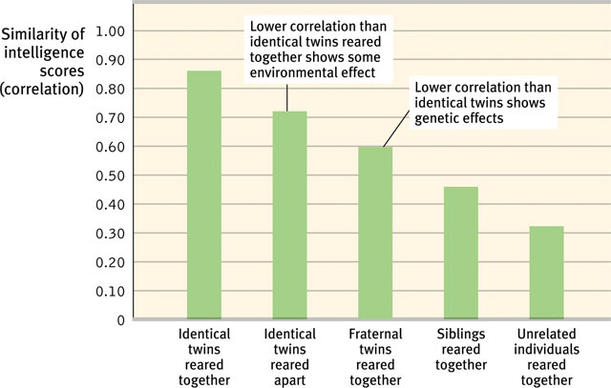
Genetic Influences
Studies of twins, family members, and adopted children together support the idea that there is a significant genetic contribution to intelligence.

Slide 54
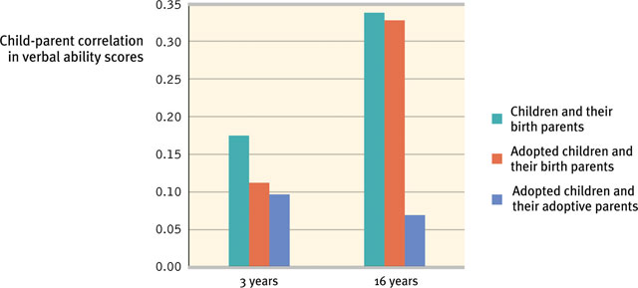
Adoption Studies
Adopted children show a marginal correlation in verbal ability to their adopted parents.

Slide 55
Heritability
The variation in intelligence test scores attributable to genetics. We credit heredity with 40-60% of the variation in intelligence.
It pertains only to why people differ from one another, not to the individual.

Slide 56
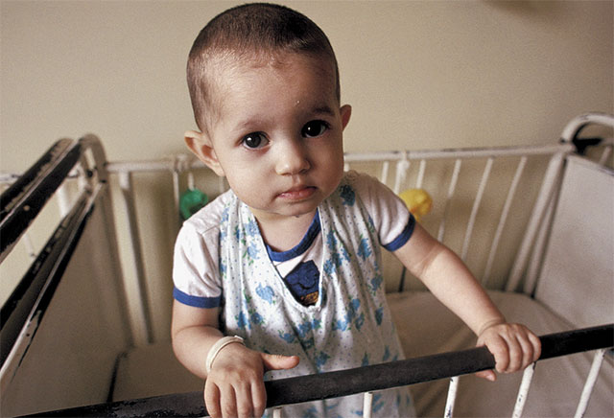
Early Intervention Effects
Early neglect from caregivers leads children to develop a lack of personal control over the environment, and it impoverishes their intelligence.
Romanian orphans with minimal
human interaction are delayed in their development.

Slide 57
Environmental variation has most effect in poor environments, especially abusive environments
ABUSIVE VERSUS NORMAL ENVIRONMENTS
IQ
__________|___________________|_____ ABUSIVE NORMAL ENRICHED
Gain from
Better Normal
E
Bad E’s have
Accelerating
Negative effects
On IQ
Notes:
Environmental influences are highest on the left hand side of this graph.
If you had a sample of children who came from normal environments, the degree of genetic influence would be relatively high, but if you had a sample from abusive environments or even perhaps the low end of normal environments, there would be more evidence for environmental influence.
The empirical data supporting this is a bit mixed, but it is certainly true that the degree of genetic influence is less if you are studying only abused children.
The low end of normal environments in the US would be working class people who send their kids to school but are not well educated and are not much interested or able to provide a lot of intellectual stimulation to their children.
The high end of normal would be yuppie-type, well educated parents who desperately try to get their kids into the best schools, hire tutors, and take them on trips the local art museum.)

Slide 58
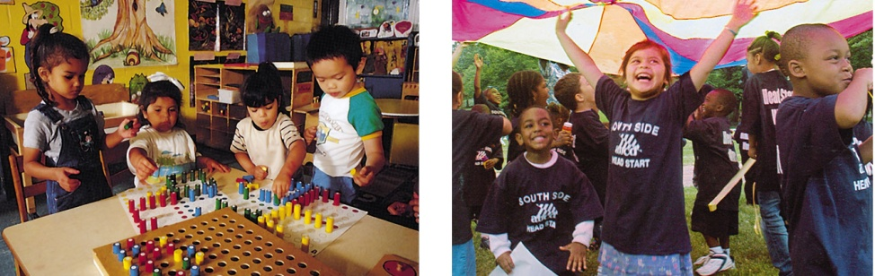
Schooling Effects
Schooling is an experience that pays dividends, which is reflected in intelligence scores. Increased schooling correlates with higher intelligence scores.

Slide 59


