Slide 1

"Marketing/Branding Strategies in CLMV "
Part I
By Ajarn Suwalya Khemvaraporn

Slide 2
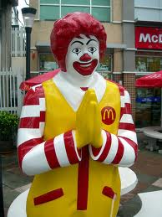
Sawasdee Krub…Ka…

Slide 3
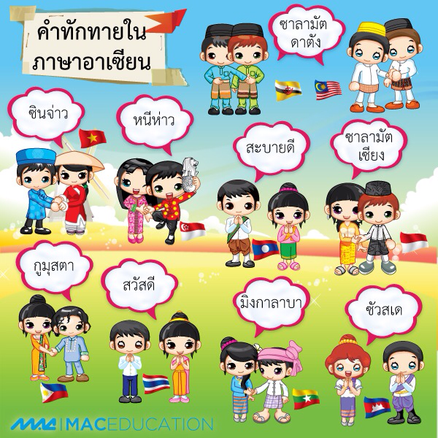

Slide 4
What we aim to accomplish
The meaning of brands
  Getting Started
The Brand Essence
  The importance of Culture and Technology
  Brand Activation in Thailand
Brand Building
  The 4 steps
The Brand Challenge- mini simulation

Slide 5
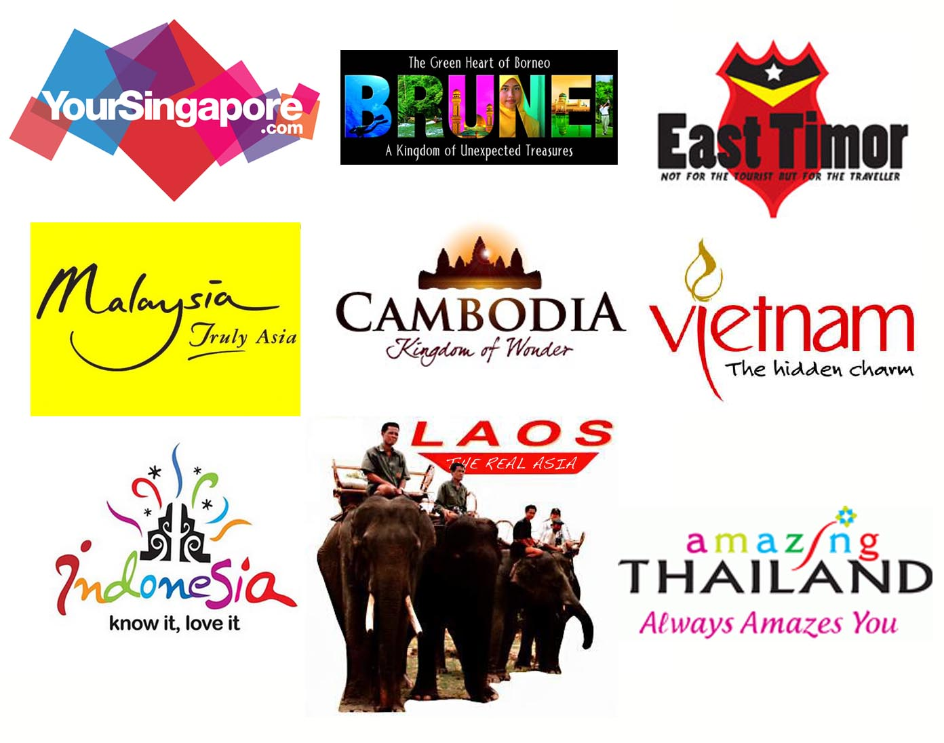
The Meaning of Brands

Slide 6
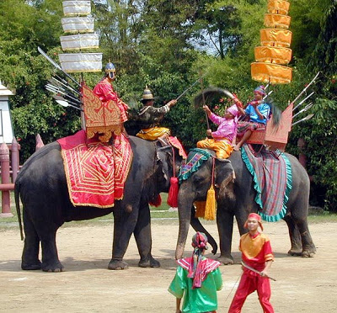
Meaning of Elephants – symbolic?

Slide 7
What is a brand?
For the American Marketing Association (AMA), a brand is a “name, term, sign, symbol, or design, or a combination of them, intended to identify the goods and services of one seller or group of sellers and to differentiate them from those of competition.”
These different components of a brand that identify and differentiate it are brand elements.
Notes:
1

Slide 8
What is a brand?
Many practicing managers refer to a brand as more than that— as something that has actually created a certain amount of awareness, reputation, prominence, and so on in the marketplace.
Notes:
1

Slide 9
Brands vs. Products
A product is anything we can offer to a market for attention, acquisition, use, or consumption that might satisfy a need or want.
A product may be a physical good, a service, a retail outlet, a person, an organization, a place, or even an idea.
Notes:
1

Slide 10
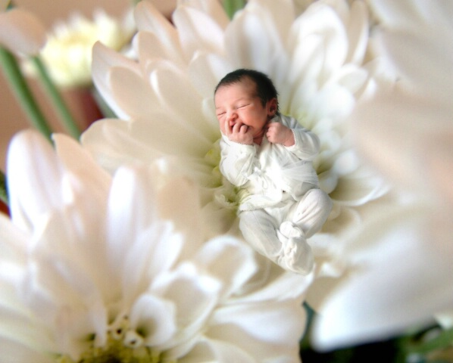
What is a Brand?

Slide 11
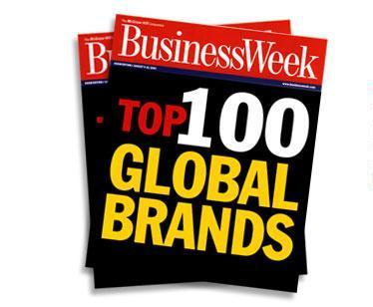
What are the strongest brands?

Slide 12
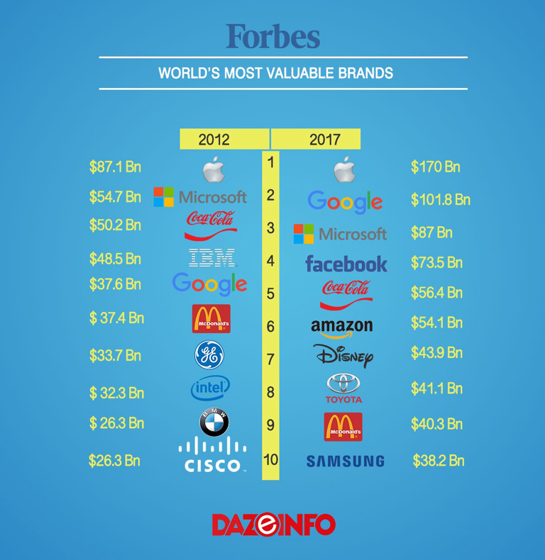

Slide 13
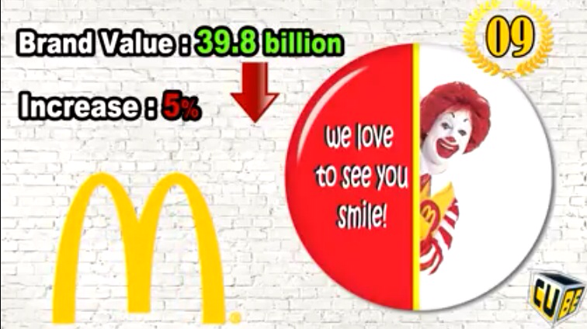


Slide 14
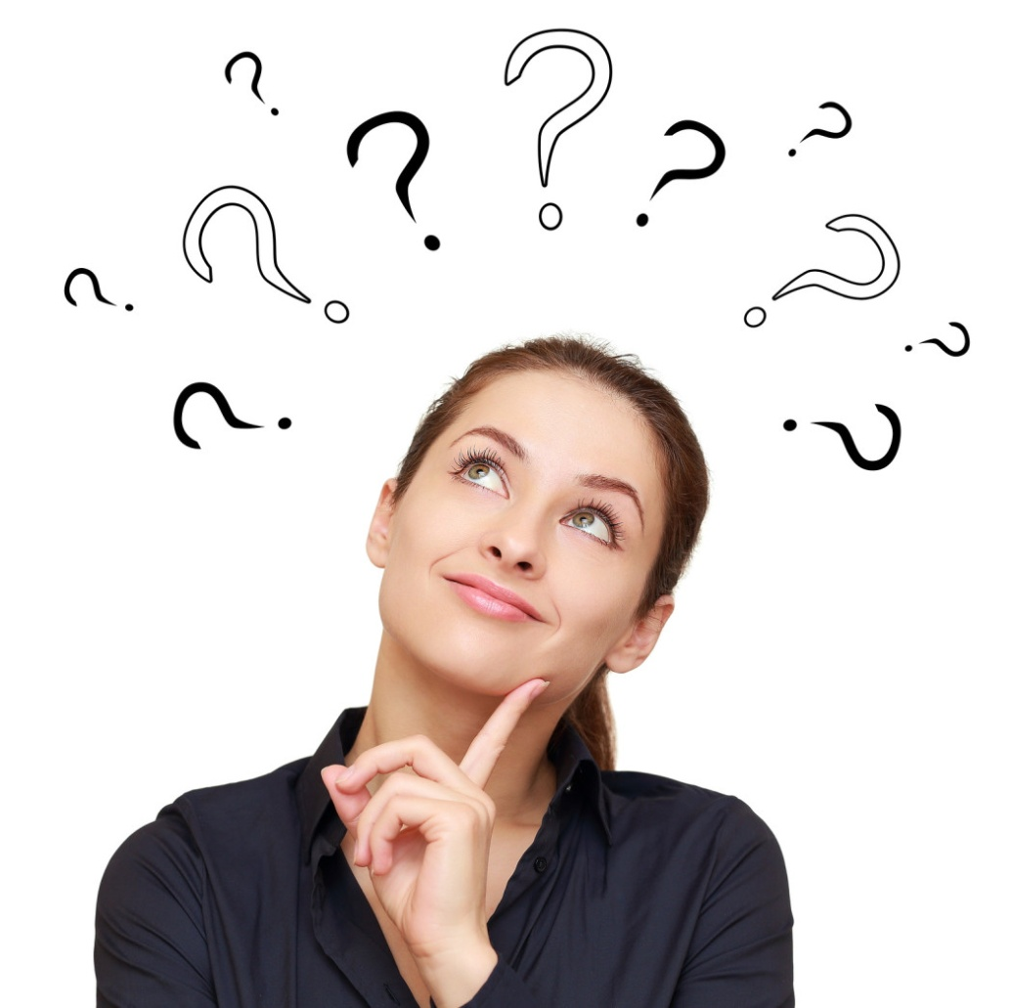
Top of Mind
Fast Food
Shampoo
Deodorant
Soft Drink
Cars

Slide 15
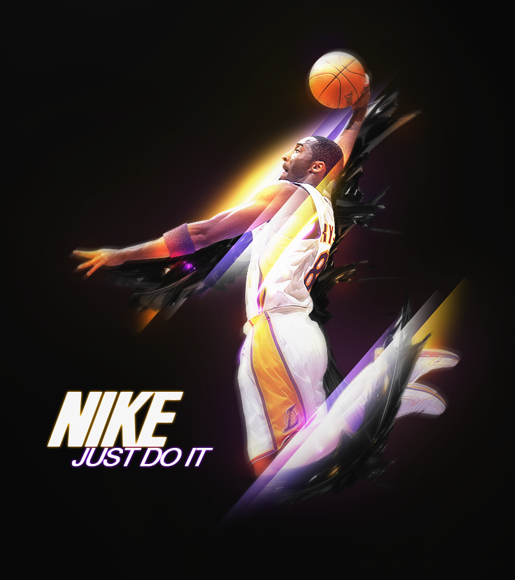
Brand Associations

Slide 16

Brand Associations

Slide 17
Can everything be branded?
Ultimately a brand is something that resides in the minds of consumers.
The key to branding is that consumers perceive differences among brands in a product category.
Even commodities can be branded:
  Coffee (Maxwell House), bath soap (Ivory), flour (Gold Medal), beer (Budweiser), salt (Morton), oatmeal (Quaker), pickles (Vlasic), bananas (Chiquita), chickens (Perdue), pineapples (Dole), and even water (Perrier)

Slide 18
What is branded?
Physical goods
Services
Retailers and distributors
Online products and services
People and organizations
Sports, arts, and entertainment
Geographic locations
Ideas and cause
Notes:
1

Slide 19
Brand Essence in Asia
Culture
Technology

Slide 20
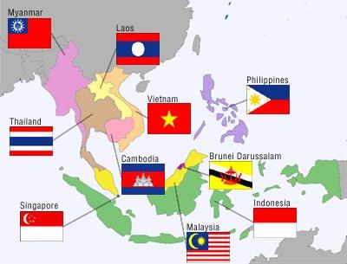
Culture and Technology
  Culture plays an important role of consumer behavior in society
    Lifestyle –live, eat, etc.
    Collective society
    Image Driven society
    Relationship building importance
2. Technology has a vital role in today’s society
“Digital Economy”

Slide 21
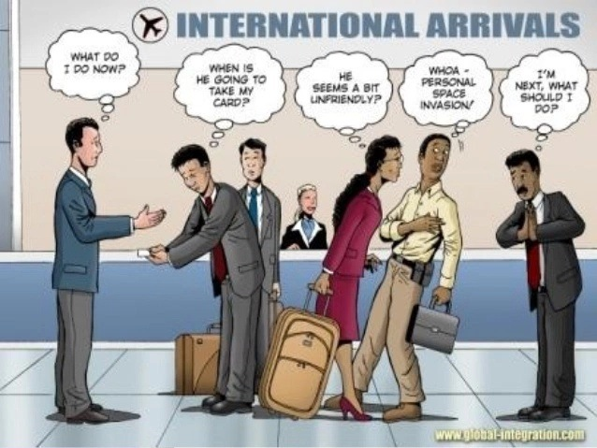

Slide 22
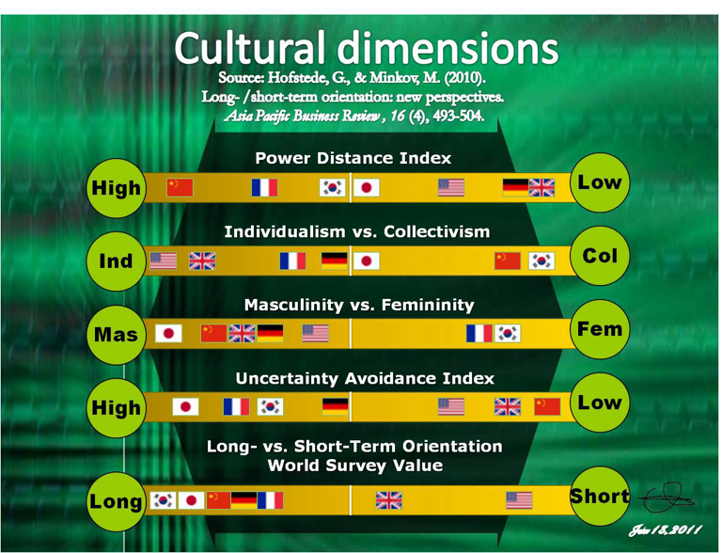

Slide 23
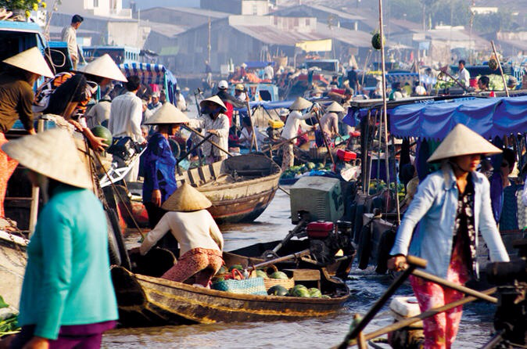
Vietnam at a Glance

Slide 24
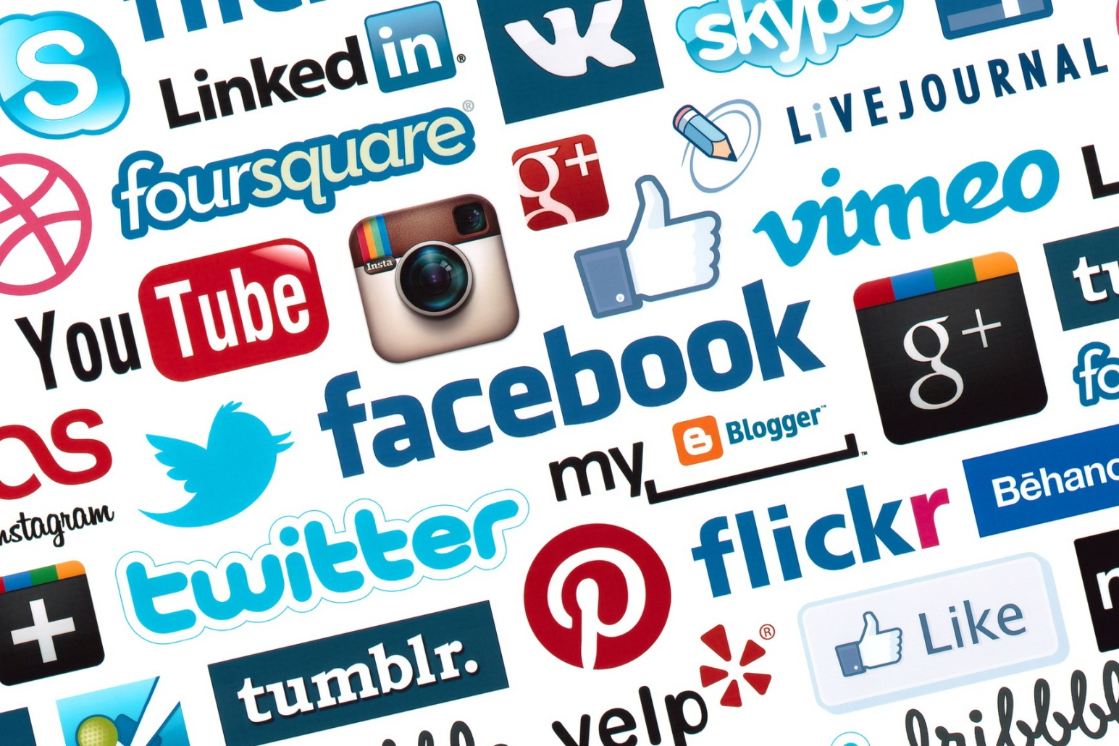
How important is Technology to brand building?

Slide 25
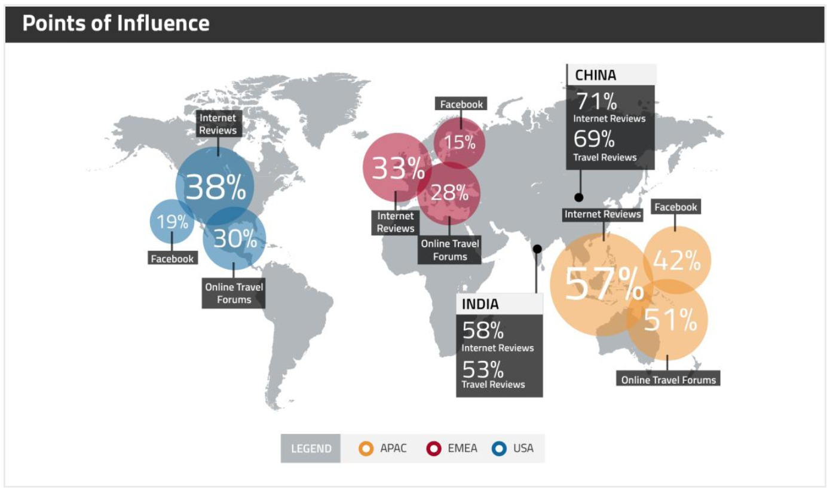

Slide 26
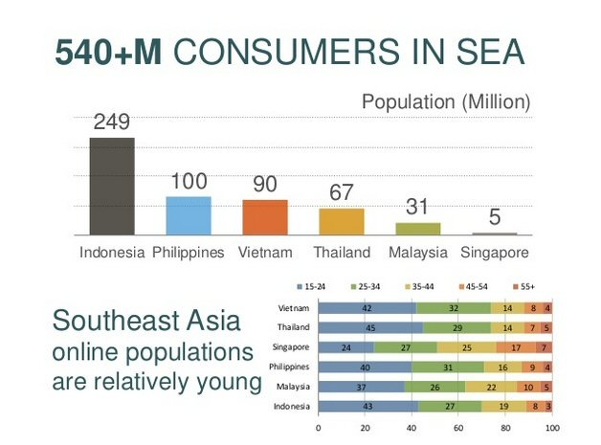

Slide 27
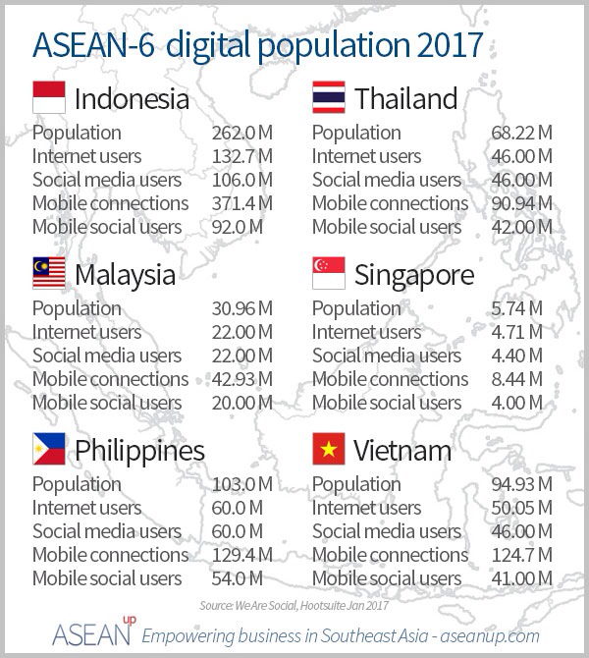

Slide 28
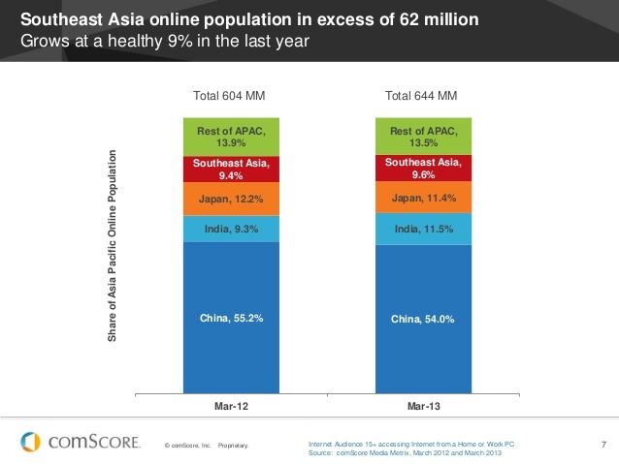
Mobile usage and online games

Slide 29
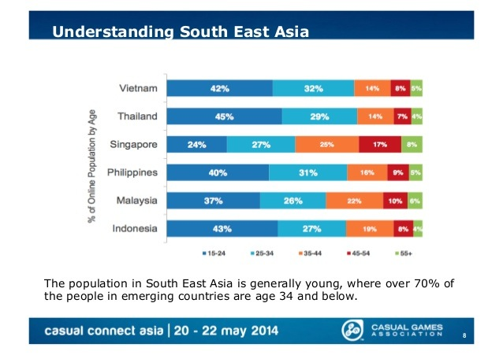

Slide 30
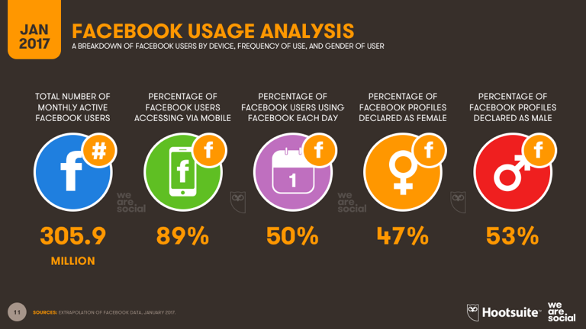

Slide 31
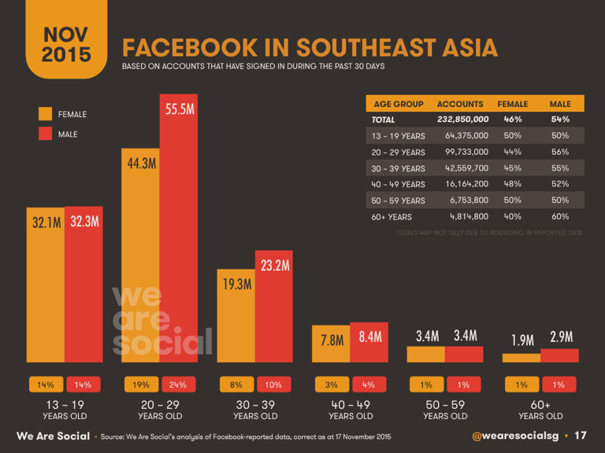

Slide 32
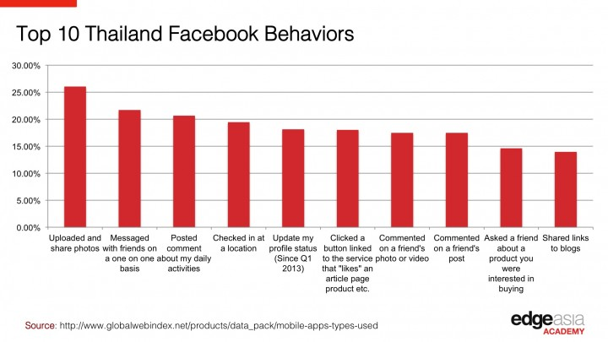
Cultural Influence

Slide 33
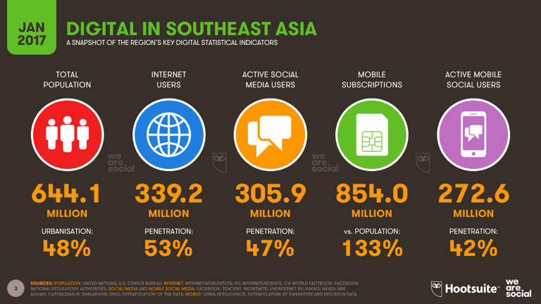

Slide 34
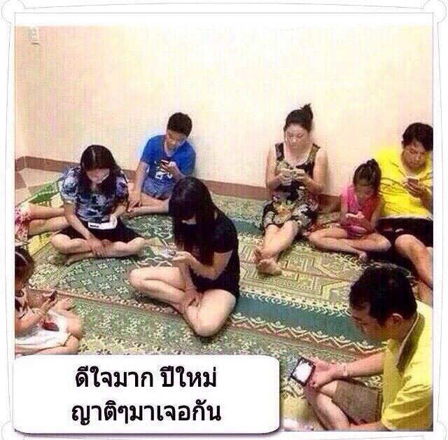
Feeling so happy that this New Year I will be reuniting with my relatives….

Slide 35
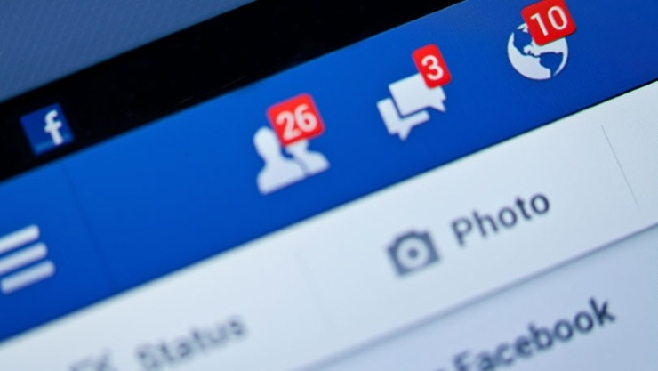
Top ASEAN Countries with the Most Number of Facebook Users

Slide 36
Brand Activation
Central Plaza
Coke
Axe excite

Slide 37
What is Brand Activation?
“Brand Activation rallies around activity that brings brands to life and encourages positive participation –physical or digitally. Regardless of how we deploy this activity. This will turn deliver tangible and mutually beneficial value to clients, brands, and customers alike.” - MAA

Slide 38
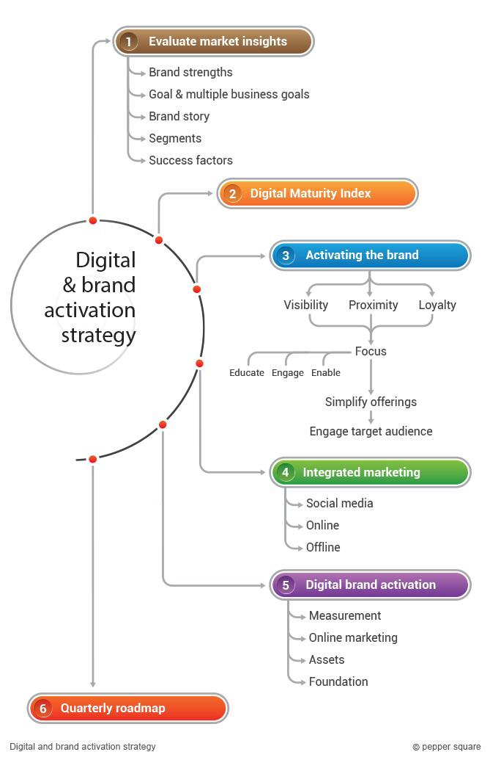

Slide 39
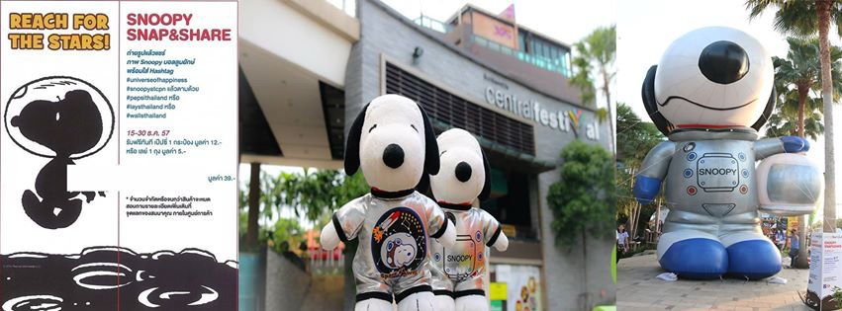
Central Group: Snoopy Snap and Share
Owners of Central Department Store
Snoopy has joint in the Christmas fever at Central Department stores with the theme of “Universe of Happiness” starting from Christmas to enable people to share happiness around the world

Slide 40
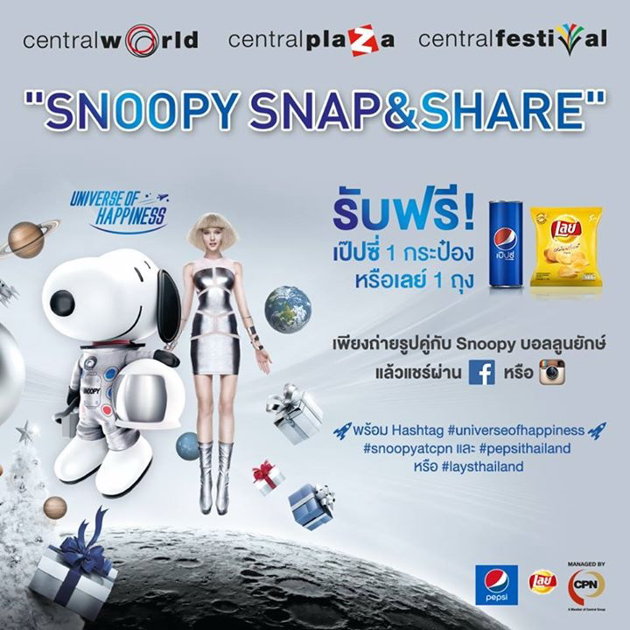

Slide 41
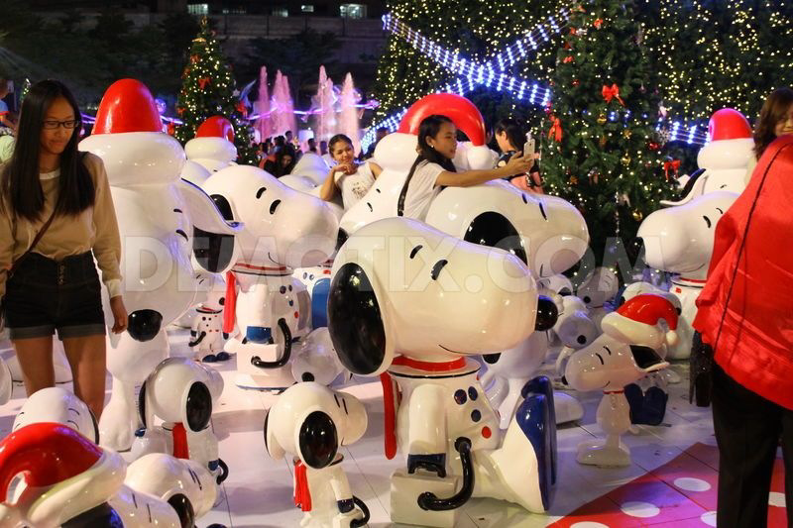
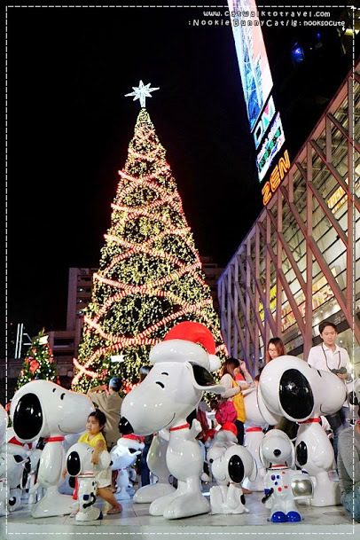
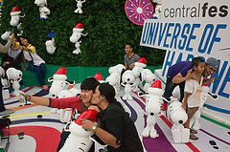
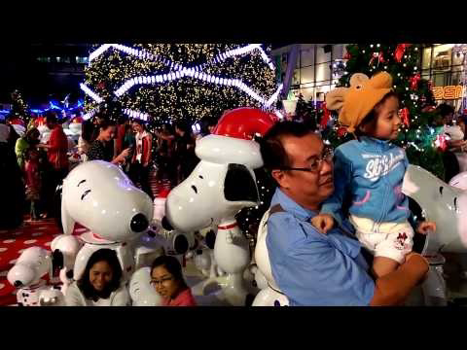

Slide 42
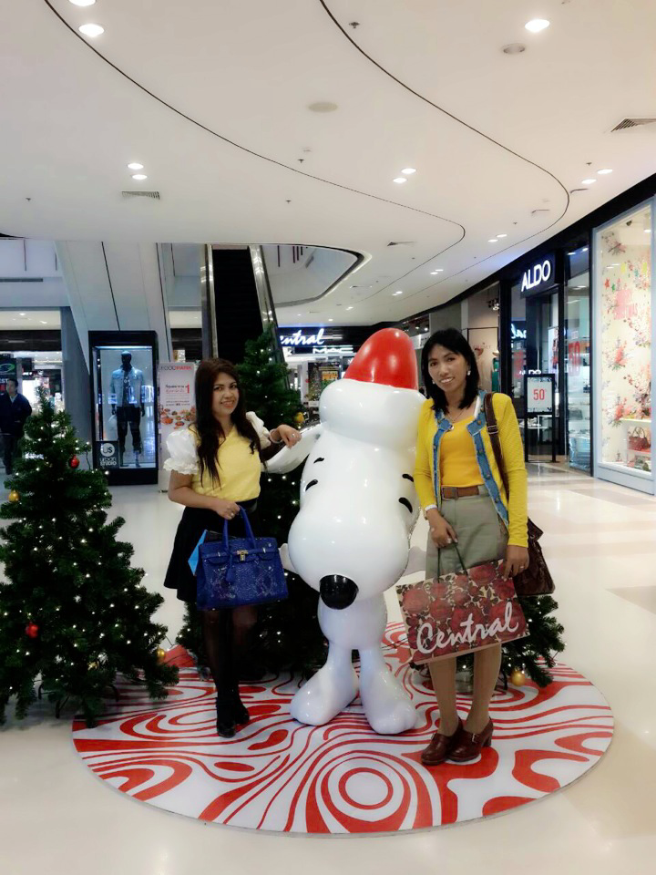
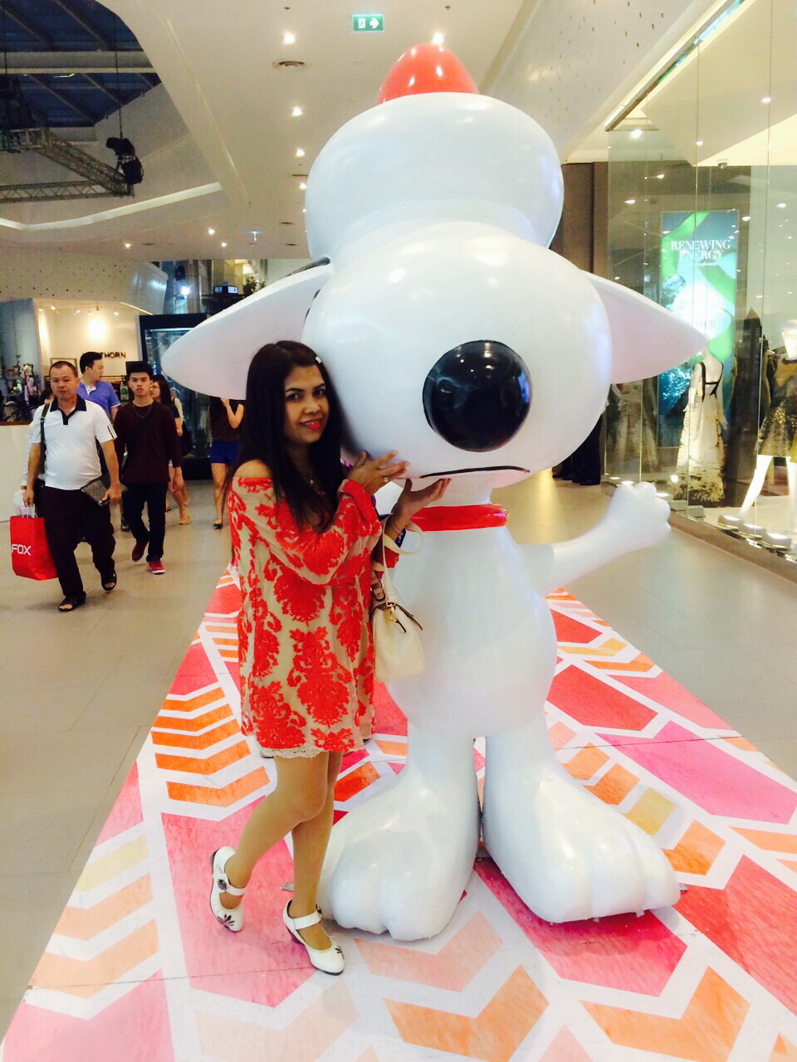
Me too..Snap and Share…

Slide 43
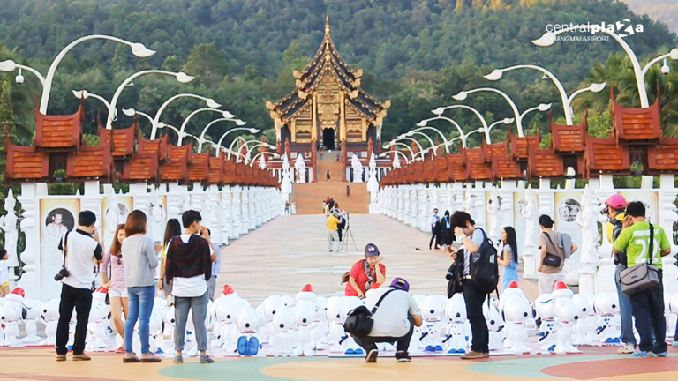
"Universe of Happiness"
Central Plaza Chiang Mai

