Slide 1

Group Assignment 9
New Retail Concept &
Retail Location Scouting

Slide 2
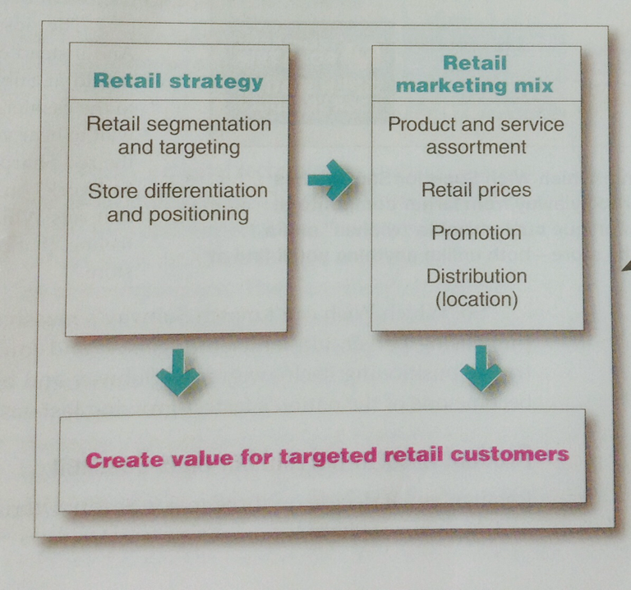
New Retail Concept
You are to create a new Retail Concept for your business, make sure it works under the corporate vision and mission. Your new retail should be a diversification strategy, meaning new format and new target, but launched by your mother company. Branding will play an important role.
What trends, consumer pain points, have influenced your decision ( please use focus group findings to support your rationale)
A clear STP will help you develop a more solid retail mix and implementation plan
One powerpoint slide, maximum limit, due next class

Slide 3

Location Scouting
You are to scout - search, analyze, propose 5 potential retail locations by analyzing the following information.
Type of retail location
Other Factors
Traffic Flow and accessibility
Parking
Visibility
Adjacent Tenants
Restriction and Cost
Cost of Land Rent/Property/Management Costs, etc.
Then you are to choose your most suitable location out of the 5.
Your 5 proposed location should be supported by facts and figures of demographics/Lifestyle of your target group
Before working on location, make sure your Retail STP for your business is clear
2 powerpoint slides maximum limit, due next class

