Slide 1
Frameworks for Community Analysis

Slide 2
Sustainable Livelihood (SL) Framework
What is a ‘livelihood’?
  ‘A livelihood comprises the capabilities, assets and activities required for a means of living’
What is a ‘sustainable livelihood’?
  ‘A livelihood is sustainable when it can cope with and recover from stresses and shocks, maintain or enhance its capabilities and assets…’
  (Chambers and Conway, 1992)

Slide 3
Sustainable Livelihood (SL) Framework
SL framework
Developed by IFAD (International Fund for Agricultural Development)
based on evolving thinking about poverty
reduction, the way the poor and vulnerable live their lives, and the importance of structural and institutional issues
→ helps to organize the factors that constrain or
enhance livelihood opportunities and shows how they relate to one
another

Slide 4
Sustainable Livelihood (SL) Framework
SL framework
→ A guide for people in the analysis of development practice and issues
→an effective tool for facilitating analysis and identifying “ways forward”
→ Suggest development activities that are people-centered, responsive and participatory, multilevel, conducted in partnership with both the public and private sectors, dynamic, and sustainable

Slide 5
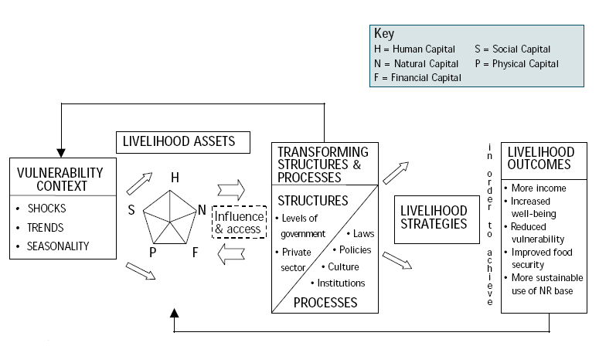
Sustainable Livelihood (SL) Framework

Slide 6
Livelihoods assets
Human Capital
Social
Capital
Natural
Capital
The Poor
Physical
Capital
Financial
Capital

Slide 7
Sustainable Livelihood (SL) Framework
Human Capital
Health
Nutrition
Education
Knowledge and skills
Capacity to work
Capacity to adapt

Slide 8
Sustainable Livelihood (SL) Framework
Natural Capital
Land and produce
Water & aquatic resources
Trees and forest products
Wildlife
Wild foods & fibres
Biodiversity
Environmental services

Slide 9
Sustainable Livelihood (SL) Framework
Physical Capital
Infrastructure
  transport - roads, vehicles, etc.
  secure shelter & buildings
  water supply & sanitation
  energy
  communications
Tools and techology
  tools and equipment for production
  seed, fertiliser, pesticides
  traditional technology

Slide 10
Sustainable Livelihood (SL) Framework
Social Capital
Networks and connections
  patronage
  neighbourhoods
  kinship
Relations of trust and mutual support
Formal and informal groups
Common rules and sanctions
Collective representation
Mechanisms for participation in decision-making
Leadership

Slide 11
Sustainable Livelihood (SL) Framework
Financial Capital
Savings
Credit/debt - formal, informal, NGOs
Remittances
Pensions
Wages

Slide 12
The Asset Mix
Sustainable Livelihood (SL) Framework
Different households with different access to livelihood “assets”
Livelihoods affected by:
  diversity of assets
  amount of assets
  balance between assets

Slide 13
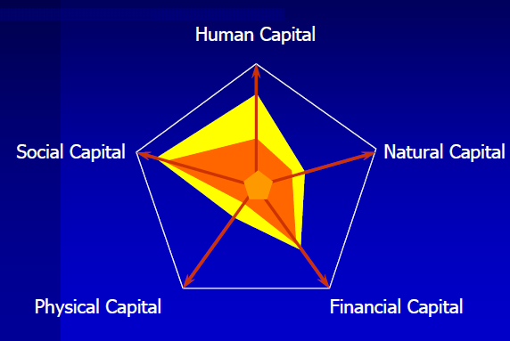
The Asset Mix
Sustainable Livelihood (SL) Framework

Slide 14
Human capital
labour capacity
no education
limited skills
Natural capital
landless
access to common property resources
Financial capital
low wages
no access to credit
Physical capital
poor water supply
poor housing
poor communications
Social capital
low social status
descrimination against women
strong links with family & friends
traditions of reciprocal exchange
= an extremely reduced “livelihood
pentagon”
Landless
female
agricultural
labourer
Human Capital
Social
Capital
Natural
Capital
Physical
Capital
Financial
Capital

Slide 15
“Vulnerability” Context
Sustainable Livelihood (SL) Framework
Shocks
  Floods, droughts, cyclones
  Deaths in the family
  Violence or civil unrest
Seasonality
Trends and changes
  Population
  Environmental change
  Technology
  Markets and trade
  Globalisation

Slide 16
“Vulnerability” Context
Sustainable Livelihood (SL) Framework
H
Vulnerability
Context
Shocks
Seasonality
Trends
Changes
S
N
The Poor
P
F

Slide 17
Policies, Institutions & Processes
Policies
  of government
  of different LEVELS of government
  of NGOs
  of interational bodies
Institutions
  political, legislative & representative bodies
  executive agencies
  judicial bodies
  civil society & membership organisations
  NGOs
  law, money
  political parties
  commercial enterprises & corporations
Processes
  the “rules of the game”
  decision-making processes
  social norms & customs
  gender, caste, class
  language

Slide 18
Policies, Institutions & Processes
H
Vulnerability
Context
Shocks
Seasonality
Trends
Changes
S
N
Policies
Institutions
Processes
The Poor
influence
P
F

Slide 19
Sustainable Livelihood (SL) Framework
Livelihood Strategies
Combining:
the assets they can access
Taking account of:
the vulnerability context
Supported or obstructed by:
policies, institutions and processes.

Slide 20
Sustainable Livelihood (SL) Framework
Livelihood Strategies
→ Actors aim to achieve livelihood outcomes
• Decisions on livelihood strategies may invoke
– Natural-resource based activities
– Non-natural resource based and off-farm activities
– Migration and remittances
– Pensions and grants
– Intensification versus diversification
– Short-term versus long-term outcomes

Slide 21
Sustainable Livelihood (SL) Framework
Livelihood Outcomes
Potential livelihood outcomes can include
– Improved food security
– Higher income
– Reduced vulnerability
– Increased well-being
– Protected rights of access
– Recovered human dignity

Slide 22
Sustainable Livelihood (SL) Framework
Livelihood Outcomes
Poverty - a “poor” livelihood outcome:
based on a fragile or unbalanced set of livelihood assets
unable to sustain to shocks, changes or trends
not supported, or actively obstructed by policies, institutions and processes that do not allow assets to be used as they might
livehood options combined in a “bad” or unsustainable strategy

Slide 23
The Sustainable Livelihoods Framework
H
Vulnerability
Context
Shocks
Seasonality
Trends
Changes
S
N
Policies
Institutions
Processes
Livelihood
Strategies
Livelihood
Outcomes
The Poor
influence
P
F

Slide 24
Sustainable Livelihood (SL) Framework
Pros
Addresses some of the “grey areas”
  Places the poor firmly at the centre – makes people visible
  Suggests the importance of clear definition of who is at the centre of the analysis
  More specific regarding key institutions and processes – and provides a more practical approach to analysing institutional and policy issues
  Incorporates political dimension more explicitly
  Helps understand entry points – based on opportunities and aspirations, possible at different levels (identifying them still depends on good analysis)

Slide 25
Sustainable Livelihood (SL) Framework
Pros
Very useful as conceptual or heuristic tool, Not necessarily easier to explain but more complete
Helps to see links between different factors affecting livelihoods
Specifically identifies many features – politics, rules, social norms, gender/age/class/ethnic issues – that will help make it more culture specific
Helps build cross-sectoral and potentially, cross-institutional dialogue
Encourages discussion

Slide 26
Sustainable Livelihood (SL) Framework
Cons
It’s one way of “organising” the complex issues surrounding poverty but it’s not the only way
Limited practical assistance for application
Non-sectoral approach does not match reality
Downplayed importance of focused technical/ financial support services, increased emphasis on ‘soft’ issues e.g. capacity-building, social organization, participation

Slide 27
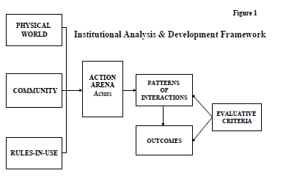
Institutional Analysis & Development (IAD) Framework

Slide 28
Institutional Analysis & Development (IAD) Framework
1. Define the policy analysis objective and specify the analytic approach
What is happening in the policy arena?
How do observed outcomes compare to policy objectives?
Which outcomes are satisfactory? Which are not?
Which outcomes are most important?
When are these outcomes occurring?
Where are they occurring?
Who is involved?
How are policy outcomes occurring?

Slide 29
Institutional Analysis & Development (IAD) Framework
2. Analyze physical and material conditions
What is the economic nature of the policy activity?
How is this good or service provided?
How is it produced?
What physical and human resources are required? What technologies and processes?
What are storage requirements and distribution channels?
What is the scale and scope of provision and production activity?

Slide 30
Institutional Analysis & Development (IAD) Framework
3. Analyze community attributes
What is the size of the community and who is in it?
What knowledge and information do members have?
What are member’ values and preferences?
What are members’ beliefs?
What are members’ beliefs about other participants’ strategy preferences and outcomes?
How homogeneous is the community?

Slide 31
Institutional Analysis & Development (IAD) Framework
4. Analyze rules-in-use
Position
Boundary
Authority
Aggregation
Scope
Information
Payoff

Slide 32
Institutional Analysis & Development (IAD) Framework
5. Integrate the analysis
Action Situation
What are the positions or roles that actors play in this situation?
Who are the participants?
What actions can participants take, and how are actions linked to outcomes?
What is the level of control that each participant has over action in this situation?
What outcomes are possible in this situation?
What information about the action situation is available to participants?
What costs and benefits do participants incur when they take action in this situation?

Slide 33
Institutional Analysis & Development (IAD) Framework
5. Integrate the analysis
Actors
Resources
Valuations
Information Processing
Selection Processes

Slide 34
Institutional Analysis & Development (IAD) Framework
6. Analyze patterns of interaction
Structure of economic and political participation
Information flows

Slide 35
Institutional Analysis & Development (IAD) Framework
7. Analyze outcomes
Efficiency
Fiscal Equivalence
Distributional Equity
Accountability
Conformance to general morality
Sustainability/Adaptability

Slide 36
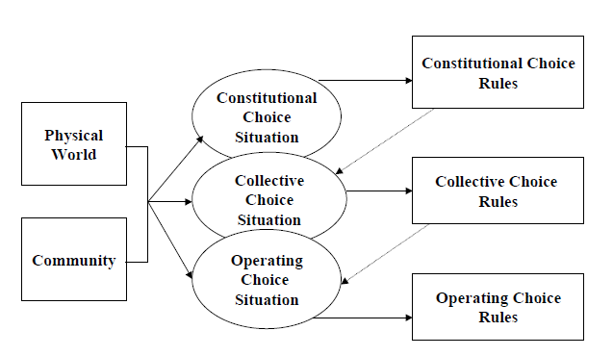
Institutional Analysis & Development (IAD) Framework
Rules and Policy System

Slide 37
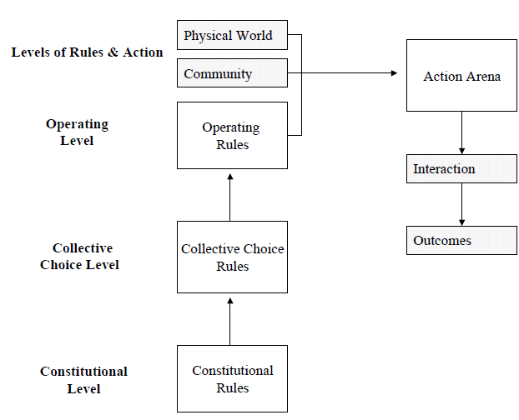
Institutional Analysis & Development (IAD) Framework

Slide 38
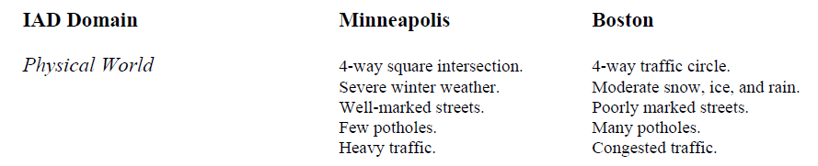
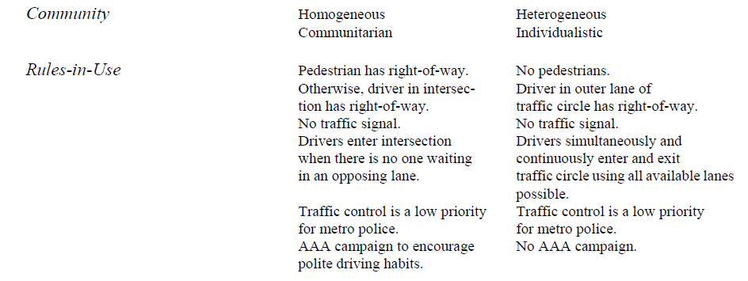
Institutional Analysis & Development (IAD) Framework

Slide 39
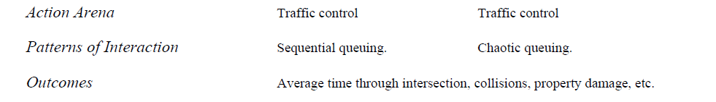
Institutional Analysis & Development (IAD) Framework

