Slide 1
AD-AS Model
Part 3

Slide 2
Revision – Aggregate Supply
AS is the total output that firms in an economy plan to sell during a specific time period. It specifies the amounts of output that will be supplied at all possible price levels.
Why is SRAS upward-sloping?
In SR, wage is sticky because of employment contracts.
P↑ >> W/P↓ >> Labor Demand↑ >> L↑ >> Y↑
Why is LRAS vertical? >> Y does not depend on P.
In LR, wage is flexible because workers can negotiate.
P↑ >> W↑ >> W/P, Labor Demand, L and Y unchanged

Slide 3
Revision – Aggregate Supply
The following events would shift SRAS to the right:
An exogenous decrease in the wage rate
An increase in capital stock and natural resource
Technological progress
The following events would shift LRAS to the right:
An increase in population
An increase in capital stock and natural resource
Technological progress

Slide 4
Equilibrium of AS-AD Model
There are two types of equilibrium in the AS-AD Model:
Short-run Equilibrium (SRE), where AD and SRAS meet.
  SRE does NOT need to be on the LRAS curve.
  SRE is temporary and is observed in the short run.
Long-run Equilibrium (LRE), where AD, SRAS, and LRAS meet.
  In the long run, the economy will move back to LRE.

Slide 5
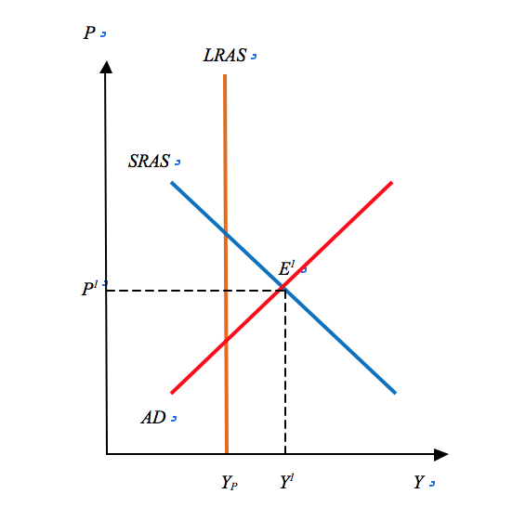
Short-Run Equilibrium (E)
SRAS
AD

Slide 6
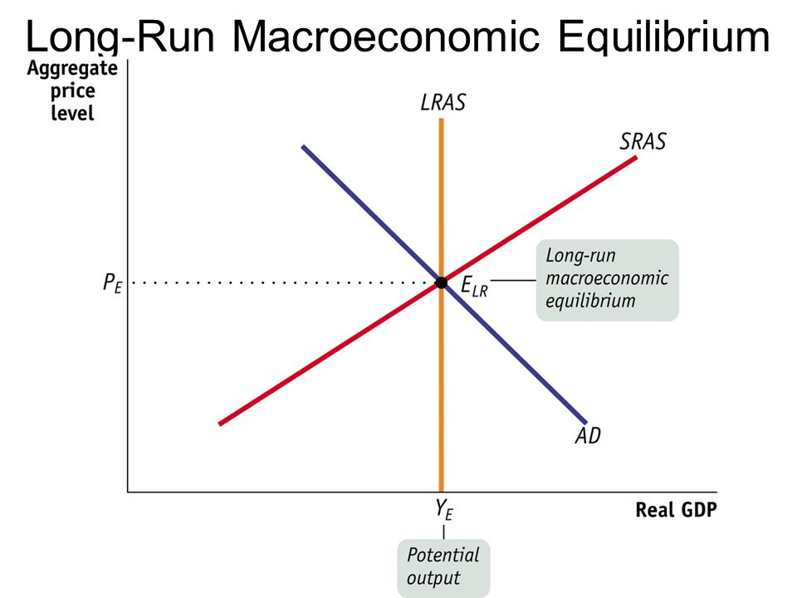

Slide 7
AS-AD and Economic Shocks
AS-AD Model is used to analyze economic fluctuations or business cycles.
In this model, economic fluctuations are due to shocks to AD or AS. These shocks can shift AD, SRAS, and LRAS.
Positive shock shifts the curve to the right. Negative shock shifts the curve to the left.
For example,
  Positive AD shocks: increase in consumer credit, etc.
  Negative AS shocks: epidemic, bad weather, etc.

Slide 8
AS-AD and Economic Shocks
AS-AD assumes that the economy starts at the LRE.
But the shocks to AD, SRAS, or LRAS can move the economy to the SRE.
At SRE, if Y* < Yf, we have recessionary gap.
At SRE, if Y* > Yf, we have inflationary gap.
To move back to the LRE,
  The economy can SLOWLY adjust itself, through shifts in SRAS.
  The government can intervene by using demand-side policies (fiscal or monetary) to shift the AD, or using supply-side policies to shift the AS.

Slide 9
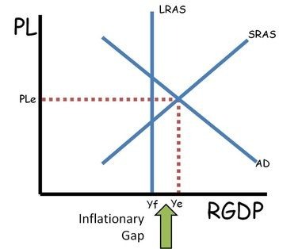
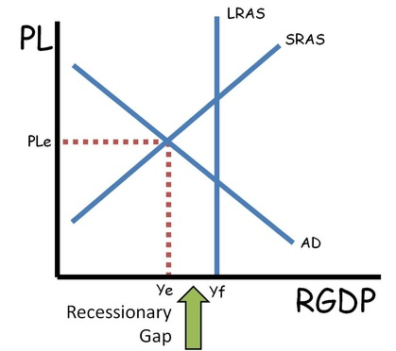
Output Gaps

Slide 10
Aggregate Demand Shocks
Factors that shift AD:
  Autonomous C and I
  Fiscal Policy (G and T) and Monetary Policy (M)
Since G, T, and M can be perfectly controlled by the government, they are NOT economic shocks.
Thus, AD shocks are the exogenous events that change autonomous C and I. For example,
  Consumers’ confidence can raise auto. C and AD.
  Investors’ optimism can raise auto. I and AD.

Slide 11
Positive AD Shock
Positive AD shock shifts AD to the right. At the new SRE, we have higher P and Y (inflationary gap).
To correct inflationary gap, the government can use “contractionary” fiscal (G or T) or monetary (M) policies to shift AD back to its original position.
Otherwise, the economy can SLOWLY adjust itself:
  Higher P means that costs of production, e.g. W, also goes up. This causes SRAS to shift left.
  The economy returns to the LRE, but with higher P.

Slide 12
Positive AD Shock

Slide 13
Aggregate Supply Shocks
AS shocks are more complicated, as we need to consider whether the shock is permanent or temporary.
Permanent AS shocks shift SRAS and LRAS. For example,
  Permanent change in birth or mortality rate
  Discovery of very large natural resources
Temporary AS shocks shift SRAS. For example,
  Good or bad weather
  Epidemic
  Short-term change in regulations

Slide 14
Permanent Negative AS Shock

Slide 15
Temporary AS Shock
Temporary AS shocks shift SRAS. Afterwards, the shocks disappear, and the SRAS moves back to its original position. For example, a short-term epidemic temporarily reduces labor force. After some time, new workers enters labor force. The economy returns to its LRE.
The government can also use fiscal or monetary policy (to shift AD) to return the economy to the LRE. It can also use supply-side policy to boost AS as well.

Slide 16
Temporary Negative AS Shock
Over time, AS2 returns to its original position (AS1).

Slide 17
Causes of Inflation
We learn that printing money is one cause of inflation.
We can use AD-AS Model to shows two other causes.
Demand-pull inflation: positive AD shock raises P (and Y)
Cost-push inflation: negative SRAS shock raises P (but reduces Y)

Slide 18
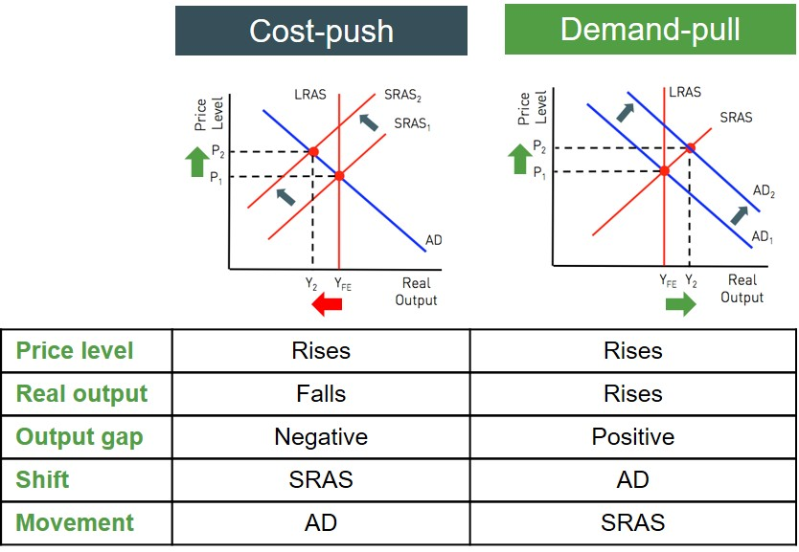
Causes of Inflation

Slide 19
Key Summary
A shift in AD affects P and Y only in the short run, but has no effect in the long run.
A temporary AS shock affects P and Y only in the short run, but has no effect in the long run.
A permanent AS shock affects P and Y both in the short run and long run.
The economy has a self-correcting mechanism to return to the long-run equilibrium, through shifts in SRAS.
Furthermore, the government can use demand-side or supply-side policies to speed up the adjustment process.

