Slide 1
EE461
Development microeconomics
Chayanee Chawanote
Semester 2/2016 (Jan – May, 2017)
Office: Room 6, 4th Floor (computer lab building)
Email: chayanee@econ.tu.ac.th
Office hours: Tuesday & Thursday, 2:30-4:00 PM (or by appointment)

Slide 2
EE461
Economic inequality and income distribution
Agriculture in modern world
POVERTY
FIRM and development
HUMAN CAPITAL
Education
Consumption smoothing
Health
Saving behavior
Population
Gender
CREDIT
MARKET FAILURE in RURAL
AREA
POLITICAL ECONOMY
and Corruption
Insurance

Slide 3
Recommended Textbooks
Ray, Debraj. (1998). Development Economics, Princeton University Press. [HD75 .R39]
[MR] Meier, Gerald M., and Rauch, James E. (2005). Leading Issues in Economic Development, 8th Edition, Oxford University Press. [HD82 .M42 2005]
Todaro, Michael P., and Smith, Stephen C. (2012). Economic Development, 11th Edition.
Deaton, Angus. (1997). The Analysis of Household Surveys: A Microeconometric Approach to Development Policy, The Johns Hopkins University Press. [You can download The World Bank published version here: http://documents.worldbank.org/curated/en/1997/07/694690/analysis-household-surveys-microeconometric-approach-development-policy]

Slide 4
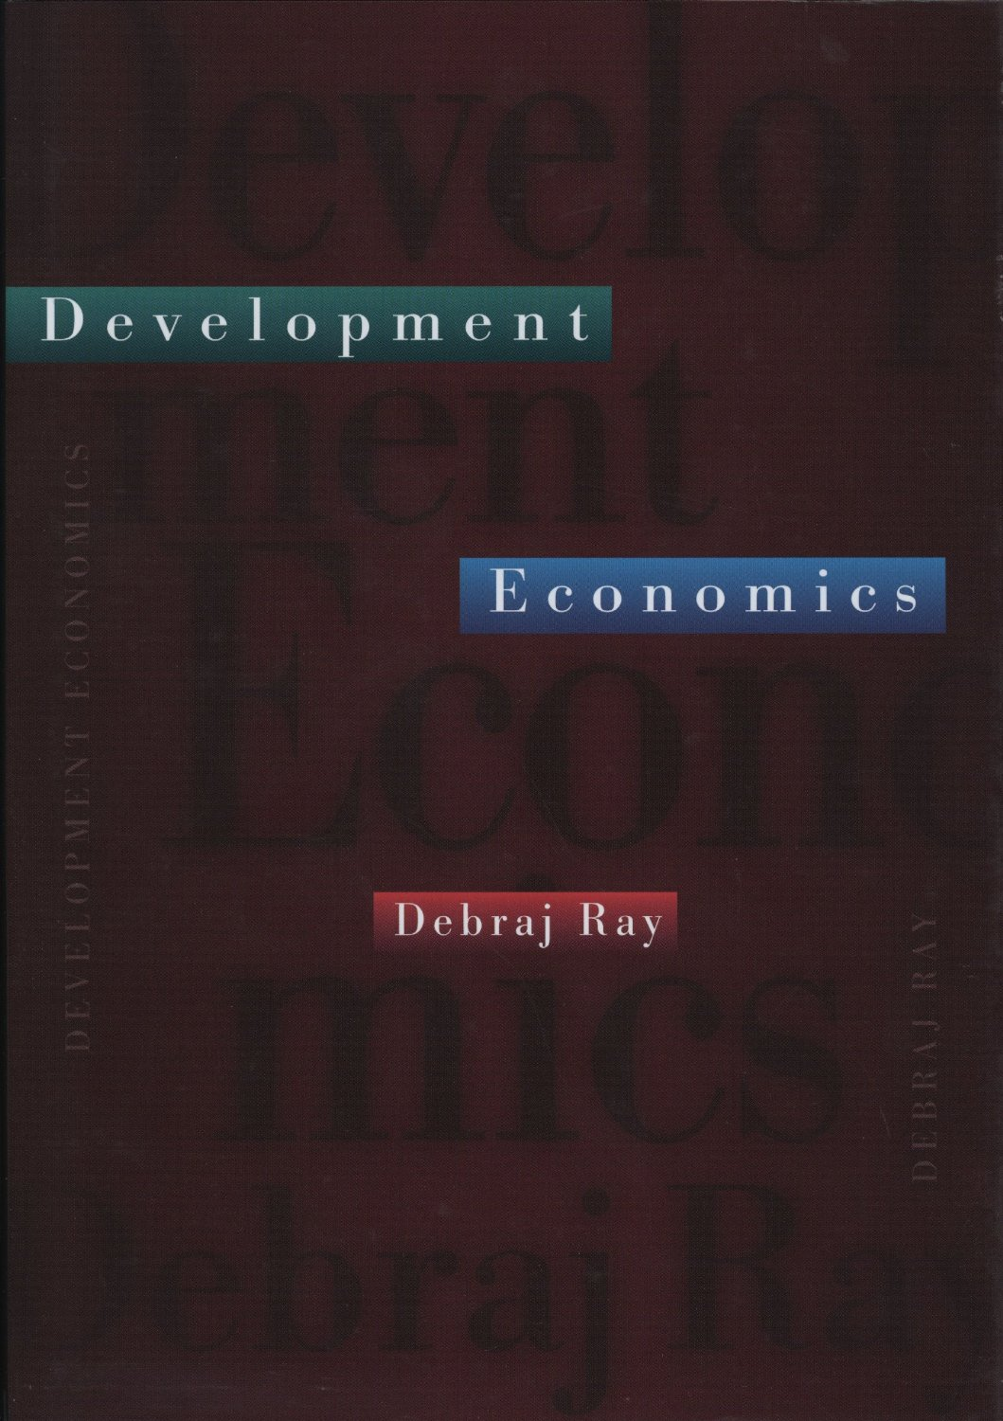
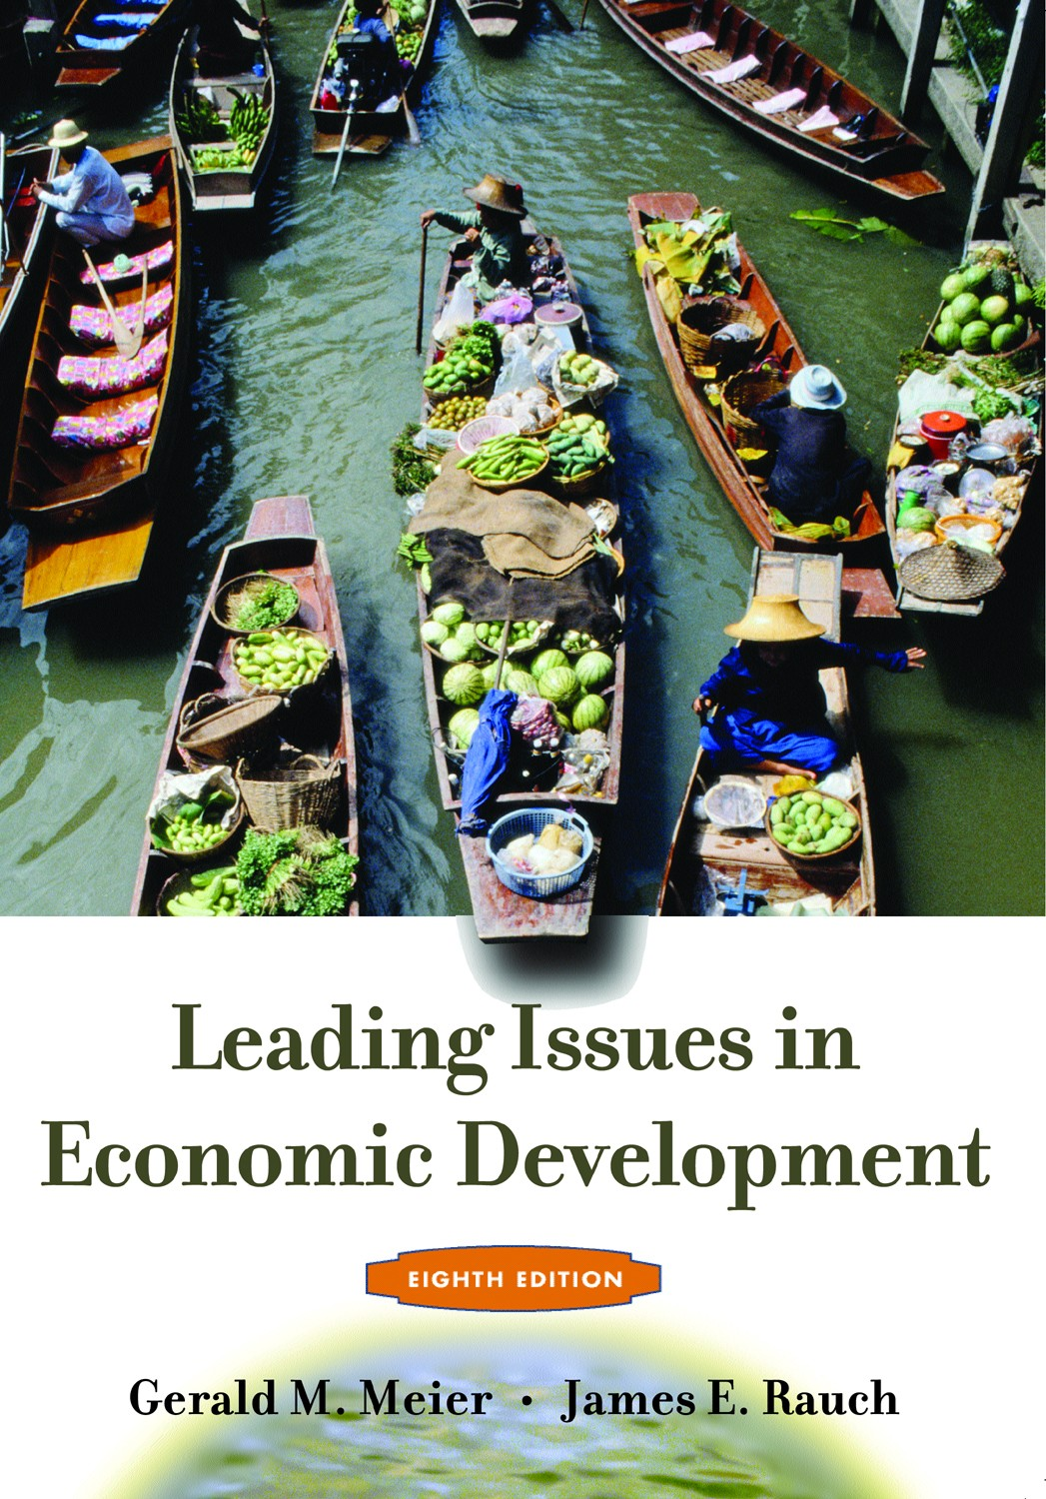
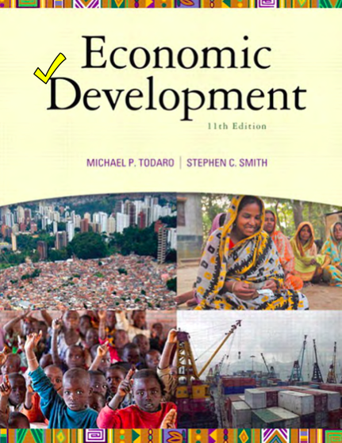
Recommended Textbooks

Slide 5
Semester plan
Date | Topics
Week 1 *no class on Jan 19 | 1. Economic Development: Overview & Data Basic
Week 2-3 | 2. Economic Inequality and Income Distribution - Measurement of income inequality - The U hypothesis relating income inequality and economic development - Inequality, savings, income, and growth - Inequality, capital markets, and development
Week 4-5 | 3. Poverty - Conceptual issues and poverty measures - The economic lives of the poor - Poverty and scarcity: a behavioral approach - Poor but rational

Slide 6
Semester plan
Date | Topic
Week 6 *make up class for Thailand U-sport week | 4.1 Human Capital: Education - The contribution of education to economic growth - Economic impact of education - Interpreting recent research on schooling in developing countries
Week 7 | 4.2 Human Capital: Health - Health: impact of poor health on development 4.3 Human Capital: Population - Economic approaches to population growth 4.4 Human Capital: Gender and Development - Gender inequality at the start of the 21st century
Week 8
March 9: 12.30-14.00 | Midterm Exam
Notes:
make up class
for Thailand university sports

Slide 7
Semester plan
Date | Topic
Week 9 | 5. Agriculture - Overview of agriculture in a modern world - Rural-urban interaction - A World without agriculture? - Markets in Agriculture
Week 10-14 * Apr 6: Chakri day * Apr 11&13: Songkran week | 6. Consumption Smoothing, Savings, Credit and Insurance - Consumption smoothing - Saving behavior and permanent income hypothesis - Rural credit markets - Formal credit and insurance rationing - Rural household’s risk management
Week 15 | 7. Firm and Labor - Entrepreneur’s characteristics in developing countries - Bottlenecks for entrepreneurship in developing countries - Transformations in the Thai labor market

Slide 8
Semester plan
Date | Topic
After Songkran | Field trip on the weekend (Apr 29-30)?
Week 16 | 8. Political Economy and Corruption - Rent seeking and government failure - Corruption and monitoring
Week 17 | 9. Natural Resources, Environment, and Development - Poverty and environment - Climate change and the poor
May 16: 9.00-12.00 | Final Exam

Slide 9
Grading:
Participations & assignments 10%
  Class participations
  About 4-5 assignments
Research project (group) 10%
  Proposal due March 16 (after midterm)
  Final report due Last day of the final exam
Book chapter review (individual) 10%
  2-3 pages review due May 13
Midterm exam 30%
Final exam 40%

Slide 10
Participation includes discussions in class and exchanging interesting topics/stories related to course topics from reading articles (e.g. from The Economist, WSJ, ThaiPublica) or development blogs. You can find some interesting blogs:
  http://blogs.worldbank.org/ (There are many blogs under the World Bank blogs)
  http://blogs.adb.org/
  http://chrisblattman.com/
Students have to develop a research paper using any dataset on any topic that they are interested and hand in infographic-type presentation. The contents include research motivation, review literature, data analyses and discussion on the research questions.

Slide 11
http://data.worldbank.org/
http://data.worldbank.org/data-catalog/world-development-indicators
http://blogs.worldbank.org/opendata/
http://blogs.worldbank.org/category/tags/dataviz

Slide 12




Book chapter review

