Slide 1

MK 322 Retail Management
Chapter 16: Managing the Store
By Ajarn Suwalya K.

Slide 2
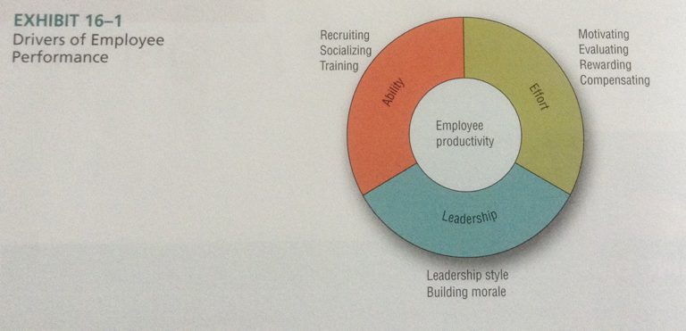
Drivers of Employee Performance
Notes:
1

Slide 3

Recruiting, Socializing, and Training Store Employees

Slide 4
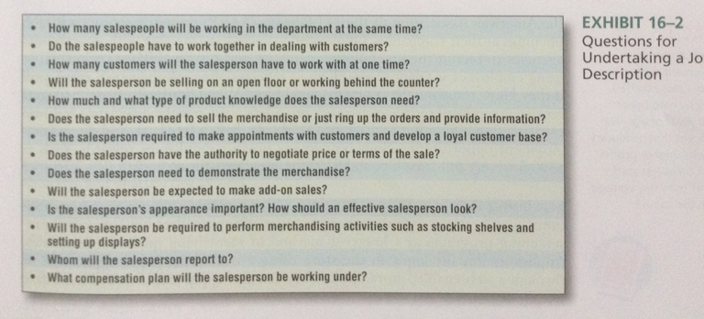
Recruiting Employees
Developing a Job Description
Notes:
1

Slide 5

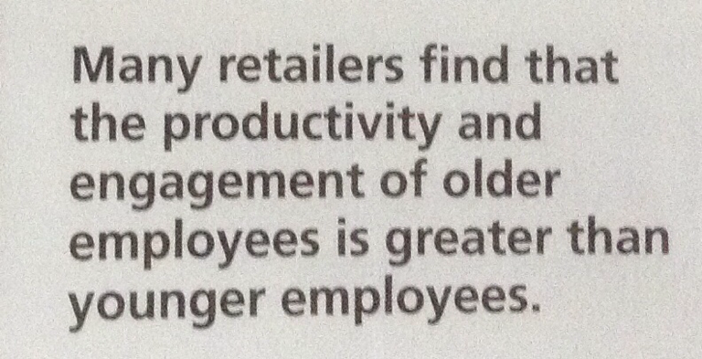
Recruiting Employees
Locating Prospective Employees
Notes:
1

Slide 6

Recruiting Employees
Screening Applicants to Interview
Application Forms
References and Online Checks
Social Media
Testing
Realistic Job Interview
Notes:
1

Slide 7
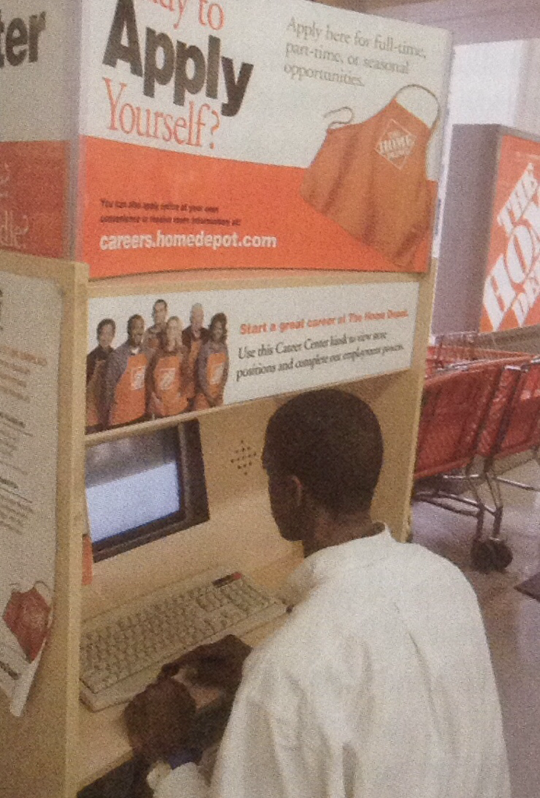
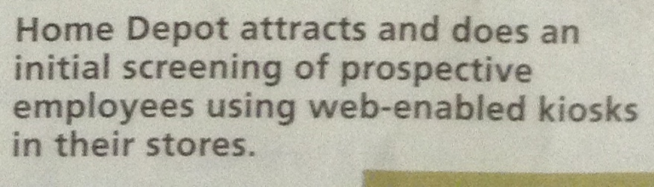
Recruiting Employees
Notes:
1

Slide 8
Recruiting Employees
Selecting Applicants
- Preparation for the interview
Behavioral Interview: ask candidates how they have handled situations in the past, especially situations requiring skills outlined in the job description
Legal Considerations in Selecting and Hiring Store Employees
Notes:
1

Slide 9
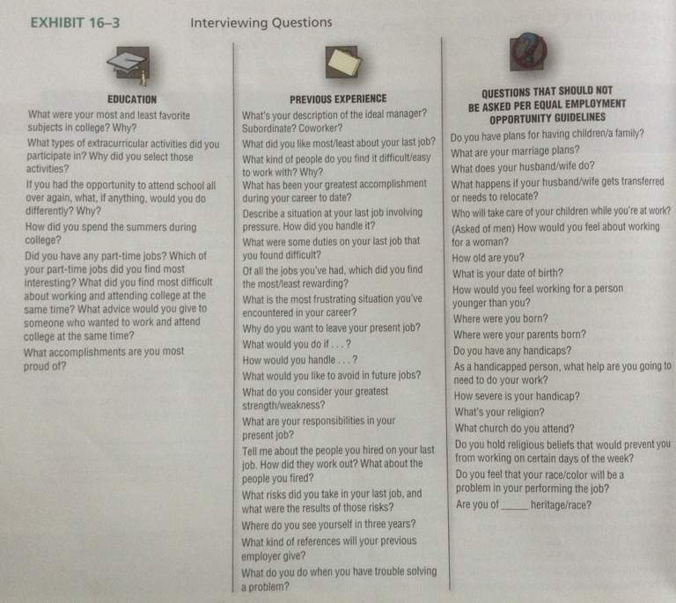
Recruiting Employees
Notes:
1

Slide 10

Socialization of New Store Employees
Orientation Programs- are critical in socializing new employees
A few hours to familiarize with rules and regulations
One element of training program
Notes:
1

Slide 11
Training Store Employees
Structured Training Program- helps new employees acquire basic skills and knowledge, which they need to be able to do their jobs
On-the-job-training- new employees work in specific jobs under direct supervision of their managers.
Blended Approach- both structure and on the job. Best Buys attend monthly, 3 after hours training on new products, services update.
Notes:
1

Slide 12
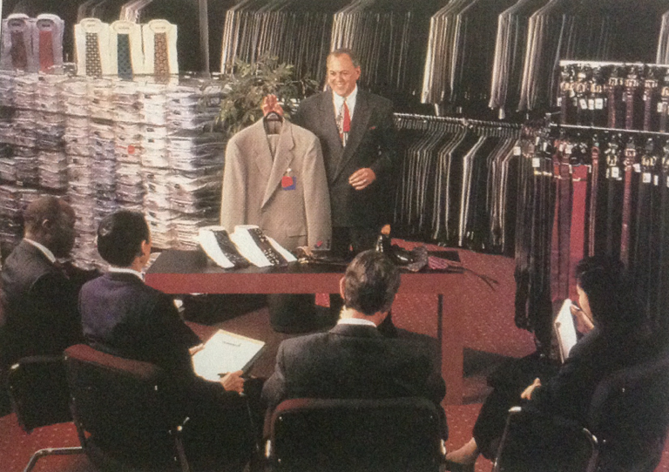
Training Store Employees
In this structured training program, newly hired Men's Wearhouse sales associates learn about the merchandise they will be selling
Notes:
1

Slide 13

Motivating, Evaluating, Rewarding, and Compensating Store Employees

Slide 14
Setting Goals to Motivate Employees
Employee performance improves when they feel
Their efforts enable them to achieve the goals set for them by their managers and
They will receive rewards they value if they achieve their goals, thus managers can motivate employees by setting realistic goals and offering rewards that employees want
Notes:
1

Slide 15

Evaluating Store Employees and Providing Feedback
Who should do the evaluation? – Manager who works closely with the employee
How often should evaluations be made?
Format of evaluation?
Notes:
1

Slide 16
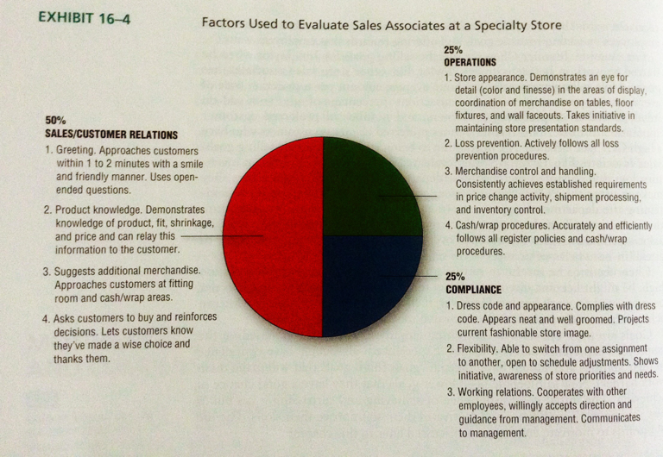
Evaluating Store Employees and Providing Feedback
Notes:
1

Slide 17
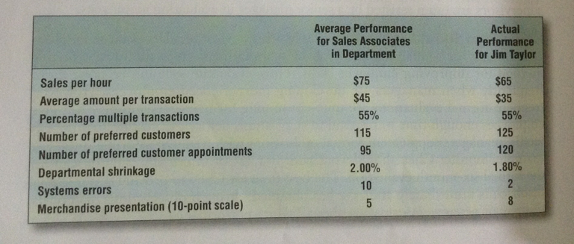
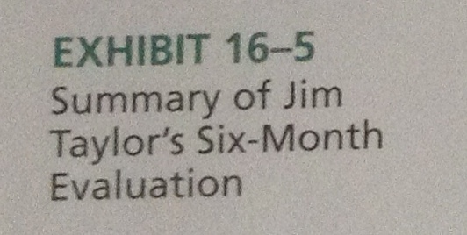
Evaluating Store Employees and Providing Feedback
Notes:
1

Slide 18
Rewarding Store Employees
Extrinsic rewards are rewards provided by either the employee's manager or the firm such as compensation, promotion and recognition
Intrinsic Rewards are rewards employees get personally doing their job well
Contests : Employee of the Month
Job Enrichment : the redesign of a job to include a greater range of tasks and responsibilities, including skill variety, task significant, autonomy, and job feedback
Notes:
1

Slide 19

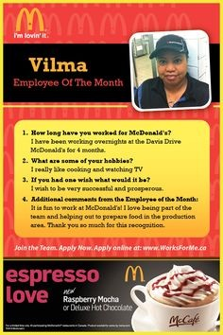
Rewarding Store Employees
Notes:
1

Slide 20
Compensation Programs
Types of Compensation Plans
Straight salary compensation: receive fix amount of compensation for each hour or week they work
Incentive compensation plans: reward employees on basis of productivity
Straight commission: income is based entirely on commission
Quota-bonus plan: a bonus is provided when their performace exceeds the quota
Team incentives:based on performance as a department or store as a whole
Notes:
1

Slide 21

Compensation Programs
Quota: is a target level used to motivate and evaluate performance
Sales per hour for salespeople
Maintained margin and inventory turnover for buyers
Notes:
1

Slide 22
Types of Leadership
Leadership is a process by which a store person attempts to influence others to accomplish a common goal or task
Autocratic leaders: make decisions on their own and announce to employees, use authority to tell employees what to do
Democratic leaders: seek information and opinions from employees and base their decisions on this information. They share power and information, and ask where and when they want and make schedules to accommodate employees
Notes:
1

Slide 23

Types of Leadership
Notes:
1

Slide 24

Types of Leadership
- Transformation leaders get people to transcend their personal needs for the sake or group or organization. They are engaged and generate excitement and create enthusiasm in employees through personal charisma; delegate challeging work to subordinates, free, open communicating and mentoring
Notes:
1

Slide 25
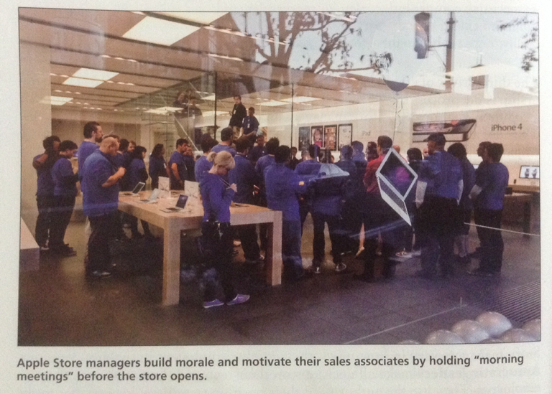

Maintaining Morale
Store managers play an important role in improving the work atmosphere and its effect on the performance of store employees
Notes:
1

Slide 26


