Slide 1
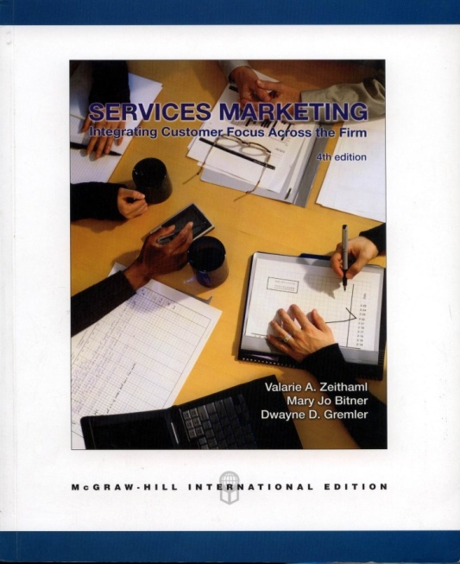
TOOLS FOR CONCEPT GENERATION
MK 324/352
Ajarn Suwalya K.

Slide 2
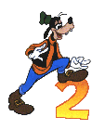
Relationships Analysis
Force combinations of dimensions …
(features, functions, and benefits) together.
Techniques:
  Two-dimensional matrix
  Multidimensional (morphological) matrix

Slide 3
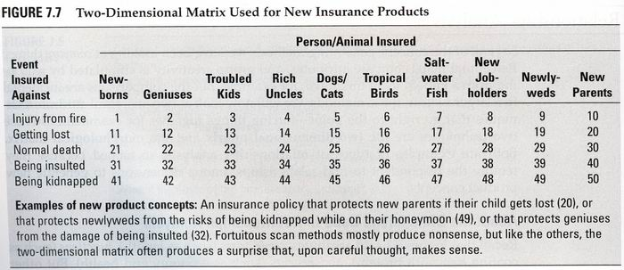
Relationships Analysis
Fig. 7.7
Two-dimensional example: person/animal insured and event insured against.

Slide 4
Relationships Analysis
Household cleaning products example used six dimensions:
  Instrument used, ingredients used, objects cleaned, type of container, substances removed, texture or form of cleaner

Slide 5


