Slide 1
Macroeconomics:
The Measurement of Economic Indicators (2): Measuring the Price Level and Unemployment
Thorn Pitidol
Faculty of Economics, Thammasat University
EE212, Semester 2/2017

Slide 2
Topics
Price indexes and inflation rates
Unemployment rates
Additional insights on GDP

Slide 3
Price indexes and inflation rates
Why measuring the changes in price?
  Price change in itself has crucial implications for the economy
    Inflation =
    Deflation =
  Inflation leads to a decline in the value of money
    Question: How would inflation affect the following parties?
      Debtors, employers, salary earners

Slide 4
Price indexes and inflation rates
Measurement of price changes
  Price Indexes (measuring change in prices for the same basket of goods and services)
Price Index for Year A =
x100
Inflation for Period A =
x 100

Slide 5
Price indexes and inflation rates
Examples of calculation
 | 2010 (Base Year) |  |  | 2011
 | Quantity (Q₁) | Price (P₁) | Spending = P₁xQ₁ | Price (P₂) | Spending = P₂xQ₁
Goods A | 12 | 15 |  | 17
Goods B | 4 | 45 |  | 60
Goods C | 18 | 15 |  | 15
Total value of spending
Price Index
Price Index for 2011 =
Inflation Rate for 2011 =

Slide 6
Price indexes and inflation rates
Types of price indexes
  Consumer Price Index (CPI):
  Producer Price Index (PPI):

Slide 7
Price indexes and inflation rates
CPI vs GDP Deflator
  GDP Deflator concerns prices of all goods and services in the economy, whereas CPI takes into account only prices of goods and services bought by consumers.
  CPI takes into account prices of imported products, while GDP Deflator does not.
  Finally, CPI is computed using a fixed basket of goods and services. GDP Deflator, on the other hand, allows the goods and services that its calculation takes into account to change over time.

Slide 8
Price indexes and inflation rates
Real interest rate
  Why using the real interest rate to calculate the return from loans?
    Example: You lend 100 bath to a friend. The inflation rate will be 10 percent. The interest rate you charge is 15 percent. What return from your loan will you actually receive?

Slide 9
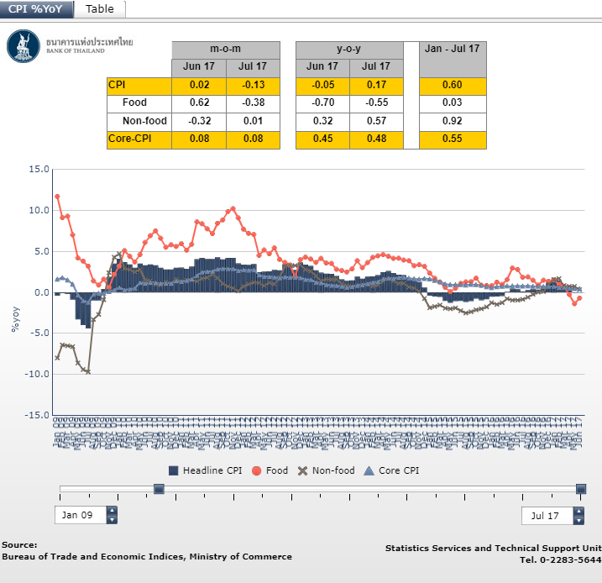
Price indexes and inflation rates
https://www.bot.or.th/English/Statistics/Graph/Pages/CPI.aspx

Slide 10
CPI, Thailand, 2013 (Base Year = 2011)
Description | weight | Jan. | Feb. | Mar. | Apr. | May. | Jun. | Jul. | Aug. | Sep. | Oct.
ALL COMMODITIES | 100 | 104.44 | 104.66 | 104.73 | 104.9 | 105.15 | 105.31 | 105.42 | 105.41 | 105.58 | 105.76
FOOD AND NON - ALCOHOLIC BEVERAGES | 33.48 | 106.59 | 106.51 | 106.79 | 107.99 | 108.93 | 108.85 | 108.62 | 108.79 | 108.96 | 109.62
RICE, FLOUR AND CEREAL PRODUCTS | 3.44 | 102.45 | 102.59 | 102.62 | 102.89 | 103.1 | 103.24 | 103.3 | 103.36 | 103.58 | 103.8
MEATS, POULTRY AND FISH | 6.35 | 103.07 | 105.13 | 105.16 | 106.45 | 107.09 | 107.49 | 108.06 | 109.49 | 109.73 | 109.5
EGGS AND DAIRY PRODUCTS | 1.77 | 101.02 | 102.18 | 101.68 | 101.7 | 104.3 | 106.18 | 104.35 | 105.35 | 107.71 | 107.56
VEGETABLES AND FRUITS | 3.95 | 116.49 | 110.46 | 113.55 | 120.7 | 126 | 123.05 | 120.97 | 118.82 | 117.91 | 123.03
SEASONINGS AND CONDIMENTS | 1.77 | 105.92 | 105.89 | 105.85 | 105.87 | 105.81 | 106.05 | 105.97 | 105.9 | 106.38 | 106.91
NON-ALCOHOLIC BEVERAGES | 1.76 | 103.65 | 103.76 | 103.75 | 103.63 | 103.81 | 103.81 | 103.91 | 103.98 | 103.9 | 104.14
PREPARED FOOD AT HOME | 8.97 | 107.94 | 108.26 | 108.21 | 108.49 | 108.66 | 108.72 | 108.48 | 108.76 | 108.88 | 108.99
FOOD AWAY FROM HOME | 5.46 | 104.73 | 104.99 | 104.8 | 105.05 | 105.07 | 105.26 | 105.6 | 105.65 | 105.8 | 106.02
APPAREL AND FOOTWARE | 3.06 | 101.29 | 101.29 | 101.3 | 101.42 | 101.9 | 102.01 | 102.02 | 102.03 | 102.11 | 102.15
HOUSING AND FURNISHING | 24.14 | 104.53 | 104.55 | 104.55 | 104.58 | 104.36 | 104.45 | 104.47 | 104.49 | 104.91 | 104.97
MEDICAL AND PERSONAL CARE | 6.54 | 101.76 | 101.85 | 101.82 | 101.83 | 101.84 | 101.93 | 101.92 | 102.02 | 102.07 | 102.11
TRANSPORTATION AND COMMUNICATION | 25.54 | 102.41 | 103.33 | 103.2 | 102.28 | 102.18 | 102.75 | 103.47 | 103.15 | 103.1 | 102.75
RECREATION AND EDUCATION | 6.03 | 100.66 | 100.71 | 100.8 | 100.75 | 100.74 | 100.94 | 100.94 | 100.98 | 100.98 | 101.11
TOBACCO AND ALCOHOLIC BEVERAGES | 1.2 | 107.78 | 107.78 | 107.85 | 107.84 | 107.84 | 107.94 | 107.95 | 107.95 | 109.21 | 111.49
NON-FOOD AND BEVERAGES | 66.52 | 103.05 | 103.42 | 103.38 | 103.04 | 102.94 | 103.22 | 103.51 | 103.41 | 103.57 | 103.52
RAW FOOD AND ENERGY | 26.91 | 108.55 | 109.13 | 109.42 | 109.9 | 110.69 | 111.05 | 111.46 | 111.26 | 111.62 | 111.99
RAW FOOD | 15.52 | 107.03 | 106.56 | 107.28 | 109.66 | 111.59 | 111.28 | 110.8 | 110.99 | 111.2 | 112.4
ENERGY | 11.4 | 111.28 | 113.25 | 112.96 | 110.92 | 110.21 | 111.45 | 113.05 | 112.32 | 112.89 | 112.16
EXCLUDE RAW FOOD AND ENERGY | 73.09 | 102.79 | 102.88 | 102.87 | 102.93 | 102.98 | 103.07 | 103.07 | 103.14 | 103.23 | 103.35
Source : Bureau of Trade and Economic Indices, Ministry of Commerce

Slide 11
PPI, Thailand, 2013 (Base Year = 2005)
Description | weight | Jan. | Feb. | Mar. | Apr. | May. | Jun. | Jul. | Aug. | Sep. | Oct.
Total Index | 100 | 139.6 | 139.9 | 139.5 | 139.5 | 141 | 139.4 | 138.5 | 138.7 | 140.1 | 139.7
Products of agriculture | 10.14 | 211.6 | 212 | 214.7 | 224.5 | 238.4 | 219.7 | 207.4 | 206.2 | 214.9 | 218.1
Crops | 7.05 | 244.9 | 243.9 | 247.2 | 258.8 | 276.8 | 249.4 | 231.5 | 228.9 | 240.5 | 244
Live-stocks | 1.7 | 130.3 | 133.4 | 133.6 | 139.5 | 145.2 | 146.9 | 146.6 | 148.6 | 148.2 | 144.9
Product of forestry | 0.05 | 135.2 | 135.2 | 135.2 | 135.2 | 135.2 | 135.2 | 135.2 | 135.2 | 135.2 | 135.2
Fish and other fishinng products | 1.34 | 121.5 | 125.1 | 127.4 | 132.6 | 134.3 | 136.9 | 139 | 141.1 | 145.6 | 154.6
Mining products | 2.92 | 103.9 | 105.3 | 102.1 | 98.9 | 99.7 | 101.9 | 105.3 | 106.9 | 108.4 | 106
Lignite, petroleum & natural gas | 2.44 | 90.4 | 91.9 | 88.2 | 84.8 | 85.7 | 88 | 91.7 | 93.5 | 95.1 | 92.5
Metal ores and other mining | 0.49 | 141.5 | 141.7 | 142.7 | 142.1 | 142.1 | 142.7 | 142.8 | 142.9 | 143.2 | 143
Manufactured products | 86.94 | 129.5 | 129.7 | 129 | 128 | 128.1 | 128.4 | 128.8 | 129 | 129.5 | 128.8
Food products,beverages & tobacco | 14.5 | 154.4 | 154.9 | 154.9 | 155.8 | 155.9 | 156.5 | 156.9 | 156.8 | 155.9 | 156
Textiles and textiles products | 7.59 | 115 | 115 | 113.9 | 114 | 114.4 | 114.7 | 115.2 | 114.9 | 114.9 | 114.9
Leather, leather products and footwears | 1.81 | 103.3 | 103.3 | 103.3 | 103.1 | 103.2 | 103.7 | 103.7 | 103.9 | 103.9 | 104
Wood and wood products | 1.08 | 127.5 | 127 | 127.9 | 126.9 | 127.1 | 127.5 | 128 | 127.7 | 127.8 | 127.6
Pulp, paper, paper products and printing | 1.85 | 110.7 | 110.7 | 111 | 110.9 | 111 | 111.1 | 111.2 | 111.2 | 111.4 | 111.5
Petroleum products | 9.09 | 146.2 | 148.7 | 145.7 | 140.4 | 142.2 | 145.7 | 149.2 | 150.9 | 154.1 | 149.6
Chemicals and chemical products | 5.06 | 113.5 | 113.8 | 114.1 | 113.3 | 112 | 112.1 | 112.7 | 112.9 | 113.9 | 113.8
Rubber and plastic products | 3.72 | 142.9 | 140.4 | 138 | 134.5 | 136.9 | 135.8 | 133.1 | 132.9 | 135.5 | 133
Non metallic mineral products | 2.87 | 121.4 | 121.6 | 121.8 | 121.9 | 122 | 122.2 | 122.3 | 122.6 | 122.6 | 122.7
Basic metals and fabricated metal products | 4.73 | 119.4 | 119.7 | 119.8 | 118.7 | 117.8 | 115.7 | 117.8 | 115.9 | 116.4 | 117.7
Machinery and equipment N.E.C. | 5.22 | 105.6 | 105.6 | 105.1 | 105.3 | 105.4 | 105.6 | 105.7 | 105.7 | 105.7 | 105.7
Electrical equipment N.E.C. | 15.7 | 99.3 | 99.3 | 99.3 | 99.2 | 99.1 | 99.1 | 99 | 98.9 | 98.9 | 98.9
Transpor equipment | 8.66 | 108.9 | 109.3 | 109.5 | 109.5 | 109.5 | 109.5 | 109.6 | 109.6 | 109.6 | 109.6
Other manufactured goods | 5.03 | 204.8 | 202.3 | 198.7 | 192 | 189 | 188 | 184.6 | 188.5 | 190.4 | 186.7
Source : Bureau of Trade and Economic Indices, Ministry of Commerce

Slide 12
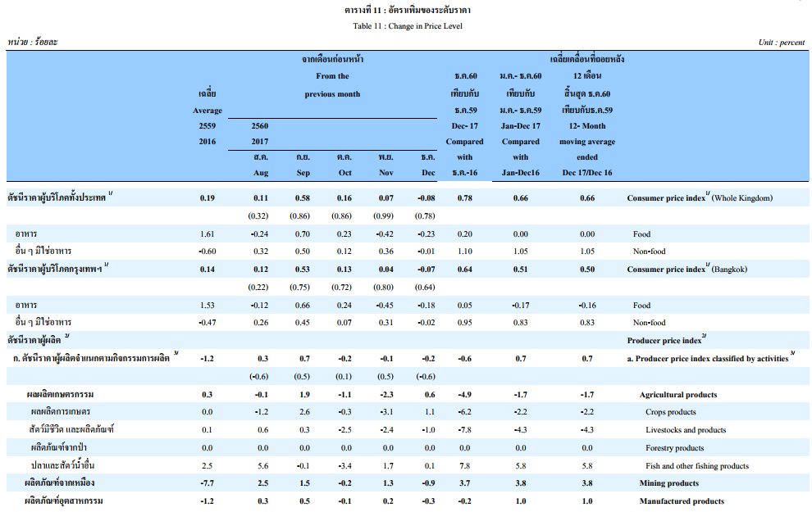
https://www.bot.or.th/English/Statistics/Indicators/Docs/tab11.pdf

Slide 13
Unemployment Rate
Unemployment
No. of Unemployed
Unemployment Rate =
X 100
Total labour fource

Slide 14
Unemployment Rate
Types of unemployment
  Frictional: occurs because it takes time for workers to move from one job to another.
  Cyclical: occurs through the recession of the economy.
  Structural: occurs when a labour market is unable to provide jobs for everyone who wants one because there is a mismatch between the skills of the unemployed and the skills needed.
    With structural unemployment, markets cannot adapt to correct the unemployment problem.
  Seasonal: occurs through a change of season, can be thought of as a less problematic form of structural unemployment.

Slide 15
Unemployment Rate
Actual calculation (Thai case)
Total Population (age > 15)
In the labour force
Not in the labour force
Housewives
Studying
Others
Employed
Seasonal unemployed
Unemployed
Unemployment = (Unemployed/Total Labour Force) x 100

Slide 16
Unemployment: Actual Calculation in Thailand
Term | Definition
Employed | Anyone age 15 or above, who in the week of survey, has the following characteristics 1) Work 1 hour or more and earn returns in the form of money or goods 2) Work 1 hour or more in an enterprise or a farm that belongs to a household or more, without receiving returns 3) Has not been working or work less than 1 hour (despite having been working before), but 3.1) still receives return from business or jobs while out of work 3.2) receiving no return from business or jobs, but will return to business or work
Unemployed | Anyone age 15 or above, who in the week of survey, has the following characteristics 1) Has not been working and has no permanent job for 30 days before the survey

Slide 17
Unemployment: Actual Calculation in Thailand
Term | Definition
Seasonal unemployed | Anyone age 15 or above, who in the week of survey, cannot be categorised as employed or unemployed. The person waits for appropriate season to work, and will usually work in farming or business that occurs seasonally.
Labour force | Anyone age 15 or above, who in the week of survey, is not categorised as being outside of the labour force and is also not categorised as seasonal unemployment.
Not in the labour force | Anyone with the following characteristics 1) Age under 15 2) Age 15 or above, but is not ready to work because 2.1 work as a housewife 2.2 studying 2.3 Too old (age above 60) 2.4 Cannot work due to disability or illness 2.5 Work for someone not in the household without receiving returns 2.6 Work for a non-profit organisation without receiving returns 2.7 Is not willing to work due to other reasons

Slide 18
Unemployment in Thailand, 2011
Population age above 15
(54.87 millions)
In the labour force
39.35 millions (71.7 percent)
Not in the labour force
15.52 millions (28.3 percent)
Employed
38.75 mil.
Seasonal
0.33 mil.
Unemployed
0.27 Mil.
Housewives
(4.68 Mil.)
Studying
(4.36 Mil.)
Others
(6.4 Mil.)
Unemployed
0.27
Unemployment =
X 100
Unemployment =
X 100 = 0.68
Labour force
39.35

Slide 19
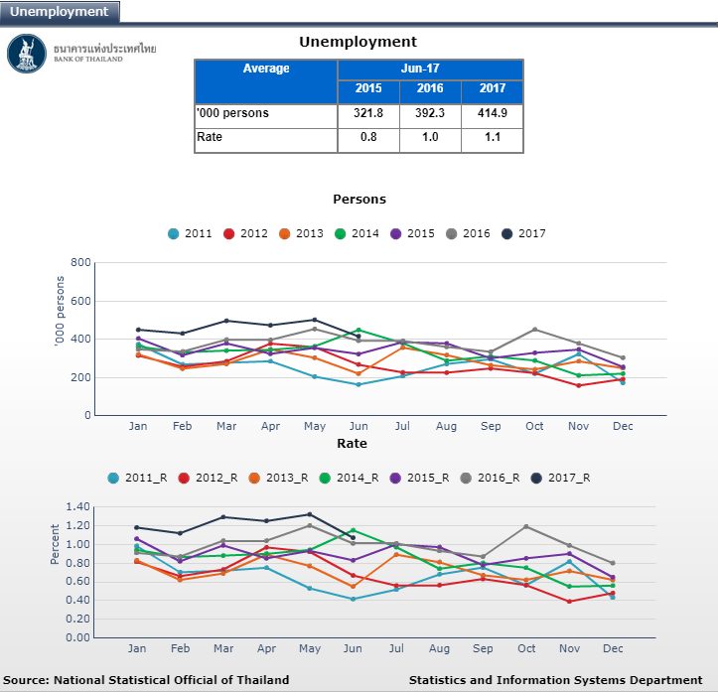
Thailand Unemployment Rate
https://www.bot.or.th/English/Statistics/Graph/Pages/Unemployment.aspx

Slide 20
Unemployment Rate 2011
% of total labour force

Slide 21
Thailand among the countries with the lowest unemployment rate in the world, why?
http://www.bloomberg.com/news/articles/2015-02-02/thailand-s-unemployment-rate-is-a-ridiculously-low-0-6-here-s-why

Slide 22
Additional insights on GDP

Slide 23
Why GDP does not measure well-being?
Several ways in which the measurement of GDP does not give an accurate picture of well-being.
  Some products are welfare-reducing (mostly in the longer-run)
  Loss of leisure
  Loss of human and social capital
  Welfare-reducing production methods
  Unequal distribution

Slide 24
Why GDP does not measure well-being?
The GDP dilemmas
Example;
  The Devastating Effects of Pollution in China
    http://www.youtube.com/watch?v=q4DtOhe2LfQ
  South Korea and Japan among the countries with highest suicide rate
    http://en.wikipedia.org/wiki/List_of_countries_by_suicide_rate
GDP cannot reflect some of the essential conditions, but should we abandon the use of GDP?

Slide 25
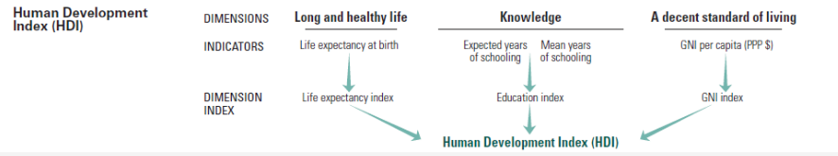
Human Development Index
“The HDI was created to emphasize that people and their capabilities should be the ultimate criteria for assessing the development of a country, not economic growth alone.”
UNDP

