Slide 1
THE EVs.
Peerapart Jamreugjang 6104640807
Thanchanok Pianmuean 6104640021
Nuntayod Tulakarnwong 6104641300
Inthad Thassaneephab 6104641292

Slide 2
INTRODUCTION

Slide 3
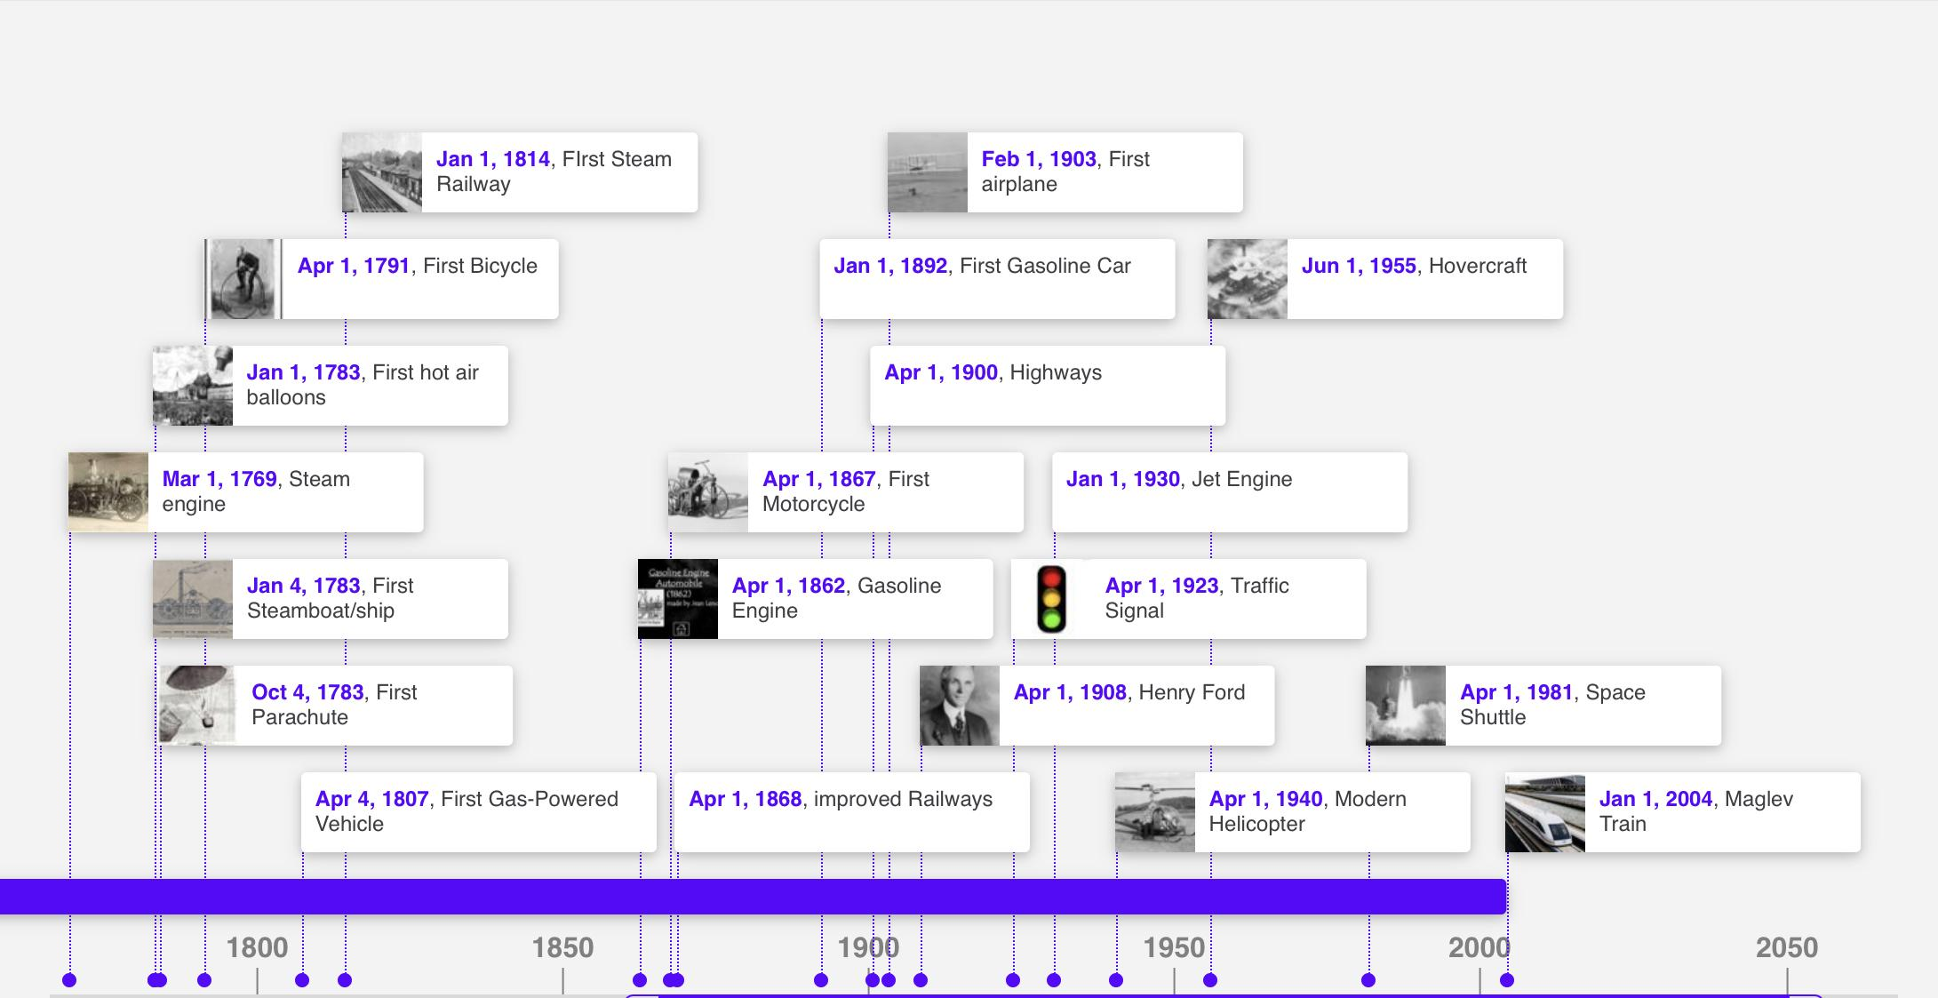
BACKGROUND
20th Century Transport
1919 Planes begin carrying passengers between London and Paris
1949 The first zebra crossing is made
1981 First flight of the space shuttle.
21th Century Transport
2004 Maglev Train
2008 EV : Tesla Roadster
2018 ITS

Slide 4
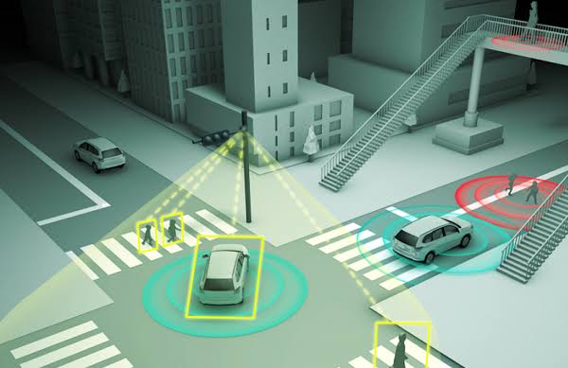
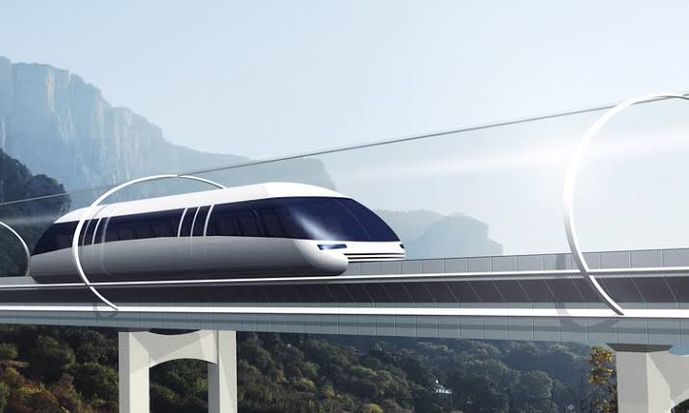

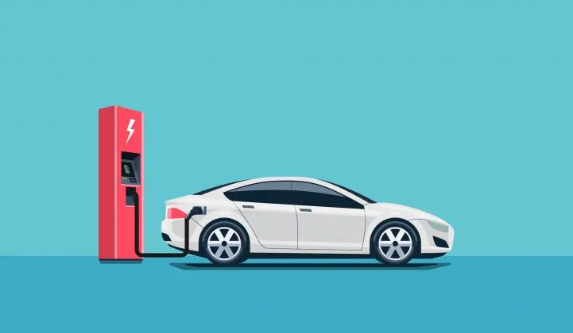
FUTURE TREND
Maglev trains
Hyperloop transportation systems
Smart roads
EV

Slide 5
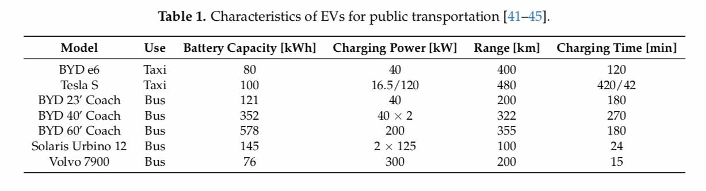
Electric Vehicles for Public Transportation
For private EVs, various models are sold in the market, such as the Nissan Leaf and Kia Soul EVs. However, these models may be not appropriate for taxis. In particular, the Nissan Leaf and Kia Soul have low distance ranges: 241 km for the Nissan Leaf and 179 km for the Kia Soul. The most appropriate models for ETs considered by investors and researchers are the BYD e6 and the Tesla S, due to their higher battery capacities and distance ranges.

Slide 6
Charging EVs for Public Transportation
Charging systems are crucial components for the adoption of EVs in transportation. Charging EVs for public transportation is a key challenge, as mentioned above, because of the higher amount of required electrical energy for charging EV batteries, as well as the time requirements.
These kinds of charging might be implemented in public charging stations, and must interact with power systems, the electricity market, and fleet operators, in order to meet their respective constraints.

Slide 7
FRAMEWORK

Slide 8
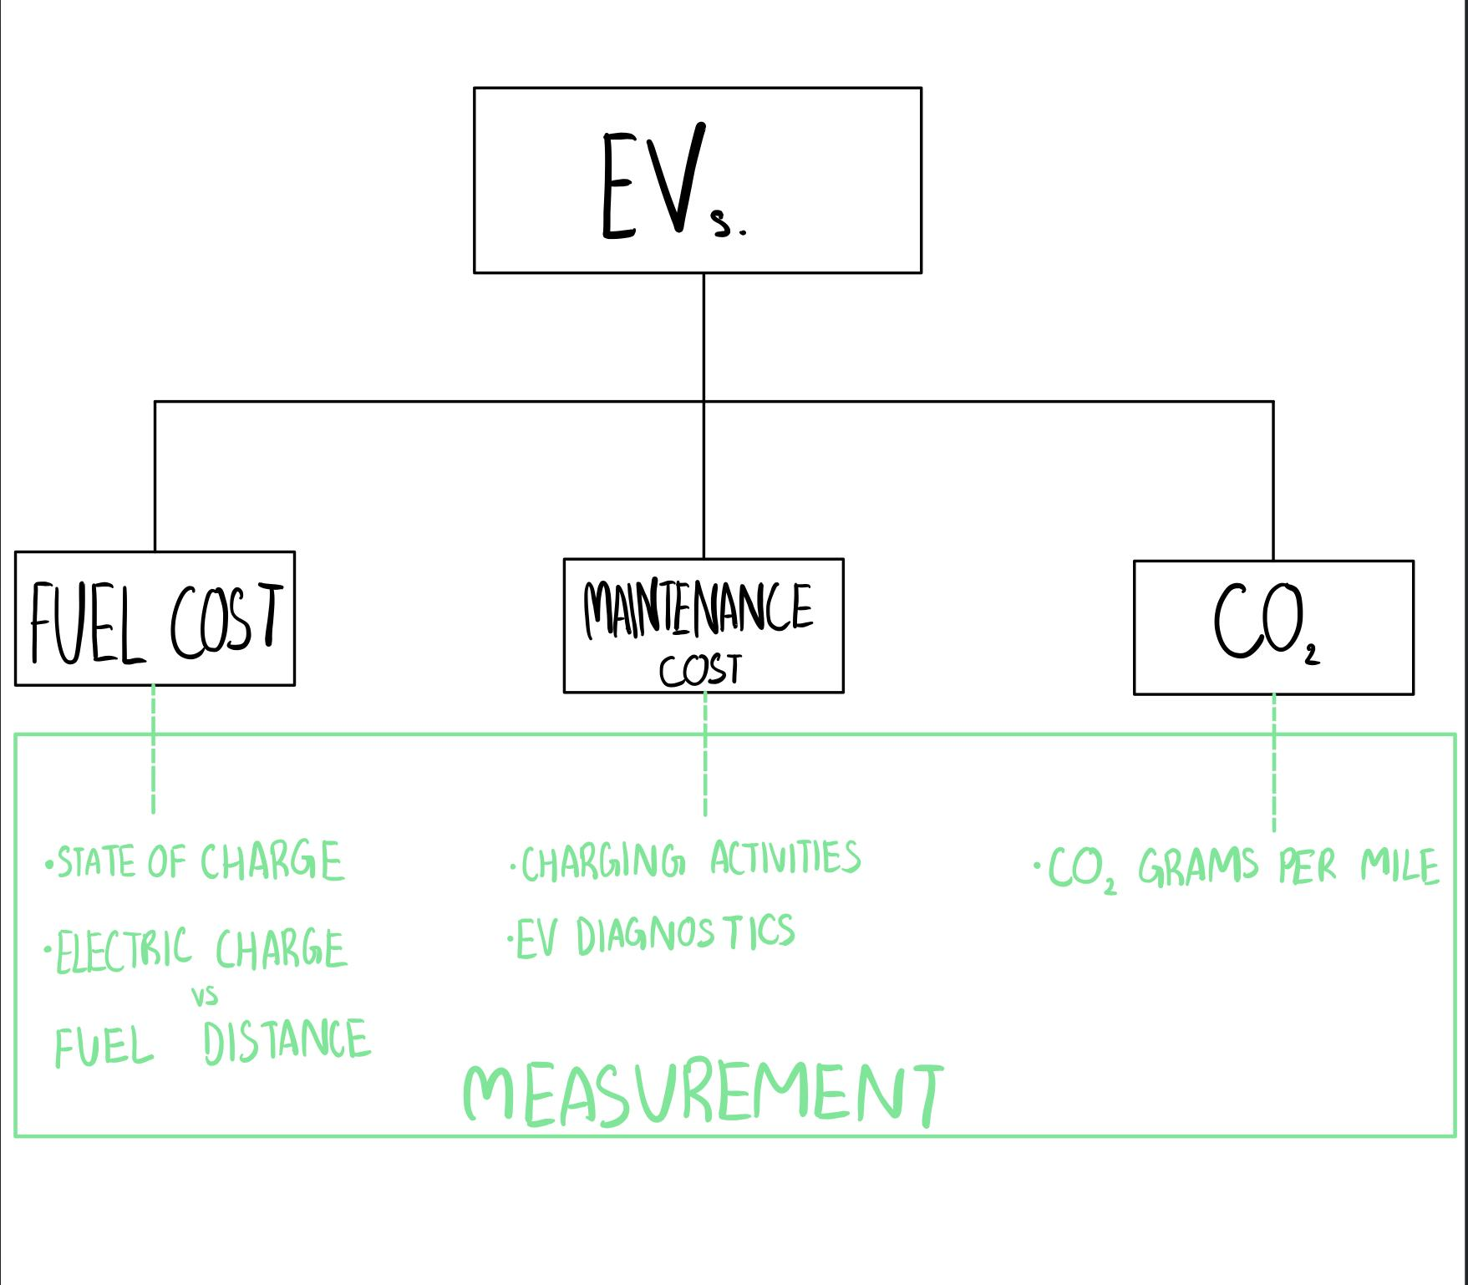

Slide 9
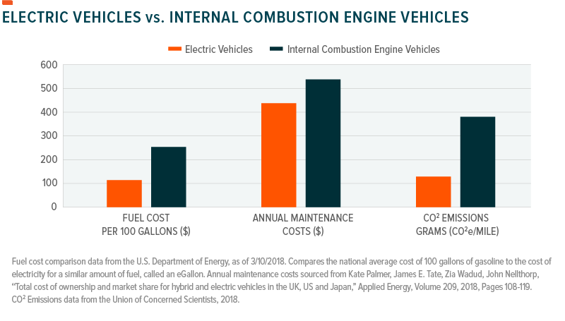

Slide 10
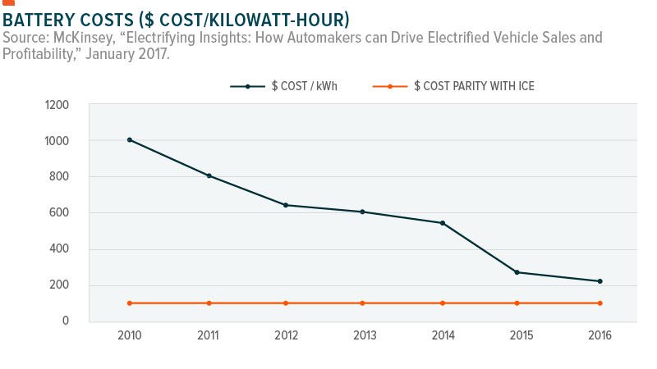

Slide 11
Impact of Electric Vehicles for Public Transportation
Electric Taxis (ETs) Approaches:
An economic analysis was performed, demonstrating that an ET fleet would reduce the costs considerably, compared to an ICV fleet. Some attention has been paid to system costs. The charging costs were defined as the loss of service income caused by charging. A plug-in ET driver can choose the ideal time slot to charge, considering the SOC, time-varying income, and queuing status at charging stations. Cost minimization was obtained through a game-theoretic approach. Another novelty concerning typical EVs is the use of taxi apps. Taxi apps allow for the finding of customers, which reduces empty cruising distance. It has also been considered that taxi apps will enable drivers to find the closest charging stations, with real-time information about charging availability.

Slide 12
Impact of Electric Vehicles for Public Transportation
Electric Bus (EB) Approaches:
The charging load model used statistical data of the travel patterns of EBs. The hourly number of EBs, starting charging time, travel distance, and charging duration were considered to be crucial variables for the forecast through prediction methods. Another exciting approach considers the scheduling of a wirelessly charged EB system. For this, an optimal methodology that minimizes system electricity costs was developed
Deploying ETs and EBs generates a new load that must be met by the power generation system. Thus, the question of optimal generation mix arises. The environmental effects of ETs and EBs were indicating a reduction of millions of kilograms of CO2

Slide 13
Methodology

Slide 14
Type of research
Quantitative research
Research methods
literature review
Use cost as measurement

Slide 15
:)

