Slide 1
The rise of absolutism in Siam
Thorn Pitidol
Thai Economic History
1/2018

Slide 2
Topics
The rise of absolutism in Siam
  Centralising the tax & building a new group of nobles
The building of the modern state
  Defining the borders
  Building forces
  Constructing ideologies
  Building bureaucracy

Slide 3
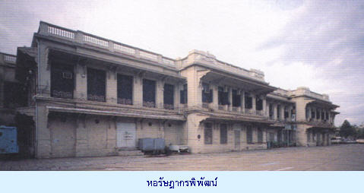
The rise of absolutism
Source: http://www.klangluang.com/th/images/stories/p4.5.jpg

Slide 4
Centralising the tax system
Rama V's centralisation of the tax collection enabled him to build “absolutist state” “centering” in Bangkok
  Full-time military, policemen, bureaucratic system, sangha, and the education system.
Source of funds? → cultivating peasants.

Slide 5
Centralising the tax system
Rama V gained control over taxes from Bunnags
  Starting from controlling Phra-Klang, and then expanded Phra-Klang control over taxes.
  The reformed tax system produced enormous wealth for Rama V.
    In 30 years (from 1890s), government income from taxes increased 35 times.

Slide 6
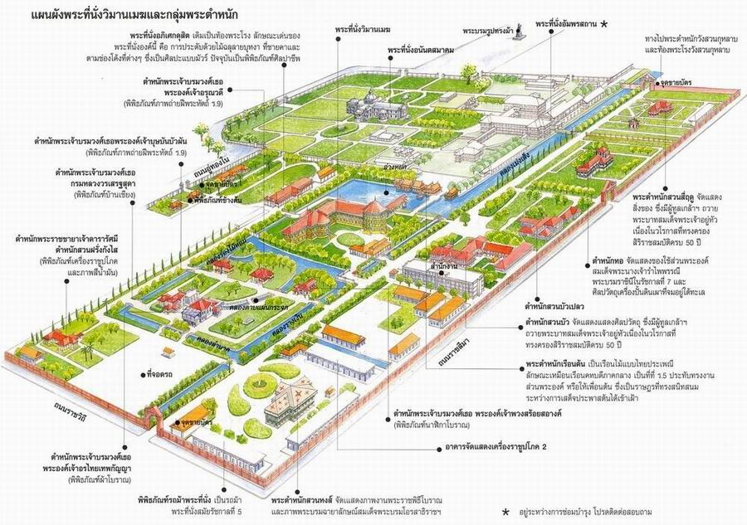
The rising wealth of Rama V

Slide 7
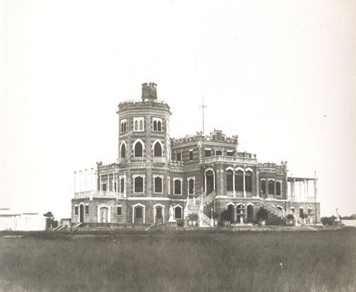
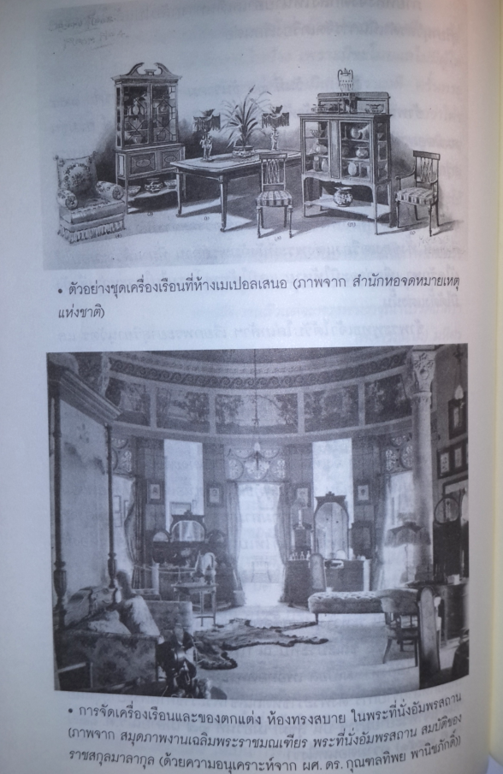
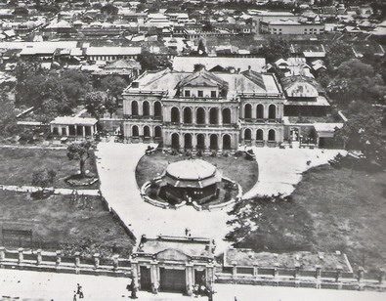
The rising wealth of Rama V

Slide 8
Centralising the tax system
Changing structure of taxes
  Moving to control taxes on liquor, gambling, and opium
Exploit the newer bases for taxes: peasants.
  Capitation tax (ratchupakarn) and land taxes
Other sources of government’s income were from logging and mining concessions.

Slide 9
Building the new group of nobles
The centralization of taxes led to the loss of power by the nobles
Rama V built his own new group of nobles
  Royal family sent for education abroad. Younger group of nobles from families such as Saeng-Xuto and Bunnag became Rama V’s loyal supporters.
  Together they formed a group called "Young Siam"
Country's administration reformed to system of ministries.
  The control of the ministries was given to members of royal family.

Slide 10
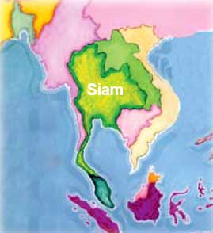
Building the absolutist state

Slide 11
Defining the borders
At first, Bangkok gov’t did not understand
But by 1880s, Bangkok enthusiastically started drawing borders and expanded control over the enclosed areas.
Thesapiban (protection over territory) system
  The system adopted from colonial systems in Malaya, India, Java, and Singapore.
  Bangkok appointed commissioners in the frontier areas

Slide 12
Defining the borders
From 1870-1900, Siam engaged with France and Britain over the drawing of borders.
  Competing ownership of areas that had multiple allegiance or belonged to no-one.
  Britain as alliance, but the relationship with France was more difficult.
    The clashed between Siam and France led to use of Maekhong as the border line.

Slide 13
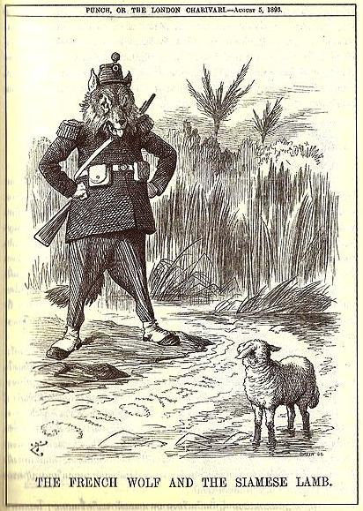
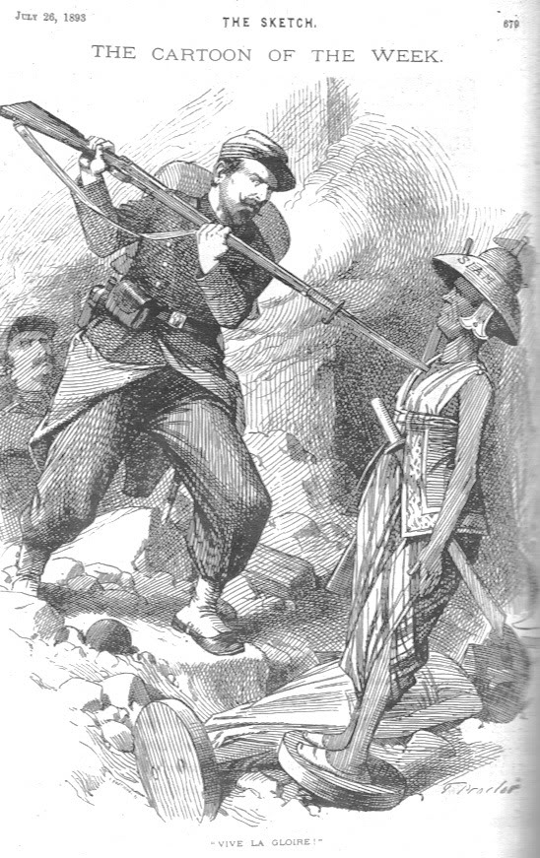
Defining the borders
Source: https://en.wikipedia.org/wiki/Franco-Siamese_War

Slide 14
Defining the borders
The new form of direct rule was created over the local rulers. Commissioners sent from Bangkok to rule and collect revenue.
  Reform of Kalahom and Mahatthai, with Mahatthai controlling all the provinces.
Benefits were exchanged to local rulers and old nobles
  They were allowed to hold on to their titles, given high salaries, and allowed a share of the government’s revenue.
  Their descendants adopted as part of the newly formed bureaucratic system.

Slide 15
Defining the borders
The reform of the governance system gradually extended until the new centralised system was completely established.
  Mahatthai replaced sakdina
  Mahatthai controlled the police, forestry, health, judicial, port.
The governance of the provinces adopted a pyramid structure from the center down to the villages.

Slide 16
Building the state's forces
Peasants rebelled against the rise in taxes and the control.
  Isan, the North, and the far South.
    Example: Phu-mi-bun rebels in Isan. The leaders of these rebels acted as local moral leader to liberate the locals from external oppression
  Many rebels supported by the ousted local rulers or nobility.
State’s forces developed to play a crucial roles

Slide 17
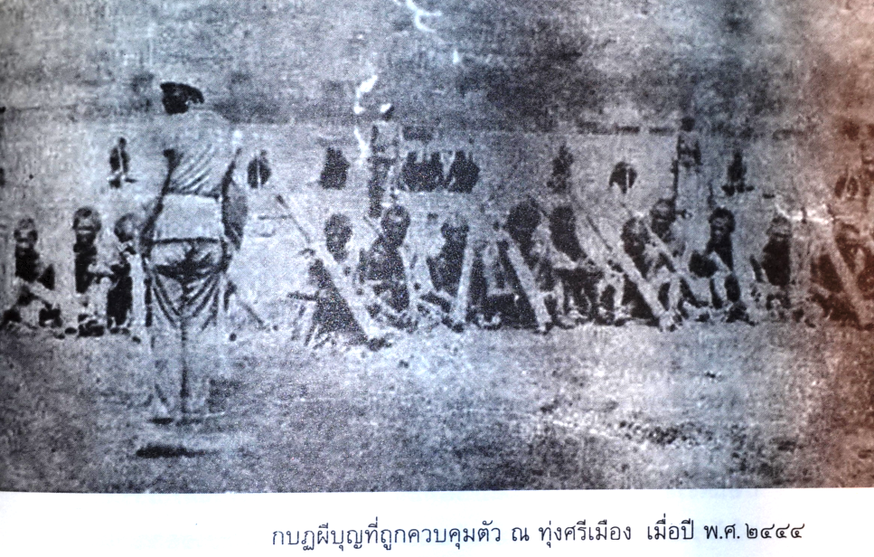
source: สายสกุล 2537 “กบฏไพร่หรือผีบุญ”

Slide 18
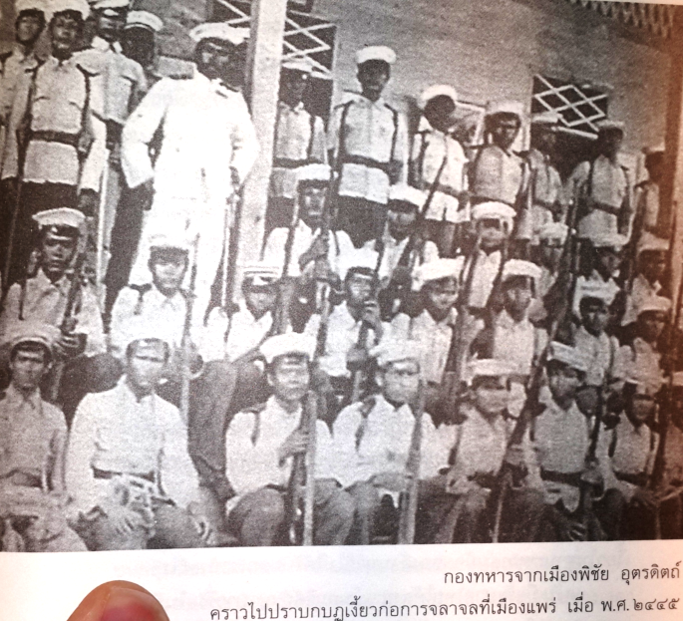
source: สายสกุล 2537 “กบฏไพร่หรือผีบุญ”

Slide 19
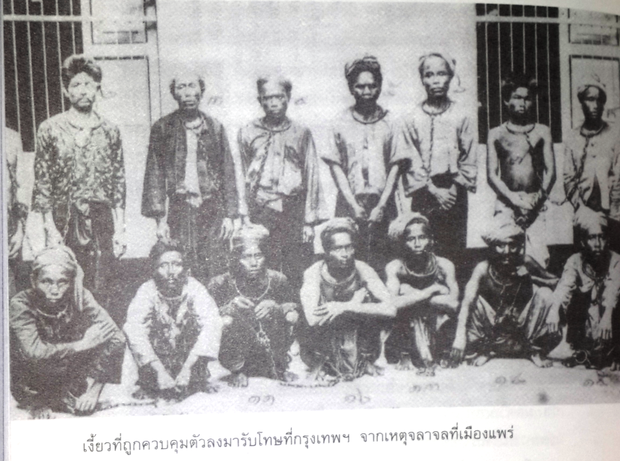
source: สายสกุล 2537 “กบฏไพร่หรือผีบุญ”

Slide 20
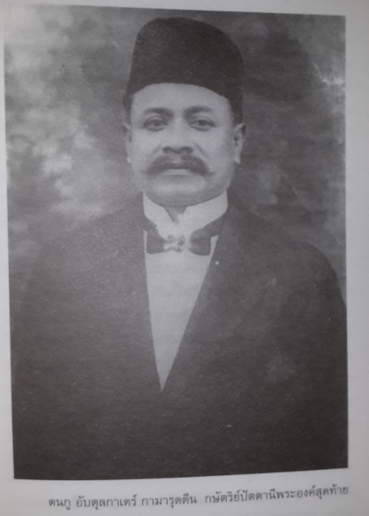
source: สายสกุล 2537 “กบฏไพร่หรือผีบุญ”

Slide 21
Building the state's forces
The government saw the need to establish a full-time military forces.
  The army was lacking personnel and training. Yet, the proposal was questioned.
It was thought that the military was to help resist colonization threats, but it was actually more about repressing the Chinese and the peasants.
  Internal affairs, not fighting external threats.
Military units were created in the rural areas. Conscription system was proposed. Full-time military finally in place as the government's finance improved.

Slide 22
Building the state's forces
The centrally controlled police force was also developed.
  Police actually existed but considered low quality.
  Phra-Klang needs made the use of police became more necessary.
Along with the creation of the police, a new centralised judicial system was created.
  Courts that used to be under different ministries were all brought under the newly created Ministry of Justice. Law school and bar association were formed.

Slide 23
Constructing the state's ideologies
To foster stability to the new governmental system, formation of ideologies needed.
  Overcoming actual diversities.
  Create cultural integration and allow the government to govern
Creation of “ideological apparatuses”
  Religion, language, education, and the new concept of “nation”

Slide 24
Constructing the state's ideologies
Buddhism Reform
  Centralized Thammayut Sect
  Monks rose through hierachical ranks; exams used to qualify them to higher position in the hierarchy.
Phra Wachirayan, Rama V’s brother, became the head of Thammayut Sect.
  He travelled to gain cooperation to the sect from local monks. The converted could gain in return the royal support.

Slide 25
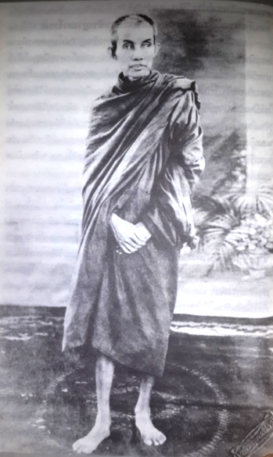
Phra Wachirayan, Rama V’s brother,
ที่มา: ปฐม (2551)

Slide 26
Constructing the state's ideologies
Education was reformed with Buddhism.
A standardised system was developed.
  Teaching a standard Thai language, arithmetic, and Buddhism.
The control of the schools was eventually handed to Mahattai.
  The school system expanded rapidly, and played a crucial role in establishing the more unified Thai culture.

Slide 27
Constructing the state's ideologies
A new idea of one nation under one King
  Process started from Rama IV, Prince Damrong furthered the task by developing the concept of the “Thai” or “Siamese” people.
  The Siamese history and tradition of Kingship starting from Sukhotai
A new idea of Tai race glossed over the ethic diversities
“Thai-ness” was broadened to cover Laotian and Shan. Older names of provinces that signified non-Thainess replaced

Slide 28
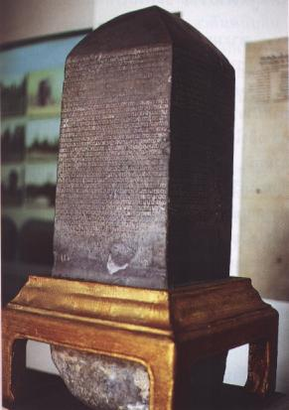
Constructing the state's ideologies
Source: http://guru.sanook.com/395/

Slide 29
Constructing the state's ideologies
From “Laotian” to being “Thai”
    “ลักษณะการปกครองแผ่นดินแต่เดิม นิยมให้เป็นอย่างประเทศราชาธิราช (empire) อันมีเมืองมีคนต่างชาติต่างภาษาเป็นเมืองขึ้นอยู่ในพระราชอาณาเขต จึงถือว่าเมืองชายพระราชอาณาเขต มณฑลนั้นเป็นเมืองลาว และเรียกชาวเมืองซึ่งอันที่จริงเป็นชนชาติไทยว่าลาว”
    Prince Damrong
    (กรมพระยาดำรงราชานุภาพ)

Slide 30
Constructing the state's ideologies
New concept “Chat” as “Nation”.
  Chat previously meant an idea of birth, race, and ethnic identity.
  Chat as “nation” → a population enclosed within a given territory, owing allegiance to a single authority (King).
This shift reflect a change in relationship between King and the people.
  Direct relationship between the King and the people
Provided basis for Rama VI to build Thai nationalism through the concepts of "Nation, Religion, and King".
  The King became the embodiment of the Thai nation.

Slide 31
Building the state's bureaucracy
The centerpiece of the new absolutist state: “bureaucracy”.
  It did the tasks “in the service of the King”.
  The head of system were new aristocrats defined by the Royal blood.
  With limited competition for its power, the bureaucrats became exceptionally powerful.

Slide 32
Building the state's bureaucracy
A large expansion of bureaucrats
  Between 1890 and 1919, the number of salaried officials grew from 12,000 to 80,000.
  Modern education system expanded as training for bureaucracy
    Civil service training school and the military academy were founded
  But attendances remained members of royal family and aristocrats.

Slide 33
Building the state's bureaucracy
Higher-ranks carefully limited to “phu-di”
  Royal and aristrocrat families,
  Or Chinese families and provincial nobles’ families.
    But not local rulers from Isan and Malayu
The divergent between higher-ranks and others
  The core of royal and aristocratic bureaucrats shape the culture and ethos of “Kha-ratchakarn” (the servant of the King).
  But some started to attach rather to the idea of them abiding texts and rules (lak-wicha).

Slide 34
Building the state's bureaucracy
Full-time military also led to the development of “military caste” and “military families”.
  The senior-ranking military commanders put their sons in the army.
  The military started developing its independent power.

Slide 35
Building the state's bureaucracy
Powerful bureaucrats contain contradictions, especially by assimilating culture from sakdina
  The culture of self-renumeration (kin-muang)
  The culture of patronage
The culture of self-renumeration
  Under Rama V such practices were actually allowed to continue as the salaries system was incomplete.
  Kin-muang also helped attract people to lower-ranks positions and the positions in far-away provinces.

Slide 36
Building the state's bureaucracy
The culture of patronage
  Nepotism dominated promotion.
  Higher ranks bureaucrats gathered followers to secured their position.
  The system of “phak-phuak” caused fragmented bureaucracy.
Patrimonialism continued to be the core of Thai bureaucracy.
  System worked through patronage and exchange of favors, and the power from civil society did not exist.

Slide 37
Evaluating the success of Rama V’s reform
Rama V great success in introducing centralised bureaucracy came at costs.
Cost of using compromise as the strategy.
  The old local rulers and nobles continued to earn benefits even under the new bureaucratic system where they have little roles.
  This led to an oversized and inefficient bureaucratic system from the start

Slide 38
Evaluating the success of Rama V’s reform
The modern bureaucrats was not yet developed, preferring to let the old culture persisted.
  This explain the persistence of the culture of corruption in Thai bureaucracy.
The aim to have blood-line underpinning access to high-ranking position contradicted the eventual development of professional bureaucrats.
  Leading to tensions facing subsequent Kings.

