Slide 1
CASH MANAGEMENT(7)
FN 323

Slide 2
What is Cash Management?
Broad service functions that help businesses process the cash transaction and management in an efficient manner
Cash Management

Slide 3
Cash management
Information Services
Liquidity Management
Payment/
Collection
Cash Management

Slide 4
Collection/Payment
Collection
Payment
Collection
Payment
Banks help you collect money from your clients
Examples:
Bill Payments
Cheque Deposit
Direct Debit
Banks help you pay money to your product/service providers
Examples:
Payroll
Direct Credit
Direct Cheque
Cash Management

Slide 5
Liquidity Management
Automatic Funds Transfer
Master Account
Account 2
Account 1
Account 3
Automatic Daily Summary
Reduce chance of mistakes
Get interest return
“Sweeping”
Cash Management

Slide 6
Information Service
Electronic Bank Statement
Cash Management Advisory
SMS Alerts
Cash Management

Slide 7
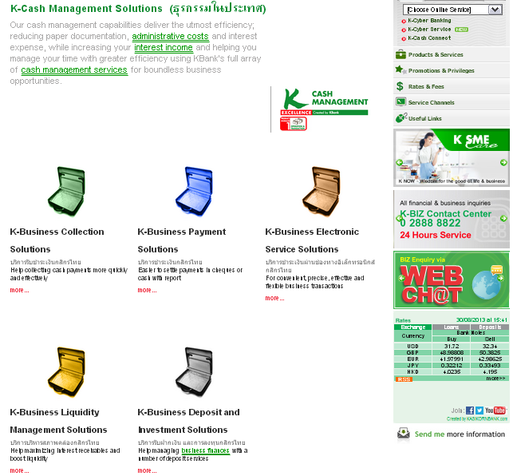
Link: www.kasikornbank.com/EN/Corporate/CashManagement/Pages/CashManagement.aspx
Cash Management

Slide 8
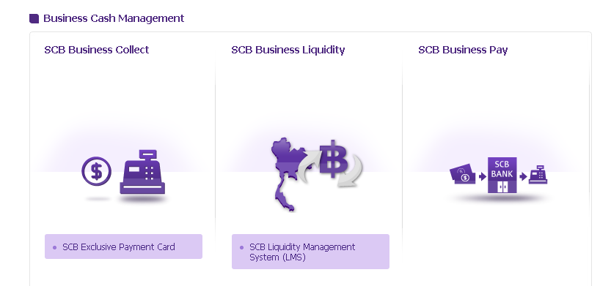
Link: http://www.scb.co.th/en/business-banking/collection-and-payment
Cash Management

Slide 9
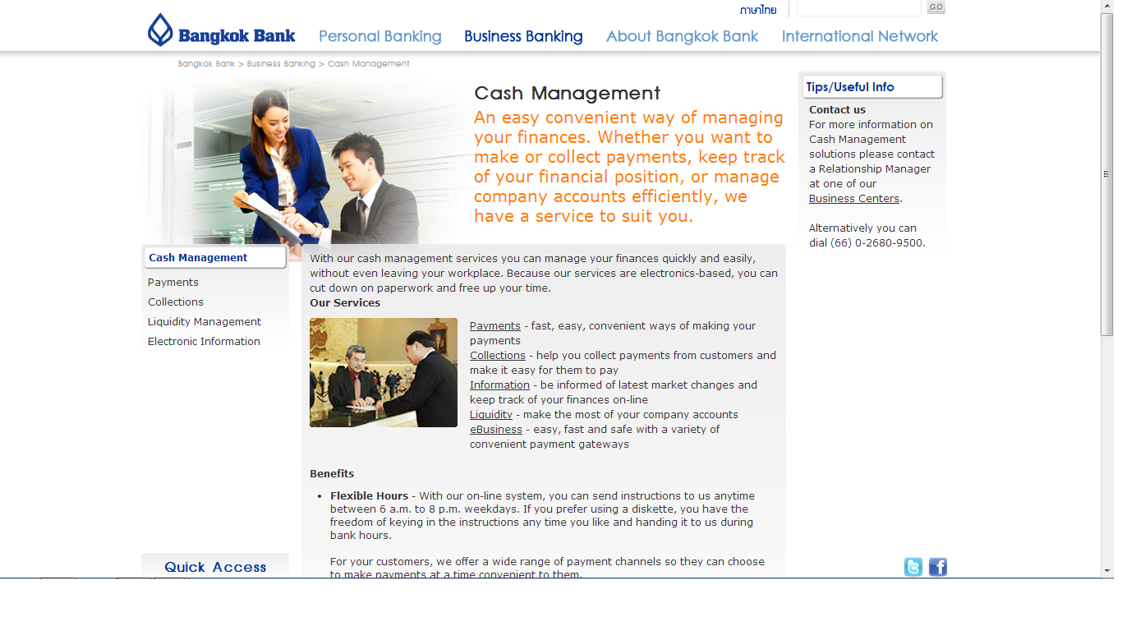
Link: www.bangkokbank.com/BangkokBank/BusinessBanking/SMEs/CashManagement/Pages/Default.aspx
Cash Management

Slide 10
Thank you for your attention
Cash Management

