Slide 1
PART 3

Slide 2
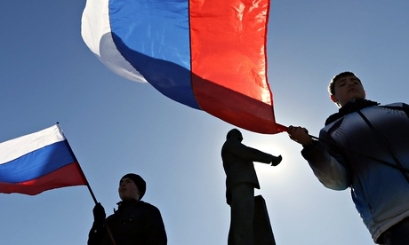
The Crimean Referendum

Slide 3
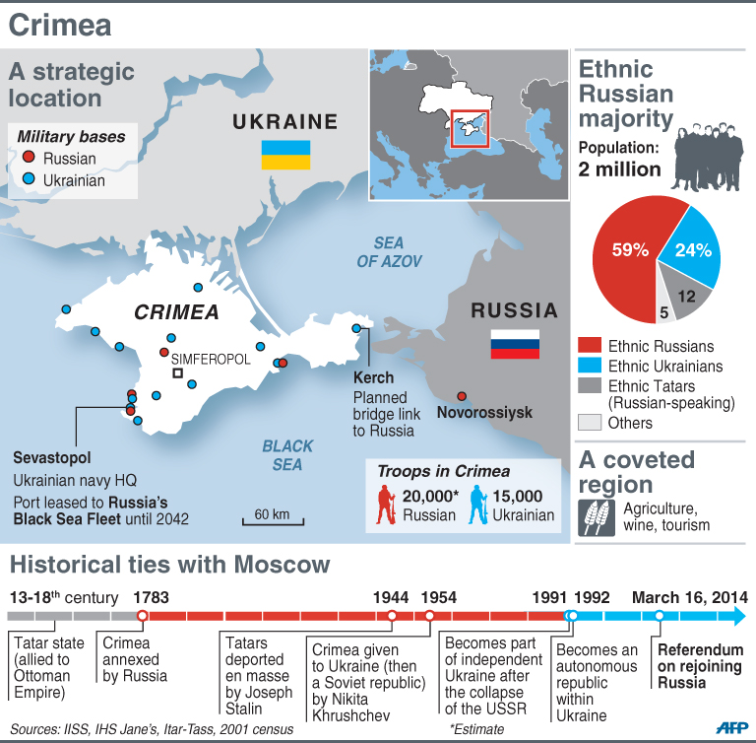

Slide 4
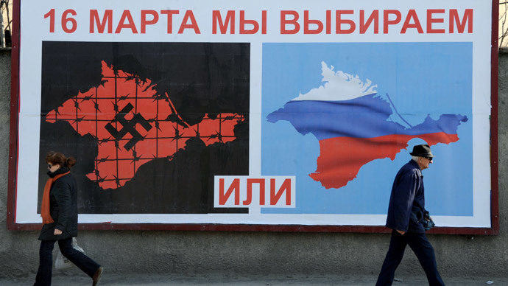

Slide 5
The Crimean Referendum
(1) In favor of the “reunification of Crimean with Russia as a part of the Russian Federation”
(2) In favor of “restoring the 1992 Constitution and the status of Crimea as a part of Ukraine”

Slide 6
Crimean Referendum:
Illegal? Illegitimate?
Domestic Law
  Article 73 of the Ukrainian Constitution: “Alterations to the territory of Ukraine shall be resolved exclusively by the All-Ukrainian referendum”.
International Law
  Not clear cut
  The right of self-determination
  No prohibition on unilateral declarations of independence

Slide 7
Crimean Referendum:
Kosovo Analogy?
Kosovo - declaration of independence (17 February 2008)
International Court of Justice (ICJ) – an advisory opinion(22 July 2010):
“The declaration of independence of the 17th of February 2008 did not violate general international law because international law contains no prohibition on declarations of independence”.

Slide 8
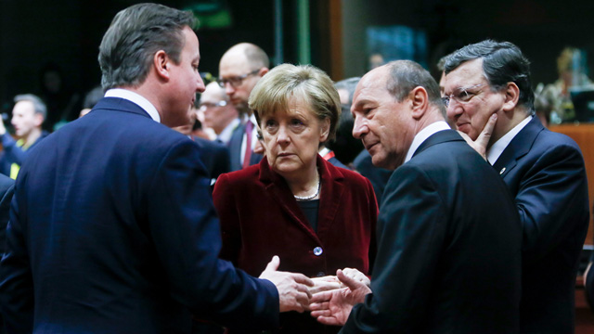
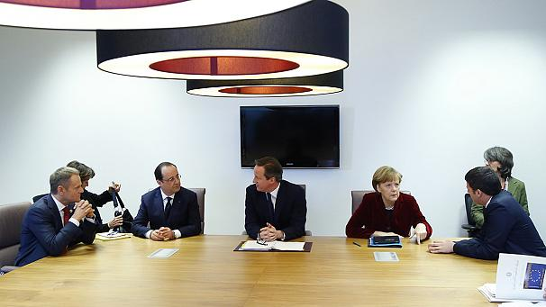
Brussels: David Cameron, Angela Merkel, François Hollande

Slide 9
The West: Politics of Sanctions
The referendum as illegal and illegitimate
Visa bans
Asset freezes on 21 Russian officials

Slide 10
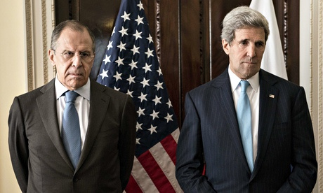
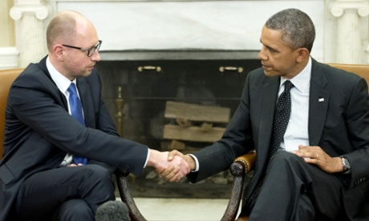
Sergei Lavrov – John Kerry
Arseniy Yatsenyuk – Barack Obama
Notes:
Obama meets Ukrainian prime minister Arseniy Yatsenyuk at the White House on Wednesday (14 March).

Slide 11
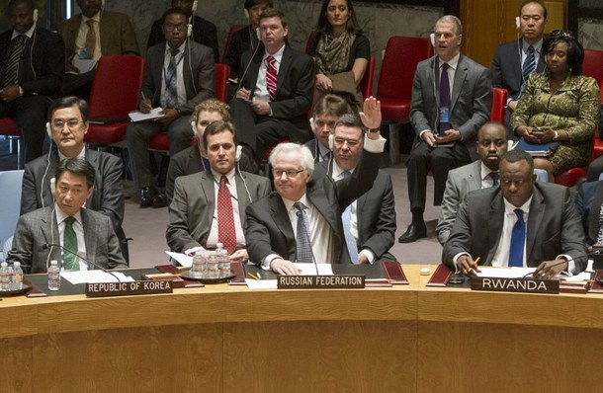
15 March: UN Security Council
Russia vetoed UN Security Council Resolution condemning Crimea referendum
China abstained.
Notes:
Russian Ambassafor to the UN Vitaly Churkin

Slide 12
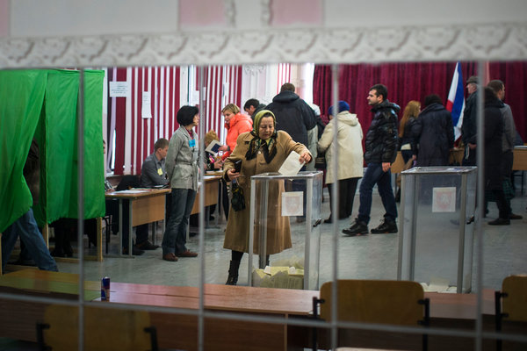
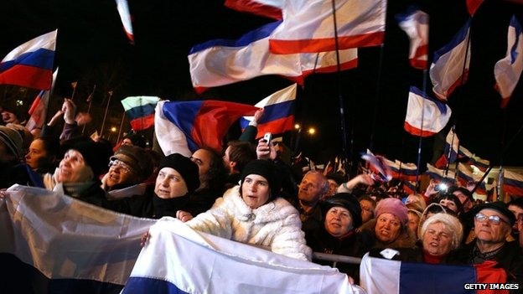
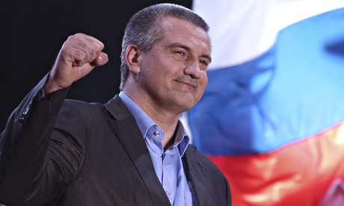
16 March: 96.8% for joining Russia

Slide 13
Crimea
Crimea’s parliament has formally declared independence from Ukraine and asked to join the Russian Federation
No Ukrainian laws
Adopting the Russian currency (ruble); clocks will move 2 hours forward to Moscow time by the end of March; Russian passports

Slide 14
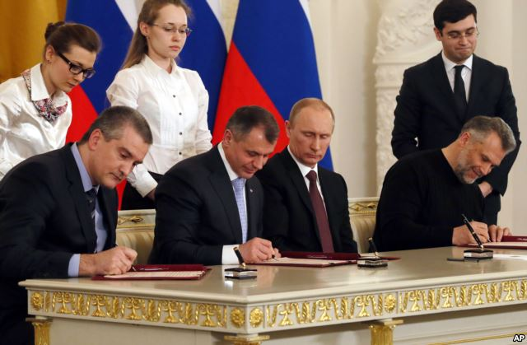
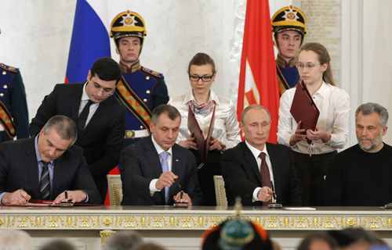
18 March: Russia-Crimea Treaty
Notes:
Russian President Vladamir Putin (second right), the State Council of Crimea Vladimir Konstantinov (second left), Chairman of the Council of Ministers of Crimea Sergei Aksyonov (left), and the mayor of Sevastopol Alexei Chaly.

Slide 15
18 March: Russia-Crimea Treaty
Putin accepted the Republic of Crimea into the Russian Federation
Crimea always was and is an “inseparable part of Russia”.
Referendum: “more than convincing”
Next Steps:
  Verification by the Constitutional Court
  Ratification by the Russian Parliament

Slide 16
Recent Developments in Crimea
Seizing Ukrainian naval bases in Simferopol and Sevastopol by pro-Russian forces and peoples
Ukraine’s plans to withdraw military personnel from Crimea; appeal to the UN to declare Crimea a demilitarized zone

Slide 17
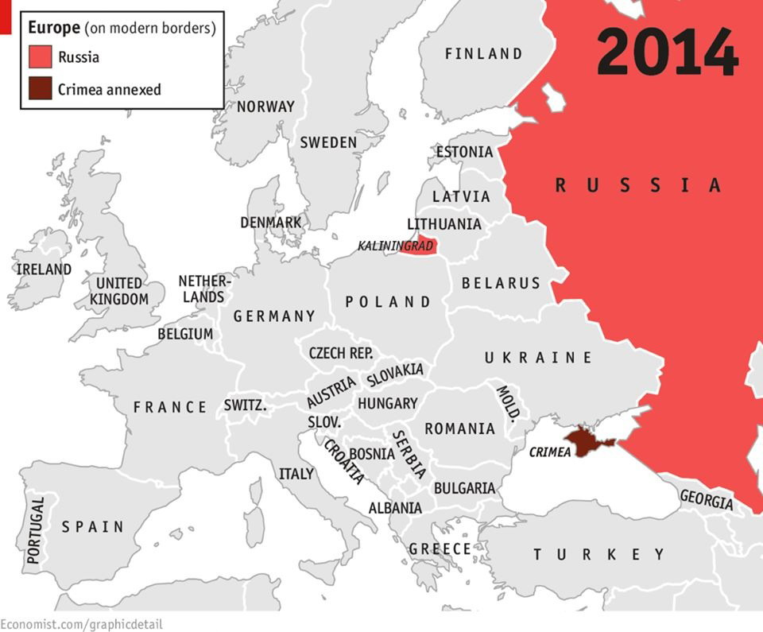
Russia

Slide 18
Russia-Georgia War (August 2008):
Lessons (Un)Learned?
Russia’s “Red lines”
  The prospect of NATO enlargement into the “near abroad”
  Russia fought back when fired upon.
Georgia’s decision to invade South Ossetia -- > Russia’s military intervention
Declarations of Independence: South Ossetia/ Abkhazia

Slide 19
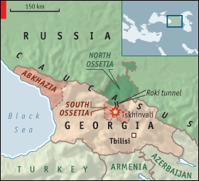
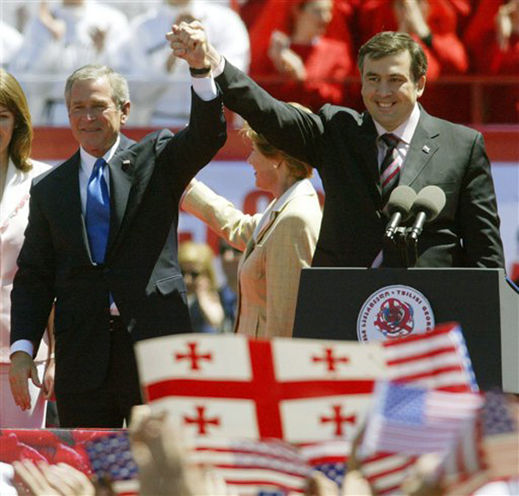
Russia-Georgia War (August 2008):
Lessons (Un)Learned?

Slide 20
Ukraine: Prospects
Weak State?
  Failed State?
  Bankrupt state? = loans with high strings attached (IMF)?
Federalization or decentralization as a way forward?
Russian-Ukrainian War?
International Military Intervention?

Slide 21
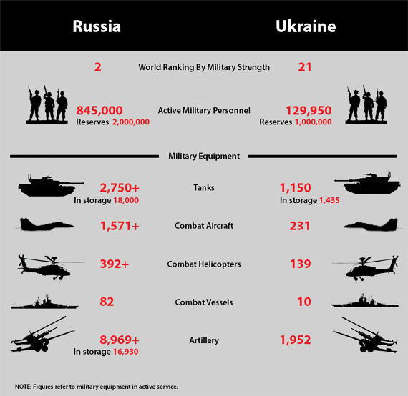
Russia vs. Ukraine

Slide 22
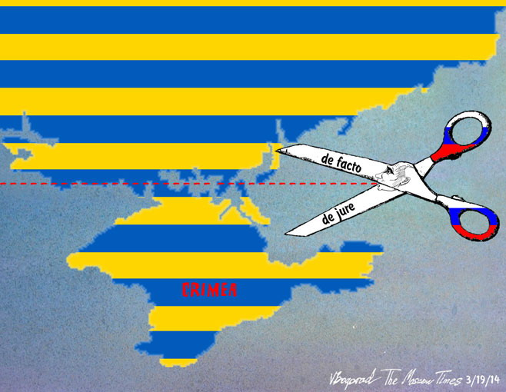
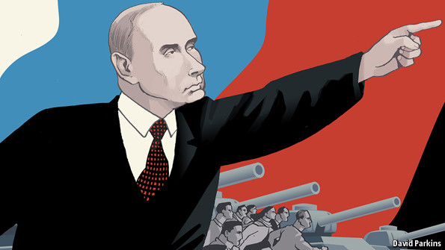
Conclusion: A divided Ukraine in a divided Europe?

