Slide 1
Review Session
For Midterm
5 March 2016

Slide 2
Finance Within the Organization
Board of Directors
Chief Executive Officer (CEO)
Chief Financial Officer (CFO)
Chief Operating Officer (COO)
Marketing, Production, Human Resources, and Other Operating Departments
Accounting, Treasury, Credit, Legal, Capital Budgeting, and Investor Relations

Slide 3
Stock Prices and Intrinsic Value
In equilibrium, a stock’s price should equal its “true” or intrinsic value.
Intrinsic value is a long-run concept.
To the extent that investor perceptions are incorrect, a stock’s price in the short run may deviate from its intrinsic value.
Ideally, managers should avoid actions that reduce intrinsic value, even if those decisions increase the stock price in the short run.
Notes:
-What exactly is intrinsic value?

Slide 4
Determinants of Intrinsic Values and Stock Prices
Managerial Actions, the Economic Environment, Taxes, and the Political Climate
“True” Investor Cash Flows
“True” Risk
“Perceived” Investor Cash Flows
“Perceived” Risk
Stock’s
Intrinsic Value
Stock’s
Market Price
Market Equilibrium:
Intrinsic Value = Stock Price
Notes:
-Don’t fully understand

Slide 5
Corporate Governance
The system of rules, practices and processes by which a company is directed and controlled
Balancing the interests of the many stakeholders in a company
Notes:
DEFINITION of 'Corporate Governance'
The system of rules, practices and processes by which a company is directed and controlled. Corporate governance essentially involves balancing the interests of the many stakeholders in a company - these include its shareholders, management, customers, suppliers, financiers, government and the community. Since corporate governance also provides the framework for attaining a company's objectives, it encompasses practically every sphere of management, from action plans and internal controls to performance measurement and corporate disclosure.
Read more: Corporate Governance Definition | Investopedia http://www.investopedia.com/terms/c/corporategovernance.asp#ixzz3wzuRxfBO
Follow us: Investopedia on Facebook

Slide 6
Conflicts Between Managers and Stockholders (Principal-Agent problem)
Managers are naturally inclined to act in their own best interests (which are not always the same as the interest of stockholders).
But the following factors affect managerial behavior:
  Managerial compensation packages
  Direct intervention by shareholders
  The threat of firing
  The threat of takeover
Notes:
-What are managers’ interests?
-What are stockholders’ interests?
-Explain these in detail
Managerial compensation packages
Direct intervention by shareholders
The threat of firing
The threat of takeover

Slide 7
Conflicts Between Stockholders and Bondholders
Stockholders are more likely to prefer riskier projects, because they receive more of the upside if the project succeeds. By contrast, bondholders receive fixed payments and are more interested in limiting risk.
Bondholders are particularly concerned about the use of additional debt.
Bondholders attempt to protect themselves by including covenants in bond agreements that limit the use of additional debt and constrain managers’ actions.
Notes:
-Give the background knowledge that firm’s money mainly come from these two sources; stockholders and bondholders. However, those two have some conflicts of interests.

Slide 8
Financial Markets and Institutions
Chapter 2
The Capital Allocation Process
Financial Markets
Financial Institutions
Stock Markets and Returns
Stock Market Efficiency

Slide 9
What is a market?
A market is a venue where goods and services are exchanged.
A financial market is a place where individuals and organizations wanting to borrow funds are brought together with those having a surplus of funds.

Slide 10
Types of Financial Markets
Physical assets vs. Financial assets
Spot vs. Futures
Money vs. Capital
Primary vs. Secondary
Public vs. Private
Notes:
-Explanation of each types; one for one slide

Slide 11
Types of Financial Institutions
Commercial banks
Investment banks
Notes:
-Definition and examples.
http://www.investopedia.com/ask/answers/061615/whats-difference-between-investment-banks-and-commercial-banks.asp

Slide 12
The Capital Allocation Process
In a well-functioning economy, capital flows efficiently from those who supply capital to those who demand it.
Suppliers of capital: individuals and institutions with “excess funds.” These groups are saving money and looking for a rate of return on their investment.
Demanders or users of capital: individuals and institutions who need to raise funds to finance their investment opportunities. These groups are willing to pay a rate of return on the capital they borrow.

Slide 13
How is capital transferred between savers and borrowers?
Direct transfers
Investment banks
Financial intermediaries
Notes:
-Explanation of each type

Slide 14
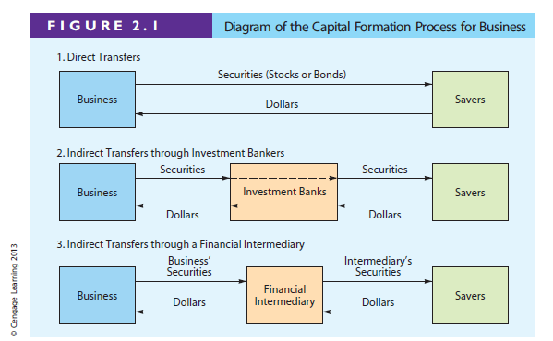

Slide 15
Stock Market Transactions
Applesauce Computer decides to issue additional common stock. An investor purchases some of the newly issued shares from the underwriter. Is this a primary market transaction or a secondary market transaction?
  Since new shares of stock are being issued, this is a primary market transaction.

Slide 16
What are derivatives? How can they be used to reduce or increase risk?
A derivative security’s value is “derived” from the price of another security (e.g., options and futures).
Can be used to “hedge” or reduce risk. For example, an importer, whose profit falls when the dollar loses value, could purchase currency futures that do well when the dollar weakens.
Notes:
May spend some more time to explain these

Slide 17
What are derivatives? How can they be used to reduce or increase risk?
Also, speculators can use derivatives to bet on the direction of future stock prices, interest rates, exchange rates, and commodity prices. In many cases, these transactions produce high returns if you guess right, but large losses if you guess wrong. Here, derivatives can increase risk.
Notes:
May spend some more time to explain these

Slide 18
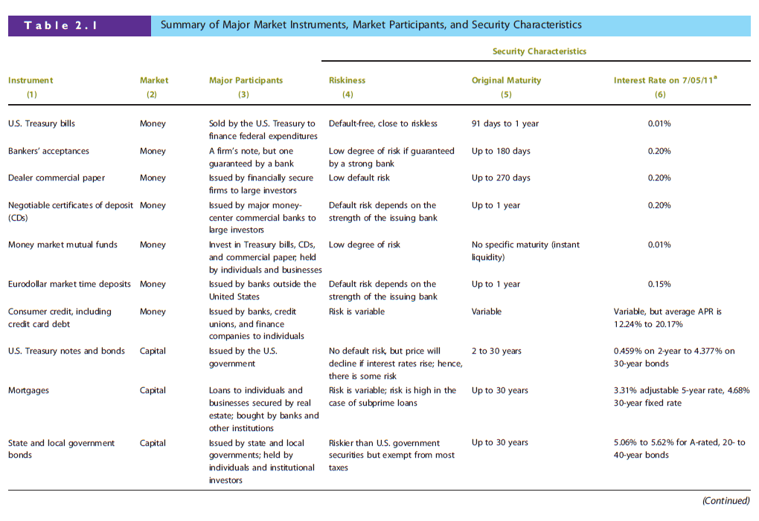
Chapter 2: Financial Markets and Institutions

Slide 19
Chapter 2: Financial Markets and Institutions

Slide 20
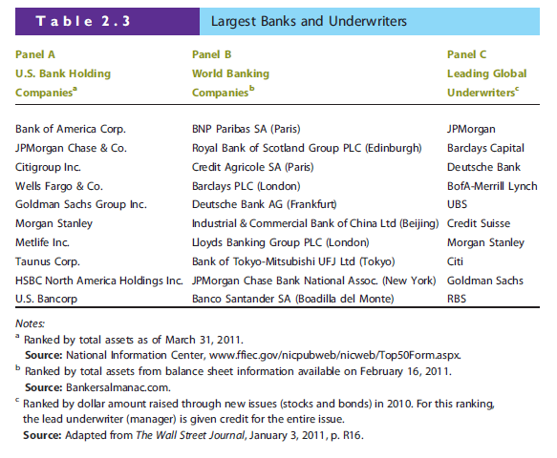
Chapter 2: Financial Markets and Institutions

Slide 21
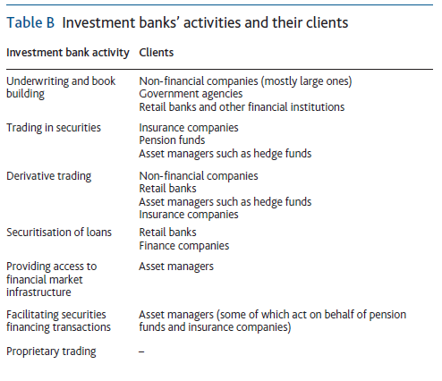

Slide 22
Investment Banks
Help firms raise capital ( funding) (financing)
Investment banks typically guarantees that the firm will raise the needed capital, therefore they are called the underwriters.

Slide 23
Financial Statements, Cash Flow, and Taxes
Chapter 3
Key Financial Statements
Balance Sheet
Income Statement
Statement of Cash Flows
Statement of Stockholders’ Equity
Free Cash Flow
Federal Tax System

Slide 24
The Annual Report
Balance sheet – provides a snapshot of a firm’s financial position at one point in time.
Income statement – summarizes a firm’s revenues and expenses over a given period of time.
Statement of cash flows – reports the impact of a firm’s activities on cash flows over a given period of time.
Statement of stockholders’ equity – shows how much of the firm’s earnings were retained, rather than paid out as dividends.

Slide 25
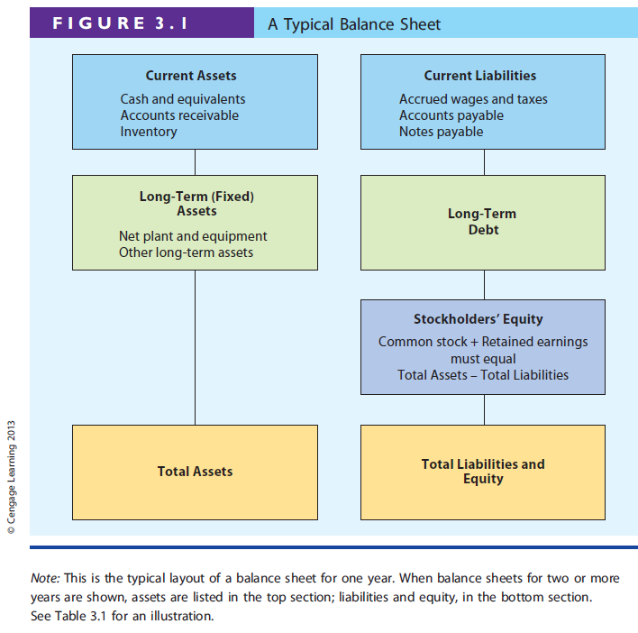

SNAPSHOT

Slide 26
Balance Sheet For Allied Food Products
It tells you net worth of this company
It also tells you the financial strength
A single year’s balance sheet is insufficient to reveal how well the company is run
  How assets are financed ( funded)
  Equity is increasing or decreasing

Slide 27
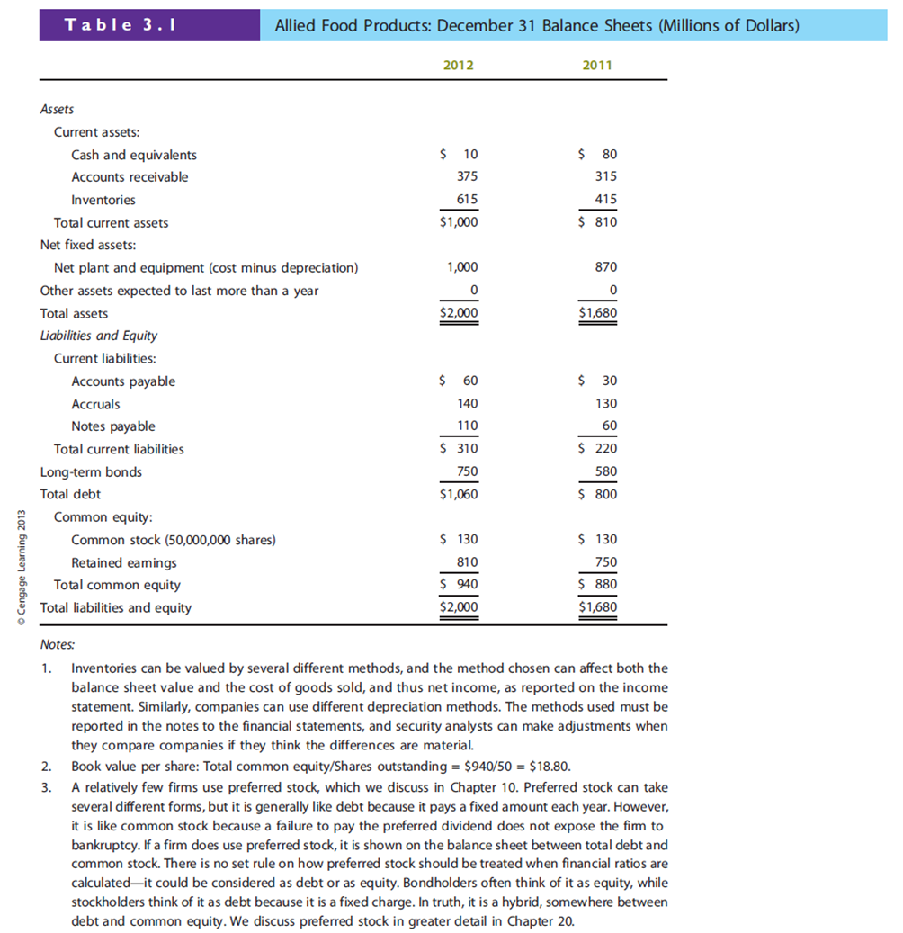

Slide 32
Depreciation
Accounting recognition of declining values of fixed assets
It can be used to reduce taxable income hence leads to lower taxes owed to the government (IRS)

Slide 33
Market VS book values
Allied purchasd its headquarter in Chicago in 1988
Value of the assets must be reported at the historical cost (what it paid in 1988) less depreciation
Market Values are much higher than the book values
If a company has problems, price can fall well below its book value

Slide 34
Balance Sheet is not static
Assets could vary enormously throughout the year
  Cash
  Inventories
  Accounts payable/ accounts receivable
  For example, retailers hold large inventories before the christmas shopping season. (seasonal adjustments)

Slide 35
If a firm reports $20 million of retained earnings on its balance sheet, could its directors declare a $20 million cash dividend without having any worries about what they were doing?

Slide 36
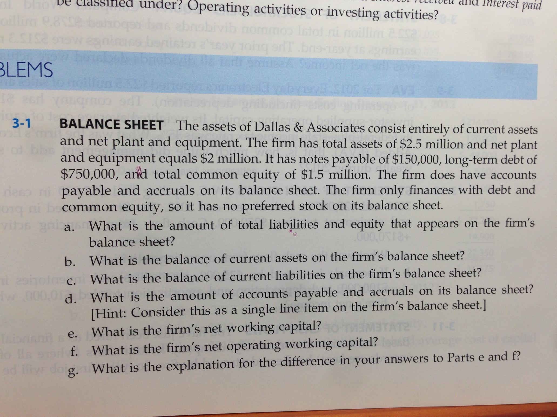

Slide 37
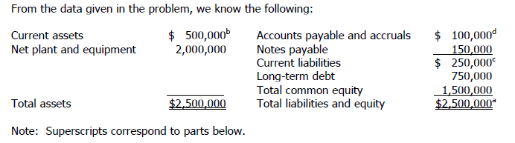

Slide 38
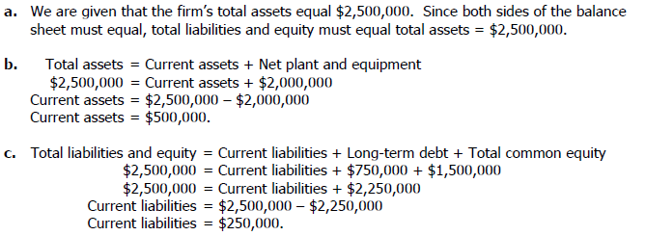

Slide 39
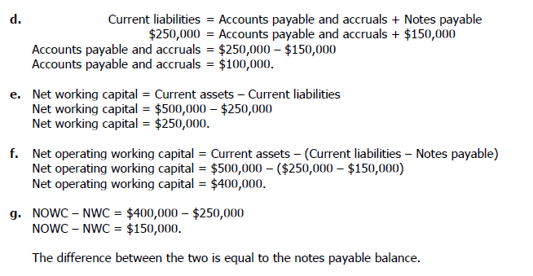

Slide 40
Income statement
Captures what has happened to the firm in terms of operation , sales, profits etc
Contrast this with the Balance Sheet

Slide 41
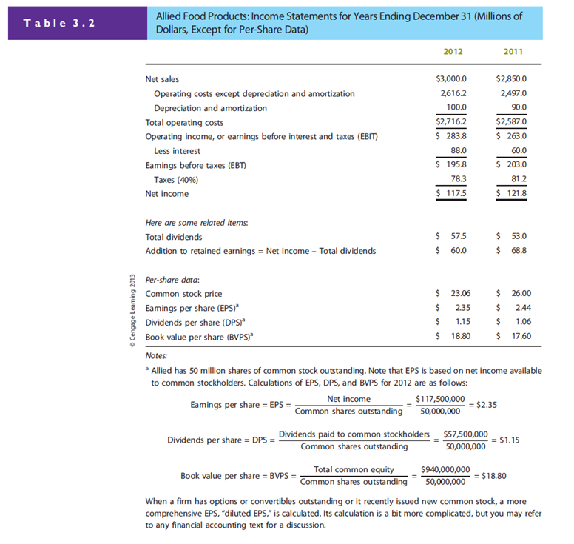
How do we find EBITDA ?

Slide 44
(Net Income/ no of shares) Earnings per share is the bottom line

Slide 48
Operating Income VS Net Income
Why are they not equal?
  What else contributed to net income
Which one should we pay more attention to?
  Why? If we want to buy a business, what number should we really look at?

Slide 49
Operating income
Derived from regular core business
Calculated before taking into account of interest expenses and taxes
Different firms have different amount of debt, tax structures (carry backs and carry forwards) and different non-operating assets( stocks or bonds , real estate or other investment in other companies)
Also, net income differs depending on how firms finance itself ( debt or equity)

Slide 50
Which one is likely to report higher net income?
Is it always the case?
  Apple computer issued bonds back in 2011 even though it is awash with cash ( why borrow cash if you already have ample cash with you)
Operating income is much more stable than the net income ( agree?)

Slide 51
Depreciation & Amortization
Depreciation ( tangible assets)
Amortization( intangible assets)
  Disney reported higher D&A from its amortization of Lucasfilm ( which owned star wars, indiana jones)
Why are D&A not the same as Asset purchase?
  Time dimension is important.
Both of them write off the costs of assets over its life ( this is subject to variations)
They are not cash expenses therefore the concept of EBITDA is introduced as managers sometimes are more concerned over the cash generation
Net income= dividends+ retained earnings

Slide 52
STATEMENT OF CASH FLOWS

Slide 53
Cash flows
This is to be used in conjunction with balance sheet and income statement to check consistencies and accounting irregularities
This traces the movement of cash over a period of time ( monthly, quarterly, annually)
Income statement is recorded on an accrual basis as opposed to on actual cash movements
Beware of firms which record positive net incomes , but continue to lose cash
It differentiates between cash and non-cash charges

Slide 54
What generates cash?
Accounts payable
Accrued wages and taxes
Reduction in inventories
Sale of assets
Loans from banks, capital markets
Issuance of Bonds/ Stocks

Slide 55
What loses cash
Accounts receivable
Inventory buildup
Investment in securities or long-term assets
Bond buybacks, stock buybacks
Repayment of bank loans
Dividend payments to stockholders

Slide 56
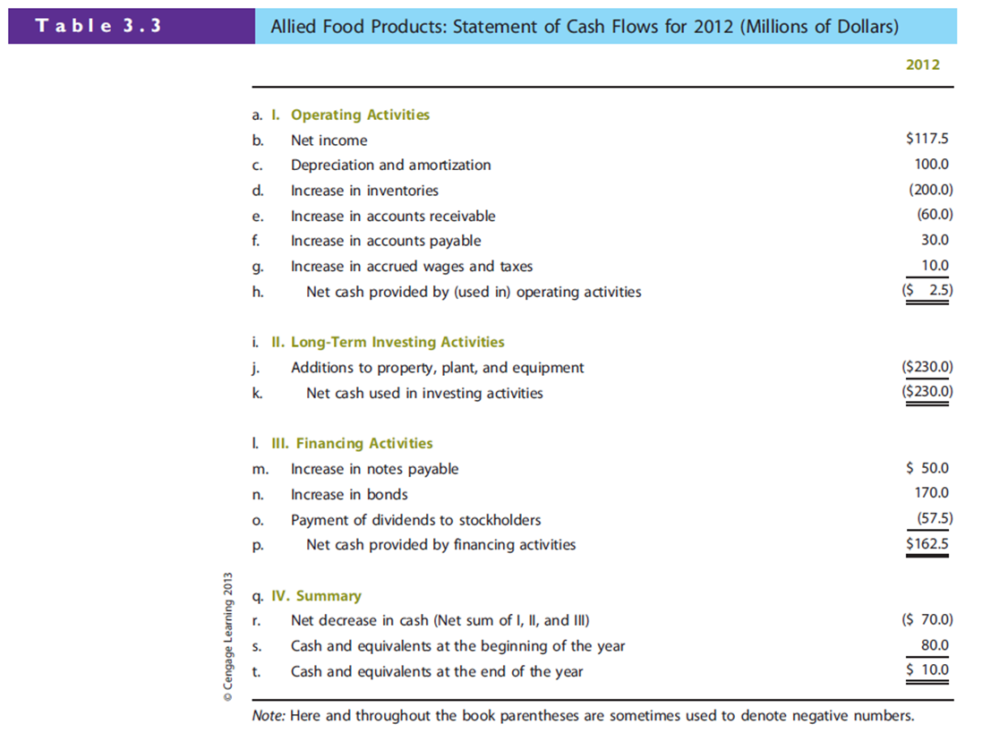

Slide 58
So what should we make of Allied Cash Flows?
Is firm running positive cash flow over time
Is cash position stable year to year
Long term investment should equal depreciation over time.

Slide 59
Massaging the numbers
Accounting fraud can take place both in income statement (more often) and statement of cash flows(less common).
Cash is harder to fabricate as it involves actual cash movement ( provided that the auditor is honest and reliable)
In 2005 Ford, GM and other companies overstated their operating cash flows, the most important section of the cash flow statement

Slide 60
GM reported more than twice as much as from operations (7.6 bn VS 3.5 bn)
HOW?
When GM sold cars to dealers, it should list the transactions as Account Receivable, but instead GM recorded these as “ Loans to dealers” and reported them as financing activity
The net cash position was NOT affected, but it made GM appear stronger than it really was

Slide 61
Try it with Allied Food in Table 3.3
Let s try to massage the book for Allied Food and see what happens

Slide 62
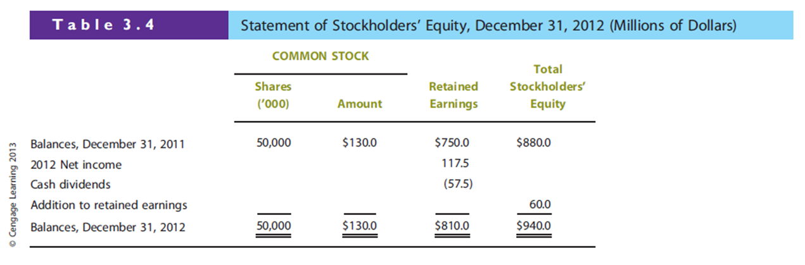
Retained Earnings are not the same as cash in hand.
They represent reinvestment in to the company over time
since the company s inception

Slide 63
USES and Limitations of financial statements
How large is the firm
Growing or shrinking?
Profitable or loss-making
Cash cows or Cash strapped firms

Slide 64
FREE CASH FLOWS (FCF)
Not reported by the financial statements as prepared by accountants
FCF defined as” the amount of cash that could be withdrawn from a firm without harming its ability to operate of produce future cash flows”

Slide 65
FCF = [EBIT(1-T) + Depreciation & Amortization]
    - [Capital Expenditures + Change in NOWC]
Negative Free cash flows means the business cannot generate cash to invest and expand , hence in need of extra funding from the capital market or bank loans

Slide 66
Most analysts regard FCF as the most important number that can be developed from the financial statements , even more important than net income
FCF shows how much cash can be disbursed to its investors ( Owners Earning).
FCF can be used to calculate stock valuation and capital budgeting

Slide 67
TAXES

Slide 68
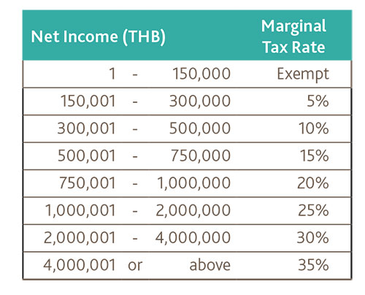

Slide 69
Corporate Loss Carry-back and Carry-Forward
Operating losses can be carried back to the preceding two years or carried forward for the next twenty years and used to offset taxable income in those years.
Can use this to reduce net income in previous years and in the future periods

Slide 70
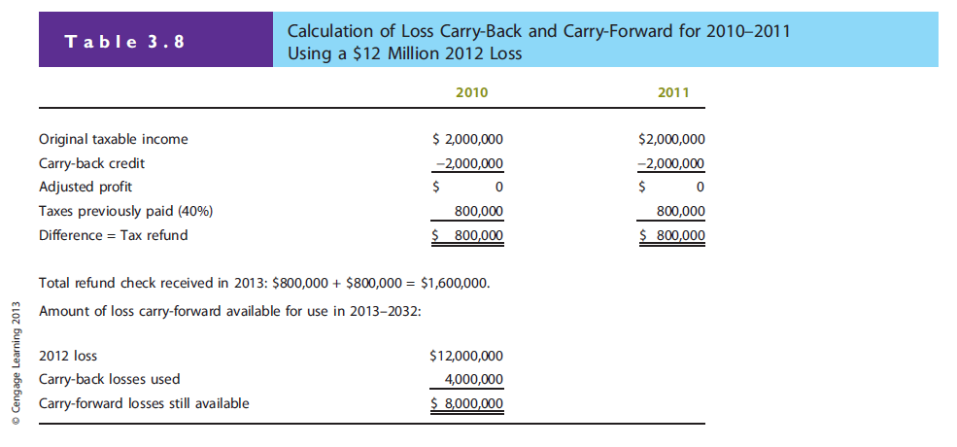

Slide 71
Interest and Dividends paid
Interest paid can be deducted from operating income but dividends paid cannot be used.
DEPRECIATION
  Also plays an important role in income tax calculations
  The larger the depreciation, the lower the tax bill and therefore higher operating cash flows

Slide 72
Conclusion
Sales are vanity
Profits are sanity
Cash is reality

