Slide 1


MK 312 Integrated Marketing Communications
Let’s RECAP
IMC, AIDA, SMILE, Brand Lovemarks
By Ajarn Suwalya K.
November 2, 2020

Slide 2


Slide 3
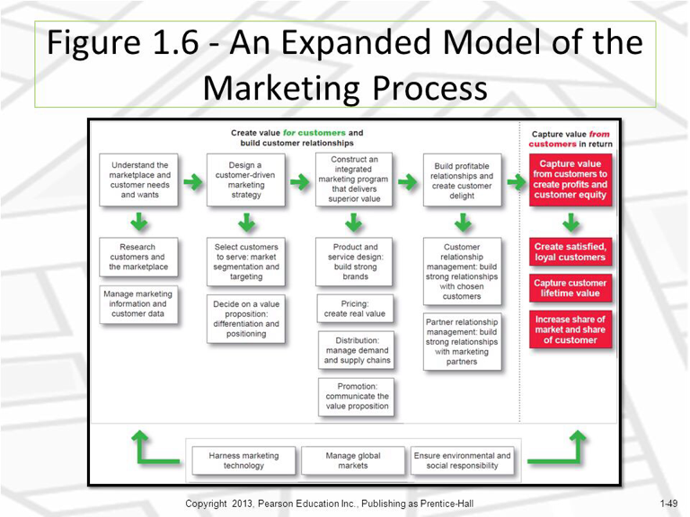

Slide 5
We may not want to serve everyone
Undifferentiated (mass) marketing
Differentiated (segmented) marketing
Micromarketing (local or individual marketing)
Concentrated (niche) marketing
Market segmentation
Target market
Geographic segmentation (countries, regions, cities, urban/rural, postcode)
Demographic segmentation (age, gender, family size, income, occupation)
Psychographic segmentation (social class, lifestyle, personality)
Behavioural segmentation (consumer knowledge, attitudes, product usage)
Targeting
broadly
Targeting
narrowly

Slide 6
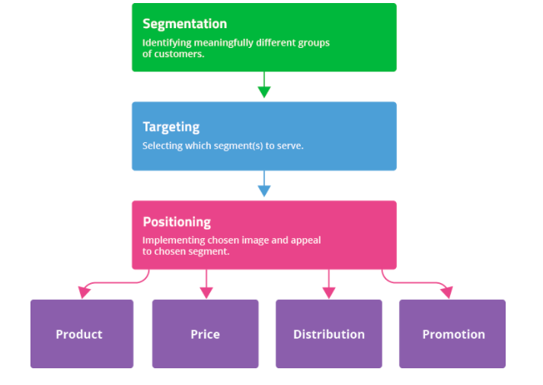
STP Process

Slide 7
The Marketing Mix for Successful Brands
4P's
Product – Clear Positioning?
Price $$$$$
Place/Distribution
Promotions- Effective communications?

Slide 8
The Four Steps of Brand Building
Ensure identification of the brand with customers and an association of the brand in customers’ minds
TARGET GROUP
Establish the totality of brand meaning in the minds of consumers
Position
Elicit the proper customer responses to the brand identification and brand meaning
Communicate
Convert brand response to create an intense, active loyalty relationship between customers and the brand Customer Relations

Slide 9

What are the strongest brands?

Slide 10
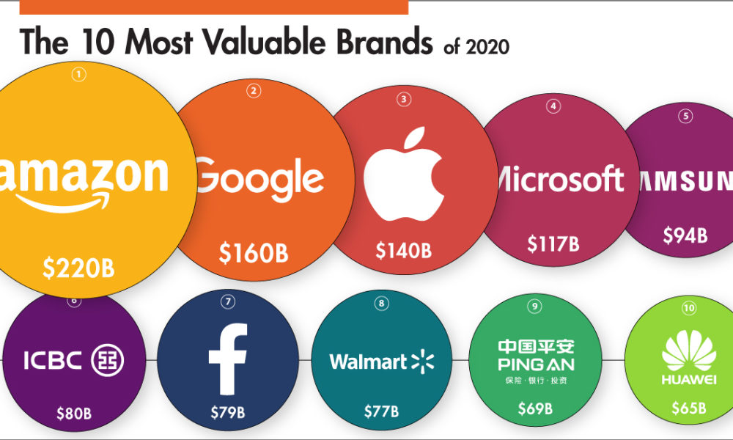

Slide 11
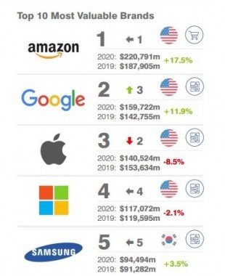
5 Most Valuable Brands

Slide 12
Figure 1-4: Brand Value as a Percentage of Market Capitalization
Company | Brand Value (in $ billions) | Total Value (in $ billions) | Brand Value as a Percentage of Overall Value
Apple | 184.1 | 868.88 | 21%
Google | 141.7 | 729.1 | 19%
Microsoft | 79.9 | 659.9 | 12%
Coca-Cola | 69.7 | 195.5 | 36%
Amazon | 64.7 | 563.5 | 11%
Samsung | 56.2 | 300 | 19%
Toyota | 50.3 | 188.2 | 27%
Facebook | 48.2 | 420.8 | 11%
Mercedes | 47.8 | 79.3 | 60%
I B M | 46.8 | 142 | 33%
Sources: Based on Inter-brand, “Best Global Brands 2010.” Yahoo! Finance, February 11.

Slide 13

Top of Mind
Fast Food
Shampoo
Deodorant
Soft Drink
Cars

Slide 14
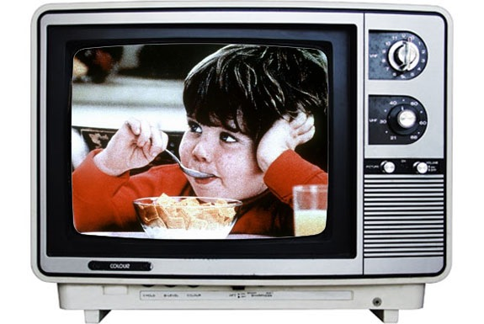
Words…What words come to your mind?
Feelings…How do you feel when watching the ad?

Slide 15
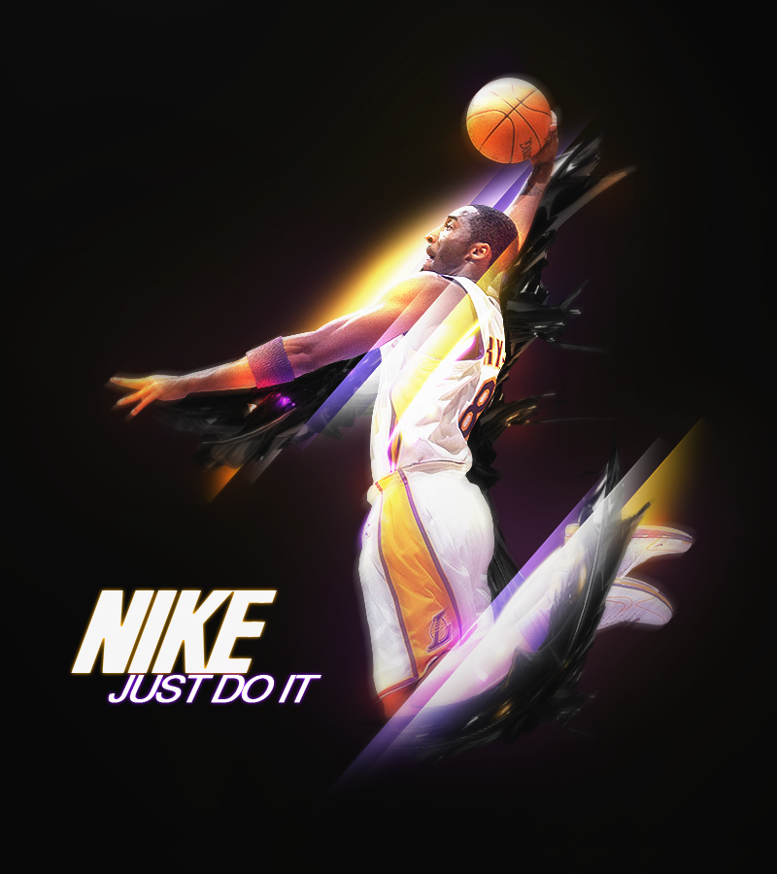
Brand Associations

Slide 16

Brand Associations

Slide 17
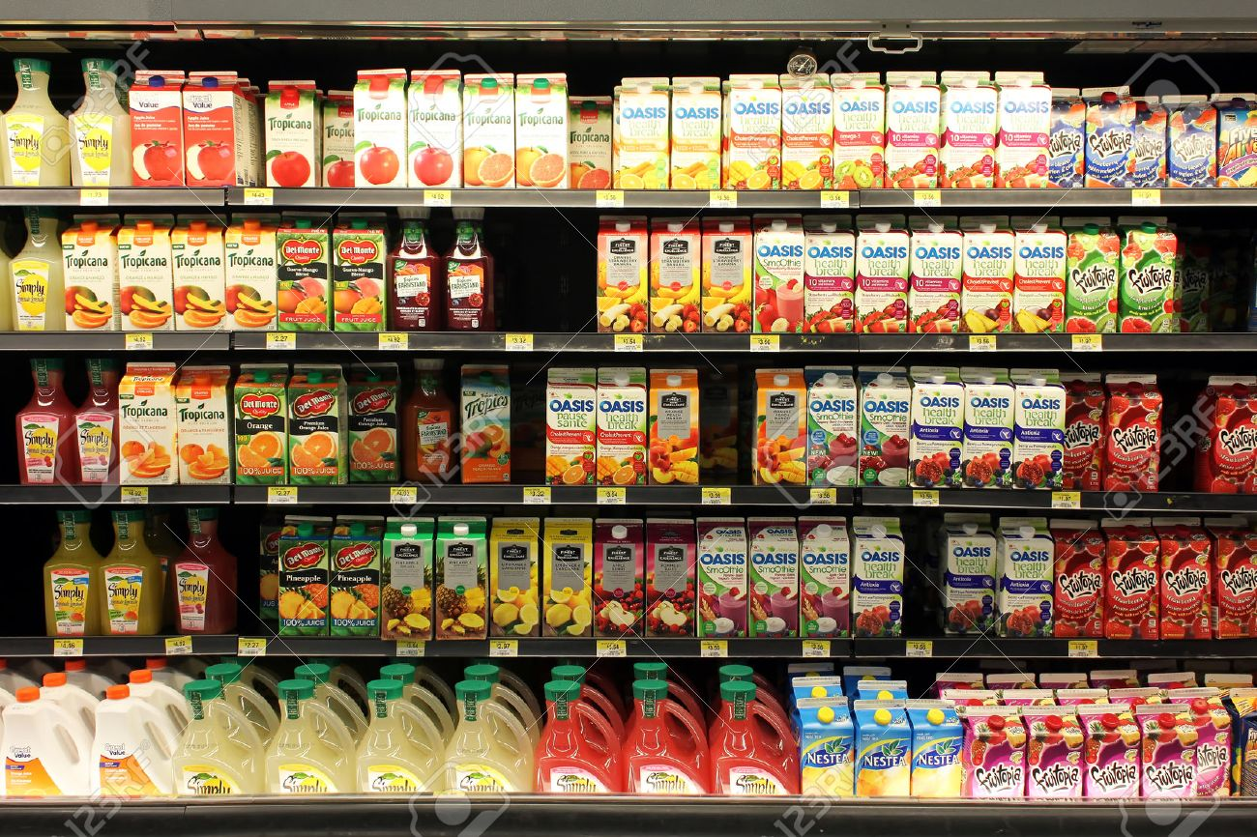
Market research is crucial to answer marketers’ questions
Who will be main target group for fruit juice product?
Which shelf level/position that consumers will see fist?
How frequent they will buy?
Will our new product be noticed? Is our packaging attractive enough?
Which sizing consumer will buy? At which price range?
Are they willing to try new product?

Slide 18
Customer Journey
Buying handbags online
Soy Milk
Awareness
Interest
Consideration
Intent
Evaluation
Purchase
See new product
See the product in friend’s Instagram
Want to look closer
Want to look in detail
Look for product information & price, Compare with other brands
Read the product information and reviews
Thinking of buying it
Thinking of buying it, go to Lazada and put it in the cart
Make sure again if it’s right decision
Think again whether to buy it for sure or to wait for 9.9
Buy it!
Let’s buy it
How your marketing activities stimulate customers in each stage?

Slide 19

IMC

Slide 20
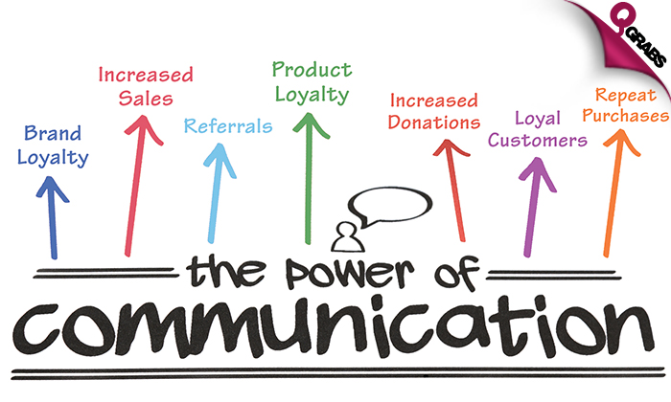

Slide 21
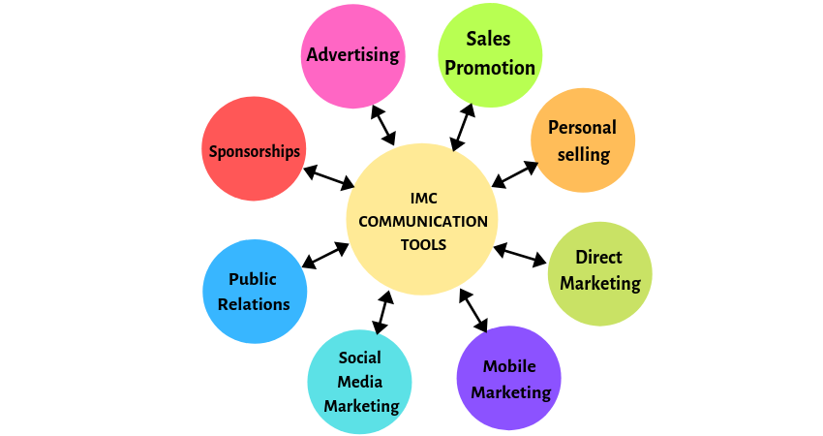
IMC Tools

Slide 22
Promotional Mix
The specific blend of promotional tools that the company uses to persuasively communicate customer value and build customer relationships.

Slide 23
Promotional Mix
Advertising
  Any paid form of non personal presentation and promotion of ideas, goods, or services by an identified sponsor.
Sales Promotion
  Short-term incentives to encourage the purchase or sale of a product or service
Personal Selling
  Personal presentation by the firm’s sales force for the purpose of making sales and building customer relationships.

Slide 24
Promotional Mix
Public Relations (PR)
  Building good relations with the company’s various publics by obtaining favorable publicity, building up a good corporate image, and handling or heading off unfavorable rumors, stories, and events.
Direct And Digital Marketing
  Engaging directly with carefully targeted individual consumers and customer communities to both obtain an immediate response and build lasting customer relationships.

Slide 25
The Changing Communications Environment
Two factors are changing the face of today’s marketing communications:
As mass markets have fragmented, marketers
are shifting away from mass marketing
Vast improvements in information technology
are speeding the movement toward segmented
marketing

Slide 26
Conflicting messages from different sources or promotional approaches can confuse company or brand images
The problem is particularly prevalent when functional specialists handle individual forms of marketing communications independently
The Need for IMC

Slide 27
IMC Concept
Using IMC, the company carefully
integrates and coordinates its many
communication channels to deliver
a clear, consistent, and compelling
message about the organization
and its products

Slide 28

The Changing Marketing Landscape

Slide 29
The Changing Marketing Landscape
The Changing Economic Environment
The Digital Age
The Growth for Not-for-Profit Marketing
Rapid Globalization
Sustainable Marketing- The Call for More Social Responsibility

Slide 30

Think Global
Act Local

Slide 31
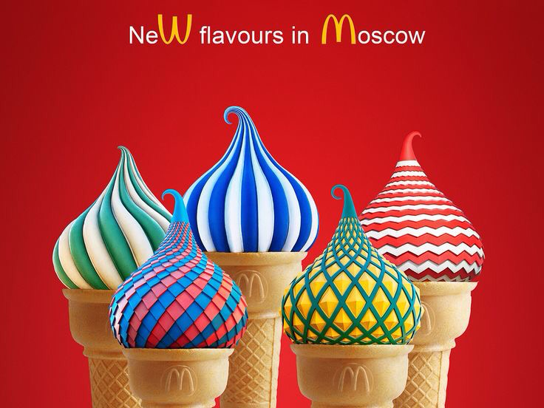

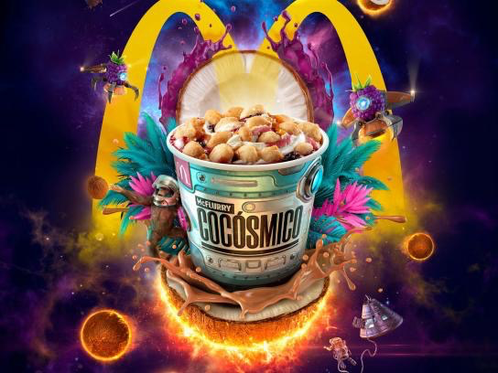
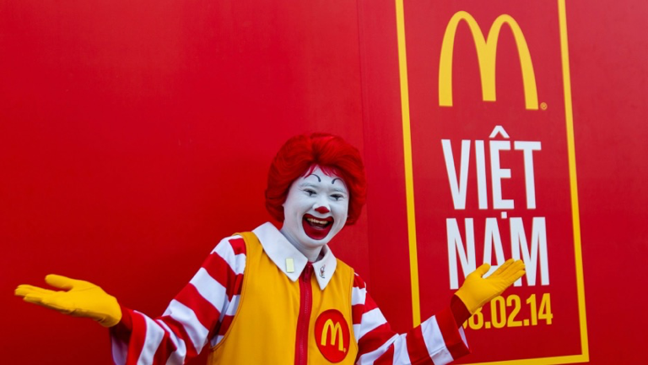



International Advertising

Slide 32

AIDA Model

Slide 33
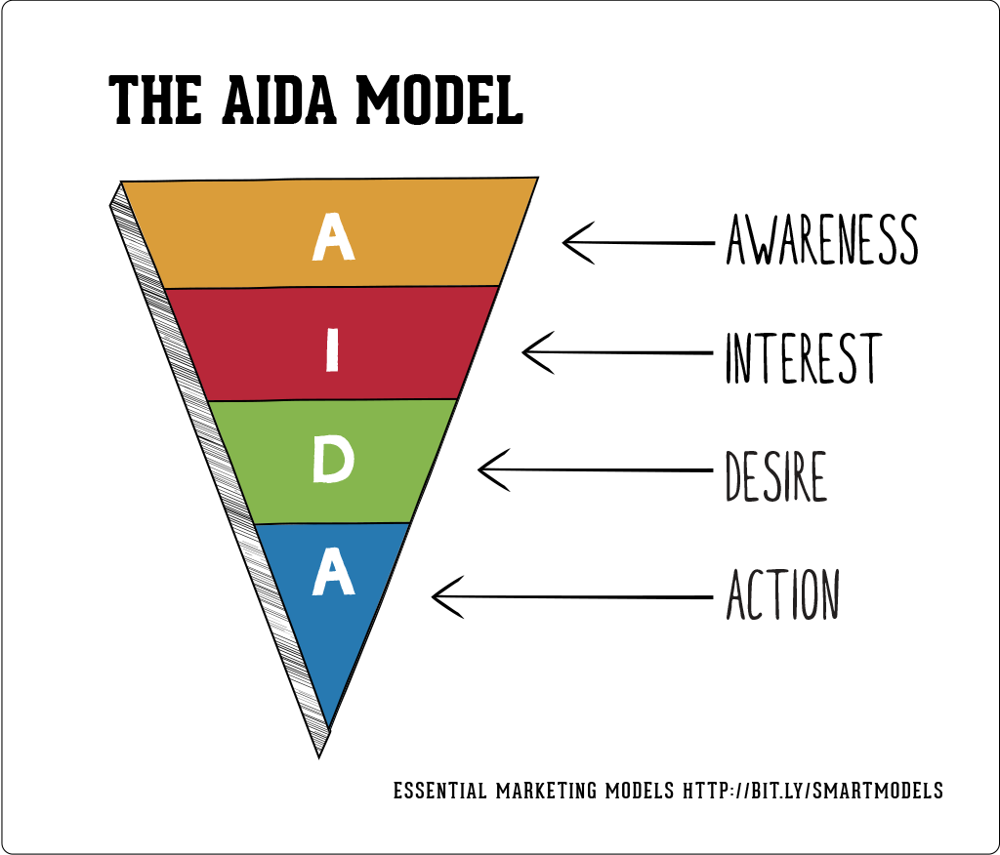

Slide 34
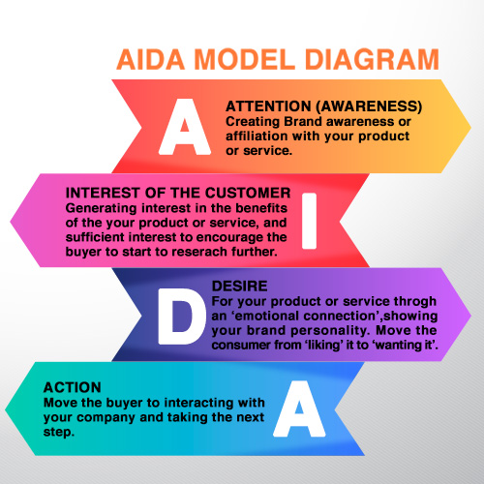
AIDA Model

Slide 35
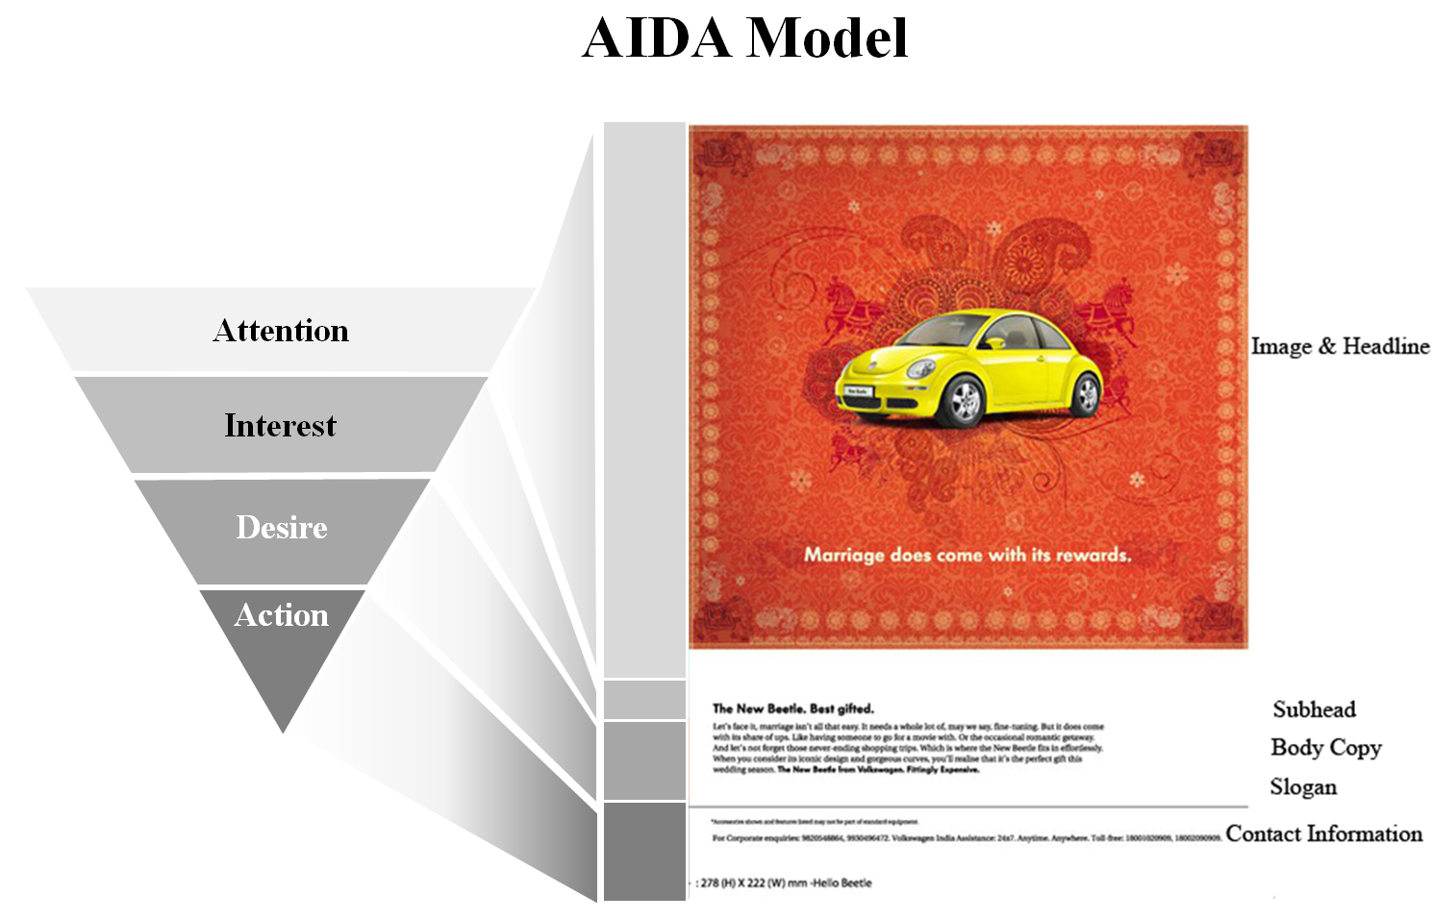
AIDA Model

Slide 36

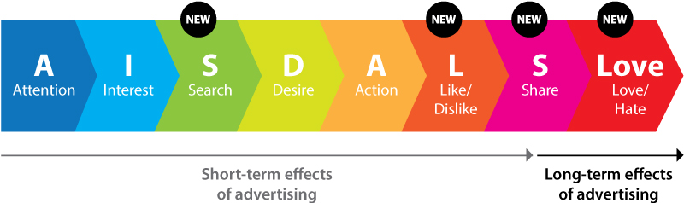
Beyond AIDA…

Slide 37
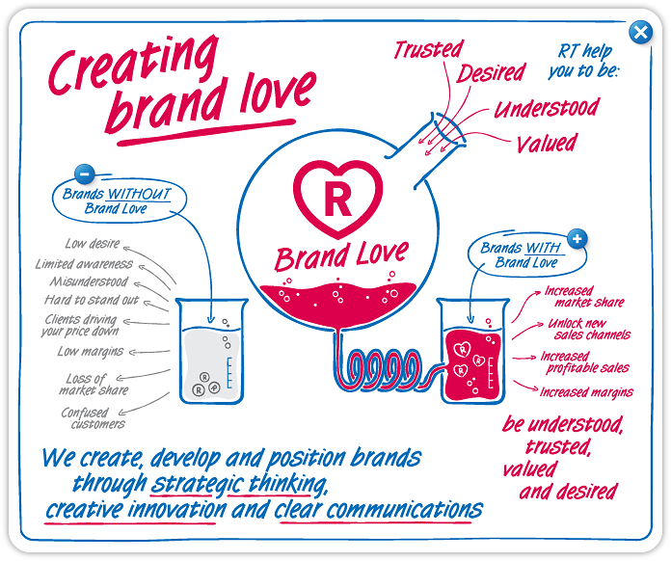
Beyond AIDA…

Slide 38
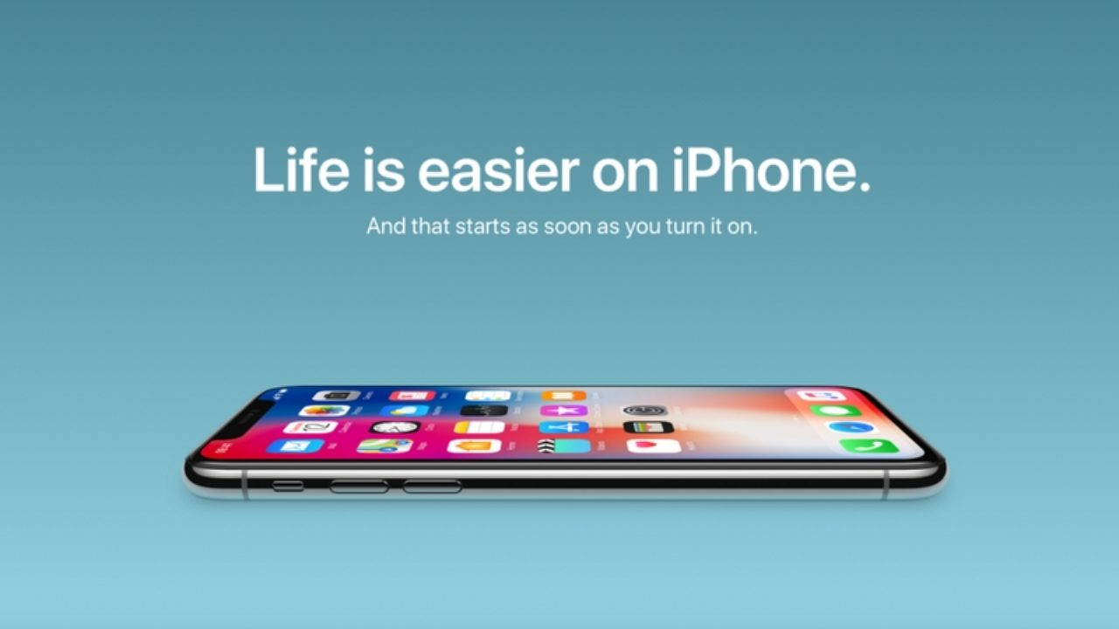

Slide 39


Slide 40


Slide 41


Slide 42
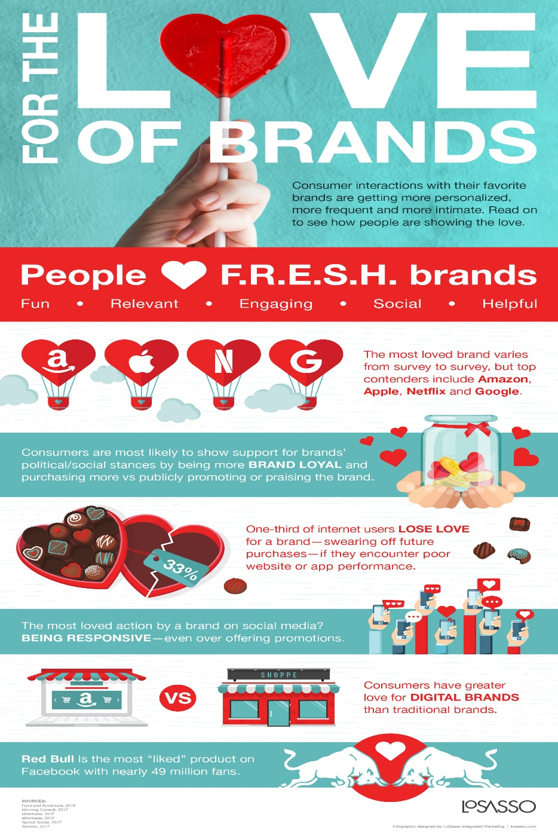
Beyond AIDA…

Slide 43

5 ways a brand can generate more love…

Slide 44
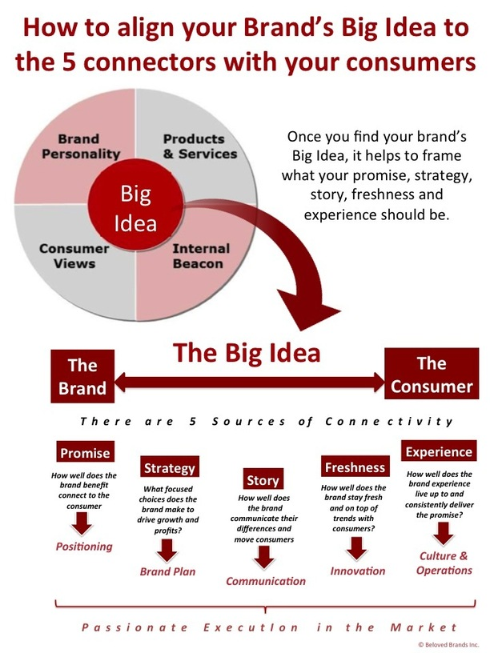

Slide 45
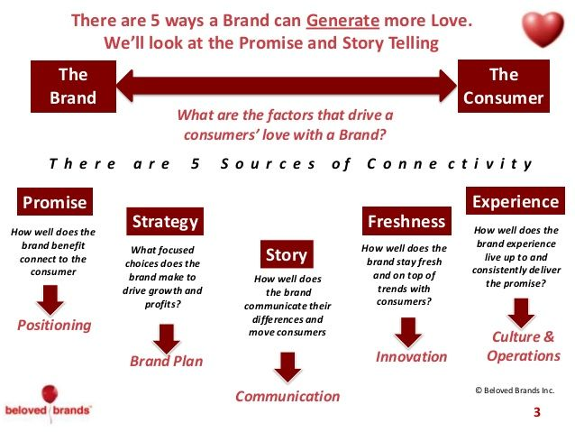

Slide 46
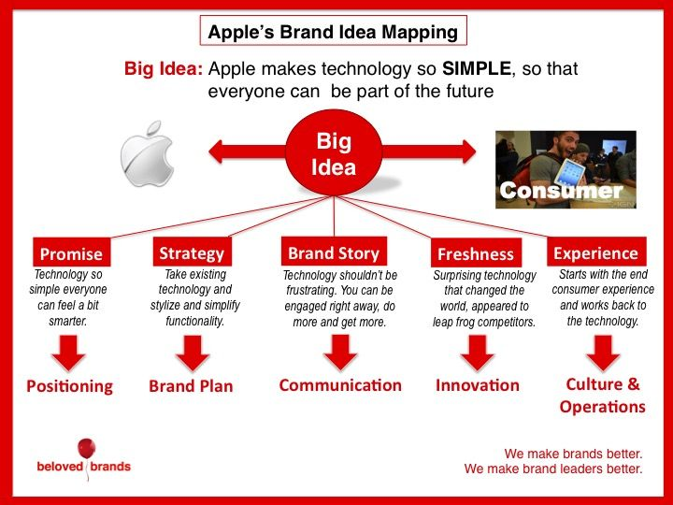

Slide 47
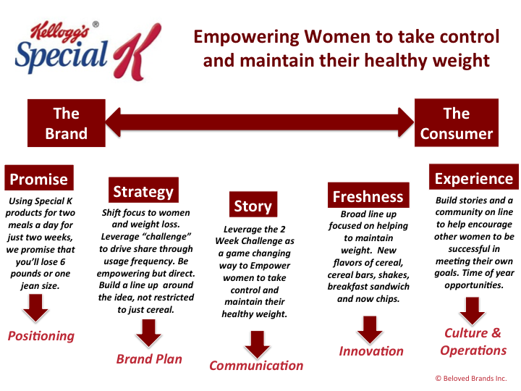

Slide 48

How to evaluate good advertising?
The “SMILE” APPROACH
S = simple, easy to understand
M= memorable, stick to consumer’s mind,
measures by a day after recall
I = interesting, employ new story, has new information to tell
L= linked to the brand, cannot be mistaken to other brands/products
E = emotionally involving

Slide 49
LET’S PRACTICE “SMILE”
Good Ads vs. Bad Ads

Slide 50
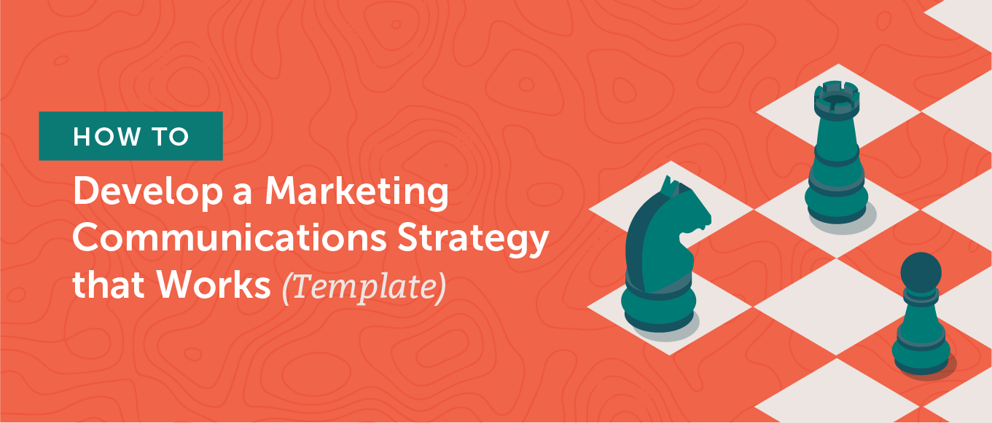
Plan Your Marketing Communications Strategy in Six Simple Steps
Identify Your Target Market. ...
Identify Your Target Customers. ...
Identify Your Unique Selling Proposition
Match Your Audience Problems to Your Product Solutions. ...
Match Your Messaging to Channels You Choose. ...
Set Your Goals and Identify a Way to Measure Them.
Speak directly to your ideal customer’s pain point instead of addressing a vague audience.
Align your messaging to each channel based on what your target customers already expect on it.
Build an easy-to-reference marketing communications document, so your team, other teams, and future hires can use it with ease.

