Slide 1
Agricultural World and Economy

Slide 2

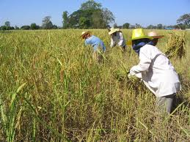

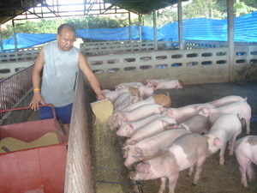
What can we see?

Slide 3
Analytical Framework to Agriculture
System approach
  Agricultural system
  Farming system
Economic approach
Social approach

Slide 4
“System approach”
the relation of components in some form of interaction and interdependence
operate within a specific boundary
to achieve some specified objectives

Slide 5
Layers of system
(McConnell and Dillon, 1997)
Natural systems
  Those that exist in nature
  Consist of
    All the materials (both physical and biological)
    Interrelated processes occurring to these materials
  rock weathering to form soil; plants sustained by such soil; animals sustained by such plants

Slide 6
Layers of system
2. Social systems
  Consist of
    Group of populations
    The institutions or social mechanisms created by such group
    Interrelationships among/between individuals, groups, communities, expressed directly or through the medium of institutions
  an economic, social, religious or political nature
  law of property

Slide 7
Layers of agricultural system
3. Artificial systems
  Do not exist in nature
  But human creation to serve human purposes
  Including “agricultural system”
  Elements are taken from both natural and social systems

Slide 8
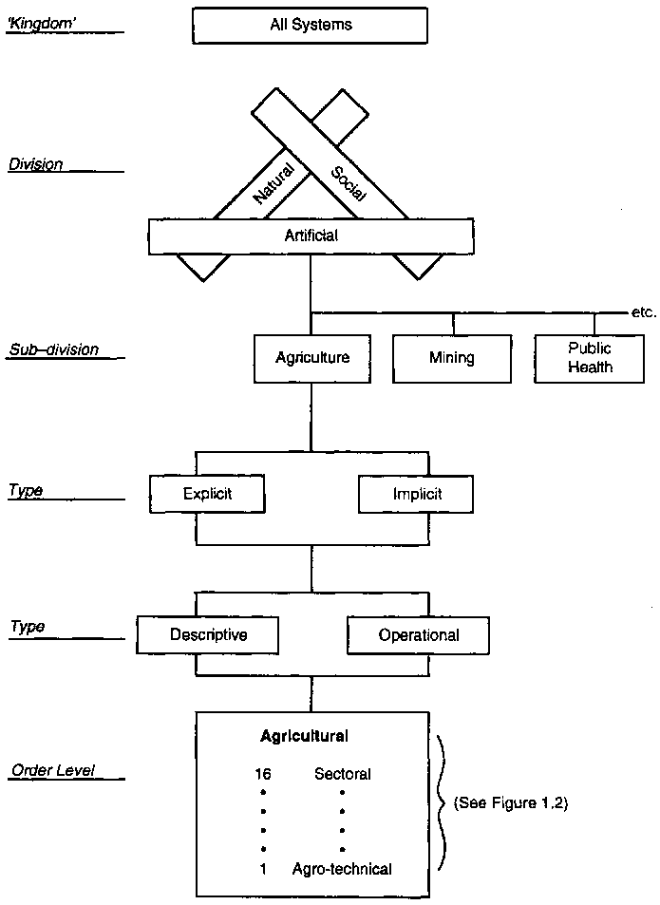

Slide 9
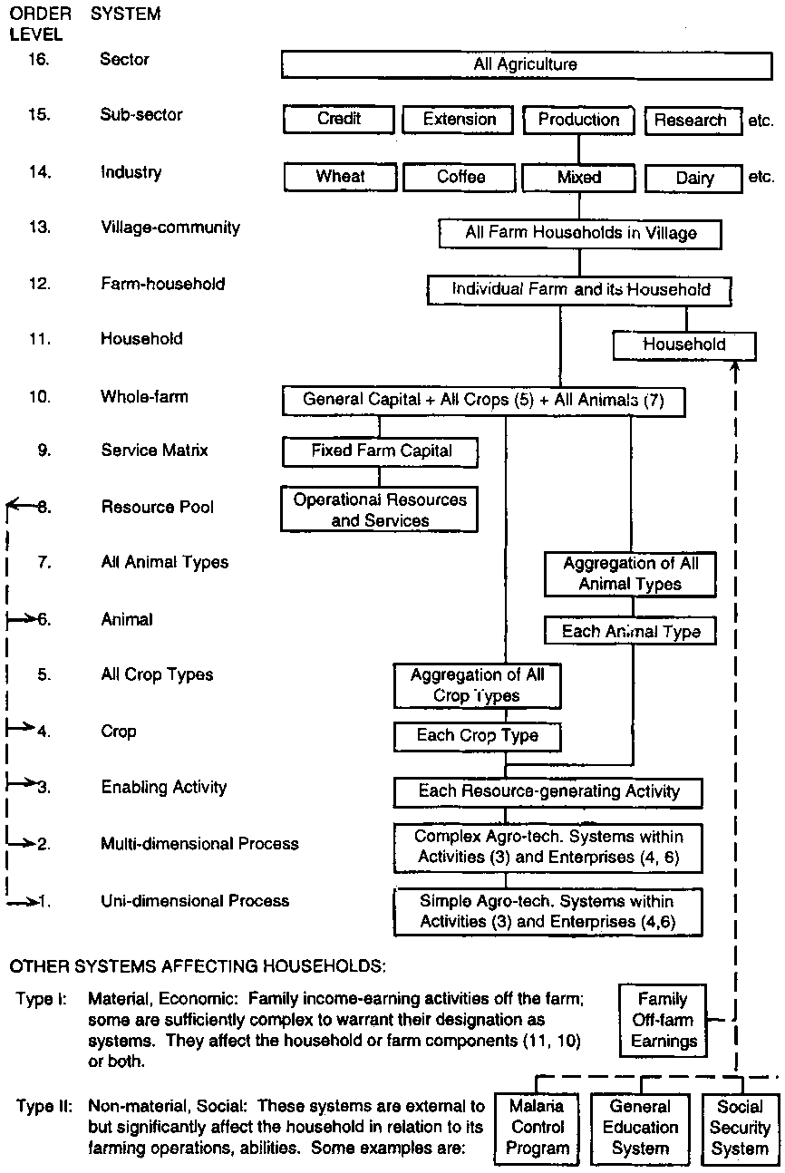
Hierarchy of agricultural system
Notes:
input-output response relationships
a wider and more realistic view of a subject or problem (several or a large number of input factors such as nitrogen, phosphorous, irrigation water, crop hygiene, soil tilth etc.) processes and as response relationships
e.g., stripping leaves off leguminous trees, keeping cattle for their manure, or buying a bag of fertilizer.
5. Mono-crop and mixed farm system

Slide 12
Farming system
The concept of farming systems
  Farmers typically view their farms, whether small subsistence units or large corporations, as systems in their own right
  the structural complexity and interrelationships between various components of a smallholding

Slide 13
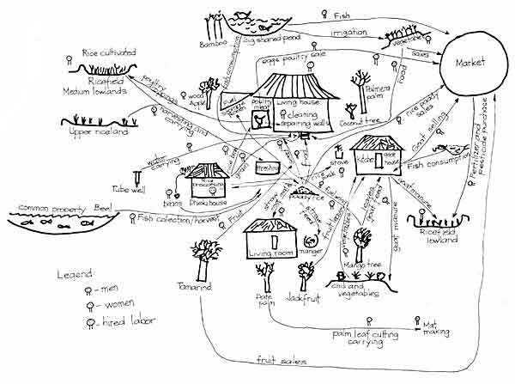

Slide 14
Farming system
Each individual farm has its own specific characteristics arising from variations in resource endowments and family circumstances.
the variety of natural resources available to farm families
different types of basic natural resources: land, various water sources and access to common property resources - including ponds, grazing areas and forest
difference in climate and biodiversity, human, social and financial capital, and the livelihoods of most smallholders.

Slide 15
Farming system
Farm system: The household, its resources, and the resource flows and interactions at this individual farm level
Function: individual farm systems are organised to produce food and to meet other household goals through the management of available resources - whether owned, rented or jointly managed - within the existing social, economic and institutional environment.

Slide 16
Major Categories of Farming System
the classification of the major farming systems provides a useful framework within which appropriate agricultural development strategies and interventions can be determined.
a considerable degree of heterogeneity within any single system

Slide 17
Major Categories of Farming System
Criteria
available natural resource base, including water, land, grazing areas and forest; climate, of which altitude is one important determinant; landscape, including slope; farm size, tenure and organization; and
dominant pattern of farm activities and household livelihoods, including field crops, livestock, trees, aquaculture, hunting and gathering, processing and off-farm activities; and taking into account the main technologies used, which determine the intensity of production and integration of crops, livestock and other activities.

Slide 18
Major Categories of Farming System
Irrigated farming systems, embracing a broad range of food and cash crop production;
Wetland rice based farming systems, dependent upon monsoon rains supplemented by irrigation;
Rainfed farming systems in humid areas of high resource potential, characterised by a crop activity (notably root crops, cereals, industrial tree crops - both small scale and plantation - and commercial horticulture) or mixed crop-livestock systems;

Slide 19
Major Categories of Farming System
4. Rainfed farming systems in steep and highland areas, which are often mixed crop-livestock systems;
5. Rainfed farming systems in dry or cold low potential areas, with mixed crop-livestock and pastoral systems merging into sparse and often dispersed systems with very low current productivity or potential because of extreme aridity or cold;
6. Dualistic (mixed large commercial and small holder) farming systems, across a variety of ecologies and with diverse production patterns;
7. Coastal artisanal fishing, often mixed farming systems; and
8. Urban based farming systems, typically focused on horticultural and livestock production.

Slide 20
Farming System
the identification of 72 farming systems with an average agricultural population of about 40 million inhabitants

Slide 21
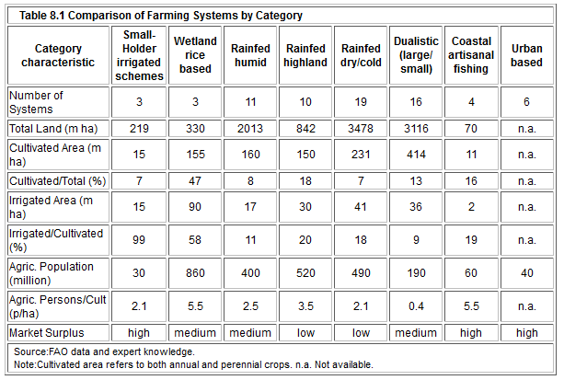

Slide 22
Farming System in East Asia
Table 6.1 Major Farming Systems in East Asia and Pacific
Farming Systems | Land Area (% of region) | Agric. Popn. (% of region) | Principal Livelihoods | Prevalence of Poverty
Lowland Rice | 12 | 42 | Rice, maize, pulses, sugarcane, oil seeds, vegetables, livestock, aquaculture, off-farm work | Moderate
Tree Crop Mixed | 5 | 3 | Rubber, oil palm, coconuts, coffee, tea, cocoa, spices, rice, livestock, off-farm work | Moderate
Root-Tuber | 2 | <1 | Root crops (yam, taro, sweet potato), vegetables, fruits, livestock (pigs and cattle), off-farm work | Limited
Upland Intensive Mixed | 19 | 27 | Rice, pulses, maize, sugarcane, oil seeds, fruits, vegetables, livestock, off-farm work | Extensive
Highland Extensive Mixed | 5 | 4 | Upland rice, pulses, maize, oil seeds, fruits, forest products, livestock, off-farm work | Moderate

Slide 23
Farming System in East Asia
Temperate Mixed | 6 | 14 | Wheat, maize, pulses, oil crops, livestock, off-farm work | Moderate
Pastoral | 20 | 4 | Livestock with irrigated crops in local suitable areas | Extensive, especially drought induced
Sparse (Forest) | 10 | 1 | Hunting, gathering, off-farm work | Moderate
Sparse (Arid) | 20 | 2 | Local grazing where water available, off-farm work | Extensive
Coastal Artisanal Fishing | 1 | 2 | Fishing, coconut, mixed cropping, off-farm work | Moderate
Urban Based | <1 | 1 | Horticulture, dairy, poultry, other work | Limited

Slide 24
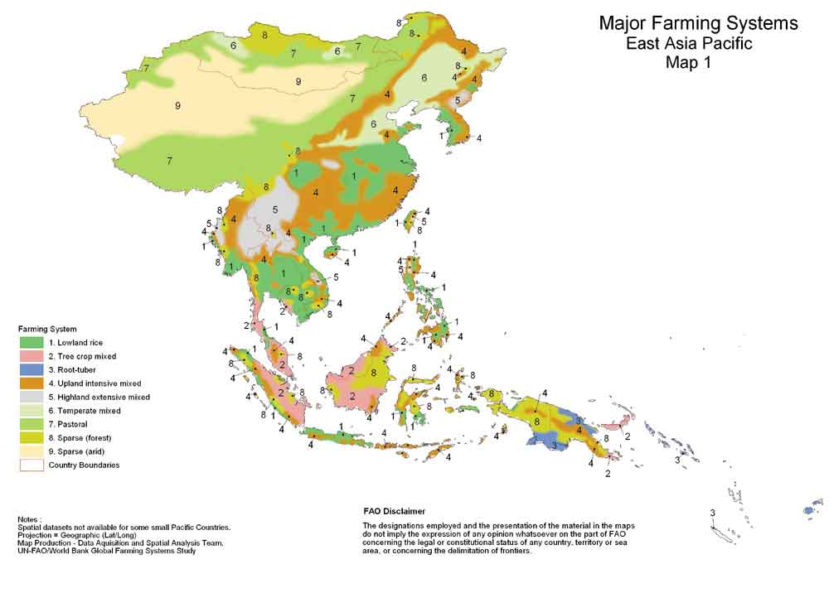

Slide 25
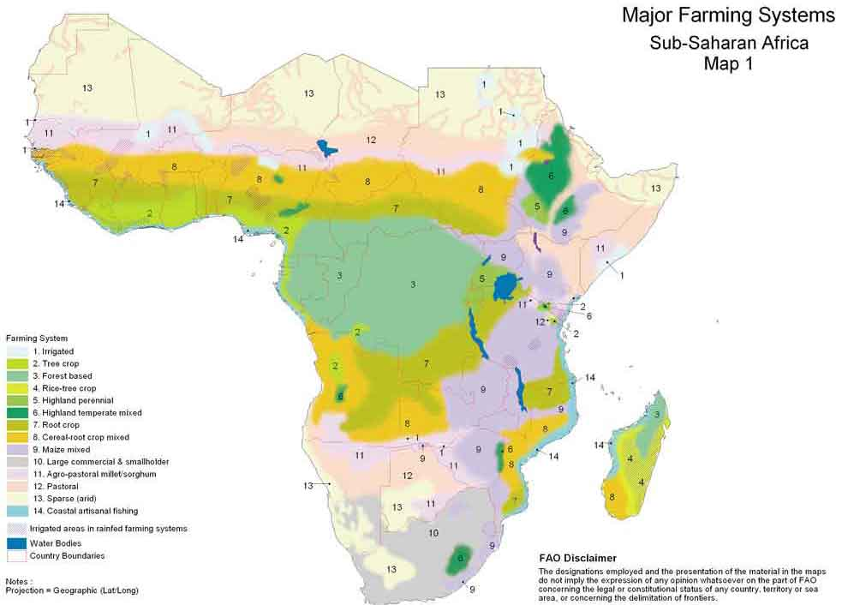

Slide 26
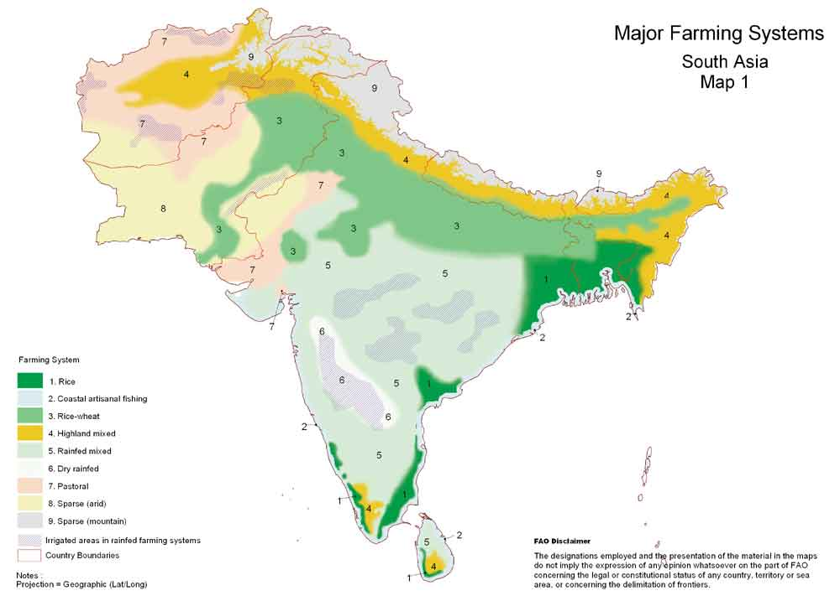

Slide 27
Farming System
The Farming System Approach considers both biophysical dimensions (such as soil nutrients and water balances) and socio-economic aspects (such as gender, food security and profitability) at the level of the farm - where most agricultural production and consumption decisions are taken.
The power of the approach lies in its ability to integrate multi-disciplinary analyses of production and its relationship to the key biophysical and socio-economic determinants of a farming system.

Slide 28
Farming System
Determinant of development
natural resources and climate;
science and technology;
trade liberalisation and market development;
policies, institutions and public goods; and
information and human capital.

Slide 29
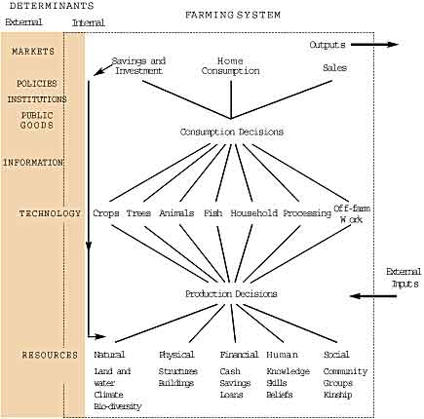

Slide 30
Farming System
Livelihoods strategies
intensification of existing production patterns;
diversification of production and processing;
expanded farm or herd size;
increased off-farm income, both agricultural and non-agricultural; and
a complete exit from the agricultural sector within a particular farming system.

Slide 31
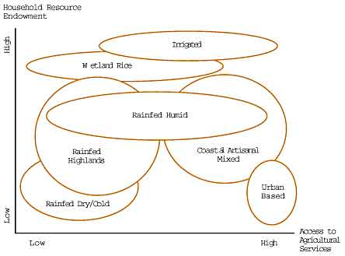

Slide 32


