Slide 1
Ee481 industrial Economics
A Quick Review

Slide 2
Textbooks
Carlton, D. W. and J. M. Perloff (2005). Modern Industrial Organization, Pearson Addison-Wesley Press. (Maintext, abbreviation = CP)
Church, J. and R. Ware (2000). Industrial Organization: A Strategic Approach, McGraw-Hill Press. (Supplement text, CW)
Tirole, J. (1989). Industrial Organization, The MIT Press.

Slide 3
1.Overview

Slide 4
Question??
What is Industrial Organization?

Slide 5
What is Industrial Organization?
“The Study of the structure of firms and markets and of their interactions” (Carlton and Perloff, 2005)
For example: Study of how hypermarkets in Thailand compete.
∗ firms -> Tesco, BigC.
∗ market -> grocery products, etc.
∗ interactions -> how firms compete, strategies they use
Basically, we try to understand and explain firms actions, interactions, decisions using economic models.

Slide 6
Ex: Why do firms give warrantees?
Markets for Lemons
Akerlof, G. A. (1970). "The Market for "Lemons": Quality Uncertainty and the Market Mechanism." The Quarterly Journal of Economics 84(3).
Product quality is not observed by buyers (asymmetric information) -> low willingness to pay.
Sellers need to ensure that the product is of high quality -> to increase willingness to pay.

Slide 7
Other examples
Why do firms offer price match deals?
  How can price match deals increase firms' profits?
Why do firms sometimes sell their products in bundles?
  How can bundling increase firms profits?
Why do firms form a cartel?
  How can cartel increase firms profits?
Etc..

Slide 8
Objectives of firms
To maximize profits - yes if 1 firm is regarded as 1 actor.
In reality
  manager maximizes their compensation ≠ firm maximize profit.
  workers maximizes their welfare ≠ firm maximize profit.
  But usually, each firm would have a way to make workers maximize the company's profits.
  Some are more successful than others.

Slide 9
Useful concepts for this course
1. Structure-Conduct-Performance (SCP)
  Market power
2. Game Theory
  Find best responses under non-cooperative games
  Find the equilibrium and outcome of the game
  Dominant firm, residual demand
  Oligopoly
3. Price Discrimination
4. Strategic Behaviors
5. Antitrust Law

Slide 10
2.Structure-Conduct-Performance

Slide 11
Structure-Conduct-Performance (SCP)
Structure = Factors that determines competitiveness of the market, i.e. number of firms, barriers to entry, etc.
Conduct = behavior of firms, i.e. whether they are collusive, type of competition strategies used, etc.
Performance = Competition outcomes, i.e. whether firms can deliver the most efficient outcome or the highest benefits to the consumers.
Diagram:

Slide 12
SCP (example)
Two industries in Thailand
Market Conditions | Industry 1 | Industry 2
Seller Concentration (CR4) | 100% | 100%
Buyer Concentration (CR4) | 0.001% | 0.001%
Homogenous product | Almost | Almost
Barriers to entry
Large plant scales | Yes | Yes
Sunk investment costs | Yes | Yes
Government License | Yes | No

Slide 13
Market Power
Market power = ability to charge price above marginal cost (earn margin)
where P = market price
MCi = marginal cost of firm i.
Si = market share of firm i.
e = price elasticity of demand for good.
sources of market power are 1) high market share, 2) lower mc, 3) low elasticity of demand, 4) collusion.

Slide 14
Market Concentration
Monopoly (n = 1) → Perfect Competion (n = ∞)
(Highest concentration) (lowest concentration)
Some Measurements of Concentration
1) Herfindahl Index (HHI) =
2) 4-firm concentration =
3) 8-firm concentration =

Slide 15
Market Concentration (example)
U.S. Retailing Industry (2002) | CR4(%)
Automobile Dealers | 5.3
Grocery Stores | 31.0
Gasoline Stations | 8.2
Florist | 1.7
Book, Periodical, & Music Stores | 48.3
Department Stores | 66.4

Slide 16
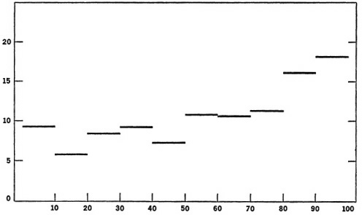
Market Concentration vs. Profit
Figure: Price-cost margins by industry concentration deciles, 352 U.S. manufacturing industries, 1967. Source: Rhoades and Cleaver (1973).
Price-cost margin (%)
CR4 (%)

Slide 17
3.Game Theory & Oligopoly Models

Slide 18
Game Theory
When there are more than 1 player, Game Theory is used to analyze players' decisions.
  Find the best response of each player taken into account the actions of other players.
In equilibrium, no player has an incentive to change their decision.
  So, each party chooses the best response that responses to other players' best responses!

Slide 19
Game Theory (example)
Coke vs. Pepsi
Supermarkets on house-brand products
Firms on advertising
Football players and the goal
Old firms vs. perspective entrant(s)
Etc.

Slide 20
Game Theory for Firms Decisions
Decisions of firms in oligopoly markets
  Cournot model
  Bertrand model
  Stakelberg leadership model
  Advertising decision
  R&D decision
  Entry deterrence decision ... etc.
Of course, these models are for non-cooperative firms. Otherwise, they would act like a joint-monopoly and split their profits.

Slide 21
Joint-monopoly decision (collusion)
All firms act like 1 monopoly - so they cooperate or collude. They choose the price and quantity which maximize joint profit. Then, split the joint profit.
Collusion is not a Nash equilibrium

Slide 22
Cournot Model
Each firm independently chooses quantity. They do not cooperate or fail to cooperate.
Cournot is a static (single-period) game of a homogenous product market.

Slide 23
Bertrand Model
Each firm independently chooses price. They do not cooperate or fail to cooperate.
Bertrand is a static (single-period) game of a homogenous product market.

Slide 24
Stackelberg Leadership Model
One firm acts first. Other firms act later. The first-mover has an advantage.
  The first mover takes into account the followers' best actions. The first mover then maximizes its profit on the residual demand.
Similar to the Dominant firm model (EE481)

Slide 25
Performance
Suppose there are 2 firms in the market. Both have the same MC.
Model | Industry Profit Rank | Firm Profit Rank
Joint Monopoly | 1 | 2
Cournot | 2 | 3
Bertrand | 4 | 5
Stakelberg Leadership | 3 | -
- Leader | - | 1
- Follower | - | 4

Slide 26
Advertising, R&D (example)
Payoff matrix for advertising game
Firm B
Firm A
 | Advertise | Don’t Advertise
Advertise | 10 , 5 | 15 , 0
Don’t advertise | 6 , 8 | 10 , 2

Slide 27
Entry Deterrence (example)
Entry Possibilities Entrant
incumbent
Entry Deterrence Entrant
incumbent
 | Enter | Stay out
High Price | 10 , 5 | 15 , 0
Low Price | 6 , 8 | 10 , 2
 | Enter | Stay out
High Price | 50 , 20 | 150 , 0
Low Price | 70 , -10 | 130 , 2

Slide 28
4.Price Discrimination

Slide 29
Price Discrimination
Price discrimination = charging the price of each unit differently
  large quantity discount
  airline tickets
  bundling
Objective = to increase profit, or get as much of the total welfare as possible

Slide 30
First-degree
Price = willingness to pay of each consumer.

Slide 31
Third-degree
Price = willingness to pay of each “group” of consumers.

Slide 32
Second-degree
Willingness to pay unobserved. Firms invent a pricing scheme to price discriminate.
  WTP for playing golf
  WTP for printers
  WTP for interest rates
  WTP for data usage on mobile phone
  etc.

Slide 33
Second-degree (two-part tariff)
One Two-part tariff
  Golf course membership + green fee
  Printer + ink

Slide 34
Second-degree (Bundling)
Multiple Two-part tariffs
  Bank Loan => different collateral vs. interest rates
  Example: borrowing packages for a 10 million baht loan.
  MLR = Minimum Loan Rate (now ≈ 7.25%)
Option No. | Collateral | Interest Rate
1 | 10 million | MLR + 1
2 | 8 million | MLR + 3
3 | 5 million | MLR + 5

Slide 35
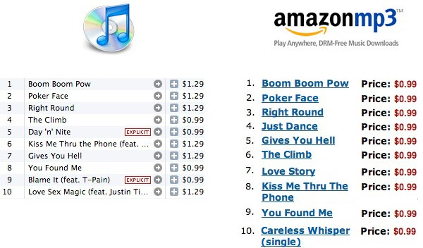
Online Music Pricing (Case Study)

Slide 36
Online Music Pricing (Case Study)
Why do you think iTune can charge more than Amazon for some songs?

Slide 37
5. Strategic Behavior

Slide 38
What is Strategic Behavior
A set of actions a firm can take to influence the market environment so as to increase profits.
Market environment = all factors that influence market outcome.
  i.e. prices, quantities, profits, welfare
  beliefs of customers, competitors
  production capacity
  costs of competitors, competitors actions, etc.

Slide 39
Advantage and Commitment
Firms can use strategic behaviors to harm their rival and benefit themselves. For a strategic behavior to work, firms need to have the followings:
1. Advantage - the firm that uses strategic actions should have some “advantage” over its competitor(s). For example, lower cost, more loyal customers, and higher production capacity.
2. Commitment - to succeed, firm should be able to commit to its behavior (credible threats). Otherwise, the competitors would not believe and the strategic actions would not result in desirable outcomes for the firm that use it.

Slide 40
Predatory pricing, Limit pricing
Predatory pricing → a firm charges price below its rival’s MC to drive the rival out of business.
Limit pricing → a firm sets low price or high quantity to make it unprofitable for the entrant to enter.

Slide 41
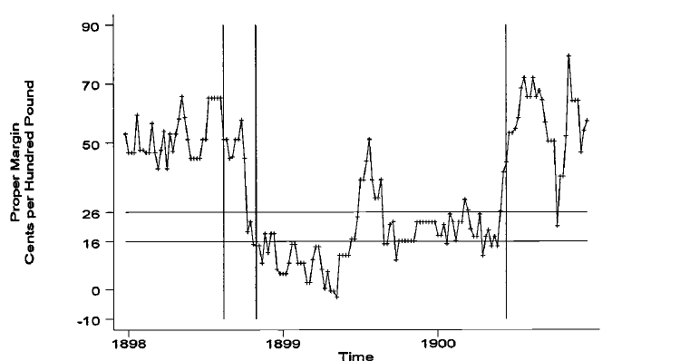
Predatory pricing (Sugar in the US.)
Margin of price over average variable cost (cents per 100 pounds refined sugar) over time.

Slide 42
Other strategies
Strategic Investment
  Building excess capacity
  Limit company’s own capacity
  R&D
  etc.
Raising Rival’s costs
  Through all means

Slide 43
6. Vertical Integration & Restraint

Slide 44
Definitions
Vertical Integration - Firms at different levels of the supply chain merge.
  Horizontal Integration - Firms that are at the same level of supply chain merge/
Vertical Restrains - A firm restricts behaviors of other firms that are at a different level of supply chain.
When to integrate and when to restrain?

Slide 45
6.1 Vertical Integration

Slide 46
Gains from vertical integration
Reduce cost and reduce market externalities
1. Lower transaction costs
2. Assure supply
3. Correct market failure (externalities)
4. Avoid government rules
5. Gain market power
6. Eliminate market power
7. Avoid double marginalization!

Slide 47
Double Marginalization (Monopoly Monopoly)
Quantity is restricted at both levels → very inefficient.
Graph:

Slide 48
Double Marginalization (Monopoly competitive)
Quantity not restricted at the downstream level. More efficient than Monopoly -> Monopoly. But since the upstream is a monopoly, there would still be some inefficiency.
Graph:

Slide 49
Vertical Integration
An upstream monopoly gains from vertical integration when downstream firms are not perfectly competitive.
But vertical integration is not always feasible.

Slide 50
6.2 Vertical Restraints

Slide 51
Vertical Restraints
Upstream firms restrict behaviors of downstream firms.
  To increase upstream firms' profit
  Avoid double marginalization
  Increase sales effort by downstream firms
  Eliminate free-rider problems (externalities)
Sometimes it's more costly to vertically integrate.. so firms to vertical restraints. Sometimes the other way around is true.

Slide 52
Reduce the free-rider problem
(among distributors)
Automobile agents
Food franchise
Etc.

Slide 53
Reduce the free-rider problem
(among manufacturers)
Exclusive dealings
Etc.

Slide 54
7. Franchising

Slide 55
Franchising
One of the methods to reduce double marginalization and increase the number of unit sold.
  Also helps solve the principal-agent problem.
  The franchisor charges 1) lumpsum franchise fee 2) variable fee
Lumpsum franchise fee = allows the manufacturer to extract available surplus
variable fee = x% of total revenue

Slide 56
Franchising (example)
Diagram
Reduce marginalization at the retail-level by
  Selling franchise right to many franchisees.
  Setting a low retail price (retail price maintenance, RPM)
Extract more profit from the franchisees through two-part tariff = fixed franchise fee + variable loyalty fee

Slide 57
8. Bundling and Tie-in Sale

Slide 58
Bundling and Tie-in
If the seller is a monopoly on both products
  Bundling can always increase profit
If 1 product is competitive
  Bundling, Tie-in on increase profit when demand for bundled produces are interrelated.
Rememember!
  Bundling only work when
    consumers cannot buy product from somewhere else.
    Resale is not possible

Slide 59
Bundling and Tie-in
Is also a type of second-degree price discrimination
  The button machine example:
  The button machine company gives the machine to each garment factory for FREE.
  Then, charge the “rent” for its machine by each factory’s usage.

Slide 60
9. Anti-trust Law and Policy

Slide 61
Main points
Antitrust laws should promote efficiency and total welfare (eliminate DWL).
Market power = power to raise price above MC. Thus, there would be DWL if a firm uses this power.
Having “market power” is not illegal, but “exploiting market power” is unlawful.
Price-fixing (and cartel) is generally prohibited.
Agreements among competitors may increase or decrease welfare. Thus, should be evaluated case-by-case.

Slide 62
Exploitation of market power
With market power, firms could exploit it by:
  Set price much higher than MC.
  Collaborate with competitors to maintain high price.
  Make its supplier(s) give a higher discount so to gain advantage over smaller competitors.
  Use the advantage (lower cost) to conduct predatory pricing.
  Lobby the government to maintain its monopoly status.
Having market power but not exploiting it is “not illegal”.
Only the “exploitation of market power” is illegal.

Slide 63
Anti-trust Law
Antitrust laws are used to prevent firms with market power from exploiting its market power.
Thailand's Competition Act 2542 (1999 BC)
  Prohibit abuse of dominant position (having market power)
  Prohibit mergers and acquisitions that could result in a higher market power and tendency to exploit it.
  Prohibit agreements among competitors that could lessen competition
  Prohibit unfair practices against competitors which could result in lessening of competition.
Antitrust laws in other countries have similar content.

Slide 64
Thai Case: Honda
In 2001, The Office of the Trade Competition Commission investigated A.P. Honda Limited for unfair practices.
  Honda allowed their dealers to sell only Honda motorcycles.

Slide 65
UK Case: Somerfield
In 2004, a Somerfield (a UK supermarket chain) submitted an application to acquire 115 Morrison (another UK supermarket chain) stores.
  Before acquisition, Somerfield owned 606 stores, Morrison owed 481 stores.
The UK competition commission authorized the acquisition, except for 12 stores.
  Because this would substantially lessen competition.
  The 12 stores can be sold to other supermarket chains.

Slide 66
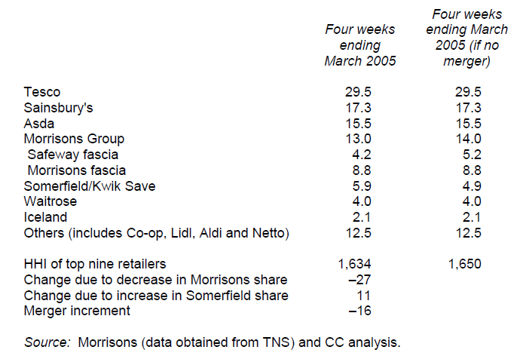
UK Case: Somerfield
Shares of retail grocery market (percent)

Slide 67
10. Case Study – Apple Inc. in 2010

Slide 68
Apple vs. S&P 500 source: created by me using data from yahoo finance.
Apple’s Share Price vs. S&P 500 Index
On 9/Jan/2012: Apple = $419.81, S&P500 = $1289.09.

Slide 69
Apple vs. S&P 500 (April 1984 = 100) source: created by me using data from yahoo finance.
Apple’s Share Price vs. S&P 500 Index
On 9/Jan/2012: Apple = $13,900.99, S&P500 = 784.26.

Slide 70
Apple History (pre 1980)
Founded in late 1970s.
  by Steve Jobs and Steve Wozniak.
First product = a computer circuit board (Apple I), on the way to develop an easy-to-use computer.
  There were 200 units of Apple I
  By the end of 1980, they sold > 100,000 units of Apple II.
  Launch IPO in December 1980.

Slide 71
Apple History (1981 - 1984)
In 1981, IBM entered the personal computer (PC) market.
  Used Microsoft’s DOS operating system (OS) and a microprocessor (CPU) from Intel.
  The IBM system is open to outsiders’ development.
The Apple system remained both horizontally and vertically integrated, they produce everything on their own.

Slide 72
Apple History (1984 - 1993)
Apple’s net income dropped 62% between 1981 – 1984.
  Steven Jobs was forced out of the company.
John Sculley became the head of the company.
  Invested in R&D (9% of sales vs. 1-5% by competitors)
  Plug and play
  Premium product (over $10,000/computer)
  Low cost product (Mac Classic, $999/computer)
  Bring out a new “hit” product every 6-12 months
  Developing Mac OS on Intel chips
  Still, the gross margin kept on decreasing.

Slide 73
Apple History (1993 - 1997)
In June 1993, Sculley was replaced by Michael Spindler.
  Cancelled the plan of Mac OS on Intel
  Gave license to make Mac clones.
  Pushed for international sales
  Later turned to the “premium” product differentiation strategy
  The company did not perform very well.

Slide 74

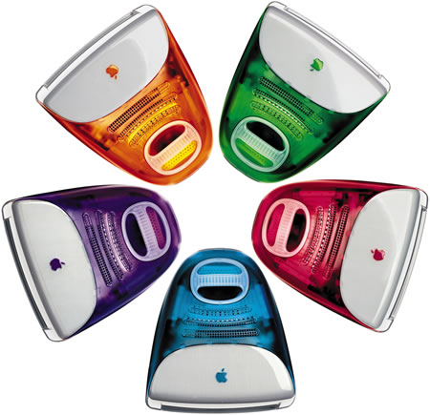
Apple History (post 1997)
In August 1997, Steve Jobs came back to Apple.
  Stop selling license to make Mac clones
  Started online store, Apple stores.
  Reduce the number of product lines from 15 to 4.
    Desktops and portable Mac for home and professionals.
  Increase R&D
  In 1998, introduced iMac – a success!
    From $1 billion loss
    To $309 profit.

Slide 75


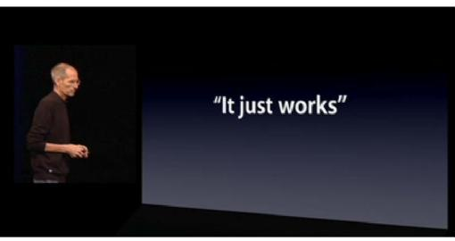
The Macintosh and Apple's “Digital Hub” Strategy
Steve Jobs’ marketing campaigns
Steve Jobs introduced the Macintosh and Apple’s “Digital Hub” Strategy
  The digital hub controls, integrate and add value to digital devices, i.e. digital camera, camcorders, mobile phones, portable music players, etc.

Slide 76
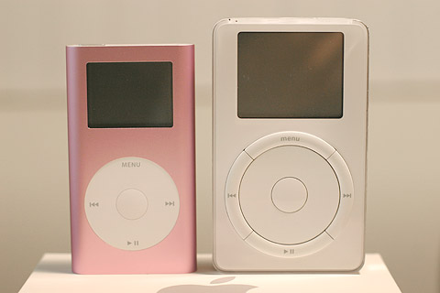
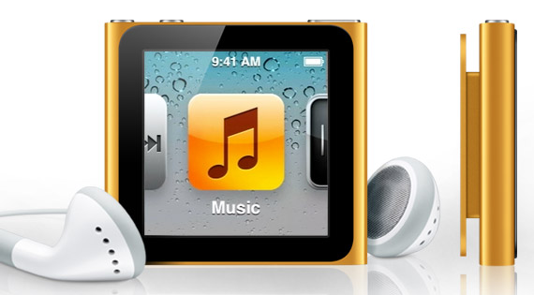
Moving Beyond the Macintosh (iPod)
In 2001, Apple introduced iPod.
Held more than 70% market share of the MP3 players in the US.
Gross margin of iPod nano = 40% in 2007.

Slide 77
Moving Beyond the Macintosh (iTune)
Opened in April 2003.
Set price at 0.99 cents/song.
The cost was already 0.70 cents/song.
iTune served as a loss-leader for a profit-driving iPod.
  iTune was what differentiated iPod from other MP3 players like Microsoft’s Zune.

Slide 78
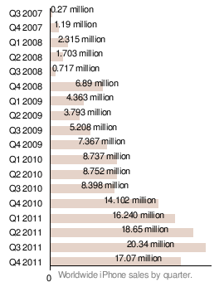
Moving Beyond the Macintosh (iPhone)
Developing a Phone is new to Apple.
The first iPhone was introduced
  in 2007
Prior to entry, Nokia, Motorola
and Samsong occupied about 60%
of market share.
The introduction of apps store
in 2008 dramatically increase
sales of iPhone.

Slide 79
Moving Beyond the Macintosh (iPad)
Launched in 2010.
A new invention. Change the way people use computer and touch-screen device.
Challenges
  Lack of physical QWERTY keyboard
  Competitors are strong : Kindle (by Amazon.com)
  Low-price netbooks
  Andriod-based tablets

Slide 80
Apple’s Unit Sales by Product, 2004 - 2009
Apple’s Unit Sales by Product Category
Source: Apple’s financial statements and (Yoffie and Kim, 2011)
(in 1,000 of units) | 2004 | 2005 | 2006 | 2007 | 2008 | 2009
Desktops | 1,625 | 2,520 | 2,434 | 2,714 | 3,712 | 3,182
Portables | 1,665 | 2,014 | 2,869 | 4,337 | 6,003 | 7,214
iPods | 4,416 | 22,497 | 39,409 | 51,630 | 54,828 | 54,132
iPhone | - | - | - | 1,389 | 11,627 | 20,731

Slide 81
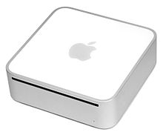
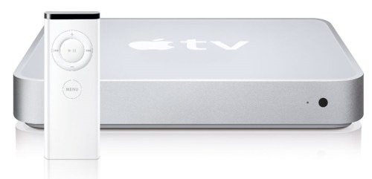
The Occasional Failures
Mac Mini
Apple TV

Slide 82
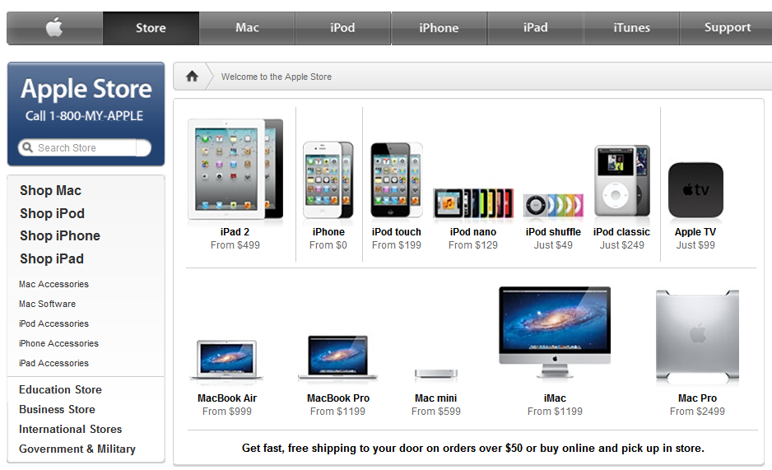
Apple Inc. in the Next Decade?
To date, there has not been a technology company which can stay high in the sky for long.
Could Apple be
  an exception?

Slide 83
Reference
Church, J. and Ware, R., Industrial Organization : A Strategic Approach, Mc.Graw – Hill International Editions, 2000.
Carlton, D.W. and Perloff, J.M., Modern Industrial Organization, Harper Collin College
Division, 2004.
Competition Commission: UK, Somerfield plc/Wm Morrison Supermarkets plc: Final Report, Competition Commission, 2005.
Yoffie, D. B. and Kim, R., Apple Inc. in 2010, Harvard Business School Case Study, 2011.

