Slide 1
Revision Slide 2
Elasticities

Slide 2
Outline
Price Elasticity of Demand (PED)
Income Elasticity of Demand (YED)
Cross Elasticity of Demand (XED)
Price Elasticity of Supply (PES)

Slide 3
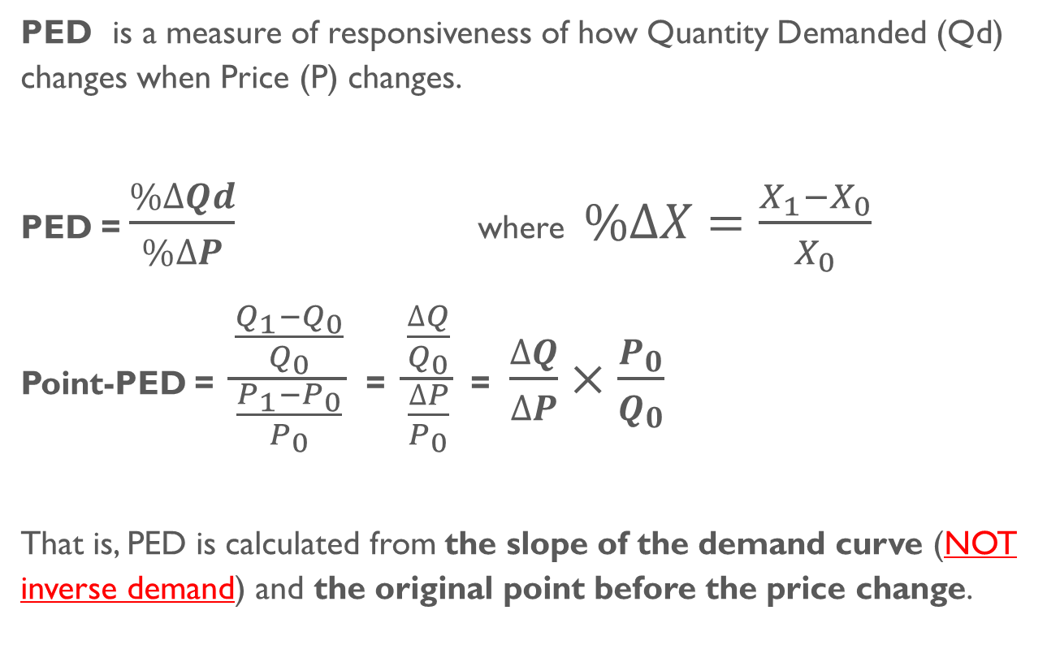
Price elasticity of demand
PED is a measure of responsiveness of how Quantity Demanded (Qd) changes when Price (P) changes.
PED = $\frac{\%∆Qd}{\%∆P}$ where $\%∆X=\frac{X_{1}−X_{0}}{X_{0}}$
Point-PED = $\frac{\frac{Q_{1}−Q_{0}}{Q_{0}}}{\frac{P_{1}−P_{0}}{P_{0}}}$ = $\frac{\frac{∆Q}{Q_{0}}}{\frac{∆P}{P_{0}}}$ = $\frac{∆Q}{∆P}×\frac{P_{0}}{Q_{0}}$
That is, PED is calculated from the slope of the demand curve (NOT inverse demand) and the original point before the price change.

Slide 4
Values of PED
PED is a negative value since a rise in price (positive %∆ in P) corresponds to a fall in quantity demanded (negative %∆ in Qd).
However, PED is sometimes reported in an absolute value, as we are interested in the “magnitude” of the change, not the “direction”.
When
|PED| > 1, demand is price-elastic.
|PED| = ∞, demand is perfectly price-elastic
|PED| < 1, demand is price-inelastic.
|PED| = 0, demand is perfectly price-inelastic
|PED| = 1, demand is unit-elastic.

Slide 5
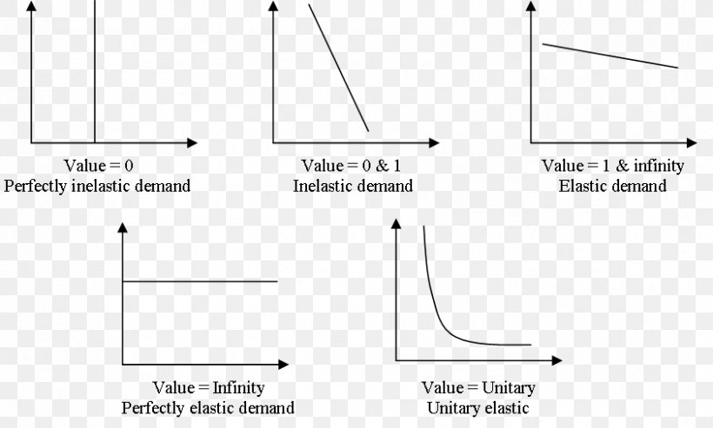
Values of PED

Slide 6
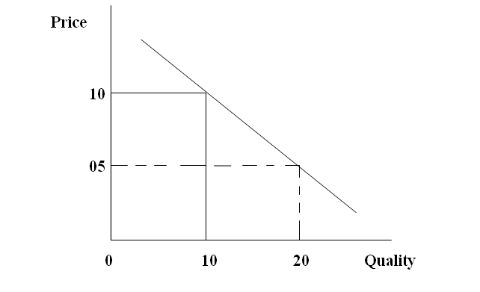
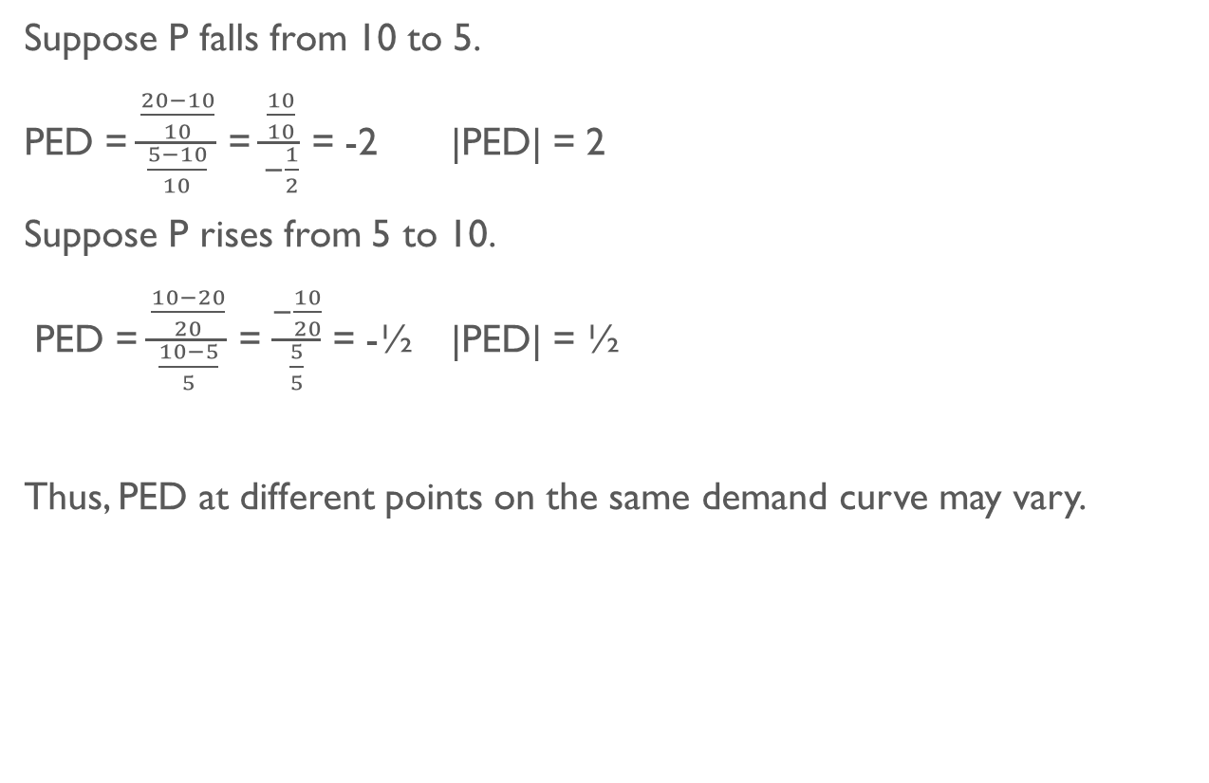
PED calculation
Suppose P falls from 10 to 5.
PED = $\frac{\frac{20−10}{10}}{\frac{5−10}{10}}$ = $\frac{\frac{10}{10}}{−\frac{1}{2}}$ = -2 |PED| = 2
Suppose P rises from 5 to 10.
PED = $\frac{\frac{10−20}{20}}{\frac{10−5}{5}}$ = $\frac{−\frac{10}{20}}{\frac{5}{5}}$ = -½ |PED| = ½
Thus, PED at different points on the same demand curve may vary.

Slide 7
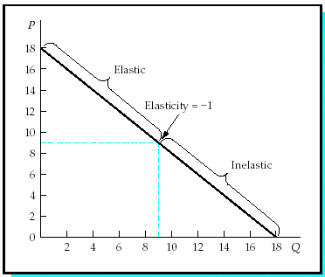
PED Along the demand curve
PED along the LINEAR demand curve varies.
At each point on the demand, the proportion of %∆Qd to %∆P varies.

Slide 8
Determinants of PED
Availability of Substitutes
  more substitutes >>> elastic
Proportion of Income Spent on the Good
  large proportion of income spent (relatively expensive) >>> elastic
Necessity vs Luxury
  necessity >>> inelastic
Addiction / Habit-Forming
  addictive >>> inelastic
Time (to look for substitutes / to adjust behavior)
  more time >>> elastic

Slide 9
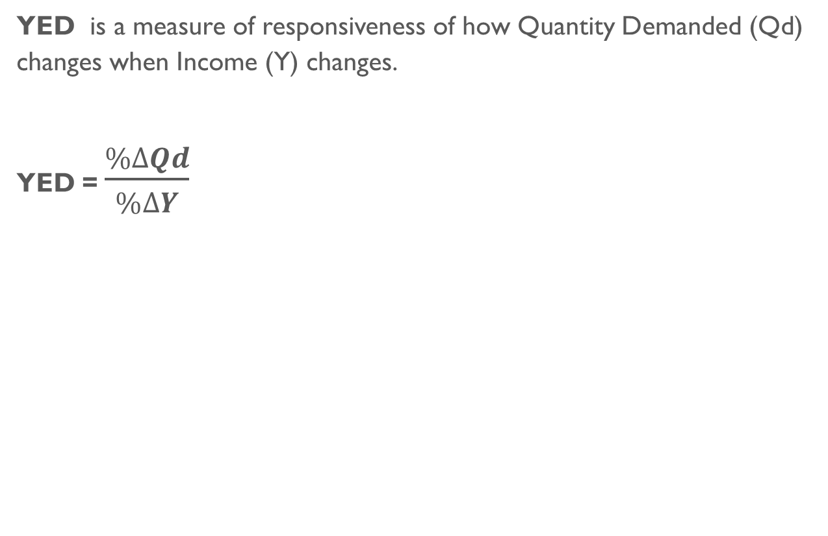
Income Elasticity of DEMAND
YED is a measure of responsiveness of how Quantity Demanded (Qd) changes when Income (Y) changes.
YED = $\frac{\%∆Qd}{\%∆Y}$

Slide 10
Values of YED
When
YED > 0, the good is NORMAL.
When income rises, consumers demand more.
For YED > 1, the good is a normal and LUXURY good.
- A change in income causes a large change in quantity demanded.
For YED < 1, the good is a normal and NECESSITY good.
- A change in income causes a small change in quantity demanded.
YED < 0, the good is INFERIOR.
When income rises, consumers demand less.

Slide 11
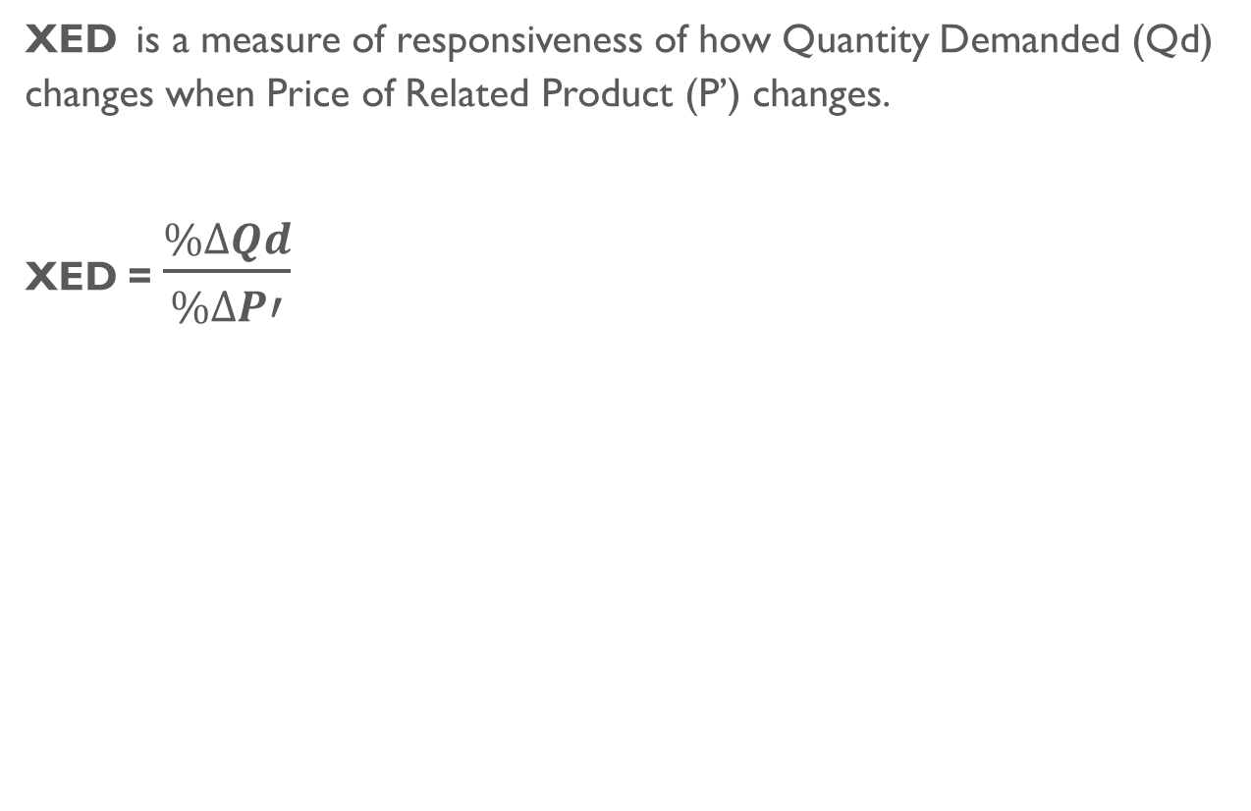
Cross Elasticity of dEmand
XED is a measure of responsiveness of how Quantity Demanded (Qd) changes when Price of Related Product (P’) changes.
XED = $\frac{\%∆Qd}{\%∆P′}$

Slide 12
Values of XED
Let X be Good 1 and Y be Good 2.
When
XED > 0, a rise in Py causes a fall in Qy, BUT a rise in Qx
Thus, the two goods are SUBSTITUTES.
XED < 0, a rise in Py causes a fall in Qy, AND a fall in Qx.
Thus, the two goods are COMPLEMENTS.
XED = 0, a rise in Py causes a fall in Qy, BUT no effect on Qx.
Tuhs, the two goods are UNRELATED.

Slide 13
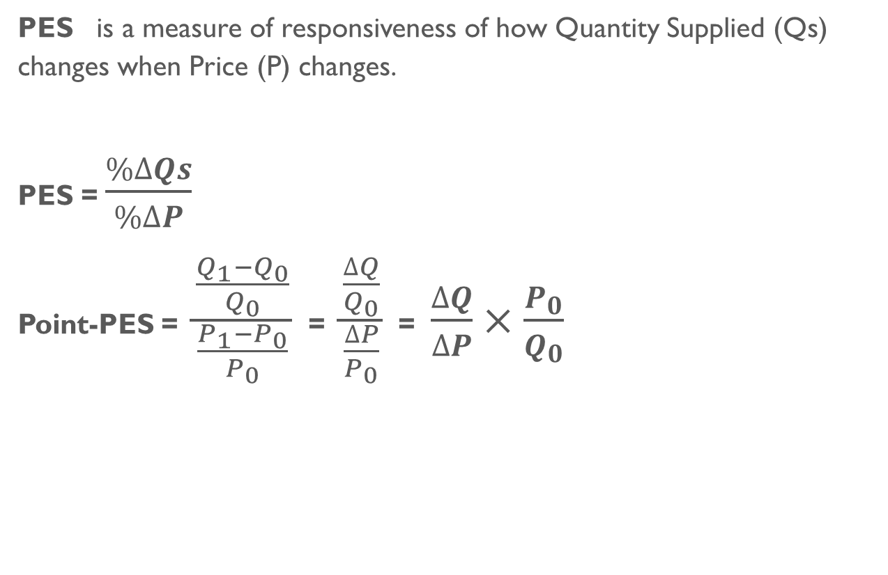
Price elasticity of Supply
PES is a measure of responsiveness of how Quantity Supplied (Qs) changes when Price (P) changes.
PES = $\frac{\%∆Qs}{\%∆P}$
Point-PES = $\frac{\frac{Q_{1}−Q_{0}}{Q_{0}}}{\frac{P_{1}−P_{0}}{P_{0}}}$ = $\frac{\frac{∆Q}{Q_{0}}}{\frac{∆P}{P_{0}}}$ = $\frac{∆Q}{∆P}×\frac{P_{0}}{Q_{0}}$

Slide 14
Values of PES
PES is a positive value since a rise in price (positive %∆ in P) corresponds to a rise in quantity supplied (positive %∆ in Qs).
When
PES > 1, supply is price-elastic.
PES = ∞, supply is perfectly price-elastic
PES < 1, supply is price-inelastic.
PES = 0, supply is perfectly price-inelastic
PES = 1, supply is unit-elastic.

Slide 15
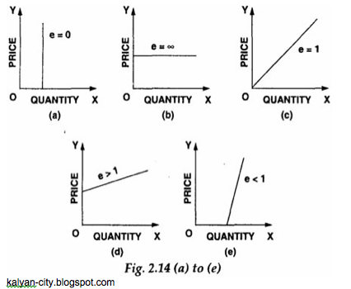
Values of PED

Slide 16
Determinants of PES
When producers can READILY adjust their production to the price change, then the supply is elastic. Such READINESS depends on
Unused Capacity (unused inputs)
  more unused inputs >>> ready to respond to ∆P >>> elastic
Mobility of Factors of Production
  mobile FOP >>> ready to respond to ∆P >>> elastic
Ability to Stock
  able to stock output >>> ready to respond to ∆P >>> elastic
Time
  more time >>> ready to respond to ∆P >>> elastic

