Slide 1
Economy of lao pdr
EE361 ECONOMIES of CLMV
Faculty of economics
Thammasat university

Slide 2
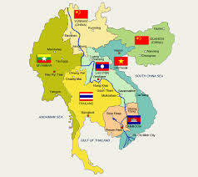
Lao PDR within the Greater Mekong Subregion
 | 2000 | 2018
Population | 5.3 million | 7.3 million
GDP per capita | $672 | $1,785
Under 5 mortality (per 100,000 births) | 106.4 | 47.3
Infant mortality (per 100,000 births) | 78.7 | 37.6
Primary education attainment | 82% | 97%
Poverty rate | 32.1% | 15.0%

Slide 3
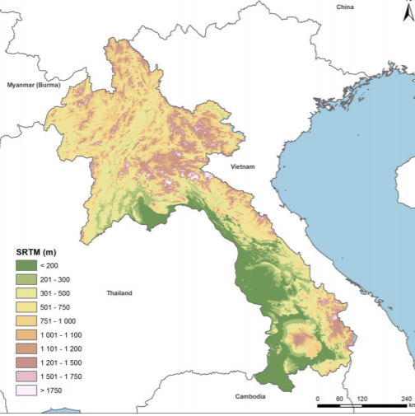
geography
Land area: 236,000 square km
Lao PDR is a landlocked country bordered by Cambodia, Thailand, Myanmar, PR China and Viet Nam
The northern and eastern areas are mountainous
Only 20% of the land area is arable, mostly on the lowlands along the Mekong river.
Lao PDR main towns and cities are located in this area
Luang Prabang
Vientiane
Thakhek
Savannakhet
Pakse

Slide 4
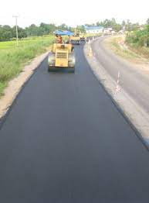
Economic Milestones
1986: Lao PDR transitions to a market economy and embarks on economic reforms (New Economic Mechanism) to stabilize the macro-economy, decentralize government control, deregulate private enterprises, and stabilize food prices
1990s: Lao PDR receives large foreign direct investment flows and official development assistance
1998 the Asian financial crisis resulted in high inflation and the Lao currency (KIP) lost 87% of its value against the USD

Slide 5
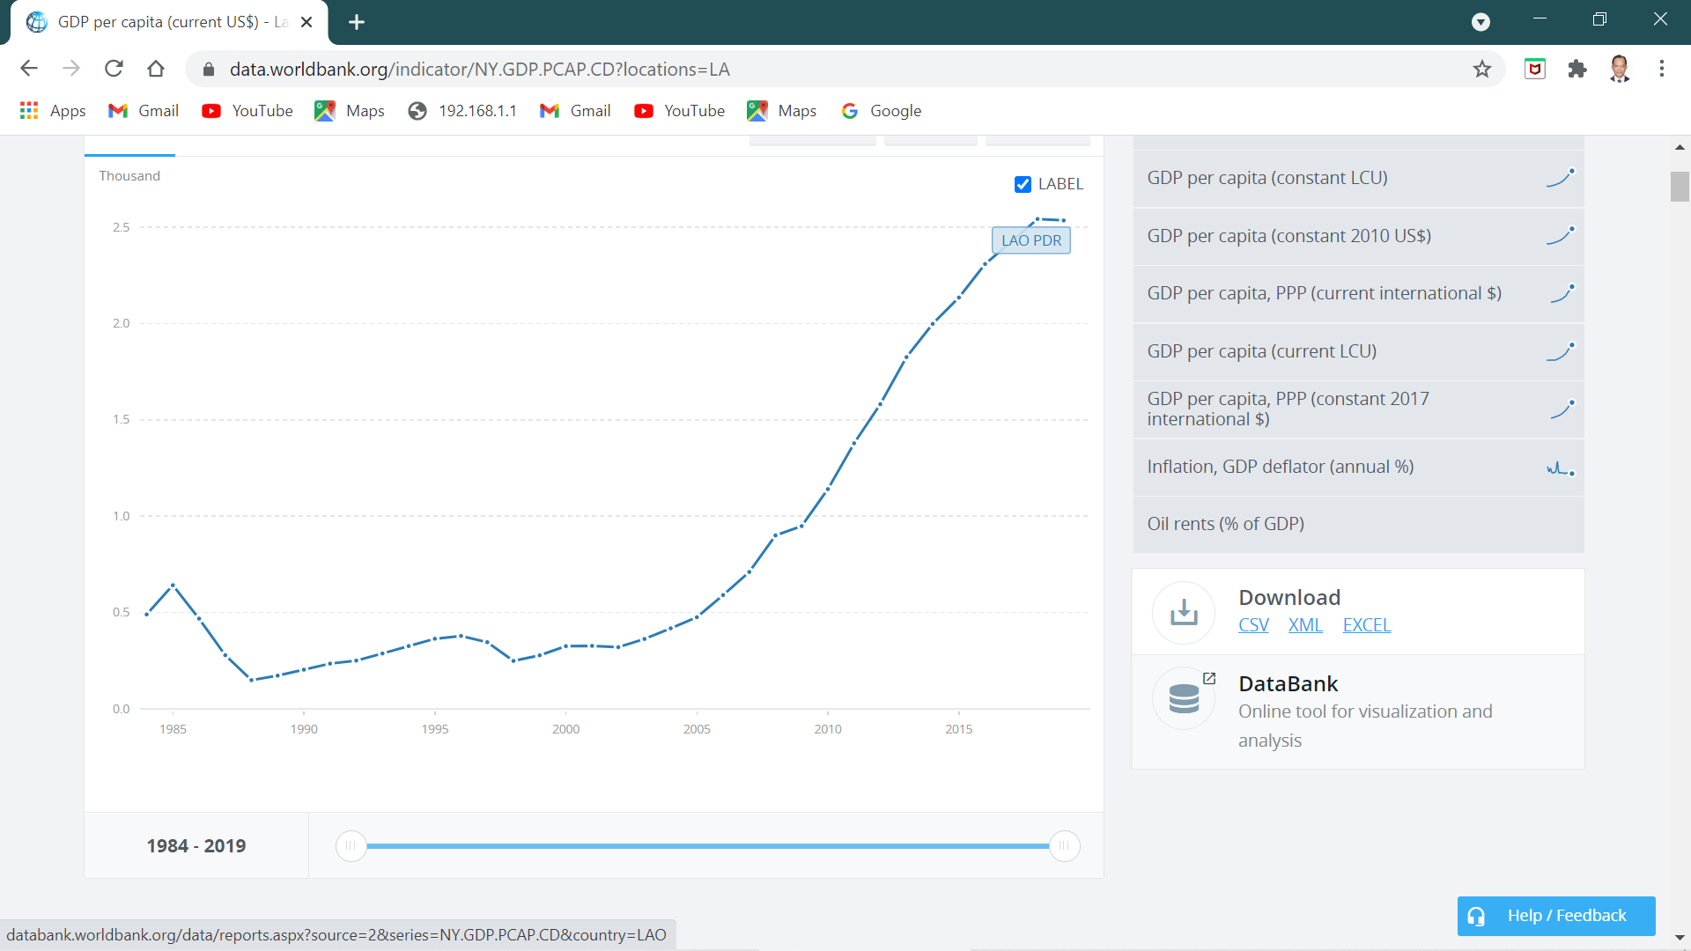
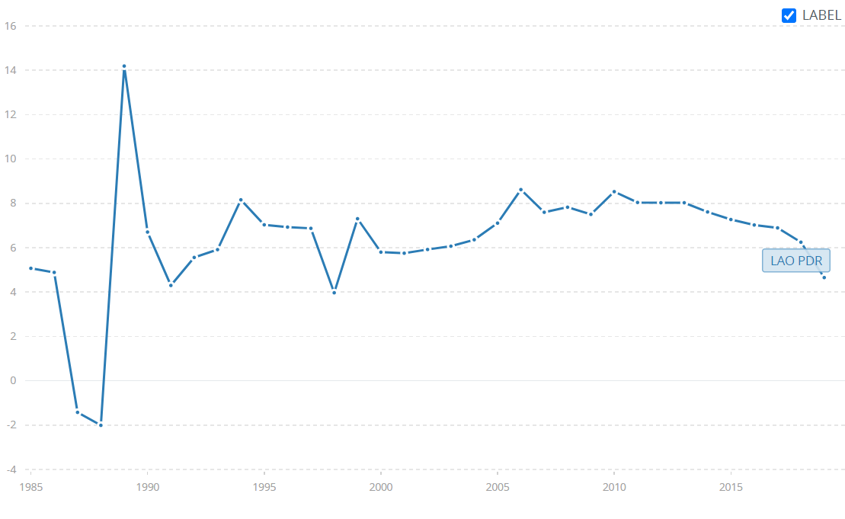
economy
GDP growth averaged 7% between 1998 and 2018,
GDP per capita increased from $672 in 2000 to $1,785 in 2018
Poverty varies substantially across ethnic and geographic lines; poverty incidence decreased from 33.5% in 2003 to 23.2% in 2018
However, inequality has widened; the Gini coefficient rose from 0.31 to 0.36 during the same period
GDP per capita, 1960-2015
GDP growth 1960-2015

Slide 6
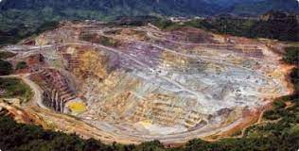
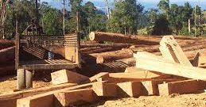
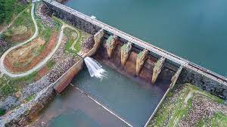
economy
The main driver of economic growth is the resource sector, particularly mining, timber extraction, and hydropower
While the economy is slowly diversifying into retail and wholesale services, tourism, and construction, given the country’s large untapped hydropower development potential and mineral endowments, it is expected the resource sector will continue to underpin economic growth

Slide 7
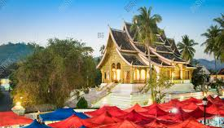
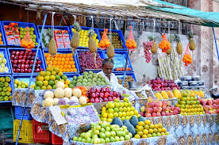
Development performance
Stable economic growth increased gross domestic product (GDP) per capita from $621 in 2006 to $2,027 in 2016.
While the economy is slowly diversifying into retail and wholesale services, tourism, and construction, given the country’s large untapped hydropower development potential and mineral endowments, it is expected the resource sector will continue to underpin economic growth in the 2030s

Slide 8
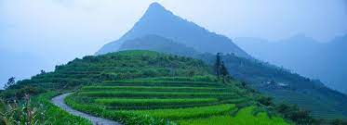
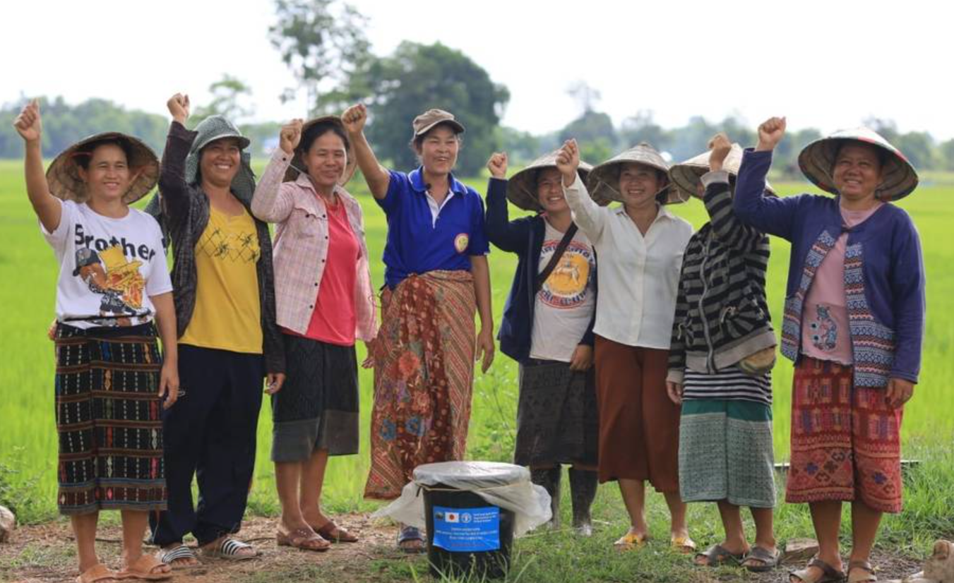
agriculture
The agriculture sector generates most of the income for the poor people, thereby reducing poverty by 44%; manufacturing and services sectors contributed to 14% and 7% of poverty reduction
The sector comprises 24% of GDP, employed around 70% of the labor force during 2011–2016
Rural farmers are vulnerable to extreme weather events (floods and drought) and price volatilities

Slide 9
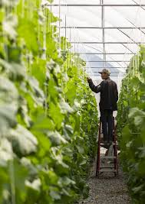
agriculture
Gradual shift to commercial agriculture. About 80% of the rural population are subsistence farmers; however agriculture production is becoming increasingly commercialized
Environment and climate change deforestation, forest degradation, and loss of biodiversity are of concern. Concessions to foreign companies has boosted agricultural exports, but also contributes to problems of land and forest degradation.
Vulnerability to climate change Lao PDR is very vulnerable to disasters, such as weather events such as typhoons, flooding and droughts, rodent and pest attacks, and animal disease epidemics.

Slide 10
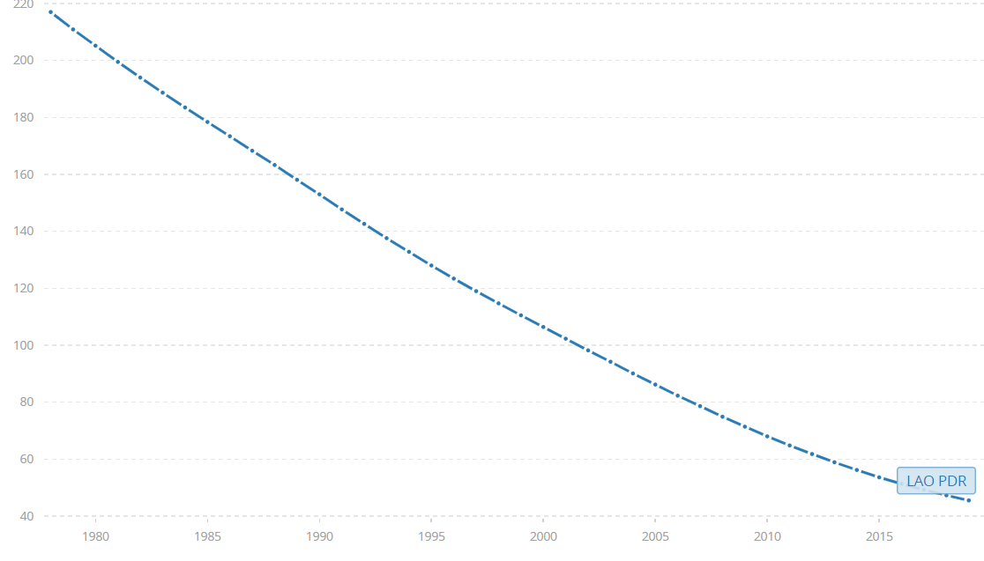
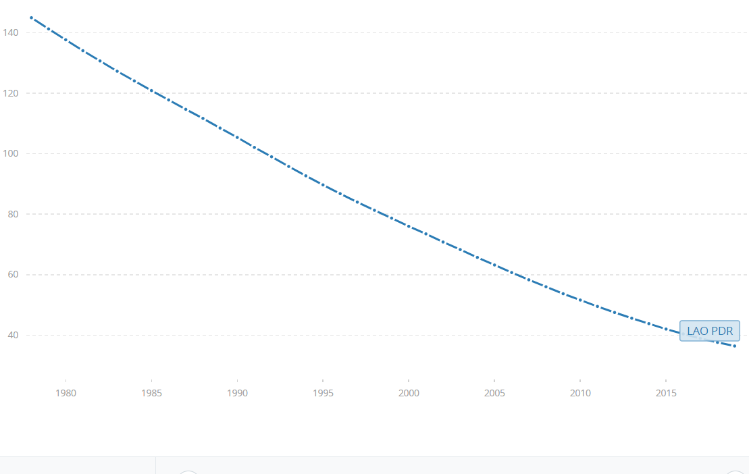
Human development
Higher education attainment facilitated the transition into non-farm employment and contributed to agriculture income growth by raising agriculture productivity
In the absence of an adequate safety net, there is a tendency for vulnerable households to fall below the poverty line in the event of natural disasters and economic shocks
Health indicators are slowly improving; life expectancy and under-5 mortality rates have improved; however chronic malnutrition in young children is a concern (stunting is at 44%, among the highest in the world
Under-5 mortality rate, 1980-2018
Infant mortality rate, 1980-2018

Slide 11
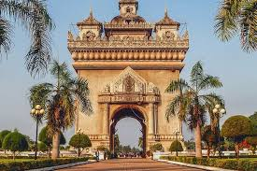
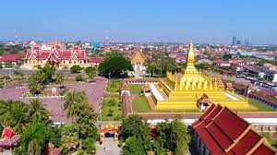
Urban development
Rapid urbanization: the share of urban population increased from 22.0% in 2000 to 35.1% in 2018
Dominance of Vientiane as the primary city will likely continue in the future; this will be followed by the secondary towns: Savannakhet as industrial and logistics center, Pakse as agricultural hub in the south and Luang Prabang as regional hub and tourist destination in northern Laos
The coverage and quality of basic urban services has improved over time, however challenges remain; access to improved water supply and sanitation is increasing, however, gaps remain and disproportionally affect the poor

Slide 12
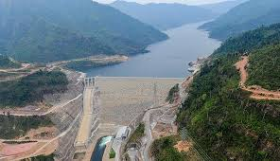
energy
Lao PDR is rich in hydropower; this is reflected in the number of hydropower projects built during the past 20 years: Nam Theun II, Thein Hinbeun and Nam Ngiep
The electrification program in Lao PDR, which is one of most successful programs in the world, has a rate of electrification exceeding 90% of households
The challenge is to reach the remaining 10 percent, mostly in poor, remote areas

Slide 13
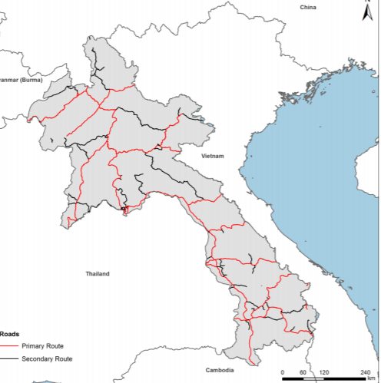
transport
National Road 13 is the main transportation backbone of Lao PDR
Although national roads are in relatively good condition (85%); however secondary and provincial roads, particularly in the northern region (50% in good condition), is a challenge
The length of the road network has increased by 50% since 2005; about 56% of the rural population have access to all weather roads, however, some areas still remain unconnected,.
Pakse

Slide 14

Development challenges
Highly concentrated production and export structure in mining (34% of exports) and power generation (21% of exports) are fueling economic growth, of which half of exports go to Thailand and the PR China; while these two sectors account for 20% of total GDP and 50% of total exports, they create only 1% of total employment
Infrastructure gaps. Investments in infrastructure is lacking; quality and coverage, of urban services, irrigation and other productive rural infrastructure, rural electrification, and land transport must be strengthened

Slide 15
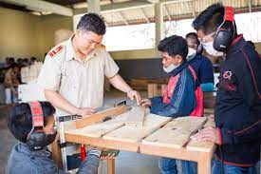
Development challenges
Limited human capital. Inadequate education and skills as well as poor access to quality health services constrain business expansion and productivity. Investments in secondary and tertiary education and vocational training are mostly through official development assistance
Inefficient governance. Governance and the business-enabling environment must be improved to attract more private investment. In 2016, the Lao PDR’s overall rank for ease of starting a business was 160 out of 190 countries assessed

Slide 16
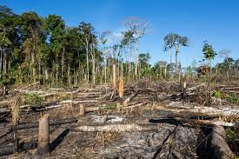
Development challenges
Environmental degradation weak land use planning, disasters triggered by natural hazards, inadequate legal and policy frameworks for environment protection, and limited natural resource management capacity contribute to environmental degradation
Climate change Frequent occurrences of natural disasters resulting from changing climate patterns and extreme weather, such as floods and drought

Slide 17
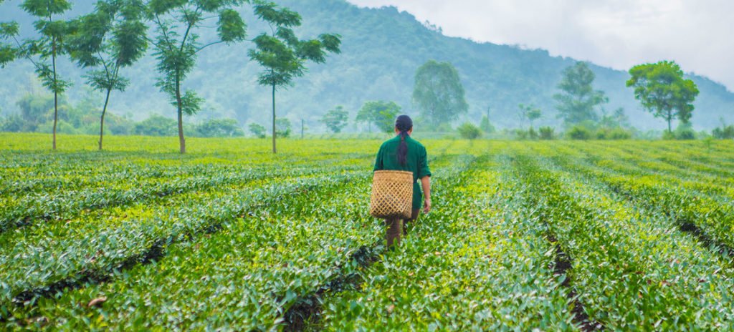
summary
Lao PDR has leveraged its substantial natural resource endowments to generate economic growth and reduce poverty
As the country moves forward, growth needs to be more inclusive and sustainable; to achieve this, the Lao PDR must:
diversify its resource-based economy
develop infrastructure to facilitate private investment

Slide 18
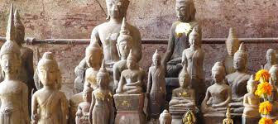
summary
develop human capital, improve productivity, and widen access to markets and social services
accelerate legal and regulatory reforms to improve the investment climate for the private sector
improve public sector management to enhance the quality and coverage of public services
address environmental degradation and climate change

