Slide 1


Customer Insight Tools and Techniques:
BRAND PERSONA
MK 312 Marketing Planning
By Ajarn Suwalya K.
November 5, 2020

Slide 2
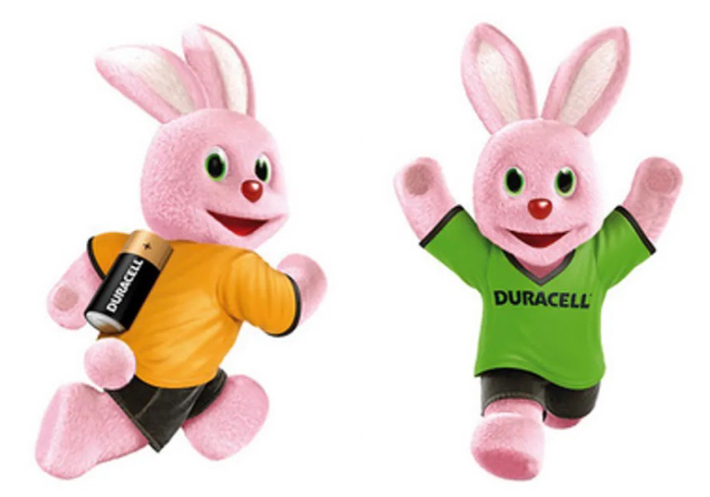
Brand Persona

Slide 3
Brand Persona Definition
A brand persona is a collection of personality traits, attitudes and values that your brand showcases on a regular basis to help connect with a certain audience segment. A brand persona can be a person, character, mascot or idea. ... A good brand persona is one that you can almost visualize as someone you know."

Slide 4
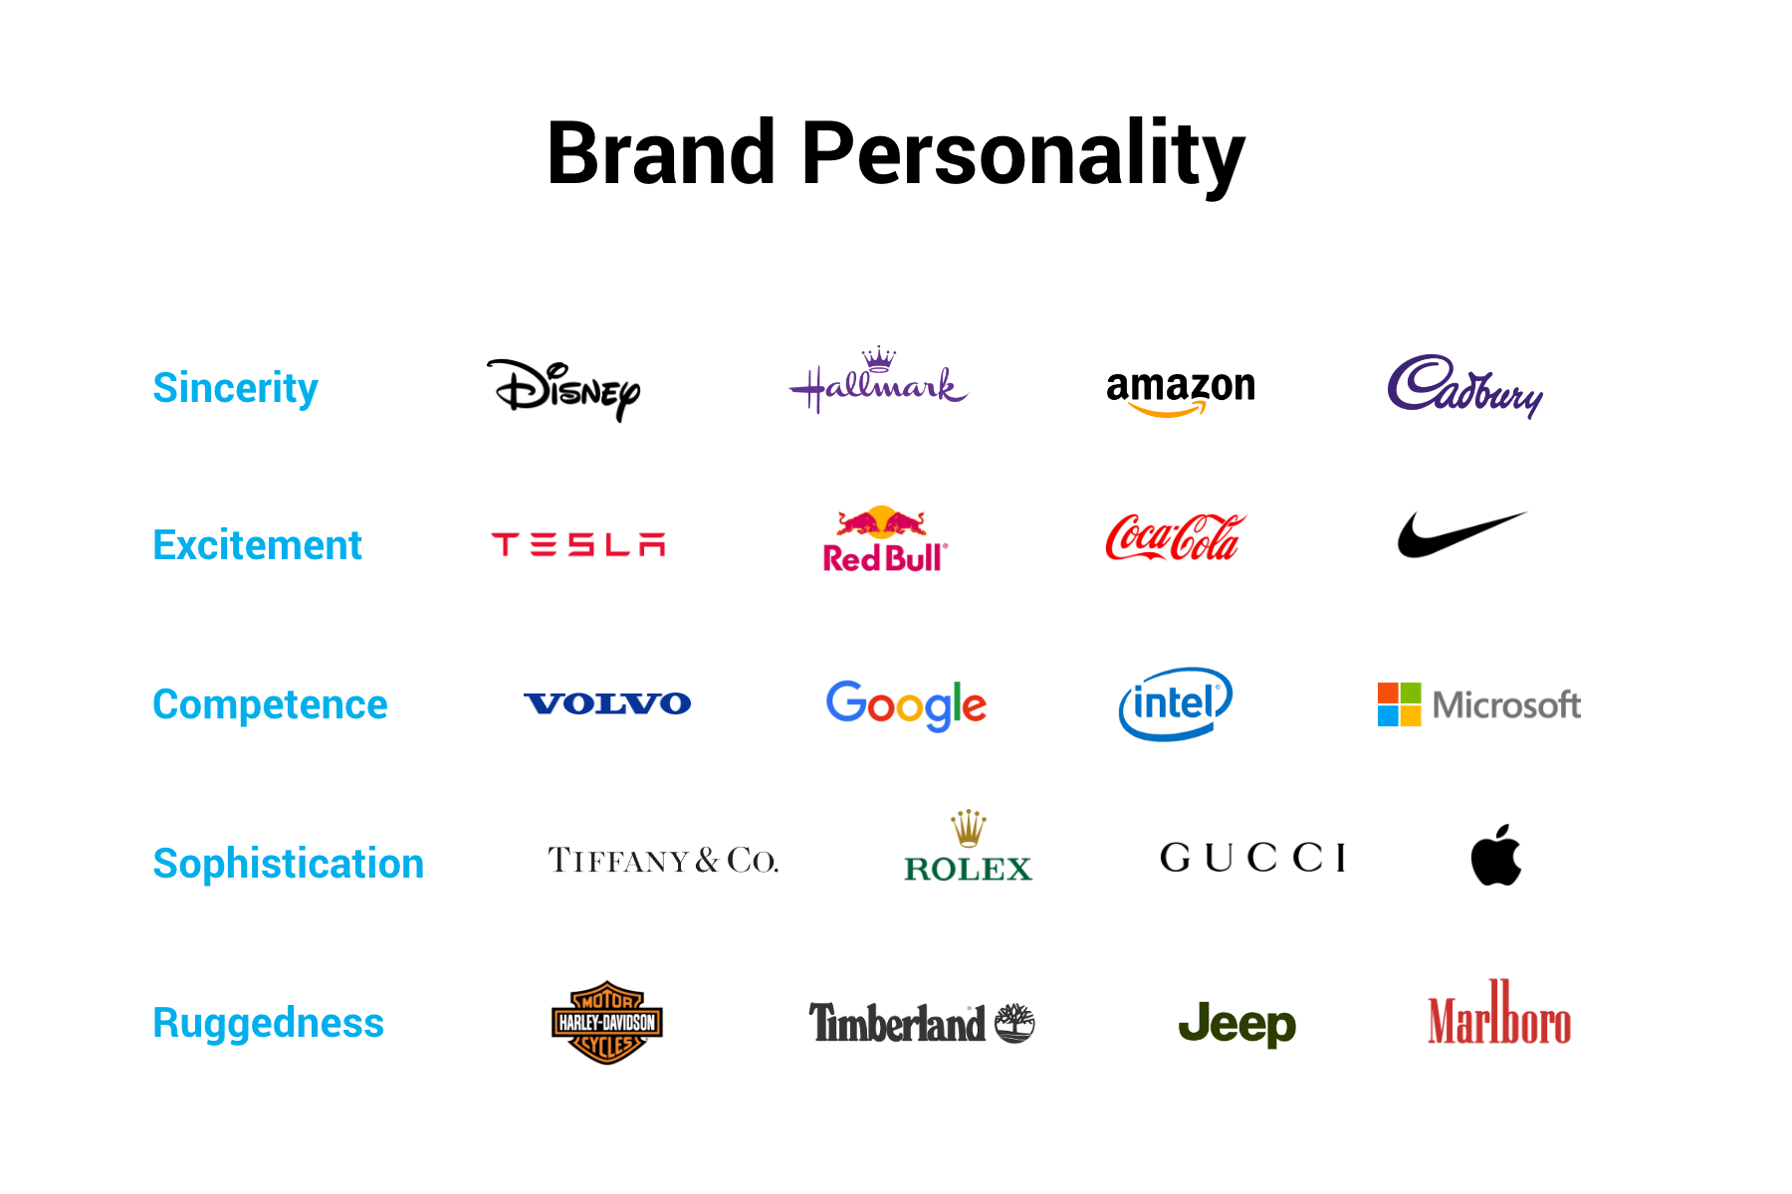

Slide 5
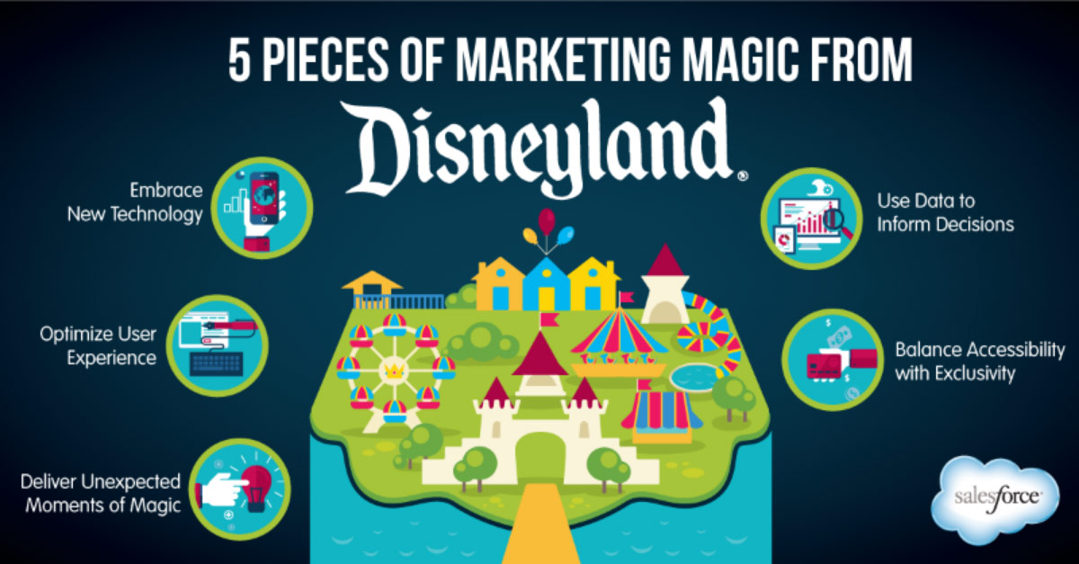

Slide 6
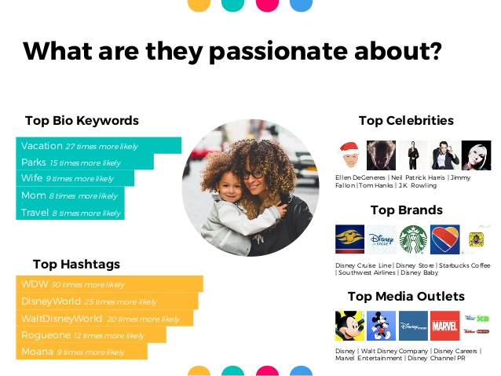

Slide 7

Brand Persona

Slide 8
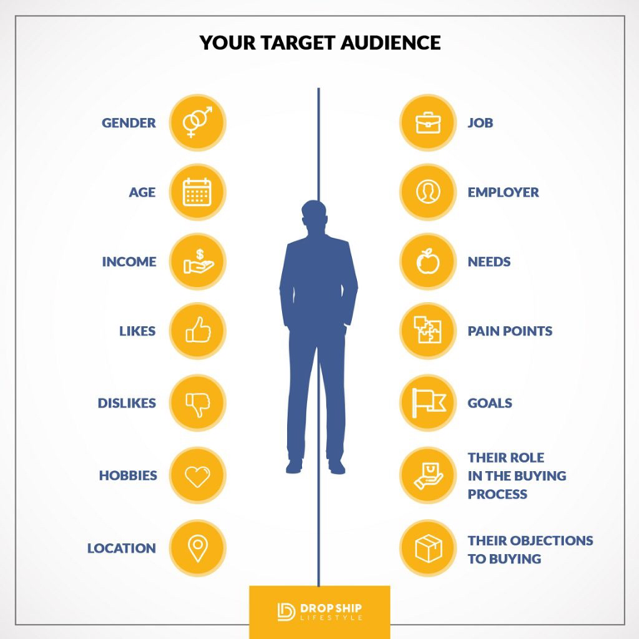
Brand Persona

Slide 9
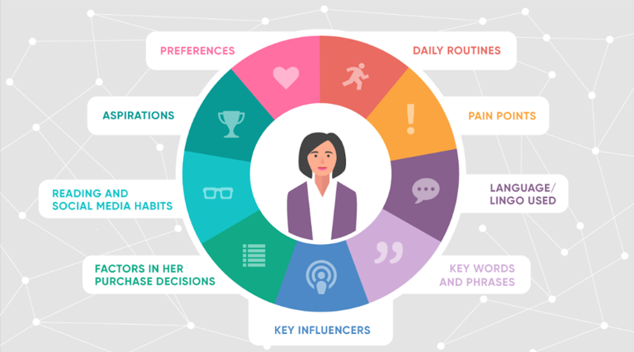
Brand Persona

Slide 10
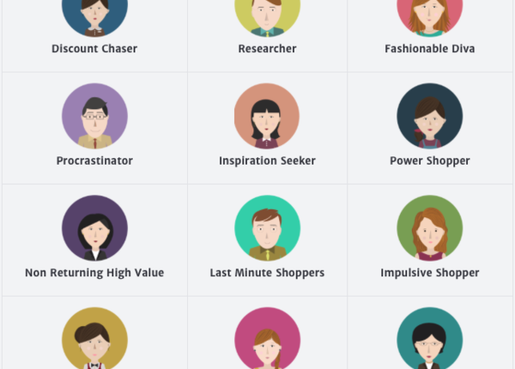
Brand Persona

Slide 11
Brand Persona creation overview:
Create a personality image. ...
Create an overview of your brand.
List traits of your brand that you want to highlight.
Map out the personality you desire from the list above.
Describe how your persona would speak, and provide examples of copy.
Describe how the persona engages with others.

Slide 12
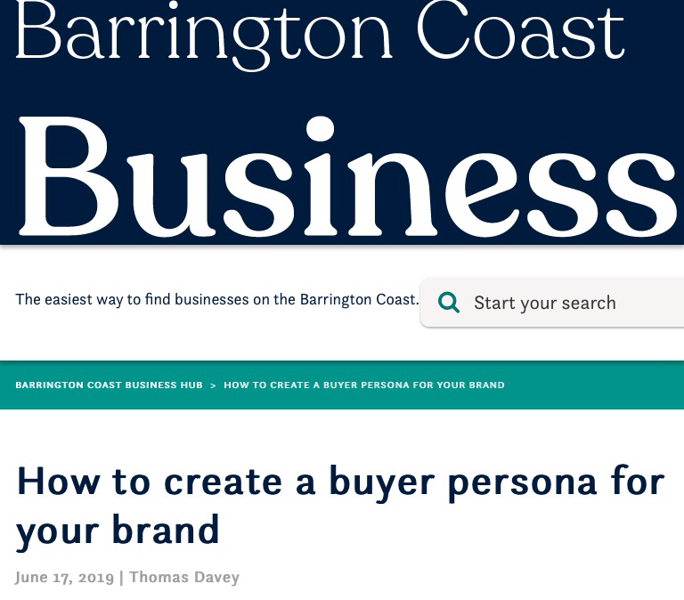

Slide 13
How to create Buyer Persona for your Brand ?
The first step to any marketing strategy is creating your buyer personas.
So what’s a buyer persona?
A buyer persona as a fictional representation of your target market. As such, it embodies the traits of all people you are looking to reach out to and helps you better understand their needs.

Slide 14
How to Create Buyer Persona for your Brand ?
Here’s a quick summary:
Determine demographics, psychographics and behavior of your target audience
Locate them on – and offline – find out what they search for, read, shop for
Connect your offering to their needs
Determine the right time to act
Offer the right product or service at the right time to help your audience reach their goals

Slide 15
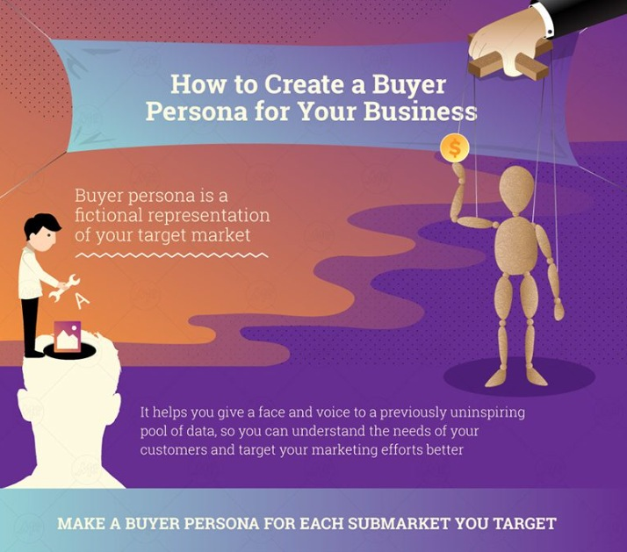
How to create Buyer Persona for your Brand ?

Slide 16
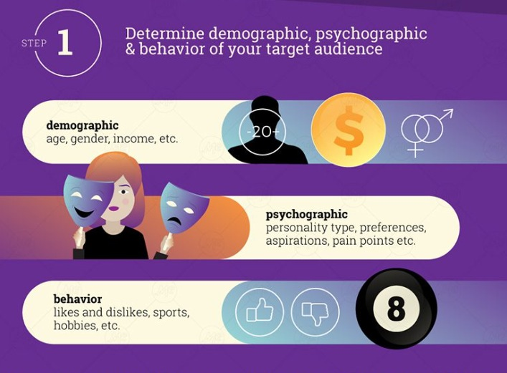
How to create Buyer Persona for your Brand ?

Slide 17
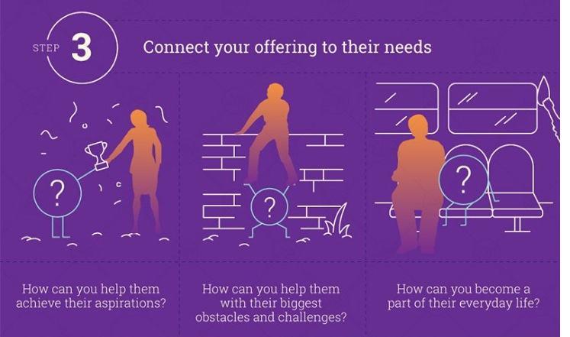
How to create Buyer Persona for your Brand ?

Slide 18
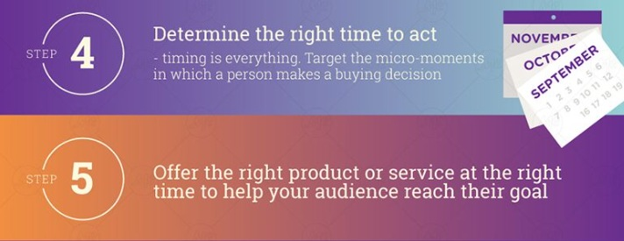
How to create Buyer Persona for your Brand ?

Slide 19
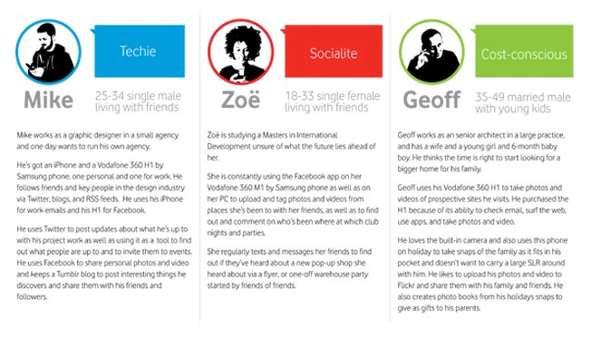
Brand Persona Example

Slide 20
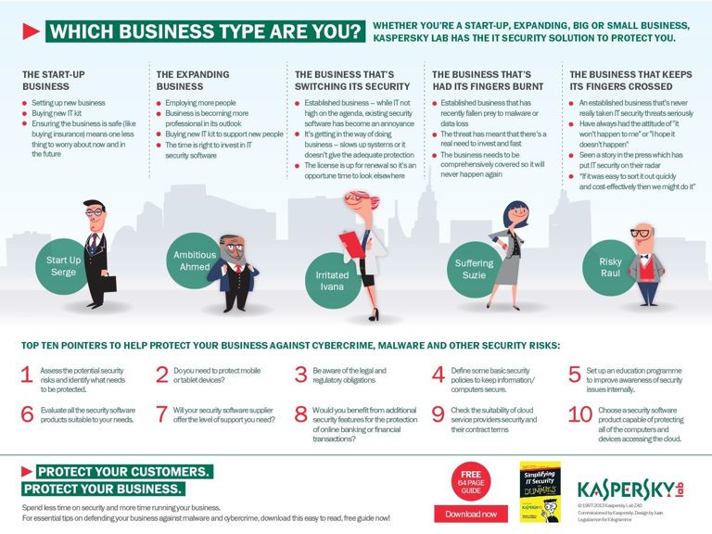
Brand Persona Guidelines

Slide 21
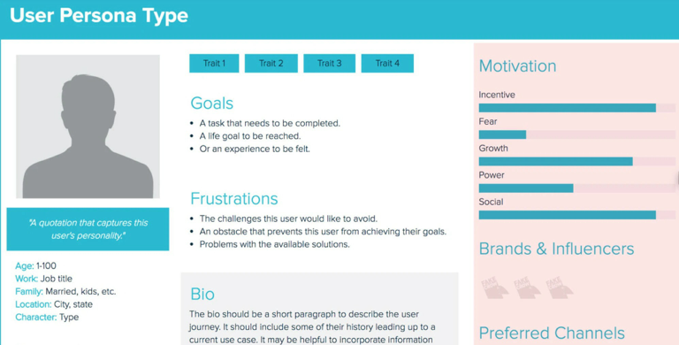
Brand Persona Guidelines

Slide 22


Slide 23
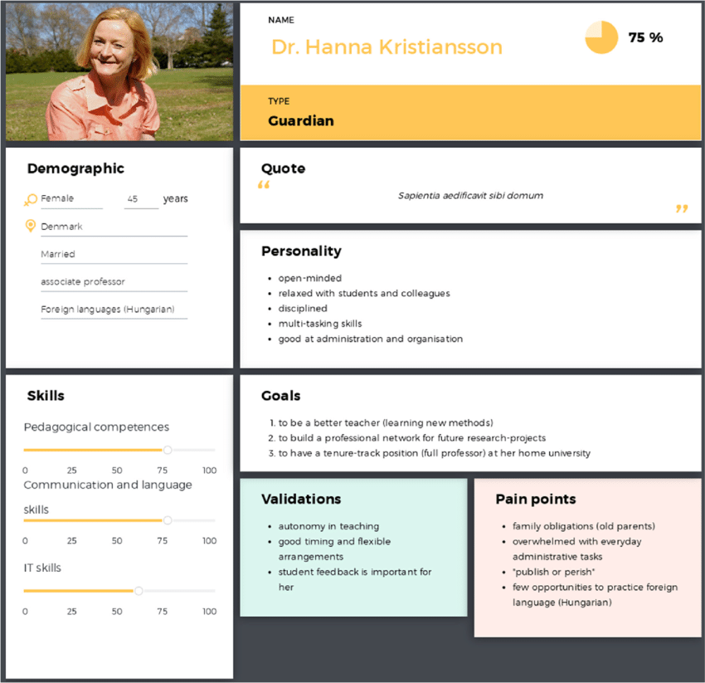

Slide 24


Slide 25
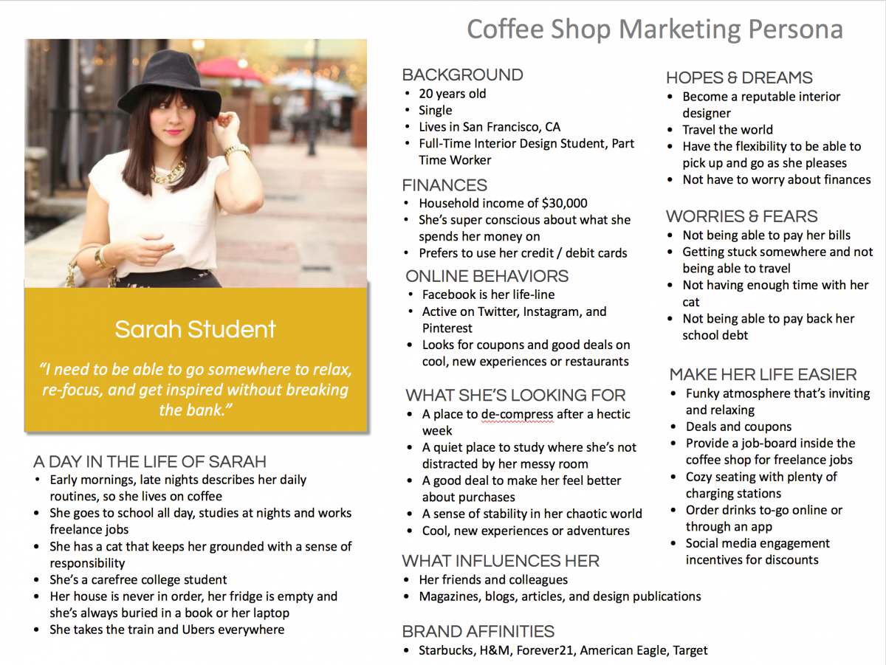

Slide 26
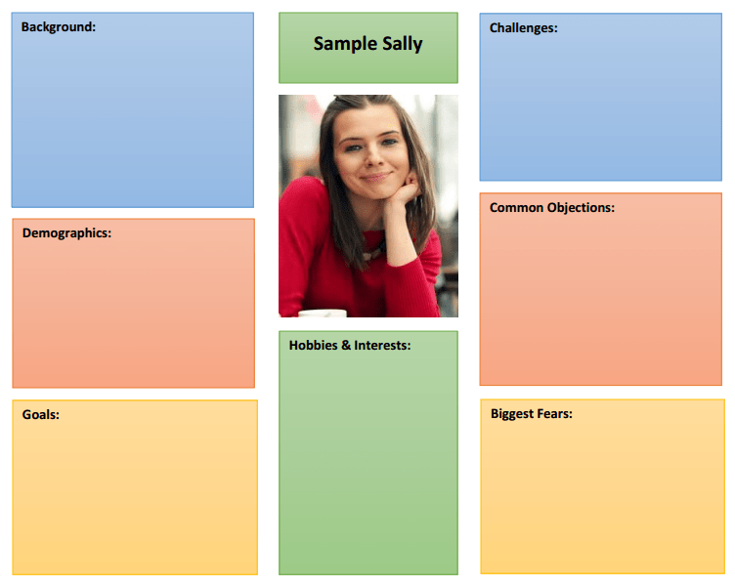

Slide 27
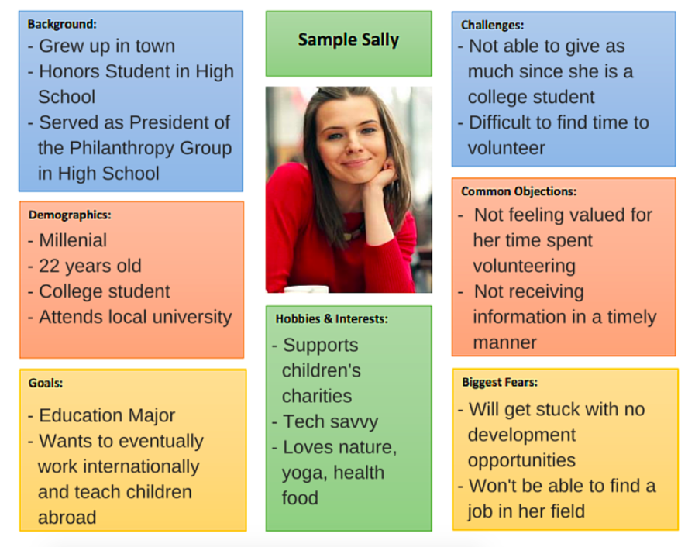

Slide 28


Slide 29
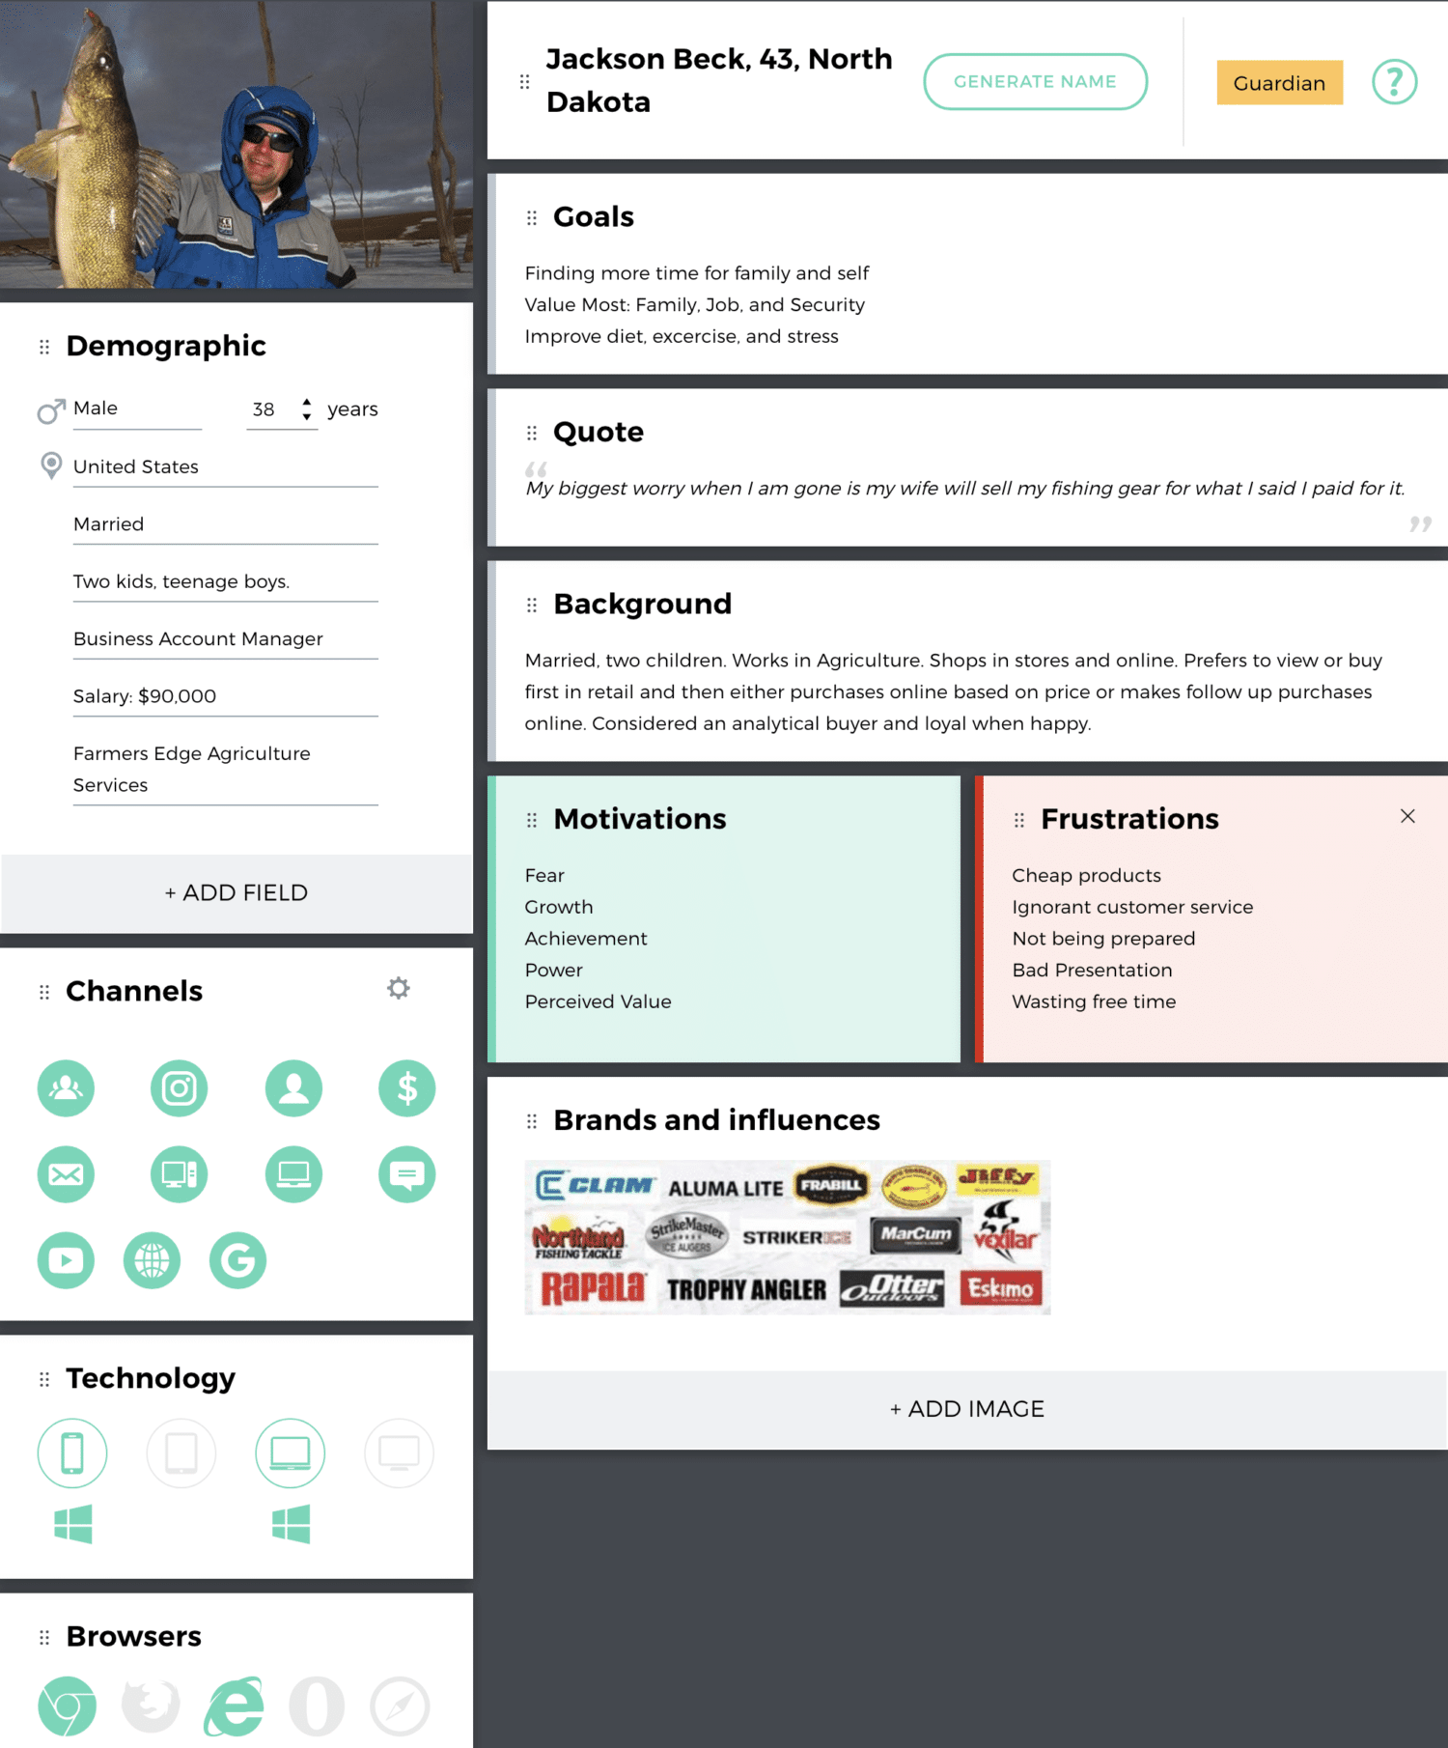

Slide 30
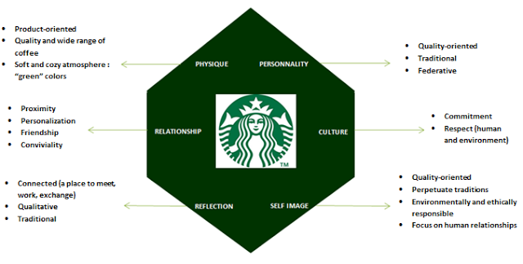

Slide 31
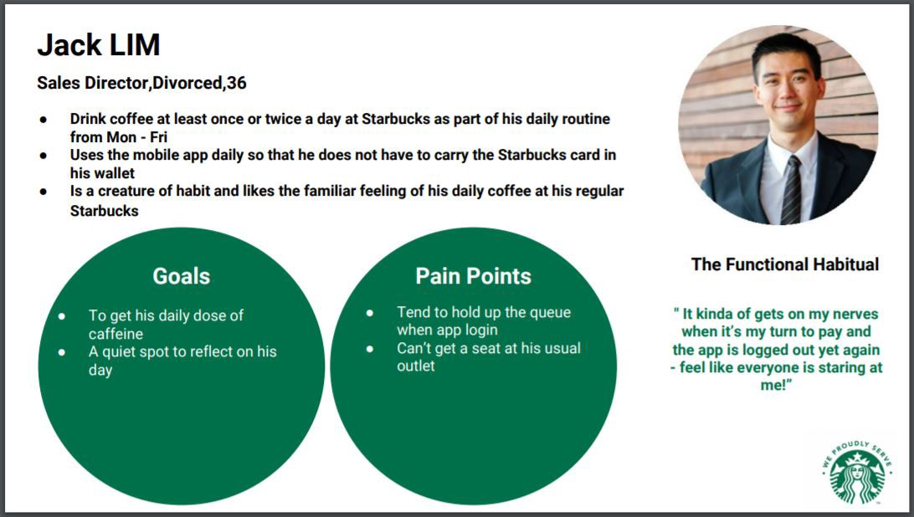

Slide 32
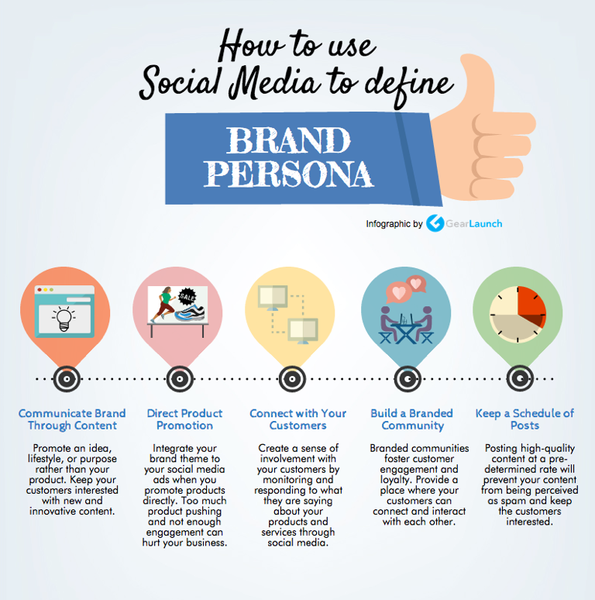
Brand Persona

Slide 33
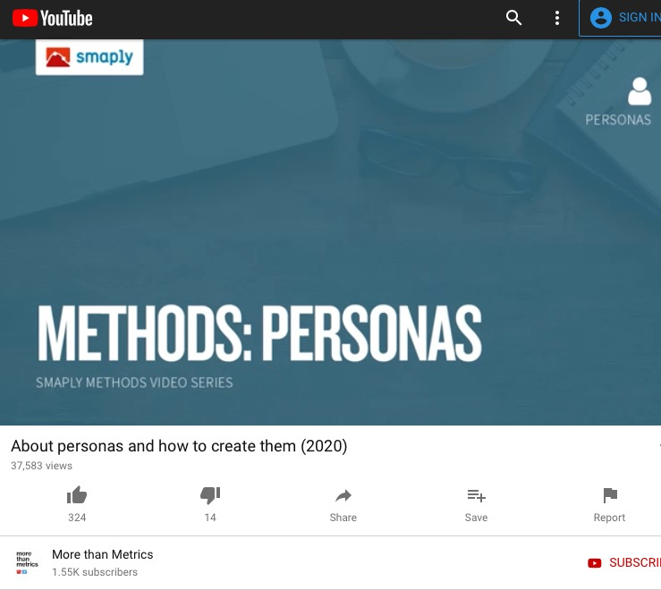
Brand Persona

Slide 34

Buyer ( customer) Persona vs Brand Persona
“ In the same way that Buyer Persona synthesizes the main characteristics of its client, the Brand Persona represents the personality of its brand. That is, it embodies the values and perceptions that you'd like your audience to have of your company.”
“ If we agree that a marketing persona is a fictional character that represents a specific user or buyer type that uses our websites, or interacts with content or a product we offer, then we'd like to stipulate that a BRAND PERSONA represents all user or buyer types that might interact with our brand.”

