Slide 1
Agriculture in Vietnam
Group 1:
Suppapong Iemkongaek 6104640195
Woradech Mawatchakij 6104640641
Tatthep Pratapsilp 6104640666
Apisom Jirattikorn 6104640823

Slide 2
1
2
Table of Contents
3
4
5
6
Overview
Briefly explain an overview of agriculture in Vietnam
Key Issues and Challenges
Identify and separate main issues of agriculture in Vietnam into short-term and long-term challenges
Government Strategies, Policies, and Legislation
Discuss government strategies dealing with issues of agriculture in Vietnam
The Role of Development Actor
Explain the role of The Ministry of Agriculture and Rural Development (MARD)
Lesson Learned
State the lesson learned of agriculture in Vietnam
Conclusion
Summarize all topics in one

Slide 3

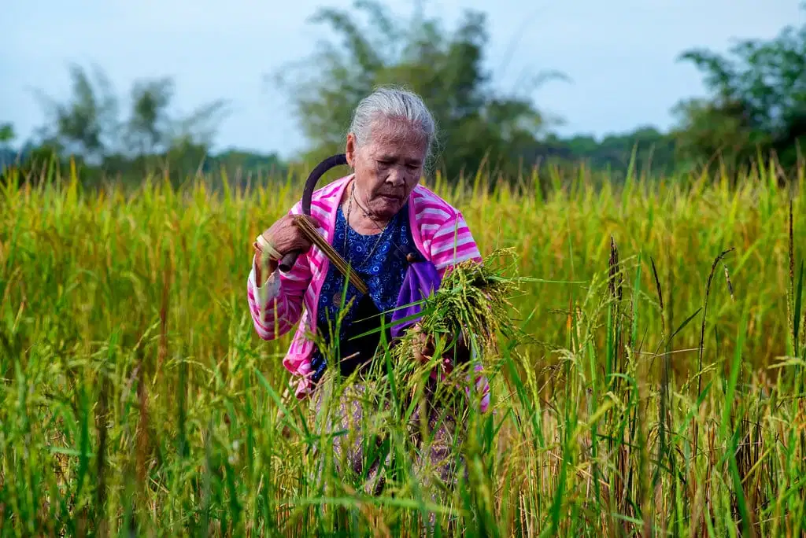
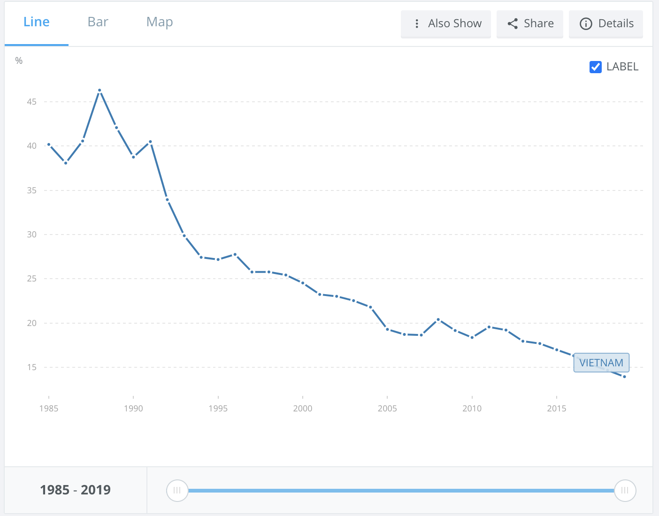
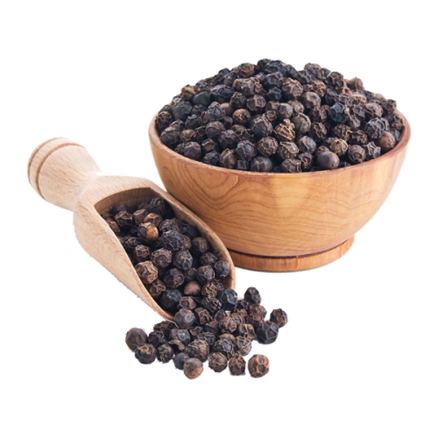
Overview
- The major crops in Vietnam are paddy rice, coffee, rubber, tea, pepper, soybeans, cashews, sugar cane, peanuts and bananas.
- Vietnam has now become the world's largest
exporter of pepper and second largest
exporter of rice and cashew nuts.
- The trend for agriculture in Vietnam
has dramatically declined from
46.3% in 1998 to 14.0% in 2019.
Overview
Key Issues
and Challenges
Government Strategies, Policies, and Legislation
The Role of Development Actor
Lesson Learned
Conclusion

Slide 4

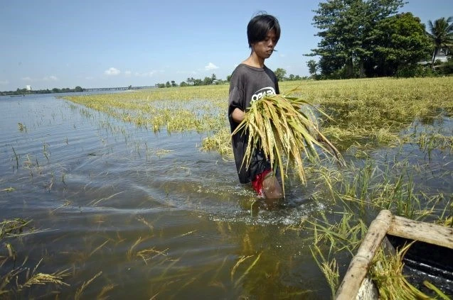
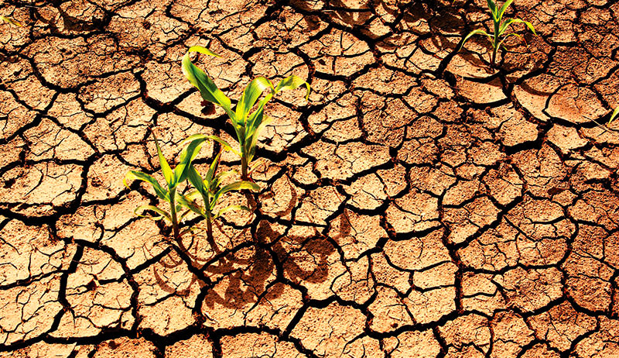
Overview
- Due to the COVID-19 pandemic, Vietnam’s economy struggles since part of its GDP relies on agriculture exports.
- Natural shocks, such as flood, and drought, have huge negative impacts
on the agriculture sector.
Overview
Key Issues
and Challenges
Government Strategies, Policies, and Legislation
The Role of Development Actor
Lesson Learned
Conclusion

Slide 5
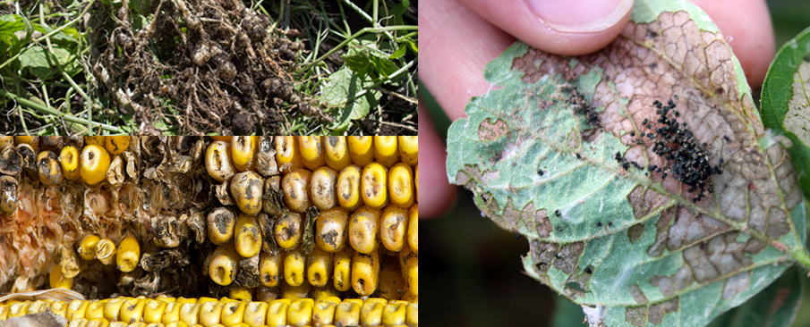
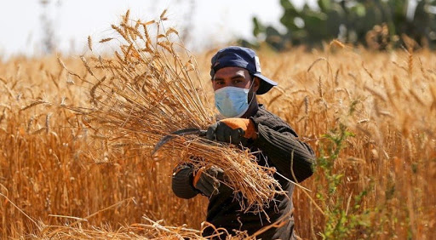
Short-term Issues and Challenges
- The shock that is most likely to occur is
agricultural disease in livestock and plants.
- Although the risk of human disease such as COVID-19 hardly occurs, it can severely cause
the negative impacts on the agricultural sector.
Overview
Key Issues
and Challenges
Government Strategies, Policies, and Legislation
The Role of Development Actor
Lesson Learned
Conclusion

Slide 6
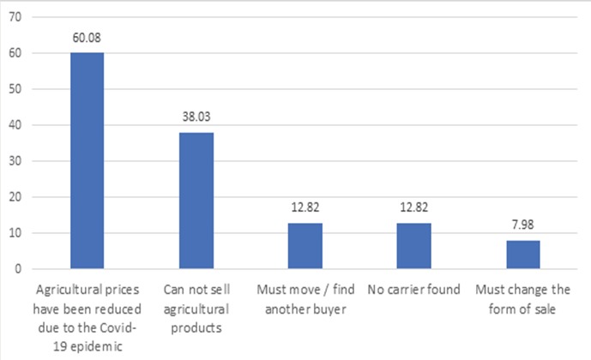
Short-term Issues and Challenges
COVID-19 pandemic and its impact on agricultural outputs
- The survey considering the negative impacts of COVID-19 on agriculture sector by the IPSARD (2016) with a sample of 1,300 households
Overview
Key Issues
and Challenges
Government Strategies, Policies, and Legislation
The Role of Development Actor
Lesson Learned
Conclusion

Slide 7
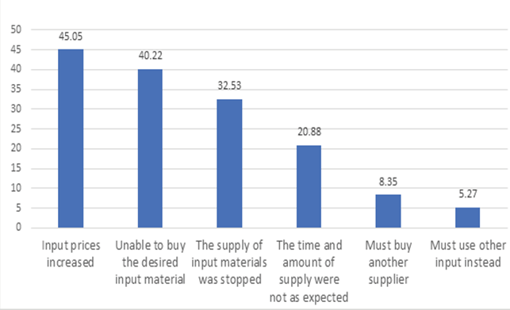
Short-term Issues and Challenges
COVID-19 pandemic and its impact on agricultural inputs
- The survey considering the negative impacts of COVID-19 on agriculture sector by the IPSARD (2016) with a sample of 1,300 households
Overview
Key Issues
and Challenges
Government Strategies, Policies, and Legislation
The Role of Development Actor
Lesson Learned
Conclusion

Slide 8
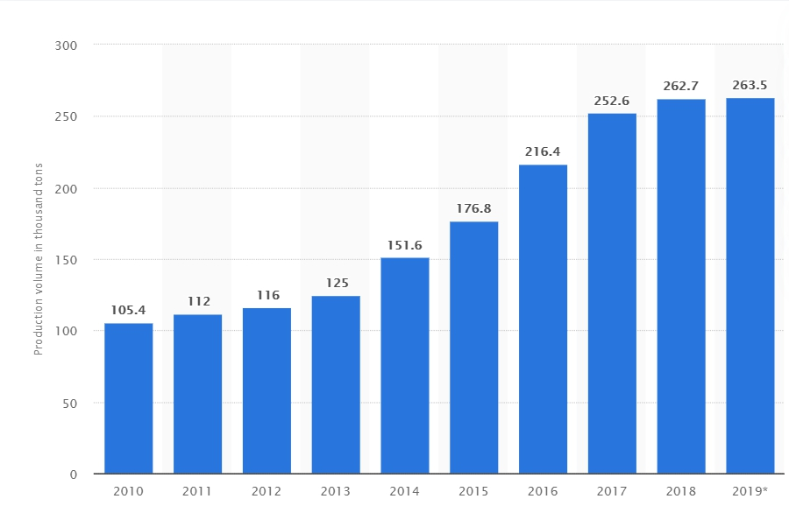
Long-term Issues and Challenges
Oversupply of agricultural products issue
The production of agricultural products is increasing and causes the price to fall significantly
Overview
Key Issues
and Challenges
Government Strategies, Policies, and Legislation
The Role of Development Actor
Lesson Learned
Conclusion

Slide 9
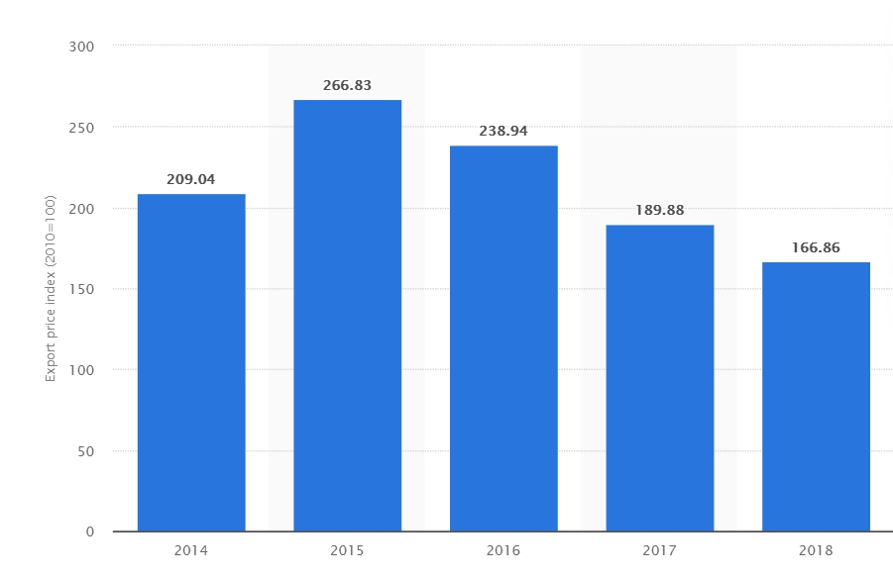
Long-term Issues and Challenges
Oversupply of agricultural products issue
Following the advice, farmers tend to hold on to their stocks
As a result, the export revenue decreases
Overview
Key Issues
and Challenges
Government Strategies, Policies, and Legislation
The Role of Development Actor
Lesson Learned
Conclusion

Slide 10
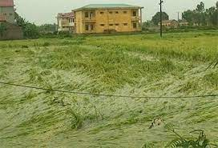
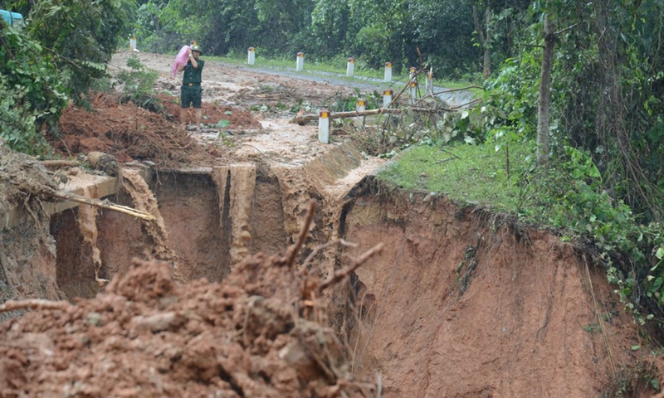
Long-term Issues and Challenges
Climate change issue
The natural disaster such as typhoons or landslide has made a severe effect on agricultural products
Has decreased the major source of income for the people
Improving agriculture growth in long-term
It depends on many factors such as agriculture innovation or greater sustainability of farm production
Overview
Key Issues
and Challenges
Government Strategies, Policies, and Legislation
The Role of Development Actor
Lesson Learned
Conclusion

Slide 11

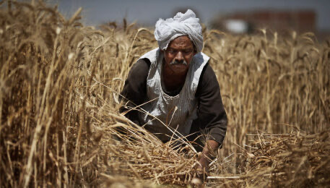
Government Strategies, Policies, and Legislation
Strategies and policies for short-term problem
Order directly to the private rice traders to maintain rice reserves equal to 5%
The government announced to stop exporting rice during the Covid-19 pandemic
Government subsidize the agricultural sector during the Covid-19 outbreak situation
Overview
Key Issues
and Challenges
Government Strategies, Policies, and Legislation
The Role of Development Actor
Lesson Learned
Conclusion

Slide 12
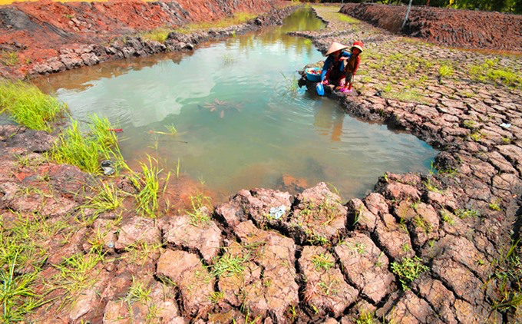
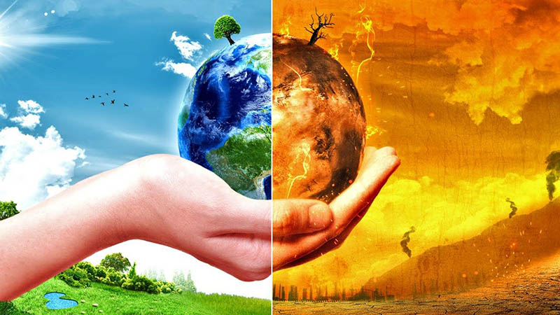
Government Strategies, Policies, and Legislation
Strategies and policies for long-term problems
Minimize climate change-related damages
Reduce the agriculture sector green gas emission
Protect the lives who are affected by climate change or natural disasters
Create the opportunity for sustainable agriculture
Overview
Key Issues
and Challenges
Government Strategies, Policies, and Legislation
The Role of Development Actor
Lesson Learned
Conclusion

Slide 13
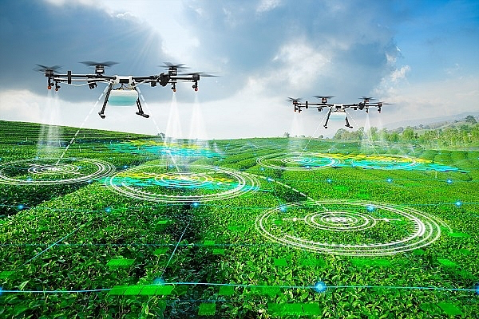
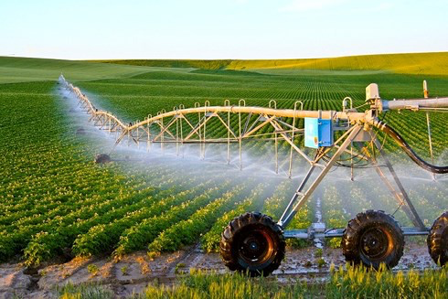
Government Strategies, Policies, and Legislation
Strategies and policies for long-term problems
Develop the infrastructure to meet the requirements of agricultural products
Strengthen competitive capacity and international integration of the sector
Improve the efficiency of the sector development management
Overview
Key Issues
and Challenges
Government Strategies, Policies, and Legislation
The Role of Development Actor
Lesson Learned
Conclusion

Slide 14

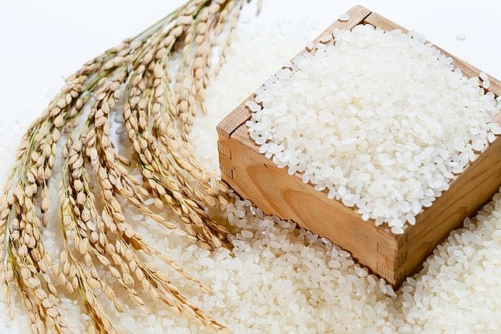
The Role of Development Actor
- The department that has an important role in planning policies and strategies is the MARD
Overview
Key Issues
and Challenges
Government Strategies, Policies, and Legislation
The Role of Development Actor
Lesson Learned
Conclusion

Slide 15
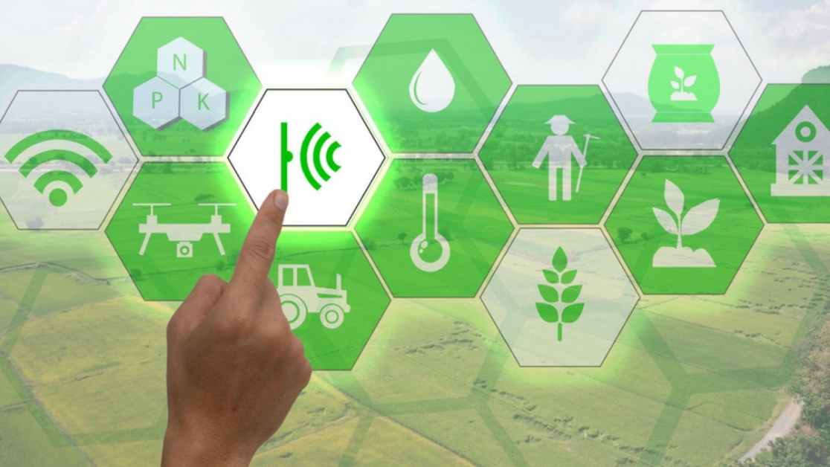
Lesson Learned
1.
1I.
1II.
Poverty
Inequality
Sustainability
Overview
Key Issues
and Challenges
Government Strategies, Policies, and Legislation
The Role of Development Actor
Lesson Learned
Conclusion

Slide 16
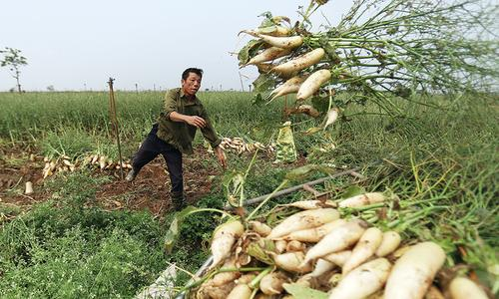

Conclusion
Vietnam’s economy heavily depends on agriculture sector and later becomes one of the biggest exporter of agricultural crops
The issues and challenges can be separated into 2 categories
  Short-term issues and challenges such as COVID-19 pandemic
  Long-term issues and challenges such as Oversupply Issue
To prevent the issues for both short-term and long-term, government needs to come up with policies
Also, there is MARD who acts as government agency in the agricultural sectors
Overview
Key Issues
and Challenges
Government Strategies, Policies, and Legislation
The Role of Development Actor
Lesson Learned
Conclusion

Slide 17
THANK YOU!

