Slide 1

EE390
Economics of Agricultural and Rural Development
Lecture 3: Global Agricultural and Rural Development Part 3
(The materials used in this lecture was prepared by Ajarn Chol Bunnag
Faculty of Economics, Thammasat University)
Kiatanantha Lounkaew
Email: klounkaew@econ.tu.ac.th
Line: k_lounkaew
ที่มาของรูป https://www.hexagongeospatial.com/industries/natural-resources/agriculture

Slide 2
Overview: the periods of Agricultural Development ideas
This class
Food security
Food price crisis
Environmental sustainability
World War II (1939 – 1945)
Growth-with-equity
1950s & 1960s
1970s
1980s & 1990s
2000s
Economic-growth-and-modernization era
Macroeconomic and policy reform
Institutional restructuring

Slide 3
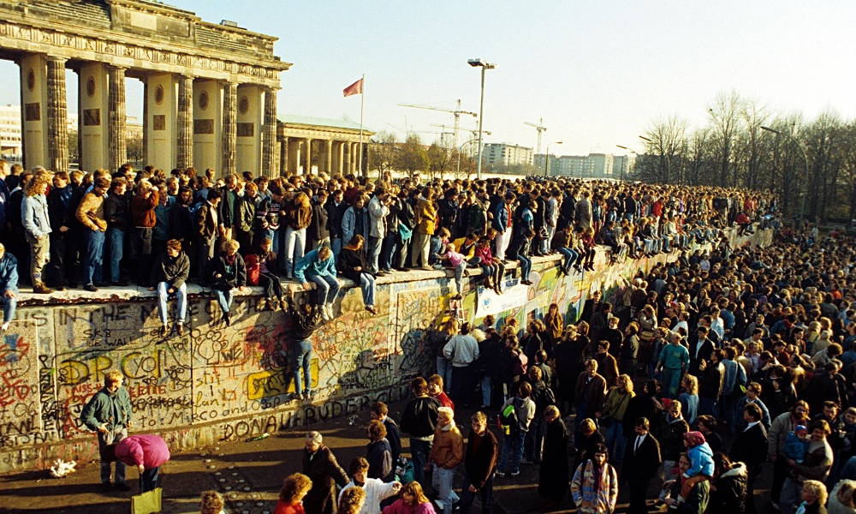

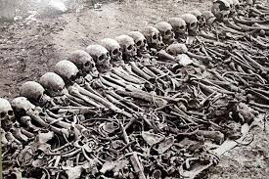
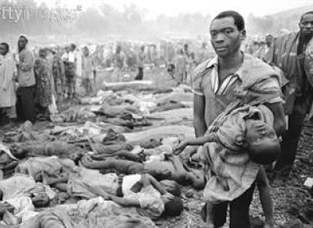
World in 1980s and 1990s

Slide 4
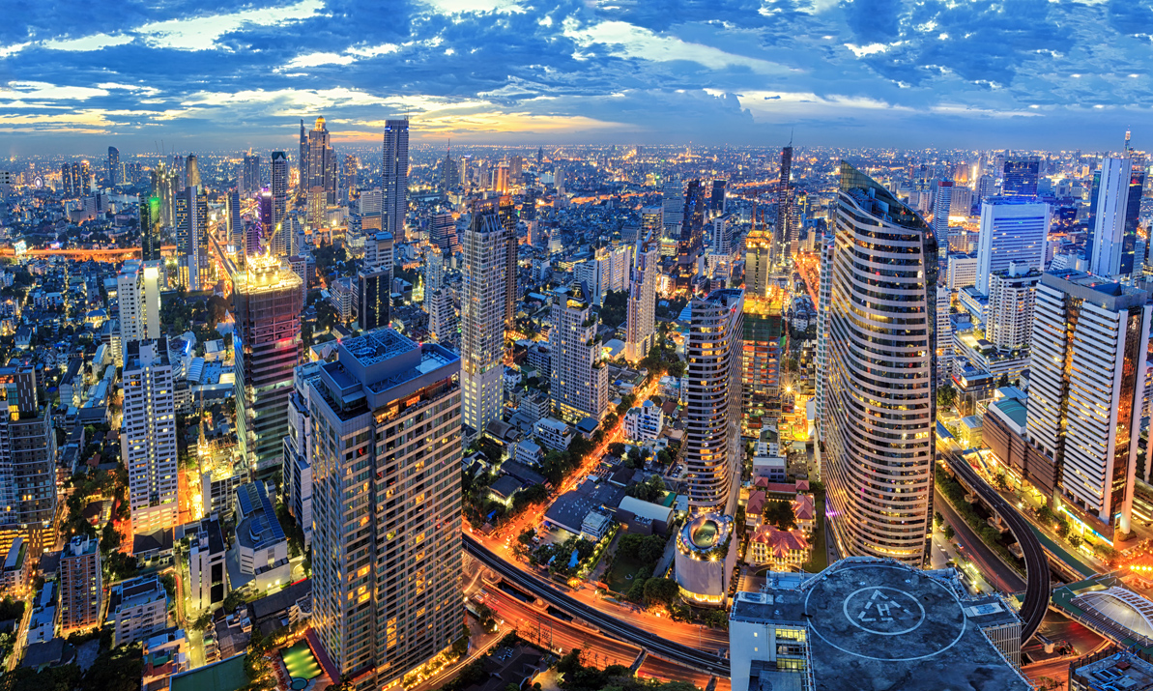
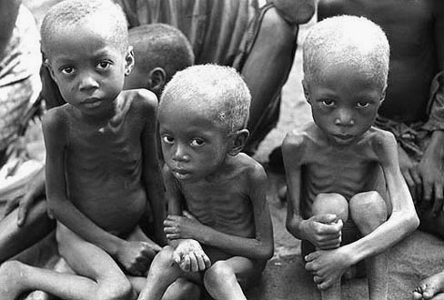
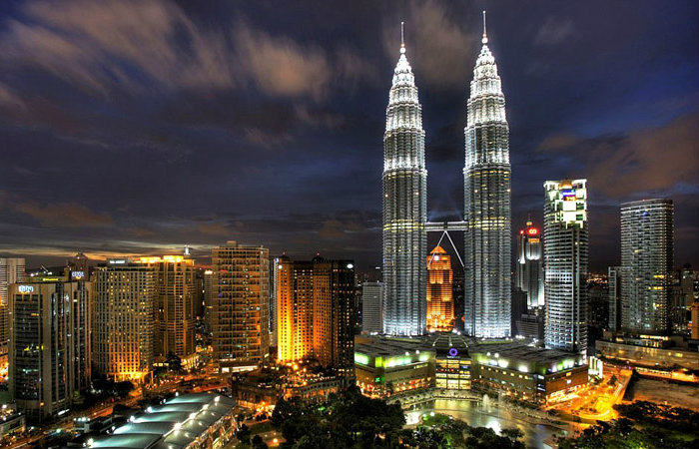
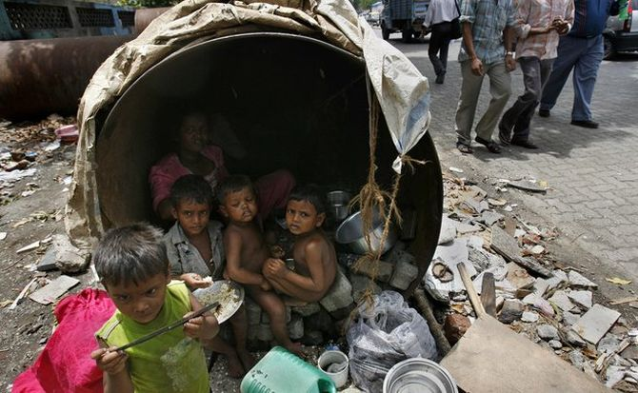
World in 1980s and 1990s

Slide 5


MACROEONOMIC REFORM AND RESTRUCTURING
INTERNATIONAL DEBT CRISIS IN THE EARLY 1980S --> Policy reforms in Latin America, Africa and Asia.
The World Bank, The IMF, International donors
Seek help
A country in debt
Policy reform Menu
Loan

Slide 6


MACROEONOMIC REFORM AND RESTRUCTURING
Structural Adjustment Programs (SAPs)
    Stabilization phase: Reestablishing macroeconomic balance
    Reduce government budget deficit
    Lowering balance-of-payment deficits
Restructuring phase: Re-igniting growth
    Getting the price right (Liberalization)
    Private sector plays more role in allocation of resources (privatization)
Scaled back subsidies on food and agricultural inputs as the programs became financially unsustainable…
Policy reform Menu

Slide 7
MACROEONOMIC REFORM AND RESTRUCTURING
In Asia, SAPs, new technology, and institutional reforms help increase agricultural growth in the 1980s and 1990s, and achieved self-sufficiency in grain production..
Yet, Hardly any improvement in the cereal and nutrient intake of the poorest 30 percent of population in several countries…
Why?

Slide 8


MACROEONOMIC REFORM AND RESTRUCTURING
GATT
WTO
NAFTA
ASEAN
EU
Many Southeast Asian countries reformed their policies towards more outward-oriented strategies, stimulating agricultural and agribusiness growth.
Expansion of World market and labor intensive manufacturing such as textiles and electronics
Target: Reducing regional and global trade barriers
Less power for domestic agricultural policies to influence agricultural incomes and rural developments
Risk from exposure to international markets.
Example: the 1997 Financial Crisis
Outcome

Slide 9


Research on the impact of macroeconomic reforms on food system performance
Domestic food and agricultural policies needed to be analyzed in an open-economy framework.
A debate:
Food Policy Analysis
Food price
Agricultural Policy
Macropolicies
The production incentive school
“Get prices right”
The basic needs approach
“Keep food prices Low”
VS

Slide 10
Research on the impact of SAPs on Agricultural development and economic growth
Findings
The poor might be especially hurt by the reduction in government spending on social services, such as health, and on subsides on basic staples.
Budget cuts would slash vital support services to agriculture, such as research, extension, and infrastructure development → limiting supply response.
Massive currency devaluations and other structural reforms allowed agriculture to play a leading role in economic growth in many countries in Latin America and Asia. However that depends on domestic and international conditions experienced by each country.
African nations experienced difficulties to development, such as sluggish world demand for their products, inability to break structural constraints.

Slide 11

Timmer’s four stages of structural transformation
Stage 1: “Mosher” stage – Getting Agriculture Moving
Stage 2: “Johnston-Mellor” stage – Agriculture contributes to economic growth through a variety of linkages.
Stage 3: “Schultz” stage – Rising agricultural incomes fall behind those in a rapidly growing non-farm economy, inducing political tensions.
Stage 4: “Johnson” stage – Labor and financial markets fully integrate the agricultural economy into the rest of the economy.

Slide 12
Institutional Restructuring
Institution : “The rules under which the economy operates”
Land tenure
Risk mngmnt strategies
Economic History: e.g. Fogel (1994), and North (1990)
Old Institutionalism: e.g. Commons (1924, 1950), and Veblen (1912, 1927)
Financial Market
Labor Market
Etc..
Policy reform
Inter
Trade
New Institutional Economics: e.g. Coase (1937, 1960) and Stiglitz (1988)

Slide 13

Institutional Restructuring
Two features of institutional analysis
1. History Matters – the concept of “Path Dependency”
    Country’s or firm’s current options depend critically on its past decisions.
    Diversity in growth patterns, institutions and applicable theories.
    ”One-size-its-all” policy reform advocated in early 1980s is unlikely to be successful.

Slide 14


Institutional Restructuring
Two features of institutional analysis
2. Transaction Costs– Importance of information and transaction costs in influencing the way economic activities are organized.
    Some seemingly inefficient or exploitative institution may have marked advantages in terms of reducing risk and transaction costs.
    Transaction costs and rural markets and food security.

Slide 15
Institutional Restructuring
Institutional Design : Helping develop organizations and rules of the game that would permit smallholders and the rural poor to capture the benefits of the more open, market-driven economies.
Good governance: Western donors emphasize on the need for good governance. Good governance is defined as having transparent rules governing the economy and civil rights, non-arbitrary enforcement of laws and contracts, and some degree of democracy.
Role for civil society organization (CSO): CSOs such as independent farmer and trader organizations and trade unions.
Larger roles of Non-governmental Organizations (NGOs): NGOs played larger roles or even major roles in development with funds from international donors when the local or national government was too weak.

Slide 16
Relationships between State-Market-Communities
Community-Yoke thesis vs Evil-market Thesis
  Community-Yoke thesis: Certain community practices are exploitation of local elites on the locals. Market access should be promoted to free those locals from the elites.
  Evil-market thesis: Community cultures and traditions are good and pure. Market brings greed and materialism into the community and destroys those good cultures and traditions.
State
Market
Community
CSOs
NGOs
Notes:
Moral Economists vs Political Economists

Slide 17
Relationships between State-Market-Communities
Moral Economists vs Political Economists
  Moral economists: Community traditions, such as reciprocity through kinship and local networks, emerged because of fluctuations in conditions for agriculture. It is necessary for the local’s survival.
  Political economists: The locals have to depend on kinship networks and other patron-client relationship because market mechanisms and other public goods are not provided, inefficient, or controlled by the local elites.
State
Market
Community
CSOs
NGOs

Slide 18
Food insecurity and Poverty
Recall previous slides…
In Asia, SAPs, new technology, and institutional reforms help increase agricultural growth in the 1980s and 1990s, and achieved self-sufficiency in grain production..
Yet, Hardly any improvement in the cereal and nutrient intake of the poorest 30 percent of population in several countries…
Why?

Slide 19
Food insecurity and Poverty
Solution to Famine and mulnutrition
Food security
= Adequate supply of food (country’s own production and trade)
+ access by the population to that supply
National food
self-sufficiency
Amatya Sen’s Poverty and Famines (1981)

Slide 20
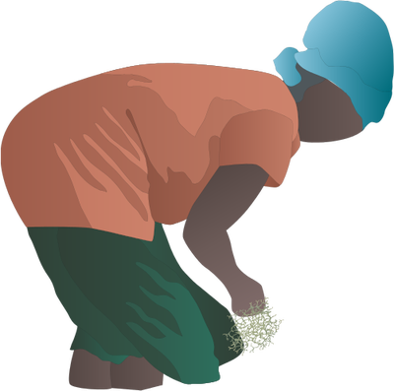
Food insecurity and Poverty
The production incentive school
“Get prices right”
Which approach to help poor farmers achieve food security?
The basic needs approach
“Keep food prices Low”

Slide 21
Food insecurity and Poverty
Turning back to Generation of Rural income and employment (in World Food Summit 1996)
Three reasons:
1. The achievement of national food self-sufficiency in many countries was unable to ensure that all family could secure their food needs.
2. Because of high urban unemployment rates, most of the new entrants to the rural labor force would have to find employment in farming and rural nonfarm activities.
3. Most countries could not finance measure such as food subsidies and food transfer programs over the long term. The rural poor need to increase their production and/or income to secure their own food needs.

Slide 22




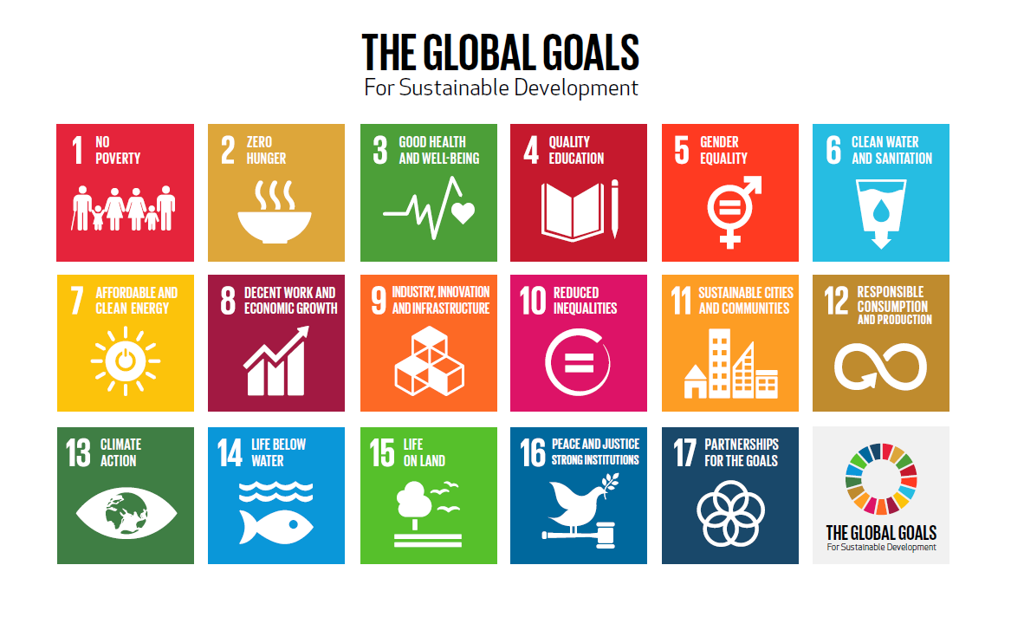


Sustainability
1962
1987
1992

Slide 23
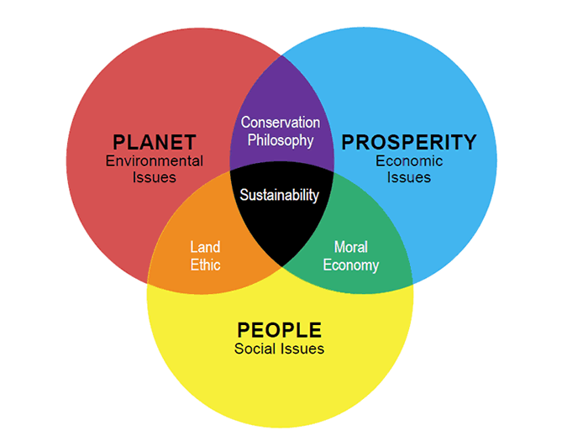

Sustainability
Sustainable Development
“Sustainable development is development that meets the needs of the present without compromising the ability of future generations to meet their own needs.”
Brundtland Report 1987

Slide 24

Sustainability
Global Warming and Climate Change
Destruction of forest and wildlife habitat
Modern Agricultural Practices
Recognition that under proper institutional arrangements, natural resources can be managed locally by farmers, herders and others in an environmentally sustainable way.
e.g. Elinor Ostrom 1990
Pesticides runoff affecting local fisheries and water supply

