Slide 1

MK 322 Retail Management
Chapter 14: Retail Pricing Part II
By Ajarn Suwalya K.

Slide 2
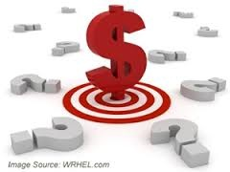
Setting Retail Prices

Slide 3
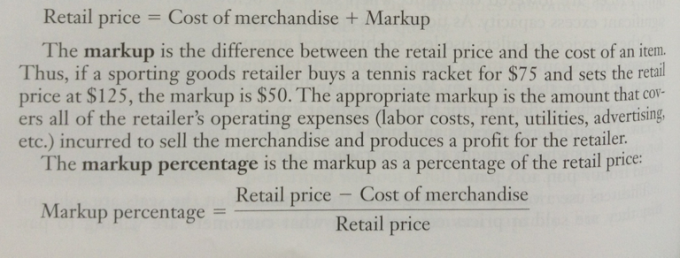
Setting Prices Based on Costs
Retail price = Cost of merchandise + Markup
Notes:
1

Slide 4
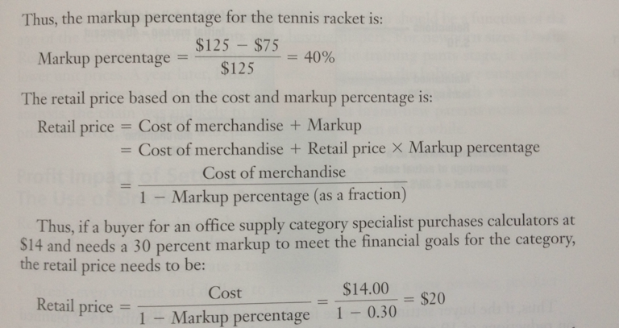
Setting Prices Based on Costs
Notes:
1

Slide 5
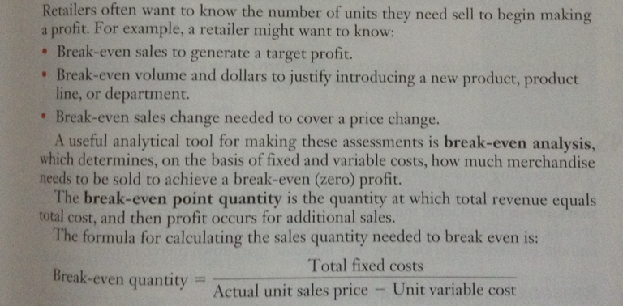
Profit Impact of Setting a Retail Price: The Use of Break-Even Analysis
Notes:
1

Slide 6
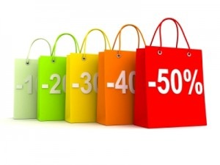
Markdowns

Slide 7
Reasons for Taking Markdowns
Two reasons for taking markdows
Clearance – to dispose of merchandise
Promotional- to generate sales
Notes:
1

Slide 8
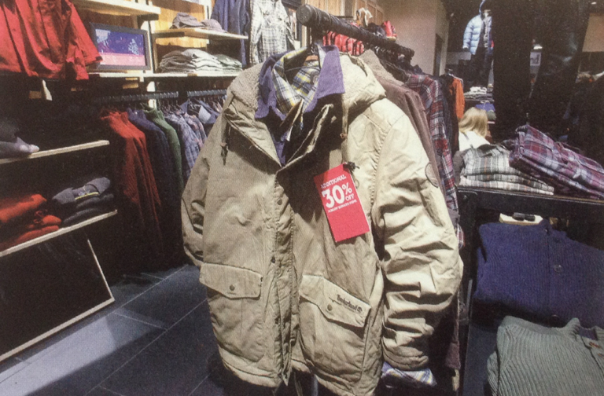
Markdowns
Pricing Optimization software recognizes when sales for winter coats are slower than expected and suggests both the timing and amount of markdowns.
Notes:
1

Slide 9
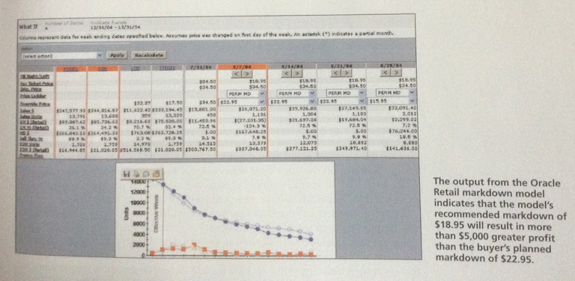
Markdowns
Notes:
1

Slide 10
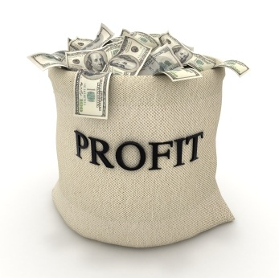
Pricing Techniques for Increasing Sales and Profits

Slide 11
Variable Pricing and Price Discrimination
Individualized Variable Pricing – retailers could maximize their profits if they charged each customer as much as the customer was willing to pay
First-degree price- Charging each individual customer a different price based on their willingness to pay, ie, auction bidding
- legal, but difficult to assess customer's willingness to pay and retailer cannot change the posted prices
Notes:
1

Slide 12
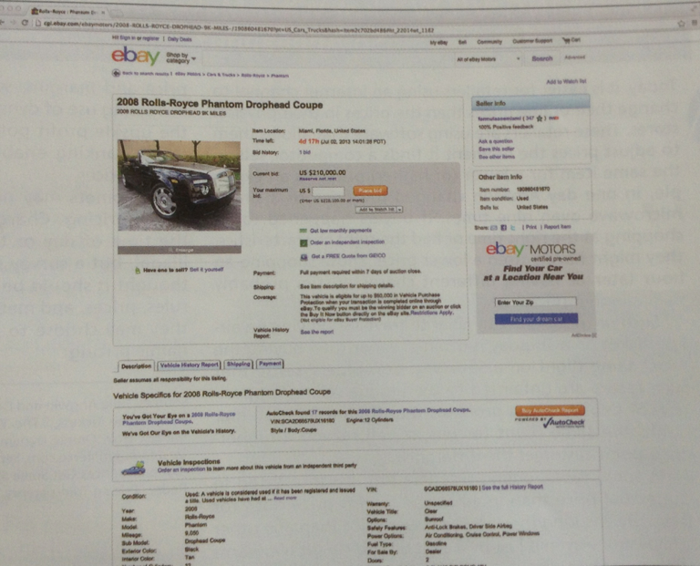
Variable Pricing and Price Discrimination
By selling on eBay Motors' online auction, this seller is using the first-degree price discrimination to get the highest price for Rolls Royce.
Notes:
1

Slide 13
Variable Pricing and Price Discrimination
Dynamic pricing or individualized pricing refers to the process of charging different prices for goods and services based on the type of customer, time of day, week or even season, and level of demand
Retailers may also charge customers different prices based on their loyalty status derived from their CRM systems – ie, the platinum customers receive lower prices than the silver ones
Notes:
1

Slide 14
Variable Pricing and Price Discrimination
Self-Selected Variable Pricing- an alternative approach for dynamic pricing is to offer the same multiple-price schedule to all customers which encourgages price-sensitive customers to take advantage of the lower price or also known as second-degree price discrimination
Notes:
1

Slide 15
Variable Pricing and Price Discrimination
Second-degree price discrimination is when retailers offer
Promotional and clearance markdowns,
Coupons (Issued in newspapers, on products,on the shelf, at cash register, over the internet and mobile, via mail, in flyers)
Price bundling (KFC family meal 299 bt.)
Multi-unit pricing (quantity discounts)
Notes:
1

Slide 16
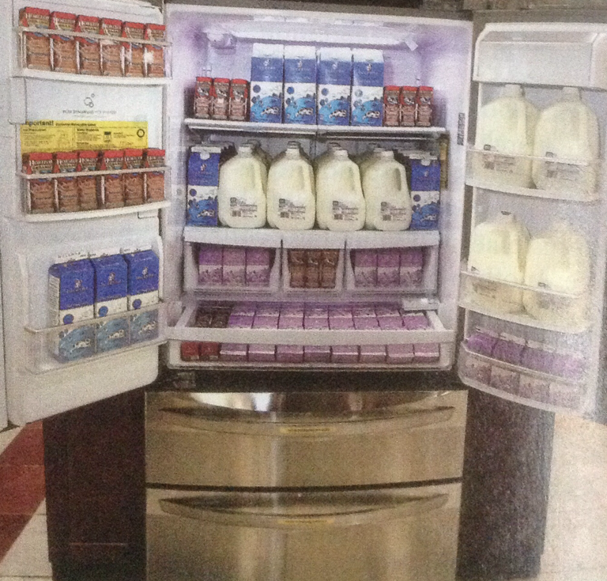
Coupons
Extreme couponing causes havock on a retailer's supply chain when one customer buys all of a store's stock of a single SKU.
Notes:
1

Slide 17
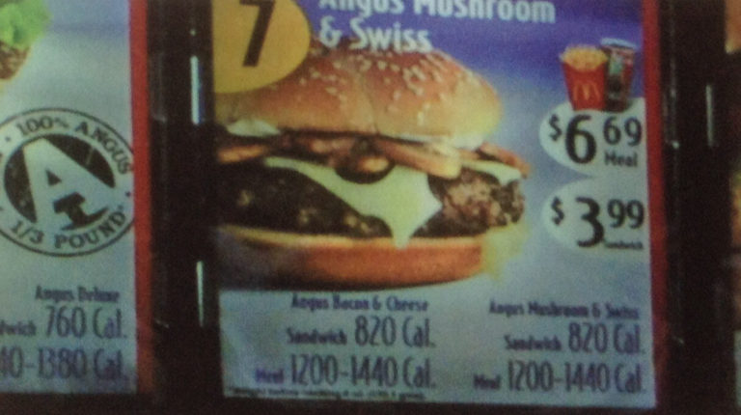
Price Bundling
McDonald's uses price bundling when it combines a sandwich, French fries, and a soft drink in a value meal.
Notes:
1

Slide 18
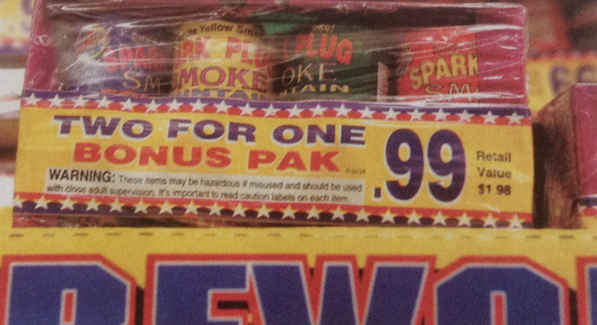

Multi-Unit Pricing
Notes:
1

Slide 19
Variable Pricing and Price Discrimination
Third-degree price discrimination : retailers charge different prices to different demographic market segments
For example movie theaters have discounts for students and seniors
Notes:
1

Slide 20
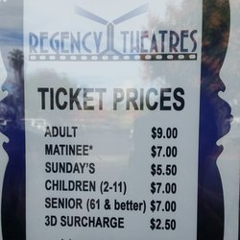

Notes:
1

Slide 21
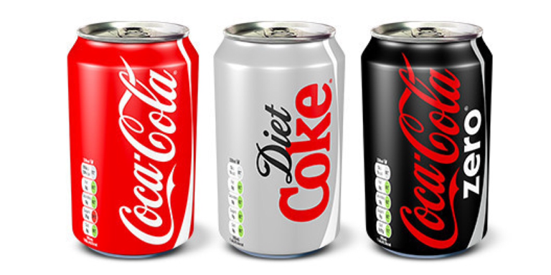
Leader Pricing
Leader Pricing or loss leader is the practice of pricing certain items lower than normal to increase traffic flow and boost sales of complementary products
Notes:
1

Slide 22
Price Lining
Price Lining: Retailers frequently offer a limited number of predetermined price points within a merchandise category
For example Kroger's vision for its store brands is to build loyalty among customers, with strong store brands that are exclusive to the retailer, it pursues a price lining store brand strategy to provide Kroger products to all customer segments
Notes:
1

Slide 23
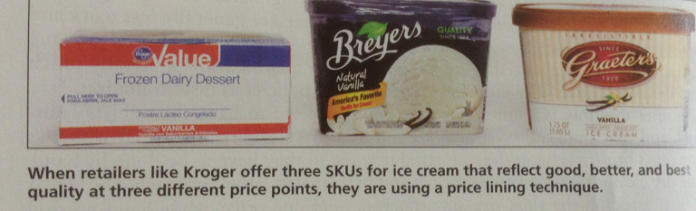
Price Lining
Notes:
1

Slide 24
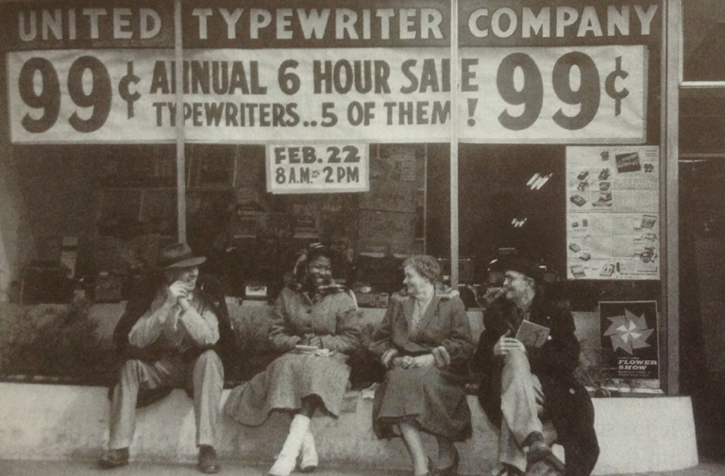
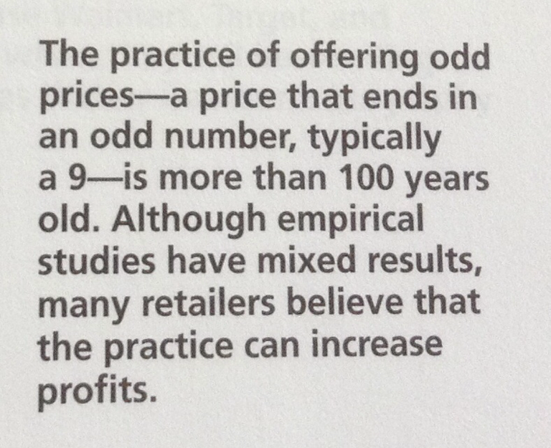
Odd Pricing
Odd pricing refers to the practice of using a price that ends in a 9.
Notes:
1

Slide 25


