Slide 1

MK 202
Integrated Marketing Communications (IMC)
Strategy II
By Ajarn Suwalya Khemvaraporn

Slide 2
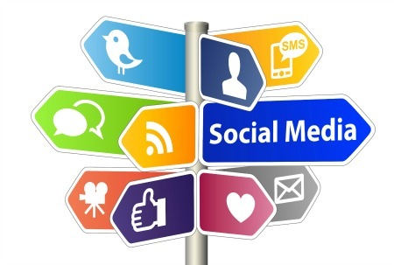
Media Mix

Slide 3
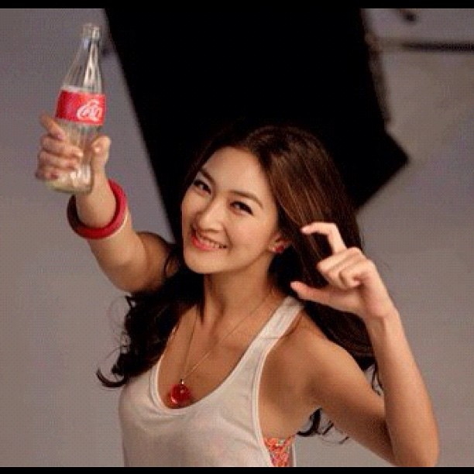
Advertising
Can reach masses of geographically dispersed buyers.
Can repeat a message many times.
Is impersonal, one-way communication.
Can be very costly for some media types.
Low cost per exposure, though overall costs are high
Consumers perceive advertised goods as more legitimate
Dramatizes company/brand
Builds brand image; may stimulate short-term sales

Slide 4
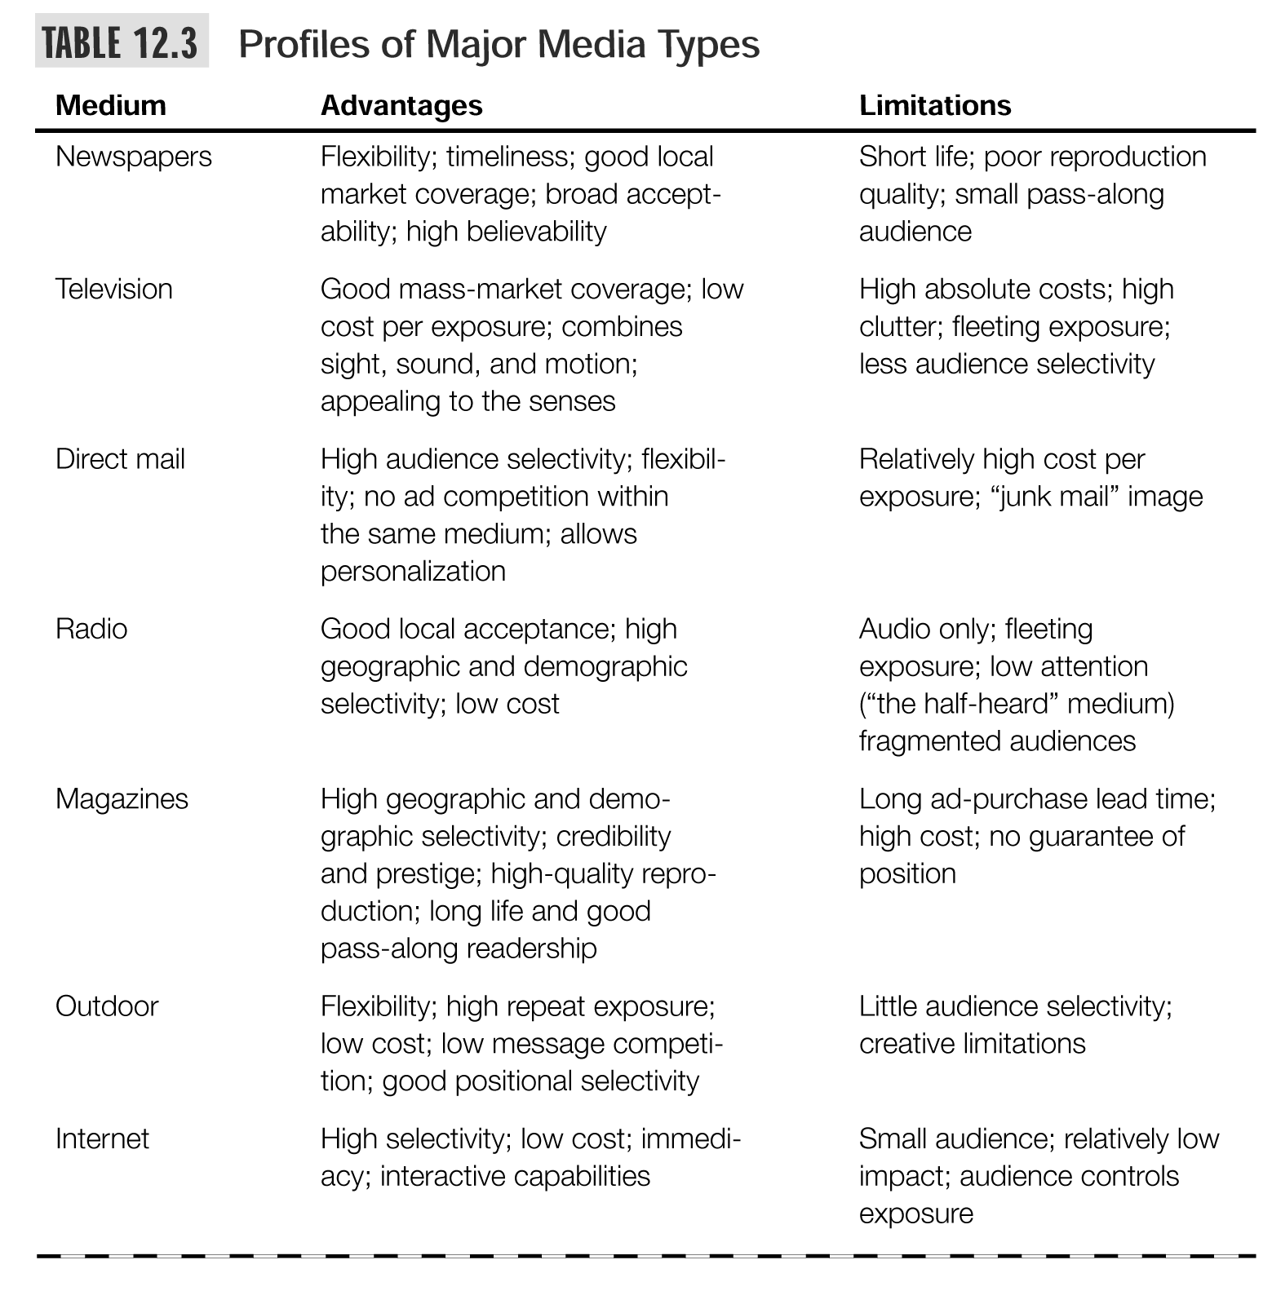

Slide 5
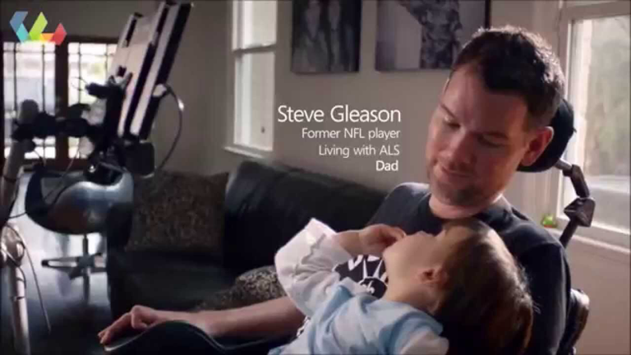

TV advertising has vast reach.Microsoft's inspiring Super Bowl XLVIII ad, "Empowering" – about how technology improves our lives- Drew 100+ million TV viewers and triggered millions of online views and shares.

Slide 6
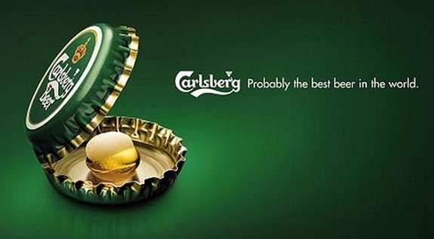
Creative Ads

Slide 7
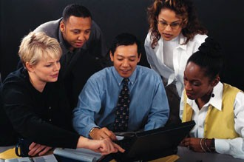
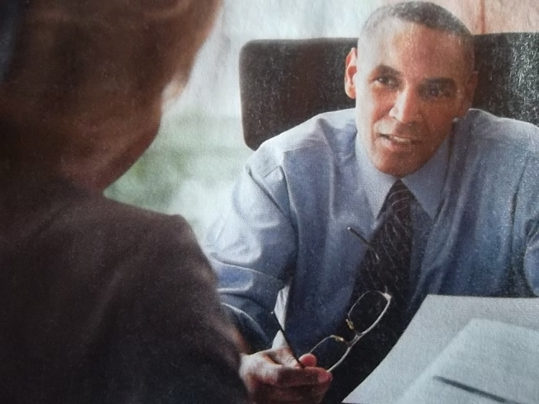
Personal Selling
Personal interaction allows for feedback and adjustments
Allows relationship building.
Most effective tool for building buyers’ preferences, convictions, and actions
Buyers are more attentive
Sales force represents a long-term commitment
Most expensive of the promotional tools
With personal selling, the customer feels a greater need to listen and respond, even if the response is a polite “No Thank you.”

Slide 8
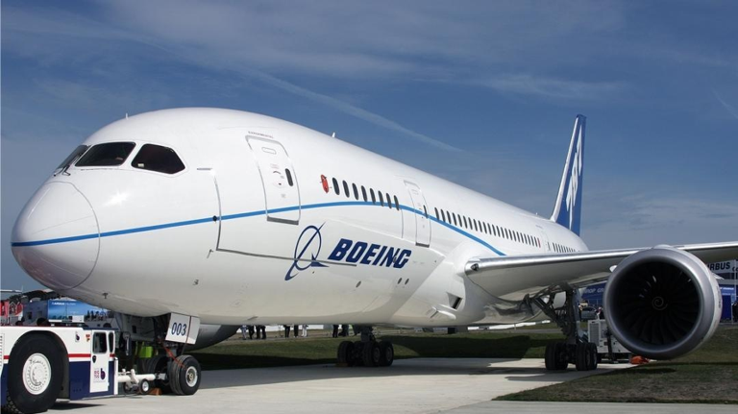
Professional selling:It takes more than fast talk and a warm smile to sell expensive airplanes.Boeing's real challenge is to win business by building partnerships-- day- in, day- out, year-in, year-out—with its customers.

Slide 9

Salespeople link the company with its customers. To many customers, the salesperson is the company.

Slide 10
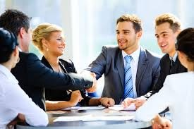
Great salespeople: The best salespeople possess intrinsic motivations, a disciplined work style,the ability to close a sale, and perhaps most important, the ability to build relationships with customers.

Slide 11
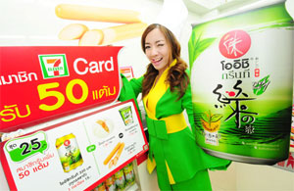
Sales Promotion
Makes use of a variety of formats: premiums, coupons, contests, etc.
Attracts attention, offers strong purchase incentives, dramatizes offers, boosts sagging sales
Offers strong incentives to buy.
Invites and rewards quick consumer response.
Stimulates quick response
Effects are short lived
Not effective at building long-term brand preferences

Slide 12
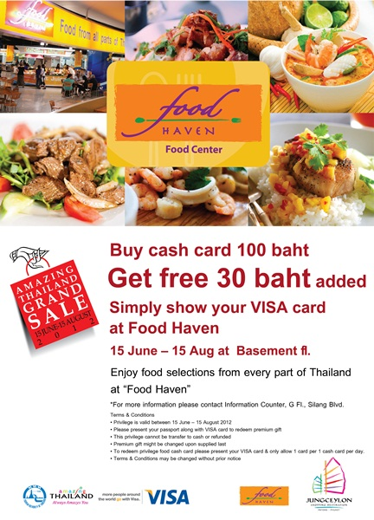
Sales Promotion
Sales promotion consists of short-term incentives to encourage the purchase or sales of a product or service.
The idea behind sales promotion is to generate immediate sales.

Slide 13
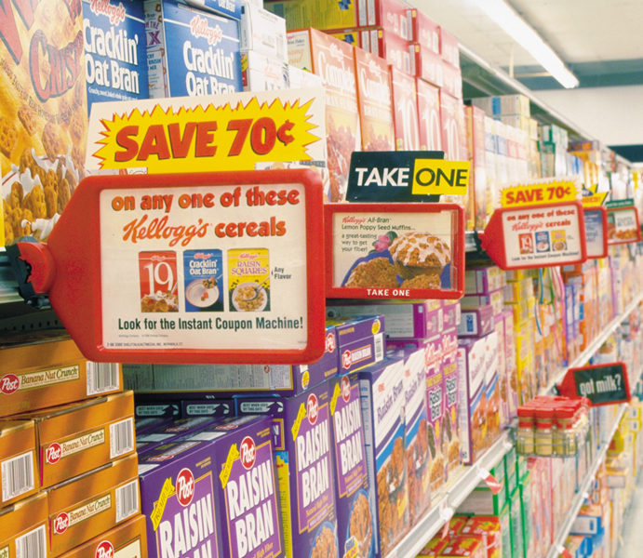
Sales Promotion
Today’s food marketers are using more and more push promotions, including consumer price promotions.

Slide 14
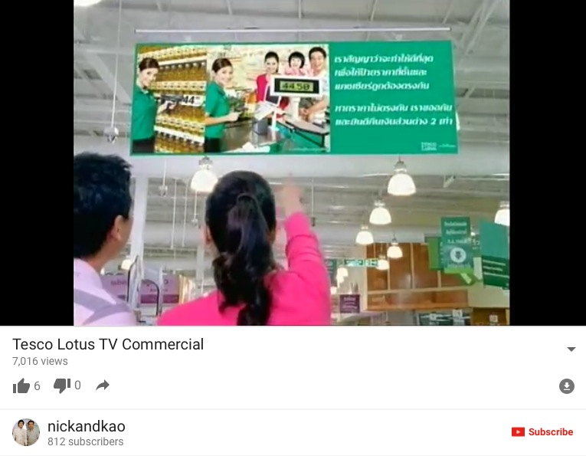

Slide 15
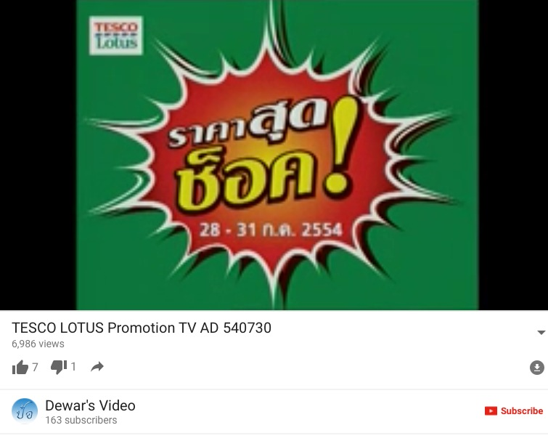

Slide 16
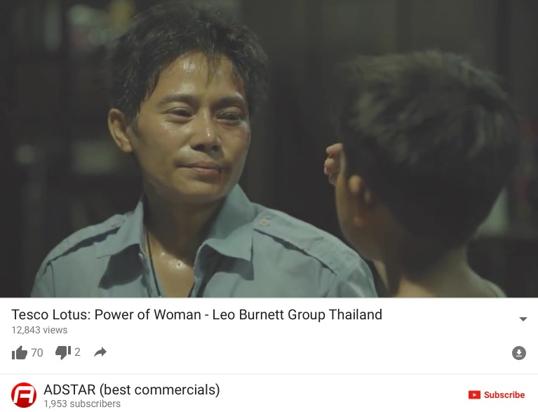

Slide 17
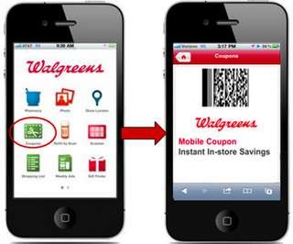
Mobile Coupons: Drugstore chain Walgreens makes coupons available to its customers through several mobile channels.

Slide 18
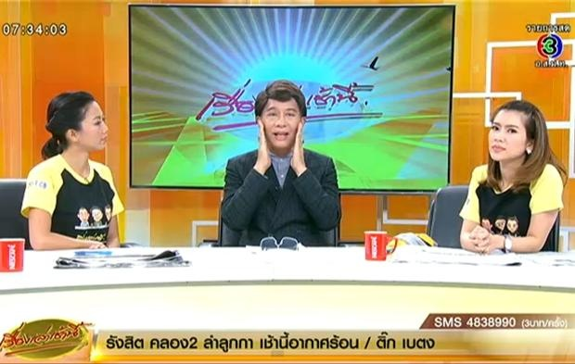
Public Relations
Very believable and credible
Reaches people who avoid salespeople and ads.
Can dramatize a company or product.
Tends to be used as an afterthought.
Planned use can be effective and economical.
Many forms: news stories, news features, events and sponsorships, etc

Slide 19
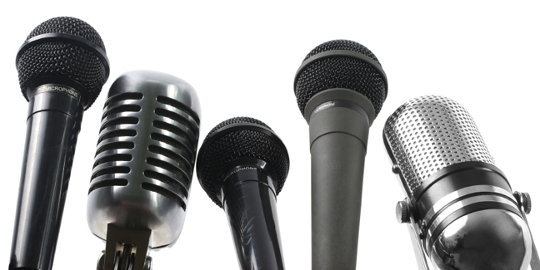
Public Relations (PR)
Public relations involves building good relations with the company’s various publics by obtaining favorable publicity, building up a good corporate image, and handling or heading off unfavorable rumors, stories, and events.

Slide 20
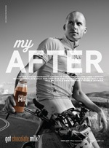
MilkPEP's "Built With Chocolate Milk" public relations campaign is repositioning chocolate milk as a sports recovery "after" beverage for both everyday and well-known adults, here Ironman World Champion Chris Lieto.

Slide 21
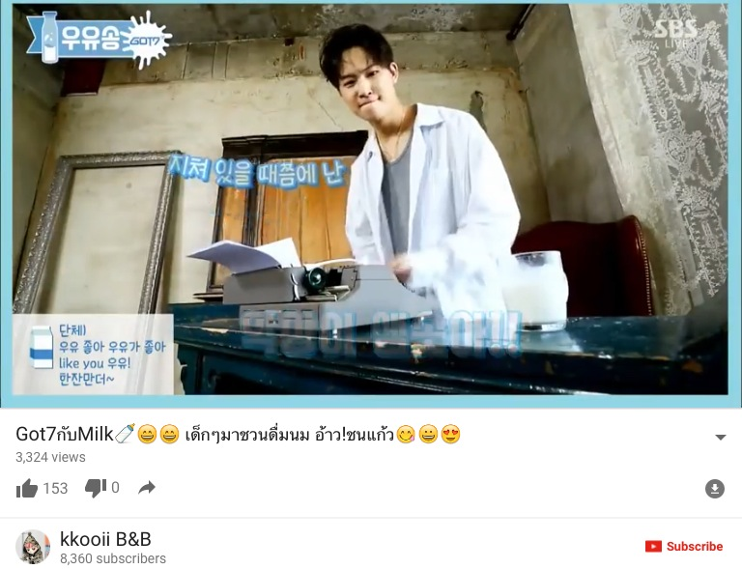

Slide 22
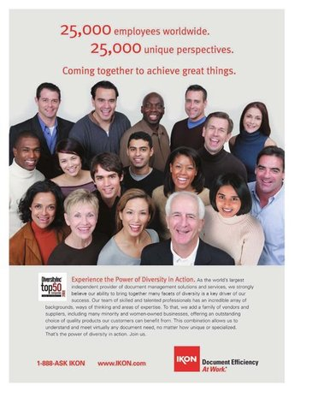
Public Relations (PR)
Role and Impact of Public Relations
  Strong impact on public awareness at lower cost than advertising
  Greater credibility than advertising
  Publicity is often underused
  Good public relations can be a powerful brand-building tool

Slide 23
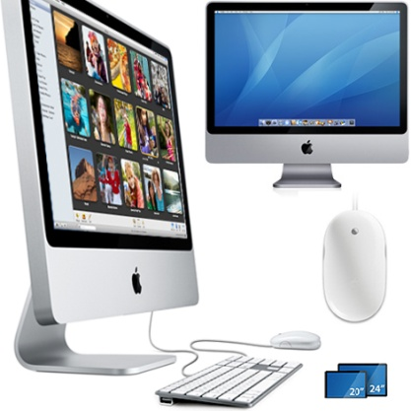
Public Relations Functions
Press relations or press agency
Product publicity
Public affairs
Lobbying
Investor relations
Development

Slide 24
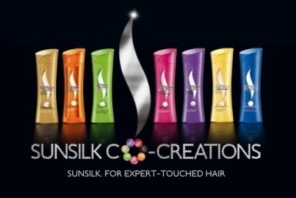
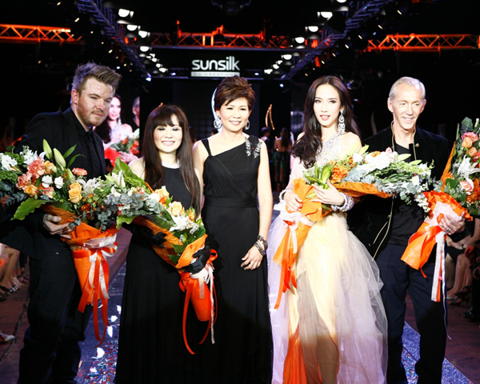
Public Relations Tools
Audiovisual materials
Corporate identity materials
Public service activities
Company Web site
News
Speeches
Special events
Buzz marketing
Mobile marketing
Written materials

Slide 25
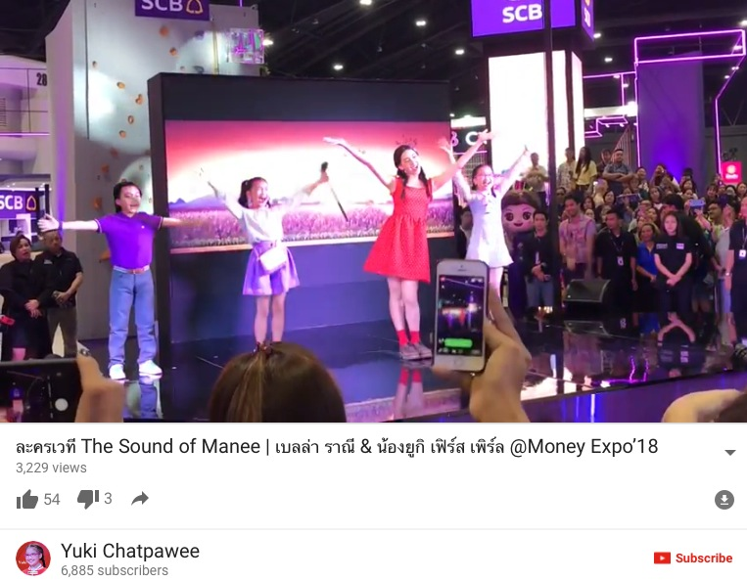

Slide 26
Event Marketing
Event Marketing( for event sponsorship): Creating a brand – marketing event or serving as a sole or participating sponsor if events created by others.

Slide 27
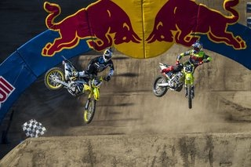
Event Marketing:Red Bull hosts hundreds of events each year in dozen of sports around the world, designed to bring high-octane world of Red Bull to its community of enthusiasts.

Slide 28
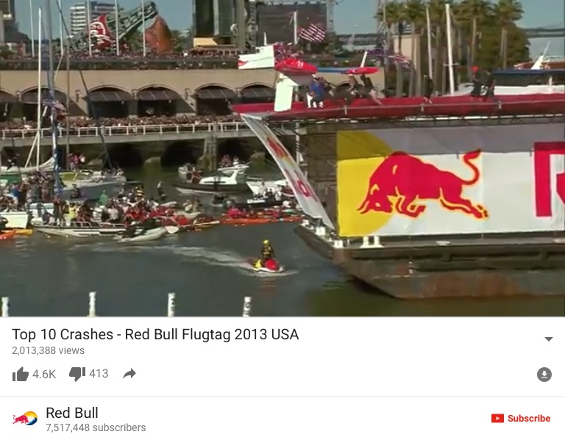

Slide 29
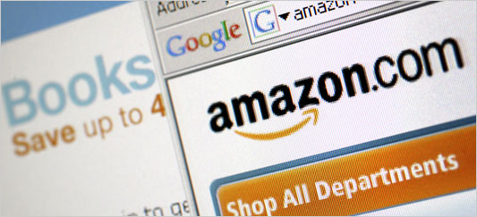
Direct Marketing –Online Media
Well suited to highly targeted marketing.
Websites
E-mail
Mobile

Slide 30
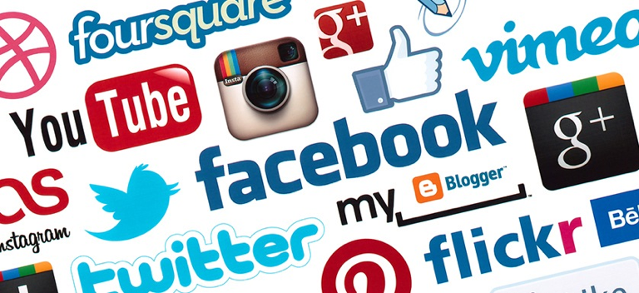
Social Media
Youtube
Facebook
Blog
Twitter

Slide 31
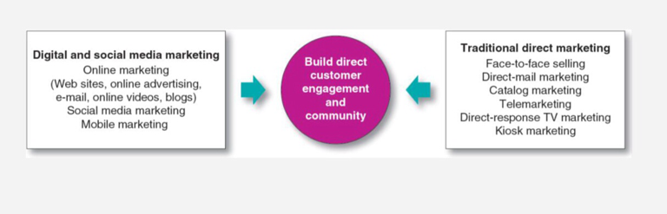
Forms of Direct and Digital Marketing
We'll begin with the exciting new digital forms of direct marketing. But remember that the traditional forms are still heavily used, and the new and old must be integrated for maximum impact.

Slide 32
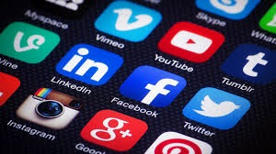
To realize its staggering marketing potential, Facebook is developing a growing portfolio of products and apps that will let it connect everyone in the world and make money doing it.

Slide 33
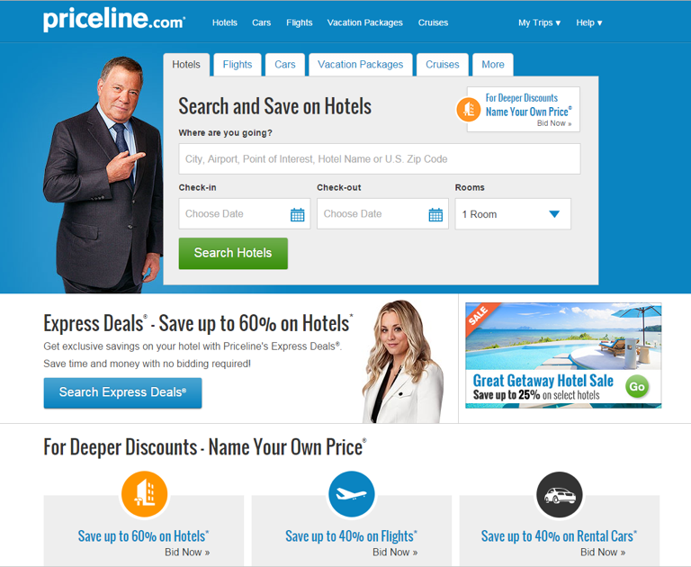
The new direct marketing model: Online travel agency Priceline.com sells services exclusively through online, mobile, and social media channels. Along with other online competitors. Priceline.com has pretty much driven traditional offline agencies into extinction.

Slide 34
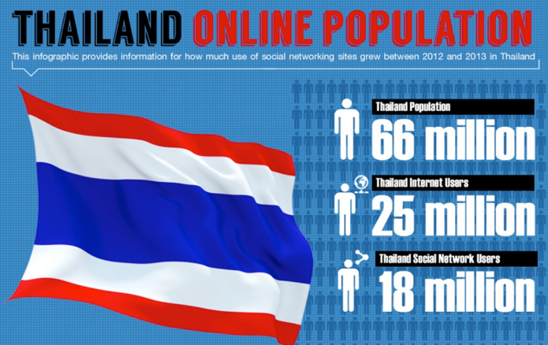

Slide 35
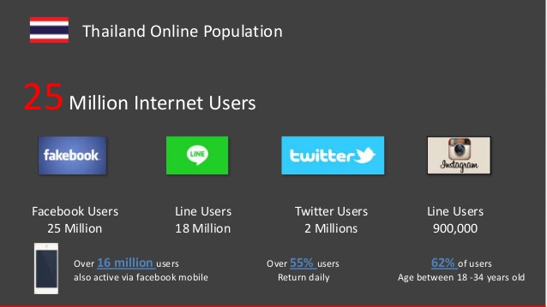

Slide 36
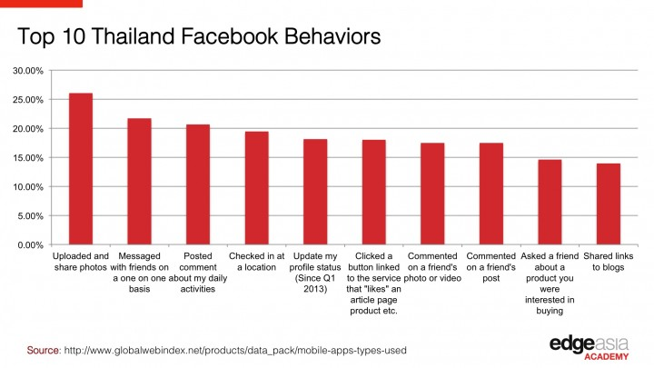
Cultural Influence

Slide 37
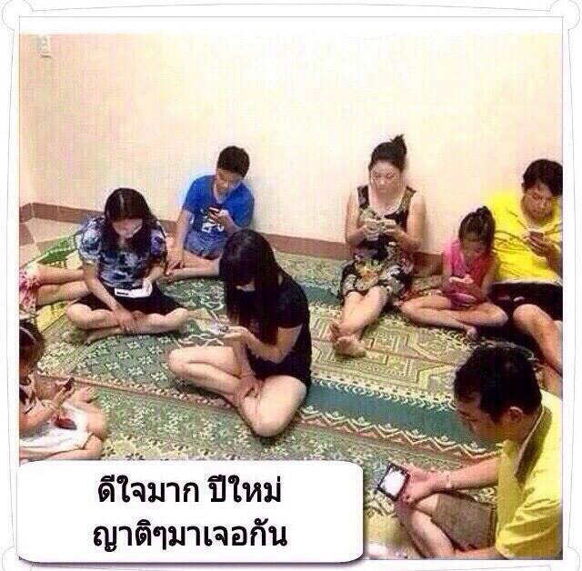
Feeling so happy that this New Year I will be reuniting with my relatives….

Slide 38

Multichannel Marketing
Multichannel Marketing: Marketing both through stores and other traditional offline channels and through digital, online, social media

Slide 39
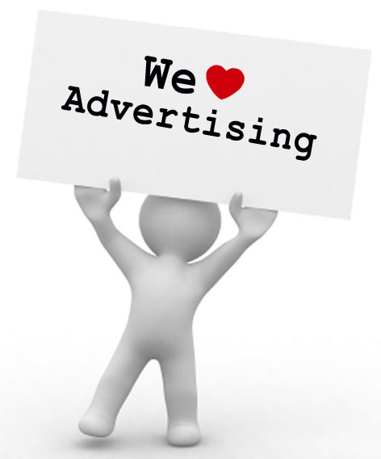
Major Decisions in Advertising

Slide 40
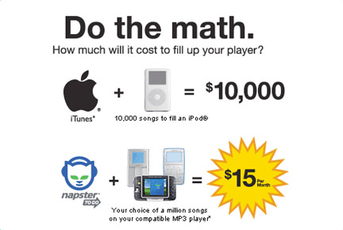
Setting Advertising Objectives
An advertising objective is a specific communication task to be accomplished with a specific target audience during a specific period of time.
Classified by purpose: Inform, Persuade, Compare, Remind

Slide 41
Purpose of Advertising
  Inform
    Introducing new products
  Persuade
    Becomes more important as competition increases
    Comparative advertising
  Remind
    Most important for mature products

Slide 42
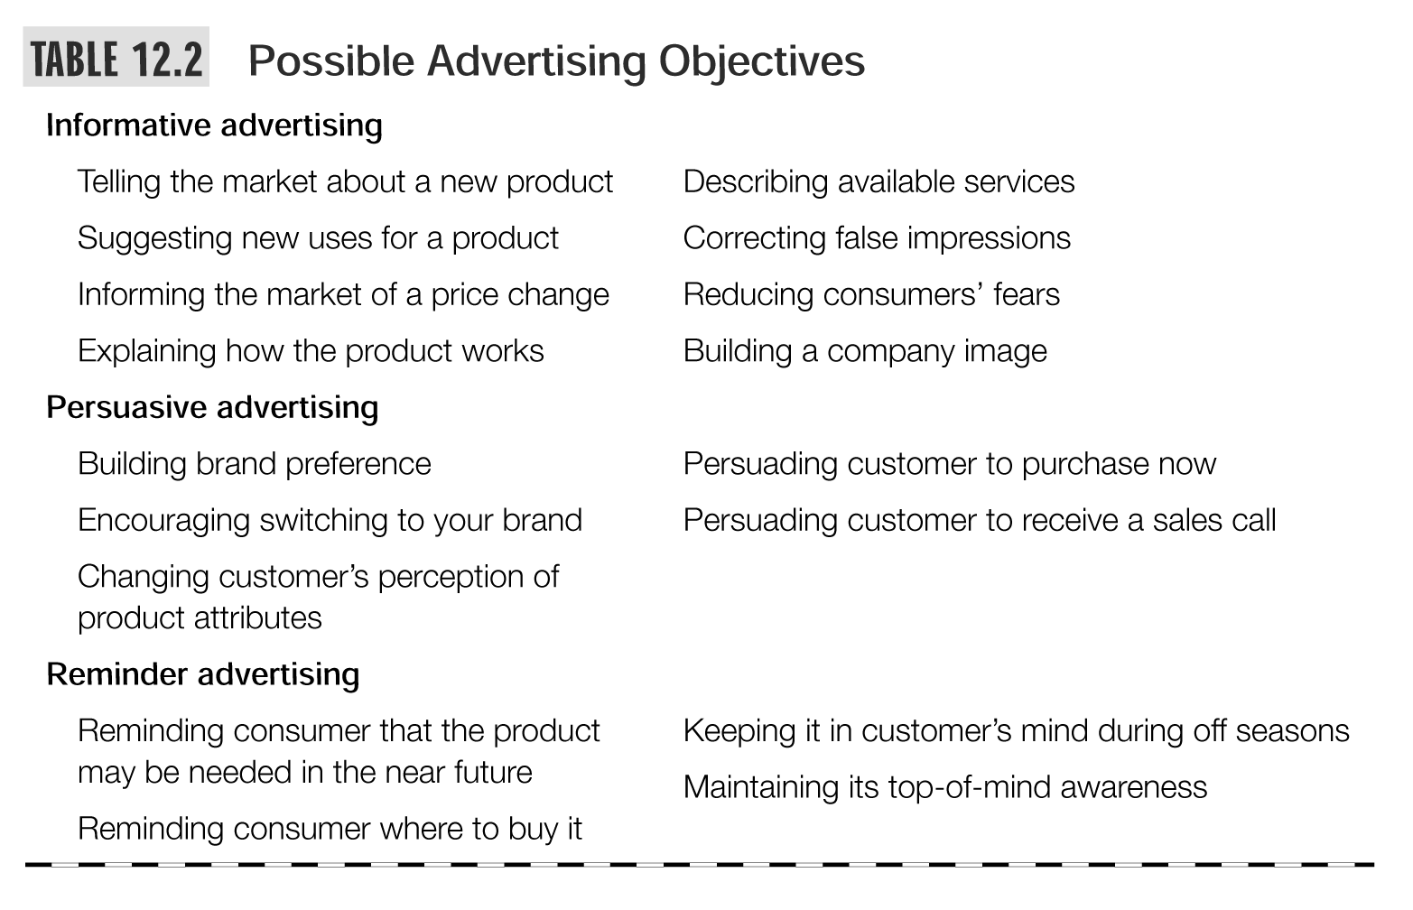

Slide 43
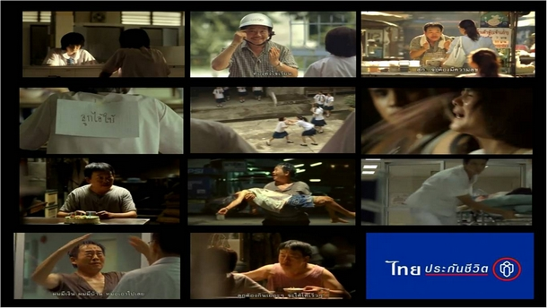

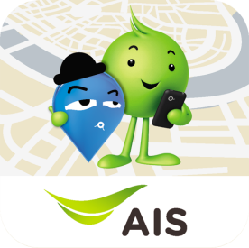
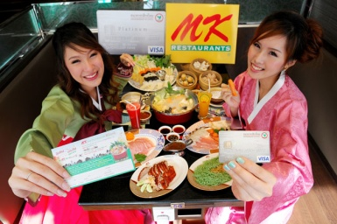
Message Execution
Slice of Life
Testimonial Evidence
or Endorsement
Lifestyle
Scientific Evidence
Typical
Approaches
Fantasy
Technical Expertise
Mood or Image
Personality Symbol
Musical

Slide 44
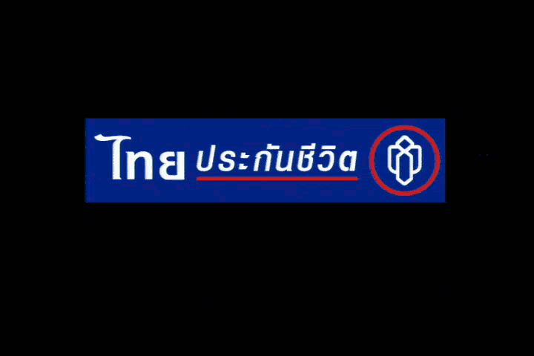
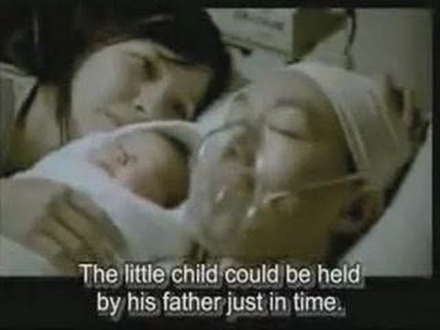
Message Execution
Choose a tone
Use memorable, attention-getting words
Choose correct format elements
  Illustration
  Headline
  Copy

Slide 46

Selecting Advertising Media
Reach
  Percentage of people exposed to ad
Frequency
  Number of times a person is exposed to ad
Media Impact
  The qualitative value of a message exposure through a given medium
Top of Mind

Slide 47
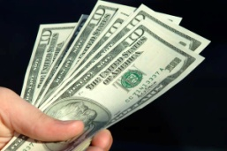
Setting the Promotion Budget
Affordable
Based on What the Company Thinks it Can Afford
Percentage-of-Sales
Based on a Percentage of Current or Forecasted Sales or
as a percentage of the unit sales price
Competitive-Parity
Set Budget to Match Competitors
Objective-and-Task
Set Objectives, Determine Tasks to Achieve Objectives,
Sum of Task Costs Equals Budget

Slide 48
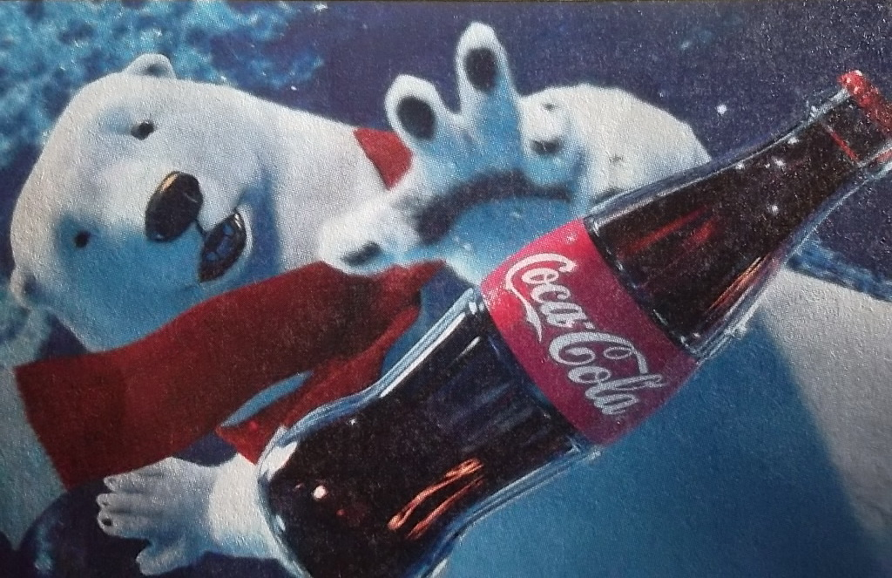
Setting the promotion budget is one of the hardest decisions facing company Coca-Cola spends hundreds of millions of dollars annually, but is that “half enough or twice too much”?

Slide 50
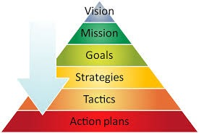
Tactical Plans

Slide 51
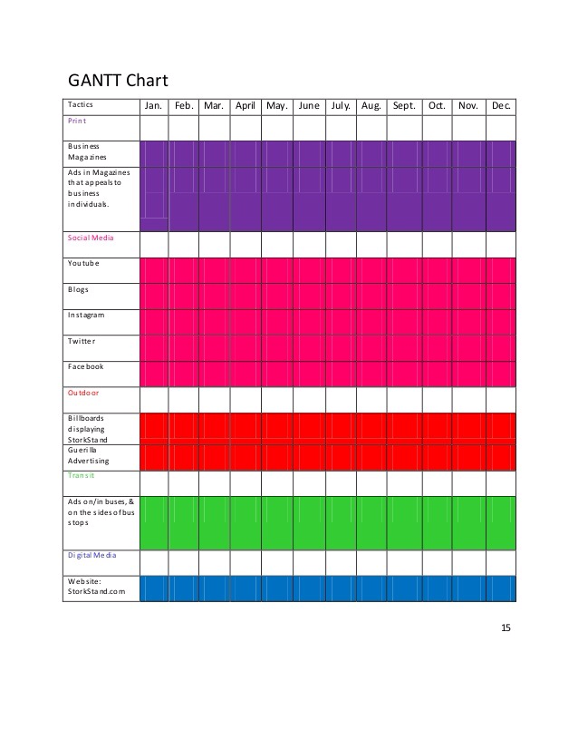

Slide 52
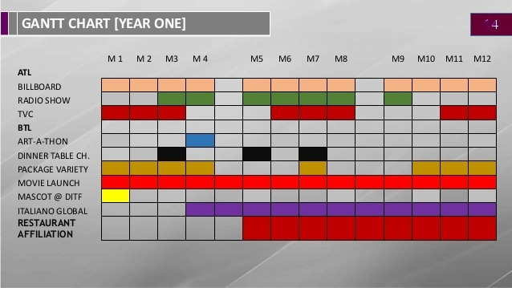

Slide 53
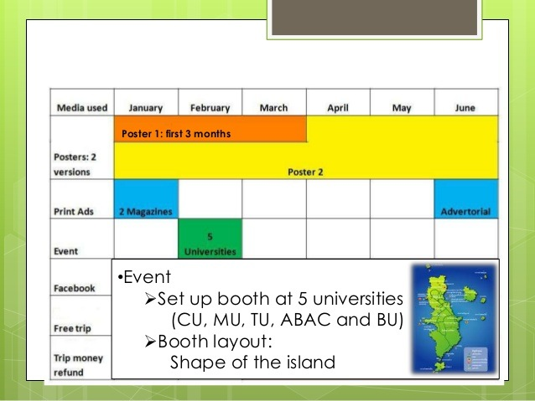

Slide 54


Slide 55

How to evaluate good advertising?
The “SMILE” APPROACH
S = simple, easy to understand
M= memorable, stick to consumer’s mind,
measures by a day after recall
I = interesting, employ new story, has new information to tell
L= linked to the brand, cannot be mistaken to other brands/products
E = emotionally involving

Slide 56
LET’S PRACTICE “SMILE”
Good Ads vs. Bad Ads

