Slide 1
Revolt and Repression
Political Change in the 14th & 6th October Events
Thai Economic History
Thorn Pitidol
1/2018

Slide 2
Topics
Revolt
  Communist Party of Thailand
  Peasant's and student's movement
The end of Sarit-Thanom regime
Repression
  Suppression of students
  Reasserting the hegemonic ideology

Slide 3
Context for the revolt
Transformation from the alliance between bureaucrats and business in Sarit's development era.
  The expansion of upland frontier
  The penetration of agribusiness
  The disintegration of agrarian society
  The rural migration to urban

Slide 4
Context for the revolt
But the achievement of economic growth came with exploitation
  Tariff and rice premium, land rights, landlessness, and low wages
In 1970s, reactions came in a wave of protests
  Peasant's movement, workers' strikes
Situation complicated further by the cold war and the expansion of communism

Slide 5
Context for the revolt
Together with wave of protests, the alliance between business and bureaucrats also weakened
  Domestic capitals grew, allowing business to be less dependent on bureaucrats
  The business leaders doubted dictatorship and repression, and the role of US
  The growth in number of university students
All the changes culminated in 14 October uprising
  Thai society opened up briefly before ending in 6th October repression.

Slide 6
Communist Party of Thailand (CPT)
The early history of CPT in Siam was centered on the Chinese immigrant in Bangkok
  Founded in 1942, but initially overshadowed by a branch of Chinese Communist Party
  Central debate was on the revolutionary strategy, whether it should be urban based (working class) or rural based (peasants)
As labour movements in Bangkok were repressed by Sarit, CPT eventually endorsed rural based strategy

Slide 7
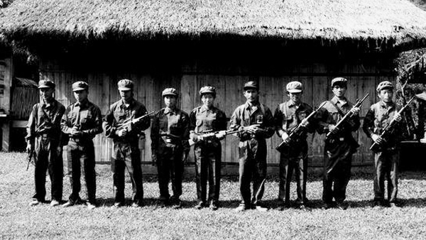
Communist Party of Thailand (CPT)

Slide 8
Communist Party of Thailand (CPT)
At the same time as US intervention in Thailand, Vietnamese and China encouraged the insurgency in NE Thailand, inviting Thai CPT members for training.
  Voice of the People of Thailand radio station
  7 August 1965, “The Gun Firing Day (วันเสียงปืนแตก)"
From 1961, the center of CPT rural organization was in NE, in Phuphan Hills.
  Isan political leaders had long history in political struggles

Slide 9
Communist Party of Thailand (CPT)
At first, the gov't and the army interpreted the insurgency as the "essentially an external creation".
  They sealed off the border and arrest local guerilla organizations. The strategy failed, and the CPT grew in strength.
CPT popularity actually bounded to the problems of upland farmers.
  CPT ideas identified with peasant beliefs that gov't was intruders.
  Hill-people also turned toward CPT.

Slide 10
Communist Party of Thailand (CPT)
The army initially had little understanding of the problems that led to CPT expansion, and resorted to suppressive measures of torture, rape, and executions.
  The clashes only led to quicker expansion.
In 1965, US encouraged the formation of Communist Suppression Operation Command (later กอ.รมน.).
US intervention also led to the use of development projects to counter insurgency.
  Villages that cooperated gets the funding in return
  Gov't turned toward using the villages as the center in fighting communism. But this strategy ended prematurely in 1973.

Slide 11
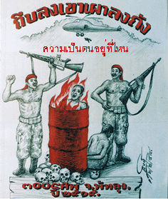
ถังแดง
ปัง ปัง โวยวาย เสียงเจ้านายรบกวน ค่ำมืดลมหวน เสียงมันชวนครางครัน กระโดดลงใต้ถุนหลบกระสุนนาย กลิ่นความตายโชยมา เขาว่าพัทลุงสบาย ฉันว่าอันตรายแท้เชียว จะไปทางไหนให้หวาดเสียว มันโกรธเรานิดเดียวเราก็ตาย จับไปลงถัง ราดน้ำมันแล้วจุดไฟ ข้อหาคอมมิวนิสต์ มันคิดไป จับพี่น้องเราใส่เตา แล้วเผาไฟ แล้วมันก็ป้ายสีแดง บ้างเมียก็เสียผัว ถูกตัดหัวเสียบประจาน มันขี้หกลูกหลาน ว่าสันดานเป็นคอมฯ แท้จริงมันคือ เจ้านาย หัวหน้าตัวร้ายไอ้สอพลอ มึงต้องออกไปไอ้หัวหมอ ไอ้พวกหัวดอ ต้องออกไป ชีวิตคนไทย มันขาย เป็นทาสรับใช้ไอ้กัน พรากลูกเมียเขาเพื่อเอาเงิน แร่ไทยมันขนกัน สุดประเมิน แล้งยังสรรเสริญเยินยอ
https://www.youtube.com/watch?v=Ymph6n2x8Dg

Slide 12
Communist Party of Thailand (CPT)
In 1971, as students began their protest against the military gov't, CPT restarted their operation in the city.
  6 October suppression prompted 2000-3000 students and intellectuals to flee to join CPT.
  At the same time, US withdrew from Vietnam, Laos and Vietnam fell, and Thai army suffered from internal tension.
Observers expected the Communists to win in Thailand within 5-10 years.

Slide 13
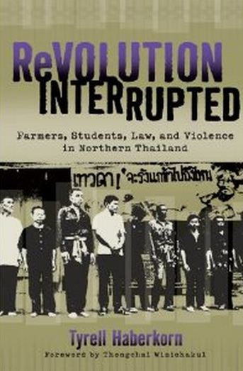
Peasant's movements
The early 1970s also saw the outbreak of protests in rural heartland.
  At the height, peasants from 41 provinces joined the protests.
  Major causes of protests range from the problems of indebtedness, land loss, and high rent.
    In the North, due to the past allowance for the nobles' land-grabbing, rent was 50% higher than the central region, 100% more than in Isan.

Slide 14
Peasant's movements
Students helped bring local protests out of the villages and onto the national stage.
  Thousands of students went to the country side in volunteering programs.
    They observed problems, injustice, and poverty.
In 1974, peasants and their student supporters mobilised their protests, resulting in the gov't responding through setting up price support scheme and establishing committees to solve land problems.

Slide 15
Peasant's movements
But the committee to solve land problems found little success in resolving problems.
The peasants later organised to pressure for the rent control law, forming the Peasants Federation of Thailand (FDT) as a result.
  Membership of FPT as large as 1.5 millions.
  FPT operated at the village level, but were seen as illegal by the gov't.
In a very short time, the peasant movement had dramatized the problems of peasants on a national scale.
  But to the gov't, the phenomenon was frightening.

Slide 16
Student's movements
Between 1961-72, the number of students expanded from 15,000 to 100,000. The students came from the middle class background, seeking to enter varieties of jobs.
  The culture of the university started to change.
    Debates over policies, discussion of social and political issues.
  Students held demonstrations, held seminars on political topics, set up volunteers to observed elections.

Slide 17
Student's movements
By the late 1960s, leftist and marxist ideas became more popular among intellectuals and students.
Students’ protests focused on the causes of problems in Thailand ranging from foreign influence (esp. the US), the role of the military, and the power of capitalism.
  Student built alliance with peasants and labour
  Jit Poumisak's Chomna Sakdina was influential
From 1973, CPT started influencing the student movements.

Slide 18
The end of Sarit-Thanom regime
The business community had grown richer and stronger under Sarit's regime. As the growth decelerated in late 1960s, they became more politically assertive.
  They started criticizing the political structure that encourage monopolies and take from them special "taxes".
  They criticised the military's monopoly of power, questioning their capacity to deal with rising insurgency.

Slide 19
The end of Sarit-Thanom regime
In the mid 1960s, the King became more concern with the prospect of continuing military dictatorship. He encouraged the military to restore the Parliament.
  New constitution introduced in 1968. Although military was allowed to have the control, a growing presence of businessmen and professionals led to the resistance against the military from within the parliament.
The King eventually became more openly critical of Thanom-Praphat regime.
  Royal addresses criticised violence and corruption.
  Seeking to balance military-bureaucrats' power.

Slide 20
The end of Sarit-Thanom regime
Thanom-Prapart control over the military faced inner conflict, especially with the controversial role of Thanom's son, Narong.
As the coalition between bureaucracy, military, royalists, and business was falling apart, the student protests pressed the fragility.
  The students' demonstration in October 1973 escalated and led had more than 400,000 involved.
  On 14 October 1973, students clashed with riot police, resulting in more than 100 killed.

Slide 21
The end of Sarit-Thanom regime
The military rulers resigned but was prepare to used force, only to be rejected by the army leader.
The King ordered Thanom, Prapart, and Narong to leave the country. Sanya Thammasak was chosen as the new PM.
Post 14 October saw the student demonstrations continued, but the palace, its royalist allies in bureaucracy and politics, and the business actually took the roles in reshaping the political process.

Slide 22
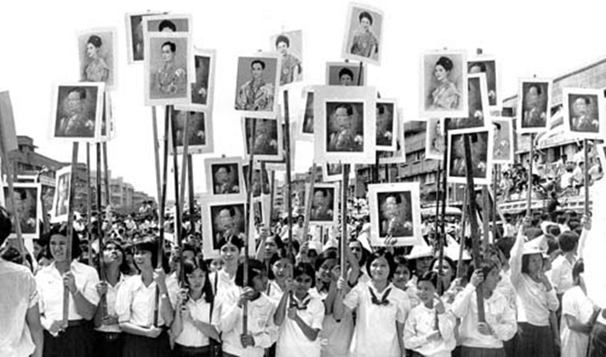

Slide 23
The end of Sarit-Thanom regime
Post 14 October saw the attempt to exclude officials and military from the parliament. Kukrit gov't came to power.
  Signifying the new alliance between the royalists, businessmen, and the military group opposing Thanom-Prapart.
Kukrit turned attention to 2 main issues: (1) turning Thai foreign affairs away from US; (2) pacifying the countryside.
  Price support scheme for rice farmers, funds to Tambons.

Slide 24
The suppression of students
In the early 1975, as the CPT raised their activeness in the city with students, the right began to move against the tide of radicalism.
The political situation raised concerns for the right, the conservatives, and the business
  Leftist and socialist parties, allowed back in politics, gained votes.
  As Communist gained upper hand in Indochina, Kukrit yielded to peasants and workers's demands.
Japanese and US investors threatened to leave and disrupt their investment.

Slide 25
The suppression of students
The first stage of the repression of came in 1975, against the background of the fall of Indochina. The army was the basis.
But the army found little success and turned toward using ISOC (กอ.รมน.) to organised right wing movements.
  Nawaphon (Ninth Power) movement recruited local businessmen and gov't officials. They were rumoured to be behind the assassination of peasants leaders.
  Village scout movement was organised by the Border Patrol Police.
  The Red Guars (Krating-Daeng) recruited vocational students.
  These movements were mobilised by the nationalist-royalist ideology.

Slide 26
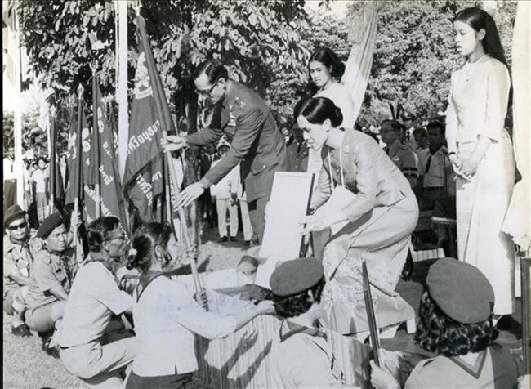
Village Scouts

Slide 27
The suppression of students
The second stage of repression came in 1976, against the background of the abolishment of the Laotian monarchy.
The anti-communist propaganda became more intense.
  Communism was pitched against Nation, Religion, and King.
  Phra Kittivuttho urged killing of the communists.
  Violence increased with a number assassination and grenade attacks.

Slide 28
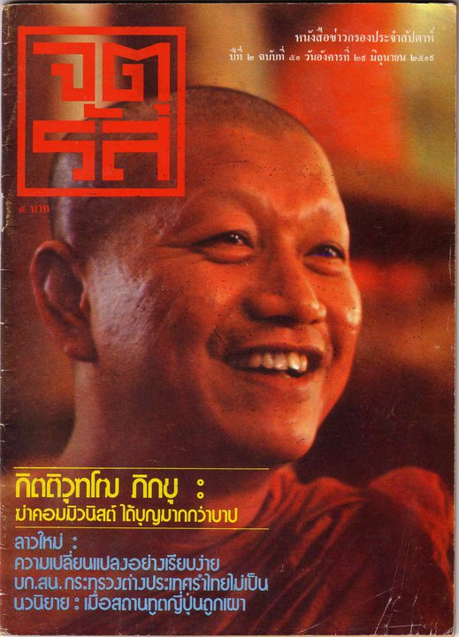
Kittivuttho

Slide 29
The suppression of students
The return of Thanom in October 1976 prompted the student to protests.
  A minister cited the King's approval for Thanom's return.
  The situation culminated in 6 October massacre.
  The polarization saw Chuan, Anan, Kukrit, and Puey accused of being communists.
The army staged a coup, return its control over the parliament, and expand the suppression. Books were banned, thousands were arrested.

Slide 30
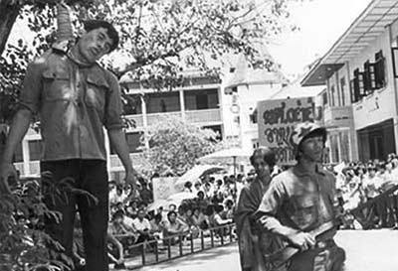
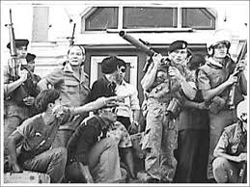
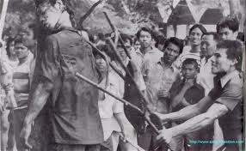
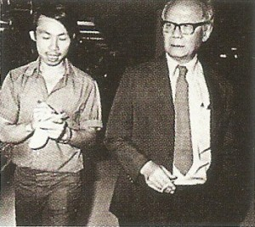
6 October

Slide 31
The suppression of students
After 6 October, some 2000-3000 students fled to join CPT in the jungle. In 1979, CPT estimated to have 10,000 armed members.
But this was the peak. The students expected to take a prominent role in CPT, but the CPT had a little trust in them.
Students were dissatisfied with CPT strategy. Many eventually left.

Slide 32
The end of CPT
Problem in Cambodia led to the conflict between China and Vietnam. Thai offered to help China in return for China ending its support of CPT.
The use of amnesty to insurgents, and political solution, found success in drawing out the members of CPT.
The strategy, later turned into Order 66/2523, were adopted nationwide.
In 1983, the ISOC announced total victory over CPT.

Slide 33
Reasserting the hegemonic ideology
In response to 1970s, members in the circle of bureucracy and old aristocracy felt the need to strengthen the ideology of nation, religion, and king.
  King had established his position as the development King.
  An idea was published that the Thai monarch is ruled by the consent of his peers. The King is judged by the happiness and benefit he bring to the country.
The military and bureaucracy projected an enlarged role for the King and the royal family in the national culture.
  Promotion done through ceremonies and TV.

Slide 34
Reasserting the hegemonic ideology
In addition, Buddhism was revived as the conservative social and political force.
Traiphum Phra Ruang was rehabilitated. The text focus on justifying social and ethical hierarchy.
  This time also saw the rise in popularity of religious movements such as
    The workship of forest monks,
    The Huppasawan movement, which combined anti-communism with wide range of faiths in the world.

Slide 35
Reasserting the hegemonic ideology
Finally, the gov't set out to renew "Thai" and "Thainess"
  Essential to Thai identity are the institution of nation, religion, and king, which "create the unity within the nation, enabling the preservation of independence and sovereignty".
Thai society portrayed as having a pyramid structure. The King at the top, and the village as the base.
  Villages are peaceful, content, not seeking wealth, not seeking changes. Thai society had no conflicts, insurgency, gaps, etc.
  Thailand as the nation of peaceful peasants who are loyal to nation, religion, king.

