Slide 1
FN 331: Financial Institutions Management
Class 4
Copyright © 2014 by the McGraw-Hill Companies, Inc. All rights reserved.
Notes:
1

Slide 2

Introduction
Ch 6-2

Slide 3
Overview
This chapter discusses insurance companies
  Two major groups:
    Life ➔ long-term
    Property & Casualty (non-life: flood, health, fire, etc.)➔ short-term
  Financial crisis and insurance companies
  Size, structure, and composition
  Balance sheets and recent trends
  Regulation of insurance companies
  Global competition and trends
Ch 6-3

Slide 4
Insurance and Financial Crisis
Insurance companies as investors in securities
  Subprime mortgage pools fell in value
  Credit default swaps (CDS) fell
  AIG was a major writer of CDS securities
Potential impact on other companies used to justify AIG bailout ➔ Too big to fail because the impact will be on other companies who are holding AIG insurance policies & all elderly population who are holding AIG Insurance policies
Increased risk exposure, mainly due to CDS in which AIG underwrites for Greece Government and others
Ch 6-4

Slide 5
Insurance Companies
Differences in services provided by:
  Life insurance companies
  Property and casualty insurance
Ch 6-5

Slide 6
Size, Structure, & Composition
Size, structure, and composition of the industry:
  In 1988: 2,300 life insurance companies with aggregate assets of $1.1 trillion
  In 2010s: 1,000 life insurance companies with aggregate assets of $5.6 trillion in 2012
Ch 6-6

Slide 7
Size, Structure & Composition continued:
  4 largest wrote 27% of new business in 2011
  Many sold through commercial banks
  e.g. ~12 % in 2012
Ch 6-7

Slide 8
Life Insurance Companies
Significant consolidation in life insurance industry although not to the same extent witnessed in banking
Competition from within industry and from other FIs
Conversion to stockholder controlled companies
Ch 6-8

Slide 9
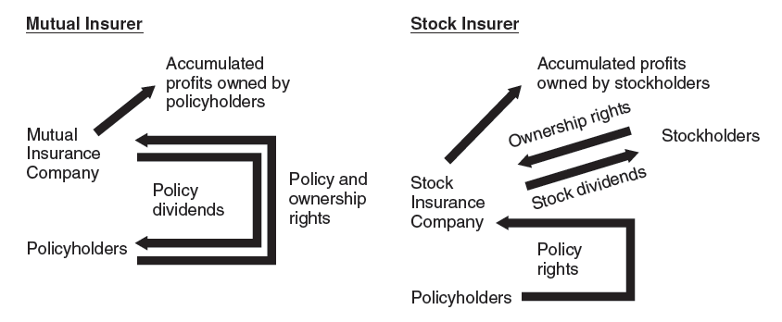
Mutual vs. Stock Insurance Companies
Ch 6-9

Slide 10
Stock vs. Mutual Insurer
AIG, Metropolitan and Prudential – they have converted into stockholder-controlled companies, listed in stock market. They gain access to the equity markets in order to realize additional capital for future business expansion and also to compete with the rapidly consolidated banking industry (especially the Universal Banks)
Mutual company is owned by policy holders, the existing capital and reserves have to be distributed to the insurer’s policyholders.
Ch 6-10

Slide 11
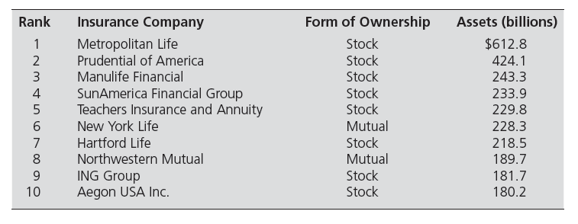
Biggest Life Insurers
Notes:
11

Slide 12
Life Insurance: Issues
Adverse selection
  Insured have higher risk than general population
    The problem is that the customers who apply for insurance policies tends to be those most in need of insurance, i.e. someone with chronic health problems is more likely to purchase a life insurance policy than someone who are in perfect health.
  Alleviated by grouping of policyholders into risk pools
    Insurance companies grouping policyholders into a more refined and defined risk pools with better understanding the statistics of each pool.
Ch 6-12

Slide 13
Life Insurance Companies
Life insurance products:
  Ordinary life
    Term life, whole life, endowment life
    Variable life, universal life, variable universal life
  Group life – life/health insurance for the company staffs
  Industrial life – weekly payments directly collected from representative of the companies
  Credit life – sold to protect lenders against borrowers death prior the repayment of debt contract (long-term) such as mortgage loan or car loan
Ch 6-13

Slide 14
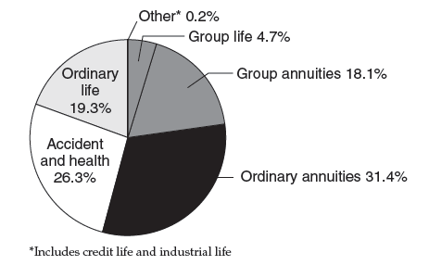
Distribution of Premiums
Ch 6-14
Notes:
14

Slide 15
Other Life Insurer Activities
  Annuities
    Reverse of life insurance activities
    Topped $334.8 billion in 2011
  Private pension funds
    Compete with other financial service cos.
    In 2012, managing over $2.6 trillion (~40% of all private pension plans)
  Accident and health insurance
    Morbidity insurance
    Over 177.8 billion in premiums in 2011
Ch 6-15

Slide 16
Balance Sheet
  Long-term assets
    Need to generate competitive returns on savings components of life insurance policies
    Bonds, equities, government securities
    Policy loans – policyholders can borrow money from insurance company up to amount but cap at the insurance coverage, using insurance policy as collateral
  Long-term liabilities
    Net policy reserves to meet policyholders’ claims
    Separate account business represented 33.7% of total liabilities and capital in 2012
      Annuity programs sponsored by life insurance companies in which the payoff on the policy is linked to the assets in which policy premiums are invested in.
Ch 6-16

Slide 17
Recent Trends
Impact of financial crisis
  Drop in value of securities
    Capital losses from bonds and stocks exceeded $35 billion
  Historically low short term interest rates
    Adverse impact on ability to lower rates on new policies
    Incentive to surrender existing policies
      Surrender value of a policy is the cash value of policy received from the insurer if a policyholder surrenders the policy before maturity. The cash surrender is normally a portion of the contract’s face value
Ch 6-17

Slide 18
Recent Regulatory Issues
Fear of systemic risk posed by AIG
Systemic risk – the risk that can make the entire economic/financial system to shrink or collapse
2009: Proposals to create optional federal charter, governed by Department of Insurance under Ministry of Commerce, and also having guarantee fund against insurance premium for insurance policyholders – same way that they protected deposit for depositors
Complaints of inconsistent regulation and barriers to innovation – that the such regulations are much more stringent towards depository institutions but not insurance companies nor investment banks who behaved like shadow banking.
2010: Wall Street Reform and Consumer Protection Act established the Federal Insurance Office
Ch 6-18

Slide 19
Web Resources
For more detailed information on insurance regulation, visit:
OIC www.oic.or.th
Ch 6-19

Slide 20
Property and Casualty Insurance
Size and Structure
  Currently about 2,700 companies
  Highly concentrated: Top 10 firms have 50% of market in terms of premiums written
    Top 200 firms: over 95%
    M&A activity is increasing concentration
Ch 6-20

Slide 21
P&C Products
Fire insurance and allied lines
Homeowners multiple-peril insurance
Commercial multiple-peril insurance
Automobile liability and physical damage insurance
Liability insurance (other than automobile)
Ch 6-21

Slide 22
Property & Casualty
Changing composition of net premiums written, 2011 versus 1960:
  Decline in fire insurance and allied lines: 2.7% in 2011 vs. 16.6% in 1960
  Homeowners MP: 14.9% vs. 5.2% in 1960
  Commercial MP: 6.8% vs. 0.4% in 1960
  Auto L&PD: 38.5% vs. 43% in 1960
  Other liability: 12.0% vs. 6.6% in 1960
Ch 6-22

Slide 23
P&C Balance Sheet
Similar to life insurance companies; long-term securities
Unlike life insurance companies; requirement for liquid assets
Major liabilities:
  Loss reserves – provision set aside the potential loss
  Loss adjustment expenses – actual losses already incurred
  Unearned premiums – reserve that set aside, containing the portion of a premium that has been paid before the insurance coverage have been provided
Ch 6-23

Slide 24
Loss Risk
Loss Risk – the key feature of claims loss exposure is the actuarial predictability of losses relative to premiums earned.
The predictability depending on a number of characteristics or features of the perils insured.
    Property vs. liability
    Severity vs. frequency
    Long tail vs. short tail
Ch 6-24

Slide 25
Loss Risk
Underwriting risk may result from:
  Unexpected increases in loss rates
  Unexpected increases in expenses
  Unexpected decreases in investment yields or returns
Property versus liability
  Losses from liability insurance less predictable
  Example: Claims due to asbestos damage to workers’ health
Ch 6-25

Slide 26
Loss Rates
Severity versus frequency
  Loss rates more predictable on low-severity, high-frequency lines (such as fire, auto, homeowners peril) than on high-severity, low-frequency lines (such as earthquake, hurricane, financial guaranty)
  Claims in high-severity, low-frequency lines may not be independent
  Higher uncertainty forces PC firms to invest in more short-term assets and hold larger capital and reserves than life insurance firms – because the claims are more often.
Ch 6-26

Slide 27
Insurance Risks Post 9/11
Crisis generated by terrorist attacks forced creation of federal terrorism insurance program in 2002
Ch 6-27

Slide 28
Long Tail Versus Short Tail
Long-tail risk exposure
  Arises where peril occurs during coverage period but claim is made many years later
  Examples: Asbestos cases and Dalkon shield case
  Efforts to contain long-tail risks within subsidiaries
Ch 6-28

Slide 29
Insurance Costs: Social Inflation
Product inflation versus social inflation
  Unexpected inflation may be systematic or line-specific
  Social inflation: Unexpected changes in awards by juries
Reinsurance
  Approximately 75 percent of reinsurance by US firms is written by non-US firms such as Munich Re
Ch 6-29

Slide 30
Underwriting Ratios
  Loss ratios have generally increased
  Expense ratios have generally decreased
  Trend toward selling directly through their own brokers rather than independent brokers
  Combined ratio:
    Includes both loss and expense experience
    If greater than 100, premiums are insufficient to cover losses and expenses
Ch 6-30

Slide 31
Investment Yield / Return Risk
Operating ratio = combined ratio after dividends minus investment yield
Importance of investment income:
  Causes PC managers to place importance on measuring and managing credit risk and interest rate risk
  Credit risk is counterparty risk or default risk
  Interest risk >> reinvestment risk which is the risk that the insurance companies will be able to reinvest at lower return when interest rate is decreasing, down trend
Ch 6-31

Slide 32
P&C: Recent Trends
Several catastrophes over 1985 - 2012
  Hurricane Hugo 1989, San Francisco Earthquake 1991, Oakland fires 1991, Hurricane Andrew 1991
  2004, Hurricanes Charley, Frances, Ivan, Jeanne in rapid succession generated claims comparable to Andrew.
  Hurricane Katrina, 2005
  September 11, 2001 terrorist attacks created an insurance crisis (and heightened demand)
Potential for crowding out market solutions (catastrophe bonds) via government actions
Ch 6-32

Slide 33
Global Issues
Insurance industry increasingly global
Worldwide, 2011 was a bad year
  Japan’s earthquake and tsunami
  Earthquakes in New Zealand
  Floods in Thailand
  Severe tornadoes in US
Ch 6-33

