Slide 1
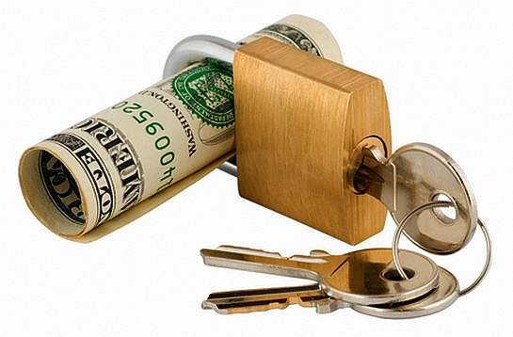



Treasury products
FN 323 GROUP PROJECT
PRESENT TO
Ajarn Worapong Janyangyuen
BY
Sirasith Sopasilpa 5402641293
Sirinda Punjathrapsin 5402641319
Teekatas Sivakua 5402641442

Slide 2
Treasury products
Treasury products are different types of products that are offered by BANKING and INVESTING INSTITUTIONS. The products will vary depending on the institution and what they decide to offer their customers.
Some of the more common treasury products are promissory notes, interest swaps, currency swaps, and interest options. Money market products are also considered to be a type of treasury product.
Players who are both lenders and borrowers :
● Commercial Banks
● Financial Institution
● Corporates

Slide 3
Treasury products
We divided the products into 3 types:
Treasury products
Foreign Exchange Market
Financial Market (Money + Capital)
Primary market in equity shares

Slide 4
Treasury products
We divided the products into 3 types:
FOREIGN EXCHANGE SPOT
Treasury products
Foreign Exchange Market
Financial Market (Money + Capital)
Primary market in equity shares
Foreign Exchange Market
FORWARD
SWAP
FX HEDGES
OPTION

Slide 5

Treasury products
The foreign exchange market (Forex, FX, or Currency Market)
A global decentralized market for the trading of currencies. The main participants in this market are the larger international banks.
Financial centers around the world function as anchors of trading between a wide range of multiple types of buyers and sellers.
The foreign exchange market determines the relative values of different currencies.
Foreign Exchange Market
Financial Market
Primary market in equity shares

Slide 6
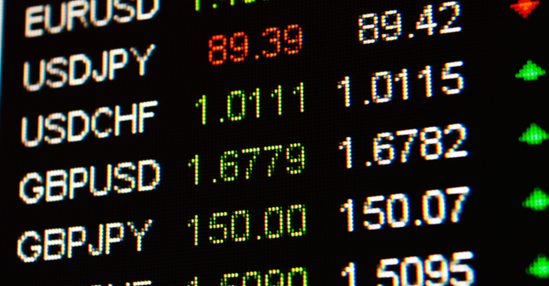
Treasury products
● Consumers and travellers
● Businesses
● Investors and speculators
Players in FX Market :
● Commercial and Investment Banks
● Government and Central Banks
USD
GBP
JPY
EUR
Main Currencies :
CHF
CAD
NZD/AUD
Foreign Exchange Market
Financial Market
Primary market in equity shares

Slide 7
Standard products
Foreign exchange spot
Also known as FX spot,
An agreement between two parties to buy one currency against selling another currency at an agreed price.
The exchange rate at which the transaction is done is called the spot exchange rate
Settlement date
The standard settlement timeframe for foreign exchange spot transactions is T + 2 days; i.e., two business days from the trade date
Method
● Direct
● Electronic broking systems
● Electronic trading systems
● Voice broker
Foreign Exchange Market
Financial Market
Primary market in equity shares

Slide 8

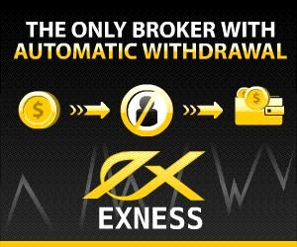

Standard products
Foreign exchange spot
Individual Trader
Trading via broker, which usually registered with Futures Commission Merchant (FCM)
Using a trading platform (ex. MetaTrader)
Leverage: The amount of money a broker will lend you for trading
      Ex. 1:100, 1:250
Foreign Exchange Market
Financial Market
Primary market in equity shares

Slide 9
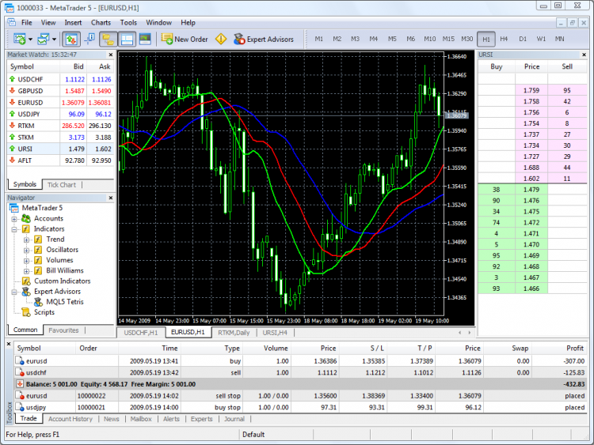
Standard products
Quote box: Info about each real-time exchange rates
Foreign exchange spot
Individual Trader
Order Type: Buy, Sell
S/L: Stop Loss
T/P: Target Price
Foreign Exchange Market
Financial Market
Primary market in equity shares

Slide 10
Standard products
Forwards
● A forward is a contract between two parties to buy or to sell an asset at a specified future time at a price agreed upon today.
● Contrast to a spot contract, which is an agreement to buy or sell an asset today.
● The party agreeing to buy the underlying asset in the future assumes a long position, and the party agreeing to sell the asset in the future assumes a short position.
● The price agreed upon is called the delivery price, which is equal to the forward price at the time the contract is entered into
Foreign Exchange Market
Financial Market
Primary market in equity shares

Slide 11
Derivative products
FX Hedged structures & Option
FX hedged structures
A transaction implemented by a forex trader to protect an existing or anticipated position from an unwanted move in exchange rates.
By using a forex hedge properly, a trader who is long a foreign currency pair can be protected from downside risk, while the trader who is short a foreign currency pair can protect against upside risk.
Option
An option is an agreement between two parties in which one party grants the other the right (but not the obligation) to buy or sell an asset under specified conditions, determined at the beginning of the period.
All options have finite lives and definable value.
Foreign Exchange Market
Financial Market
Primary market in equity shares

Slide 12

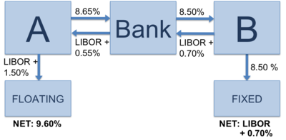
Standard products
SWAP
Swaps are financial agreements to exchange cash flows. Swaps can be based on interest rates, foreign currency exchange rates and even commodities prices.
Interest rate swap One party pays a fixed interest rate and the other pays a floating interest rate *** Commonly use ***
Foreign Exchange Market
Financial Market
Primary market in equity shares

Slide 13
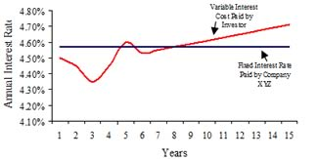
Standard products
SWAP
Example
Company XYZ agrees to pay Investor ABC 4.58% on $10,000,000 each year for 15 years. Investor ABC agrees to pay Company XYZ LIBOR + 1.5% on $10,000,000 per year for 15 years.
Investor ABC thinks that interest rates are going to go down. He is willing to accept fixed rates from Company XYZ
Foreign Exchange Market
Financial Market
Primary market in equity shares

Slide 14
Treasury products
FOREX’s Advantage:
Helps in risk management
  Avoiding the risk of currency fluctuations.
  Also called currency hedging
Foreign Exchange Market
Financial Market
Primary market in equity shares
Notes:
allowing you to protect costs on products and services bought abroad; protect profit margins on products and services sold overseas.
in the case of forward foreign exchange, locks in exchange rates for as long as a year in advance

Slide 15
Treasury products
We divided the products into 3 types:
DEPOSITS
Treasury products
Foreign Exchange Market
Financial Market (Money + Capital)
Primary market in equity shares
Financial Money Market
COMMERCIAL PAPER
BANKERS’ ACCEPTANCE
FORWARD-FORWARD DEPOSITS
STRUCTURED DEPOSITS

Slide 16

Treasury products
The money markets are used for the raising of short term finance, sometimes for loans that are expected to be paid back as early as overnight.
● Central government
● Public Sector Undertaking
● Insurance Companies
● Mutual Funds
● Banks
● Corporate
Players in Money Market :
● Others
- Foreign Institutional Investors
- Investment Trusts
Financial Market
Foreign Exchange Market
Primary market in equity shares

Slide 17

Standard products
Deposits
Individuals and corporations need money to pursue their daily business. They place the money on deposit to earn interest, using the money market.
Types of deposits are:
●Transactional account the depositor has the right to use the money at any time
● Term deposit bear a fixed time and fixed interest rate
● Overnight lending occurs usually from noon to noon, using a special rate.
Financial Market
Foreign Exchange Market
Primary market in equity shares

Slide 18
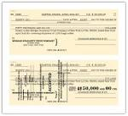
Standard products
Commercial Paper
An unsecured, short-term debt instrument issued by a corporation, typically for the financing of accounts receivable, inventories and meeting short-term liabilities.
Maturities on commercial paper mostly range shorter than 270 days.
The debt is usually issued at a discount, reflecting prevailing market interest rates.
Commercial paper is not usually backed by any form of collateral, so only firms with high-quality debt ratings will easily find buyers without having to offer a substantial discount (higher cost) for the debt issue.
Benefits:
● NO need to be registered with the SEC
● Making it a very cost-effective means of financing
● Can only be used on current assets (inventories)
Financial Market
Foreign Exchange Market
Primary market in equity shares

Slide 19
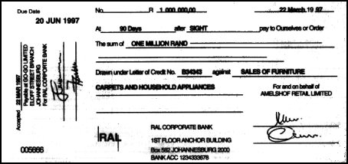
Standard products
Bankers’ Acceptance
A promised future payment, or time draft, which is accepted and guaranteed by a bank and drawn on a deposit at the bank.
The banker's acceptance specifies the amount of money, the date, and the person to which the payment is due. Available in a variety of maturity dates up to a maximum of one year
After acceptance, the draft becomes an unconditional liability of the bank.
But the holder of the draft can sell (exchange) it for cash at a discount to a buyer who is willing to wait until the
maturity date for the funds in the deposit.
Financial Market
Foreign Exchange Market
Primary market in equity shares

Slide 20
Derivative products
Forward-Forward Deposits
A forward -forward deposit is an arrangement by one party to place a deposit with another party at an agreed rate and date in the future for a specified period of time.
The deposit commences in the future and matures at an even further date in the future
Financial Market
Foreign Exchange Market
Primary market in equity shares

Slide 21
Derivative products
Structured deposits
A structured deposit combines a deposit with an investment product. The return on a structured deposit depends on the performance of an underlying financial asset, product or benchmark.
A structured deposit is different from a fixed deposit. Structured deposits may provide the potential for higher returns compared to fixed deposits, but you take on more risks when you buy a structured deposit, including the risk that you receive returns that are lower than expected.
At maturity, you will receive the principal amount of the structured deposit.
The return of the principal and any returns is subject to the credit risk of the bank holding the deposit.
If the deposit is withdrawn early, you may not receive 100% of the money invested back.
Financial Market
Foreign Exchange Market
Primary market in equity shares

Slide 22
Treasury products
We divided the products into 3 types:
Treasury products
Foreign Exchange Market
Financial Market (Money + Capital)
Primary market in equity shares
TREASURY BILLS
Financial Market (Continued)
TREASURY BONDS
PROMISSORY NOTES
CORPORATE BOND
CREDIT LINKED NOTES
STRUCTURED NOTES

Slide 23
Standard products
Promissory Notes
A financial instrument that contains a written promise by one party to pay another party a definite sum of money either on demand or at a specified future date. A promissory note typically contains all the terms such as the amount, interest rate, maturity date, date and place of issuance, and issuer's signature.
Financial Market
Foreign Exchange Market
Primary market in equity shares

Slide 24
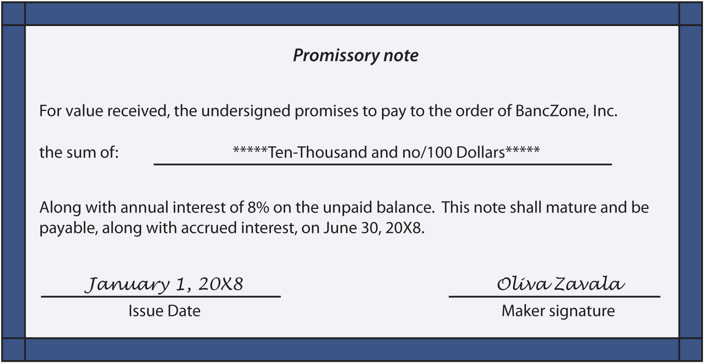
Standard products
Promissory Notes
Financial Market
Foreign Exchange Market
Primary market in equity shares

Slide 25
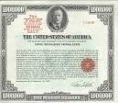
Standard products
Treasury Bill (T-Bill)
It is a short-term debt obligation backed by the U.S. government with a maturity of less than one year. T-bills are sold in denominations of $1,000 up to a maximum purchase of $5 million and commonly have maturities of one month, three months or six months.
T-bills are issued through a competitive bidding process at a discount from par, which means that rather than paying fixed interest payments like conventional bonds, the appreciation of the bond provides the return to the holder.
Financial Market
Foreign Exchange Market
Primary market in equity shares

Slide 26
Treasury products
The capital markets are used for the raising of long term finance, such as the purchase of shares, or for loans that are not expected to be fully paid back for at least a year.
● Pure Borrowers
- Government
- Public Sector Undertakings
Players in Capital Markets :
● Pure Investors
- Insurance Companies
- Mutual Funds
- Provident Funds
- Pension Funds
- Retailed Investors
Financial Market
Foreign Exchange Market
Primary market in equity shares

Slide 27
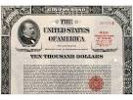

Standard products
Treasury Bond (T-Bond)
It’s a marketable, fixed-interest U.S. government debt security with a maturity of more than 10 years. Treasury bonds make interest payments semi-annually and the income that holders receive is only taxed at the federal level.
Financial Market
Foreign Exchange Market
Primary market in equity shares

Slide 28


Standard products
Corporate Bond
A debt security issued by a corporation and sold to investors. The backing for the bond is usually the payment ability of the company, which is typically money to be earned from future operations. In some cases, the company's physical assets may be used as collateral for bonds.
- Higher risk than government bonds.
- Major source of capital for many businesses along with equity and bank loans/lines of credit.
- Taxable with terms of more than one year. Corporate debt that matures in less than one year is typically called "commercial paper".
Financial Market
Foreign Exchange Market
Primary market in equity shares
28
28
28
28
28
28

Slide 29
Derivative products
Structured Notes
A hybrid security that includes several financial products, typically a stock or bond plus a derivative.
A simple example would be a five-year bond tied together with an option contract.
The addition of the option contract changes the security's risk/return profile to make it more tailored to an investor's comfort zone.
This makes it possible to invest in an asset class that would otherwise be considered too risky.
Financial Market
Foreign Exchange Market
Primary market in equity shares
29
29

Slide 30
Derivative products
Structured Notes
Example of structured notes
A commercial bank issues structured notes tied with THB/USD with following features …
  $1,000 principle
  6 months maturity
  With conditions
    If THB/USD > or = 41 , investor will get a return of 4%
    If THB/USD < 41 , investor will get a return of 0%
  On maturity date, THB/USD is 42.10, investor will receive the principle plus another 4%
  Hedge against currency exchange flunctuations
Financial Market
Foreign Exchange Market
Primary market in equity shares
30
30

Slide 31
Derivative products
Credit Linked Notes (CLN)
Structured notes that have credit risk as underlying asset. They offer attractive yields, diversification and flexibility. This alternative investment is primarily intended for investment funds and banks (due to less stringent regulations than other categories of investors).
Under this structure, the coupon or price of the note is linked to the performance of a reference asset. It offers borrowers a hedge against credit risk, and gives investors a higher yield on the note for accepting exposure to a specified credit event.
Financial Market
Foreign Exchange Market
Primary market in equity shares
31
31
31
31
31
31

Slide 32
Treasury products
Treasury products
Foreign Exchange Market
Money Market
Capital Market
Primary market in equity shares
Primary market in equity shares
FIXED PRICE OFFER
BOOK-BUILDING
32
32

Slide 33
Treasury products
The primary equity market ( New Issued Market) is used for offering new equity issues in the market. This market provides the companies the source of generating funds for the business purpose.
At the same time, the primary equity market along with the secondary market help the investors to get a share in the company which is offering the shares.
The investor can also make good amount of money from this market.
Primary market in equity shares
Foreign Exchange Market
Financial Market
33
33
33
33
33
33
33
33

Slide 34
Fixed Price Offer
One-time offer by a company looking to acquire another company that includes the desire to purchase a certain number of shares at a fixed price. The fixed price is usually set at a premium above the current market price.
Primary market in equity shares
Foreign Exchange Market
Financial Market
34
34
34
34
34
34
34
34

Slide 35
Book-Building
The process of determining the price at which an Initial Public Offering will be offered. The book is filled with the prices that investors indicate they are willing to pay per share, and when the book is closed, the issue price is determined by an underwriter by analyzing these values.
Primary market in equity shares
Foreign Exchange Market
Financial Market
35
35
35
35
35
35
35
35

Slide 36

Thank you

