Slide 1
Competitiveness of Thailand’s Manufacturing Sector
Bhanupong
Lecture 13

Slide 2
Outline
The importance of FDI for industrial development
Overview of Thailand’s industry
Global competitiveness
Thailand’s manufacturing sector
Diversification of exports

Slide 3
The important role of FDI
With strong value of the baht, rising wage rate, and political uncertainty, foreign direct investment has been directed to other countries in the region; thereby constraining capacity output growth and competitiveness of the industries.
FDI is the dominant factor determining the success of Thailand’s manufactured exports

Slide 4
Manufacturing capital stock deepening through FDI

Slide 5
China’s foreign investment
​For two decades, foreign direct investment flooded into China at an astonishing clip. But after reaching a peak of some $300 billion in 2013, foreign inflows have cooled just as Chinese direct investment overseas has skyrocketed. To win back jittery investors, China’s leaders have promised to liberalize investment laws.
Several much-heralded revisions to China’s foreign-investment laws has come into force. Leaders promise a shift from a regime reliant on politicized administrative approvals to a registration system involving just a short “negative list” of forbidden investments.

Slide 6
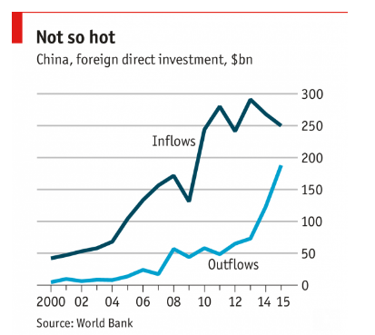

Slide 7
Damp squib: China’s foreign investment inflows
Sadly there is less to the latest reforms than meets the eye.
Nothing in them puts foreign firms on an equal legal footing with local ones, for example.
Also, there are already signs of bureaucratic resistance to the shift to a registration system.
Chinese leaders must do more if they want to persuade foreign investors the welcome mat is out.

Slide 8
1. Overview of Thailand’s industries
The growth of Thailand’s industry is largely determined by external demand. The world business cycles are responsible for fluctuations in Thailand’s manufactured exports.
Thailand is a price taker in the world markets.
On the supply side, capital stock of the industry accumulated from substantial flows of foreign direct investment contributed to spectacular export performance in the past.

Slide 9
Export supply is determined by capital stock, export demand by world prices and external demand

Slide 11
Manufacturing Production Index (MPI)

Slide 12
Deviation from the trend

Slide 13
Domestic Oriented Industry
(Export-output ratio < 0.3)

Slide 14
Export-oriented Industry:
0.3 <(X/Q)<0.6
Weight in MPI (%)

Slide 15
Ultra export-oriented Industry:
(X/Q) > 0.6
Weight in MPI (%)

Slide 16
Capacity utilization by type of market orientation
Exported-oriented industries experienced d lower capacity utilization
than domestic- oriented

Slide 17
2. Global Competitiveness
A country’s future prosperity depends on its growth in productivity, which government policies can influence.
Nations compete to choose policies to promote higher living standards.
International Institute for Management Development (IMD) and World Economic Forum (WEF) have their own ways of measuring competitiveness.

Slide 18
Krugman, Paul. "Competitiveness: a dangerous obsession." Foreign affairs (1994): 28-44.
International trade is not a zero-sum game.
Countries do not compete in the same way as companies.
When two countries compete through trade, they both win.

Slide 19
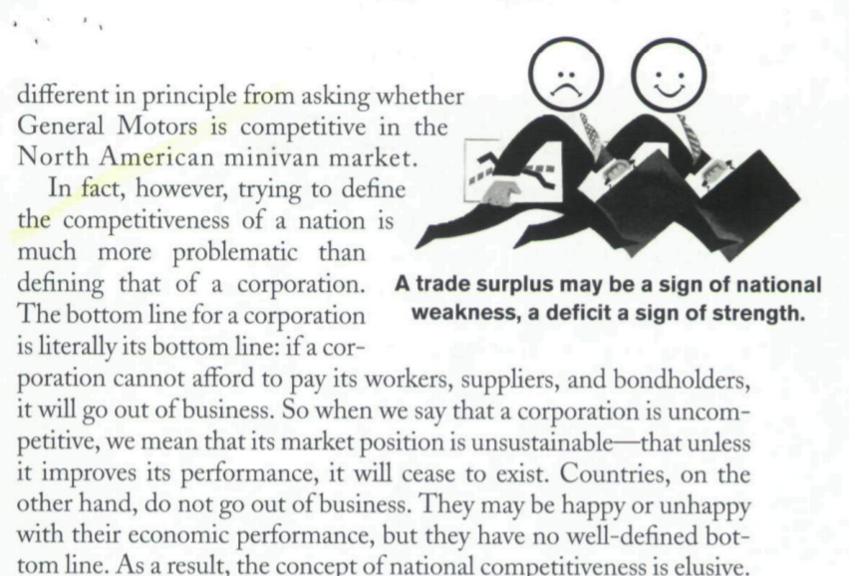
Paul Krugman

Slide 20
Trade and growth relationship
Is “Competitiveness” a meaningless word?
Jeffrey Sachs found a fairly strong correlation between recent growth rates and the competitiveness index.
Critique: Correlation between the two variables does not guarantee that the competitive index will be a good predictor of economies’ future growth prospects.
Sachs’ definition of competitiveness:
The ability of a country to achieve sustained high rates of growth in GDP per capita.

Slide 21
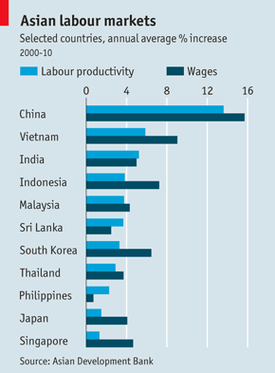
Productivity growth and competitiveness

Slide 22
The Global Competitiveness Report 2016-2017
The Global Competitiveness Report 2016-2017 assesses the competitiveness landscape of 138 economies, providing insight into the drivers of their productivity and prosperity.
This year’s edition highlights that declining openness is threatening growth and prosperity.
It also highlights that monetary stimulus measures such as quantitative easing are not enough to sustain growth and must be accompanied by competitiveness reforms.
Key finding points to the fact that updated business practices and investment in innovation are now as important as infrastructure, skills and efficient markets.

Slide 23
The Global Competitiveness Report 2016-2017
Switzerland, Singapore and the United States remain the three world’s most competitive economies.
“Declining openness in the global economy is harming competitiveness and making it harder for leaders to drive sustainable, inclusive growth,” said Klaus Schwab, Founder and Executive Chairman, World Economic Forum.

Slide 24
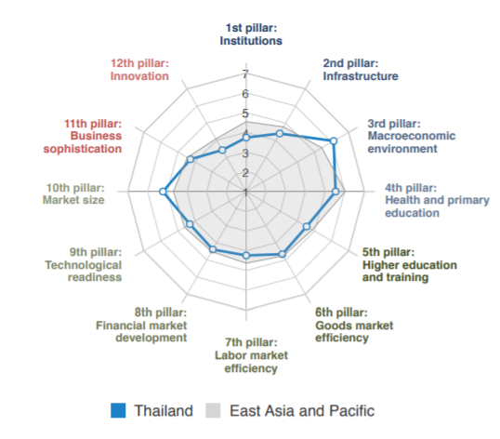

Slide 26
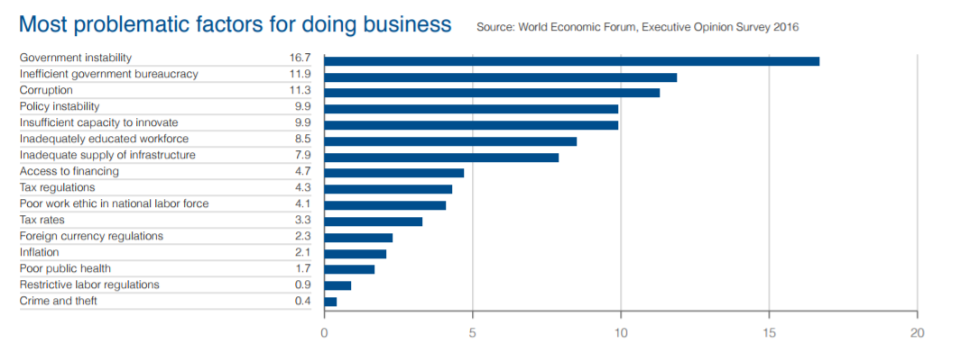
Thailand’s problems
Government instability, inefficient bureaucracy, corruption, policy instability, insufficient capacity to innovate, inadequately educated workforce, inadequate supply of infrastructure

Slide 27
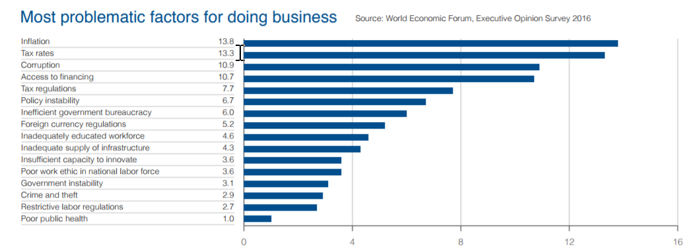
A country with rank 43th, score 4.5
Russian Federation

Slide 28
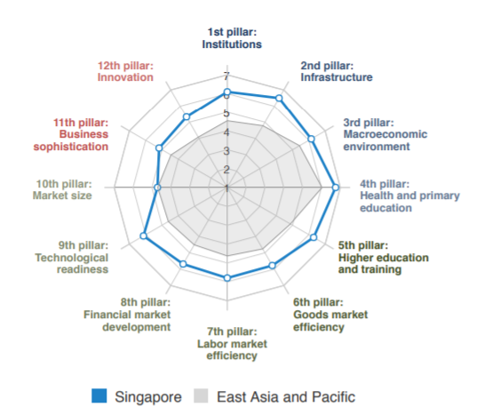
Rank 2nd/148, score 5.7

Slide 29
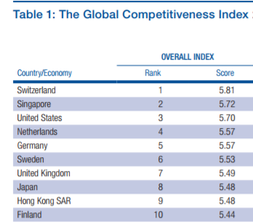
2016-2017

Slide 30
WEF’s recommendations for Thailand
The country needs to be concerned about sustained growth, and pay attention to more complex areas of competitiveness, where the shortcomings are.
Despite having come up with the "Thailand 4.0" policy in order to focus more on innovation and technology, it would take some time for the necessary development to take place and move the country out of the middle-income trap.
The WEF recommended Thailand attach high importance to and seriously develop its human resources related to the education system, focusing on the quality of primary education, internet use in schools, future workforce skills, school life expectancy, and critical thinking in teaching.

Slide 31
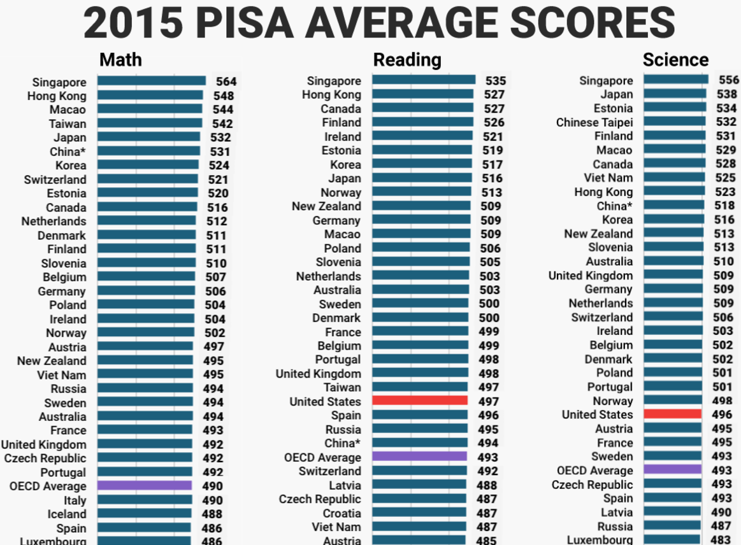

Slide 34
3. Competitiveness of Thai Manufacturing sector via BCG model
Boston Consulting Group (BCG) model
Export the commodities which are growing faster than world trade volume (high income elasticity of demand)
Manufacture commodities which gain the world market share (revealing competitiveness)

Slide 35
Competitive Positioning
Revealed competitiveness (Ż>0)and income elasticity of demand (η)
Export the right commodity
 | Declining share of that product in world trade (η<1) Declining sectors | Rising share of that product in world trade (η>1) Growing sectors
Gaining world market share (Ż>0) Winners | Falling stars (Cash Cows) | Rising stars (Stars)
Losing world market share(Ż<0) Losers | Retreat (Dog) | Lost Opportunity (Problem Child)
Export the commodity right

Slide 36
Competitive Positioning
Revealed competitiveness (Ż>0)and income elasticity of demand (η)
Export the right commodity
 | Declining share of that product in world trade (η<1) Declining sectors | Rising share of that product in world trade (η>1) Growing sectors
Gaining world market share (Ż>0) Winners | Falling stars (Cash Cows) | Rising stars (Stars)
Losing world market share(Ż<0) Losers | Retreat (Dog) | Lost Opportunity (Problem Child)
Export the commodity right

Slide 37
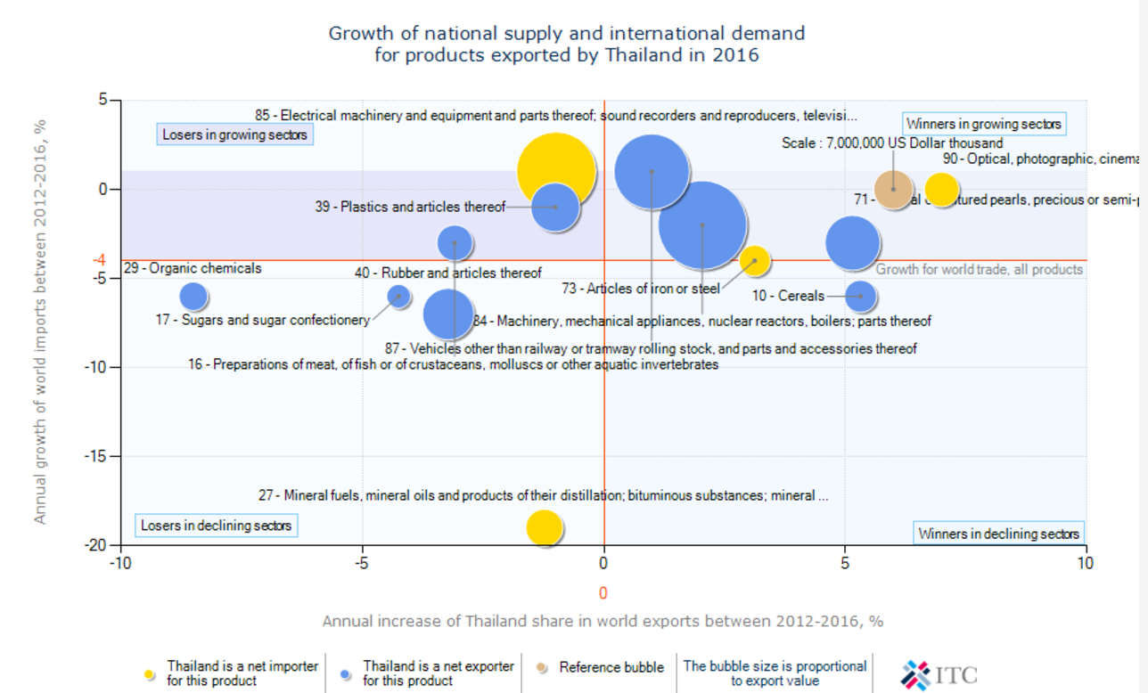

Slide 38
Michael Porter (1990)
The Competitive Advantages of Nations
There are two basic types of competitive advantages: lower cost and product differentiation.
Pure cost advantages are less sustainable than differentiation: Any new source of lower costs can nullify a firm’s cost advantage.
Differentiation is the ability to provide unique and superior value to buyers in terms of product quality, special features, or after-sale service.
Examples: differentiation in services provided by banks, supermarkets, and gasoline stations.

Slide 39
More advice from
Michael Porter
Differentiation allows a firm to command a premium price, which leads to superior profitability provided costs are comparable to those of competitors.
Pure cost advantages are more vulnerable because new product designs or other forms of differentiation can eliminate cost advantage.
The government can raise the odds of gaining competitive advantage but lacks the power to create advantage itself.

Slide 40
Innovation raises unit cost, but it can fetch higher prices, as the demand
become less inelastic
D²_{x}
S _{x}²
P
S¹_{X}
P_{x} ²
B
P_{w}
A
D¹_{x}
Q _{x}
Higher export values, despite lower quantity of exports
Due to product differentiation through innovation

Slide 41
4. Diversification of Thai exports
Product and market diversification
A country is considered competitive in products in which it is increasing its world market share.
An export product is considered dynamic in world trade if it is growing faster than the average for all products (either rising or falling stars).
Thailand’s exports were in the rising stars category for 54% in 1996, but they fell to 15% by 2000.
Ten years after this study, the figures were totally different in 2006.
Thailand did not do as well as its major competitors during the 1996-2000 boom in electronic exports.
Thus the share of loss opportunity category increased from 3% to 43% of total exports.

Slide 45
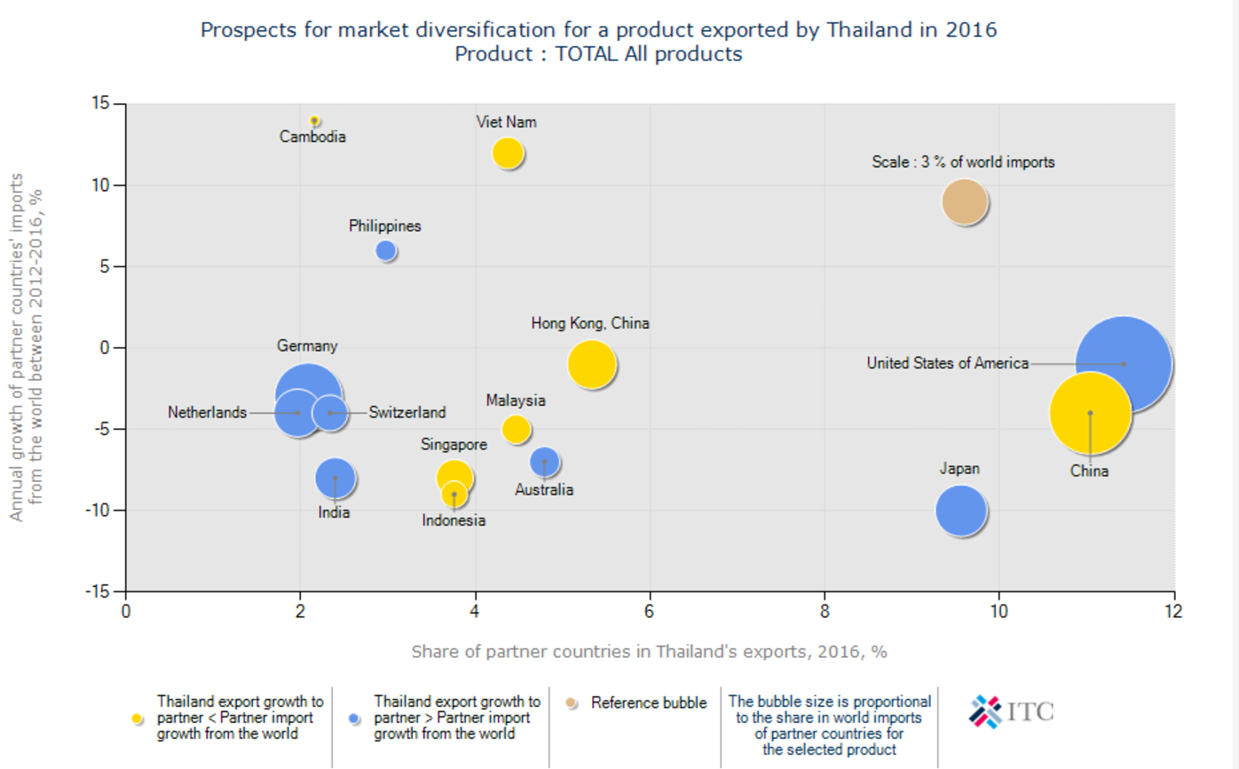

Slide 46
Review Questions
What was the geographical diversification of Thai exports in 2016?
How was the manufacturing sector affected by the 2009 global recession and global growth slowdown in 2016?
What went wrong with Thailand’s exports in between 2014 and 2016?
Would Thai exports resume its growth path in 2017?

