Slide 1
PY211 General Psychology
Introduction

Slide 2
Outline
Introduction
Subfields of Psychology
History of Psychology
Contemporary Approaches
Research in Psychology
Ethics of Psychological Research

Slide 3
Definition
Psychology: Scientific study of behavior and mental processes
  Scientific: scientific method
  Behavior: what can be directly observed
  Mental processes: thoughts, feelings, motives

Slide 4
Goals of Psychology
Describe: the different ways an organism behaves
Explain: the cause of behavior
Predict: how the organism will behave in certain situations
Control: an organism’s behavior

Slide 5
Subfields of Psychology
Behavioral Genetics
Behavioral Neuroscience
Clinical Psychology
Clinical Neuropsychology
Cognitive Psychology
Counseling Psychology
Cross-cultural Psychology

Slide 6
Subfields of Psychology
Developmental Psychology
Educational Psychology
Environmental Psychology
Evolutionary Psychology
Experimental Psychology
Forensic Psychology
Health Psychology

Slide 7
Subfields of Psychology
Industrial/
organizational Psychology
Personality Psychology
Program Evaluation
Psychology of Women
School Psychology
Social Psychology
Sport Psychology

Slide 8
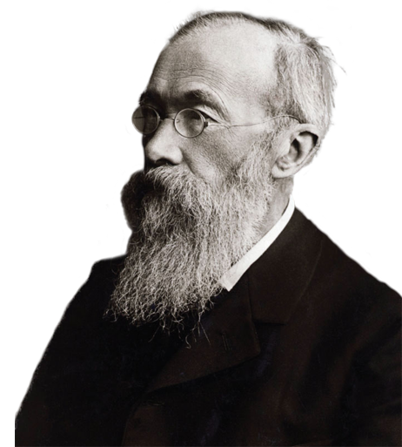
History of Psychology
Structuralism
  Wilhelm Wundt (1832-1920)
  Focused on uncovering the fundamental mental components of consciousness, thinking, and other kinds of mental states and activities
  Introspection: Procedure used to study the structure of the mind in which subjects are asked to describe in detail what they are experiencing when they are exposed to a stimulus

Slide 9
History of Psychology
Criticisms of structuralism
  Introspection was not a scientific technique
  People had difficulty describing some kinds of inner experiences
These drawbacks led to the development of newer approaches

Slide 10
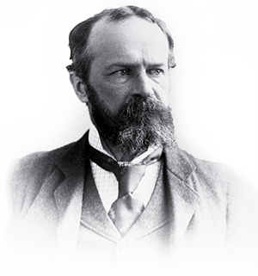
History of Psychology
Functionalism
  William James (1842-1910)
  Concentrated on what the mind does and the role of behavior in allowing people to adapt to their environments

Slide 11
History of Psychology
Gestalt psychology
  Hermann Ebbinghaus, Max Wertheimer, and others
  Focuses on the organization of perception and thinking in a whole sense rather than on the individual elements of perception
  “The whole is different from the sum of its parts”

Slide 12
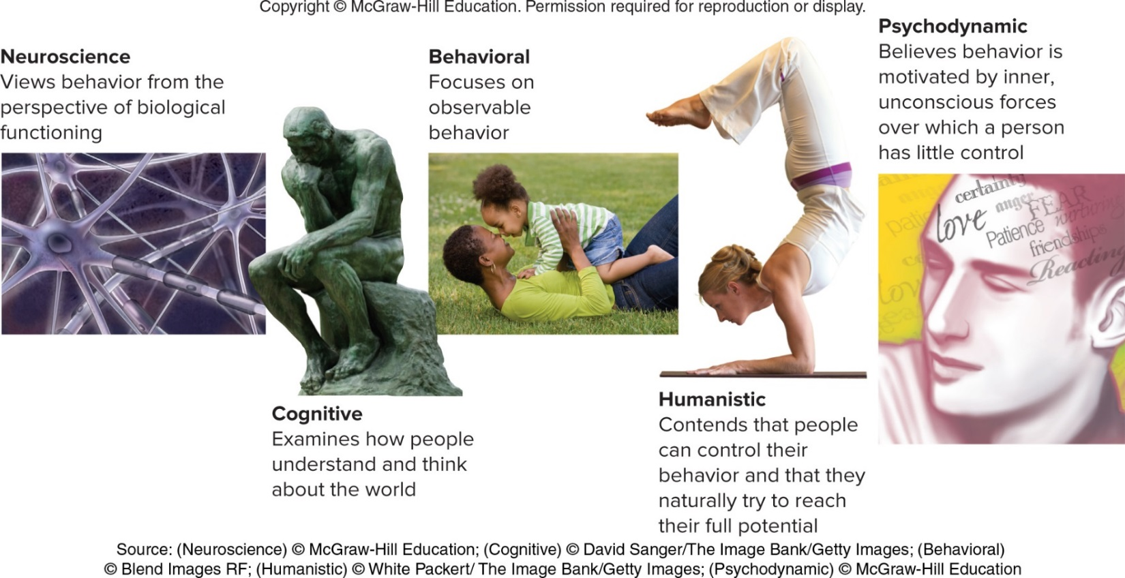
Contemporary Approaches

Slide 13
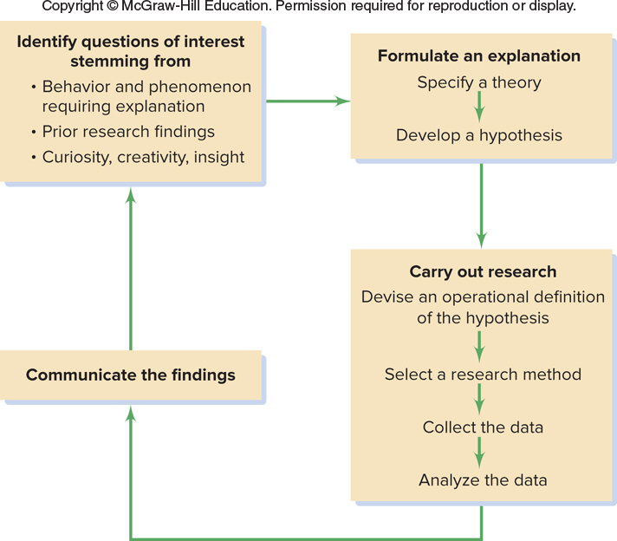
Research in Psychology
The scientific method: approach through which psychologists systematically acquire knowledge and understanding about behavior and other phenomena of interest

Slide 14
Theories
Broad explanations and predictions concerning phenomena of interest
  Provide a framework for understanding the relationships among a set of unorganized facts or principles
  Example: diffusion of responsibility
    With more bystanders in an emergency situation, the smaller the share of the responsibility each person feels
    Developed by Bibb Latané and John Darley

Slide 15
Hypotheses: Crafting Testable Predictions
Hypothesis: A prediction, stemming from a theory, stated in a way that allows it to be tested
Operational definition: Translation of a hypothesis into specific, testable procedures that can be measured and observed

Slide 16
Psychological Research
Research
  Systematic inquiry aimed at the discovery of new knowledge
  Key to understanding the accuracy of hypotheses and theories
Descriptive research
  Systematic investigation of a person, group, or pattern of behavior
  Several types of descriptive research

Slide 17
Archival Research
Existing data are examined to test a hypothesis
  Census documents
  College records
  Online databases
  Newspaper clippings
Advantage - Inexpensive
Disadvantage - Problems with using existing data
  Data may not be in a form that allows the researcher to test a hypothesis fully

Slide 18
Naturalistic Observation
Investigator observes some naturally occurring behavior
  Does not make a change in the situation
Advantage - Sample of what people do in their natural habitat
Disadvantage - Inability to control any factors of interest

Slide 19
Survey Research
People are asked a series of questions about their behavior, thoughts, or attitudes
Advantage - can infer how a larger group would respond, if a representative sample is surveyed
Disadvantage - results will be inconsequential if the sample is not representative
  Survey respondents may not want to admit to holding socially undesirable attitudes

Slide 20
The Case Study
In-depth, intensive investigation of an individual or a small group of people
  Often include psychological testing
Advantage - can use insights to improve our understanding of people in general
Disadvantage - unique individuals make it impossible for generalizations

Slide 21
Correlational Research
Research in which the relationship between two sets of variables is examined to determine:
  Whether they are associated, or correlated
  Variables: Behaviors, events, or other characteristics that can change, or vary, in some way

Slide 22
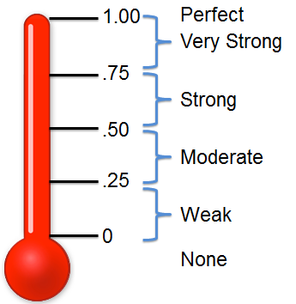
Correlational Research
Correlation coefficient - Represents the strength and direction of the relationship between two variables
  Value can range from +1.00 to -1.00

Slide 23
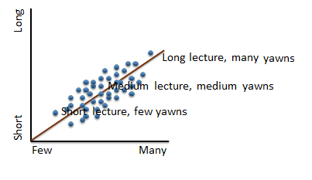
Correlational Research
  Positive - As the value of one variable increases, so will the value of the other variable
  E.G. The longer the lecture, the more yawns

Slide 24
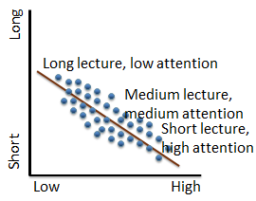
Correlational Research
  Negative - As the value of one variable increases, value of the other variable will decrease
  E.G. The longer the lecture, the lower student attentiveness

Slide 25
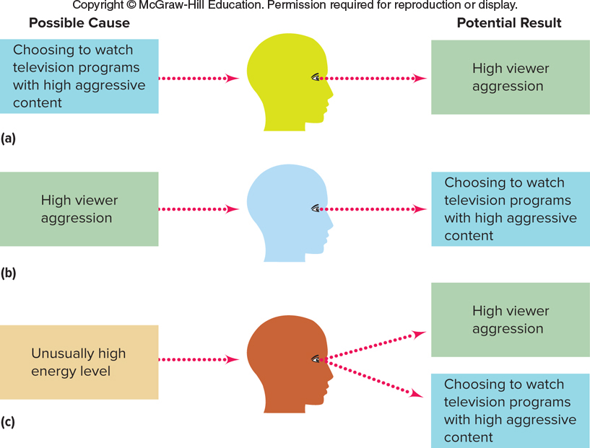
Correlational Research
Disadvantages
  Inability to demonstrate cause-and-effect relationships
  Directionality
  Third variable

Slide 26
Experimental Research
Experiment: Investigation of the relationship between two (or more) variables by:
  Producing a change in one variable in a situation and observing the effects on the second variable
Experimental manipulation: Change that an experimenter deliberately produces in a situation

Slide 27
Experimental Research
Experimental groups and control groups
  Treatment
    Manipulation implemented by the experimenter
  Experimental group
    Any group participating in an experiment that receives a treatment
  Control group
    Group participating in an experiment that receives no treatment

Slide 28
Experimental Research
Independent variable: The variable that is manipulated by an experimenter
Dependent variable: The variable that is measured
  Expected to change as a result of changes in the independent variable
  Dependent on the actions of the research participants that are taking part in the experiment

Slide 29
Experimental Research
Random assignment to condition: Participants are assigned to different experimental groups or conditions on the basis of chance
Significant outcome: Statistically meaningful results
  Makes it possible for researchers to feel confident that they have confirmed their hypotheses
Replicated research: Research that is repeated, in other settings and with other groups of participants, to increase confidence in prior findings

Slide 30
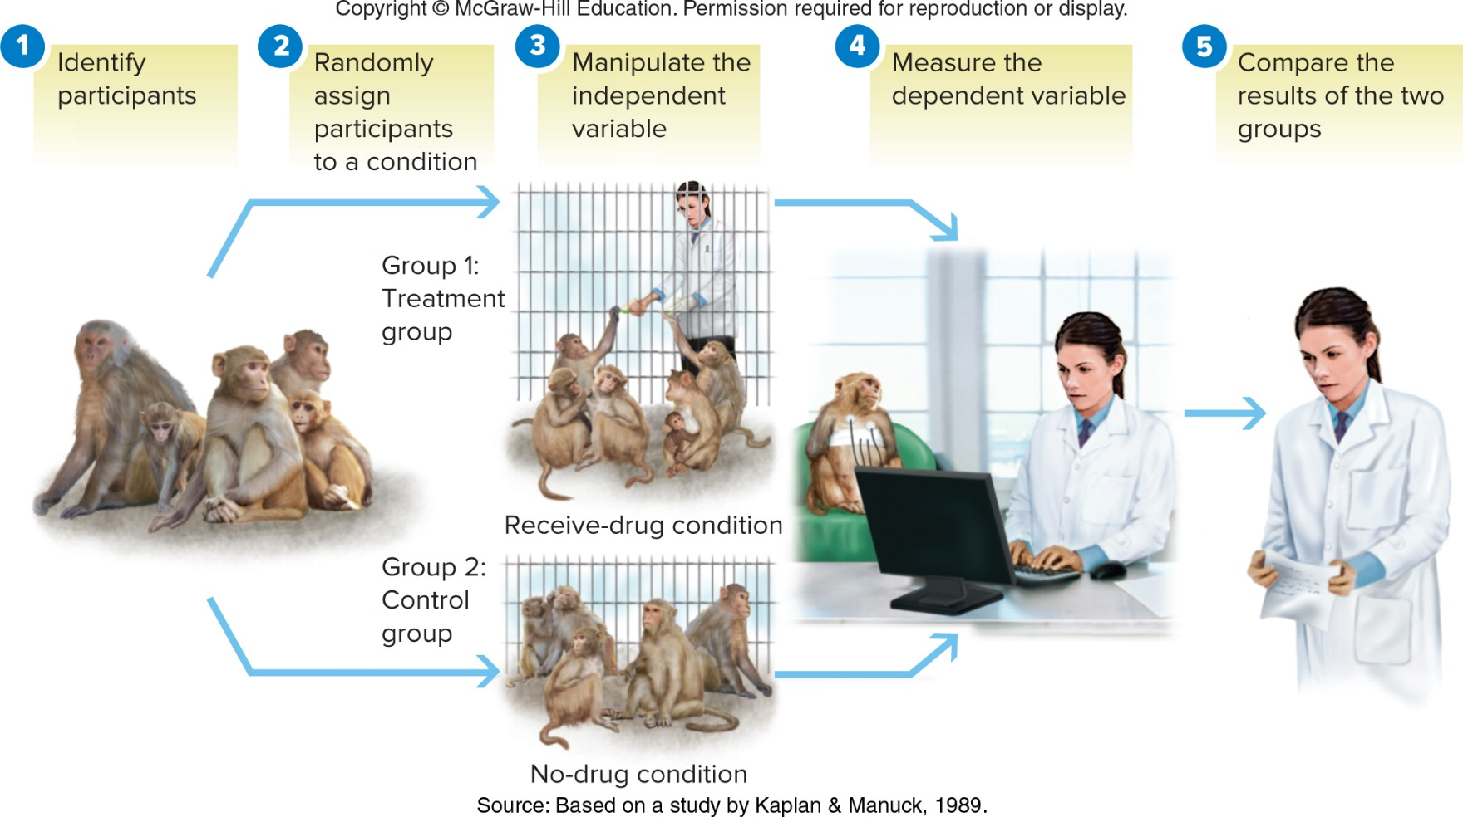
Experimental Research

Slide 31
Ethics
Guidelines that protect participants
  Protection of participants from physical and mental harm
  Right of participants to privacy regarding their behavior
  Assurance that participation in research is completely voluntary
  Necessity of informing participants about the nature of procedures before their participation in the experiment
  All experiments must be reviewed by an independent panel before being conducted

