Slide 1


MK 333/326 International Marketing
Assignment 4: Chapter 2 Main Points
By Ajarn Suwalya K.

Slide 2

MK 333/326 Group Assignment 4:
Chapter 2
Topic: The Dynamic Environment of International Trade
Each group is to prepare a maximum 5 page powerpoint slide presentation by finding information on the below for your project country and involvement. Please discuss what impact it has and its current status. If you can find the latest news, will be great ka. We will discuss in next class.
Trade Barriers -TARIFF
Multinational Corporations
GATT
WTO
IMF
Notes:
1

Slide 3

11 Countries for MK 333/326
Sequence
1.Germany
2.India
3.New Zealand
4.Switzerland
5.Spain
6.France
7.Sweden
8.Russia
9.Italy
10.Portugal
11.Canada

Slide 4
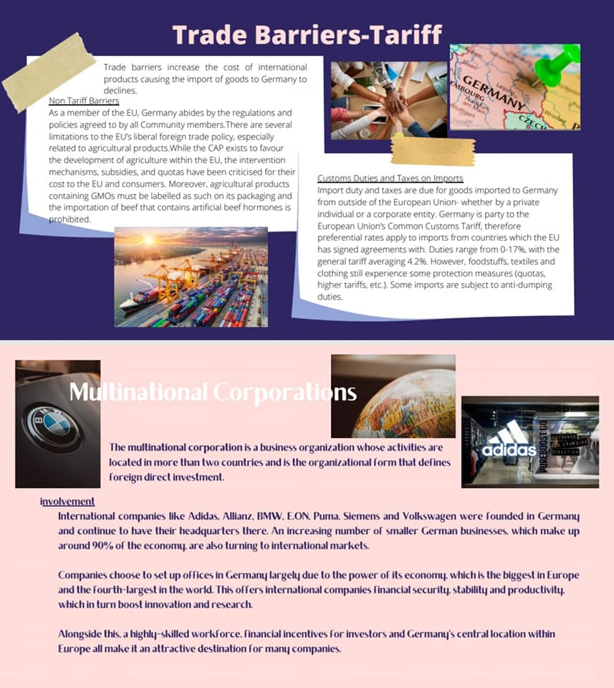

Germany

Slide 5
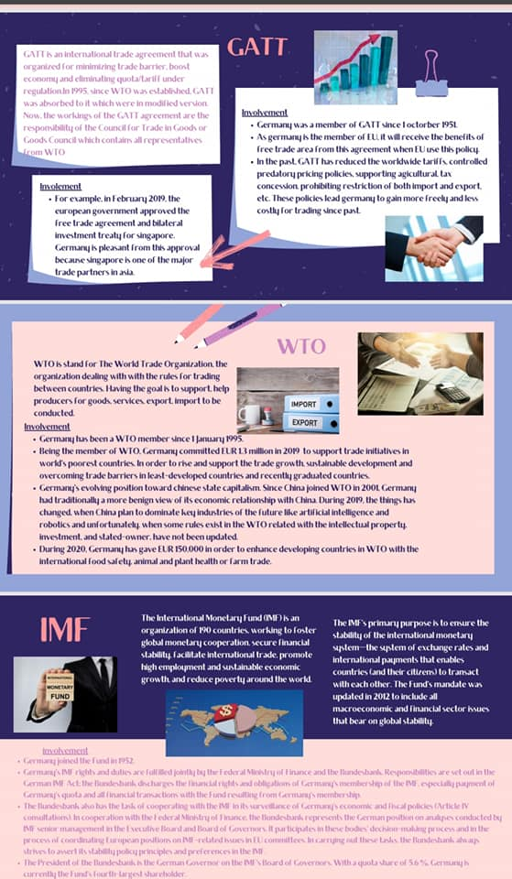
Germany

Slide 6
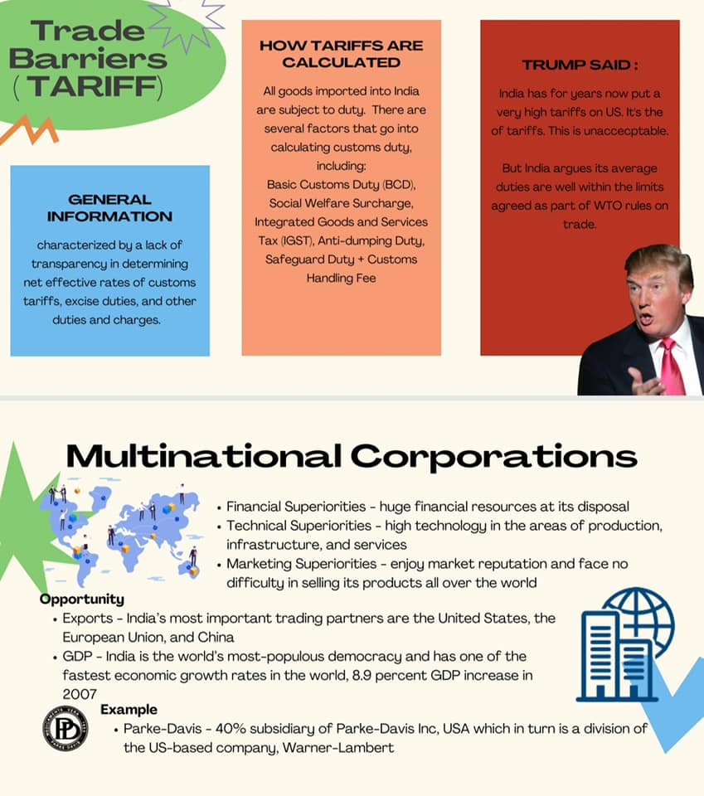

India

Slide 7
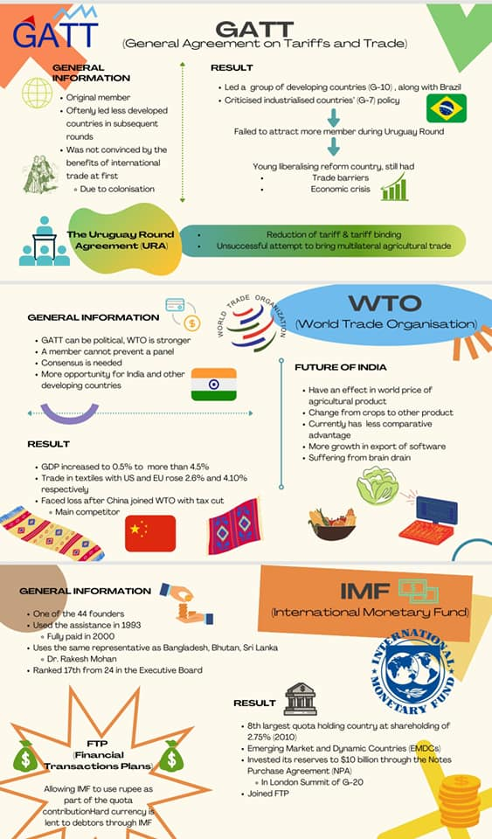
India

Slide 8
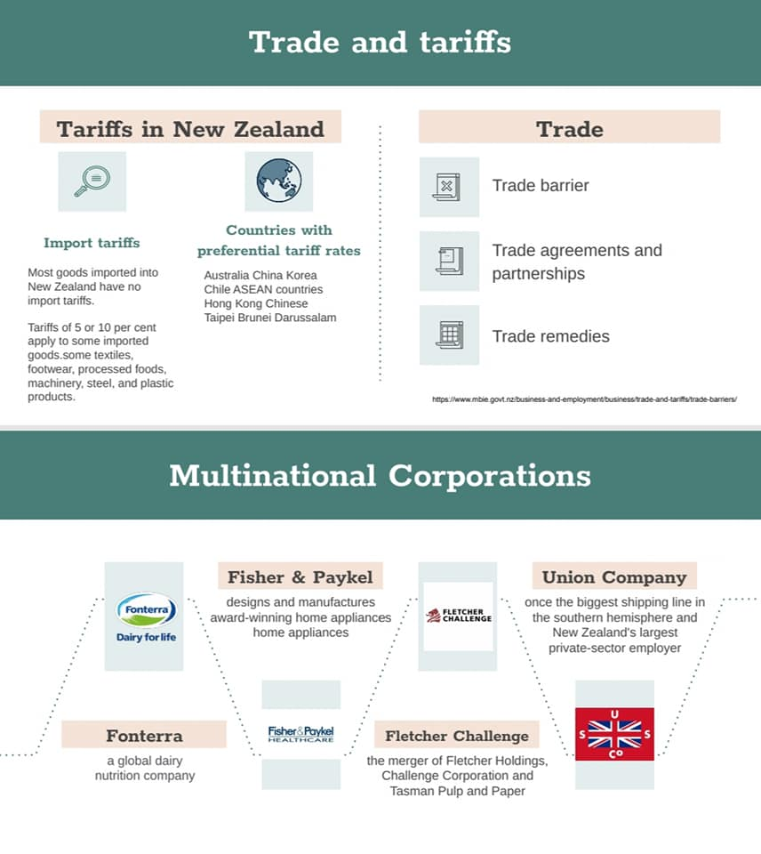

New Zealand

Slide 9
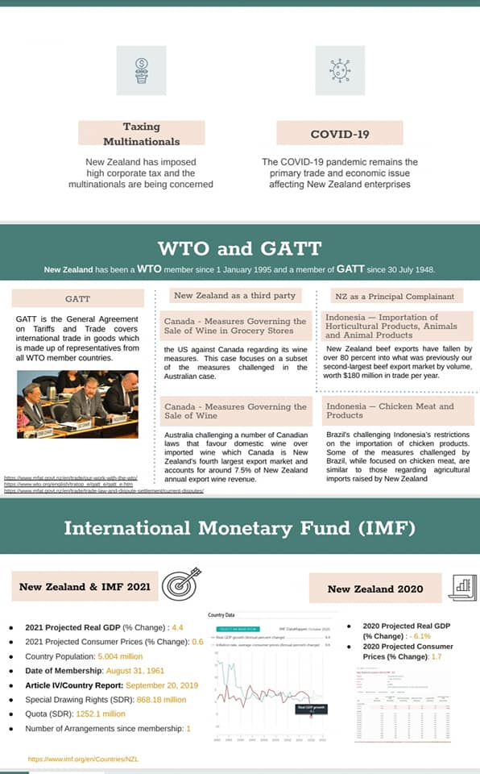
New Zealand

Slide 10


Switzerland

Slide 11
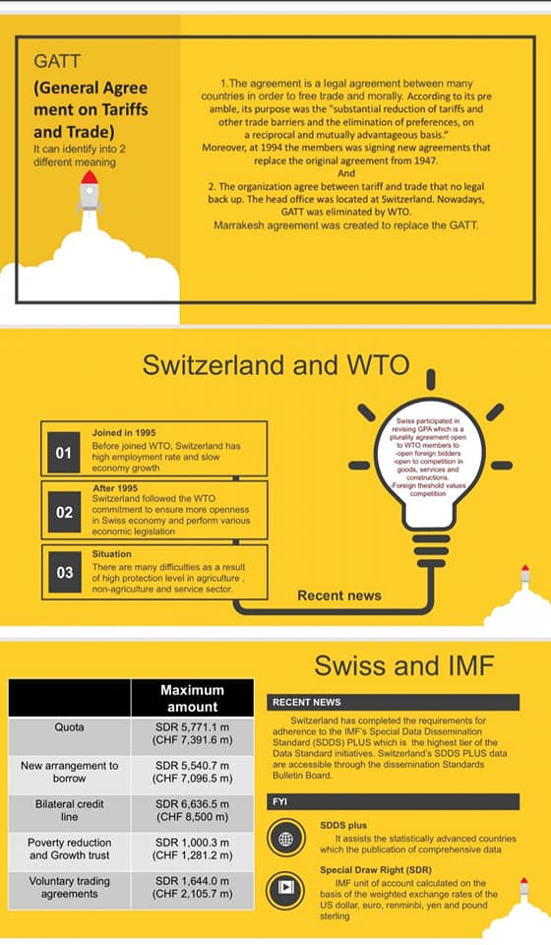
Switzerland

Slide 12
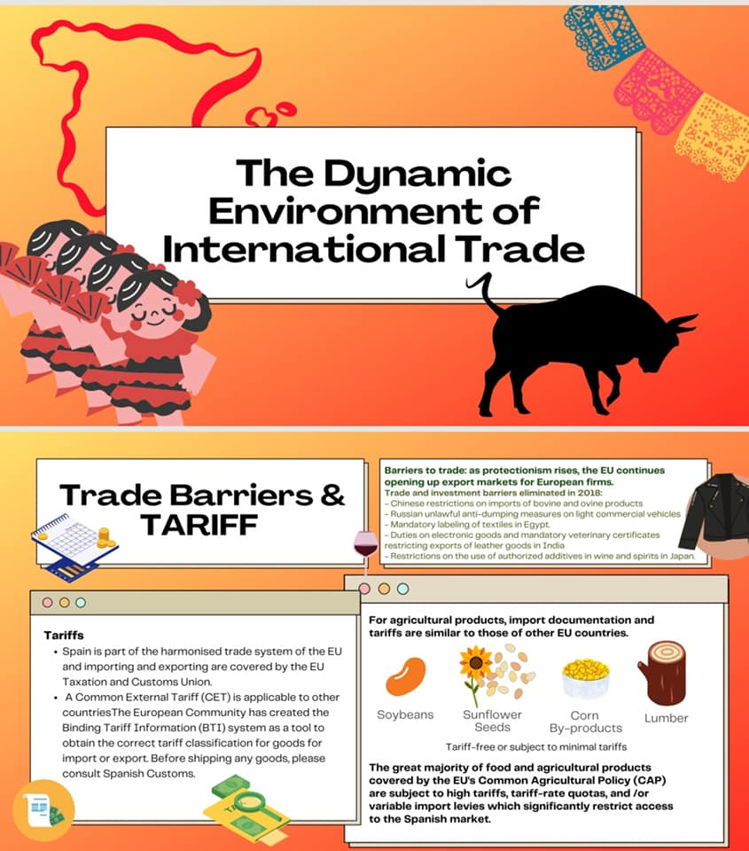
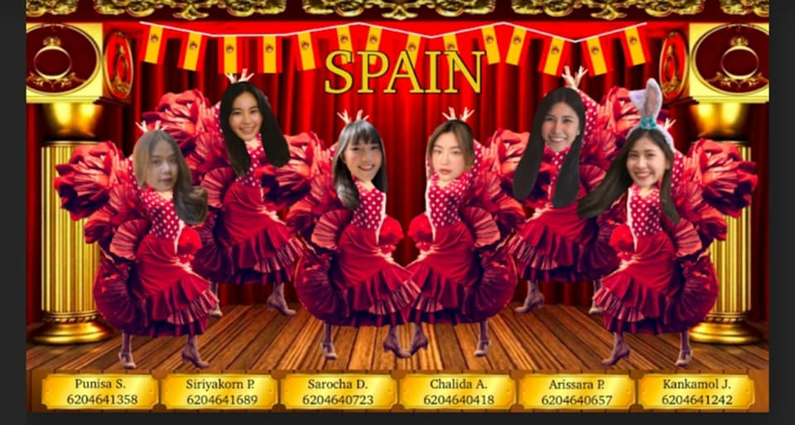
Spain

Slide 13
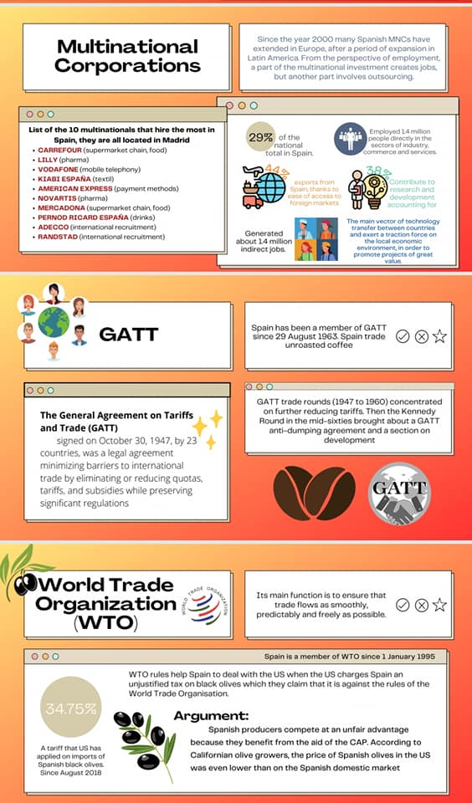
Spain

Slide 14
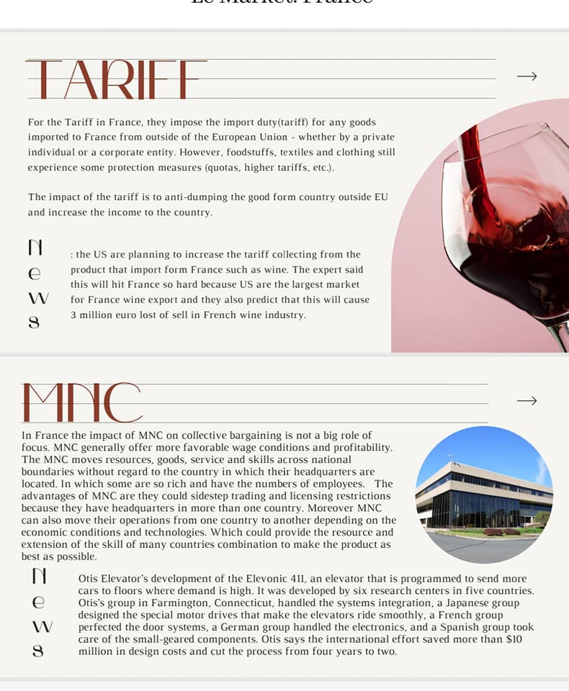

France

Slide 15
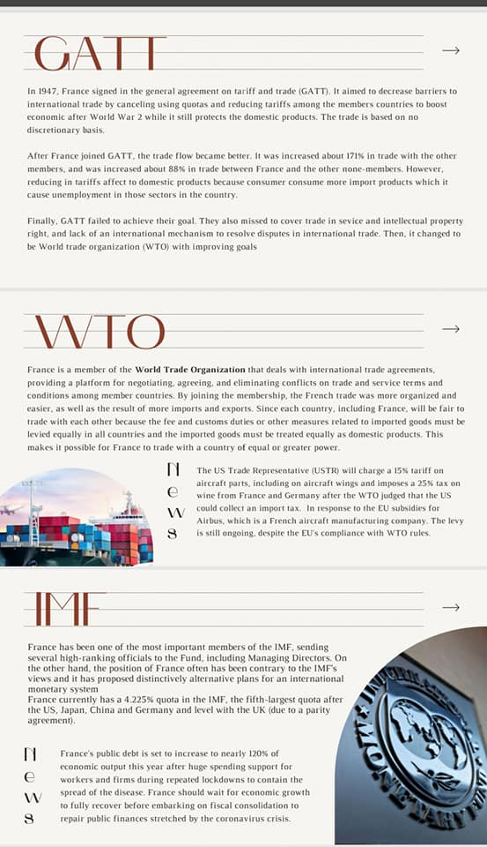
France

Slide 16
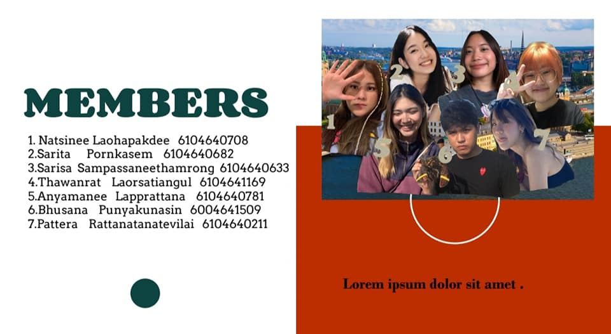

Sweden

Slide 17
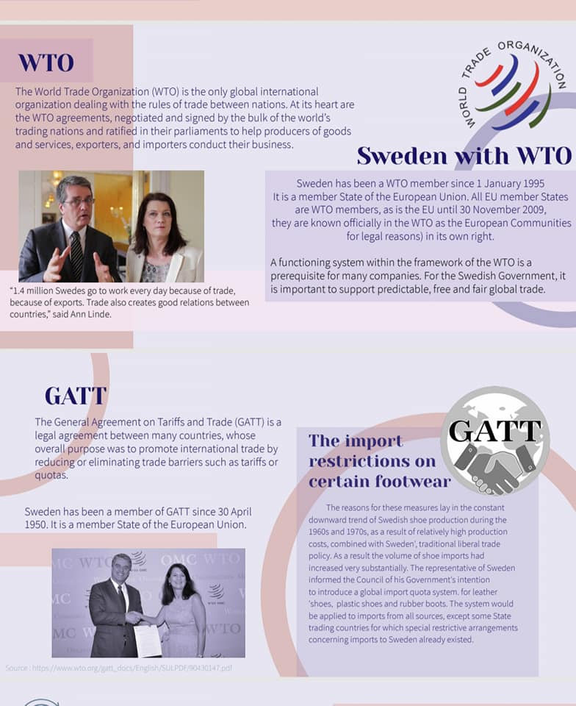
Sweden

Slide 18
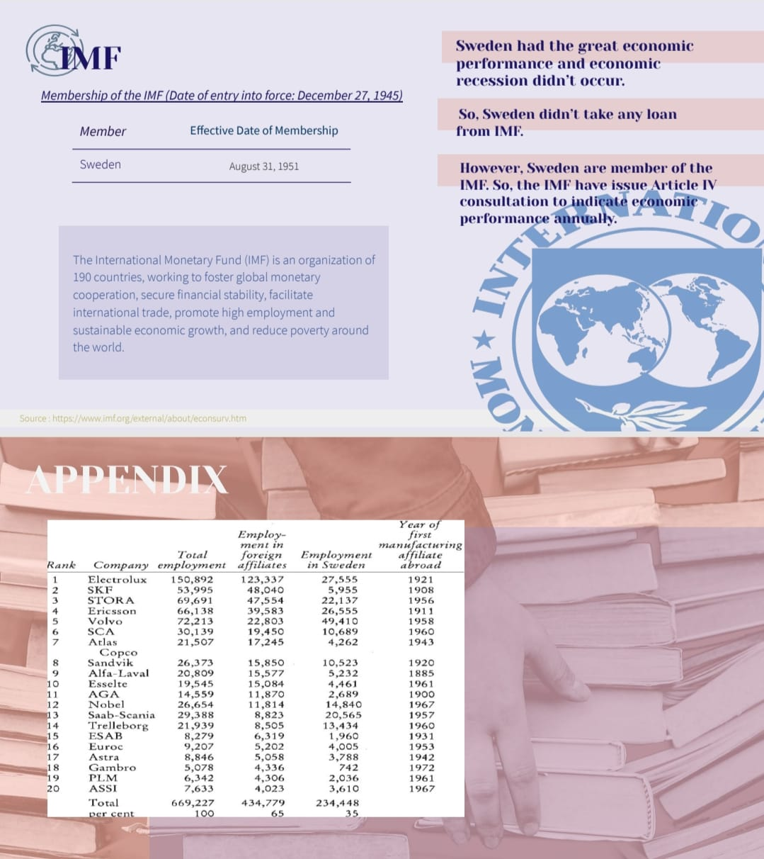
Sweden

Slide 19


Russia

Slide 20
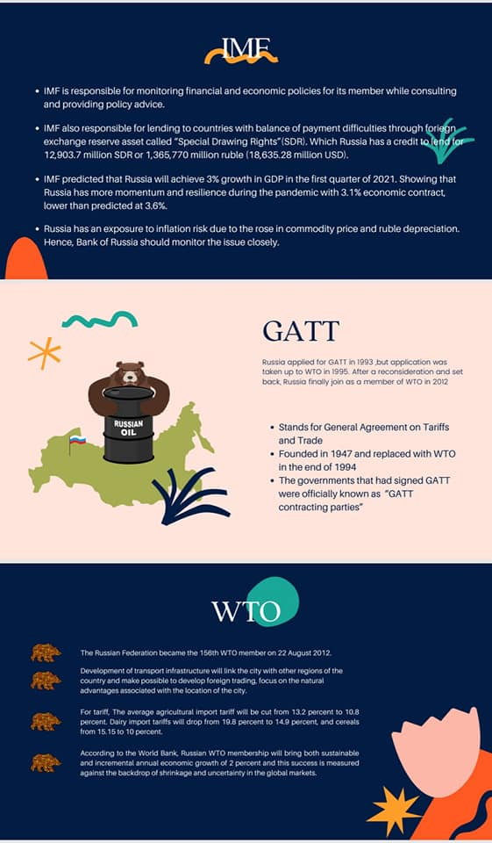
Russia

Slide 21
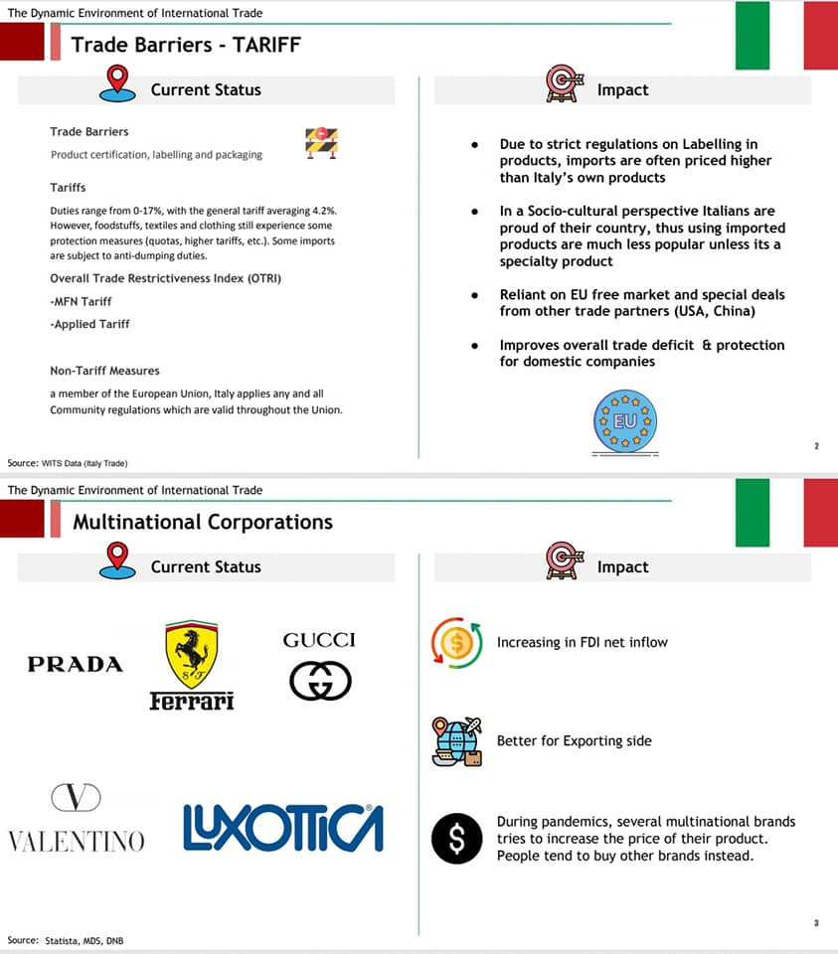
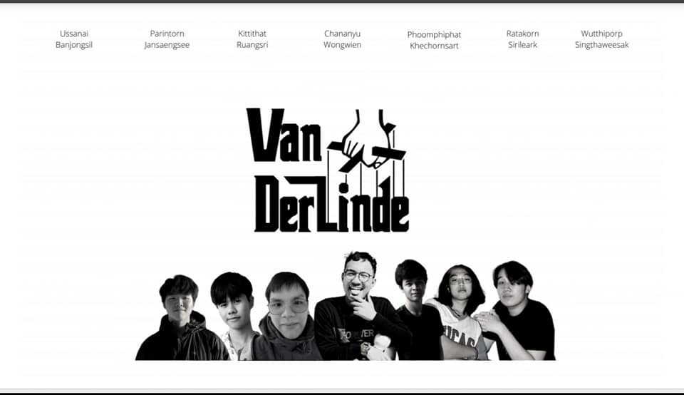
Italy

Slide 22
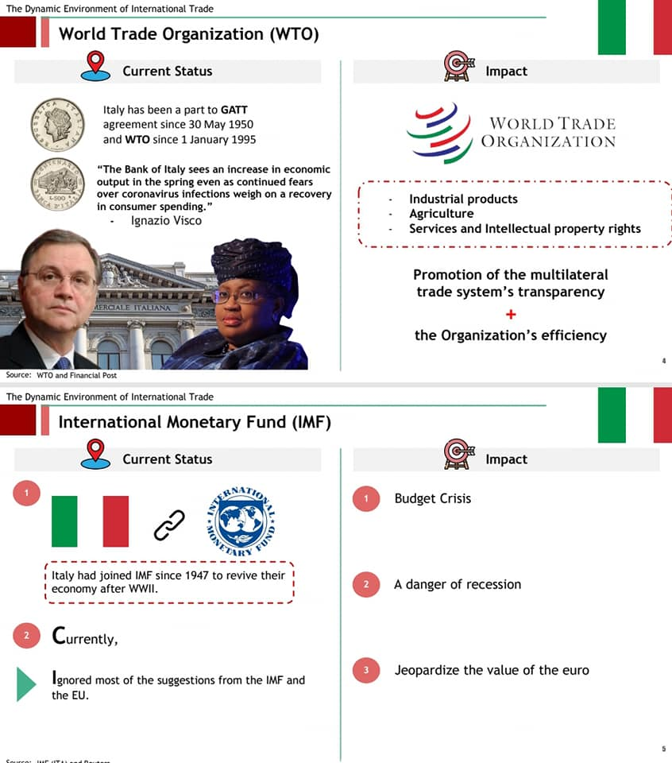
Italy

Slide 23
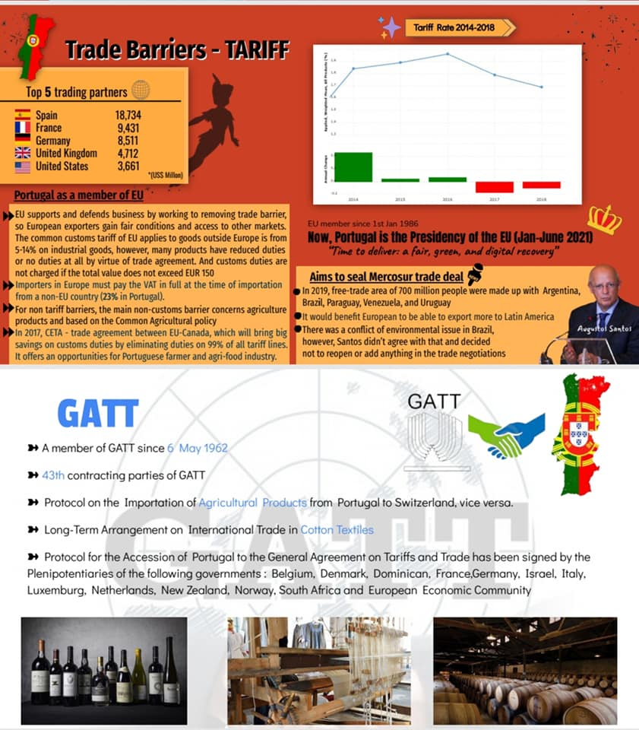

Portugal

Slide 24
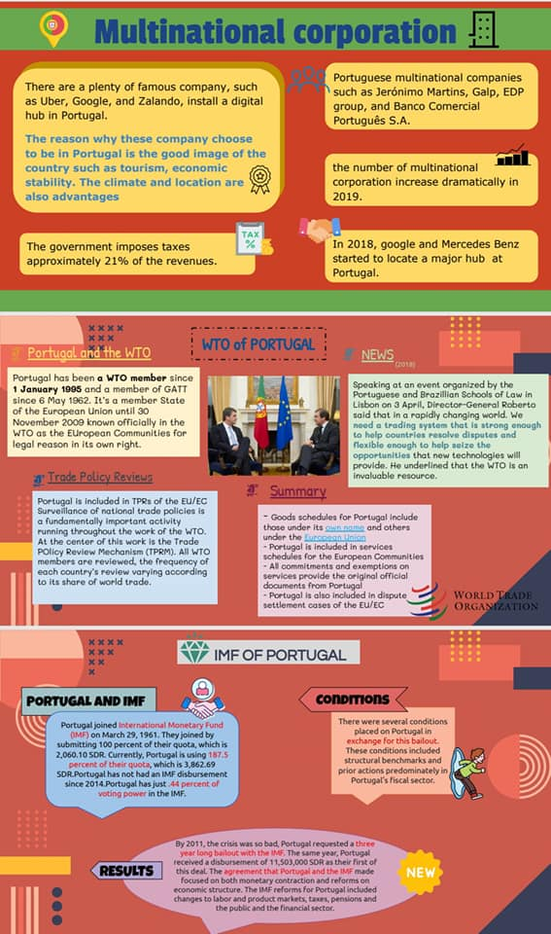
Portugal

Slide 25


Canada

Slide 26
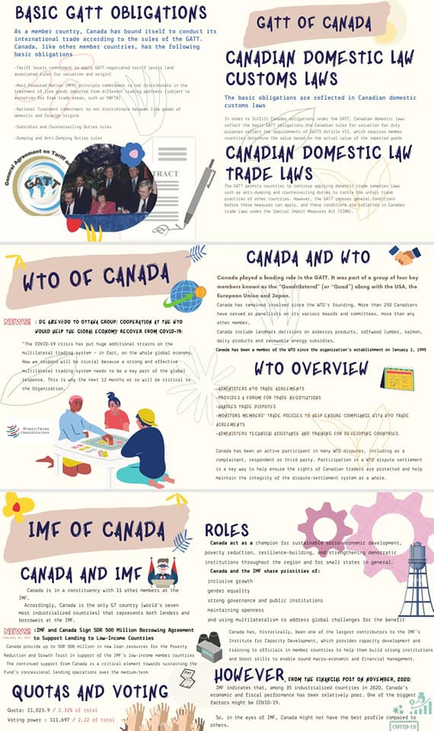
Canada

Slide 27


