Slide 1
MK 312 Brand Management
Section 2
5 Project Teams
Ajarn Suwalya K.

Slide 2
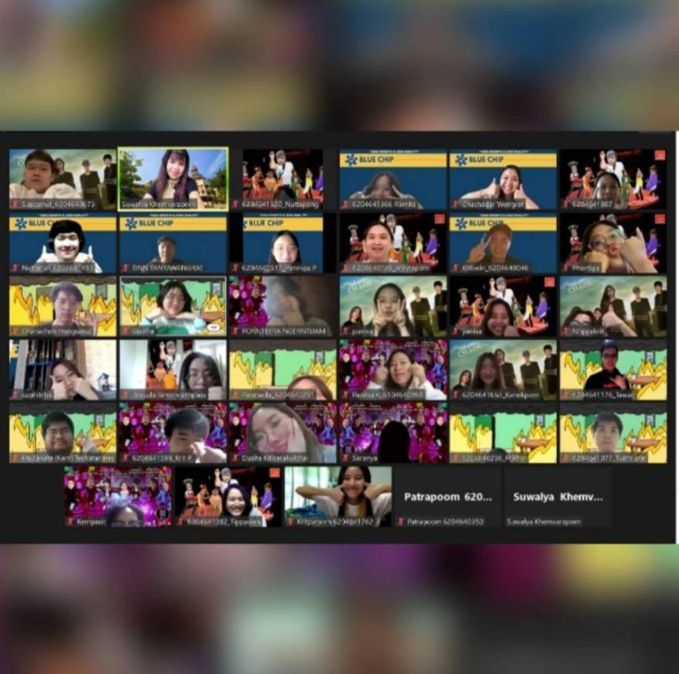
Teams
1. 6 Idiot and a CEO
2. Blue Chip
3. MRT
4. Mealism
5. Chaos

Slide 3
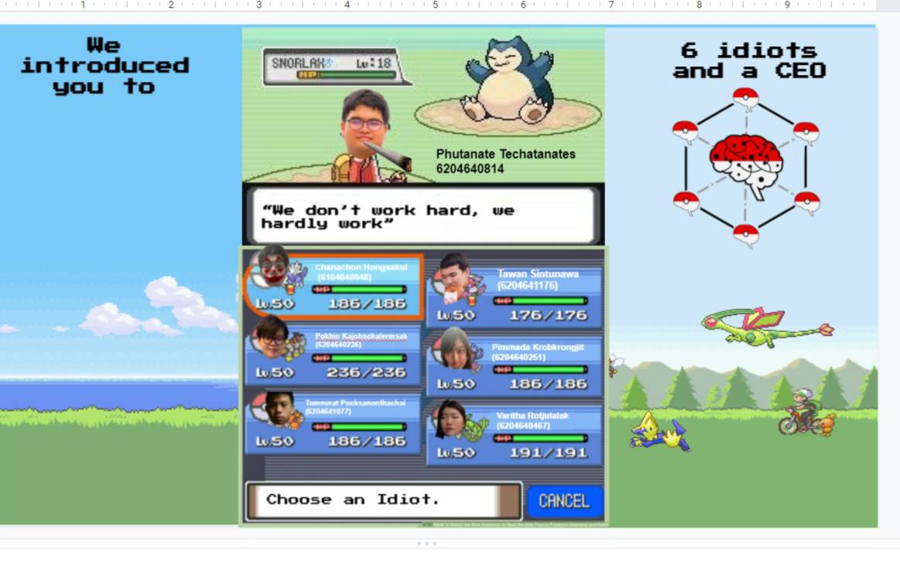
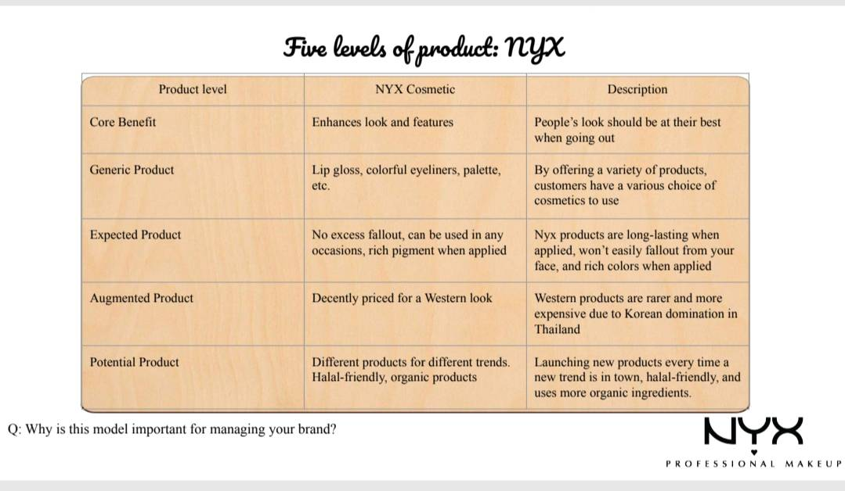

Slide 4
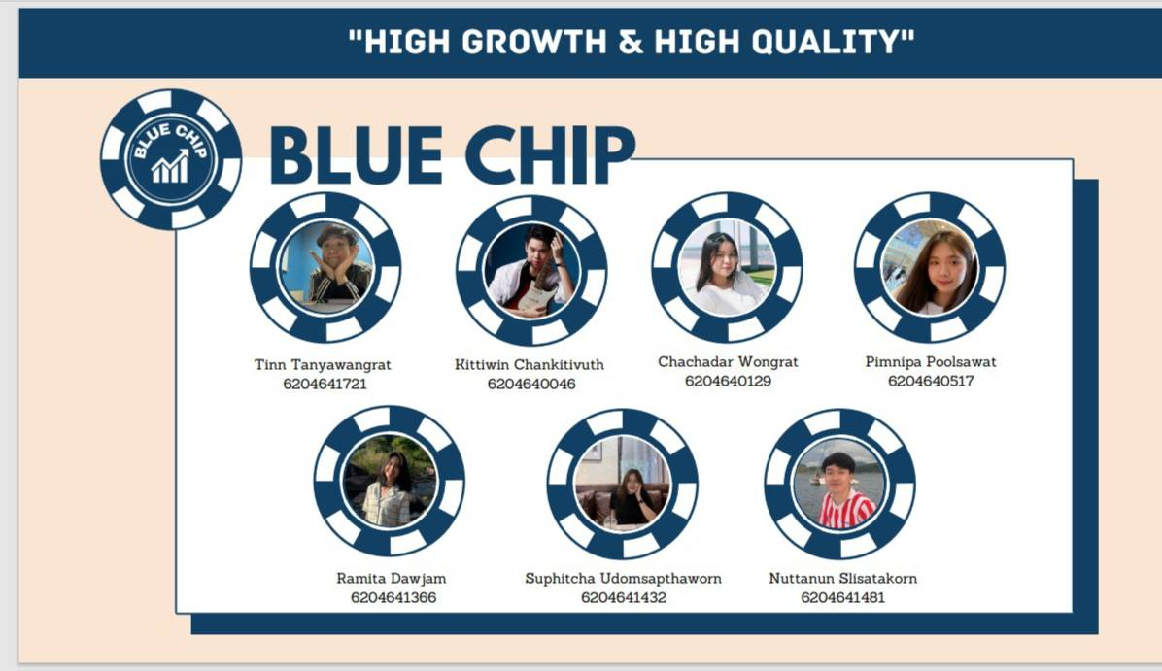


Slide 5
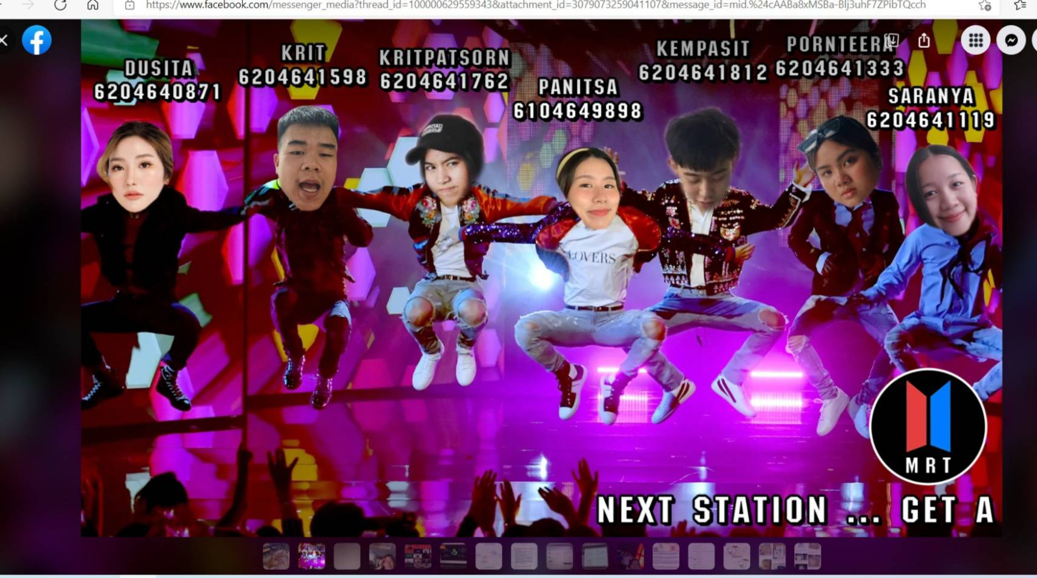
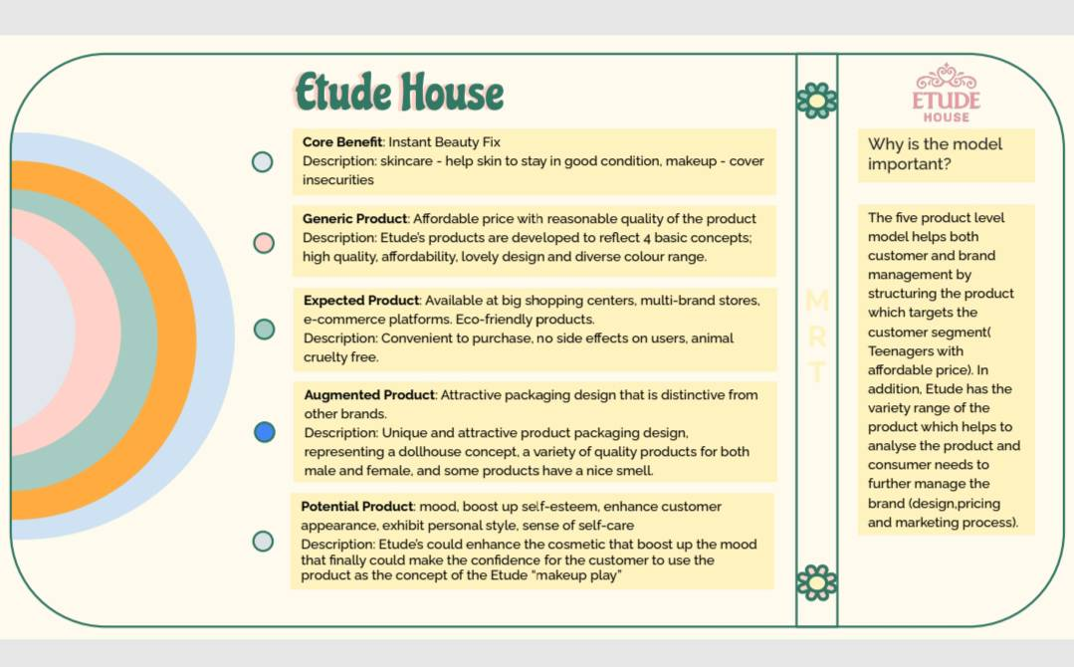
Excellent Research

Slide 6
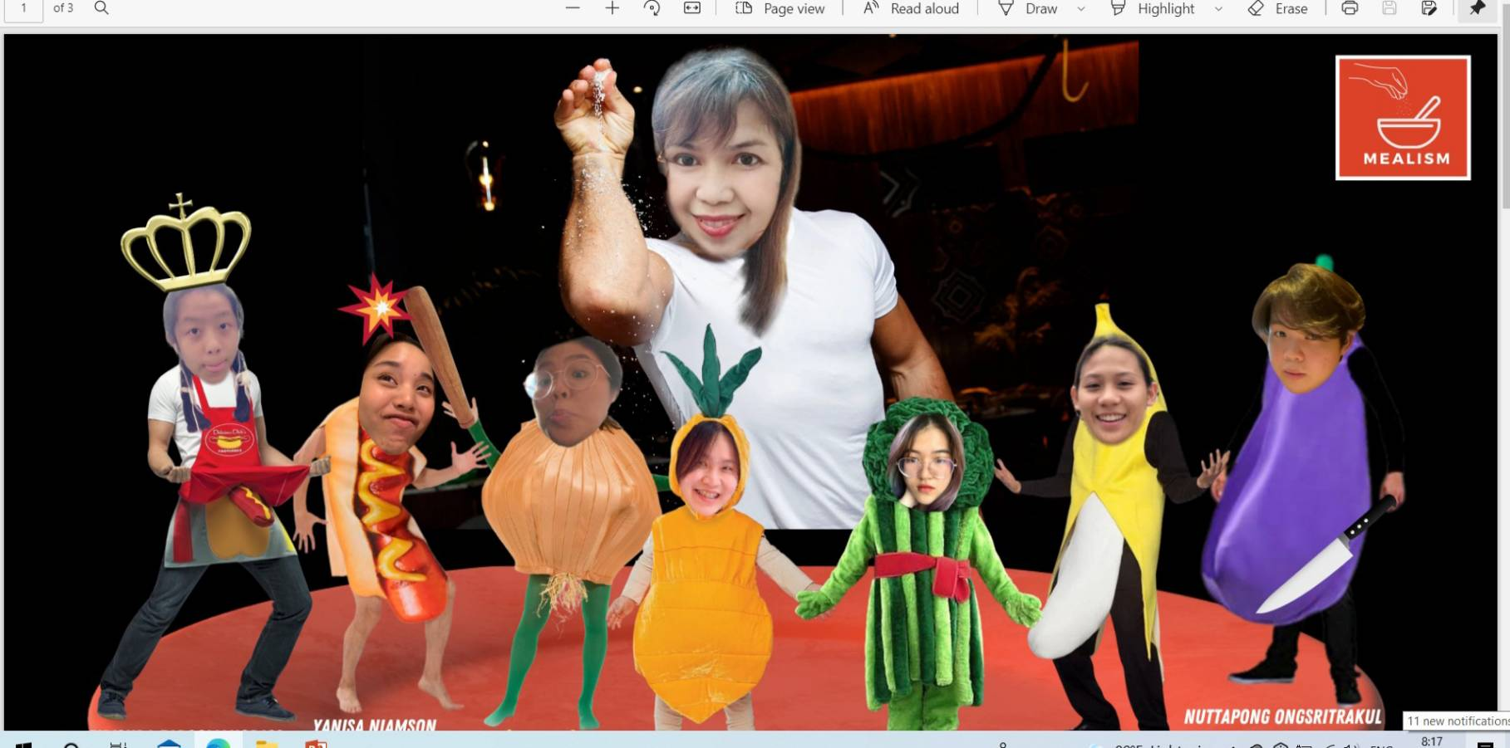
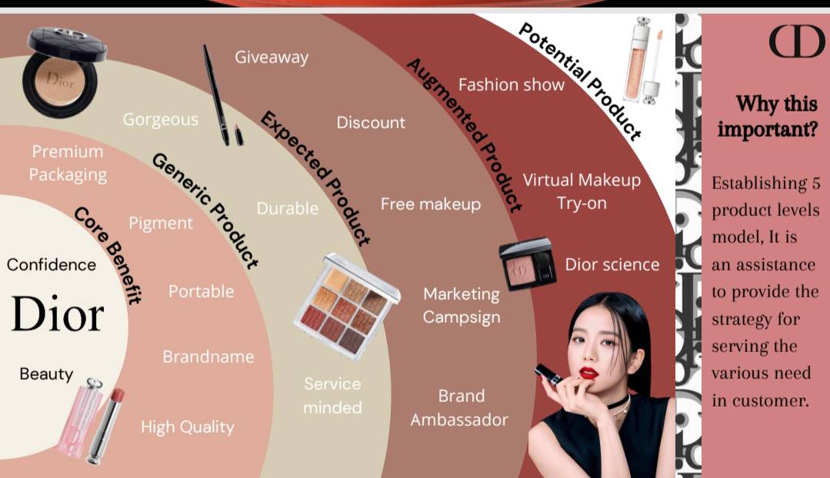
Excellent Creative Design

Slide 7



