Slide 1

1997 Crisis of Financial Institutions in Thailand

Slide 2


Outline
Overview
Cause
Impact
Solution and analysis
Recommendation
1997 Crisis of Financial Institutions in Thailand

Slide 3
Overview

Slide 4
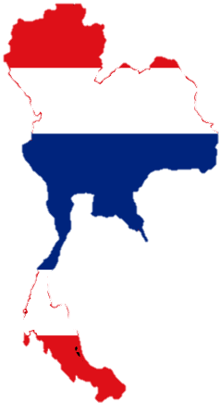
Pre-crisis
Thailand is a prominent economy with around 9% growth rates
High interest rate induced foreign capital flows.
Pegged exchange rate encouraged external borrowing.
Real estate sector was booming.

Slide 5

Crisis started
Asset price began to collapse
    Causing individuals and companies to default
    Panic among lenders – led to withdrawal of funds
Pressure on exchange rate to depreciate
Government tried to buy the excess baht currency to maintain the peg exchange rate.
    However, the capital flight had not stopped.
On July 2nd, 1997, Thai government allowed currency to float
    Sharp depreciation
    Further increasing debt obligation and worsening the crisis.
Crisis in Thailand spread to other countries: Indonesia, Malaysia, Philippines etc.

Slide 6
Cause of the crisis

Slide 7

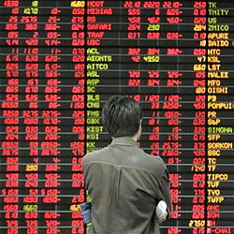
Cause
    Massive current account deficit
    Financial liberalization and inflows of short-term foreign capital
    Weakness in Thai financial sector
    Speculative attack on Baht currency

Slide 8
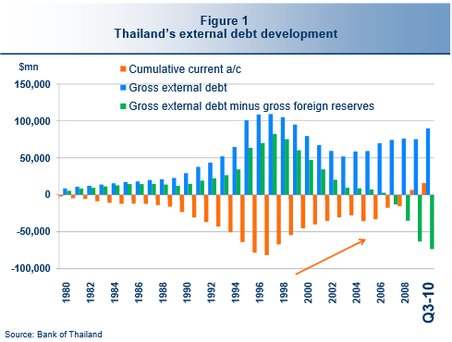
Massive current account deficit
Cause
Thailand had persistent current account deficit ranging from -8.10% to-5.08% of GDP since 1990.
Reason
  could not adjust fast enough to absorb the rise in labor cost.
  export declined due to an increasing competition from other countries
Need to rely on the foreign capital to tackle with the massive current account deficit.
Year | Current Account (%of GDP)
1990 | -8.5
1991 | -7.71
1992 | -5.66
1993 | -5.08
1994 | -5.6
1995 | -8.06
1996 | -8.1
1997 | -1.9
Source: IMF

Slide 9
Financial liberalization and inflows of short-term foreign capital
Cause
There was a large amount of short-term capital flow into Thailand.
Why Thailand become attractive to a magnitude of capital inflow?
= high interest rate + pegged exchange rate system
+ financial liberalization
Why the capital flow are key implication to the crisis?
  Part of the inflow was loaned to the Bangkok International Banking Facility (BIBF) which was established in 1992 as part of the financial liberalization package.
  The BIBF made it possible to borrow in foreign currencies from abroad and lend money in Thailand.
  Due to high interest rate in Thailand and fixed exchange rate regime, domestic borrowers were eager to borrow abroad because this money was cheaper and people think that they have no currency risk.
  So, there is excessive investment and off-shore borrowing. The amount of foreign debt in Thailand increased significantly.

Slide 10

Weakness in Thai financial sector
Cause
How?
1. investment misallocation
: financial sector invested (lent) too much
to the real estate investment which did not
contribute to higher productivity.
2. Lack of rules and adequate supervision of financial system
r: BOT failed to implement strict prudential regulation and credit control on financial institution.
Since part of the capital inflows were channeled to the real estate sector,
it generated an asset bubble.
When the asset price began to collapse, many companies defaulted.
Ultimately, the bubble posed a serious problem of non-performing loan to the financial institution when it collapsed.

Slide 11
Weakness in Thai financial sector
Obvious example
Somprasong Land
Finance One

Slide 12
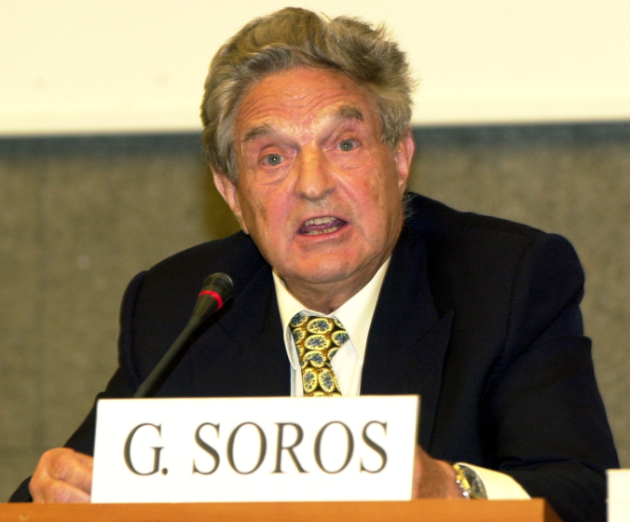
Speculative attack on Baht currency
Cause
Against this background, the market viewed that Thai foreign exchange rate regime was unsustainable.
Many foreign speculators leading by George Soros attacked Thai baht by short selling Thai baht.
Baht fell or depreciated.
BOT used the foreign reserves to defend against the speculative attack and finally ran out of foreign reserve.

Slide 13
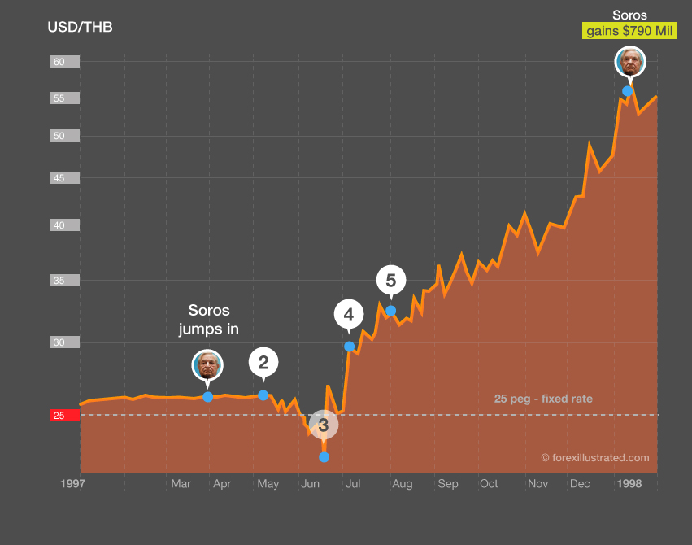
Speculative attack on Baht currency

Slide 14
Impact from the crisis

Slide 15
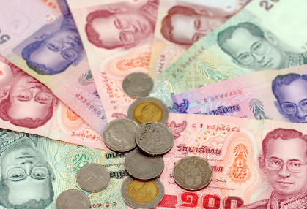


Impact
    Depreciation of exchange rates
    Massive rise in external debt
    Economic recessions
    Stock markets collapses
    Financial institution crisis
    Contagion: the Asian financial crisis

Slide 16
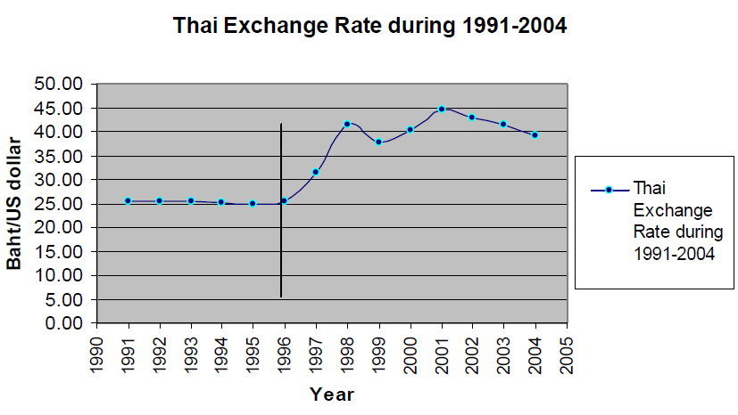
Currency devaluation
Impact
Highly depreciated baht because the lack of confidence in Thai economy.
Before the crisis, The baht was pegged at 25 to the US dollar.
After the crisis, baht is devalued and reached the lowest point of 56 baht per USD.

Slide 17
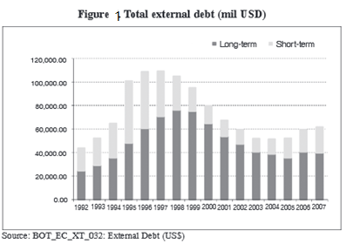
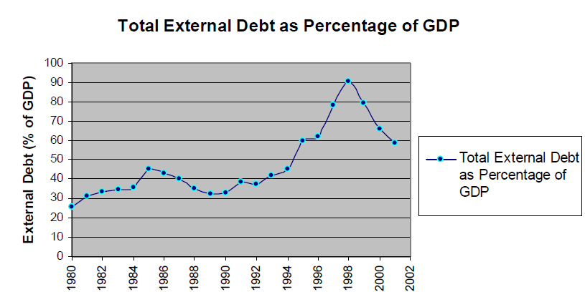
Massive rise in external debt
Impact
Massive increase in external debt burden due to high dependency on foreign capital and deeply depreciated baht.
The external debt increased from 40 billion USD in 1992 to 80 billion USD in March 1997. The total outstanding debt as a share of GDP increased from 35% in 1990 to 65% in 1996, showing in the figure 2.

Slide 18
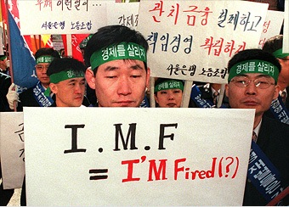
Domestic Economy
Impact
Economic recession
Small domestic demand due to have less
purchasing power
Higher unemployment rate
Less GDP per capita
Less social welfare
Slow in country economic improvement
 | 1996 | 1997 | 1998 | 1999
Real GDP Growth | 5.9 | -1.4 | -10.3 | 4.4
GDP ($bln) | 182 | 151 | 112 | 123
Per capita GDP | 6741 | 6580 | 5817 | 6094
Unemployment | 3.5 | 3.2 | 7.3 | 6.2
Export | 56.0 | 58.4 | 54.5 | 58.5
Import | 72.2 | 63.3 | 42.4 | 49.9
Current Acct. Balance | -6.2 | -4.9 | +2.1 | +8.6

Slide 19
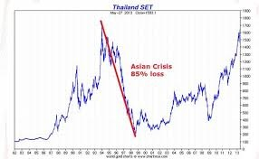
Impact
Equity Market
Experienced a sharp fall in stock market
SET index went down over 70%

Slide 20
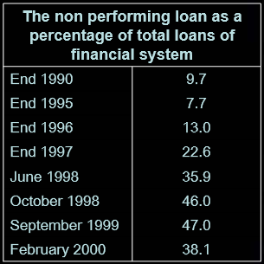
Financial institution crisis
Impact
The cheaper baht made foreign debts more expensive in baht terms for both bank and non bank with foreign debt.
So it badly affected their balance sheet and leading to lending reduction and financial chaos
Collapse of insolvent financial institutions
Remaining financial institutions suffering
from financial panic
Liquidity crunch
Rising NPLs

Slide 21
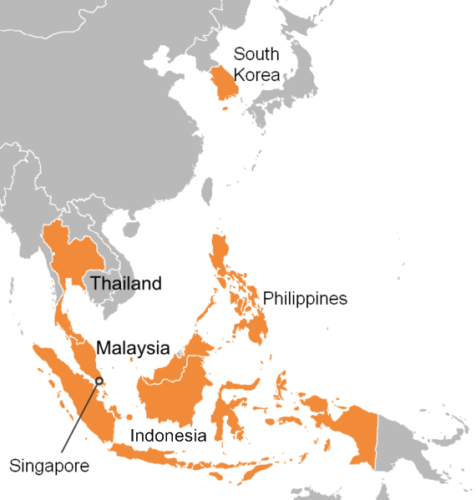
Impact
Contagion
Thai crisis spreads quickly from
Thailand to other countries
in the region
including Malaysia, Indonesia,
Philippines , South Korea
and Japan.
Asian Financial Crisis

Slide 22
Solution to the crisis

Slide 23
Solution
    FIDF
    Floating exchange rate
    IMF assistance
    Financial restructuring: IMF + further

Slide 24
1. FIDF
Cause
Many finance companies were “suspended”, causing panic of deposit withdrawals
Solve
BOT used the “Financial Institution Development Fund” (FIDF) to provide the liquidity for the troubled finance companies because funds began to fell institutions that were perceived as weak. but failed and most finance companies were finally closed
Result
failed and most finance companies were finally closed

Slide 25
2. Floating exchange rate
Cause
speculative attack on Thai baht leaded to a depletion on Thai foreign reserve.
Solution
floating exchange rate

Slide 26
3. IMF assistance
IMF assistance to Thailand during the crisis
= Financial Support in the total USD 17.2 Billion
There are 5 restriction in exchange of the loan.
    Reducing government spending
    Increasing tax
    Encouraging privatization on SOEs
    Increasing interest rate
    Restructuring financial sector

Slide 27
IMF: financial sector restructuring
Liquidation of 56 insolvent finance companies
Recapitalization of banking system
Issuance of Baht 500 billion in bonds to help Financial Institution Development Fund
Stringent rules and regulations on banking system
Corporate debt restructuring
Giving full guarantee of all depositors and creditors
aimed to strengthen the banking system by closing possible loopholes on facilitating new credits by hurting as least people as possible

Slide 28
Further Comprehensive Financial and Corporate Debt Restructuring
Encouragement of commercial bank and financial institution consolidation
Creation of asset management corporations
→ Thai Asset Management Corporation (TAMC)
  : set up in 2001 to buy multi-creditor NPLs from state-owned banks, using government bonds, to facilitate debt repayment and improve banks’ financial position
More regulation on new bankruptcy law and foreclosure

Slide 29
Analysis on solution
Contractionary fiscal policies (↓G, ↑T, encourage privatization of SOEs)
    reducing social safety net
    time and administrative lag on fiscal policies
Contractionary monetary policies (↑i)
    Unable to stop capital outflow due to lack of confidence
↓G and ↑i
    GDP↓
    NPLs↑
    Bankruptcy
    Unemployment↑
Regulation in too short time frame
  → shock in business sector → credit crunch and more NPLs

Slide 30
Recommendation

Slide 31

Recommendations
Watching the degree of openness of the country
    The degree of openness should be appropriate such that can maximize the country’s benefits
Beware of the Financial liberalization
    Fast jump to the financial liberalization would lead to economic instability.
    So, need to prepare in order to deal with the speculators
Managing on investment (Quantity vs Quality)
    Consider both quantity and quality
    High quantity doesn’t mean high quality
Reducing external finance dependency & increase self-reliance
Central bank restructuring + tighten controls over bank and financial institutions.

Slide 32
Q&A

